Slide 1
Regular Services Program (RSP) Midprogram Training
Crisis Counseling Assistance and
Training Program (CCP)
Additional content available in slide notes
Notes:
Begin the course by welcoming participants and introducing yourself.

Slide 2
Introductions
Please introduce yourself by sharing the following:
Your name and pronouns
Your role or position in the CCP
Something you’ve done that no one else here has done
2
Notes:
Ask participants to introduce themselves by sharing the following:
• Their names and pronouns
• Their role or position in the CCP
• Something they’ve done that they think no one else here has done
During the introductions, if someone else in the room has done what the person introducing him- or herself has done, then the participant must state something else until he or she finds something no one else has done.

Slide 3
Objectives
After training, participants will be able to do the following:
Recognize program successes and challenges.
Identify the current needs of individuals, the community, and staff.
Identify current service needs, and utilize appropriate skills.
Identify effective approaches to program management.
Apply techniques for managing stress.
3
Notes:
Review objectives of the course. Note that the course agenda and objectives appear in the workbook.
Objectives—By the end of the course, participants will be able to do the following:
Recognize program successes and challenges.
Identify the current needs of individuals, the community, and staff.
Identify current service needs, and utilize appropriate skills.
Identify effective approaches to program management.
Apply techniques for managing stress.
Emphasize the theme of this course is to utilize activities and group interaction to reflect on what has been accomplished during the RSP to date, identify next steps, and begin to think about phasedown.

Slide 4
Agenda
Morning
Welcome and Introductions
Objectives and Agenda
Section 1: Program Assessment
Section 2: Individual, Community, and Staff Needs
Section 3: Crisis Counseling Services and Skills
Afternoon
Section 3: Crisis Counseling Services and Skills (cont.)
Section 4: Program Management
Section 5: Stress Management
Applying Your Learning and Course Evaluation
4
Notes:
Review the course schedule, and discuss how the objectives will be addressed during the training.
Be sure to cover logistical details, such as the following:
• Lunch and break times and locations
• Restroom locations
• Time (follow clock in the room)
• Include any special instructions for virtual training, if applicable
• Address safety protocols, such as physical distancing, and building evacuation routes
Pause and ask for participants’ reactions or questions.
Introduce the CCP RSP Midprogram Participant Workbook, and describe how it will be used during the course.
Highlight the following:
• The workbook will be used to convey key concepts covered in the course.
• There is space to make notes and capture reflections.

Slide 5
Guidelines for Working Together
Keep time (start on time, return from breaks on time, end on time).
Switch mobile phones off or silence them.
Participate fully.
Ask questions freely.
Balance talking and listening.
Respect each other’s points of view.
Use “person-first” language, i.e., “person with a disability.”
5
Notes:
As in any course, having agreed-upon norms is helpful. Write the following guidelines on a tear sheet, and review them with participants. These guidelines also appear in the CCP RSP Midprogram Training Participant Workbook.
• Keep time (start on time, return from breaks on time, end on time).
• Switch mobile phones off or silence them.
• Participate fully.
• Ask questions freely.
• Balance talking and listening.
• Respect each other’s points of view.
• Use “person-first” language, i.e., “person with a disability.”
Ask the participants to decide together on the following:
• If there are any guidelines they would like to modify
• If there are any guidelines to add
Write any additional guidelines on the tear sheet, and check to see if everyone in the room can agree to the list. You can keep it light by asking them to shake hands with someone at their table to signify agreement with this “social contract.”
Warmly welcome the participants again, and jump into the content of the course.

Slide 6
Section 1: Program Assessment
Program Successes and Challenges
Using Program Data
6
Notes:
Introduce this session by telling participants that we’re going to start our work together today by taking stock of the program’s successes and challenges to date in a way that’s fun and creative.

Slide 7
Section 1: Objective
Recognize and illustrate program successes and challenges.
7
Notes:
Review the session objective:
• Recognize and illustrate program successes and challenges.

Slide 8
Program Successes and Challenges
Mural Activity
Individually, think about the successes and challenges of this CCP over time.
With your group, share your lists of successes and challenges.
Come to agreement on two or three successes and two or three challenges you’d like to put on the mural.
Draw them on the timeline sheets on the wall—use a combination of images and words.
8
Notes:
Explain that we’re going to create a mural that shows the program’s successes and challenges over time.
Preparation
Create a timeline along the wall using tear sheets. Tape tear sheets on the wall, end to end, and draw a timeline across the center of each page, from left to right. Start the timeline with the disaster, and mark the months up to the present time. Write “Successes” on the top center of the page. Write “Challenges” on the bottom center. When the participants draw on the mural, they will draw successes above the timeline and challenges below the timeline.
Task
Have participants reflect individually on the successes and challenges the program has faced to date. (5 minutes)
Divide the participants into groups along functional and geographic roles and responsibilities. For example—have the program management team members form one group, the administrative team members form another group, and crisis counselors form geographic groups based on their area of responsibility.
If the program has a small staff, you may want to have mixed groups with program staff (administration, finance, etc.) integrated with crisis counseling staff.
Have participants share their reflections on successes and challenges in their group. They should come to agreement on two or three successes and two or three challenges and have one person from the team draw them on the timeline on the wall. They can use a combination of drawings and words, if they’d like. (15 minutes)
Once all the groups have finished, have the participants stand in front of the mural they have created. Ask each group to tell the story behind the drawings they have made. (15 minutes)
Summarize the discussion, and explain that this mural they’ve created is a common starting point for us to continue our work today as a group. We will use this foundation of what they’ve accomplished and struggled with as we collectively strategize about where the program needs to go from here and how to get there. (5 minutes)
Transition to the next lesson on using program data.

Slide 9
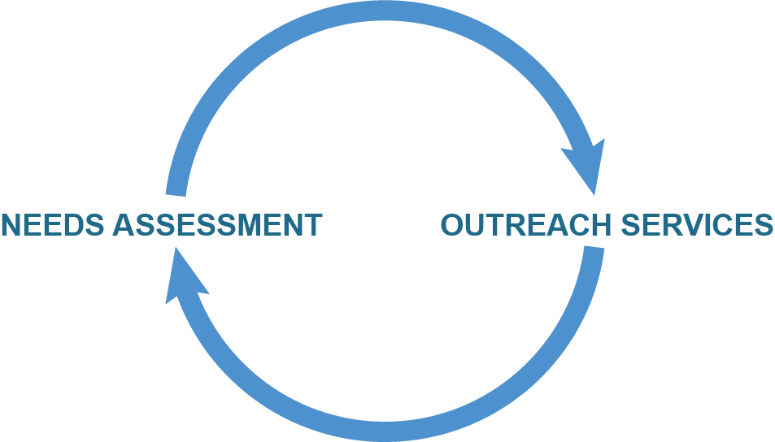
Using Program Data
Program Evaluation: Program evaluation is a systematic effort to collect, analyze, and use data to inform and improve service delivery.
Data collection
Data analysis
Feedback loop
Program evaluation plan
9
Notes:
Review the definition of program evaluation, and discuss the various aspects of the data collection and program evaluation process.
Program evaluation is a systematic effort to collect, analyze, and use data to inform and improve service delivery.
• Data collection: A process of gathering information about survivors and services.
• Data analysis: A process of reviewing and interpreting the information that has been collected.
• Feedback loop: A process of sharing findings from the analysis and developing a strategy to address them.
• Program evaluation plan: A plan for how you will monitor and evaluate your program service delivery to assess improvements and support decision making.

Slide 10

Using Program Data (cont. 1)
Data Collection
    Challenges with using the data systems?
Data Analysis
    What has the data shown?
    What is missing from the data?
Feedback Loop
    How has data been used so far?
Program Evaluation Plan
    Who is responsible?
10
Notes:
Discuss the role of the CCP staff in data collection and program evaluation. Explain that there is more to the data than them just entering it into ODCES. All staff should be aware of and involved in all steps in the process.
• Data Collection
- Challenges with using the data systems?
• Data Analysis
- What has the data shown? What is missing from the data?
• Feedback Loop
- How has data been used so far?
• Program Evaluation Plan
- Who is responsible?
Suggested talking points:
• How to improve the reach of the service delivery system or how to improve the efficacy of the services themselves, using program evaluation to provide a data-driven basis for the actions.
• Data collection is performed by the crisis counselors while data analysis is performed by program managers.
• The feedback loop is performed by program managers with input from the crisis counselors.
• The program evaluation plan is implemented by the crisis counselors and team leaders and monitored by the program managers.

Slide 11
Using Program Data (cont. 2)
What does the data show?
What populations have been reached?
What parts of the community are under-reached/not yet reached?
What is working best for the program?
What are the biggest challenges?
What changes should be made based on what the data shows?
11
Notes:
Activity: (For this activity the instructor must prepare by getting the needs assessment and recent demographic data reports from the program manager ahead of the training. The reports should show the specific program data along broad categories like basic demographics of their survivors and the split of services. The trainer should be prepared to share/display them during the activity.)
Use data from program and original needs assessment to compare what was predicted and what is happening.
As a large group, review the data and discuss the following questions:
• What populations have been reached?
• What parts of the community are under-reached/not yet reached?
• What is working best for the program?
• What are the biggest challenges?
• What changes should be made based on what the data shows?
Ask for the group to brainstorm why the actual data differs from the original needs assessment, and what should be changed at this point in the program to better address the community’s needs.
Ask them to share specific challenges that they have experienced so far in the program. How have those challenges affected the program overall (as shown by the data)?
Conclude this section and mention that we will discuss data collection and evaluation again later in the training. We will now move into talking about individual, community, and staff needs.

Slide 12
Section 2: Individual, Community, and Staff Needs
Current and Upcoming Phases of Disaster
Working Group Discussions
Working Group Presentations
12
Notes:
Introduce this session by explaining that we’re going to build upon our shared understanding of the program’s history now by looking at the current state of needs for individuals, communities, and the CCP staff.

Slide 13
Section 2: Objective
Identify the current needs of individuals, the community, and staff.
13
Notes:
Review the session objective:
• Identify the current needs of individuals, the community, and staff.

Slide 14
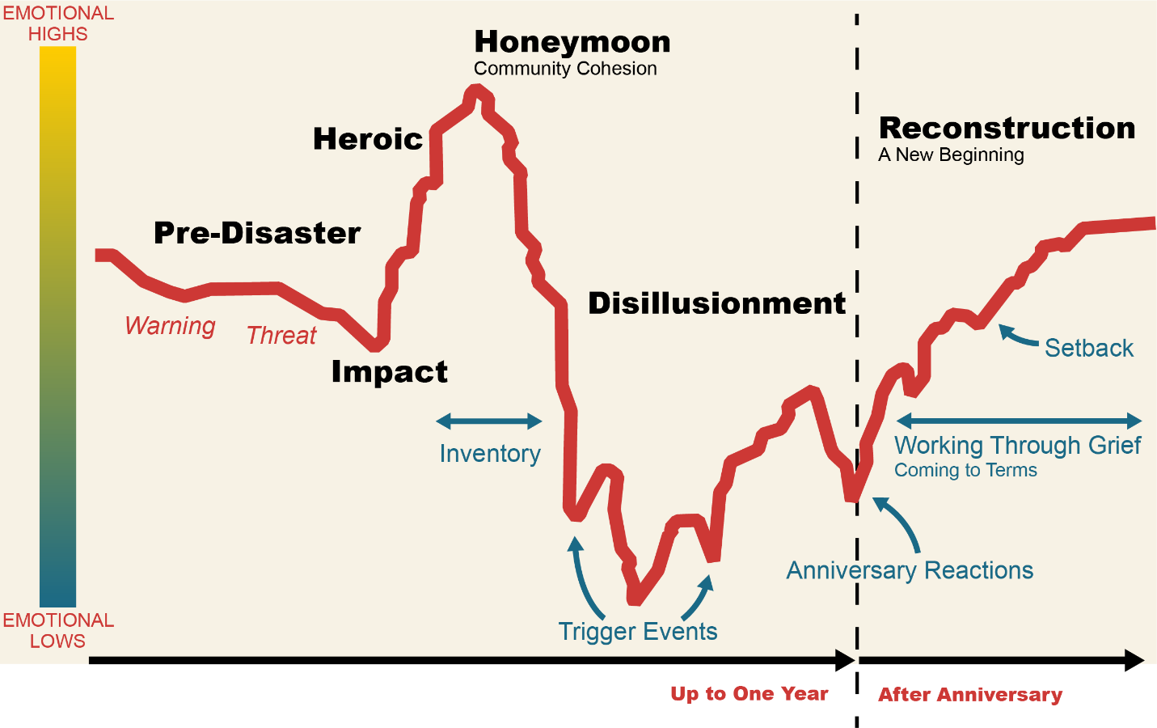
Current and Upcoming Phases of the Disaster
What phase are you in?
Source: Zunin/Myers, as cited in DeWolfe, D. J. (2000). Training manual for mental health and human service workers in major disasters (Publication No. ADM 90-538). U.S. Department of Health and Human Services, Substance Abuse and Mental Health Services Administration, Center for Mental Health Services. ERIC. https://eric.ed.gov/?id=ED459383
14
Notes:
Explain that in order to understand current needs, it’s important to know what phase of the disaster and recovery the community is in.
Review the phases of disaster graph (see suggested talking points below).
Ask participants what phase the community, or different parts of the community, are in right now. What effect does the current phase of disaster have on individuals, the community, and staff?
Suggested talking points:
• This graph is a simple model of the community (rather than individual) reactions to disaster.
• A CCP is a year or longer in duration. It is “more of a marathon than a sprint.”
• Communities progress through these phases at different rates, depending on the type of disaster and the degree of exposure. They may also move back and forth between phases.
• The Chronic Cyclical Disaster Model is a newer approach which considers multiple or overlapping disasters. An infographic is available here: https://chroniccyclicaldisasters.info.
• Crisis counseling interventions need to be adapted to the phase of the disaster response. Data can inform where certain groups/communities might be in the phases.
• This diagram identifies processes and events in addition to the main phases of disaster.
• Inventory is the process by which communities and individuals come to realize the limits of disaster assistance. This usually begins later in the honeymoon phase and causes the decline into the disillusionment phase.
• Trigger events can happen in any phase following the onset of a disaster but are more typical in the later phases—after the reality of the initial traumatic event has set in. Trigger events vary by disaster, community, and individual, but some trigger events can be predicted. For example, upsetting reports in the media about survivors’ suffering or shortcomings in the disaster response can increase stress in individuals and communities.
• Anniversary reactions are often responses to trigger events that occur around the anniversary of the disaster event. While each disaster is different, experience with past disasters has shown that disaster event anniversaries are often accompanied by painful memories and potentially stressful media, political, and community attention. Some of these reactions are predictable and can be planned for.
• Working through grief is the process of coming to terms with disaster losses, developing constructive coping strategies, and building a new post-disaster life. This process can sometimes take years. Setbacks are trigger events in the reconstruction phase—e.g., recurrence of disaster or media coverage of new and painful discoveries related to the disaster. A community’s sense of recovery—of having come to terms with the disaster—can be damaged by these unexpected setbacks.

Slide 15
Current and Upcoming Phases of the Disaster (cont. 1)
  Disillusionment phase:
    Stress and fatigue take a toll.
    Optimism turns into discouragement.
    There may be an increased need for substance use services.
    The larger community returns to business as usual.
    The CCP may have an increased demand for services as individuals and communities become ready to accept support.
    Reality of losses sets in.
    Diminishing assistance leads to feelings of abandonment.
15
Notes:
Discuss the characteristics of the disillusionment and reconstruction phases.
Ask—Does this match with what you’re seeing? With what you expect to see in the next phase?
Suggested talking points:
• The RSP Midprogram Training usually falls near the disillusionment phase of the disaster. The issues related to disillusionment affect the CCP staff, the community, and the survivors. Therefore, these issues must be addressed at all three of these levels in order to effectively move to the next stage of the CCP.
• Χηαλλενγεσ οφ τηε δisillusionment phase:
o Stress and fatigue take a toll.
o Optimism turns into discouragement.
o There may be an increased need for substance use services.
o The larger community returns to business as usual.
o The CCP may have an increased demand for services as individuals and communities become ready to accept support.
o Reality of losses sets in.
o Diminishing assistance leads to feelings of abandonment.

Slide 16
Current and Upcoming Phases of the Disaster (cont. 2)
  Reconstruction phase:
    Individuals and communities begin to assume responsibility for rebuilding their lives.
    People begin to adjust to new circumstances.
    There is recognition of growth and opportunity.
    The reconstruction process may continue for years.
    People adjust to a new “normal,” while continuing to grieve losses.
16
Notes:
• Ρεχονστρυχτιον πηασε:
o Individuals and communities begin to assume responsibility for rebuilding their lives.
o People begin to adjust to new circumstances.
o There is recognition of growth and opportunity.
o The reconstruction process may continue for years.
o People adjust to a new “normal” while continuing to grieve losses.
Give the participants a 15-minute break before proceeding to the next segment on identifying current needs.

Slide 17
Working Group Discussions
  Decide which topic you want to discuss:
    Individual needs
    Community needs
    Staff needs
  In your working group:
    Choose a facilitator, reporter, and presenter.
    Discuss the questions listed in your workbook for your topic.
    You have 20 minutes for your discussion.
    Be prepared to present your recommendations for future directions
    to the rest of the group.
17
Notes:
Say that with a better understanding of the current and anticipated phases the community will be experiencing, we’ll now explore the implications for individuals, communities, and staff. Refer the group back to the data review and the mural as a starting point.
Explain that in order to cover the most ground in the shortest amount of time, we’ll be dividing into three working groups to look at the specific needs of each of those groups.
Divide participants into three working groups, corresponding to the following focus areas: individual needs, community needs, and staff needs. Ask them to choose the group that matches the topic in which they are most interested. Adjust the group sizes as needed so that you have a relatively similar number of participants in each of the three groups.
If you have a very large group, you may want to have more than three groups, e.g., two groups for each topic area.
Explain that in this session, they’ll be working in their groups to assess the current status of that group and identify unmet needs.
Tell the groups that they’ll have 20 minutes for their discussion and that they should prepare to present their recommendations for future directions to the large group.
Individual Needs Questions
• What is the status of:
o Populations targeted and reached?
o Survivor needs and challenges?
o Program data analysis and feedback process?
o Available resources and challenges?
o Long-term recovery planning?
• Where do we go from here?
o Interpret program data with regard to individual needs.
o Identify populations needing to be reached.
o Plan to address survivor needs and challenges.
o Identify needed resources.
Community Needs Questions
• What is the status of:
o Community recovery?
o Communities targeted and reached?
o Program data analysis and feedback process?
o Community activities and events?
• Is anyone missing that needs to be brought to the table?
o Inclusion of community leaders and cultural brokers?
o Involvement of community organizations?
• Where do we go from here?
o Interpret program data with regard to community needs.
o Identify and address remaining community needs and challenges.
o Identify new ways to promote community recovery.
Staff Needs Questions
How can the staff needs be addressed in order to support the continued needs for individuals and the community?
• What is the status of:
o Staff skills? What trainings are needed?
o Staff resources?
o Stress management for staff?
•What other supports are needed?
• How can program data be used to address staff needs?
• What program management supports are needed?

Slide 18
Working Group Presentations
Present the following:
A brief summary of the current status of needs
The recommendations your group is making for future actions
18
Notes:
Facilitate the group presentations and discussion. (30 minutes)
Encourage the team leaders and program managers to take notes to take back to their program.
Summarize key points and action items after each presentation.
Wrap up the session, and transition to the next section on crisis counseling skills.
You may want to give the group a quick stretch break (5 minutes) before proceeding to the next session.

Slide 19
Section 3: Crisis Counseling Services and Skills
Crisis Counseling Services at Midprogram
Group Crisis Counseling
Community Networking
Assessment and Referral
Public Education
19
Notes:
Introduce this session by previewing what we’ll cover in this section.
Tell participants that we’ll do the following:
• Conduct a self-assessment of their crisis counseling skills.
• Identify strategies for strengthening group counseling services.
• Strategize around community networking.
• Check in on any challenges they’re facing in assessment and referral.
• Practice effective message delivery for public education.
Explain that we’ll cover individual/family and group counseling before lunch, and then the rest after lunch (if you are following the one-day training schedule).

Slide 20
Section 3: Objective
Identify current service needs, and utilize appropriate skills.
20
Notes:
Review the session objective:
• Identify current service needs, and utilize appropriate skills.

Slide 21
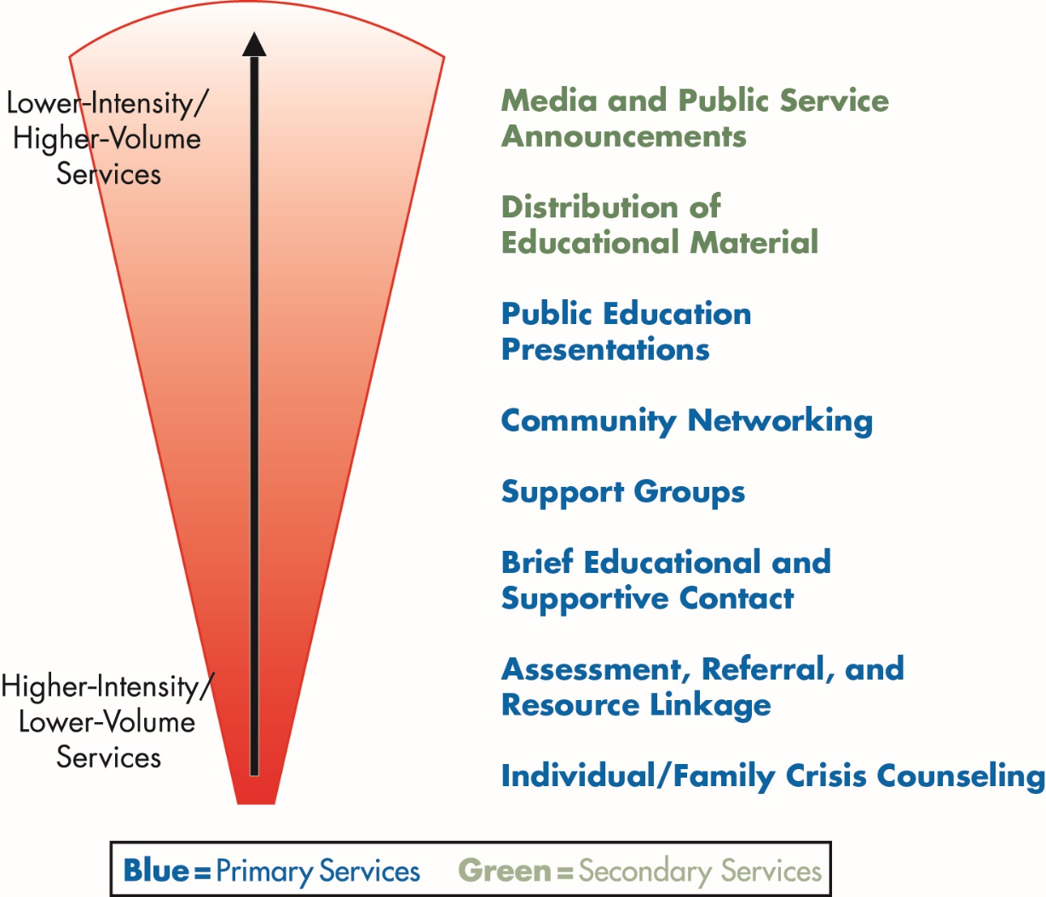
Crisis Counseling Services at Midprogram
CCP reach of services: What services are you currently providing?
*
*
Blue = Primary Services Green* = Secondary Services
21
Notes:
Start the session by discussing the reach of services diagram and the implications for services at midprogram.
Suggested talking points:
• This graphic illustrates the reach and intensity of crisis counseling services.
• Primary services involve interaction of crisis counselors and survivors.
• Secondary services involve dissemination of information.
• Face-to-face primary services should be the focus of the CCP.
• Lower-intensity services reach a larger number of people.
• It is important to emphasize that as the program moves into the RSP midprogram phase, individual/family crisis counseling sessions continue.
• It is important to canvass hard-hit areas for returnees or those now ready to accept services.
• Continue individual/family crisis counseling with those who have more intensive needs, continue using the Assessment and Referral Tools, when appropriate, and continue referrals.
• Group counseling increases during the RSP, as individuals become ready for this approach and counselors identify groups of survivors with common needs, issues, and concerns.
• Community efforts are increased through outreach to schools, businesses, and community and faith-based organizations.
• Public education increases and messaging may shift.

Slide 22
Crisis Counseling Services at Midprogram (cont. 1)
Midprogram is a time to do the following:
Increase focus on group crisis counseling services, community support, networking, and public education.
Continue individual/family crisis counseling and targeted outreach.
Use data to adapt outreach strategies.
Learn from challenges and strengthen crisis counseling skills.
Facilitate referral of individuals and families to existing long-term community resources by utilizing the assessment and referral tools.
Build connections to community-based services that will continue after the CCP has ended.
22
Notes:
Discuss how the focus of crisis counseling services changes at midprogram, as well as the areas to which the program should be paying particular attention.
• Increase focus on group crisis counseling services, community support, networking, and public education.
• Continue individual/family crisis counseling and targeted outreach.
• Use data to adapt outreach strategies.
• Learn from challenges and strengthen crisis counseling skills.
• Facilitate referral of individuals and families to existing long-term community resources by utilizing the Assessment and Referral Tools.
• Build connections to community-based services that will continue after the CCP has ended.

Slide 23

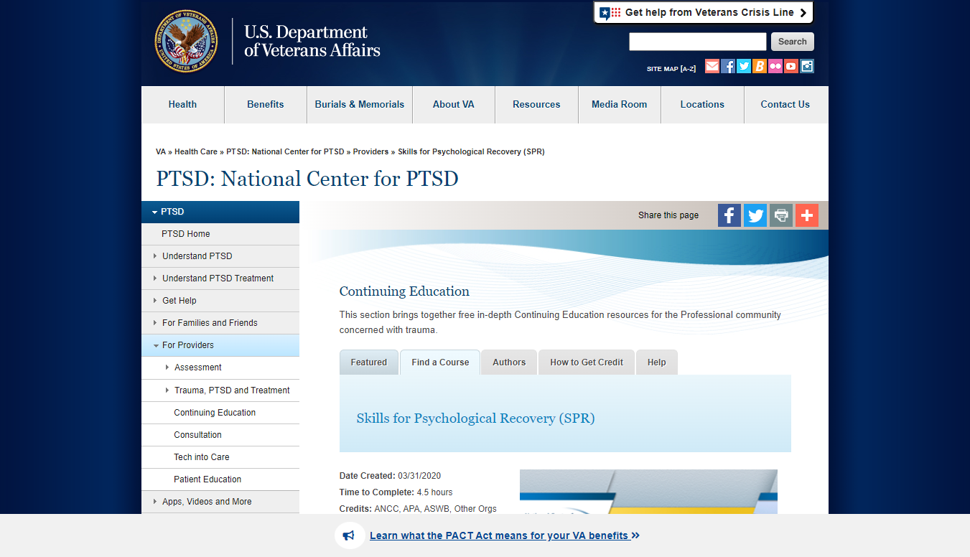
Crisis Counseling Services at Midprogram (cont. 2)
Additional Crisis Counseling Skills and Resources
Psychological First Aid (PFA): https://www.nctsn.org/treatments-and-practices/psychological-first-aid-and-skills-for-psychological-recovery/about-pfa
Skills for Psychological Recovery (SPR) https://www.ptsd.va.gov/professional/continuing_ed/skills_psychological_recovery.asp
23
Notes:
Introduce the concepts of Psychological First Aid and Skills for Psychological Recovery:
Psychological First Aid (PFA) is an online training from the National Child Traumatic Stress Network (NCTSN): https://www.nctsn.org/treatments-and-practices/psychological-first-aid-and-skills-for-psychological-recovery/about-pfa.
PFA (which was introduced in the Core Content Module) is designed to reduce the initial distress caused by traumatic events and to foster short- and long-term adaptive functioning and coping. PFA does not assume that all survivors will develop severe mental health problems or long-term difficulties in recovery. Instead, it is based on an understanding that disaster survivors and others affected by such events will experience a broad range of early reactions (e.g., physical, psychological, behavioral, spiritual). Some of these reactions will cause enough distress to interfere with adaptive coping, and recovery may be helped by support from compassionate and caring disaster responders.
Skills for Psychological Recovery (SPR), An online or in-person training through the National Center for PTSD: https://www.ptsd.va.gov/professional/continuing_ed/skills_psychological_recovery.asp.
Intended for use in the weeks and months after a disaster event, SPR aims to help survivors gain skills to manage distress and cope with stress and adversity after disasters and mass violence events:
SPR is a flexible, evidence-based model that helps providers teach core skills—problem-solving, behavioral activation, management of stress reactions, helpful thinking, and rebuilding healthy social connections—to help reduce distress and improve functioning.
Ask if the participants have taken these courses (or others that they would recommend) and how they have used these skills in their encounters with survivors.

Slide 24
Crisis Counseling Services at Midprogram (cont. 3)
Crisis counseling skills self-assessment:
Complete the self-assessment in your workbook to identify your strengths and challenges in providing crisis counseling.
Discuss your results with a partner.
Prepare to share real-life examples with the group.
24
Notes:
Tell participants we want to check in with them about what’s working well for them personally in their provision of crisis counseling and what challenges they’re facing.
Ask them to complete the self-assessment of their strengths, skills, and challenges in their workbook on page 13. (5 minutes)
Have them discuss their self-assessment with a partner. (10 minutes)
Facilitate a large-group discussion about their self-assessment results. (15 minutes)
• Take a few examples of strengths from participants, and ask them to share any specific examples or tips for the strengths they identified.
• Ask them for examples of the skills they use to facilitate role modeling, empowerment, etc.
• Spend the majority of the discussion time asking them about the challenges they are facing.
• Ask for examples of the challenges they identified. Check to see if the examples they give are common to other staff members. Ask what advice they have for addressing each challenge. Provide your own advice as well.
Transition to focus on group crisis counseling.

Slide 25
Group Crisis Counseling
Activity Option A:
Finding, forming, and facilitating groups:
For the topic assigned to your group, brainstorm a list of strategies or tips.
You have 10 minutes.
  Remember the four ground rules of brainstorming:
Focus on quantity.
Withhold criticism.
Welcome unusual ideas.
Combine and improve ideas.
25
Notes:
Trainer’s Note: For this segment of the course, you have two options for aspects of group crisis counseling to focus on:
• Option A: Strategies for finding, forming, and facilitating groups
• Option B: Managing challenges in group counseling
Choose which option to use based on what you learned about the current status of group counseling when talking with the program manager prior to the course. For example, if the program doesn’t have many groups and is having difficulty getting groups started, choose option A. If the program has a number of groups established, then choose option B. You might also want to poll the staff to find out which topic would be most helpful to them.
For either option, refer back to the work previously done by group members and ask the group to begin their brainstorming based on the needs identified in the previous activity.
Option A: Strategies for Finding, Forming, and Facilitating Groups
• Divide participants into three or six groups (use three groups if the class size is about 15 participants; use six groups if the class includes 25 or more participants).
• Have the groups spread out in the room and gather around some blank tear sheets taped to the wall.
• Tell participants we’re going to do a quick brainstorming session on finding, forming, and facilitating groups.
Remind participants of the four ground rules of brainstorming:
o Focus on quantity—the greater the number of ideas generated, the greater the chance of producing an outstanding idea.
o Withhold criticism—by suspending judgment until later, individuals feel free to generate unusual ideas.
o Welcome unusual ideas—new ways of thinking may provide better solutions.
o Combine and improve ideas—good ideas may be combined to form a single better idea.
• Brainstorm (10 minutes)
o Have one or two of the groups brainstorm a list of strategies for finding groups.
o Have one or two groups brainstorm a list of strategies for forming groups.
o Have one to two groups brainstorm tips for facilitating groups.
o Hear quick reports from the groups—emphasize and reinforce the best strategies each group identified. (20 minutes)
Continue on Community Networking slide.
Lunch break (if following one-day schedule)

Slide 26
Group Crisis Counseling (cont.)
Activity Option B:
Managing challenges in group crisis counseling:
For the challenge assigned to your table, discuss what you might do to manage or overcome that challenge.
Be prepared to share your strategy or tips.
26
Notes:
Option B: Tracking Progress and Managing Challenges in Group Counseling
• Divide participants into three or six groups (use three groups if the class size is about 15 participants; use six groups if the class includes 25 or more participants).
• Materials needed: One index card per person
• Begin a discussion about the kinds of challenges CCP staff are facing in group counseling—e.g., difficult group members, getting a session started, transitioning responsibility to the group members.
• Ask participants to write on an index card a description of a challenge they are struggling with in facilitating group counseling. (5 minutes)
• Collect the cards from participants. Have them discuss the challenges they identified in their groups, while you quickly review the cards and choose two to work with. You might want to choose challenges that appear most frequently, or ones that provide the most substance for discussion. (5 minutes)
• Assign half of the groups in the room one of the challenges, and have them do some problem solving around what they would do to manage that challenge. Assign the other half of the room the other challenge you have chosen.
• Give the groups 10 minutes to identify a strategy or tips for managing this challenge.
• Facilitate a discussion of the similarities and differences of the different groups’ responses. Give your own perspective.
• Repeat the process for the other case. (10 minutes per case)
OR
• Transition to discuss the examples of progress and success made in groups so far. (10 minutes)
Lunch break (if following one-day schedule)

Slide 27

Community Networking
Identify which community groups and leaders you want to engage in anniversary or phasedown planning.
Identify how you want to engage them—what are some key actions you’ll take?
27
Notes:
Trainer’s Note: In this section, you may choose to focus the discussion on either anniversary planning or phasedown preparation, based on the timing of the training relative to either anniversary or phasedown. Discuss with the program manager before the training the event on which they would like to focus, or if both should be discussed.
Discuss the role of the CCP and the community in preparing for and commemorating either the disaster anniversary or the phasedown of the CCP.
• Emphasize that the CCP plays a supportive role in the disaster anniversary planning and commemoration of the community.
• Emphasize that the community must be integrally involved in the preparation and conduct of the CCP phasedown. After the CCP ceases operations, it is the community that must continue to provide services to its members.
• Emphasize that the CCP is a first step and initial connection to an ongoing system that will remain after the CCP is over.
Tell participants that we’re going to take some time to begin discussing how to engage the community in anniversary or phasedown planning.
Ask participants to work with others at their table to do the following (10 minutes):
• Identify which community groups and leaders you want to engage in anniversary/phasedown planning.
• Identify how you want to engage them—what are some key actions you’ll take?
Ask groups which groups/leaders they identified. Record them on a tear sheet and incorporate into a future timeline.
Ask them what actions they’ll take to engage these groups.
Summarize the discussion, and transition to a discussion of assessment and referral.

Slide 28
Assessment and Referral
Why are the Assessment and Referral Tools so important to the CCP?
Provides additional support for individuals not able to access
their personal coping skills and resiliency
Prevents long-term trauma through referral to preventative treatment
Connects individuals with the local systems of care which can address their mental health and substance use needs longer-term
28
Notes:
Review the importance of the Assessment and Referral Tools:
• The CCP is resiliency-based and helps people access their personal coping skills. At this point after a disaster, if someone isn't able to access their personal coping skills it could mean they need professional help.
• The CCP is designed to help prevent long-term trauma and stress reactions like PTSD. The best way the program can do that is by referring individuals who are struggling to preventative treatment.
• The Assessment and Referral Tools are important implements to connect individuals with the local systems of care which can address their mental health and substance use needs. Part of the role of the CCP is to develop partnerships and connections with local resources/providers that continue offering services after the CCP ends. Developing, understanding, and utilizing this network is an important part of this phase of the grant.
Ask the participants to share other reasons why the Tools are important to the CCP program.

Slide 29
Assessment and Referral (cont. 1)
What are some specific situations that are appropriate to administer the Assessment and Referral Tools?
What are some examples of assessment and referral from the past month or so?
Are there circumstances in which you are reluctant to make a referral, even when it could be indicated? What are these circumstances?
What are some ways to overcome these obstacles?
What are some of the grounds for emergency referral?
29
Notes:
Facilitate a large-group discussion about assessment and referral:
• What are some specific situations that are appropriate to administer the Assessment and Referral Tools?
• How have you seen the needs for assessment and referral change over time?
• What are some current examples of assessment and referral from the past month or so?
• Are there circumstances in which you are reluctant to make a referral, even when it could be indicated? What are these circumstances? (Record these on a tear sheet.)
• What are some ways to overcome these obstacles?
• What are some of the grounds for emergency referral?

Slide 30
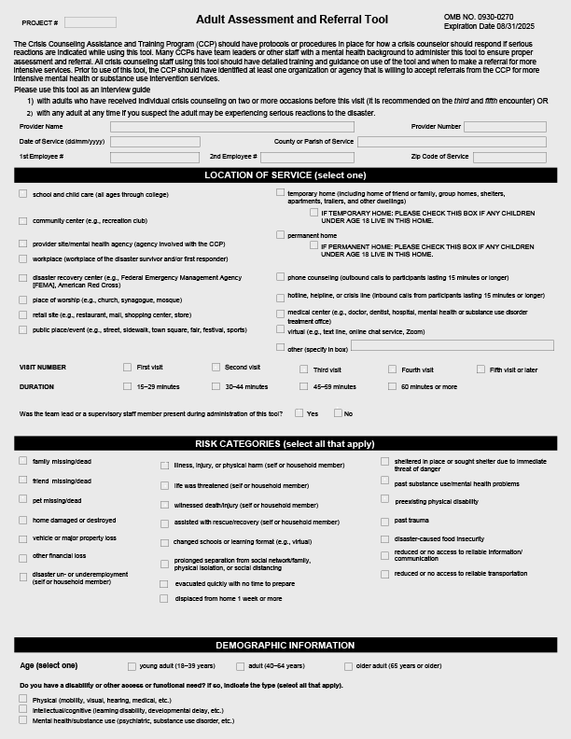
Assessment and Referral (cont. 2)
Adult Assessment and Referral Tool:
It is used to facilitate referrals to more intensive behavioral health services.
It can be used at any time to assess those who may be experiencing severe reactions.
It measures risk categories and event reactions using a structured interview approach.
If a person scores three or more “intense” reactions (scored 4 or 5), then referral for more intensive services should be discussed.
30
Notes:
Review the Adult Assessment and Referral Tool.
Discuss the following talking points/reminders:
The Assessment and Referral Tools are often underutilized by CCP programs. Following the guidelines on when to use the tools ensures they will be utilized at the correct times.
In the mobile app, the tool will prompt the user when the criteria are met, and crisis counselors should be using the form when appropriate.
At the end of the form, you should review the responses that are highly rated and be prepared to offer the respondent a referral for more intensive services.
It is important to have a plan in place (that adheres to your employer’s protocol) for what to do if the individual says “yes” to the question “Is there any possibility that you might hurt or kill yourself?”
A crisis counselor can still make visits to a survivor who has received an assessment and referral.

Slide 31
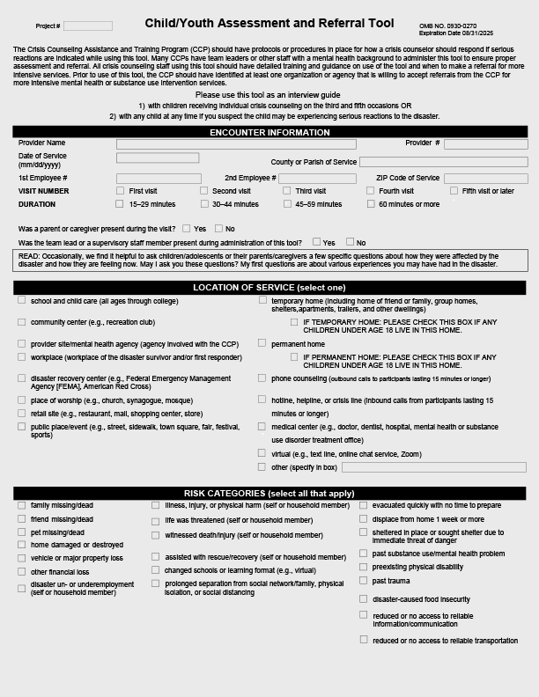
Assessment and Referral (cont. 3)
Child/Youth Assessment and Referral Tool and Response Card:
Used to facilitate referrals to more intensive mental health and/or substance use disorder services
Should be used at any time the crisis counselor suspects the child may be experiencing serious reactions to the disaster
Includes questions for the parent about the child (required for children ages 0–7)
Measures reactions using a structured interview approach
31
Notes:
Review the Child/Youth Assessment and Referral Tool.
Remind participants that training videos on these forms are available online: https://www.samhsa.gov/dtac/ccp-toolkit/train-your-ccp-staff. Suggest the participants watch the videos at a future team meeting and do the forms together to practice as a group. This will help them become more familiar and comfortable with asking the questions.

Slide 32
Assessment and Referral (cont. 4)
Emergency treatment referral:
Alert the team leader immediately if:
  There is intent or means to harm self or others.
  A person experiences severe paranoia, delusions, or hallucinations.
  Functioning is so poor that the person’s (or his or her dependent’s) safety is in danger.
  Excessive substance use is placing the person or others at risk.
Call or text 988 for confidential emotional support to people in suicidal crisis or emotional distress.
When in doubt, call 911, or refer for immediate psychiatric or medical intervention.
32
Notes:
Review the guidelines for emergency treatment referral. Emphasize that crisis counselors should know local emergency resources before going out into the community.
Ask the program managers to share with the group how their work interfaces with existing mobile crisis response in addition to the 988 call centers.

Slide 33
Assessment and Referral (cont. 5)
Nonemergency treatment referral:
Reduce perceived stigma:
  Demystify mental health or substance use treatment by explaining it.
  Explore referral options, and give choices.
Increase compliance:
  Explore obstacles to accepting services.
  Encourage person to call for the appointment while the counselor is there.
  Accompany person to first appointment, if necessary and appropriate.
33
Notes:
Review the guidelines for nonemergency treatment referral.
Refer to the table in their workbooks describing the difference between traditional case management and CCP resource linkage.
Facilitate a discussion with the participants around the following questions:
How might you know a person needs assessment and possibly also a referral?
What resources do you have to refer people to?
When should you contact your supervisor?
What protocols do you have in place if someone answers “yes” to a question about self-harm?
What real-life experiences have you had with the Assessment and Referral Tools? Do you have any lessons learned to share with the group?
Transition to discussing public education.

Slide 34
Public Education
Where do you currently provide public education?
What are some additional venues or audiences where/for whom you could provide public education and information?
What makes for an effective public education presentation?
How could public education be improved?
34
Notes:
Discuss how the need for public education increases at midprogram.
Ask participants where they currently provide public education and information—what venues, what audience?
Ask them to identify places they are not providing public education but could—what are some untapped opportunities?
Record these on a tear sheet. Get the group to identify at least three opportunities.
Ask if the message has changed since the beginning of the program? Should any messaging by updated to reflect the status of the CCP program, and the eventual phasedown?
Ask them to imagine they’re preparing a presentation at one of the venues identified above—what would you do to prepare in order to be successful? The group will hopefully identify some of the following:
• Be clear about the purpose of your presentation.
• Know who the audience is and make your message inclusive and accessible.
• Gather appropriate supporting materials—visual aids, handouts.
• Know what you’re going to say—prepare your remarks.
• Use effective presentation skills.

Slide 35

Public Education (cont. 1)
Effective presentations require that you:
Know your audience.
Plan your presentation.
Deliver an effective message.
35
Notes:
Emphasize that there are three key aspects to making an effective public education presentation:
• Know your audience.
• Plan your presentation.
• Deliver an effective message.

Slide 36
Public Education (cont. 2)
Know your audience:
General information:
  Age, gender, education level, economic status, ethnic makeup, access/functional needs
Their interests and needs:
  Knowledge of subject
  Attitude toward subject
  What they want to know
  What they care about
  What they need to receive and understand the message (consider language, customs, and beliefs)
36
Notes:
Discuss what you want to find out about your audience before making a presentation:
Know Your Audience:
• General information about your audience—e.g., age, gender, education level, economic status, ethnicity
• Their interests and needs:
o Knowledge level of your subject
o Attitude toward the subject
o What they want to know
o What they care about
o What they need to receive and understand the message (consider language, customs, and beliefs)
The most important thing to think about and determine is, what’s in it for the audience? Why should they care about what you’re saying? Orient your presentation around that. Explain that you won’t always know for sure what their interests and needs are, but you can make an educated guess.

Slide 37
Public Education (cont. 3)
Plan your presentation:
Determine your key message.
Decide on the top three points of your message.
Identify supporting facts, examples, and stories.
Craft a strong opening and closing statement.
Develop supporting materials—visual aids, handouts, etc.
37
Notes:
Explain the key steps in planning and preparing a presentation:
Plan Your Presentation:
• Determine your key message—what do you want them to think, do, or know?
• Decide on the top three points of your message—these points should be concise.
• Identify supporting facts, examples, or stories—people remember examples and stories best.
• Craft a strong opening and closing statement—tell people what you’re going to tell them; tell them; and then, tell them what you told them. Repetition of your key message will enhance audience retention.
• Develop supporting materials (visual aids, handouts, etc.)—when possible, use visuals and handouts to supplement your presentation.

Slide 38
Public Education (cont. 4)
Deliver an effective message:
Voice tone and speaking style:
  Speak loudly and clearly.
  Use your voice for emphasis.
Body language:
  Gestures—maintain an open body posture.
  Facial expressions—these should be appropriate to content.
  Eye contact—look for an “ally” in the group.
38
Notes:
Discuss the aspects of delivering an effective message.
Deliver an Effective Message
• Voice tone and speaking style:
o Speak loudly, slowly, and clearly—use your voice for emphasis.
o Avoid talking in a monotone and trailing off at the end of sentences.
• Body language:
o Gestures
• Maintain an “open” body posture—don’t cross or clasp your hands; face the audience.
• Don’t fidget with anything; put down pens, markers, and papers.
• Move around somewhat while presenting.
o Facial expressions:
• Make sure your facial expression matches what you’re saying—excited, serious, etc.
• Smile when appropriate.
o Eye contact:
• Look for an “ally” in the group—but don’t fixate on that one person!
• Move your gaze about the room.
• Don’t look over people’s heads.
•Preparing:
o Write out what you want to say and put it in your own voice.
o Practice ahead of time.
o Practice in front of a mirror.

Slide 39
Public Education (cont. 5)
Activity instructions:
For the audience or venue assigned to your group, prepare a 3- to 5-minute public education presentation.
Discuss what you know about your audience.
Plan the presentation.
Identify someone in your group to deliver the message.
Take 15 minutes to prepare.
39
Notes:
Note that many of these tips are common sense and probably aren’t anything new to them. The hard part is doing it, and the secret to that is practice!
Tell them they are going to have a chance to practice crafting a public education message for a specific group and delivering that message.
Break the participants into three groups (or some multiple of three, depending on the size of the group).
Choose three venues/audiences from the list of potential public education opportunities the group brainstormed.
Assign one venue/audience to each group.
Their task is to prepare a public education message for that group (3–5 minutes) and identify supporting materials they would want to provide.
Tell them they have a total of 30 minutes to prepare and take a break before we start the presentations; it’s up to them how they want to manage their time (i.e., take a break first, then work, or vice versa).

Slide 40
Public Education (cont. 6)
Presentations:
As you observe the other two groups’ presentations, take notes on the observer worksheets in your workbook, page XX.
Be prepared to give positive and constructive feedback to the presenter and his or her group.
40
Notes:
Have each group present its public education message and describe what supporting materials it would provide at the meeting.
Facilitate a brief feedback session after each presentation—on both the presenter’s delivery (body languages, voice) and the message itself (clarity, persuasiveness). Ask the other participants to give feedback first, and then add in your perspective. Start by asking these questions:
• What worked well in this presentation?
• What could be improved?
Spend about 10 minutes per group for the presentation and then feedback. (30 minutes total)
Summarize—or ask the participants to summarize—the key messages about planning and delivering effective public education.
Wrap up this session, and transition to the next section on program management.
Give a 15-minute break if following the one-day schedule.

Slide 41
Section 4: Program Management
Communication
Quality Assurance
Data Collection and Program Evaluation
Supervision
Training
Preparation for Phasedown
41
Notes:
Introduce this session by saying that we’re going to review and discuss a few key areas of program management to identify what’s working well and where there’s room for improvement.

Slide 42
Section 4: Objective
Identify effective approaches to program management.
42
Notes:
Review the session objective:
• Identify effective approaches to program management.
Share with the group that while this sections says program management, we want to hear from everyone, not just management/leadership.

Slide 43
Communication
Who is responsible for ensuring an effective overall system of communication?
What is the communication structure?
How does it operate on a state, provider, and team level?
Have there been breakdowns in communication?
  Where?
  When?
  How can they be resolved?
Are crisis counselors getting the information and support they need?
How can program communication be improved?
43
Notes:
Trainer’s Note: In this section, slides with suggested questions are provided for a variety of program management issues. Based on your understanding of the group, the program, and the program management, you can choose a few topics to focus discussion on in this session, or try to cover all topics quickly.
Facilitate discussion about the current status of communication within the project:
• Who is responsible for ensuring an effective overall system of communication?
• What is the communication structure (i.e., mobile phones, email, team meetings, supervisor meetings)?
• What tools are being used to facilitate communication (i.e., the ODCES mobile app Resources function)?
• How does it operate on a state, provider, and team level?
• Have there been breakdowns in communication?
o Where?
o When?
o How can they be resolved?
• Are crisis counselors getting the information and support they need?
• How can program communication be improved?

Slide 44
Quality Assurance
How does your program demonstrate:
Adherence to the CCP model?
An effective communication system?
Regularly scheduled team meetings?
Effective management and supervision?
Collection, analysis, and utilization of data?
Identification of problems and gaps in service?
Ongoing needs assessment?
44
Notes:
Ask about their current mechanisms for quality assurance.
How does your program demonstrate:
• Adherence to the CCP model?
• An effective communication system?
• Regularly scheduled team meetings?
• Effective management and supervision?
• Collection, analysis, and utilization of data?
• Identification of problems and gaps in service?
• Ongoing needs assessment?
The CCP may have a formal quality assurance process in place. If so, have the program leadership and participants describe it and how it is working. Or, ask participants to review the list on the slide and identify one or two they would like to enhance in the coming months.

Slide 45
Data Collection and Program Evaluation
How have data collection and analysis:
Assisted program managers/team leaders?
Assisted crisis counselors?
Assisted in identifying program trends and survivor needs?
Documented the program’s accomplishments?
Provided accountability to stakeholders (e.g., Congress, Government Accountability Office, federal agencies)?
45
Notes:
Facilitate discussion on how data collection and program evaluation have been useful in the program. The earlier discussion on data focused on interpretation of the data, but this section focuses on how data impacts the program’s internal processes. Focus the discussion on how the answers to the questions on the slide will be captured and shared with stakeholders going forward.
How have data collection and analysis:
• Assisted program managers/team leaders?
• Assisted crisis counselors?
• Assisted in identifying program trends and survivor needs?
• Documented the program’s accomplishments?
• Provided accountability to stakeholders (e.g., Congress, Government Accountability Office, federal agencies)?
Ask for examples of how data has been used to change aspects of the CCP to better serve the needs of the community. The trainer may also want to share some real-world examples with the group.

Slide 46
Supervision
How is your program/team:
Conducting group meetings to discuss staff needs?
Conducting regularly scheduled individual supervision sessions?
Ensuring availability of needed supplies and equipment?
Providing ongoing training opportunities on CCP-specific topics?
46
Notes:
Facilitate a discussion of supervision in the program.
How is your program/team:
• Conducting group meetings to discuss staff needs?
• Conducting regularly scheduled individual supervision sessions?
• Ensuring availability of needed supplies and equipment?
• Providing ongoing training opportunities on CCP-specific topics?
Suggested talking points:
• If the participants are unfamiliar with supervision, as it is carried out in the mental health field, discuss what types of issues might be addressed in supervision (e.g., what happens in individual supervision).
• Supervisors need to ensure that new and existing staff understand the CCP model and the parameters of the program.
• At the start of the CCP, there should be regular daily all-staff meetings. Typical topics include necessary trainings, supervision techniques, and stress management.
• There should be regular meetings, in-service trainings, and open communication to ensure staff stay within the boundaries of the CCP and do not engage in non-allowable activities such as case management and advocacy.
• Identify staff needs:
o By observing through face-to-face outreach with the team
o Through group and individual support
o Through training
• Address staff needs through the following:
o Face-to-face outreach modeling and education
o Supervision and education
o Training focused on specific needs

Slide 47
Training
How is your program/team:
Using team meetings/supervision to identify gaps in training?
Assisting with the development of crisis counseling skills?
Identifying and educating crisis counselors in other program areas (culture, geography, physical safety)?
Improving techniques to teach survivor tools?
47
Notes:
Ask about the training provided by the program/team to staff.
How is your program/team:
• Using team meeting/supervision to identify gaps in training?
• Assisting with the development of crisis counseling skills?
• Identifying and educating crisis counselors in other program areas (culture, geography, physical safety)?
• Improving techniques to teach survivor tools?
Discuss any challenges and successes with supervision and training. What has worked best for the CCP teams? What could be improved?

Slide 48
Preparation for Phasedown
The CCP is a time-limited program.
The CCP supports, but does not replace, community infrastructure.
Bridging and transitioning needs and services back to communities is a key part of the CCP.
Crisis counselors should facilitate community response to individual and community needs.
Active community involvement is an important sign of recovery and critical to successful phasedown efforts.
48
Notes:
Introduce the concept of phasedown, and explain why it’s important to pay attention to at midprogram.
• The CCP is a time-limited program.
• The CCP supports, but does not replace, community infrastructure.
• Bridging and transitioning needs and services back to communities is a key part of the CCP model.
• Crisis counselors should facilitate community response to individual and community needs.
• Active community involvement is an important sign of recovery and critical to successful phasedown efforts.
Suggested talking points:
• At this point in the program, the participants should be taking stock and doing a general assessment of these areas:
o Individual and community needs
o Where they are as a program
o Where they have been
o Where they want to go, and how to get there (e.g., additional outreach and intervention strategies, goals for the remainder of the program)
Ask what plans they have to begin preparing for phasedown.
Bring this session to a close, and transition to the last session on stress management.
Give the participants a quick stretch break if they need it before moving on to the next session.

Slide 49
Section 5: Stress Management
Stress Management Techniques
49
Notes:
Introduce this session by saying that we want to promote a “marketplace of ideas” on stress management, as this is such a critical area for maintaining the health of the staff and for promoting survivor recovery.

Slide 50
Section 5: Objective
Apply techniques for managing stress.
50
Notes:
Review the session objective:
• Apply techniques for managing stress.

Slide 51
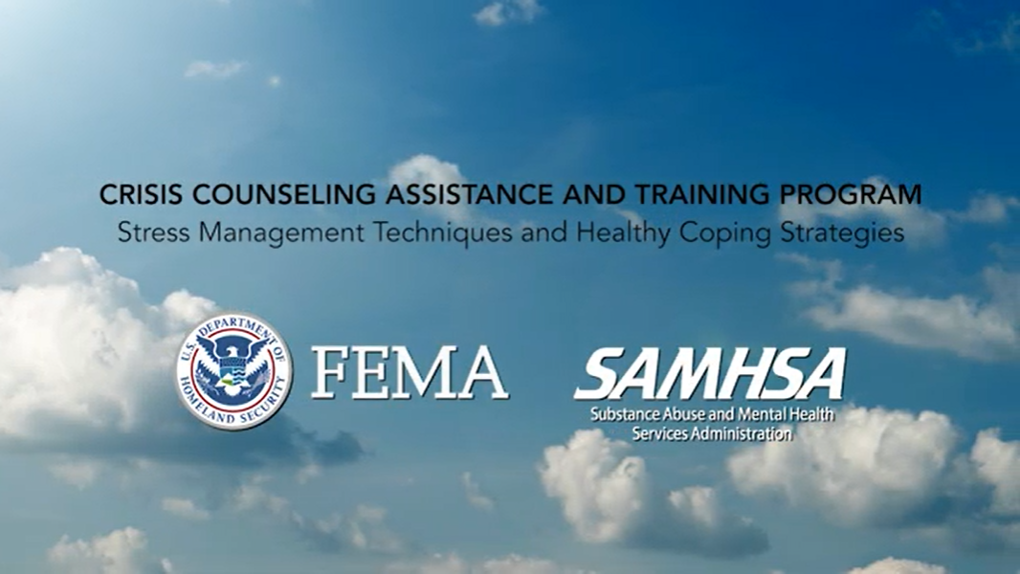
Stress Management Techniques
What stress management techniques work well for you?
What techniques have you introduced to survivors?
  Stress Management Techniques video:
  https://www.youtube.com/watch?v=IqpCCnmwNVY
51
Notes:
Emphasize how important stress management is, for staff themselves and for role modeling for survivors.
Remind the staff that the CCP Toolkit includes a video on Stress Management Techniques, which can be found at https://www.youtube.com/watch?v=IqpCCnmwNVY. If time allows and the classroom has the proper audio/visual set up, show the video to the class. If not, encourage the participants to watch it on their own.
Ask participants to think about answers to these questions:
• What stress management techniques work well for you?
• What techniques have you introduced to survivors?
Give them a few minutes to reflect individually and make some notes in their workbooks.

Slide 52
Stress Management Techniques (cont.)
Stress Management Marketplace Activity
With your group, share your stress management techniques.
Choose one you’d like to market to the rest of the group.
Create a poster advertising this technique.
Identify two spokespersons.
Share your findings with the larger group.
52
Notes:
Explain that we’re going to create a marketplace for stress management techniques.
Tell participants to share their techniques at their tables and choose one that they will “market” to the rest of the group. Have them create a poster advertising the stress management technique they want to share with the rest of the group. (20 minutes)
Have each group identify two people who will stay with the poster to explain the technique to interested “shoppers” in the “marketplace.” The first person—ideally the person who contributed the idea—will stay and explain the poster for the first 10 minutes of the marketplace; the second person will stay during the next 10 minutes of the marketplace.
Give the participants 20 minutes to mill around the “marketplace,” learning about each group’s stress management techniques. Encourage them to take notes on the new techniques they’re learning.
After 10 minutes, announce that it’s time to switch the poster presenters. Give the presenters time to switch; then, start up the marketplace again for another 10 minutes.
At the end of 20 minutes, have all the participants take their seats again. Ask these questions:
• What have you learned that you’re excited about?
• What can you use yourself?
• What can you use with survivors?
• What can you use with your teams?
If time permits, check with participants about how well the program management and program systems/procedures are supporting them in managing their stress. You could either facilitate a brief discussion, or do a suggestion box, where participants write down a suggestion for improving organizational stress management and hand it in. You then give the suggestions to the program manager for consideration and follow up.

Slide 53
Substance Abuse and Mental Health Services Administration (SAMHSA) Disaster Technical Assistance Center (DTAC)
SAMHSA DTAC supports SAMHSA’s efforts to prepare states, territories, and local entities to deliver an effective behavioral health response during disasters.
Toll-free: 1–800–308–3515
Email: DTAC@samhsa.hhs.gov
Web: http://www.samhsa.gov/dtac
53
Notes:
Bring this session to a close, and transition to the final segment of the training—applying your learning and course evaluation.
Remind participants that SAMHSA DTAC is available as a resource for information, assistance, and questions regarding the CCP.

