Slide 1
2023 National Survey on Drug Use and Health: Among the American Indian or Alaska Native (AIAN) Population Aged 12 or Older
Center for Behavioral Health Statistics and Quality
Substance Abuse and Mental Health Services Administration
U.S. Department of Health and Human Services
2024

Slide 2
NSDUH Scope and Target Population
Conducted by the Federal Government since 1971
Comprehensive household interview survey of substance use, substance use disorders, mental health, and the receipt of treatment services for these disorders in the United States
Produces estimates representative of the population at national and state levels
Covers the civilian, noninstitutionalized population aged 12 or older in all 50 states and Washington, DC:
  Includes households, college dorms, homeless in shelters, civilians on military bases
  Excludes active military, long-term hospital residents, prison populations, homeless not in shelters
NSDUH 2023 sample included 67,679 people (including 1,310 AIAN people)

Slide 3
Comparing Data Across Years
A new trend line began in 2021 due to NSDUH data collection changing to a multimode design (web and in-person).
  Do not compare 2021-2023 data with data from prior years.
In 2022, weighting procedures were updated to stabilize the effect of mode on estimates across years.¹
  These procedures also were applied to the 2021 analysis weights.
  Updated 2021 estimates were generated for the 2022 Detailed Tables to facilitate comparisons with 2022 estimates.
  These updated 2021 estimates should be used for comparison with 2022 and 2023 estimates.
¹ See Section 3.3.3 in the following reference: Center for Behavioral Health Statistics and Quality. (2023). 2022 National Survey on Drug Use and Health (NSDUH): Methodological Summary and Definitions. https://www.samhsa.gov/data/report/2022-methodological-summary-and-definitions.

Slide 4
About This Presentation
The racial and ethnic groups discussed in this presentation are mutually exclusive. People who were of Hispanic or Latino ethnicity could be of any race but are not included in the estimates for any of the racial categories. Estimates for people who were not of Hispanic or Latino ethnicity are reported by race. People reporting two or more races and who were not of Hispanic or Latino ethnicity are noted as “Multiracial” in this presentation. People reporting their race as Black or African American are subsequently referred to as Black. People reporting their ethnicity as Hispanic or Latino are subsequently referred to as Hispanic.
Statistical testing was performed for comparisons of estimates across age groups and among racial and ethnic groups according to procedures described in the 2023 Methodological Summary and Definitions report.² For consistency with the typical criteria for statistical testing in NSDUH, age group differences were considered statistically significant at the .05 level of significance. For testing among racial and ethnic groups, a more conservative level of .01 was used for considering differences to be statistically significant. Statistically significant differences resulting from these testing procedures are described using terms such as “higher,” “lower,” “more likely,” or “less likely.” Statements use terms such as “similar” or “the same” when a difference was not statistically significant. When estimates are presented without reference to differences across groups, statistical significance is not implied.
² See Section 3.2.3 in the following reference: Center for Behavioral Health Statistics and Quality. (2024). 2023 National Survey on Drug Use and Health (NSDUH): Methodological Summary and Definitions. https://www.samhsa.gov/data/report/2023-methodological-summary-and-definitions.

Slide 5
Suppression Due to Low Precision
The following estimates for AIAN people are not presented due to low precision:
  Substance use
    past month: type of tobacco product use or nicotine vaping
    past year: illicit drug use and marijuana use by age group, use of prescription pain reliever subtypes
  Substance use disorder by age groups or severity level
  Mental health and mental health treatment among adolescents
  Receipt of mental health services, substance use by mental illness, perceived recovery, and receipt of substance use treatment or mental health services among adults

Slide 6
Substance Use in the Past Month

Slide 7
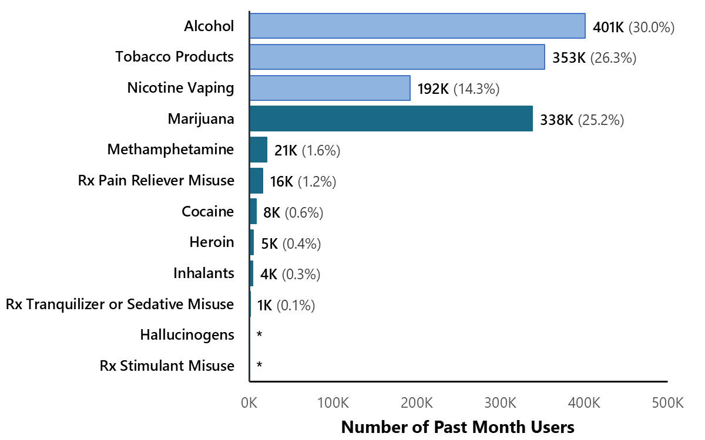
Past Month Substance Use: Among AIAN People Aged 12 or Older
* Low precision; no estimate reported.
Rx = prescription.
Note: The estimated numbers of current users of different substances are not mutually exclusive because people could have used more than one type of substance in the past month.

Slide 8
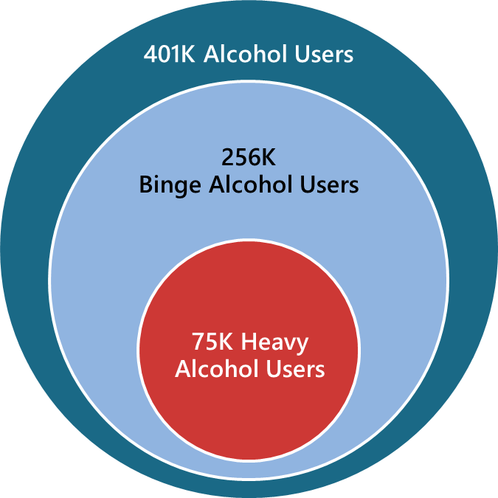
Past Month Alcohol Use, Binge Alcohol Use, and Heavy Alcohol Use: Among AIAN People Aged 12 or Older
Nearly 2 in 3 past month AIAN alcohol users were binge drinkers
Note: Binge Alcohol Use is defined as drinking five or more drinks (for males) or four or more drinks (for females) on the same occasion on at least 1 day in the past 30 days. Heavy Alcohol Use is defined as binge drinking on the same occasion on 5 or more days in the past 30 days; all heavy alcohol users are also binge alcohol users.

Slide 9
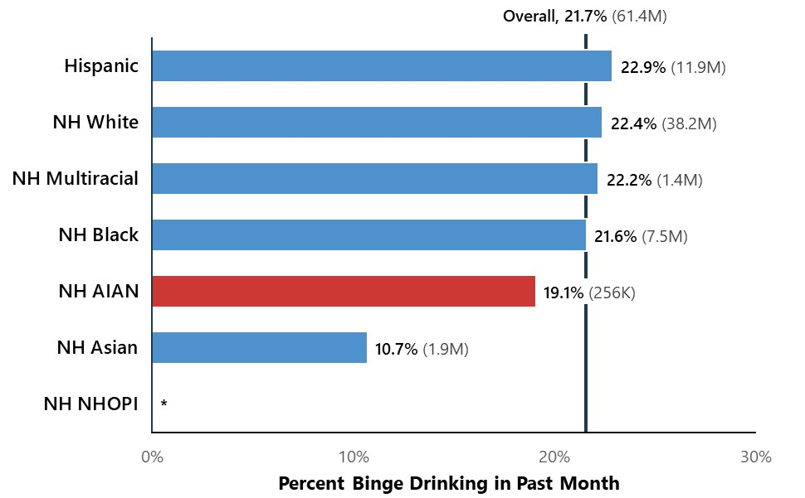
Binge Alcohol Use in the Past Month by Racial and Ethnic Groups:
Among People Aged 12 or Older
AIAN people were just as likely to binge drink as people from all other racial or ethnic groups
* Low precision; no estimate reported.
NH = Not Hispanic or Latino; AIAN = American Indian or Alaska Native; Black = Black or African American; Hispanic = Hispanic or Latino; NHOPI = Native Hawaiian or Other Pacific Islander.
Note: Binge Alcohol Use is defined as drinking five or more drinks (for males) or four or more drinks (for females) on the same occasion on at least 1 day in the past 30 days.

Slide 10
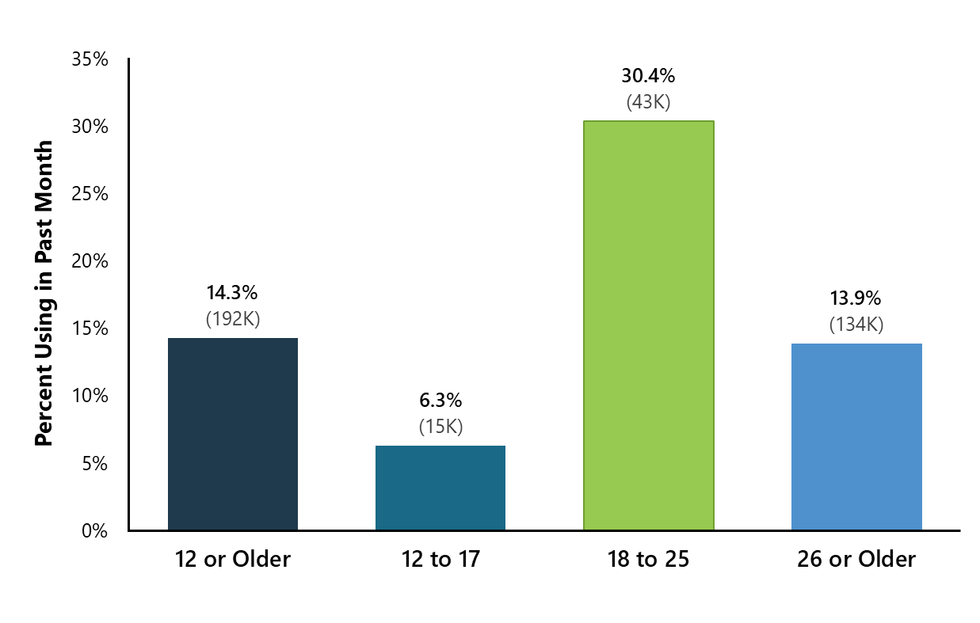
Past Month Nicotine Vaping: Among AIAN People
Aged 12 or Older
The percentage of people who vaped nicotine was highest among AIAN young adults aged 18 to 25

Slide 11
Past Year and Past Month Illicit Drug Use

Slide 12
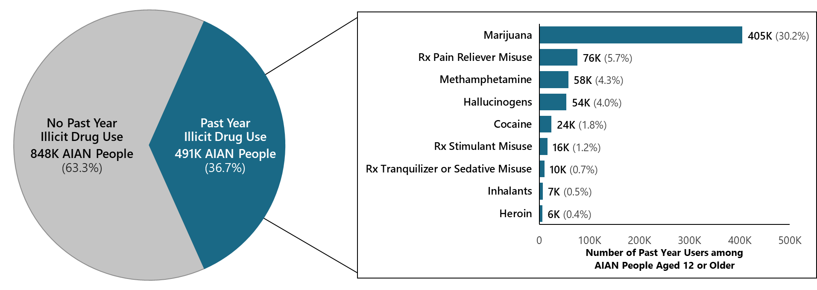
Past Year Illicit Drug Use: Among AIAN People Aged 12 or Older
Rx = prescription.
Note: The estimated numbers of past year users of different illicit drugs are not mutually exclusive because people could have used more than one type of illicit drug in the past year.

Slide 13
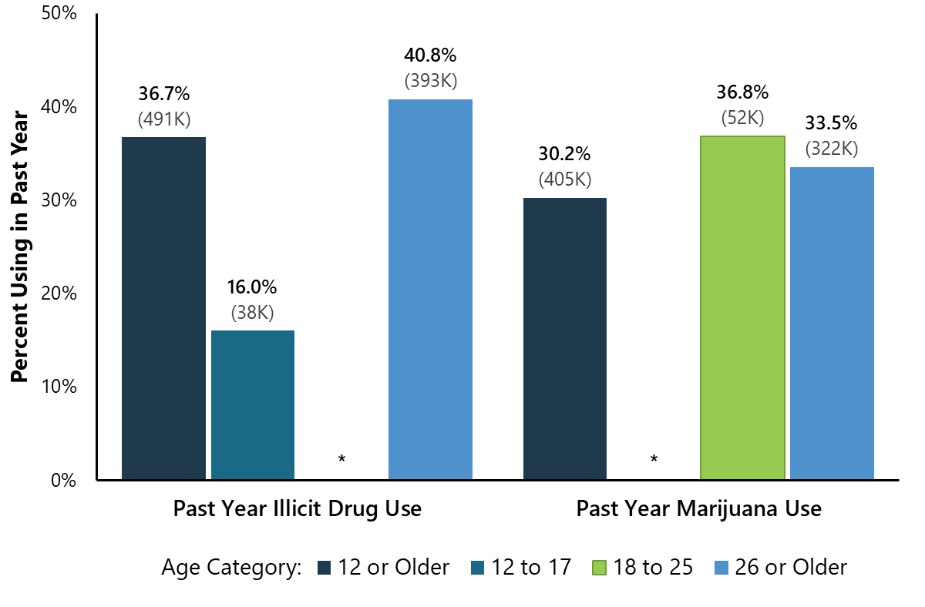
Past Year Illicit Drug Use and Marijuana Use:
Among AIAN People Aged 12 or Older
Among AIAN people aged 26 or older, 40.8% used illicit drugs and 33.5% used marijuana in the past year
* Low precision; no estimate reported.

Slide 14
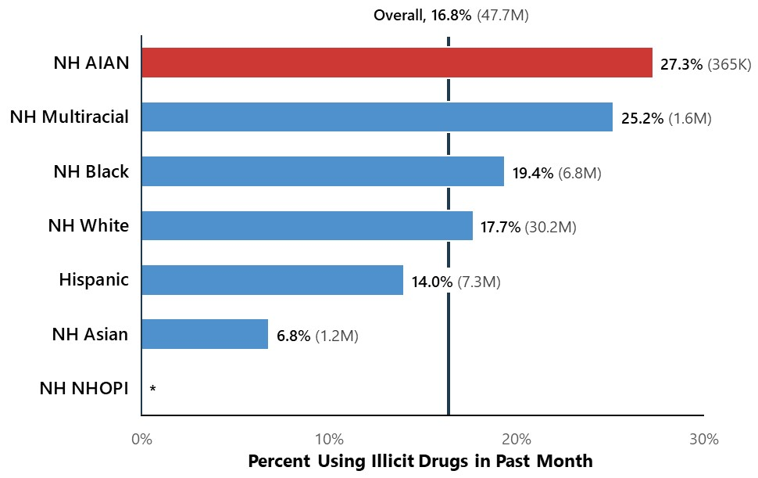
Illicit Drug Use in the Past Month by Racial and Ethnic Groups:
Among People Aged 12 or Older
AIAN people were more likely than White and Hispanic people to use illicit drugs in the past month
* Low precision; no estimate reported.
NH = Not Hispanic or Latino; AIAN = American Indian or Alaska Native; Black = Black or African American; Hispanic = Hispanic or Latino; NHOPI = Native Hawaiian or Other Pacific Islander.

Slide 15
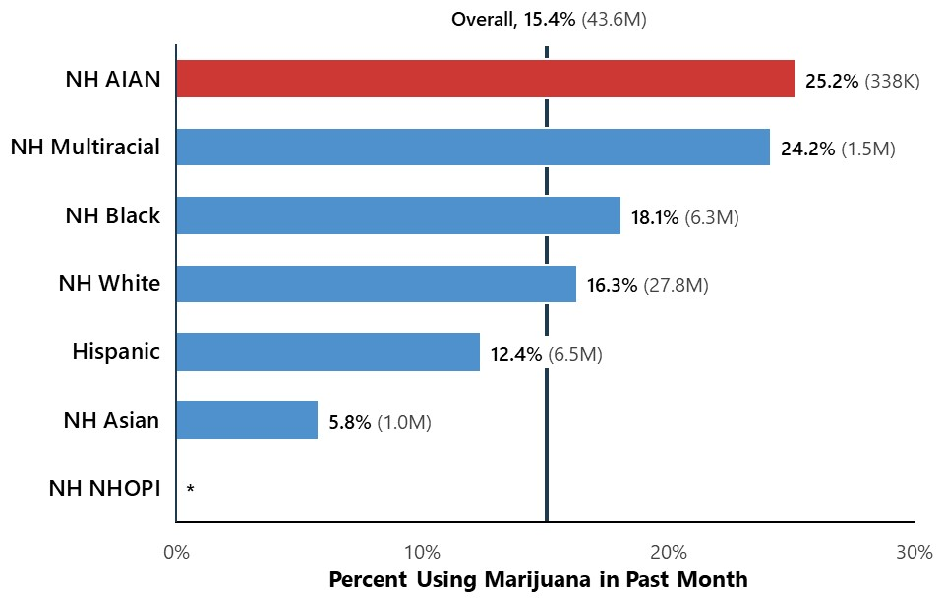
Marijuana Use in the Past Month by Racial and Ethnic Groups: Among People Aged 12 or Older
AIAN people were more likely to use marijuana than Hispanic people
* Low precision; no estimate reported.
NH = Not Hispanic or Latino; AIAN = American Indian or Alaska Native; Black = Black or African American; Hispanic = Hispanic or Latino; NHOPI = Native Hawaiian or Other Pacific Islander.

Slide 16
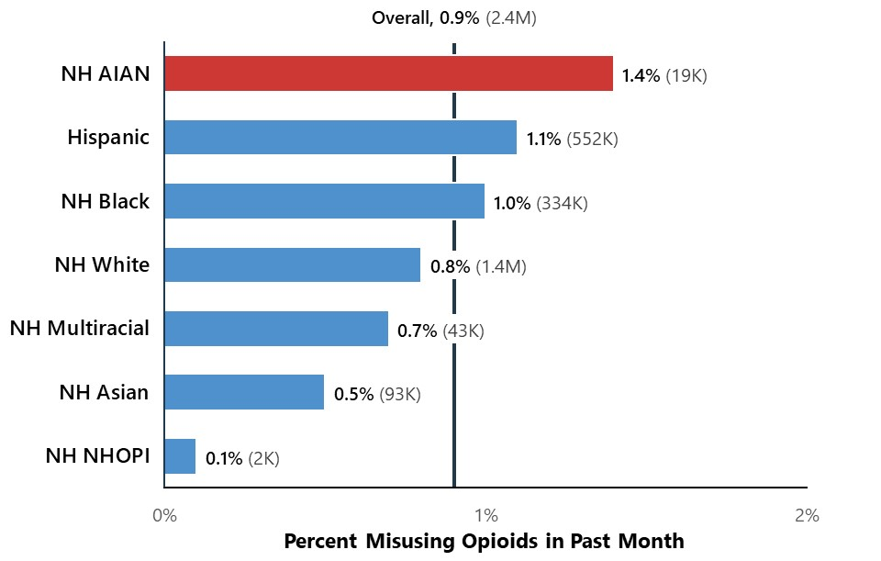
Opioid Misuse in the Past Month by Racial and Ethnic Groups: Among People Aged 12 or Older
AIAN people were just as likely to have misused opioids as people from all other racial or ethnic groups
NH = Not Hispanic or Latino; AIAN = American Indian or Alaska Native; Black = Black or African American; Hispanic = Hispanic or Latino; NHOPI = Native Hawaiian or Other Pacific Islander.

Slide 17
Substance Use Disorder

Slide 18
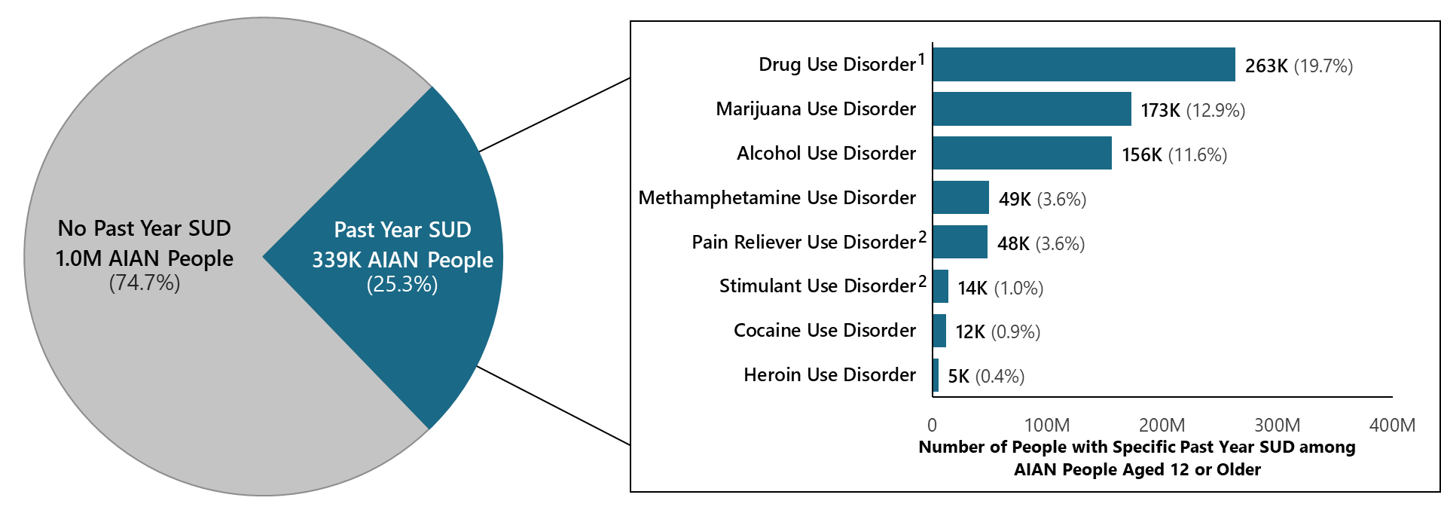
Past Year Substance Use Disorder (SUD): Among AIAN People
Aged 12 or Older
Note: The estimated numbers of people with substance use disorders are not mutually exclusive because people could have use disorders for more than one substance.
¹ Includes data from all past year users of marijuana, cocaine, heroin, hallucinogens, inhalants, methamphetamine, and prescription psychotherapeutic drugs (i.e., pain relievers, tranquilizers, stimulants, or sedatives).
² Includes data from all past year users of the specific prescription drug.

Slide 19
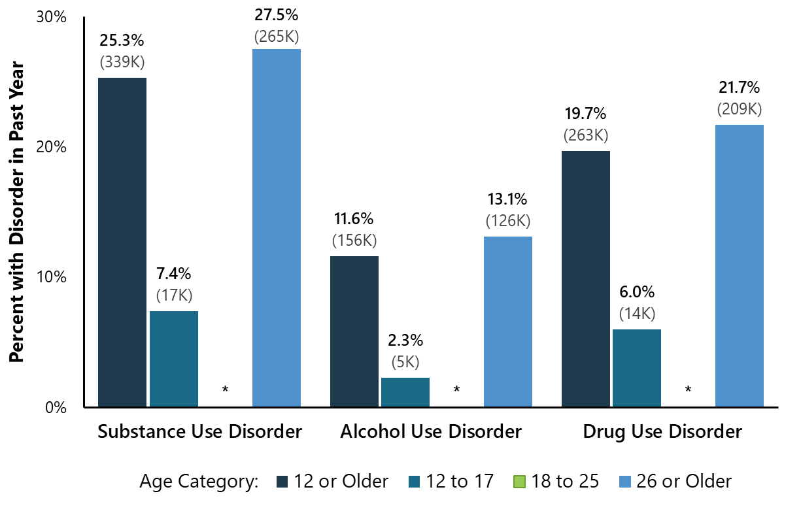
Past Year Substance Use Disorder: Among AIAN People Aged 12 or Older
* Low precision; no estimate reported.
¹ Includes data from all past year users of marijuana, cocaine, heroin, hallucinogens, inhalants, methamphetamine, and prescription psychotherapeutic drugs (i.e., pain relievers, tranquilizers, stimulants, or sedatives).

Slide 20
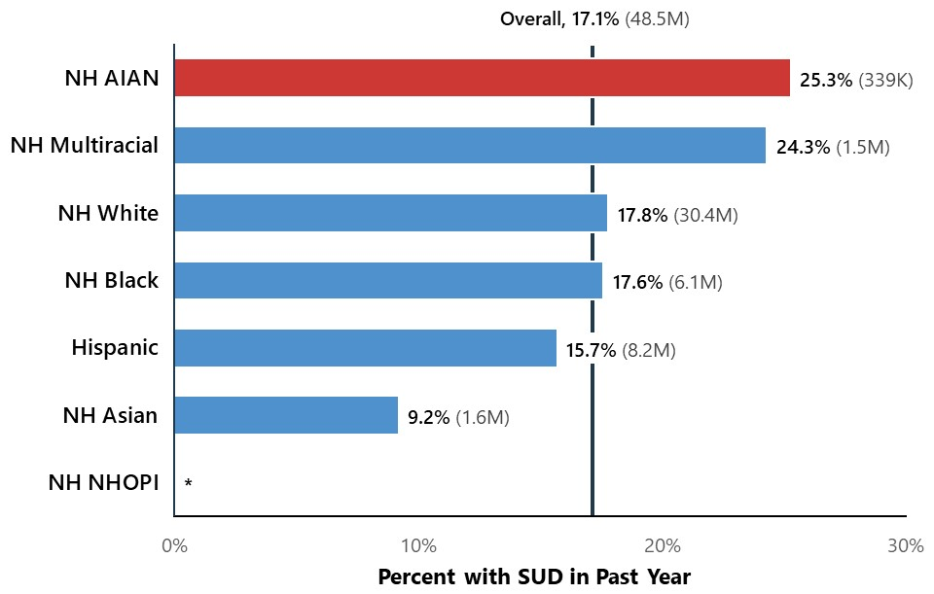
Substance Use Disorder (SUD) in the Past Year by Racial and Ethnic Groups: Among People Aged 12 or Older
AIAN people were more likely to have an SUD than Hispanic people
* Low precision; no estimate reported.
NH = Not Hispanic or Latino; AIAN = American Indian or Alaska Native; Black = Black or African American; Hispanic = Hispanic or Latino; NHOPI = Native Hawaiian or Other Pacific Islander.

Slide 21
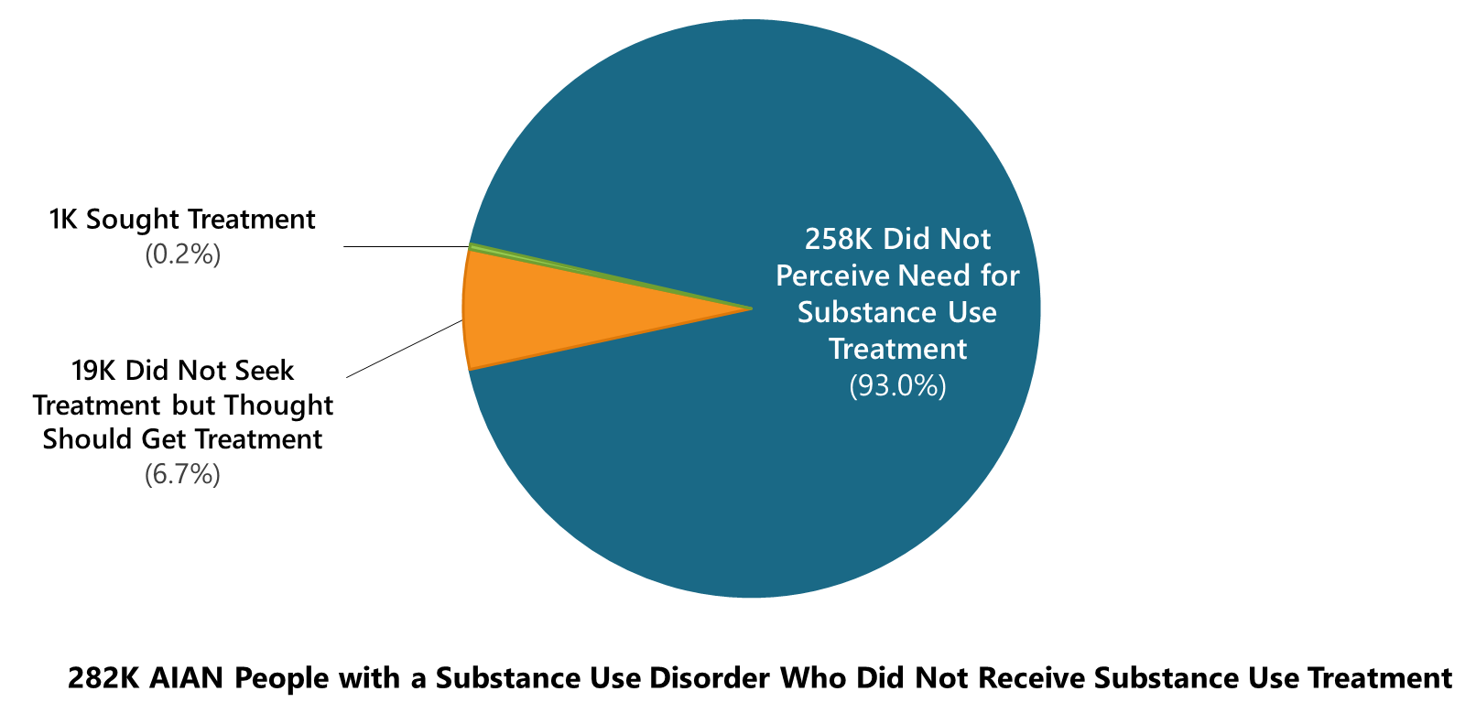
Perceived Need for Substance Use Treatment:
Among AIAN People Aged 12 or Older with a Past Year Substance Use Disorder Who Did Not Receive Substance Use Treatment in the Past Year
Nearly all AIAN people with a substance use disorder who did not receive substance use treatment did not think they needed treatment
Note: Respondents with unknown information for perceptions of need for substance use treatment were excluded from the analyses.

Slide 22
Any or Serious Mental Illness:
Among Adults Aged 18 or Older

Slide 23
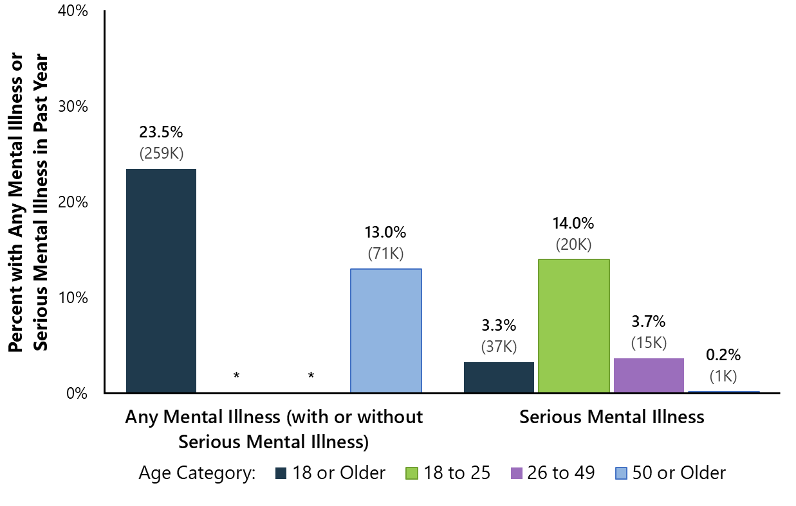
Past Year Mental Illness: Among AIAN Adults Aged 18 or Older
The prevalence of mental illness was highest among adults 18 to 25 years old, for both any mental illness and serious mental illness
1 in 30 AIAN adults aged 18 or older had past year serious mental illness
* Low precision; no estimate reported.

Slide 24
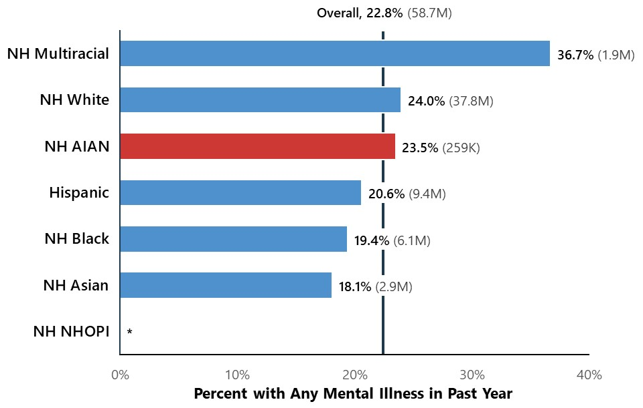
Any Mental Illness in the Past Year by Racial and Ethnic Groups:
Among Adults Aged 18 or Older
AIAN adults were less likely to have any mental illness than Multiracial adults
AIAN adults were more likely to have any mental illness than Asian adults
* Low precision; no estimate reported.
NH = Not Hispanic or Latino; AIAN = American Indian or Alaska Native; Black = Black or African American; Hispanic = Hispanic or Latino; NHOPI = Native Hawaiian or Other Pacific Islander.

Slide 25
Serious Thoughts of Suicide, Suicide Plans, and Suicide Attempts

Slide 26
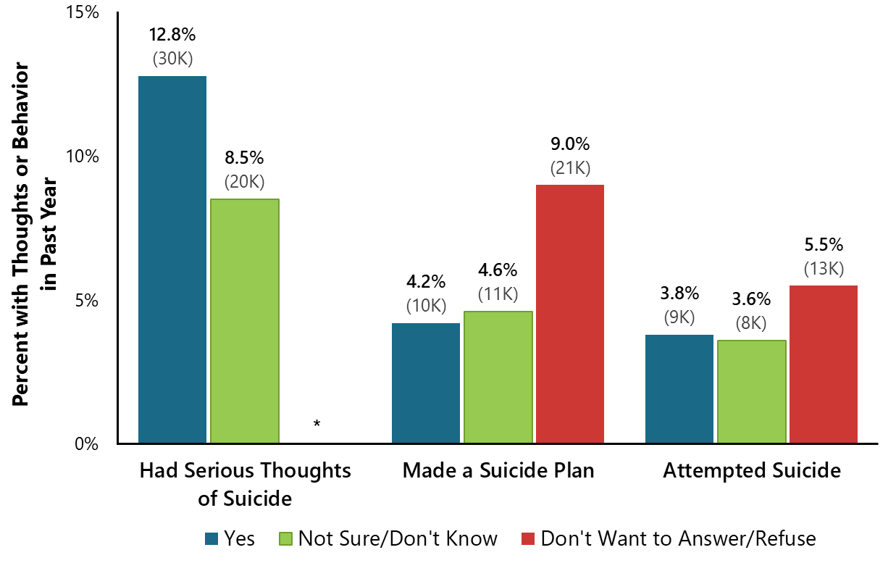
Past Year Serious Thoughts of Suicide, Suicide Plans, or Suicide Attempts: Among AIAN Adolescents Aged 12 to 17
12.8% of AIAN adolescents had thoughts of suicide
4.2% made a suicide plan
3.8% attempted suicide
Many adolescents did not want to answer questions about suicide, which suggests that some adolescents could have had these thoughts but did not feel comfortable disclosing that information
* Low precision; no estimate reported.

Slide 27
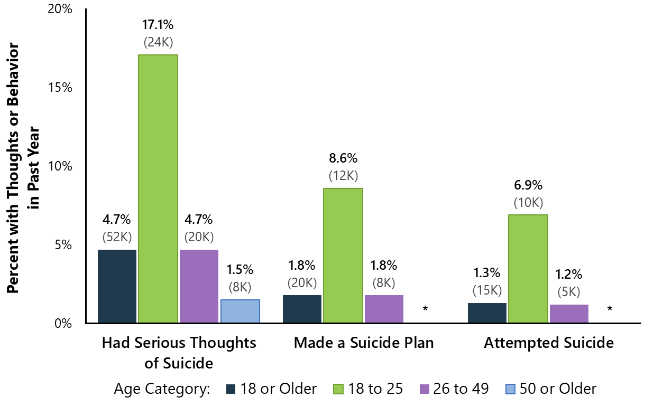
Past Year Serious Thoughts of Suicide, Suicide Plans, or
Suicide Attempts: Among AIAN Adults Aged 18 or Older
Thoughts of suicide, suicide plans, and suicide attempts were highest among people 18 to 25 years of age
Thoughts of suicide and made a suicide plan were highest among AIAN young adults aged 18 to 25
* Low precision; no estimate reported.

Slide 28
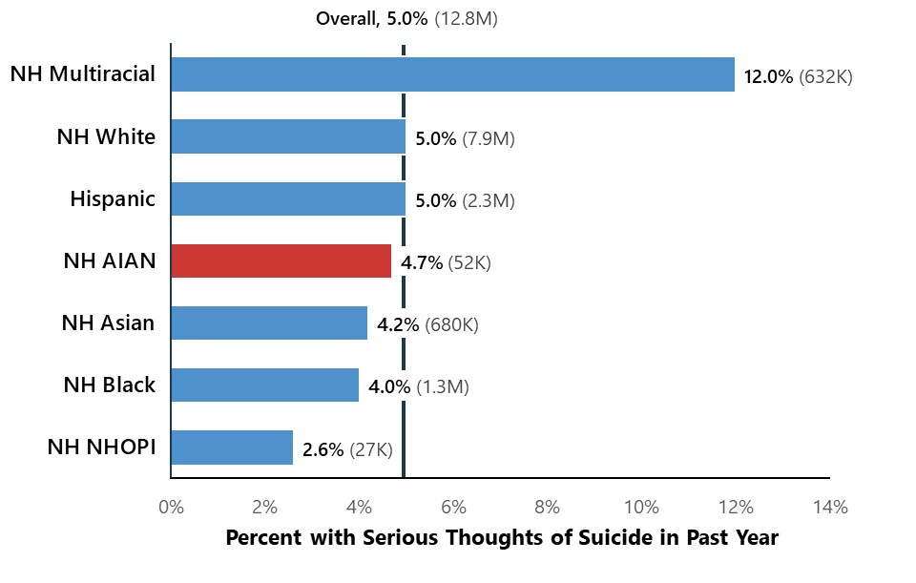
Serious Thoughts of Suicide in the Past Year by Racial and Ethnic Groups: Among Adults Aged 18 or Older
AIAN adults were less likely to have serious thoughts of suicide than Multiracial adults
AIAN adults were more likely to have serious thoughts of suicide than Asian adults
NH = Not Hispanic or Latino; AIAN = American Indian or Alaska Native; Black = Black or African American; Hispanic = Hispanic or Latino; NHOPI = Native Hawaiian or Other Pacific Islander.

Slide 29
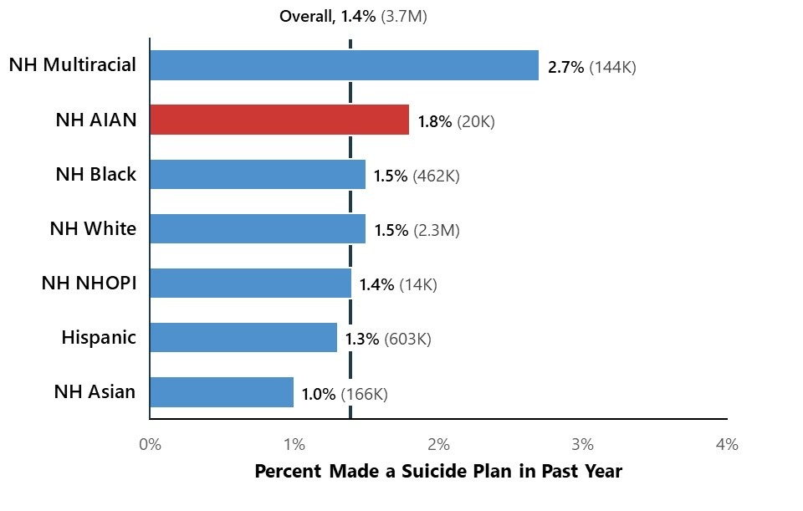
Made a Suicide Plan in the Past Year by Racial and Ethnic Groups: Among Adults Aged 18 or Older
AIAN adults were just as likely to have made a suicide plan as adults from all other racial or ethnic groups
NH = Not Hispanic or Latino; AIAN = American Indian or Alaska Native; Black = Black or African American; Hispanic = Hispanic or Latino; NHOPI = Native Hawaiian or Other Pacific Islander.

Slide 30
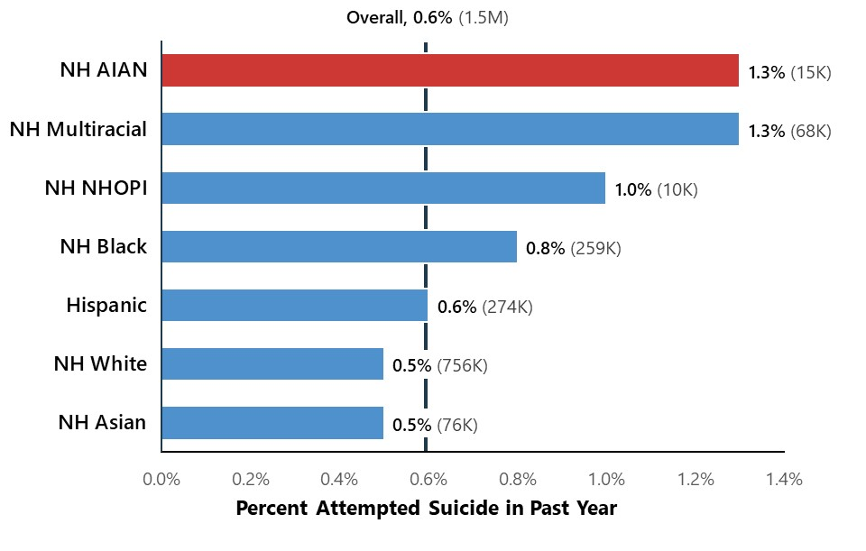
Attempted Suicide in the Past Year by Racial and Ethnic Groups: Among Adults Aged 18 or Older
AIAN adults were just as likely to have attempted suicide as adults in other racial or ethnic groups
NH = Not Hispanic or Latino; AIAN = American Indian or Alaska Native; Black = Black or African American; Hispanic = Hispanic or Latino; NHOPI = Native Hawaiian or Other Pacific Islander.

Slide 31
Co-Occurring Substance Use Disorder and
Mental Illness: Among Adults Aged 18 or Older

Slide 32
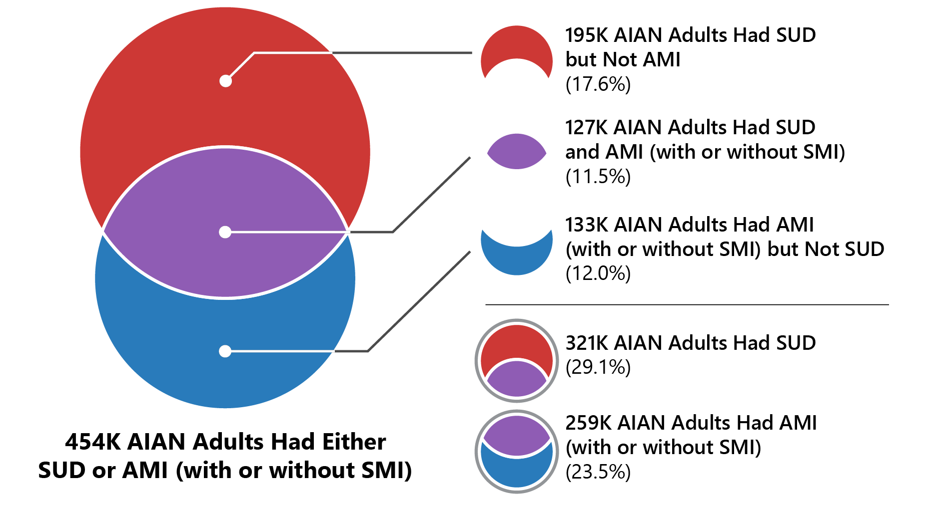
Co-Occurring Substance Use Disorder and Any Mental Illness:
Among AIAN Adults Aged 18 or Older
Additionally, nearly half (45.8%) of all young adults aged 18 to 25 had SUD or AMI.
127,000 (11.5%) AIAN adults aged 18 or older had co-occurring SUD and AMI
AMI = any mental illness; SMI = serious mental illness; SUD = substance use disorder.

