Slide 1
Crisis Counseling Assistance and Training Program (CCP)
Substance Abuse and Mental Health Services Administration
U.S. Department of Health and Human Services
Revised 8/2020
Transition to Regular Services Program (RSP) and Midprogram
Training (Virtual)
Notes:
Begin the course by welcoming participants and introducing yourself. Prior to the training, send your bio to the participants with the Participant Workbook. Encourage them to print the participant workbooks, as the workbooks include space for participants to make notes. Let them know that if they cannot print the participant workbooks, they should come to the course prepared to make notes on their own.
Prior to the training, encourage CCPs who will be sending employees to participate in the training to designate one employee to take notes on key insights, ideas, and action items that come up during the training.

Slide 2
Technological Platform/Instructions
Send a private chat message for tech support.
Send a chat message to the entire group for questions or comments related to training content.
You may be assigned to breakout rooms during the training. Your participation is appreciated.
If possible, participate in this training through your computer only (audio, video, and microphone). If you call in by phone, please “rename” yourself with your full name instead of phone number so that we can better assign you to breakout sessions.
Notes:
In platforms such as Zoom, keep in mind that anything put in the chat boxes can be captured for review later. For this reason, it is recommended that the trainer encourage the use of the chat feature throughout the training over the use of a question-and-answer (Q&A) feature.
Additional session and platform-specific guidance can be placed here.

Slide 3
Training Delivery During the COVID-19 Pandemic
Notes:
Before going to the next slide, pause, and if delivering the training during the COVID-19 pandemic, open the training with the following:
As discussed at the start of virtual Core Content Training, the environment we are all currently living in is not “normal.” In fact, while people involved in disaster response often talk about how each disaster is different, the COVID-19 pandemic is in many ways like nothing that has happened before. Although the CCP encourages programs to include staff from within the disaster-affected area, the COVID-19 pandemic is unusual in that we are all in some way part of that affected population.
For this reason, as we did at the start of Core Content Training, we want to acknowledge the emotions you may be carrying today. We are going to be talking about disaster-affected individuals who may be isolated and lonely, and you may be feeling lonely. We will talk about those who may be feeling especially vulnerable for economic reasons or due to previous experience with depression, anxiety, or substance misuse, and you may be whispering to yourself, “Hey, that’s me too.”
Wherever you are at today, before we go any further, we want to acknowledge that you are not alone in these feelings. As we will talk about today, many of these reactions are common reactions to a very uncommon event. As we walk through this training together today, please take note of how you are feeling, and reach out to your program leadership with any concerns that you have. During this training, as well as during the entire CCP, you can only be helpful to others when you are also taking care of yourself and staying healthy and able to serve your community.
We will end the training on this topic too but felt that it was important to begin here due to current circumstances. So as we transition into the training, thank you for being a part of this work, and please remember to take care of yourselves and one another.

Slide 4
Introductions (for a small group)
Take turns introducing yourselves with the following information:
  Your name
  Your role or position in the CCP
  Something you’ve done that no one else here has done
Notes:
Transition to introductions.
Ask participants to introduce themselves by sharing the following:
• Their names
• Their role or position in the CCP
• Something they have done that they think no one else taking the course has done
Call on participants one by one to provide their role or position and thing they have done that they think no one else in the training has done.
(The large-group introduction activity is on the next slide. Please use either slide 4 or slide 5 for introductions.)

Slide 5
Introductions (for a large group)
  Have participants submit answers to one of the following questions via chat:
  What is one thing you are hoping to learn about in this course?
  What are two things you’re grateful for that begin with your initials?
Notes:
Transition to introductions.
Ask participants to answer one of these questions via chat:
What is one thing you are hoping to learn about in this course?
What are two things you’re grateful for that begin with your initials?
Comment on results, noting any interesting trends.

Slide 6
Getting Started Activity
Using page 2 in the Participant Workbook, take 5 minutes to write down 20 things you do for fun.
Notes:
The purpose of this activity is to provide an opportunity for team building early in the training.
Ask participants make a list of 20 things they do to have fun, using the worksheet on page 2 in their Participant Workbooks. While 20 things may seem like a lot, encourage them to think hard and be creative, and they can certainly come up with at least that many. It also may help to be specific. For example, instead of listing “reading,” a participant could write the many genres and authors he or she likes to read, e.g., “reading science fiction,” “reading books by Isaac Asimov,” “reading comic books,” etc. They do not need to limit themselves to things they can do during physical distancing orders and practices related to COVID-19. (5 minutes)

Slide 7
Poll Question #1 (Getting Started)
Select the items that correspond to your top three, four, or five favorite fun activities.
Reading
Writing
Watching television
Watching movies
Going to museums
Going to sports events
Playing a sport
Going to concerts and outdoor events
Hunting or fishing
Going to a shooting range
Going to an amusement park
Online gaming
Exercising at the gym
Playing board or card games
Shopping for clothing and shoes
Exercising somewhere other than at the gym
Spending time with friends
Spending time with spouse/significant other
Cooking or baking
Hosting dinner parties
Going out to dinner
Other
Note: If you are not using the Zoom application, you will not have access to the poll questions. In that case, please type your answer in the chat box.
Notes:
Conduct a poll of participants regarding their top three to five favorite fun activities. If the training is being delivered through Zoom and participants do not have the Zoom application, ask that they type their answers into the chat box.
Present and comment on the results, highlighting any trends. If you’d like, you might ask people who chose “other” what their activities were.

Slide 8
Getting Started Activity (cont.)
Hold onto the lists you made. An important part of self-care is making time for activities you enjoy.
This activity is also one you can do with survivors, so they can make their own favorite activities part of their self-care.
Notes:
Summarize what participants just did in this activity—they came up with ideas that can help them with self-care, as an element of self-care is making sure to take part in activities you enjoy. This is also an activity that they can use with disaster survivors, to help them come up with their own self-care lists.
Bring the conversation to a close, and transition to the next section on course objectives, agenda, and norms.

Slide 9
Objectives
By the end of this course, you will be able to do the following:
  Identify goals and objectives of the RSP, as well as goals specific to your grant program.
  Describe ongoing and emerging disaster reactions related to the current phase of disaster.
  Identify the current needs of survivors, and utilize appropriate crisis counseling, outreach, and communication skills to meet their needs.
  Complete data collection forms correctly.
  Apply techniques for stress management.

Slide 10
Course Agenda
Morning
Welcome and Introductions
Objectives and Agenda
Section 1: Successes, Challenges, and Goals
Section 2: Current Reactions, Strengths, and Resilience
Afternoon
Section 3: Services, Interventions, and Skills
Section 4: Data Collection and Program Evaluation
Section 5: Stress Management
Applying Your Learning and Course Evaluation
Notes:
Adjust as needed to fit the actual timing of training delivery. The training is designed to last for 8 hours, but you may opt to deliver it in a few blocks of time over two days, several days, etc., depending on the needs of training participants.

Slide 11
Guidelines for Working Together
  Keep time (start on time, return from breaks on time, end on time).
  Switch mobile phones off or to “vibrate.”
  Turn off computer notifications.
  Mute yourself when you are not speaking so others can be heard clearly.
  Participate fully.
  Ask/submit questions freely.
  Balance talking and listening.
  Respect each other’s points of view.
Notes:
Briefly review the guidelines for working together.

Slide 12
Section 1—Successes, Challenges, and Goals
CCP Timeline
RSP Goals and Objectives
Reflection and Planning
Notes:
Introduce this session by telling participants that we’re going to take some time to understand where their CCPs are now, talk about successes, think about possible future challenges, and begin thinking of ways to address the challenges.

Slide 13
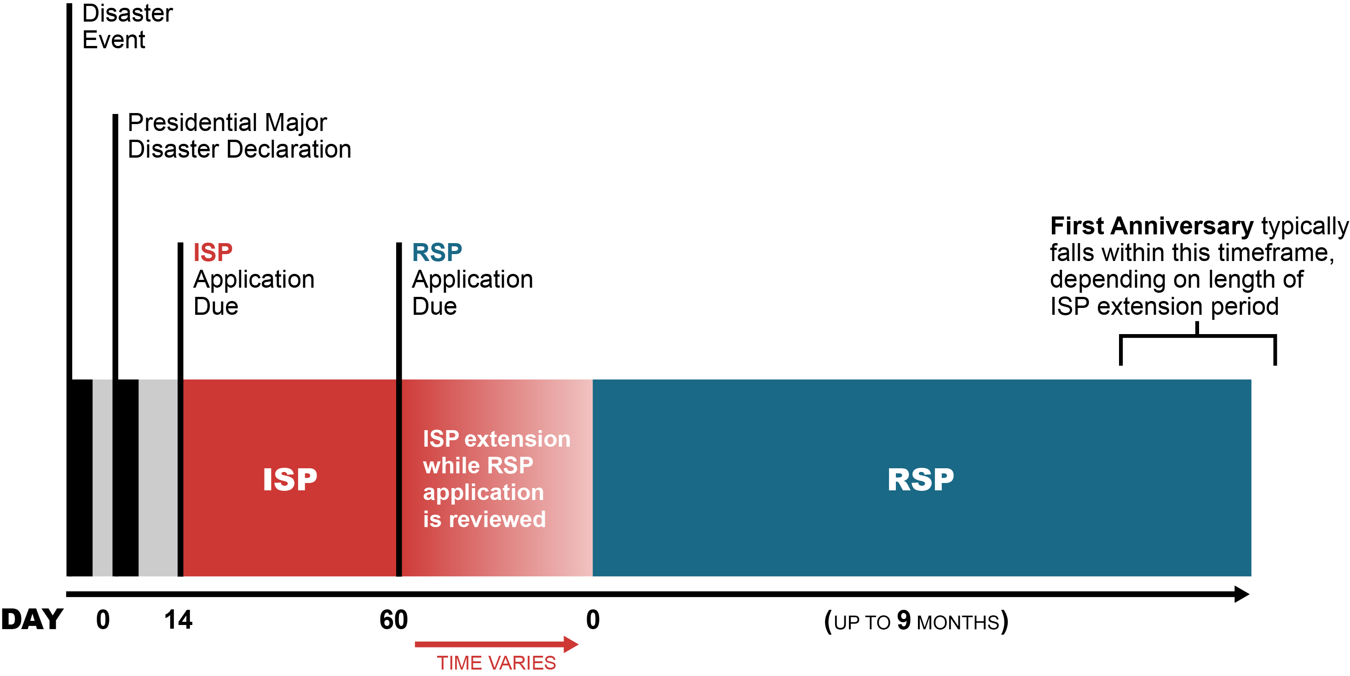
Typical CCP Timeline
Where is your CCP?
Notes:
Very briefly review the typical CCP timeline:
The Immediate Services Program (ISP) funds services for up to 60 days from the date of the declaration. If a state, territory, or federally recognized tribal government has submitted an application for the Regular Services Program (RSP), the ISP may be extended for an additional 30 days while the RSP application is under review.
The RSP application is due within 60 days of the major disaster declaration.
RSPs last up to 9 months.

Slide 14
Goals and Objectives of the RSP
Areas to focus on during the RSP:
  Ongoing needs assessment
  Ongoing provision of the full range of CCP services
  Fostering of individual and community resilience
  Identification of and targeted outreach to special populations
  Community networking
  Assessment and referral
  Resource linkage
Notes:
Introduce this list of typical RSP goals and objectives. Clarify what is meant by each one—a focus on the following areas:
Ongoing needs assessment
Ongoing provision of the full range of CCP services, from individual and family services to group crisis counseling and public education to media messaging and public service announcements
Fostering of individual and community resilience
Identification of special populations and targeted outreach to them
Community networking
Assessment and referral
Resource linkage

Slide 15
Goals and Objectives of the RSP (cont.)
Areas to focus on during the RSP (cont.):
  Reassessment of training needs
  Continued stress management
  Analysis and use of program data
  Comprehensive quality assurance process
  Program legacy for individuals, community, and staff
Notes:
Continue to review typical RSP goals and objectives. Clarify what is meant by each one:
Reassessment of training needs
Continued stress management
Analysis and use of program data
Comprehensive quality assurance process
Program legacy for individuals, community, and staff

Slide 16
Reflection and Planning—Panel Discussion
This training is an opportunity to think about what your program has achieved and where you would like it to go.
  Reflecting on the program to date—what stands out?
    Successes and accomplishments
    Challenges
  Looking ahead:
    What do you need to pay attention to as the program moves forward?
    What do you want to see the program accomplish?
    What challenges do you anticipate? How might you address them?
The Participant Workbook (page 5) includes space where you can make notes on the answers to the questions on the slide.
Notes:
Prior to the training, for each CCP grant represented by a participant in the training, identify a program representative, ideally a program manager, to answer the following questions as part of a panel discussion during the training:
Reflecting on the program to date—what stands out?
Successes and accomplishments
Challenges
Looking ahead:
What do you need to pay attention to as the program moves forward?
What do you want to see the program accomplish?
What challenges do you anticipate? How might you address them?
This segment should last for 30 minutes. Allow yourself a few minutes at the beginning of the segment to introduce it, as well as 5 minutes at the end of the segment to conclude the panel discussion and thank participants. Determine how much time each panelist will have to answer questions (e.g., if three CCPs are represented at the training, then each panelist should have about 7 minutes total). Communicate this time limit to panelists so they can prepare effectively. If possible, practice this panel discussion in advance with the panelists to identify and address any potential problems before the day of the training.
At the start of this segment, explain that this training is an opportunity for the program or programs involved to take stock of their successes and consider issues to attend to after training. Tell participants that this will be a panel discussion, with representation by management from each of the CCPs involved in the training.
Moderate a panel with the pre-identified panelists. Ask each question, and allow panelists one by one to answer them.
In the last 5 minutes of this part of the training, close the panel, thank panelists, and highlight any salient points for programs to carry forward after the training.

Slide 17
Section 2—Current Reactions, Strengths, and Resilience
Review of Key Concepts
What Individual Reactions Have We Seen?
What Strengths Have We Seen?
How Are We Fostering Resilience?
Notes:
Introduce this session by telling participants that you and they will explore the reactions they are encountering and can expect to encounter in this and coming phases of the disaster. Specifically, you and they will talk about collective, individual, and severe reactions and also about fostering resilience among individuals and in the community.

Slide 18
Review of Key Concepts
Have you observed any of the following?
  Everyone who experiences a disaster is affected by it in some way.
  People pull together during and after a disaster.
  Stress and grief are common reactions to uncommon situations.
  People’s natural resilience will support individual and collective recovery.
Notes:
Begin by reviewing some of the key concepts of disaster reactions and asking participants if they have observed them to be true thus far.
NOTE: These key concepts frame the CCP approach to disaster work—a strengths-based model that assumes natural resilience in the majority, while being careful to assess for the severe reactions that some survivors may experience.
Suggested talking points:
The use of the word “normal” can be emotionally loaded. “Common” is the preferred adjective.
The CCP is intended to help people access their natural resilience and develop positive coping skills to diminish disruptions in daily living.

Slide 19
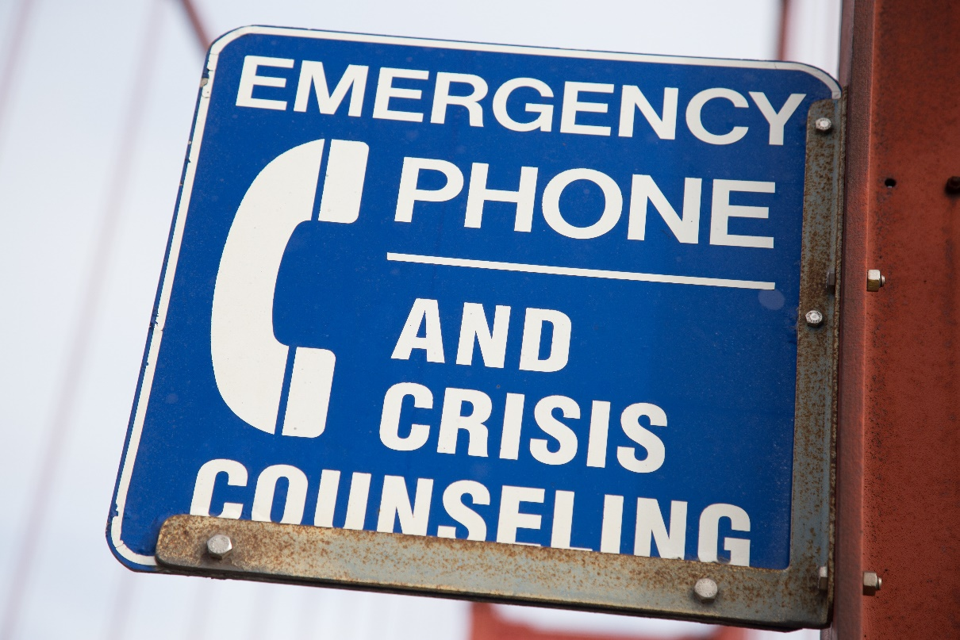
Review of Key Concepts (cont.)
  Typical outcomes of disaster:
    Some people will have severe reactions.
    Few will develop diagnosable conditions.
    Most do not seek help
    or treatment.
    Survivors often reject help.
Notes:
Review the typical outcomes of disaster.
Remind participants of information provided in Core Content Training: severe reactions are relatively rare in typical disasters, and most survivors do not seek help. They may even reject help.
Emphasize that disaster reactions should always be considered in terms of context and culture.

Slide 20

Review of Key Concepts (cont.)
Disasters have impacts on two levels:
  Individual
    Stress and grief
    Fatigue, irritability, hopelessness,
    and relationship conflicts
  Collective
    Damages to infrastructure, social networks, and community support
    Reduced ability of individual
    community members to cope
Notes:
Remind participants of the distinction between individual and collective impacts of disasters, both of which the CCP is designed to help address.
Tell participants that you will focus on collective impacts first.

Slide 21
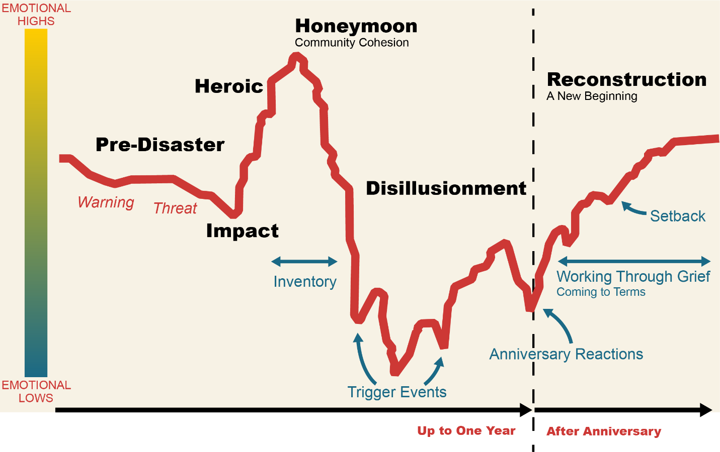
Review of Key Concepts (cont.)
Source: Zunin & Myers, as cited in Center for Mental Health Services. (2000). Training manual for mental health and human service workers in major disasters (DHHS Publication 90-538). U.S. Department of Health and Human Services, Substance Abuse and Mental Health Services Administration.
Notes:
Review the graphic showing typical phases of disaster for communities. Tell participants that they can refer to pages 6–7 in the Participant Workbook for the graphic and details of the phases. You will also be reviewing the phases in greater depth in a moment.
Reiterate the following points:
Communities move through the phases at different rates depending on the type and nature of the disaster. They may also move back and forth between phases, or seem to be in more than one phase at a given time.
Crisis counseling interventions should be adapted to the phase of disaster response.
Provide the following information about the typical phases of disaster graphic:
The graphic identifies processes and events in addition to the main phases of disaster.
Inventory is the process by which communities and individuals come to realize the limits of disaster assistance. This usually begins later in the honeymoon phase and causes the decline into the disillusionment phase.
Trigger events can happen in any phase following the onset of a disaster but are more typical in the later phases—after the reality of the initial traumatic event has set in. Trigger events vary by disaster, community, and individual.
Working through grief is the process of coming to terms with disaster losses, developing constructive coping strategies, and building a new post-disaster life. This process can sometimes take years.
Setbacks are trigger events in the reconstruction phase—e.g., a new disaster, or media coverage of new and painful discoveries related to the disaster. A community’s sense of recovery—of having come to terms with the disaster—can be damaged by these unexpected setbacks.

Slide 22
Poll Question #2
The community my CCP serves is in the __________ phase of disaster.
Impact
Heroic
Honeymoon
Disillusionment
Reconstruction
More than one of the phases of disaster
None of the above
Note: If you are not using the Zoom application, you will not have access to the poll questions. In that case, please type your answer in the chat box.
Notes:
Conduct a poll of participants regarding which phase of disaster the community they serve is in, with the options on the slide as possible responses. If the training is being delivered through Zoom and participants do not have the Zoom application, ask that they type their answers into the chat box.
Present and comment on the results. Ask participants why they chose the answers they did. Request that they respond via chat if meeting software does not allow audio or video response.
If delivering the training to participants working for CCPs established during the COVID-19 pandemic, you might spend time discussing whether these phases seem to fit, given the protracted impact phase of the pandemic; physical distancing and its impacts; and discoveries, advances, setbacks, and policy changes associated with the disaster.

Slide 23
Collective Reactions
Typical Phases of Disaster
  Pre-disaster phase
    Disasters with no warning can cause feelings of vulnerability, lack of security, and loss of control; fear of future unpredicted tragedies; and inability to protect oneself and one’s family.
    Disasters with warning can cause guilt or self-blame for failure to heed warnings.
  Impact phase
    Reactions can range from shock to overt panic.
    Initial confusion and disbelief are followed by a focus on self-preservation and family protection.
Notes:
Quickly review the characteristics of the various phases of disaster. Participants can refer to this information in the Participant Workbooks.
If delivering this training during the COVID-19 pandemic, it may also be helpful to spend some time discussing the prolonged impact phase of this disaster event, and the muddiness of transitions between phases.

Slide 24
Collective Reactions (cont.)
Typical Phases of Disaster (cont.)
  Heroic phase
    Many survivors exhibit adrenaline-induced rescue behavior, as well as high activity with low productivity.
    Risk assessment may be impaired.
    There is a sense of altruism.
  Honeymoon phase
    Disaster assistance is readily available.
    Community bonding occurs.
    Many are optimistic that everything will quickly return to normal.
    CCP staff can establish program identity, gain access to survivors, and build relationships with stakeholders.

Slide 25
Collective Reactions (cont.)
Typical Phases of Disaster (cont.)
  Disillusionment phase
    Stress and fatigue take a toll.
    Optimism turns into discouragement.
    Need for substance use services may increase.
    The larger community returns to business as usual.
    Demand for CCP services may increase as individuals and communities become ready to accept support.
  Reconstruction phase
    Individuals and communities begin to assume responsibility for rebuilding their lives.
    People begin adjusting to new circumstances.
    There is a recognition of growth and opportunity.
Notes:
9/24/2020
Tell participants that the disillusionment and reconstruction phases are generally where communities are when the training they are attending is being delivered.

Slide 26
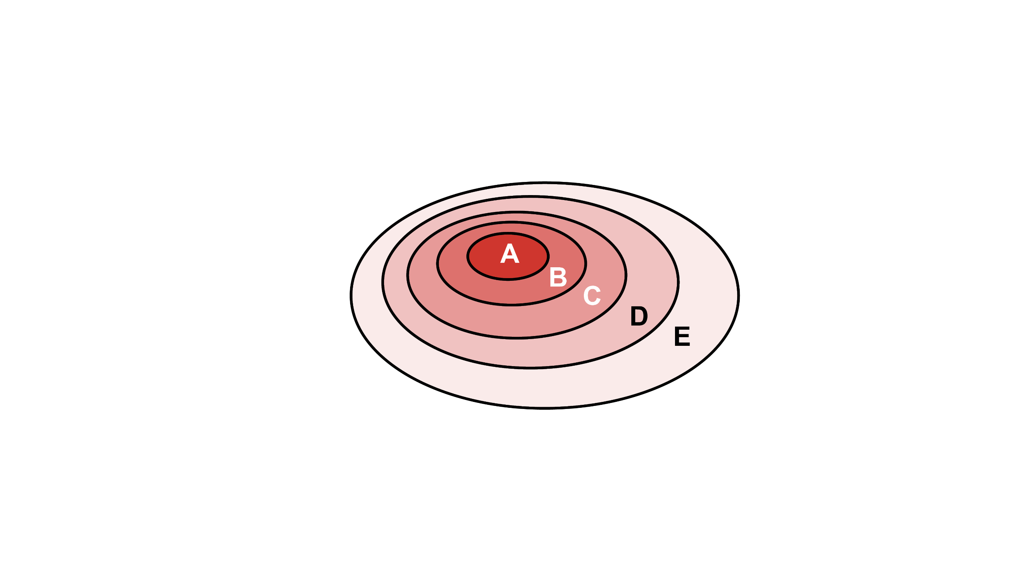
Poll Question #3 (Risk Factors—Population Exposure Model)
Select the three populations you have interacted with most since starting work on your current CCP.
Injured survivors, bereaved family members
Survivors with high exposure to disaster trauma,
or evacuated from disaster zones
Bereaved extended family and friends,
first responders
People who lost homes, jobs, and possessions;
people with preexisting trauma and
dysfunction; at-risk groups and other
disaster responders
Affected people from the larger community
Adapted from DeWolfe, 2002, as cited in SAMHSA, Center for Mental Health Services (CMHS). (2003). Mental health all-hazards disaster planning guidance (DHHS Pub. No. SMA 3829). Rockville, MD: SAMHSA, CMHS.
Notes:
Conduct a poll of participants. Ask that they respond to the poll by selecting the three populations they have interacted with most since starting work on their current CCP. Display and comment on the results, identifying any points of interest.
Continue with a brief review of the model. Remind participants that survivors closer to the center of the model (survivors in groups A and B, for example) may be more likely to experience intense reactions to a disaster.
Note that individual/family crisis counseling may be appropriate for groups closer to the center. Educational efforts to build community resilience may be more appropriate for the “outer” groups.
Trainer Note: If conducting this training during the COVID-19 pandemic, you may want to discuss impacts of physical distancing order and practices on the service mix for CCPs.

Slide 27

What Individual Reactions Have We Seen?
Types of individual reactions:
  Physical
  Emotional
  Cognitive
  Behavioral
  Spiritual
  Please refer to page 8 of the
  Participant Workbook for a summary of
  the types of disaster reactions.
Notes:
Briefly review the range of types of disaster reactions that were first introduced in Core Content Training. A summary of the different types of disaster reactions is included in the Participant Workbook (page 8).
Suggested talking points:
People affected by disaster may experience more than one type of reaction.
Reactions may change over time.
Reactions may be more intense if people have experienced the event more directly or have gone through previous trauma or crises.
Typical reactions vary by developmental stage.
Reactions can include positive and negative responses.

Slide 28
What Individual Reactions Have We Seen? (cont.)
In the Participant Workbook (page 9) or on your own paper:
  Draw a map of the phases of this disaster—what you’ve observed to date and projecting into the future.
  Identify the typical individual reactions you’re seeing.
  Identify potential future trigger points.
You have 5 minutes.
Notes:
Tell participants that they will next be mapping the phases of the current disaster on their own. Refer them to page 9 of the Transition to RSP Participant Workbook, where there is space for them to map the disaster. If they do not have a printout of the participant workbook, suggest that they use their own paper. Give them the following instructions:
Draw a map of the phases of this disaster—what you’ve observed to date and projecting into the future.
Identify the typical individual reactions you’re seeing.
Identify potential future trigger points.
When participants are finished (after about 5 minutes), ask for examples of the reactions they identified.
Facilitate a discussion about the reactions:
Are these reactions you also saw in earlier phases?
Which ones have become worse or better over time?
Trainer Note: If delivering the training for CCPs established during the COVID-19 pandemic, during the discussion, be sure to call out specific ways that counselors can recognize these reactions when interacting with survivors remotely. For example, does a survivor’s voice seem shaky or unsteady? Does the survivor seem to be having trouble following the conversation?

Slide 29
What Individual Reactions Have We Seen? (cont.)
  Severe reactions:
  The severity of reactions is affected by the type of exposure to the disaster, the level of exposure, and casualties associated with the disaster.
  Preexisting trauma may increase the risk of severe reactions.
  CCP staff members identify and refer for treatment anyone experiencing severe reactions.
  Preexisting levels of support will affect the severity of reactions.
Notes:
Discuss the factors that influence severe reactions.
Note that while preexisting trauma may increase risk of severe reactions, some survivors with preexisting trauma have increased coping skills and ability to deal with challenges.

Slide 30
What Individual Reactions Have We Seen? (cont.)
Severe reactions may be a sign of the following:
  Depressive disorders
  Substance use disorders
  Suicidal thoughts, plans, or behavior
  Acute stress disorder
  Posttraumatic stress disorder (PTSD)
  Dissociative disorders
  Anxiety disorders
  Paranoia
  Social isolation
Notes:
Explain that severe reactions may signal a range of psychological disorders and issues.
Emphasize the following point:
The treatment of severe reactions is beyond the scope of the CCP; however, the ability to recognize such symptoms is crucial for the crisis counselor to be able to make appropriate referrals.
Remind training participants of the resources crisis counselors have available to them when working with a survivor experiencing a severe reaction:
The fellow crisis counselor with whom they are partnered (if conducting a face-to-face encounter)
The supervisor, whom they may always call
The Adult and Child/Youth Assessment and Referral Tools (which will be covered in greater depth later in the training)

Slide 31
What Individual Reactions Have We Seen? (cont.)
A severe reaction:
Has a significant impact on the person’s functioning
Presents a health or safety risk
Does not resolve or diminish over time
We will discuss severe reactions, assessment, and referral in greater depth later in this training
Notes:
Recognizing severe reactions—A severe reaction:
Has a significant impact on the person’s functioning
Presents a health or safety risk
Does not resolve or diminish over time
We will discuss more about severe reactions, assessment, and referral later in this training.

Slide 32
What Strengths Have We Seen?
What individual strengths have you seen?
What collective strengths have you seen?
What examples of personal growth have you seen?
Notes:
Ask participants to respond to these questions (via chat or verbally, depending on what meeting technology allows):
What kinds of individual and collective strengths have you seen?
What examples of personal growth have you seen?
Examples of personal growth:
Becoming closer to loved ones
Having faith in the ability to rebuild one’s life
Becoming more spiritual or religious
Finding a deeper meaning and purpose in life
Discovering inner strength
Comment on any common themes or trends you notice in participants’ responses, or on interesting differences across responses.

Slide 33
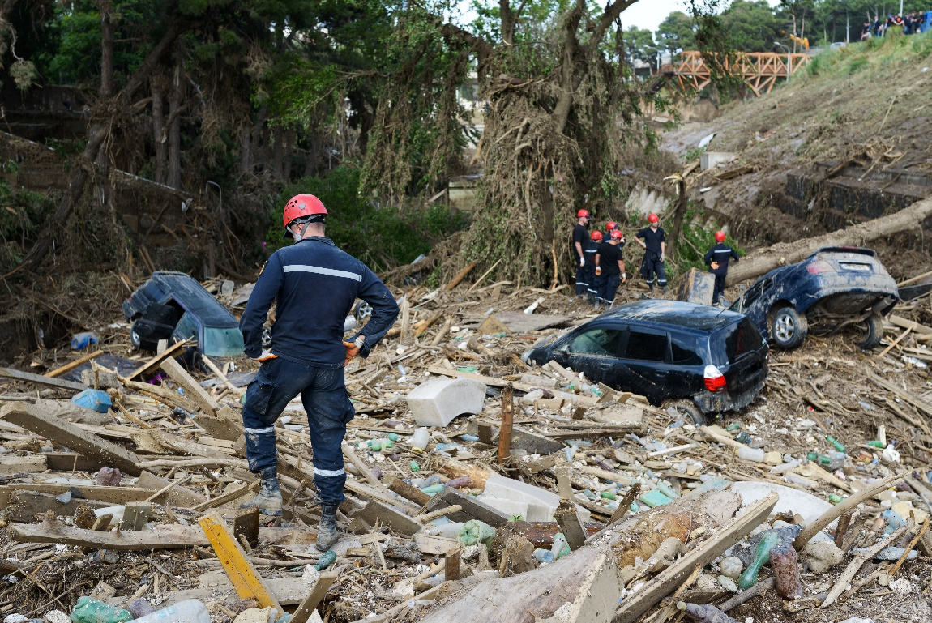
How Are We Fostering Resilience?
“ . . . Resilience [is] the process of
adapting well in the face of adversity,
trauma, tragedy, threats or significant
sources of stress . . . .”
American Psychological Association (APA), (2012).
Building your resilience.
https://www.apa.org/topics/resilience
Notes:
Make the link between strengths and resilience—it is through strengths that we help survivors access and build their resilience.
Present the definition of resilience on the slide. Ask participants to respond to the definition via chat. Do they think it gets at what resilience is? Should anything be added?
Some key points to highlight:
Resilience varies across situations and within individuals at different times.
The level of resilience in individuals and communities can change and be fostered.
It is crucial to recognize people's strengths, as well as the suffering they have experienced.
Probably the most consistent principle of disaster behavioral health emerging from the literature is that people are resilient.
Emotional distress is common after exposure to severely traumatic events. However, even after intense exposure to the most severe disasters, only a minority of the disaster-affected population is likely to suffer from PTSD, and most people do not develop any psychiatric disorder.

Slide 34
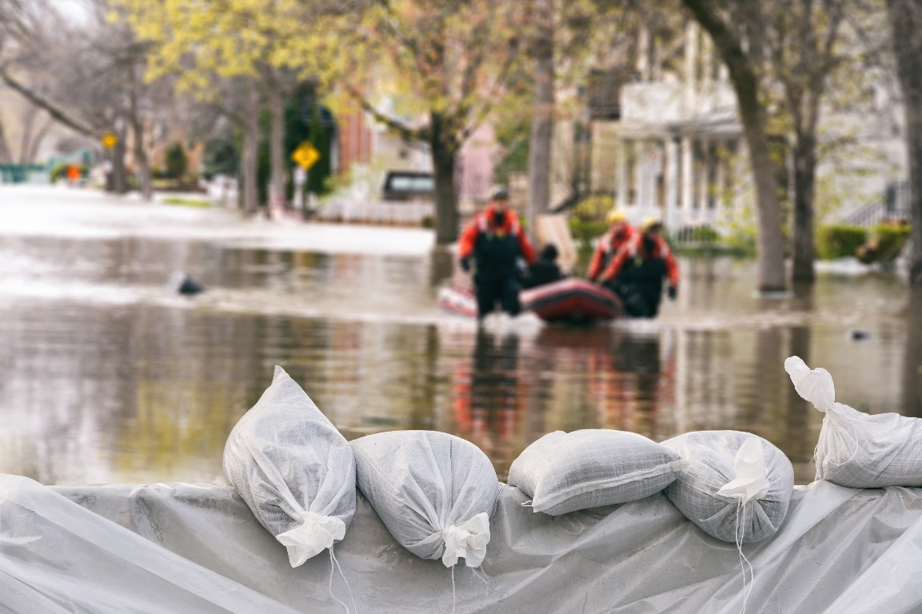
How Are We Fostering Resilience? (cont.)
The APA identifies four core
components of resilience:
  Connection
  Wellness
  Healthy thinking
  Meaning and purpose
  APA, 2020, https://www.apa.org/topics/resilience
Notes:
The APA identifies four core components of resilience:
Connection to people, organizations, and communities
Wellness, including healthy habits; mindfulness; and avoiding using alcohol, drugs, and compulsive behavior in areas such as over- or undereating, shopping, or gambling to avoid difficult feelings
Healthy thinking, including countering all-or-nothing thinking and strengthening optimism
Meaning, including finding purpose through helping others and setting and working toward goals
As time permits, ask participants if they think any component is missing. Request that they respond via chat.
Transition to talking about how to foster resilience.

Slide 35
How Are We Fostering Resilience? (cont.)
How have you helped survivors to:
  Reach out to people they trust and care about (connection)?
  Engage in self-care and mindfulness practices such as healthy eating, journal writing, yoga, prayer, or meditation (wellness)?
  Maintain a hopeful outlook (healthy thinking)?
  Set realistic goals and take steps to carry them out (meaning and purpose)?
  Focus on finding solutions (meaning and purpose)?
  APA, 2020, https://www.apa.org/topics/resilience
Notes:
Make the point that resilience is not a trait that people either have or do not have. It involves behaviors, thoughts, and actions that can be learned and developed.
Discuss the ways crisis counselors can help survivors to develop resilience.

Slide 36
Poll Question #4 (Fostering Resilience)
Indicate which of the following tools you teach to survivors or help them to use. Please select as many as you teach or help survivors to use.
Make and prioritize connections.
Practice effective self-care.
Keep things in perspective.
Accept change as a part of living.
Maintain a hopeful outlook.
Look back at who or what was helpful in previous episodes of distress for guidance on how to respond to the current situation.
Consider what they can do about problems in their lives.
Move toward goals.
Look for opportunities for self-discovery.
APA, 2020, https://www.apa.org/topics/resilience
Note: If you are not using the Zoom application, you will not have access to the poll questions. In that case, please type your answers in the chat box.
Notes:
Conduct a poll of participants regarding the tools they help survivors to use to enhance their resilience. If the training is being delivered through Zoom and participants do not have the Zoom application, ask that they type their answers into the chat box.
Present and comment on the results. Review a few items. Help participants to see they are building resilience through everything they do with survivors, and encourage them to keep in mind that their goal is always to build resilience.

Slide 37
Section 3—Services, Interventions, and Skills
  Needs Assessment and Outreach
  Range of Crisis Counseling Services
  Individuals/Families
  Groups
  CCP Services Discussions
  Public Education
Notes:
Introduce this session by telling participants that we’re going to focus now on needs assessment and outreach, as well as the full range of interventions and skills that CCP staff use in the RSP.

Slide 38
Needs Assessment and Outreach
Needs assessment:
  The foundation of outreach and the entire CCP
  An ongoing process to guide adjustments to outreach and services
  Sources of information on community needs:
  Federal Emergency Management Agency (FEMA) preliminary damage assessment or registration information (if applicable)
  State emergency management agency
  Voluntary agencies such as the American Red Cross
  Media
  Crisis counselors and other workers deployed by state agencies
Notes:
Start by saying that:
Needs assessment is the foundation of outreach and of the entire CCP. The information uncovered in the initial needs assessment provides the rationale and justification for the CCP’s existence and identifies the groups who will be targeted for outreach.
Needs assessment is an ongoing process to bring new information into the program, and program outreach and services are adjusted to meet emerging needs or “discovered” special populations.
Review the following additional information about needs assessment and outreach:
The most reliable data on disaster damage generally will come from the FEMA preliminary damage assessment, if applicable, which can be provided by the FEMA regional office responsible for the disaster response.
Other important sources of information on crisis counseling needs may include the state emergency management agency (SEMA); voluntary agencies, such as the American Red Cross; and media sources. In addition, any crisis counselors and other human services workers deployed by the state mental health authority (SMHA) or other public agencies in the immediate aftermath of a disaster may provide information on crisis counseling needs.
During disasters, individuals in the affected area seek support from trusted members of their own communities rather than mental health professionals.
Further training of these community leaders and cultural brokers can expand the availability of mental health and substance use disorder treatment services after disasters.

Slide 39
Breakout Groups
Needs assessment:
  Which populations have you targeted and reached?
  Which populations have not been reached?
  Which new populations need to be targeted?
  Outreach:
  What are your outreach strategies?
  How successful have they been?
  What new strategies could you use?
  The Participant Workbook (page 14) includes space where you can make notes.
Notes:
Explain to the participants that they will be divided into breakout groups. Each group will discuss the questions about needs assessment and outreach. They will have 20 minutes for discussion. Ask groups to identify a member who can record a summary of their discussion in case there is time (or the training class is small enough) for the trainer to ask for some summaries from this exercise.
Move participants into breakout groups. Allow them 20 minutes to work together before transitioning them back into the plenary session.
Facilitate internal processing of the activity. Ask participants to respond verbally or via chat to these questions:
Where did you see linkages between the two sections?
Where did you notice gaps or inconsistencies—areas where we need to make sure needs assessment and outreach are working together, not at cross purposes?
Summarize the discussion, and transition to a review of the range of crisis counseling services.

Slide 40
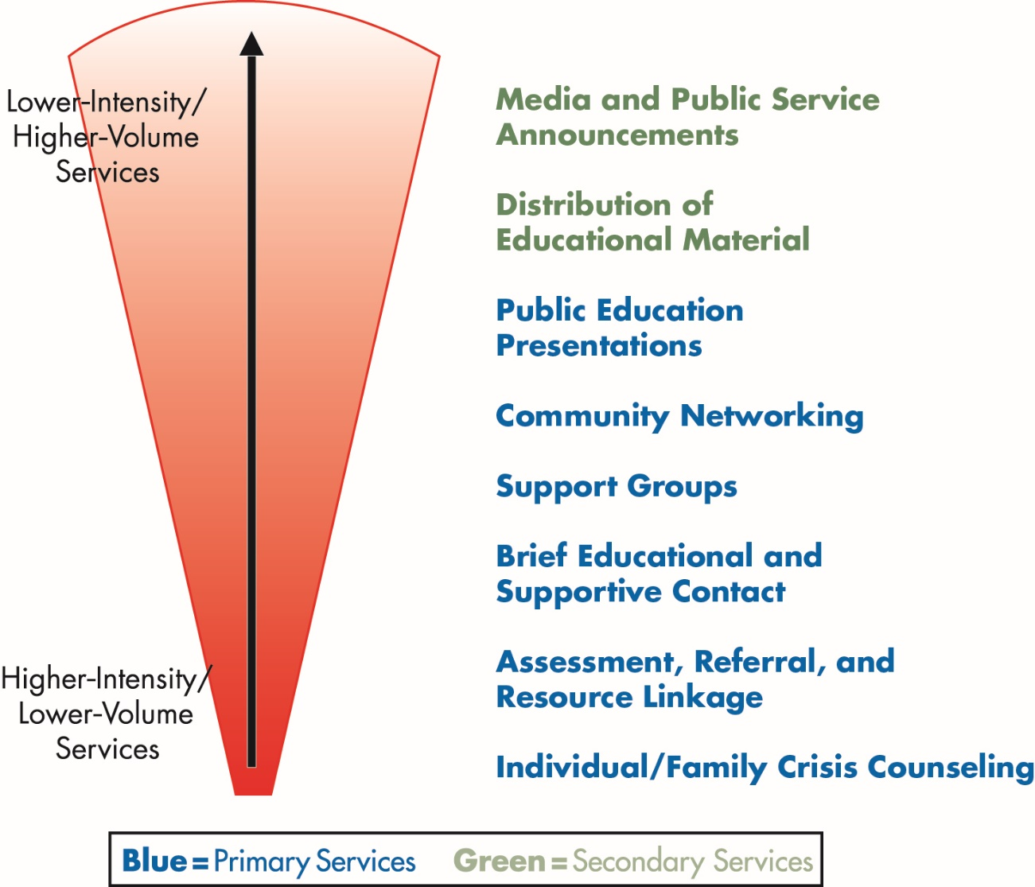
Range of Crisis Counseling Services
What services are you
currently providing?
Notes:
Quickly review the range of CCP services.
Facilitate a discussion in response to these questions:
What services were most important in the past for your program(s)? Why?
Where do you see the most need or demand for services now?
What services do you expect to be most needed in the coming months?
Cover these key points:
This graphic illustrates the reach and intensity of crisis counseling services.
In general, if the service reaches more people, its intensity is lower (e.g., the intensity of media and public service announcements, which reach many people at once, is lower than the intensity of assessment, referral, and resource linkage, services that involve working with fewer people at a time).
Primary services involve interaction of crisis counselors and survivors.
Secondary services involve dissemination of information.
Face-to-face primary services should typically be the focus of the CCP.
Trainer Note: If delivering this training during the COVID-19 pandemic, you may want to talk about how physical distancing may be altering service delivery—and specifically how it has forced CCPs to use methods other than primary services to reach and support disaster-affected communities.
It is important to canvass hard-hit areas for returnees or those now ready to accept services.
Group counseling usually increases during the RSP, as individuals become ready for this approach and counselors identify groups of survivors with common needs, issues, and concerns. Public education usually also increases during the RSP.
Trainer Note: If delivering this training during COVID-19, you may want to talk about how CCPs may have been providing group counseling and public education more in the ISP.
Community efforts are increased through outreach to schools, businesses, and community and faith-based organizations.

Slide 41
Individuals/Families
Goals of individual/family crisis counseling—assist participant(s) in doing the following:
  Understanding their situations and reactions
  Regaining a sense of mastery and control
  Identifying, labeling, and expressing emotions
  Adjusting to the disaster and losses
  Managing stress
  Making decisions and taking action
  Developing coping strategies
  Using community resources
Notes:
Remind participants of the basic goals or tasks of crisis counseling.

Slide 42
Individuals/Families (cont.)
What are some tips or techniques for assisting survivors in the following? You can make notes in the Participant Workbook (page 17).
  Understanding their situations and reactions
  Regaining a sense of mastery and control
  Identifying, labeling, and expressing emotions
  Adjusting to the disaster and losses
  Managing stress
  Making decisions and taking action
  Developing coping strategies
  Using community resources
Notes:
Ask participants to take a moment and reflect upon what they’ve learned from their experience in crisis counseling. What are some things they have done that have been helpful? Write one tip or technique for each of these eight goals or tasks in their Participant Workbooks (5 minutes).
Facilitate a quick sharing of the tips and techniques. (15 minutes)

Slide 43
Groups
Where are we now?
  What types of groups are you providing?
  What are the common themes?
  What’s working well about these groups?
  What’s been challenging?
How are we providing groups?
  What technology are you using? Is it working well?
  Have you encountered challenges related to the technology you’re using?
Notes:
Facilitate a discussion about where participants are now in terms of group crisis counseling. Ask that they provide responses via chat (or verbally, if the technology you’re using allows it). If participants respond via chat, read responses aloud. Highlight any trends you notice.
What types of groups are you currently providing (e.g., support and education groups, self-help groups)?
What are the common themes of the groups (e.g., similar levels of exposure, similar needs, special populations)?
What’s working well about these groups?
What’s been challenging (e.g., getting the groups started, maintaining participation, facilitating the sessions, marketing, transitioning to member-led)?
Trainer Note: Include the “How are we providing groups?” questions on the slide, and discussion in the slide notes, if you are providing training while physical distancing orders are in effect in many parts of the United States due to COVID-19.
Ask participants about how they are providing groups. Comment on responses, highlighting any trends you notice.
What technology (or technologies) are you using?
Is the technology working well? Poorly?
Have you encountered challenges related to the technology you’re using?

Slide 44
Groups (cont.)
Where are we going?
  What communities have emerged that would benefit from forming a group?
Notes:
Facilitate a brainstorming session to identify what groups will be needed—what communities have emerged that would benefit from forming a group?
If CCP grants have named participants or other staff to attend and take notes, you may want to ask participants when they offer ideas to identify their CCP grant so that note-takers can bring information specific to their grant program back after the training.
Ask if someone would be willing to write down ideas that come up during brainstorming. If you’d prefer, you can do so on your own. You will need this information for demonstration and practice activities in this training.

Slide 45
Groups (cont.)
Goals of group crisis counseling—assist group members in doing the following:
  Understanding their current situations and reactions to the disaster
  Achieving mutual support
  Developing skills related to stress management, coping with triggers, expressing emotions, and problem solving
  Becoming knowledgeable about available community resources
  Developing and implementing personal and group goals
Notes:
Review the goals of group counseling.
Suggested talking points:
Group counseling may vary from less structured, purely educational groups to more structured support groups. All groups are likely to share some elements of support and education.
It is important to ensure that group members have had similar levels of exposure to the disaster event. People with low exposure should not be exposed to stories of people whose exposure was significantly higher.
When members of social support networks are struggling with the disaster’s aftermath, counseling groups may augment overloaded support systems.
Groups can be led by a licensed mental health or substance use disorder treatment professional, co-facilitated by a mental health or substance use disorder treatment professional and a paraprofessional, or led by survivors themselves.
Group crisis counseling refers to services that help group members understand their current situations and reactions to the disaster, review or discuss their options, access emotional support or referral services, and attain skills to cope with their current situations and reactions. In group counseling, participants do most of the talking.

Slide 46
Groups (cont.)
Factors that affect the group process:
  Co-facilitation of the group
  Knowledge and skills of group leaders
  Group leaders’ awareness of their own values and beliefs and how these affect the group
  Respect for confidentiality
  Utilization of evaluation (formal and informal) by leaders of the group
Thomas, R. V., & Pender, D. A. (2008). Association for Specialists in Group Work: Best practice guidelines 2007 revisions. The Journal for Specialists in Group Work, 33(2), 111–117. https://c3c51c6c-8c32-4f6a-9af6-0d715ac3a752.filesusr.com/ugd/513c96_93df348d51134a08b789df5374b6dfb7.pdf
Notes:
Discuss the factors affecting the group process.
Suggested talking points:
Counselors should assess their own skills and knowledge about the group’s content to set clear boundaries on how to approach the group process. Group members may inquire about symptoms on which counselors are not authorized to give advice. Counselors can, however, provide concrete information and make appropriate referrals to mental health and substance use disorder treatment professionals.
Be aware of personal biases related to religion, spirituality, culture, ethnicity, and gender. It is common and healthy to recognize these qualities for personal reflection, but it is detrimental if these qualities disrupt the group process.
Respect and maintain confidentiality. A group should be in a safe place in which people, families, and communities can freely share their feelings without worrying about other people knowing their personal business.
Facilitate the group by making sure that each member has a chance to talk and that no one person is dominating the conversation. Ask a member who has not spoken if he or she would like to talk; however, respect his or her right to just sit back and listen.
Ask for feedback. Some groups may warrant more structure than others will; however, it can be empowering for group members to become actively engaged in the process of deciding what they would like to achieve in group sessions.
Adapted from Thomas, R. V., & Pender, D. A. (2008). Association for Specialists in Group Work: Best practice guidelines 2007 revisions. The Journal for Specialists in Group Work, 33(2), 111–117. https://c3c51c6c-8c32-4f6a-9af6-0d715ac3a752.filesusr.com/ugd/513c96_93df348d51134a08b789df5374b6dfb7.pdf

Slide 47
Groups (cont.)
Group crisis counseling skills:
  Promoting safety and comfort
  Listening
  Modeling effective communication skills
  Facilitating group interaction
  Facilitating the group process
  Dealing with difficult group members and situations
Notes:
Review group counseling skills:
Promoting safety and comfort
Listening
Modeling effective communication skills
Facilitating group interaction
Facilitating the group process
Dealing with difficult group members and situations

Slide 48
Groups (cont.)
Group crisis counseling skills:
  Handling difficult subject matter
  Identifying and interpreting shared reactions and experiences
  Assessing and responding to group needs
  Educating members about common reactions, stress management, and effective coping skills
  Identifying and responding to other educational needs
  Facilitating group cohesiveness
Notes:
Handling difficult subject matter
Identifying and interpreting shared reactions and experiences
Assessing and responding to group needs
Educating members about common reactions, stress management, and effective coping skills
Identifying and responding to other educational needs
Facilitating group cohesiveness

Slide 49
Groups (cont.)
Preparation for practice:
  Think about survivors you have worked with individually or in groups.
  Based on your experience, write a description of a fictional survivor whose role you’ll play in the group. Please be careful to maintain confidentiality of actual survivors.
  This survivor role should fit in with the type of group that has been selected.
  The Participant Workbook (page 21) includes space where you can make notes on the survivor role you’re developing.
Notes:
Choose a type of group and a theme from the discussion earlier in this session (the responses during the brainstorming session to the question “What communities have emerged that would benefit from forming a group?”). This type of group/theme will be used in a demonstration of group crisis counseling. You can either select a type of group from the list the participants brainstormed earlier or ask the participants to select one.
Give the following task instructions:
Think about survivors you have worked with individually or in groups.
Based on your experience, write a description of a fictional survivor whose role you’ll play in the group. Please be careful to maintain confidentiality of actual survivors.
This role should fit in with the type of group selected.
Invite participants to make notes in the Participant Workbook (page 21) or on their own paper or computer.

Slide 50

Groups (cont.)
Group Counseling Demonstration
Notes:
Ask for four volunteers from the group to participate in a brief demonstration, in which you’ll lead a group and they’ll play the role of survivors. You may opt to lead the demonstration with your co-trainer instead, to save on time.
Ask those not participating to pay close attention to the skills they see being used and to be prepared to talk about them afterward. Ask that they keep their computer and phone lines muted during the demonstration, and ask the participants to unmute their lines when they speak during the demonstration.
Give a brief demonstration (about 10 minutes), in which you lead a group session with the four participants.
Ask participants to take a few minutes to reflect and make notes on the worksheet in the Participant Workbook (page 22). Then facilitate a discussion about the skills they saw you (the trainer, and maybe also your co-trainer) demonstrating.

Slide 51
CCP Services Discussions
Topics:
  Community Support and Networking
  Public Education and Media Messaging
  Cultural Awareness
Focus of discussion:
  What are we doing now?
  Where do we go from here?
Notes:
Tell participants that we are going to spend some time discussing CCP services beyond individual and family and group crisis counseling.
The purpose of these discussions, in keeping with the theme of this course overall, is to provide an opportunity to assess what they’re currently doing in these areas and where they want to go from here.
Topics:
Community support and networking
Public education and media messaging
Cultural awareness
Tell participants that they will be placed in breakout groups to discuss the topics. Each group will be assigned one topic to discuss and provided questions to guide discussion. State that each breakout group should select a member to give a short report-out on the key themes and highlights from the discussions after they are completed.

Slide 52
CCP Services Discussions: Breakout Groups
Community Support and Networking
What is your program doing to provide community support and networking?
What are the emerging community needs?
What opportunities for further outreach exist?
Public Education and Media Messaging
What is the program doing in public education and media messaging?
How are needs for public education and media messaging changing over time?
Public Education and Media Messaging (cont.)
What opportunities exist for extending the reach of your public education activities and media messaging?
Cultural Awareness
How are your program’s services culturally appropriate?
What opportunities exist to increase the cultural awareness and appropriateness of the program?
Notes:
Assign participants to breakout groups. Let each group know which topic has been assigned to them for discussion. If possible, “visit” groups virtually to make sure they’re progressing well and aren’t struggling with the assignment. Allow groups 15 minutes to work together.
When the breakout group time has finished, move participants back into the full training session.
Facilitate conversation for the whole group about key ideas and insights and any patterns that emerged. Ask the reporters from each group to report out on their topics first; then, if time permits, invite others to contribute additional points.

Slide 53

Public Education
Effective presentations require that you:
  Know your audience
  Plan your presentation
  Deliver an effective message
Notes:
9/24/2020
9/24/2020
CCP Trainer’s Toolkit
Core Content Training
53
Emphasize that there are three key aspects to making an effective public education presentation:
• Know your audience.
• Plan your presentation.
• Deliver an effective message.

Slide 54
Public Education (cont.)
Know your audience:
  General information:
    Age, gender, education level, economic status, ethnic makeup
  Their interests and needs:
    Knowledge of subject
    Attitude toward subject
    What they want to know
    What they care about
Notes:
9/24/2020
9/24/2020
CCP Trainer’s Toolkit
Core Content Training
54
Discuss what you want to find out about your audience before making a presentation.
Know Your Audience
• General information about your audience—e.g., age, gender, education level, economic status, ethnicity
• Their interests and needs
o Knowledge level of your subject
o Attitude toward the subject
o What they want to know
o What they care about
The most important thing to think about and determine is, what’s in it for the audience? Why should they care about what you’re saying? Orient your presentation around that. Explain that you won’t always know for sure what their interests and needs are, but you can make an educated guess.

Slide 55
Public Education (cont.)
Plan your presentation:
  Determine your key message.
  Decide on the top three points of your message.
  Identify supporting facts, examples, and stories.
  Craft a strong opening and closing statement.
  Develop supporting materials—visual aids, handouts, etc.
Notes:
9/24/2020
9/24/2020
CCP Trainer’s Toolkit
Core Content Training
55
Explain the key steps in planning and preparing a presentation.
Plan Your Presentation
• Determine your key message—what do you want them to think, do, or know?
• Decide on the top three points of your message—these points should be concise.
• Identify supporting facts, examples, or stories—people remember examples and stories best.
• Craft a strong opening and closing statement—tell people what you’re going to tell them; tell them; and then, tell them what you told them. Repetition of your key message will enhance audience retention.
• Develop supporting materials (visual aids, handouts, etc.)—when possible, use visuals and handouts to supplement your presentation.
Trainer Note: If delivering training to participants from COVID-19-related CCPs, acknowledge that, just as public education presentations may need to be delivered virtually, supporting materials may need to be shared virtually as well, as electronic (non-print) documents. Suggest that materials be provided in advance of the presentation if possible (through a website, as email attachments, etc.).

Slide 56
Public Education (cont.)
Deliver an effective message:
  Voice tone and speaking style:
    Speak loudly and clearly—use your voice for emphasis.
    Avoid talking in a monotone.
  Body language:
    Gestures—maintain an open body posture.
    Facial expressions—these should be appropriate to content.
    Eye contact—look for an “ally” in the group.
Notes:
9/24/2020
9/24/2020
CCP Trainer’s Toolkit
Core Content Training
56
Discuss the aspects of delivering an effective message.
Deliver an Effective Message
• Voice tone and speaking style:
o Speak loudly and clearly—use your voice for emphasis.
o Avoid talking in a monotone and trailing off at the end of sentences.
Trainer Note: If delivering this training to participants who work for COVID-19-related CCPs, you might also mention that if they will be delivering a presentation using meeting software and have a wireless headset available, it may allow for better sound quality than their computer’s built-in speakers—and so, if possible and available, that is what they should use.
• Body language:
o Gestures: Maintain an “open” body posture—don’t cross or clasp your hands; face the audience.
o Don’t fidget with anything; put down pens, markers, and papers.
o Move around somewhat while presenting.
Trainer Note: If delivering this training after COVID-19 and training participants are likely to be providing public education through virtual meetings, you may want to adapt these tips. While the first two apply to virtual presentations, the third (moving around) may not be advisable during a remote presentation. You might suggest configuring the presentation site in a way that allows the presenter to be both comfortable and alert—easy for people taking part in the virtual meeting to see, and not blocked by anything.
o Facial expressions
— Make sure your facial expression matches what you’re saying—excited, serious, etc.
— Smile when appropriate.
o Eye contact
— Look for an “ally” in the group—but don’t fixate on that one person!
— Move your gaze about the room.
— Don’t look over people’s heads.
Trainer Note: If delivering this training after COVID-19 and participants are likely to be providing public education through virtual meetings, the final point may be the most difficult. The trainer should identify any tips or tricks he or she has for focusing on where the camera is on the computer. If a presenter looks at participants’ images on a computer screen, he or she may appear to be looking down or not directly at them. Fortunately, many meeting software applications allow users to preview themselves and record meetings. While practicing a presentation before delivering it is always a good idea, run-throughs become especially important with virtual meetings, and recording is a great way to capture various aspects of your presentation that you can fine-tune before going live before an actual audience.
Note that many of these tips are common sense and probably aren’t anything new to them. The hard part is doing it, and the secret to that is practice!

Slide 57

Public Education (cont.)
Where do you currently provide public education?
What are some additional venues or audiences where/for whom you could provide public education and information?
What makes for an effective public education presentation?
Notes:
9/24/2020
9/24/2020
CCP Trainer’s Toolkit
Core Content Training
57
Discuss how the need for public education often increases during the RSP.
Trainer Note: If delivering this training after COVID-19 to participants from CCPs supporting response to the pandemic, discuss how the service mix for COVID-19-related CCPs may look different from the service mix for other CCPs—and specifically that public education and media messaging may have been far more important to COVID-19-related CCPs from day 1, rather than becoming more important as the programs move to the RSP phase.
Ask participants where, and how, they currently provide public education and information—which venues, using which technologies (if virtual), and to which audiences?
Ask them to identify places they are not providing public education but could—what are some untapped opportunities?
Ask them to imagine they’re preparing a presentation at one of the venues identified above—what would you do to prepare in order to be successful?
The group will hopefully identify some of the following:
Be clear about the purpose of your presentation.
Know who the audience is.
Gather appropriate supporting materials—visual aids, handouts.
Know what you’re going to say—prepare your remarks.
Use effective presentation skills.

Slide 58
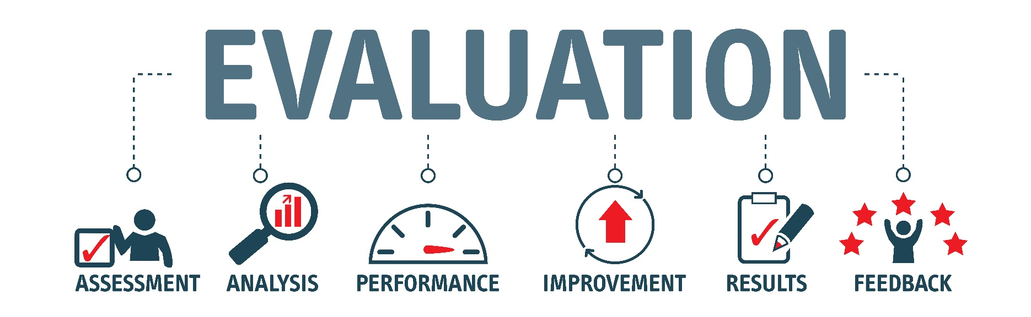
Section 4—Data Collection and Program Evaluation
Data Collection and Program Evaluation
Data Collection Tools
Notes:
Explain that in the next part of the training, we’ll focus on the uses and importance of data collection, while reviewing the tools available for data collection.
Remind the CCP staff that they should have completed data forms training when they started with the program, and that this section is an overview of some of the forms that are probably already being used.
This section will also review several new feedback forms that will be administered during the RSP.

Slide 59
Poll Question #5 (Data Collection and Program Evaluation)
How comfortable are you with data collection at this point in your program?
Choose the number that matches your comfort level on a scale of 1 to 5, where 1 is completely uncomfortable and 5 is completely comfortable.
Note: If you are not using the Zoom application, you will not have access to the poll questions. In that case, please type your answers in the chat box.
Notes:
Conduct a poll of participants regarding their level of comfort with data collection at this point in the CCP. If the training is being delivered through Zoom and participants do not have the Zoom application, ask that they type their answers into the chat box.
Present and facilitate a discussion about the results. Ask participants why they chose the answer they did, and ask that they respond via chat or verbally if your meeting software allows it. Ask participants if they think there is anything that could help make them more comfortable with data collection.

Slide 60
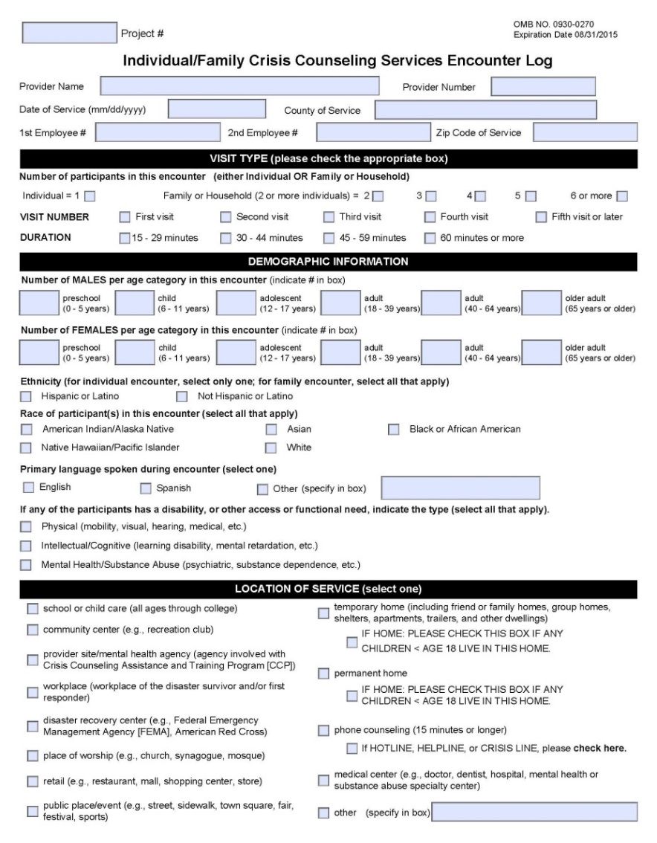
Data Collection Tools
Individual/Family Crisis Counseling
Services Encounter Logs:
Document interactions with individuals
or families lasting at least 15 minutes
and involving participant disclosure
Capture visit type, demographic information,
number of people involved in encounter,
location, risk categories, event reactions,
focus of encounter, materials provided,
and referrals
Are completed by the crisis counselor after
the encounter ends but before moving to
the next activity
Notes:
Briefly review (2 minutes) the Individual/Family Crisis Counseling Services Encounter Log, as this tool was covered in the Core Content Training and in the initial SAMHSA DTAC Forms Training.

Slide 61
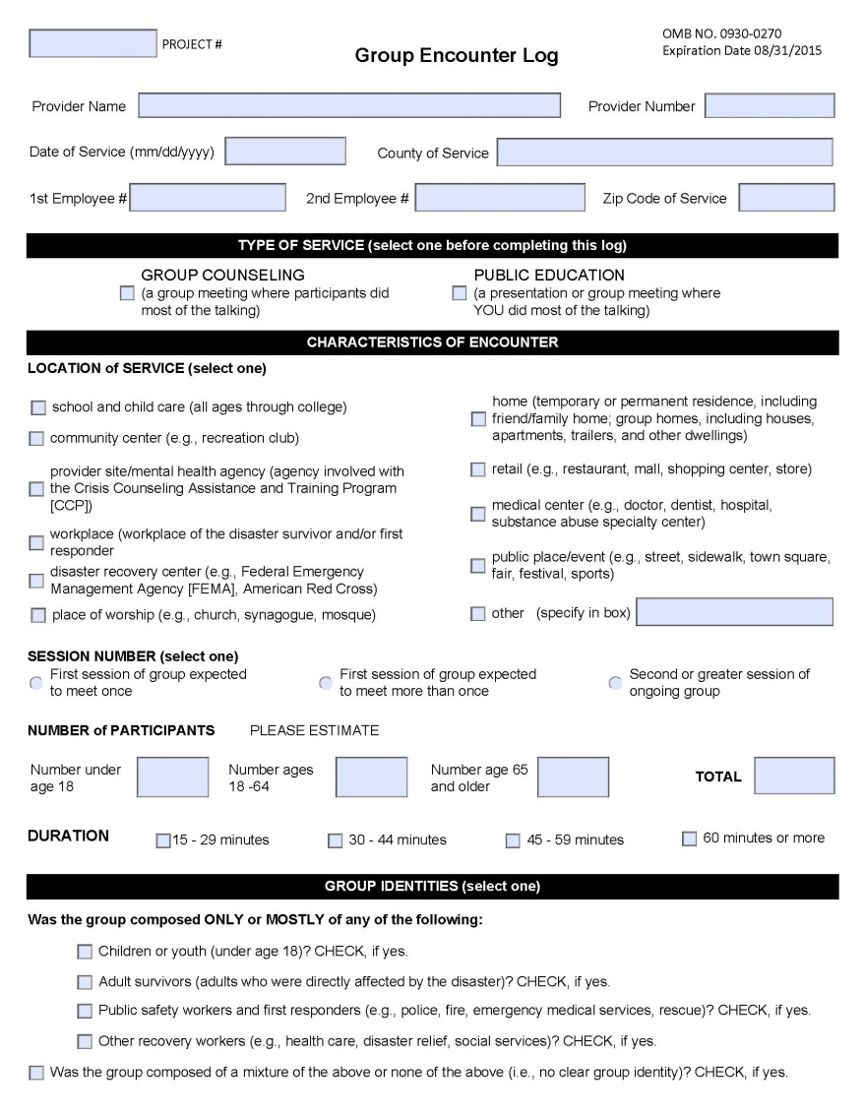
Data Collection Tools (cont.)
Group Encounter Logs:
Document group crisis counseling (in which
participants do most of the talking) and public
education (in which the counselor does most
of the talking)
Measure encounter characteristics, group
identities, and focus
Are completed by the crisis counselor after
the encounter ends but before moving to
the next activity
Notes:
Briefly review (2 minutes) the Group Encounter Log, as it has been covered in prior training.
Note that crisis counselors should be encouraged to use the Group Encounter Log to capture a wide range of public education and community activities, in addition to more formal group crisis counseling.
Traditionally, you will use the Group Encounter Log form more often in the RSP than in the ISP.
Trainer Note: If delivering this training to participants who work for CCPs established to support coping with COVID-19, perhaps mention that they may have been using this form more frequently during the ISP due to physical distancing orders in effect throughout the United States and resultant differences in service mix.

Slide 62
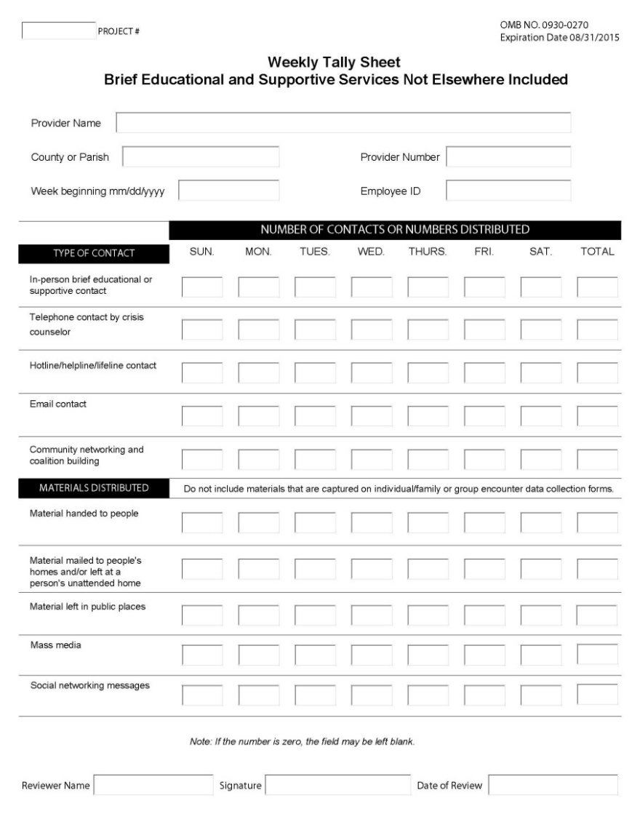
Data Collection Tools (cont.)
Weekly Tally Sheets:
Document brief educational and supportive
contacts (less than 15 minutes), telephone
calls, emails, and material distribution
Include information for 1 week (beginning
Sunday)
Tally services at the county level, using
three-digit county code
Should be completed by crisis counselors
or designated staff for each county in
which they work (one sheet for each county)
Notes:
Briefly review (2 minutes) the Weekly Tally Sheet, as it was covered in prior training.
Note that we will next review the advanced evaluation tools that should also be used, as appropriate.

Slide 63
Data Collection Tools (cont.)
Assessment and Referral Tools:
  The Child/Youth Assessment and Referral Tool and the Adult Assessment and Referral Tool should both be used in the ISP and the RSP, as needed.
  These tools can be used to help staff assess severe reactions and to help them decide whether referral is needed.
  The questions are supposed to be read aloud to the child or the parent during the encounter.
  Staff should be provided separate training on employer’s protocol for how to respond to severe reactions and should have identified at least one referral agency that can assist.
Notes:
Review both the Adult Assessment and Referral Tool and the Child/Youth Assessment and Referral Tool.
Suggested talking points for both of these forms:
Both tools are used in the ISP and the RSP as needed.
CCP program managers will provide separate training and instructions for when and how these forms will be implemented.
While these forms are specifically recommended for use during the third encounter, either can be used at any point when a crisis counselor, in conjunction with a team leader, feels additional assessment may be warranted (for example, during specialized crisis counseling or to keep track of the progress of an individual survivor).
Event reactions are assessed using the Short Posttraumatic Stress Disorder Rating Interview (expanded version, the SPRINT–E), which has been validated in a CCP context.
The Individual/Family Crisis Counseling Services Encounter Log should also be filled out if an encounter lasting 15 minutes or more precipitated the use of the Adult or the Child/Youth Assessment and Referral Tool. If a follow-up visit is scheduled by a team leader to administer the tool, then only this form needs to be completed.
These tools serve as a reminder that crisis counseling is intended to be a short-term intervention. Managers need to ensure that protocols are in place in their settings to ensure that individual/family crisis counseling does not become therapy.

Slide 64
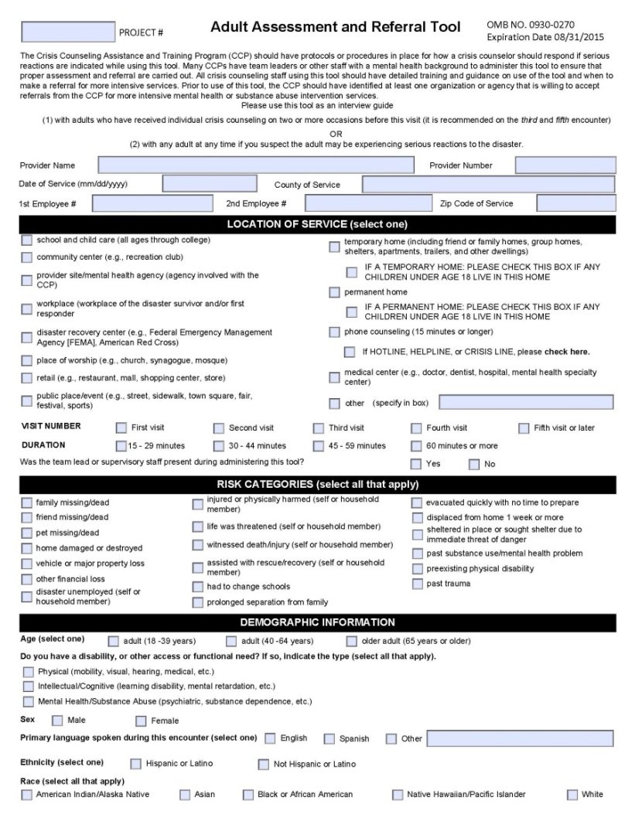
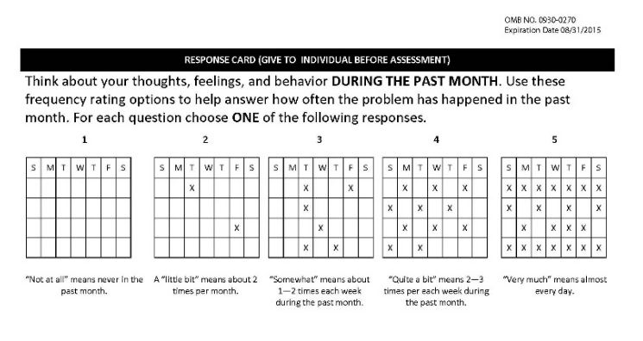
Assessment and Referral (cont.)
Adult Assessment and Referral Tool:
  It is used to facilitate referrals to more intensive mental health or substance use disorder treatment services.
  It is typically used during a third encounter but can be used at any time to assess those who may be experiencing severe reactions.
  It measures risk categories and event reactions using a structured interview approach.
  If a person scores 3 or more “intense” reactions (ones scored 4 or 5), then referral for more intensive services should be discussed.
Notes:
Briefly review the Adult Assessment and Referral Tool.

Slide 65
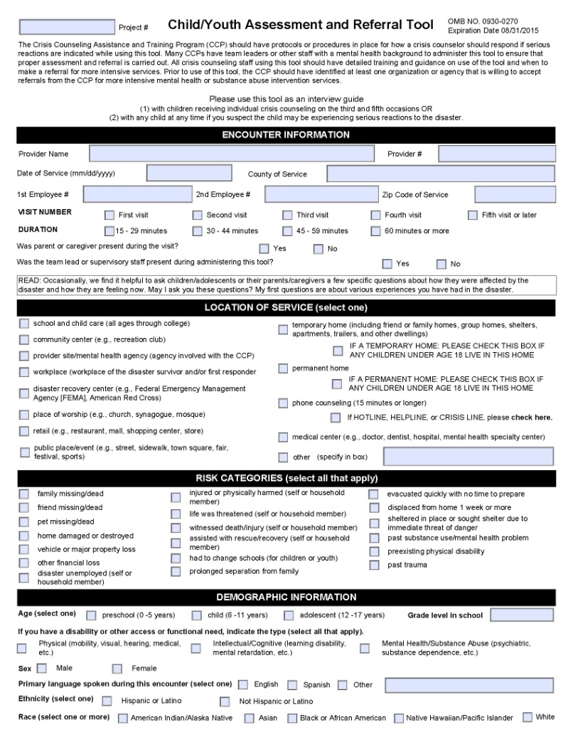
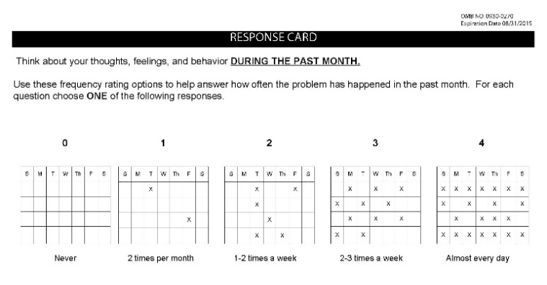
Assessment and Referral (cont.)
Child/Youth Assessment and Referral Tool and Response Card:
  These tools are used to facilitate referrals to more intensive mental health treatment services (and substance use disorder treatment services if appropriate).
  They are typically used with children on the third visit but can be used at any time the crisis counselor suspects the child may be experiencing serious reactions to the disaster.
  They include questions for the parent about the child (required for children of 0–7 years).
  They measure reactions using a structured interview approach.
Notes:
Briefly review the Child/Youth Assessment and Referral Tool.

Slide 66
Assessment and Referral (cont.)
How have you seen the need for assessment and referral change over time?
What are some examples of assessment and referral from the past month or so?
Are there circumstances in which you are reluctant to make a referral, even when it could be indicated? What are these circumstances?
What are some ways to overcome these obstacles?
What are some of the grounds for emergency referral?
Notes:
Facilitate a large-group discussion (or chat) about assessment and referral (10 minutes):
• How have you seen the need for assessment and referral change over time?
• What are some examples of assessment and referral from the past month or so?
• Are there circumstances in which you are reluctant to make a referral, even when it could be indicated? What are these circumstances?
• What are some ways to overcome these obstacles?
• What are some of the grounds for emergency referral?

Slide 67
Assessment and Referral (cont.)
Emergency treatment referral:
  Alert the team leader immediately if:
    There is intent or means to harm self or others.
    A person experiences severe paranoia, delusions, or hallucinations.
    Functioning is so poor that the person’s (or his or her dependent’s) safety is in danger.
    Excessive substance use is placing the person or others at risk.
  When in doubt, call 911, or refer for immediate psychiatric or medical intervention.
  Follow your program’s protocols, and reach out to your team leader if you need more information.
Notes:
Review the guidelines for emergency treatment referral.
Emphasize that crisis counselors should know local emergency resources before going out into the community.

Slide 68
Assessment and Referral (cont.)
Nonemergency treatment referral:
  Reduce perceived stigma:
    Demystify mental health or substance use disorder treatment by explaining it.
    Explore referral options, and give choices.
  Increase compliance:
    Explore obstacles to accepting services.
    Encourage person to call for the appointment while you are there.
    Accompany person to first appointment, if necessary and appropriate.
    Related resource: Table with contrasts between traditional case management and CCP resource linkage, Participant Workbook (page 34)
Notes:
Review the guidelines for nonemergency treatment referral.
Refer to the table in the Participant Workbook describing the difference between traditional case management and CCP resource linkage.

Slide 69
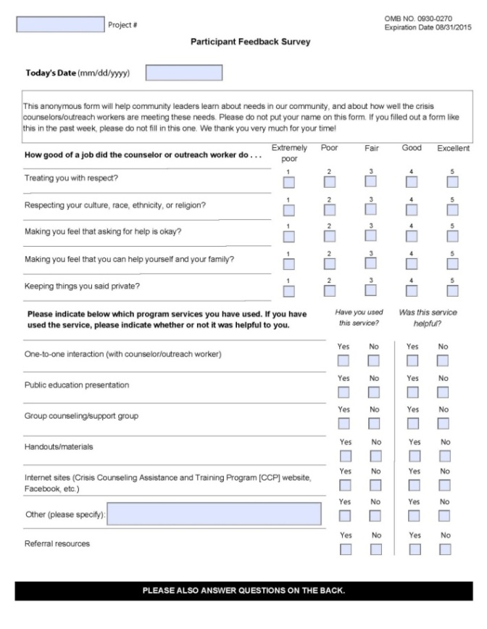
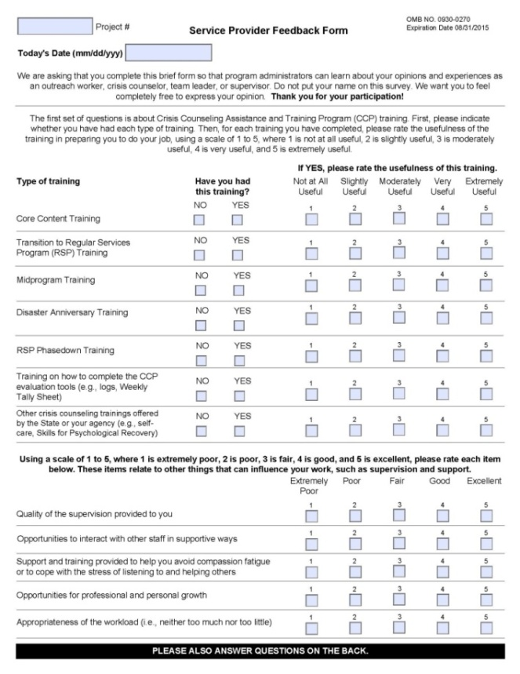
Data Collection Tools (cont.)
Program Evaluation Tools:
  Two feedback forms are administered during the RSP (typically at 6 and 12 months after the disaster).
  These provide feedback to CCP managers on
    Client perceptions of service quality and personal improvements in functioning
    Perspectives from staff on workload, usefulness of trainings, etc.
Notes:
Explain that two feedback surveys are introduced during the RSP for evaluation purposes (typically at 6 and 12 months after the disaster).
The information gathered provides feedback to CCP managers about client perceptions of service quality and personal improvements in functioning. Perspectives from the CCP crisis counseling staff are also gathered about the staff’s workload, perceived usefulness of trainings, etc.

Slide 70
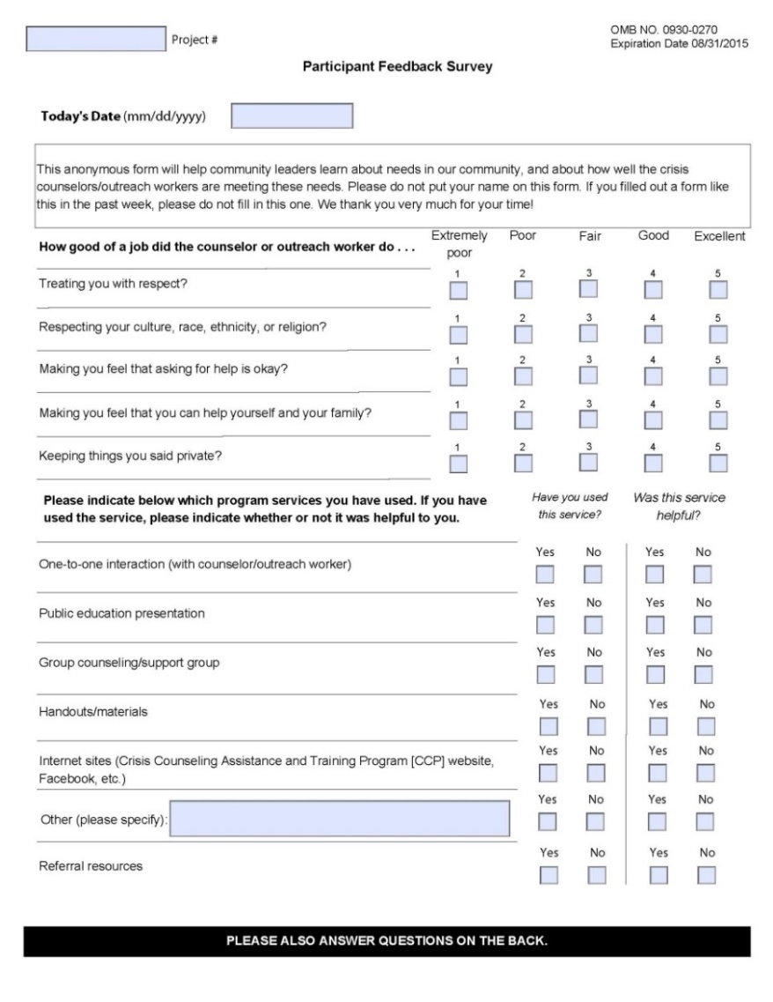
Data Collection Tools (cont.)
Participant Feedback Surveys:
  Are used to obtain feedback about the program
  Are conducted twice during an RSP
  Survey all adults receiving individual/family or group crisis counseling
  Provide some data about immediate outcomes of crisis counseling
Notes:
Introduce the Participant Feedback Survey.
Suggested talking points:
This survey captures information about disaster exposure and event reactions that have been experienced. It also measures client perceptions about the CCP services they have received.
Typically, the survey is conducted at 6 and 12 months after the disaster event. Exact timing should be determined in consultation with the assigned Substance Abuse and Mental Health Services Administration (SAMHSA) project officer.
The Participant Feedback Survey can be administered on paper or electronically, via a link sent to adults who receive individual/family and group crisis counseling services within a specific window of time.
If the survey is administered on paper, it is recommended that the Participant Feedback Survey packet contain a cover letter, survey, pen, and stamped return envelope. The participants mail the survey back to an identified central location. The provider who distributed the surveys does not collect the surveys.
Briefly review the sections of the surveys:
The first part of the survey includes questions to gauge what kinds of services were received and whether those services were helpful.
The second part includes questions about how helpful the CCP was to the recipient, followed by a section about the disaster-related experiences the respondent had.
The following section asks about the respondent’s disaster reactions.
There is also a place where contact information is provided for a crisis counselor whom respondents can talk to about their reactions.
The following section asks respondents to compare how they were doing before the disaster to how they are doing now.
The survey concludes with items on basic demographics, preferred language, and disability status.
Explain how it is administered:
The providers need to keep track of the number of surveys distributed and provide this information to the state CCP evaluation coordinator.
The crisis counselor must be invested in the process and emphasize the importance of the process to the participant. Participants must be convinced that the survey is a serious endeavor. It is their opportunity to identify needs and rate how well the program is meeting those needs.

Slide 71
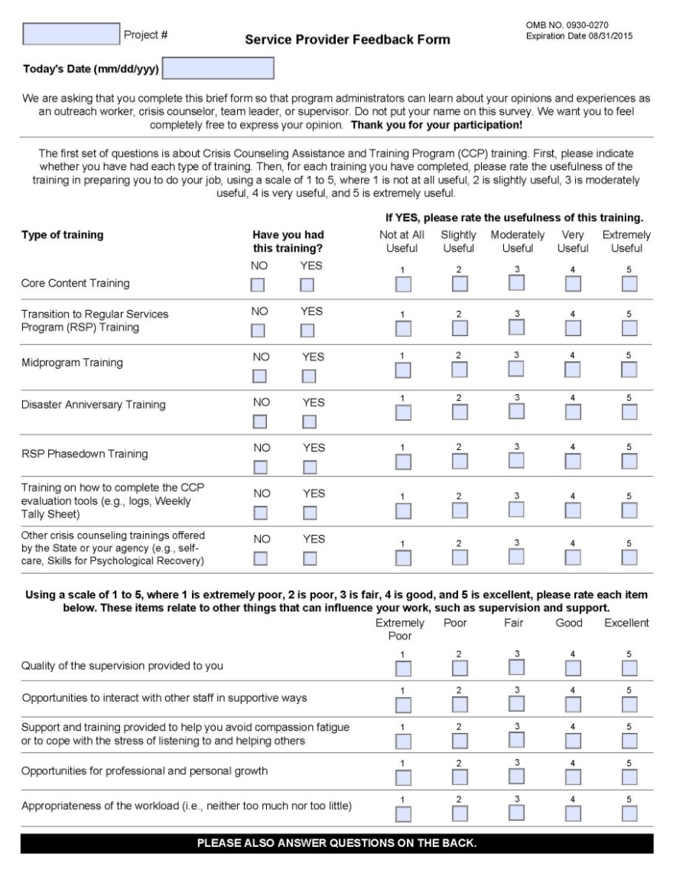
Data Collection Tools (cont.)
Service Provider Feedback Forms:
  Used to capture crisis counselors’ opinions about their training, resources, supervision, workload, support, and overall quality of the CCP
  Collected anonymously from crisis counseling staff around 6 and 12 months after the disaster
Notes:
Introduce the Service Provider Feedback Form.
Suggested talking points:
This form collects feedback from crisis counselors who provide direct, face-to-face services and their immediate supervisors (team leaders).
Feedback is collected twice during the CCP, at around 6 and then 12 months after the disaster (typically within the RSP).
Briefly review the sections of the feedback form:
The first section asks staff to evaluate the usefulness of the CCP trainings they have received.
The next section asks staff to evaluate supervision, opportunities for growth, workload, and adequacy of tools provided.
The section that follows is composed of five questions about stress.
The feedback form requires management to include a phone number of someone outside of the chain of supervision whom counselors can call to receive assistance if they are feeling especially stressed.
The final section inquires about demographics and tenure and includes a space to write comments.
Explain how it is administered:
The forms are disseminated by the state CCP evaluation coordinator and in coordination with templates provided by the SAMHSA Disaster Technical Assistance Center (DTAC).
CCP leadership staff should convey the reasons for and importance of the survey, explaining why high response rate matters.
CCP crisis counseling staff complete the forms online. Paper administration is acceptable only when online administration is not possible.
The feedback is anonymous. The crisis counselor’s identity is protected by lack of identifying information, return of the survey to an external evaluator, and aggregation of results.
SAMHSA DTAC will provide the state CCP evaluation coordinator with summary information regarding the results of the survey, but not with the surveys themselves.

Slide 72
Section 5—Stress Management
  Typical Stressors
  Warning Signs of Excessive Stress
  Stress Management
  *Organizational Approaches to Stress Management
Notes:
Introduce this session by telling participants that stress management is absolutely crucial in a CCP and something that must be carefully attended to during the longer RSP. Although we don’t go into detail on organizational approaches to stress management, programs and program leadership should also be aware of the organization’s ability to mitigate stress (additional information on pages 49–52 of the Participant Workbook).
The core of a CCP is its staff—the program’s success is directly dependent on staff’s ability to regulate their own stress. Particular care needs to be taken to address and process the effects that work for the CCP can have on the crisis counselor.

Slide 73
Typical Stressors
How stressful are these for you?
  Repeatedly hearing survivors’ distressing stories
  Approaching survivors who may reject help
  Feeling overwhelmed by the sadness of others
  Feeling unable to alleviate the pain of others
  Working long hours
  Having personal experience with the disaster
Notes:
Note that the first step in personal stress management is awareness of what causes you stress.
Review the list of typical stressors.
Tell participants that we’re going to poll them about what causes them stress.

Slide 74
Poll Question #6
How stressful are these experiences for you? Choose 1 to 5, where 1 is least stressful and 5 is most stressful.
Repeatedly hearing survivors’ distressing stories
Approaching survivors who may reject help
Feeling overwhelmed by the sadness of others
Feeling unable to alleviate the pain of others
Working long hours
Having personal experience with the disaster
Note: If you are not using the Zoom application, you will not have access to the poll questions. In that case, please type your answers in the chat box.
Notes:
Conduct a poll of participants regarding how stressful they find various experiences associated with work for the CCP. If the training is being delivered through Zoom and participants do not have the Zoom application, ask that they type their answers into the chat box.
Present and facilitate a discussion about the results. Ask participants:
Why particular factors are or are not stressful for them
What they do to manage the stress they feel from this experience

Slide 75
Warning Signs of Excessive Stress
  You cannot shake distressing images from your mind.
  Work consumes you at the expense of family and friends.
  You experience an increase in substance use or misuse.
  You are excessively irritable and impatient.
  You exhibit other serious or severe reactions.
Notes:
Review the warning signs of excessive stress.
Suggested talking points:
As with disaster survivors, assessment of crisis counselors hinges on the question of how much stress is too much.
Disaster workers commonly experience many reactions that have limited impact on performance. However, when many reactions are experienced simultaneously and intensely, functioning is likely to be impaired. Under these circumstances, the worker should take a break from the disaster assignment for a few hours at first, and then longer, if necessary. If normal functioning does not return, the person needs to discontinue the assignment.
Supervision is essential when a disaster worker’s personal coping strategies are wearing thin.
Suggestions can be made for stress-reduction activities. Usually, stress symptoms will gradually subside when the worker is no longer in the disaster relief environment. However, if this does not occur, then professional mental health assistance is indicated.

Slide 76
Self-Assessment and Planning
  Complete the warning signs for excessive stress checklist in the Participant Workbook (page 47).
  Then complete the personal stress management plan (page 48).
Notes:
Have participants fill out the checklist for warning signs of excessive stress and the stress management plan worksheet.
After they have done so, facilitate a brief discussion of positive steps they will take to manage their individual stress level.
Trainer Note: One resource that may be helpful is the video Stress Management Techniques, Healthy Coping Strategies, Breathing Exercise, which you can access at https://www.youtube.com/watch?v=IqpCCnmwNVY&feature=youtu.be. At about 5 minutes and 30 seconds into the 8-minute video, you can view a demonstration of a breathing exercise for relaxation.

Slide 77
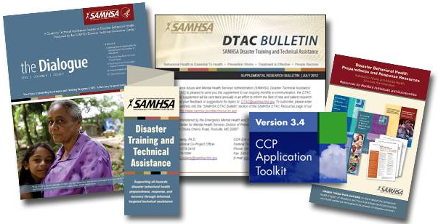

Substance Abuse and Mental Health Services Administration (SAMHSA) Disaster Technical Assistance Center (DTAC)
SAMHSA DTAC supports SAMHSA’s efforts to prepare states, territories, and local entities to deliver an effective mental health and substance use-related response during disasters.
  Toll-free: 1–800–308–3515
  Email: dtac@samhsa.hhs.gov
  Web: https://www.samhsa.gov/dtac
Notes:
Thank participants for their effort and creativity.
Training Evaluation Survey: https://bit.ly/3bjs76M
Invite the program leadership to make any closing remarks.

