Slide 1

Transition to Regular Services
Program (RSP) Training
Crisis Counseling Assistance and
Training Program (CCP)

Slide 2
Introductions
Please introduce yourself by sharing the following:
  Your name and pronouns
  Two things you’re grateful for that begin with your initials
  Your role or position in the CCP
Notes:
Ask participants to introduce themselves by sharing the following:
Their names and pronouns
Two things they’re grateful for that begin with their initials
Their roles or positions in the CCP
Give an example of the introduction by using your own name—e.g., "I’m Mary Smith, and I’m thankful for my ability to memorize, and for smiles.”
Give participants a moment to think before starting the introductions.

Slide 3
Getting Started Activity
Notes:
The purpose of this activity is to provide an opportunity for team building early in the training. The activities suggested below help participants to get to know each other better, in a fun and relaxed way. See activity details on page 10 of The Trainer Manual.
Activity Option 1—20 Fun Things (30 minutes)
Activity Option 2—Symbols and Statements Activity (30 minutes)
Activity Option 3—Personal Crest (30 minutes)

Slide 4
Getting Started Activity
Option 1—20 Fun Things (30 minutes)
Notes:
Activity Option 1—20 Fun Things (30 minutes)
Ask participants make a list of 20 things they do to have fun, using the worksheet in their workbooks. While 20 things may seem like a lot, encourage them to think hard and be creative, and they can certainly come up with at least that many. (10 minutes)
Invite participants to stand up and mingle, sharing their lists with each other. Encourage them to share lists with as many people as possible, and to pay attention to things they learn about others that are surprising, or where they have things in common. (10 minutes)
Call an end to the mingling, and have participants post their lists on a wall—making a mosaic of their collective interests. Encourage participants to browse the wall of interests during lunch and breaks. Have them return to their seats.
Lead a large-group discussion about what they learned about each other. (10 minutes)
• What were some of the most surprising or unique things you learned?
• What common interests did you discover?
• How might this experience help you to work better as a team?
• How might an activity like this be useful in crisis counseling?
Bring the conversation to a close, and transition to the next section on course objectives, agenda, and norms.

Slide 5
Getting Started Activity
Option 2—Symbols and Statements Activity (30 minutes)
Notes:
Activity Option 2—Symbols and Statements Activity (30 minutes)
Preparation: Before the start of the course, prepare and post eight tear sheets around the room and cover them up so they cannot be seen. Four of the tear sheets will relate to part 1 of the activity, the other four to part 2.
Part 1: Quotes about Disaster (Preparation)
Prior to the course, choose four quotes that represent different views or attitudes about disaster. Here are several examples:
• “Only after disaster can we be resurrected.” Chuck Palahniuk, Author
• “There’s no disaster that cannot become a blessing, and no blessing that cannot become a disaster.” Richard Bach, Author
• “There are moments when you just have to walk away and cry.” Lou Angeli, Filmmaker
• “Living things have been doing just that for a long, long time. Through every kind of disaster and setback and catastrophe. We are survivors.” Robert Fulghum, Author
• “I always tried to turn every disaster into an opportunity.” John D. Rockefeller, Businessman
• “I beg you take courage; the brave soul can mend even disaster.” Catherine the Great, Russian Czarina
Put one quote on each of four tear sheets and post them around the room. Cover the tear sheets up so participants cannot see them.
Part 2: The Role of the Crisis Counselor (Preparation)
Choose four symbols/objects that could represent various views on the role of the crisis counselor—e.g., a Band-Aid, a bottle of glue, an outstretched hand, a shoulder, a lighthouse, a life preserver, and so on. Put one symbol on each of four tear sheets and post them around the room. Cover the tear sheets up so participants cannot see them.
Part 1: Quotes about Disaster (Instructions)
Reveal each of the four quotes about disaster.
Have participants go stand by the tear sheet they are most drawn to or agree with.
Each tear sheet should have a small group assembled beside it—if anyone is standing alone, ask the participant to join another group, whichever would be his or her second choice.
Ask participants to discuss within their groups why they chose this quote—what does it mean to you? What about it do you agree with? (5 minutes)
Have each group share the highlights of their discussion. (10 minutes)
Part 2: The Role of the Crisis Counselor (Instructions)
• Reveal each of the four symbol tear sheets, telling participants that each one represents the role of the crisis counselor in some way.
• Have participants go stand by the tear sheet they most identify with, or one that most closely corresponds with their views on the role of the crisis counselor.
• Each tear sheet should have a small group assembled beside it—if anyone is standing alone, ask the participant to join another group, whichever symbol would be his or her second choice.
• Ask participants to discuss why they chose this symbol—what does it represent for you about the role of the crisis counselor? (5 minutes)
• Have each group share the highlights of their discussion. (5 minutes)
• As you bring this activity to a close, ask participants what they’re taking away from this conversation and how it might help them to work better together as a team. (5 minutes)
• Transition to the next segment on course objectives, agenda, and norms.

Slide 6
Getting Started Activity
Option 3—Personal Crest (30 minutes)
Notes:
Activity Option 3—Personal Crest (30 minutes)
Materials needed—Markers, colored pencils, or crayons in a variety of colors, with several for each participant
Explain that a personal crest—like a family coat of arms—is a visual, symbolic representation of a person’s identity. You’ll be drawing your own personal crest to share with the group.
Tell participants not to worry about artistic ability—all crests will be beautiful no matter how they’re drawn. Get creative!
Using the worksheet in their workbooks, have participants draw their own personal crests. The crest is divided into four quadrants, and each one has a question assigned to it. Ask participants to answer each question about themselves in pictures, using no words, in the designated place on the crest.
• Top left—What is one strength you bring to the CCP team?
• Top right—What is one thing you need from your CCP team members?
• Bottom left—What is a hidden talent you have?
• Bottom right—What is one value you hold that is very important to you?
Post a tear sheet with an outline of the crest and with each question listed in the appropriate quadrant.
Drawing time (10 minutes)
• Make notes of what you hear in others’ responses.
Announce when time is up, and have participants post their crests on a wall—making a mosaic of their collective strengths, needs, talents, and values. Encourage them to browse this mosaic during lunch and breaks. Have them return to their seats.
Large Sharing of Crests: “Speed Connecting” (10 minutes)
Provide the following instructions:
• Stand up, walk around, and find one other person you don’t know well.
• Share your crest with that person and listen to him or her talk about his or her crest.
• When you are done, find another partner and share.
• Group Discussion (10 minutes)
Ask the group for examples of what they saw and discussed in each quadrant:
• What are some examples of the strengths represented on this team?
• What are some examples of the things you need from each other?
• What are some interesting hidden talents you learned about?
• What are some of the important values people hold?
Ask the group these questions:
• How might this experience help you to work better as a team?
• How might an activity like this be useful in crisis counseling?
Bring the conversation to a close, and transition to the next section on course objectives, agenda, and norms.

Slide 7
Objectives
By the end of this course, you will be able to do the following:
  Identify issues that occur when transitioning from Immediate Services Program (ISP) to Regular Services Program (RSP).
  Define the goals and objectives of the RSP.
  Identify ongoing and emerging disaster reactions related to the current phase of the disaster.
  Describe crisis counseling services related to the current phase.
  Practice crisis counseling skills.
  Complete data collection forms correctly.
  Update personal and organizational strategies for managing stress.
Notes:
Review objectives of the course. Note that the course agenda and objectives appear in the workbook on page 4.
Objectives—By the end of the course, participants will be able to do the following:
Identify issues that occur when transitioning from ISP to RSP.
Define the goals and objectives of the RSP.
Identify ongoing and emerging disaster reactions related to the current phase of disaster.
Describe crisis counseling services related to the current phase.
Practice crisis counseling skills.
Complete data collection forms correctly.
Update personal and organizational strategies for managing stress.
Emphasize the organizing theme of this course—reflecting on what the program has done thus far, assessing current needs, and planning future actions for the RSP.

Slide 8
Guidelines for Working Together
  Keep time (start on time, return from breaks on time, end on time).
  Switch mobile phones off or to “vibrate.”
  Participate fully.
  Ask questions freely.
  Balance talking and listening.
  Respect each other’s points of view.
  Use “person-first” language, i.e., “person with a disability.”
Notes:
As in any course, having agreed-upon norms is helpful. Write the following guidelines on a flipchart pad and review them with participants. These guidelines also appear in the CCP Transition to RSP Training Participant Workbook.
Keep time (start on time, return from breaks on time, end on time).
Switch mobile phones off or to “vibrate.” Minimize distractions such as email, when possible.
Participate fully.
Ask questions freely.
Balance talking and listening.
Respect each other’s points of view.
Use “person-first” language, i.e., “person with a disability.”
Ask the participants to decide on the following:
If there are any norms they would like to modify
If any are missing
Write any additional guidelines on the flipchart pad, and check to see if everyone can agree to the list. You can keep it light by asking them to shake hands (or other minimal-contact gesture, such as a head nod or elbow bump) with someone at their table to signify agreement with this “social contract.”

Slide 9
Course Agenda
Day 1
AM Sessions
Welcome and Introductions
Getting Started Activity
Transition From ISP to RSP
Current Disaster Reactions, Strengths,
and Resilience
PM Sessions
Lunch
Crisis Counseling Services and Interventions
Individual/Family Crisis Counseling
Group Crisis Counseling
Adjourn
Day 2
AM Sessions
Crisis Counseling Services (cont.)
Data Collection and Program Evaluation
Stress Management for Staff
Team Building Activity
PM Sessions
Applying Your Learning
Course Evaluation
Adjourn
Notes:
Review the course schedule and discuss how the objectives will be addressed.
Be sure to cover logistical details:
Lunch and break times and locations.
Restroom locations.
Time (follow clock in the room).
Include any special instructions for virtual training, if applicable.
For in-person training, address safety protocols, such as physical distancing, and building evacuation routes.
Pause and ask for participants’ reactions or questions and ask whether they feel there is anything missing from this program agenda.
Introduce the CCP Transition to RSP Training Participant Workbook and describe how it will be used during the course. Highlight the following:
The workbook will be used to convey key concepts covered in the course.
There is space to make notes as well as capture reflections.
Reference materials are included for use during and after the course.

Slide 10
Section 1—Transition From ISP to RSP
CCP Timeline
Goals of the RSP
Program Management
Program Services Issues
Notes:
Introduce this session by telling participants that we’re going to explore the range of common issues that CCPs face as they transition from an ISP to an RSP. Take some time to identify what the RSP specifically should pay attention to in the coming weeks.

Slide 11

Session Objectives
  Identify ISP-to-RSP transition issues.
  Define the goals of the RSP.
Notes:
Review the session objectives:
Identify ISP-to-RSP transition issues.
Define the goals of the RSP
Note: Instructor should gather information from the state, territory, or tribe on what their goals are for the RSP (from their application) and/or what they are hoping to accomplish through the RSP. This is a good place to set that expectation and then refer to it later in the training.

Slide 12
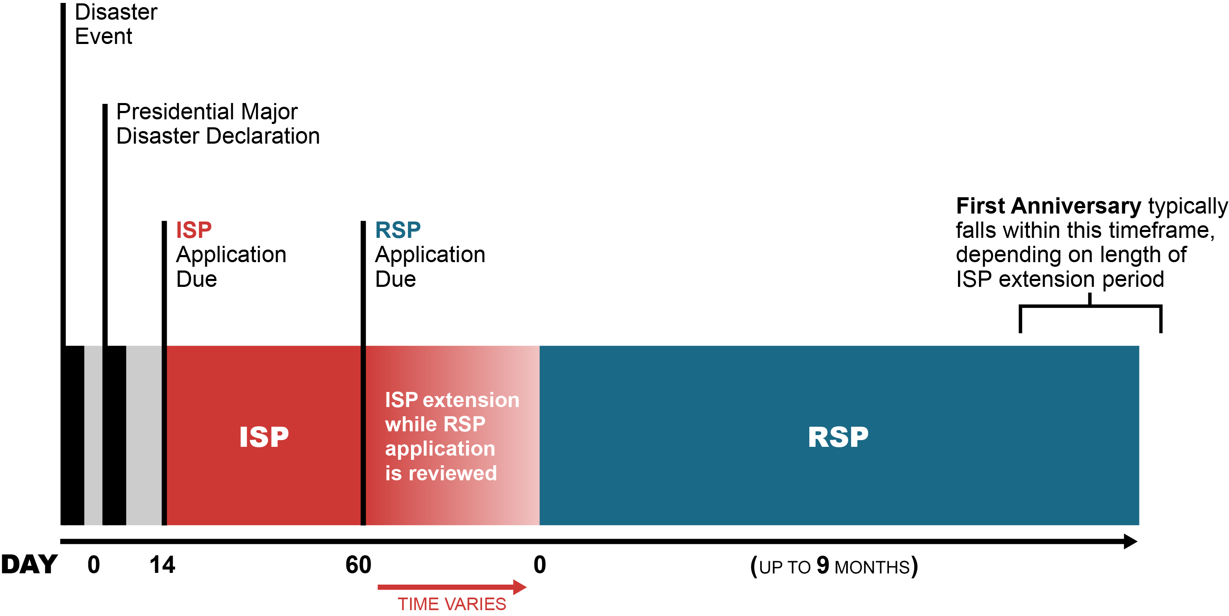
CCP Timeline
Where is your CCP in the typical timeline?
Notes:
Explore the typical CCP timeline (as shown in the graphic) in relation to the actual timeline of ISP application and award for the state’s CCP.
Ask these questions:
Where is your CCP in this timeline?
How much time has passed since the disaster?
What was the start date of your ISP? Was your ISP extended? What was the final end date for your ISP?
What are the start and end dates of your RSP?
NOTE: You should find out these dates from the program management prior to the training. The purpose of asking these questions here is to confirm and ensure that all staff know these dates.
Make sure participants are aware that most RSPs last 9 months. This program is time limited in duration.
Discuss with participants what this means for individual survivors, the community, and the staff.

Slide 13
Goals of the RSP
During the transition it is important to emphasize the following:
  Reflecting on the ISP—what stands out for you?
    Successes and accomplishments
    Challenges
  Looking ahead to the RSP:
    What do you need to pay attention to during the transition?
    What lessons learned from the ISP can you bring to the RSP?
    What do you want to see the RSP accomplish?
    What challenges do you anticipate?
Notes:
Building upon the discussion of where the program is in its transition from ISP to RSP, facilitate a large-group discussion on the history of the ISP and what issues participants must focus on as they start their RSP. Allow up to 20 minutes for this discussion. Remind participants that this is our initial discussion, and we will discuss these topics in more depth later.
Reflecting on the ISP, what stands out for you—successes, accomplishments, and challenges?
What lessons were learned from the ISP that you can bring to the RSP?
How do you think the RSP will be different than the ISP?
Looking ahead to the RSP, what do you need to pay attention to during the transition? What do you want to see accomplished during the RSP? What challenges do you anticipate?
Record key points from the large-group discussion on a flipchart pad for future reference.
Transition to discussing the goals of the RSP, building upon this discussion.

Slide 14
Goals of the RSP (cont.)
During the transition it is important to emphasize:
  Ongoing needs assessment
  Continued focus on individual and family services
  Fostering of individual and community resilience
  Continued identification of special populations
  Services of lower intensity and higher volume
Notes:
Prior to this training session, list the items below, and on the following two slides, on three flipchart pads and then post the pages on the wall. Introduce this list of typical RSP goals and objectives. Clarify what is meant by each one with focus on the following areas:
Ongoing needs assessment
Continued focus on individual and family services
Fostering of individual and community resilience
Continued identification of special populations
Services of lower intensity and higher volume

Slide 15
Goals of the RSP (cont.)
Focus on:
  Group crisis counseling, public education, and media messaging
  Targeted outreach to special populations
  Increased community networking
  Assessment and referral
  Resource linkage
Notes:
Some areas the RSP will focus on are:
Group crisis counseling, public education, and media messaging
Targeted outreach to special populations
Increased community networking
Assessment and referral
Resource linkage

Slide 16
Goals of the RSP (cont.)
Focus on:
  Reassessment of training needs
  Continued stress management
  Analysis and use of program data
  Comprehensive quality assurance process
  Program legacy for individuals, community, and staff
Notes:
Tell participants to turn to their workbooks, page 8, where the RSP goals are listed.
Explain. While reviewing the RSP goals, the participants should be thinking about priorities.
Ask them to place a check mark in their notebooks next to the items that they feel are priorities:
Reassessment of training needs
Continued stress management
Analysis and use of program data
Comprehensive quality assurance process
Program legacy for individuals, community, and staff
Suggested Activity: Write the goals onto one or two flipchart pads. Divide the class into groups and assign the groups to specific flipchart pads listed with the goals. Ask the groups to briefly discuss the goals and list possible examples of how this might be achieved in their RSP.
Once all goals have been reviewed:
Ask participants to come up to the flipchart pads and place a mark (using a sticker or a marker) next to the ones they feel are priorities.
Discuss the results as a group, focusing on each of the items that received the most marks:
Why is this item a priority?
What are some things you can or should do in this area?
Summarize the discussion of priorities for the RSP and segue to a discussion of the program management issues related to transition to RSP.

Slide 17
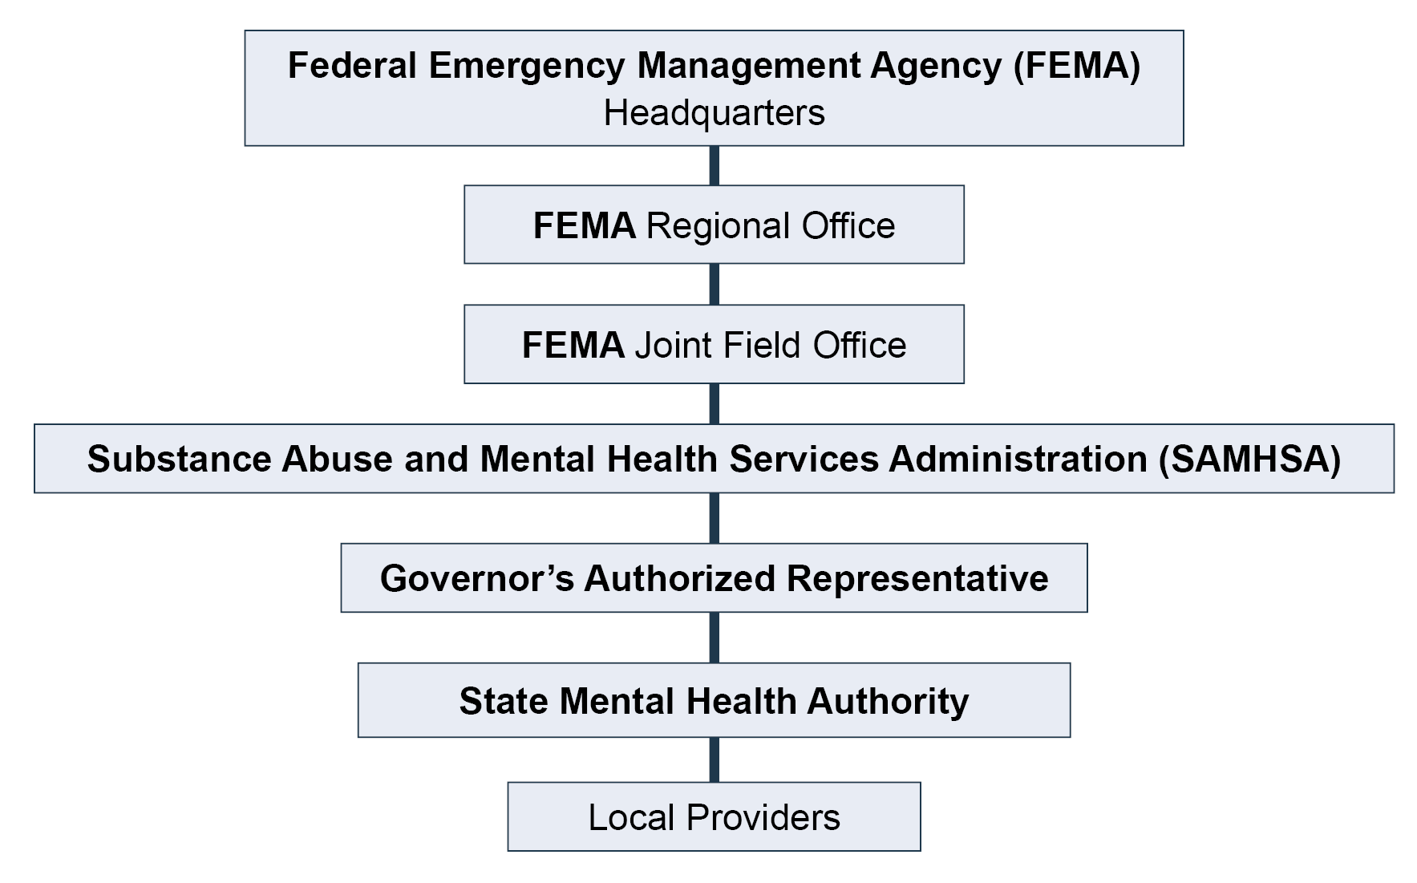
Program Management
RSP administrative structure:
Notes:
Explain how the RSP administrative structure is different from the ISP structure.
The State Mental Health Authority (SMHA) applies directly to the Federal Emergency Management Agency (FEMA) for RSP funding.
Typically, funding flows from FEMA to SAMHSA to the SMHA.
CCP administrators must be aware of this difference in funding flow to avoid state fiscal mechanism issues.
Local community mental health and substance use disorder treatment providers are the provider organizations often contracted to conduct CCP services.
Partnerships with all stakeholders are crucial during the response and recovery efforts.
Note: The Governor’s Authorized Representative’s (GAR) involvement is different based on where you are in the country. Note that this might look different in the participants’ state. While the GAR signs the application, they may have no involvement in the CCP program.

Slide 18
Program Management (cont.)
Emphasis should be on a review of:
  Needs assessment and outreach strategy
  Staffing plan
  Crisis counseling services
  Supervision and team meetings
  Training
Notes:
Explain that during transition from ISP to RSP, program management should review existing strategies and plans for both provision of services and internal program management.
Suggested talking points:
Needs assessment and outreach strategy are the foundation of the CCP. Together they make up a continuous process necessary to ensure the relevance of the program for the duration of the effort.
Staffing plans consider the CCP staff roles and the number of individuals to be hired in each position. The type of CCP staff positions and individuals hired is informed by the needs assessment and existing state and provider structures.
Training is essential to the quality of service provided and program success. Skilled staff must be trained on expectations and limitations of services, and they must understand and adhere to the CCP model.
Supervision and team meetings are critical elements of program management in the CCP. In the beginning of the program, teams meet twice daily. Later in the program, teams meet weekly. Consider what is appropriate for the RSP.
Crisis counseling services will change in relation to the program’s ongoing needs assessment and the phase of the disaster.

Slide 19
Program Management (cont.)
The following areas will be reviewed and assessed during the transition to RSP:
  Fiscal management
  Quality assurance
  Stress management
  Data collection and evaluation
  Program media and marketing
Notes:
Discuss the administrative systems that should be assessed during the transition to ensure services and interventions are being provided efficiently.
Ask participants what program management challenges and successes they have encountered during the ISP and share strategies and solutions that were successful and might be helpful to others, as it relates to the above.

Slide 20
Program Services
  Survivors’ reactions will change over time, resulting in the need for programmatic changes in the RSP.
  There will be an increased need and opportunity for group crisis counseling and public education.
  Survivors may experience deepened anxiety or depression as the new reality of life after disaster sets in.
  While every disaster is different, there are some reactions that can be anticipated.
Notes:
Discuss some of the anticipated changes in survivor reactions and need for services.
Emphasize that these anticipated reactions and needs are based on lessons learned in previous CCPs and disaster behavioral health research.
At the same time, the program must continue to conduct ongoing needs assessment to ensure these anticipated reactions apply to the disaster. Needs assessment should still drive services.
Use these points to segue to the next section on disaster reactions.

Slide 21
Section 2—Current Disaster Reactions,
Strengths, and Resilience
Review of Key Concepts
What Individual Reactions Have We Seen?
What Strengths Have We Seen?
How Are We Fostering Resilience?
Notes:
Introduce this session by telling participants that you all will now explore the reactions they are encountering and can expect to encounter in this and coming phases of the disaster. Specifically, we will talk about collective, individual, and severe reactions and about fostering resilience among individuals and in the community.

Slide 22
Session Objective
  Identify ongoing and emerging disaster reactions related to the current phase of disaster.
Notes:
Review the session objective:
Identify ongoing and emerging disaster reactions related to the current phase of disaster.

Slide 23
Review of Key Concepts
Have you observed the following?
  Everyone who experiences a disaster is affected by it in some way.
  People pull together during and after a disaster.
  Stress and grief are common reactions to uncommon situations.
  People’s natural resilience will support individual and collective recovery.
Notes:
Begin by reviewing some of the key concepts of disaster reactions on this slide and the following slide. Ask participants if they have observed them to be true thus far.
Ask participants to raise their hands if they have observed the behavior/if they agree with each statement as they are read.
NOTE: These key concepts of transition-related disaster reactions frame the CCP approach to disaster work, a strengths-based model that assumes natural resilience in the majority, while being careful to assess for severe reactions in the minority.
Suggested talking points:
During and after a disaster, people may function at a level of high activity but low efficiency.
The use of the word “normal” can be emotionally loaded. “Common” is the preferred adjective.
The CCP is intended to help people access their natural resilience and develop positive coping skills to diminish disruptions in daily living.
People have natural resilience; in fact, most survivors will recover to their former functioning levels within 6 to 18 months without outside mental health or substance use intervention.

Slide 24
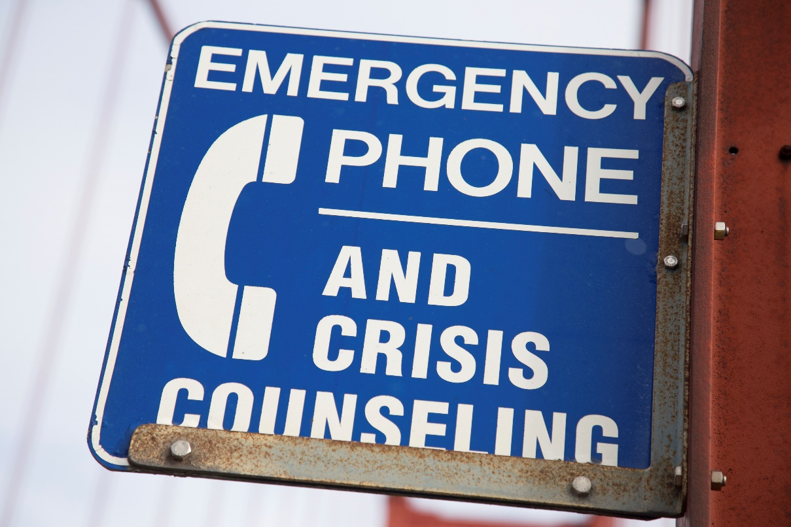
Review of Key Concepts (cont.)
  Typical outcomes of disaster:
    Some will have severe reactions.
    Few will develop diagnosable conditions.
    Most do not seek help or treatment.
    Survivors often reject help.
Notes:
Continue reviewing some of the key concepts of disaster reactions and asking participants if they have observed them to be true thus far.
Review the typical outcomes of disaster.
Emphasize that disaster reactions should always be considered in terms of context and culture.
Note: Ask for feedback on the final point on the slide, “Survivors often reject help.” Ask for examples of what they have seen in their communities related to this concept.

Slide 25

Review of Key Concepts (cont.)
Two types of disaster impacts:
  Individual disaster impact:
    May cause stress and grief
    May cause fatigue, irritability, hopelessness, and relationship conflicts
  Collective disaster impact:
    May damage community support
    May affect individual coping
Notes:
Remind participants of the distinction between individual and collective disaster impact. Also, note that trauma is not the same as disaster impact. People can experience impact from a disaster, without experiencing trauma.
The CCP addresses both individual (survivors, families of survivors, and other affected people) and collective (community) disaster impact.
Individual disaster impact is an emotional or psychological injury usually resulting from an extremely stressful or life-threatening situation.
Collective disaster impact is a psychological effect shared by a group of people of any size, up to and including an entire society. Disaster events witnessed by an entire society can stir up collective sentiment, often resulting in a shift in that society's culture and mass actions.
Tell participants that you will focus on collective disaster impact reactions first.
Some examples of collective disaster impact include the attacks of September 11, 2001, and the changes in airline operations, Transportation Security Administration policies, etc.; Hurricane Katrina caused changes in federal regulations and outreach.
Local disasters will sometimes result in local community infrastructure regulation changes.

Slide 26
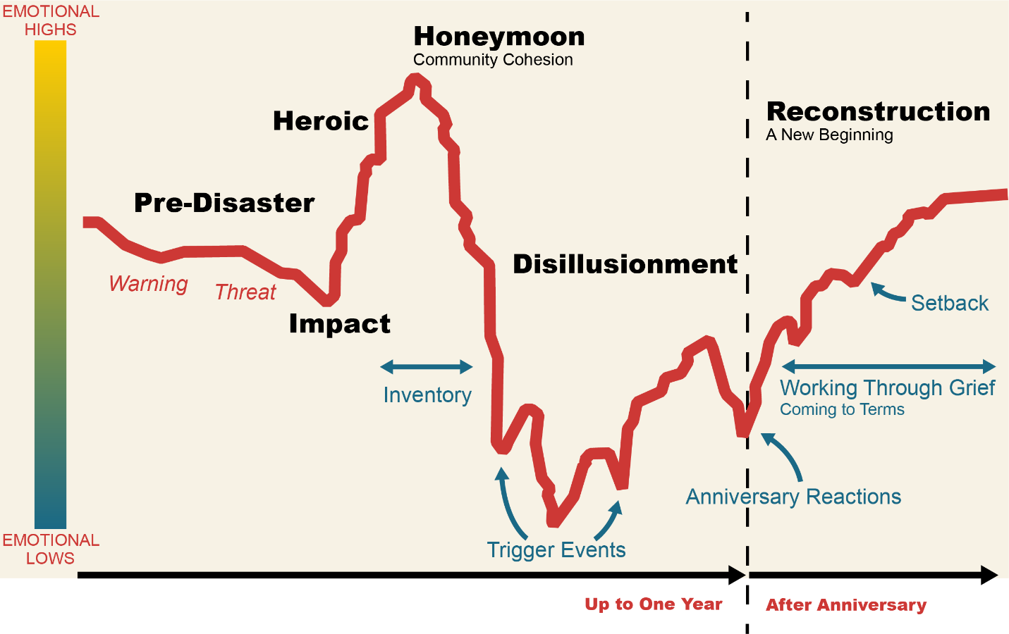
Review of Key Concepts (cont.)
Collective Reactions
Source: Zunin/Meyers, as cited in U.S. Department of Health and Human Services. (2000). Training manual for mental health and human service workers in major disasters (DHHS Publication 90–538). Washington, DC: U.S. Department of Health and Human Services, Substance Abuse and Mental Health Services Administration , Center for Mental Health Services.
Notes:
Show the phases of disaster graph and explain that this graph illustrates a typical disaster and the associated emotional highs and lows. Provide a quick review of the phases as a reminder.
Explain every disaster is different and unique, and in a few minutes, we’ll personalize this graph to fit this specific disaster.
Ask participants what phase they currently are in.

Slide 27
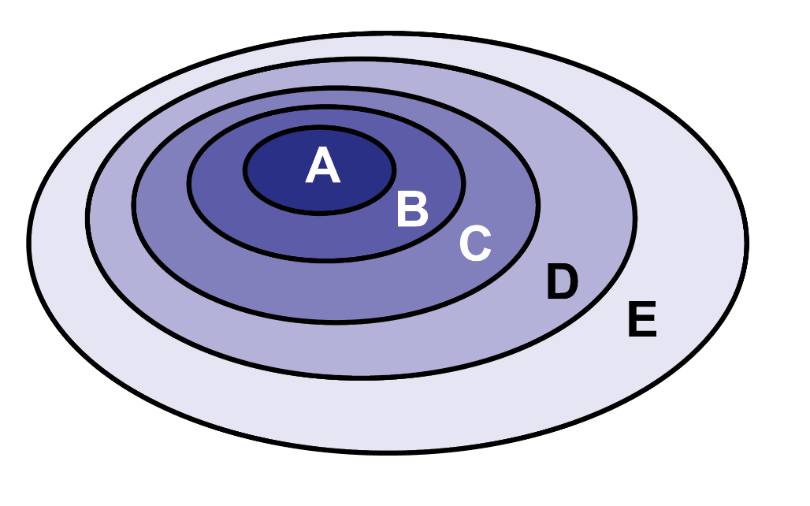
Review of Key Concepts (cont.)
Risk Factors—Population Exposure Model
A. Injured survivors; bereaved family members
B. Survivors with high exposure to disaster trauma or evacuated from disaster zones
C. Bereaved extended family and friends,
first responders
D. People who lost homes, jobs, or possessions; people with
preexisting trauma and
dysfunction; special populations;
other disaster responders
Affected people from the larger community
Adapted from DeWolfe, D. (2002). Mental health interventions following major disasters: A guide for administrators, policy makers, planners, and providers. Rockville, MD: U.S. Department of Health and Human Services, SAMHSA, CMHS.
Notes:
Continue the discussion of collective reactions by reviewing the risk factors—population exposure model. (Adapted by DeWolfe, D. (2002). Mental health interventions following major disasters: A guide for administrators, policy makers, planners, and providers. Rockville, MD: U.S. Department of Health and Human Services, SAMHSA, Center for Mental Health Services.)
Ask about the reactions of specific groups represented in the model. How have you seen their reactions and needs change over time?
Note that more intensive individual/family crisis counseling may be appropriate closer to the center. Educational efforts to build community resilience may be more appropriate for the “outer” groups.
Adapted from DeWolfe, D. (2002). Mental health interventions following major disasters: A guide for administrators, policy makers, planners, and providers. Rockville, MD: U.S. Department of Health and Human Services, Substance Abuse and Mental Health Services Administration, Center for Mental Health Services.

Slide 28

What Individual Reactions Have We Seen?
Types of individual reactions:
  Physical
  Emotional
  Cognitive
  Behavioral
Notes:
Review the range of types of disaster reactions. A summary of the different types of disaster reactions is included in the participant workbook, page 12.
Suggested talking points:
People affected by disaster may experience more than one type of reaction.
Reactions may change over time and may get more or less intense over time.
Reactions may be more intense if people have experienced the event more directly or have gone through previous trauma or crises.
Typical reactions can vary by developmental stage.
Reactions can include positive and negative responses.

Slide 29
What Individual Reactions Have We Seen? (cont.)
Activity:
With a partner:
  Draw a map of the phases of this disaster—what you’ve observed to date and projecting into the future.
  Use the template in your workbook.
  Identify the typical individual reactions you’re seeing.
  Identify potential future trigger points.
You have 10 minutes.
Notes:
Give the following instructions:
Find a partner.
Together, draw a map of the phases of this disaster in the workbook (page 9)—what you’ve observed to date and projecting into the future.
Identify the typical individual reactions you’re seeing.
Identify potential future trigger points.
When the pairs are finished (after about 10 minutes), ask for examples of the reactions they identified. Record these reactions on a flipchart pad.
Facilitate a discussion about these reactions:
Are the reactions something noticed in earlier phases?
Which reactions have become worse or better over time?

Slide 30
What Individual Reactions Have We Seen? (cont.)
Anticipated reactions:
  Anger around the limits of governmental assistance and insurance (e.g., “the system,” “red tape”)
  Increased substance use
  Unaddressed trauma leading to diagnosable conditions such as depression or posttraumatic stress disorder (PTSD)
  Stress from financial hardship as resources diminish
  Frustration and disillusionment at the lack of resources and pace of repairs
  Continued anxiety around dislocation and separation
Notes:
Summarize and reinforce key points about how reactions change over time using this slide of anticipated reactions.
Additional reactions over time:
Anxiety about recurrence of the disaster or new disaster
Distress due to the experience of being a victim of a predatory scam or another, similar crime
Frustration in finding workers to make home repairs
Cumulative stress over dislocation and separation from family, friends, and social support network
Survivors who have developed mental health conditions may be at higher risk for substance use or misuse
Ask the participants to share some of the future triggers they identified.
Ask how these potential triggers are related to future phases of disaster.
Ask what reactions these triggers are likely to produce for individuals and collectively.

Slide 31
Activity – Identifying Immediate and Long-term Reactions
Separate into groups based on teams, providers, or regionally.
Select a recorder.
On top of the paper, write “immediate” in top left corner. On the top right corner, write “over time.” Draw an arrow from “immediate” to “over time.”
You will have 15 minutes to:
    Identify how immediate reactions may evolve into intermediate and then long-term reactions.
    Focus on individual and community reactions, not interventions.
*After 15 minutes, you will report out.
Notes:
Suggested Activity : Identifying Immediate and Long-term Reactions (15 mins)
Objective: To have the group generate and report the immediate and long-term reactions to disaster.
Separate participants into groups based on their teams, providers, or regional affiliations in the CCP.
Provide each group with an easel, flipchart pad, and markers.
At the top of the paper, have one person in each group write “immediate” in the upper left corner, followed by an arrow, and then, “over time” in the upper right corner.
Explain that the ISP and RSP are relatively arbitrary dates, in the sense that a calendar date cannot determine the time frame for reactions.
Each group is to identify how immediate reactions might evolve into intermediate, and then long-term reactions.
The arrow at the top of the page represents the expected lifespan of the CCP.
Have group members select a recorder who will list the anticipated reactions over time.
Have the group focus on listing individual and community reactions, not interventions.
Have each group report their findings to the larger group.
Summarize the discussion, adding your own observations about phases of disaster, triggers, and individual and collective reactions.
Transition to a discussion of identifying and responding to severe reactions.

Slide 32
What Individual Reactions Have We Seen? (cont.)
  The severity of reactions is affected by the type of, level of exposure to, and casualties associated with the disaster.
  Preexisting trauma may increase the risk of severe reactions.
  CCP staff members refer anyone for treatment experiencing severe reactions.
  Preexisting levels of support will affect the severity of reactions.
Notes:
Discuss the factors that influence severe reactions.
Note that while preexisting trauma may increase risk of severe reactions, some survivors with preexisting trauma have increased coping skills and ability to deal with the effects of disasters.

Slide 33
What Individual Reactions Have We Seen? (cont.)
Severe reactions may be a sign of the following:
  Depressive disorders
  Suicidal behavior
  Substance misuse
  Acute stress disorder
  PTSD
  Dissociative disorders
  Anxiety disorders
Notes:
Explain that severe reactions may signal a range of psychological disorders.
Emphasize the following points:
The treatment of severe reactions is beyond the scope of the CCP; however, the ability to recognize such symptoms is crucial for the crisis counselor to make appropriate referrals.
CCPs may benefit from staffing structures that have professional mental health and substance use disorder treatment clinicians supervising paraprofessional crisis counselors. In this way, clinicians are available to support paraprofessionals in the assessment and referral of people exhibiting severe reactions.
Disasters affect the community infrastructure; therefore, referral resources will vary based on the following:
◦ Preexisting community infrastructure
◦ Damage to the community infrastructure
This doesn’t mean that people will go on and develop a diagnosable condition. Most people recover without developing any disorders. Some of these may have been conditions that were present before the disaster and were amplified by the disaster.

Slide 34
What Individual Reactions Have We Seen? (cont.)
Severe reactions:
    Significantly affects life functioning (school, work, relationships, etc.)
    Presents a health or safety risk, including suicidal behavior
    Does not resolve or diminish over time
How do you recognize when a reaction becomes severe?
When does a severe reaction warrant referral?
How are you using the Assessment and Referral Tools for adults and for children?
Notes:
Facilitate discussion with the participants about the following:
How to recognize severe reactions
How to handle a severe reaction
When to refer
How they are currently using the Assessment and Referral Tools
Recognizing severe reactions—A reaction is severe when it does the following things:
Significantly affects life functioning
Presents a health or safety risk
Does not resolve or diminish over time
When to refer—When a severe reaction or psychiatric disorder is suspected, the crisis counselor needs to alert the CCP team leader or clinical supervisor immediately. The team leader and crisis counselor should work with the survivor to determine if a referral is needed and if so, the crisis counselor should use his or her knowledge of local resources to connect the survivor to needed services. Crisis counselors should check back in with survivors to see if they have followed through with the referral. The crisis counselor should know and follow the contractor’s procedures if a disaster survivor presents with suicidal behavior.
Using the Assessment and Referral Tools—Using the Adult and Child/Youth Assessment and Referral Tools is a way to keep track of survivors who may be suffering from severe reactions to disaster. As with all issues related to severe reactions and psychiatric disorders, using the tools for this purpose should be done in consultation with CCP team leaders and clinical personnel.

Slide 35
Activity: Part 1, Talk at Tables:
What Survivors Have Been Reached? Who Still Needs Service?
For the next 10 minutes, talk at your tables about successes, challenges, and next steps in reaching special populations.
Discuss:
The groups the CCP has been most successful at connecting with
Groups that haven’t been reached and the plan for reaching them
Unanticipated challenges and unique issues discovered during the ISP in serving some populations
Share strategies for engaging special populations
Notes:
Activity: Part 1, Talk at Tables: What Survivors Have Been Reached? Who Still Needs Service? (15 mins)
Objective: To assess how to reach survivors who have not yet been served and who may still need help.
Ask participants to spend 15 minutes talking at their tables about successes, challenges, and next steps in reaching special populations.
Suggest they discuss:
Which groups has the CCP been most successful at connecting with?
Which groups haven’t been reached yet, and what is the plan to reach them?
Discuss any unanticipated challenges and unique issues serving some populations discovered during the ISP.
Share strategies for engaging special populations.
Ask them to take notes on a flipchart and prepare to share with the large group. Note that we will also use their notes for an upcoming activity.

Slide 36
What Strengths Have We Seen?
  What individual strengths have you seen?
  What collective strengths have you seen?
  What examples of personal growth have you seen?
Notes:
Ask participants these questions:
What types of individual strengths have you observed?
What types of collective strengths have you observed?
What are some examples of personal growth you have observed?
Examples of personal growth:
Becoming closer to loved ones
Having faith in the ability to rebuild one’s life
Becoming more spiritual or religious
Finding a deeper meaning and purpose in life
Discovering inner strength
Feeling more connected to community

Slide 37
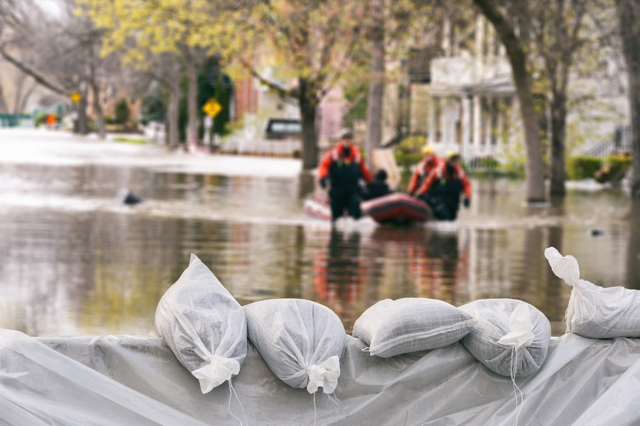
Resilience
The American Psychological
Association (APA) identifies four
core components of resilience:
  Connection
  Wellness
  Healthy thinking
  Meaning and purpose
  Resilience: an ability to recover
  from or adjust easily to misfortune or change
  APA, 2020, https://www.apa.org/topics/resilience/building-your-resilience
Notes:
The APA identifies four core components of resilience:
Connection to people, organizations, and communities
Wellness, including healthy habits; mindfulness; and avoiding using alcohol, drugs, and compulsive behavior in areas such as over- or undereating, shopping, or gambling to avoid difficult feelings
Healthy thinking, including countering all-or-nothing thinking and strengthening optimism
Meaning, including finding purpose through helping others and setting and working toward goals
Make the link between strengths and resilience explaining that it is through strengths that we build resilience.
Remind participants of the definition of resilience.
Suggested talking points:
Resilience varies across situations and within individuals at different times.
The level of resilience in individuals and communities can change and can be fostered.
It is crucial to recognize people's strengths, as well as the suffering they have experienced.
While survivors' suffering must be acknowledged, and compassion and empathy conveyed to them, it is also important that those who care for them believe in and support their capacity to master this experience.
Information and education help people's understanding and should be an integral part of the support and care systems.
People are helped with mastery of their experience and recovery by all of the following: preparation prior to disaster, information about what has happened, education about common responses to such events, training in what to do to help with psychological recovery, information centers, and ongoing informational feedback to affected communities
National Center for PTSD. Helping Survivors: Early Interventions Following Disaster and Mass Violence. Retrieved from https://www.ptsd.va.gov/professional/treat/type/disaster_earlyintervention_tx.asp
As time permits, ask participants if they think any component is missing.
Transition to talking about how to foster resilience.

Slide 38
How Are We Fostering Resilience?
How have you seen these factors affect survivors’ resilience?
  Life situation
  Individual traits and coping styles
  Disaster and trauma experience
  Family and social support
  Spiritual beliefs
  Presence of perceived control and hope
  Availability of accurate information
  An effective and caring emergency response
Notes:
Discuss the factors that affect resilience. Start by asking how participants have observed these factors affecting resilience.
Suggested talking points:
Some people are at higher risk for or more vulnerable to disaster stress reactions due to their life situations, individual differences, or experiences prior to the disaster.
Life situation factors include socioeconomic status, education level, and current life stressors.
Individual traits include coping strategies, capacity to tolerate stress, substance use and misuse, and gender.
Disaster and trauma experience factors include previous disaster experience and losses, and prior trauma or violence history.
Depending on where people are in terms of these factors (e.g., high versus low capacity to tolerate stress), after a disaster they may be in a resilient state that lessens the effects of trauma and stress and assists them in coping, or they may experience more challenging reactions.
Probably the most far-reaching, but most easily overlooked, principle of disaster behavioral health emerging from the literature is that people are resilient.
Even after intense exposure to the most severe disasters, only a minority of the most highly affected population is likely to suffer from PTSD, and most people do not develop any psychiatric disorder.
Emotional distress is common after exposure to severely traumatic events.
Uncomplicated distress should not be confused with psychiatric illness. This kind of confusion unnecessarily pathologizes the healthy population and trivializes the experience of those directly exposed to extremely traumatic events (North, C. S. [2004]. Approaching disaster mental health research after the 9/11 World Trade Center terrorist attacks. Psychiatric Clinics of North America, 27, 589–602).

Slide 39
How Are We Fostering Resilience? (cont.)
How have you helped survivors to:
  Reach out to people they trust and care about (connection)?
  Engage in self-care and mindfulness practices such as healthy eating, journal writing, yoga, prayer, or meditation (wellness)?
  Maintain a hopeful outlook (healthy thinking)?
  Set realistic goals and take steps to carry them out (meaning and purpose)?
  Focus on finding solutions (meaning and purpose)?
Notes:
Make the point that resilience is not a trait that people either have or do not have. It involves behaviors, thoughts, and actions that can be learned and developed.
Discuss the ways crisis counselors can help survivors to develop resilience.
You may want to discuss the following additional points on how to foster resilience:
Maintain flexibility and balance when dealing with stressful circumstances and traumatic events.
It is all right to experience strong emotions, if the individual is attending to other responsibilities in addition to experiencing and moving through emotions.
Step forward and take action to deal with problems and meet the demands of daily living, while stepping back to rest and reenergize.
Spend time with loved ones to gain support and encouragement.
APA, 2020, https://www.apa.org/topics/resilience

Slide 40
How Are We Fostering Resilience? (cont.)
Which of the following have you taught survivors?
  Making connections
  Avoiding seeing crises as insurmountable problems
  Accepting change as a part of living
  Moving toward goals
  Taking decisive action
  Looking for opportunities for self-discovery
  Nurturing a positive view of self
  Keeping things in perspective
  Maintaining a hopeful outlook
  Practicing effective self-care
Notes:
Review the additional tools crisis counselors can use to teach survivors.
APA, 2020, https://www.apa.org/topics/resilience

Slide 41
How Are We Fostering Resilience? (cont.)
  Complete the self-assessment checklist in your workbook, page 16.
  Make a check mark next to the tools you feel you help survivors to use.
  For the ones you checked, make some notes about how you do this, including specific examples.
Notes:
Facilitate a discussion about real life use of these survivor tools for resilience.
Ask the participants to contribute specific examples of how they build resilience. Help participants recognize that they are building resilience through everything they do with survivors and encourage them to always keep in mind that the goal is to build resilience.
Bring the session to a close by telling participants that in the next section we will continue to work with how to foster resilience and support recovery over time through the range of CCP services. We’ll pay particular attention to group counseling.

Slide 42
Section 3—Crisis Counseling Services and Interventions
  Needs Assessment and Outreach
  Range of Crisis Counseling Services
  Individuals/Families
  Groups
  Communities
  Public Education and Media Messaging
  Assessment, Referral, and Resource Linkage
  Ethical Considerations
  Cultural Awareness
Notes:
Introduce this section by telling participants that we’re going to spend the rest of this afternoon focusing on needs assessment and outreach, reviewing individual and family counseling skills, and practicing group crisis counseling.
Tomorrow morning we’ll spend time discussing the other crisis counseling services, identifying successes to date, and areas to focus on going forward.

Slide 43
Session Objective
  Describe crisis counseling services related to the current phase.
Notes:
Review the session objective:
Describe the crisis counseling services related to the current phase.

Slide 44
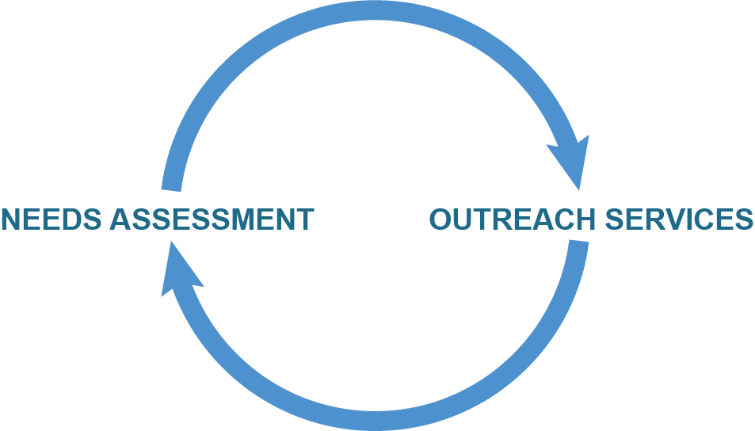
Needs Assessment and Outreach
  Needs assessment is an ongoing process whereby new information is brought into the program, and program outreach and services are adjusted to meet emergent needs or “discovered” special populations.
  Program outreach and services are adjusted to meet identified needs.
Notes:
Start by saying that:
Needs assessment is the foundation of outreach and of the entire CCP. The information uncovered in the initial needs assessment provides the rationale and justification for the CCP’s existence and identifies the populations which will be identified for outreach. It is an ongoing process.
Needs assessment is an ongoing process whereby new information is brought into the program, and program outreach and services are adjusted to meet emergent needs or “discovered” special populations.
Summarize the discussion, and transition to a review of the range of crisis counseling services.
Additional talking points:
The most reliable data on disaster damage generally will come from the FEMA preliminary damage assessment, which can be provided by the FEMA regional office responsible for the disaster response.
Other important sources of information on crisis counseling needs may include the state emergency management agency; voluntary agencies, such as the American Red Cross; and media sources. In addition, any crisis counselors and other human services workers deployed by the SMHA or other public agencies in the immediate aftermath of a disaster may provide information on crisis counseling needs.
During disasters, survivors seek support from trusted members of their own communities rather than disaster behavioral health professionals.
Further training of these community resource people can expand the availability of mental health services after community disasters.
North, C. S., & Hong, B. A. (2000). Project CREST: A new model for mental health intervention after a community disaster. American Journal of Public Health, 90(7), 1057–1058.

Slide 45
Activity: Part 2, Share With the Group:
Who Still Needs Service? How Can We Reach Them?
Identify characteristics, demographics, and geographic indicators to identify survivors who still need service and to what degree.
  How can the CCP use outreach and needs assessment to reach these segments of the population?
  What are steps to be included in an action plan as services are refocused on reaching the unserved or underserved survivor population?
Notes:
Activity: Part 2, Share with the Group: Who Still Needs Service? How Can We Reach Them? (15 mins)
Objective: To assess how to reach survivors who have not yet been served and who may still need help.
Guide a group discussion using the prompts on the discussion from earlier and/or the questions below.
Briefly review results from Part 1 of the activity: Which populations have been successfully served through outreach and needs assessment? How were they identified? In what geographic area were they served? What might be common characteristics of those who have been served? What strategies have been successful?
Identify characteristics, demographics, and geographic indicators to identify survivors who still need service and to what degree.
How can the CCP use outreach and needs assessment to reach these segments of the population?
What are steps to be included in an action plan as services are refocused on reaching the unserved or underserved survivor population?
What new strategies could you use?

Slide 46
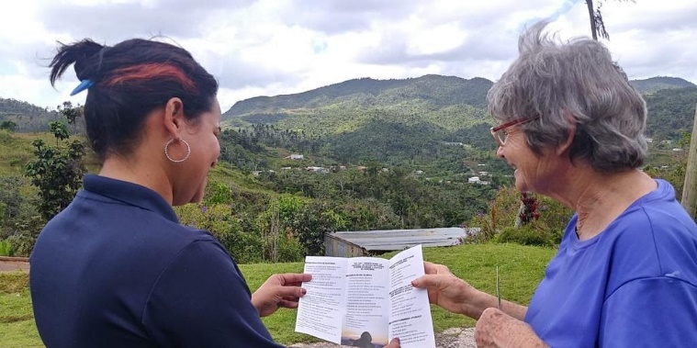
Range of Crisis Counseling services
  Individual/family crisis counseling
  Brief educational or supportive
  contact
  Group crisis counseling:
    Support and educational groups
    Self-help groups
  Assessment, referral, and resource linkage
  Community support and networking
  Public education
  Development and distribution of educational materials
  Media messaging and risk communications
  Virtual services
Notes:
8/24/2022
8/24/2022
CCP Trainer’s Toolkit
Core Content Training
46
Building upon the previous discussion, we are going to review the range of crisis counseling services that make up a CCP.
Quickly review the range of CCP services.
Ask these questions:
What services were most important during the ISP? Why?
Where do you see the most need or demand for services now?
What services do you expect to be most needed in the coming months?
How has the need shifted, and why?
Transition to a review of crisis counseling skills.

Slide 47
Individuals/Families
Goals of individual/family crisis counseling—assist participant(s) in doing the following:
  Understanding their situations and reactions
  Regaining a sense of mastery and control
  Identifying, labeling, and expressing emotions
  Adjusting to the disaster and losses
  Managing stress
  Making decisions and taking action
  Developing coping strategies
  Using community resources
Notes:
Explain that now that the basics have been reviewed, participants will take a closer look at some of the tips and techniques learned from their experience with crisis counseling.
Remind participants of the basic goals or tasks of crisis counseling.
Ask participants to take a moment and reflect upon what they’ve learned from their experience in crisis counseling. What are some things they have done that have been helpful? For each goal listed, have participants write in their workbooks (page 21) one tip or technique that can be used to achieve each goal. (5 minutes)
Have participants discuss their tips and techniques at their tables. (5 minutes)
Facilitate a quick large group discussion of the tips and techniques. (10 minutes)
Remind participants that training videos are available online for future reference: https://www.samhsa.gov/dtac/ccp-toolkit/train-your-ccp-staff.
Give participants a break, and tell them that when they return, they will be discussing and practicing group crisis counseling.

Slide 48
Groups
Where are we now?
  What types of groups are you providing, or planning to provide?
  What are the common themes?
  What’s working well about these groups?
  What’s been challenging?
Where are we going?
  What communities have emerged that would benefit from forming a group?
Notes:
Start by asking the group where they are now in regard to group outreach:
What types of groups are currently provided (e.g., support and education groups, self-help groups)?
What groups can the CCP provide in the future, or start planning for now?
What are the common themes of the groups (e.g., similar levels of exposure, similar needs, special populations)?
What’s working well about these groups?
What’s been challenging (e.g., getting the groups started, maintaining participation, facilitating the sessions, marketing, transitioning to member-led)?
Facilitate a brainstorming session to identify the types of groups that will be needed during the RSP. Discuss the types of communities that have emerged that would benefit from forming a group?
Chart these responses. The list created in this brainstorming will be used in a later activity.

Slide 49
Groups (cont.)
Goals of group crisis counseling—assist group members in doing the following:
  Understanding their current situations and reactions to the disaster
  Achieving mutual support
  Developing skills related to stress management, coping with triggers, expressing emotions, and problem solving
  Becoming knowledgeable about available community resources
  Developing and implementing personal and group goals
  Ensuring cultural competency and representation of the population through the group leaders
Notes:
Review the goals of group counseling.
Suggested talking points:
Group counseling may vary from less structured, purely educational groups to more structured support groups. All groups are likely to share some elements of support and education.
Group counseling must be accessible to the affected community. Consider how to reduce barriers so that all affected community members can access the group services (e.g., geographic location, accessible buildings, transportation, computer equipment).
It is important to ensure that group members have had similar levels of exposure to the disaster event. People with low exposure should not be exposed to stories of people whose exposure was significantly higher.
When members of social support networks are struggling with the disaster’s aftermath, counseling groups may augment overloaded support systems.
Groups can be led by a licensed mental health and/or substance use disorder treatment professional, co-facilitated with a mental health professional and a paraprofessional, or led by survivors themselves.
Group leaders should implement cultural competency. It is important that group leaders can connect with the group members and their culture to create a safe and welcoming environment. When possible, group leaders should be representatives of the population they seek to support.
Group crisis counseling refers to services that help group members:
Understand their current situations and reactions to the disaster.
Review or discuss their options.
Access emotional support or referral services.
Attain skills to cope with their current situations and reactions.
In group counseling, participants do most of the talking.

Slide 50
Groups (cont.)
Factors that affect the group process:
  Co-facilitation by two crisis counselors
  Knowledge and skills of group leaders
  Group leaders’ awareness of their own values, biases, and beliefs, and how these affect the group
  Respect and confidentiality
  Utilization of feedback from the group
Notes:
Discuss the factors affecting the group process.
Suggested talking points:
Crisis counselors should assess their own skills and knowledge about the content to be discussed, so they may set clear boundaries on how to approach the group process. Group members may inquire about symptoms on which counselors are not authorized to give advice. Counselors can, however, provide concrete information and make appropriate referrals to mental health and substance use disorder treatment professionals.
Be aware of personal biases related to religion, spirituality, culture, ethnicity, and gender. It is common and healthy to recognize these qualities for personal reflection, but it is detrimental if these qualities disrupt the group process. Group facilitators should strive to be anti-oppressive, antiracist, and attend to group members’ broadly-defined overlapping social and cultural realities.
Respect and maintain confidentiality. A group should be in a safe place in which people, families, and communities can freely share their feelings without worrying about other people knowing their personal business.
Facilitate the group by making sure that each member has a chance to talk and that no one person dominates the conversation. Ask a member who has not spoken if he or she would like to talk; however, respect his or her right to just sit back and listen. Never force someone to talk as that can be retraumatizing.
Ask for feedback. Some groups may warrant more structure than others; however, it can be empowering for group members to become actively engaged in the process of deciding what they would like to achieve in group sessions.
Adapted from ASGW Guiding Principles for Group Work, https://asgw.org/wp-content/uploads/2021/07/ASGW-Guiding-Principles-May-2021.pdf.

Slide 51
Groups (cont.)
Group crisis counseling skills:
  Promoting safety and comfort
  Listening
  Modeling effective communication skills
  Facilitating group interaction
  Facilitating the group process
  Dealing with difficult group members and situations
Notes:
Review group counseling skills:
Promoting safety and comfort
Listening
Modeling effective communication skills
Facilitating group interaction
Facilitating the group process
Dealing with difficult group members and situations

Slide 52
Groups (cont.)
Group crisis counseling skills:
  Handling difficult subject matter
  Identifying and interpreting shared reactions and experiences
  Assessing and responding to group needs
  Educating members about common reactions, stress management, and effective coping skills
  Identifying and responding to other educational needs
  Facilitating group cohesiveness
Notes:
Handling difficult subject matter
Identifying and interpreting shared reactions and experiences
Assessing and responding to group needs
Educating members about common reactions, stress management, and effective coping skills
Identifying and responding to other educational needs
Facilitating group cohesiveness

Slide 53
Group Counseling Exercise (cont.)
Preparation for exercise:
  Think about survivors you have worked with individually or in groups.
  Based on your experience, write a description of a fictional survivor whose role you’ll play in the group. Please be careful to maintain confidentiality of actual survivors.
  This survivor role should fit in with the type of populations that have been identified as part of the needs assessment.
Notes:
Choose a type of group identified during the earlier session. The group type included in the brainstorm list can be chosen by group participants or by the instructor.
Give the following task instructions:
Think about survivors you have worked with individually or in groups.
Based on your experience, write a description of a fictional survivor whose role you’ll play in the group. Consider their needs, emotions, stressors, and other factors affecting their physical and emotional state. Please be careful to maintain confidentiality of actual survivors.
The role created should fit with the type of group selected from the brainstorming list.
Tell participants to make notes in their workbooks (page 26) about their survivor, to reference during the activity.

Slide 54

Group Counseling Exercise (cont.)
Group Counseling Demonstration and Exercise
Notes:
Prior to this exercise, it is helpful for the trainer to prepare their thoughts ahead of time on the topic to be discussed.
Ask for four volunteers to participate in a brief demonstration, in which you’ll lead a group and they’ll play the role of survivors.
Ask those not participating to pay close attention to the skills demonstrated by the group leader and to be prepared to talk about their observations after the activity.
Conduct a brief demonstration (about 10 minutes), in which you lead a mock group session with the four volunteers.
Ask everyone to take a few minutes to reflect and make notes on the worksheet in the participant workbook (page 28). Next, facilitate a discussion about the leader’s skills observed during the demonstration.
Say that now they’ll have a chance to practice and get feedback from others.

Slide 55
Group Counseling Exercise (cont.)
Continue with the exercise, giving everyone in your group a turn to facilitate:
  Form groups of four people each.
  Simulate a 40-minute group counseling session.
  Each person will lead the group for 10 minutes.
  When not facilitating, play the survivor role you created.
  The trainer will keep track of time and announce when to switch facilitators.
  Before the practice, choose a feedback partner. You and your partner will observe each other during the practice and give each other feedback afterward.
Notes:
Explain that they will now work in groups of four to simulate a group counseling session.
Explain the exercise will take 40 minutes, about equivalent to one group session. Each person in the group will take turns facilitating for 10 minutes, with each facilitator picking up where the last one left off.
Explain that the other members of the group will play the survivor roles when not acting as the facilitator. Also explain the groups will use the same type of group as used for the earlier demonstration.
Explain that during the simulation, one of the group members will also act as an observer who will give feedback to the facilitator. When a new facilitator takes over, a new observer should be identified to give the feedback. Just as group members take turns being a facilitator, group members should also take turns being the facilitator observer.
Explain that each group will have a few minutes to prepare before the simulation begins.
Tell them that you’ll keep track of time and tell them when to switch facilitators.
Ask if they have any questions about how the practice will work.
Tell them to turn to their workbooks, page 29, and take a few minutes to prepare for the simulation, including review of the worksheet for assessing the activity. Give them 5 minutes to prepare.
Organize participants into groups of four people each.
Remind them to identify a group member to observe and provide feedback to a specific facilitator.
Tell them to decide the order in which they will act as the facilitator (e.g., who starts, who goes next, etc.).
Start the simulation. Keep time and have the groups switch facilitators every 10 minutes.
Circulate around the room to observe the groups as the simulation takes place. Note anything you see that you want to mention during the large-group discussion.

Slide 56

Group Counseling Exercise (cont.)
Post-practice reflection:
  Complete the reflection sheet in your workbook.
  Also, finish making any notes on your partner’s facilitation on the feedback worksheet.
Notes:
After the practice concludes, tell the participants to take a few minutes to complete the worksheet in their workbooks (page 28) documenting how they felt about the effectiveness of their facilitation session and to make any notes about other group member’s facilitation.
Tell the group members to get back together in their groups and share their facilitation feedback.

Slide 57
Group Counseling Exercise (cont.)
Post-practice reflection (cont.):
  Overall, how did the exercise go?
    What was easy?
    What was hard?
  What skills did you use?
    What was the impact on the group?
  What lessons are you taking away about facilitating group counseling?
Notes:
Ask everyone to come back together as a large group and facilitate a discussion of the lessons learned from the simulation.
Overall, how did the practice go? What was easy? Challenging?
What skills did you use? What was the impact on the group?
What could be improved?
What lessons are you taking away about facilitating group counseling?
For the discussion, start with participants sharing their impressions and then, add your observations. If you start by giving your assessment, it might inhibit the participants’ willingness to contribute their views.

Slide 58
Course Agenda (Day 2)
  CCP Services, Interventions, and Skills
  Data Collection and Program Evaluation
  Stress Management
  CCP Team Vision for Success
  Applying Your Learning
Notes:
Review the agenda for today.
If you didn’t have participants discuss their journal reflections yesterday, do it now.
Tell participants to find a partner and discuss their journal reflections.
Hear from a few participants willing to share a few examples of their journal responses in the large group.
Check in with participants to see if they have any questions remaining about the topics discussed yesterday. Review topics and questions from the index cards submitted at the end of day one.
Ask if there are any questions about the readings from last night. Most of the reading should have been a review and not new information. Encourage participants to reflect on the readings during the morning’s discussion .
Discuss the CCP Transition to RSP—Program and Services Assessment Questionnaire from the reading. These are the types of questions the program should use for assessment as it transitions from ISP to RSP. We are addressing and discussing many of these questions during this workshop, but not all of them. Program management should be sure to review this list and actively seek to answer the questions—both among the management team and by soliciting staff input and perspectives.

Slide 59
CCP Services, Interventions, and Skills
Cultural Awareness:
Definitions:
Awareness of your own culture as a set of values, behaviors, attitudes, and practices, and the understanding that other cultures may be different from your own
Respect for the beliefs, languages, and behaviors of others
A quality that develops over time, usually involving increasing sensitivity and long-term commitment
Notes:
Review the definitions of cultural awareness and its importance in the CCP.
Additional talking points:
CCP staff should reflect the makeup of the community and speak the languages of the communities served. This is an effective strategy for better engagement and ability to reach special populations.
Reduce barriers to the program by addressing access issues such as language, physical access to space, technology limitations, education level, etc.
Recognize that perceptions of mental health or substance use vary among people in general, as well as across cultural groups.

Slide 60
CCP Services, Interventions, and Skills (cont.)
Cultural Awareness:
Staff/Individual:
Be dependable, nonjudgmental, and respectful.
Recognize cultural variation in the expression of help-seeking, customs, traditions, and support networks.
Recognize different experiences with and beliefs about healing, trauma, and loss.
Learn local norms from community leaders.
Program:
Recruit multicultural staff from the community.
Provide information in multiple languages and formats, when needed.
Allow time to gain acceptance in a community.
Notes:
Review the elements of staff/individual cultural awareness, and programmatic cultural awareness.
Additional talking points:
Recruit crisis counselors who represent the various cultural groups affected by the disaster.
Provide ongoing cultural awareness training to staff.
Identify the various cultural groups or populations in need of services.
Ensure that services are accessible, appropriate, and equitable.
Allow time to gain acceptance in a community.
Involve cultural brokers and community leaders in a meaningful way.
Ensure that program materials are sensitive to and reflect the languages of the cultural groups served.
Develop mechanisms, use team meetings, and use quality assurance processes to ensure the program is moving toward cultural awareness.

Slide 61
CCP Services Roundtables
Topics:
  Community Support and Networking
  Public Education and Media Messaging
  Assessment, Referral, and Resource Linkage
  Cultural Awareness
Focus of discussion:
  What are we doing now?
  Where do we go from here?
Notes:
Tell participants that this morning we are going to start with a series of roundtable discussions about other CCP services beyond individual and family and group crisis counseling.
The purpose of these discussions, in keeping with the theme of this course overall, is to provide an opportunity to assess what they’re currently doing in these areas and where they want to go from here.
Topics:
Community support and networking
Public education and media messaging
Assessment, referral, and resource linkage
Cultural awareness
Preparation for Roundtables
Organize the room into four groups, each at a separate table, one for each of the topics. If you have more than 25 participants, you’ll want to have more than four tables. Each table should have about four to six participants.
Place an easel with flipchart pad next to each table along with markers. On each flipchart pad list the topic and associated questions to be the focus of this activity.
Using the easels with flipchart pads, have participants write or illustrate the key ideas.
Have participants choose which topic they’d like to start with and go to that table. Adjust the number of people at each table, if necessary, to make sure participants are evenly distributed at the tables.

Slide 62
CCP Services Roundtables (cont.)
Process:
  Conduct two rounds of discussion, 20 minutes each.
  Discuss the questions listed.
  Choose the two topics you are most interested in discussing.
  Each table will have a “host” who stays for both rounds of discussion.
  The host’s role is to facilitate the discussion and keep track of patterns and themes.
Notes:
Describe how the roundtables will work. During this session, there will be two rounds of conversation, 20 minutes each. This means individuals will not have a chance to discuss every topic. Participants should choose which two topics they are most interested in discussing.
Each table will have questions related to their service to guide their discussion. The questions will be related to what the program has done thus far in that service area, and what it should do in the future. Suggest the participants use the CCP Creative Strategies document (https://www.samhsa.gov/sites/default/files/dtac/ccp-grantee-strategies-ideas-virtual-outreach.pdf) as a resource. What ideas from that list might work for your CCP?
Community support and networking:
What is the program doing to provide community support and networking?
What are the emerging community needs?
What opportunities for further outreach exist?
Public education and media messaging:
What is the program doing in public education and media messaging?
How are the needs for public education and media messaging changing over time?
What opportunities exist for extending the reach of your public education activities and media messaging?
Assessment, referral, and resource linkage:
How are you doing assessment, referral, and resource linkage?
How are the needs for assessment, referral, and resource linkage changing over time?
What opportunities exist for improving assessment, referral, and resource linkages?
Cultural awareness:
How are the program’s services culturally appropriate and reaching diverse community groups?
What are you doing in your program to address cultural awareness? What are some specific examples?
What opportunities exist to increase the cultural awareness of the program and its reach into diverse community groups?
Call time at the end of 20 minutes. Remind the hosts to stay where they are and ask the participants to move to another table. Adjust the number of people at the tables, if necessary.
Start the second roundtable session.
Call time after 20 minutes.
After the second round, facilitate conversation for the whole group about key ideas and insights and any patterns that emerged. Ask the hosts to report out on their topics first; then, invite others to contribute additional points.
Ask participants if they have any tips, tricks, or best practices to share with the group on CCP service deliveries.
Bring the conversation to a close, and transition to the next section on data collection and program evaluation.

Slide 63

Section 4—Data Collection and
Program Evaluation
Importance of Data Collection and Program Evaluation
Data Collection Tools
Opportunities for Improvement
https://www.samhsa.gov/dtac/ccp-toolkit/ccp-data-forms-trainings
Notes:
Explain that in the next section, we’ll focus on the uses and importance of data collection and reviewing the tools available for data collection.
Remind the CCP staff that they should have completed another forms training following the Core Content Training, and that this section will include a brief overview of some of the forms that are probably already being used.
This section will focus on several new feedback forms that will be administered during the RSP.
Remind participants that all tools and forms, and more information for each, is available online: https://www.samhsa.gov/dtac/ccp-toolkit/ccp-data-forms-trainings.

Slide 64
Session Objectives
  Describe the importance of data collection and program evaluation.
  Identify how data and evaluation have been used in the ISP.
  Describe the data collection forms that will be used in the RSP.
  Identify how data will be used in the RSP.
Notes:
Review the session objectives:
Describe the importance of data collection and program evaluation.
Identify how data and evaluation have been used in the ISP.
Describe the data collection forms that will be used in the RSP.
Identify how data will be used in the RSP.

Slide 65
Importance of CCP Evaluation and Data Collection Toolkit
How have data collection and analysis:
  Assisted program managers?
  Assisted crisis counselors?
  Assisted in identifying program trends and survivor needs?
  Documented the program’s accomplishments?
  Provided accountability to stakeholders (e.g., Congress, Government Accountability Office, federal agencies)?
Notes:
To start this session, facilitate a discussion about how data collection has been used in the CCP up to this point.
How have data collection and analysis:
Assisted program managers?
Assisted crisis counselors?
Assisted in identifying program trends and survivor needs?
Documented the program’s accomplishments?
Provided accountability to stakeholders (e.g., Congress, Government Accountability Office, federal agencies)?

Slide 66
Importance of Data Collection and Program Evaluation
Program evaluation is a systematic effort to collect, analyze, and use data to inform and improve service delivery.
The components of program evaluation are:
  Data collection: A process of gathering information about survivors and services.
  Data analysis: A process of reviewing and interpreting the information that has been collected.
  Feedback loop: A process of sharing findings from the analysis and developing a strategy to address them.
  Program evaluation plan: An ongoing process to inform and improve service delivery.
Notes:
Discuss the importance of data collection and program evaluation.
Suggested talking points:
Program evaluation refers to systematic efforts to collect, analyze, and interpret information about the execution or effectiveness of interventions.
Whether questions concern how to improve the reach of the service delivery system or the efficacy of the services themselves, program evaluation provides an empirical basis for the answers.
Data collection is performed by the crisis counselors.
Data analysis is performed by program managers.
The feedback loop is performed by program managers with input from the crisis counselors.
The program evaluation plan is implemented by the crisis counselors and team leaders and monitored by the program managers.
Ask participants to share some data points/data analysis from their ISP (or a previous CCP) and how the feedback loop changed or improved the program. If the program hasn’t yet instituted a feedback loop, have the participants discuss how they would design and implement a process to ensure that everyone is aware of data trends and how they can be used to shift service delivery.

Slide 67
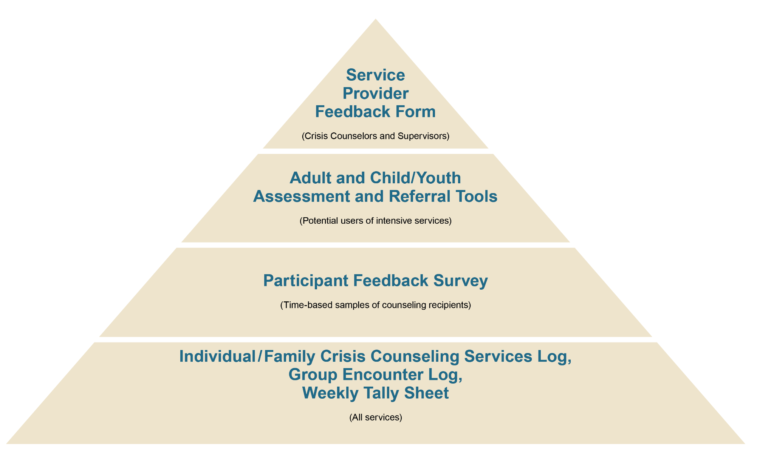
Review of Data Collection Tools
Notes:
Present an overview of the data collection forms.
Suggested talking points:
The pyramid indicates prevalence of use of the forms.
The bottom section of the pyramid houses the three main forms used by all crisis counselors throughout the program (both ISP and RSP).
The top three sections show forms that are used less frequently, according to the instructions for each form’s use.
The forms are cleared by the federal Office of Management and Budget (OMB) and have an official OMB number. They may be altered only by SAMHSA through a formal process and may not be changed by the states.
Every CCP is required to utilize and complete all of these forms, as appropriate.
Included with each form is a page of detailed instructions for your reference.
Note that we will next provide a brief overview of each of the data collection forms.

Slide 68
Data Collection Tools
Individual/Family Crisis Counseling Services Encounter Logs:
  Document interactions with individuals or families, last at least 15 minutes, and involve participant disclosure
  Capture visit type, demographic information, number of people involved in encounter, location, risk categories, event reactions, focus of encounter, materials provided, and referrals
  Are completed by the crisis counselor after the encounter ends but before moving to the next activity
Group Encounter Logs:
  Document group crisis counseling (in which participants do most of the talking) and public education (in which the counselor does most of the talking)
  Measure encounter characteristics, group identities, and focus
  Are completed by the crisis counselor after the encounter ends but before moving to the next activity
Notes:
Review the Individual/Family Crisis Counseling Services Encounter Log and Group Encounter Log.
Quickly review these tools. They were covered in the Core Content Training and in the initial SAMHSA DTAC Forms Training.
Note that crisis counselors should be encouraged to use the Group Encounter Log to capture a wide range of public education and community activities, in addition to more formal group crisis counseling.
The Group Encounter Log is the form that you will likely begin to use more often in the RSP than in the ISP.
Remind participants that training videos on the forms are available online: https://www.samhsa.gov/dtac/ccp-toolkit/train-your-ccp-staff.

Slide 69
Data Collection Tools (cont.)
Weekly Tally Sheets:
  Document brief educational and supportive contacts (less than 15 minutes), telephone calls, emails, and material distribution
  Include information for 1 week (beginning Sunday)
  Tally services at the county level, using three-digit county code
  Should be completed by crisis counselors or designated staff for each county in which they work (one sheet for each county)
Notes:
Review the Weekly Tally Sheet.
Quickly review this tool. It was covered in the Core Content Training and in the initial SAMHSA DTAC Forms Training.
Note that the county is the county in which the services were provided, rather than the county in which a person lives. Every state has assigned three-digit county codes to each county.
Review any questions or examples that were submitted at the end of day 1 that are related to the Individual, Group, or Weekly Tally Forms. Take a few minutes to discuss questions, scenarios, or issues they have encountered using the forms during the ISP.
Note that we will next review the advanced evaluation tools that should also be used, as appropriate.

Slide 70
Data Collection Tools (cont.)
Assessment and Referral: More Than Data Collection
The Assessment and Referral Tools are important implements to connect survivors with the local systems of care which can address their mental health and substance use needs.
Staff use the tools to collect data, but more importantly the tools help assess the need for referral to additional resources, beyond what the CCP can provide.
Notes:
The Assessment and Referral Tools are often underutilized by CCP programs. However, they are a critical element of the CCP. In the next few slides, we will review the tools and when they should be used.

Slide 71
Data Collection Tools (cont.)
Assessment and Referral Tools:
While these forms are specifically recommended for use during the third and fifth encounters, either can be used at any point in the ISP and the RSP, as needed.
  These tools can be used to help staff assess severe reactions and to help them decide whether a referral is needed.
  The questions are supposed to be read aloud to adults, as well as children and their parents during the encounter.
  Staff should be provided separate training on employer’s protocol for how to respond to severe reactions and should have identified at least one referral agency that can assist.
Notes:
Review both the Adult Assessment and Referral Tool and the Child/Youth Assessment and Referral Tool.
Suggested talking points for both of these forms:
Both tools are to be used in the ISP and the RSP as needed.
CCP program managers will provide additional training and instructions for when and how these forms will be implemented.
While these forms are specifically recommended for use during the third encounter, either can be used at any point when a crisis counselor, in conjunction with a team leader, feels additional assessment may be warranted (for example, during specialized crisis counseling or to keep track of the progress of an individual survivor).
The Individual/Family Crisis Counseling Services Encounter Log should also be filled out if an encounter lasting 15 minutes or more precipitated the use of the Adult or the Child/Youth Assessment and Referral Tool. If a follow-up visit is scheduled by a team leader to administer the tool, then only this form needs to be completed.
These tools serve as a reminder that crisis counseling is intended to be a short-term intervention. Managers need to ensure that protocols are in place in their settings to ensure that individual/family crisis counseling does not become therapy.

Slide 72
Data Collection Tools (cont.)
Adult Assessment and Referral Tool and Response Card:
  This is used to facilitate referrals to more intensive mental health services.
  It measures risk categories and event reactions using a structured interview approach.
  If a person scores three or more “intense” reactions (ones scored 4 or 5), then referral for more intensive services should be discussed.
  In the mobile app, the tool will prompt the user when the criteria are met, and crisis counselors should be using the form when appropriate.
  It is important to have a plan in place (that adheres to your employer’s protocol) for what to do if the individual says “yes” to the question “Is there any possibility that you might hurt or kill yourself?”
Notes:
When using the mobile app, it will prompt them when the criteria is met, and they should be using the form when warranted.
Unlike the Individual/Family Crisis Counseling Services Encounter Log, the questions on these forms are supposed to be read aloud to the individual as an interview guide. There are instructions on each form on how to do this.
At the end of the form, you should review the responses that are highly rated and be prepared to offer the respondent a referral for more intensive services.
You should also have a plan in place (that adheres to your employer’s protocol) for what to do if the individual says “yes” to the question “Is there any possibility that you might hurt or kill yourself?”
A crisis counselor can still make visits to a survivor who has received an assessment and referral.

Slide 73
Data Collection Tools (cont.)
Child/Youth Assessment and Referral Tool and Response Card:
  Used to facilitate referrals to more intensive mental health and/or substance use disorder services
  Typically used with children on the third or fifth visits, but can be used at any time the crisis counselor suspects the child may be experiencing serious reactions to the disaster
  Includes questions for the parent about the child (required for children ages 0–7)
  Measures reactions using a structured interview approach
https://www.samhsa.gov/dtac/ccp-toolkit/train-your-ccp-staff
Notes:
Remind participants that training videos on these forms are available online: https://www.samhsa.gov/dtac/ccp-toolkit/train-your-ccp-staff.

Slide 74
Data Collection Tools (cont.)
Complete an Assessment and Referral Tool when any of the following conditions are met:
1. When conducting the third or fifth or later visit. All visits counted do not need to be conducted by the same crisis counselor.
2. If one or more of the following risk categories are selected:
Family missing/dead
Preexisting physical disability
Friend missing/dead
Injures or physically harmed
Pet missing/dead
Witnessed death/injury
Life was threatened
Past substance use/mental health problem
Assisted with rescue
Past trauma
Notes:
The guidelines on these two slides give specific direction on when an Assessment and Referral Tool should be completed.
Review the criteria that counselors should be aware of when determining whether to use this tool or not. The Assessment and Referral Tools are often underutilized by CCP programs. Following the guidelines on when to use the tools ensures they will be utilized at the correct times.

Slide 75
Data Collection Tools (cont.)
3. If four or more event reactions are selected.
4. A crisis counselor can complete an Assessment and Referral Tool with any individual at any time if the crisis counselor suspects the individual may be experiencing serious reactions to the disaster.
Notes:
Facilitate a discussion with the participants around the following questions:
What cues tell you a person needs assessment and possibly also a referral?
What resources do you have to refer people to?
When should you contact your supervisor?
What protocols do you have in place if someone answers “yes” to a question about self-harm?
What experiences have you had with the Assessment and Referral Tools? Do you have any lessons learned to share with the group?
Conclude the section on the Assessment and Referral Tools.

Slide 76
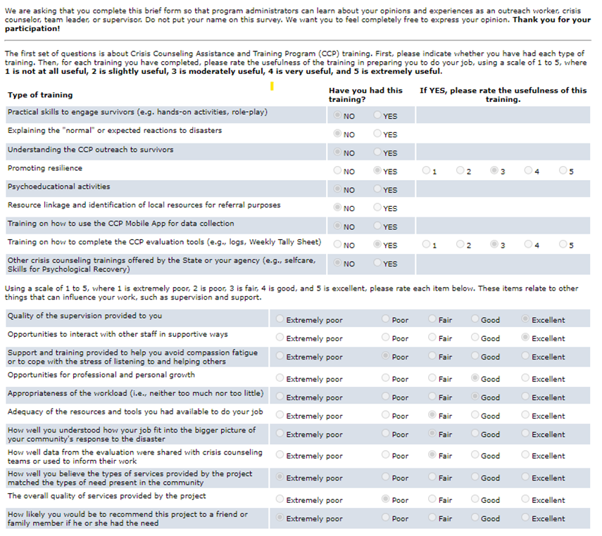
Data Collection Tools (cont.)
Program Evaluation Tools:
  Two feedback forms are administered during the RSP (typically at 6 and 12 months after the disaster).
  These provide feedback to CCP managers on:
    Client perceptions of service quality and personal improvements in functioning
    Perspectives from staff on workload, usefulness of trainings, etc.
Notes:
Explain that the next data collection tools we will discuses are the two feedback surveys. These are introduced during the RSP for evaluation purposes (typically at 6 and 12 months after the disaster).
The information gathered provides feedback to CCP managers about client perceptions of service quality and personal improvements in functioning. Perspectives from the CCP crisis counseling staff are also gathered about the staff’s workload, perceived usefulness of trainings, etc.

Slide 77
Data Collection Tools (cont.)
Participant Feedback Surveys:
  Are used to obtain feedback about the program
  Are conducted twice during an RSP
  Survey all adults receiving individual/family or group crisis counseling
  Provide some data about immediate outcomes of crisis counseling
Notes:
Introduce the Participant Feedback Survey.
Suggested talking points:
This survey captures information about disaster exposure and event reactions that have been experienced. It also measures client perceptions about the CCP services they have received.
Typically, the survey is conducted at 6 and 12 months after the disaster event, which is usually in the second half of the first quarter and at the end of the second quarter of the RSP. Exact timing should be determined in consultation with the assigned SAMHSA Project Officer.
It is recommended that the Participant Feedback Survey packet contain a cover letter, survey, pen, and stamped return envelope. The participants mail the survey back to an identified central location. The provider who distributed the surveys does not collect the surveys.
Briefly review the sections of the surveys:
The first page includes questions to gauge what kinds of services were received and whether those services were helpful.
The second page questions how helpful the CCP was to the recipient and concludes with a section describing the ways in which the respondent was exposed to the disaster.
The third page of the survey collects information on event reactions and provides contact information so the respondents can talk with a crisis counselor about their reactions. It also asks several questions comparing the survivor’s perceptions of how he or she was doing before the disaster and how he or she is doing now. The survey concludes with items on basic demographics, language, and disability status.
Explain how it is administered:
The providers need to keep track of the number of surveys distributed and provide this information to the state CCP evaluation coordinator.
The crisis counselor must be invested in the process and emphasize the importance of the process to the participant. Participants must be convinced that the survey is a serious endeavor. It is their opportunity to identify needs and rate how well the program is meeting those needs.

Slide 78
Data Collection Tools (cont.)
Service Provider Feedback Form:
  It is used to capture crisis counselors’ opinions about their training, resources, supervision, workload, support, and overall quality of the CCP.
  It is collected anonymously from crisis counseling staff around 6 and 12 months after the disaster.
Notes:
Introduce the Service Provider Feedback Form.
Suggested talking points:
This form collects feedback from crisis counselors who provide direct, face-to-face services, and their immediate supervisors (team leaders).
Feedback is collected twice during the CCP, at around 6 and then 12 months after the disaster (typically within the RSP).
Briefly review the sections of the feedback form:
The first section asks staff to evaluate the usefulness of the CCP trainings they have received.
The next section asks staff to evaluate supervision, opportunities for growth, workload, and adequacy of tools provided.
The section that follows is composed of five questions about stress.
The feedback form requires management to include a phone number of someone outside of the chain of supervision whom counselors can call to receive assistance if they are feeling especially stressed.
The final section inquires about demographics and tenure and includes a space to write comments.
Explain how it is administered:
The online forms are disseminated by the state CCP evaluation coordinator and in coordination with templates provided by SAMHSA DTAC.
CCP leadership staff should convey the reasons for and importance of the survey, explaining why high response rate matters.
CCP crisis counseling staff complete the forms online. Paper administration is acceptable only when online administration is not possible.
The feedback is provided anonymously. The crisis counselor’s identity is protected by lack of identifying information, return of the survey to an external evaluator, and aggregation of results.
SAMHSA DTAC will provide the state CCP evaluation coordinator with summary information regarding the results of the survey, but not with the surveys themselves.

Slide 79
Data Collection Tools (cont.)
How will we use data in the RSP?
  Data are used to assess:
    Customer satisfaction
    Worker satisfaction
    Program changes
    Output and outcomes
    Overall trends in the CCP
Are there other ways the data can be used?
Notes:
Facilitate a discussion about how data will be collected and used in the RSP.
Ask specifically—what will change during the RSP about how you collect data?
What will change in the RSP that changes how you use data?
Bring this session to a close and give participants a break before proceeding to the next section on stress management.

Slide 80
Section 5—Stress Management for Staff
  Typical Stressors
  Warning Signs of Excessive Stress
  Organizational Approaches to Stress Management
Notes:
Introduce this session by telling participants that stress management is absolutely crucial in a CCP and something that must be carefully attended to during the longer RSP.
At the core of a CCP are its staff—the program’s success is directly dependent on staff’s ability to regulate their own stress. Particular care needs to be taken to address and process the effects this exposure can have on the crisis counselor.
There are two key elements to stress management—personal stress management and organizational approaches to stress management. The individual must take measures to manage his or her own stress, but the organization must also do its part to support staff and minimize the amount of stress placed upon them.
In this session, we will explore both personal stress management and organizational stress management.

Slide 81
Stress and Compassion Fatigue
Definitions:
Stress: The physiological or psychological response to internal or external stressors. Stress involves changes affecting nearly every system of the body, influencing how people feel and behave.
Compassion Fatigue: The burnout and stress-related symptoms experienced by caregivers and other helping professionals in reaction to working with traumatized people over an extended period of time.
Notes:
Review the APA definitions of stress and compassion fatigue.
https://dictionary.apa.org/stress
https://dictionary.apa.org/compassion-fatigue

Slide 82
Typical Stressors
How stressful are these for you?
  Repeatedly hearing survivors’ distressing stories
  Approaching survivors who may reject help
  Feeling overwhelmed by the sadness of others
  Feeling unable to alleviate the pain of others
  Working long hours
  Having personal experience with the disaster
Notes:
Note that the first step in personal stress management is self-awareness around what causes you stress.
Review the list of typical stressors.
Tell participants that we’re going to poll them about what causes them stress.
Have participants complete the stress management activity in their workbooks (page 50).

Slide 83
Typical Stressors (cont.)
  Activity:
  Imagine a scale running the length of this room.
  Go stand at the point on the scale that represents how stressful this factor is for you.
  Discuss with the others gathered there:
    Why this factor is or isn’t stressful for you
    What you do to manage the stress you do feel from this stimulus
Notes:
Allow participants to opt out of this activity, or take breaks as needed, if they are feeling uncomfortable/overwhelmed discussing their personal stress.
Ask them to imagine a Likert scale (1 to 5, 1 being the lowest, 5 being the highest) running the length of the classroom. Tell them which end of the room represents 1 and which end represents 5 and show them where the middle is.
Choose three stressors from the list on the previous slide.
Read off the first stressor you’ve selected and ask participants to go and stand on which part of the scale fits with how stressed they are by this factor.
For example, if you find it very stressful to hear survivors’ stories, please go stand in the part of the room that represents 5 on the scale. If you find it somewhat stressful, stand in the middle. If you don’t find it stressful at all, go stand in the part of the room that represents 1 on the scale.
Discuss these items with the other people gathered there:
Why this factor is or isn’t stressful for you
What you do to manage the stress you do feel from this stimulus
Ask the groups to quickly share the highlights of their discussion.
Repeat for the second and third stressor.
Ask participants to take their seats again. Transition to talking about warning signs of excessive stress.
Review the warning signs of excessive stress.

Slide 84
Warning Signs of Excessive Stress
  You cannot shake distressing images from your mind.
  Work consumes you at the expense of family and friends.
  You experience an increase in substance use or misuse.
  You are excessively irritable and impatient.
  You exhibit other serious or severe reactions.
Notes:
Suggested talking points:
As with disaster survivors, assessment of crisis counselors hinges on the question of how much stress is too much.
Disaster workers commonly experience many reactions that have limited impact on performance. However, when a number of reactions are experienced simultaneously and intensely, functioning is likely to be impaired. Under these circumstances, the worker should take a break from the disaster assignment for a few hours at first, and then longer, if necessary. If normal functioning does not return, the person needs to discontinue the assignment.
Supervision is essential when a disaster worker’s personal coping strategies are wearing thin.
Suggestions can be made for stress-reduction activities. Usually, stress symptoms will gradually subside when the worker is no longer in the disaster relief environment. However, if this does not occur, then professional mental health and/or substance use disorder assistance is indicated.

Slide 85
Warning Signs of Excessive Stress (cont.)
  Complete the warning signs for excessive stress checklist in your workbook.
  Then complete the personal stress management plan.
  When you’re finished, share your stress management plan with a partner.
Notes:
Have participants fill out the checklist for warning signs of excessive stress and the stress management plan worksheet (page 51).
Ask them to discuss their responses with a partner and identify what positive steps they will take to manage their individual stress level.
Tell them that they don’t have to discuss the warning signs checklist if they don’t want to; that’s for their own personal use.
Give the pairs about 10 minutes to talk. Ask for a few examples from the pairs of specific actions they identified to better manage their stress.
Transition to organizational approaches to stress management.

Slide 86
Organizational Approaches for Stress Management
  Complete the scorecard in your workbook.
  When you’re finished, review the organizational approaches for stress prevention and management table on the next page.
Notes:
Re-emphasize how important it is for program management to pay attention to organizational stress management.
Tell participants that we want to take some time to review the organizational stress management measures the program currently has in place and identify some opportunities for improvement.
Ask them to complete the Organizational Stress Management Scorecard in their workbooks (page 53).

Slide 87
Organizational Approaches to Stress Management (cont.)
  Discuss your scorecard responses.
    On which items did you score the highest? Why?
    On which items did you score the lowest? Why?
  Identify three priority actions to improve organizational stress management.
Notes:
Have participants work in groups to do the following:
Discuss your scorecard responses. On which items did you score the highest, and on which did you score the lowest? Why?
Identify three priority actions to improve organizational stress management.
You may want to assign a specific area for each table to focus on when generating recommendations—e.g., supervision, training, crisis counseling skills.
Make sure that each group has a member of the program management staff in it to hear the conversation firsthand.

Slide 88
Organizational Approaches to Stress Management (cont.)
Group reports:
  One or two items on which we scored the highest and why
  One or two items on which we scored the lowest and why
  Three priority actions to improve organizational stress management
Notes:
Have each group report out on the following things:
The one to two items on which they scored the highest and why.
The one to two items on which they scored the lowest and why.
Their three priority actions.
Chart the actions and give to management for follow-up action.
Bring this session to a close. Segue to the closing team building activity.

Slide 89

Section 6—Team Building Activity
Purpose:
Build the sense of team identity and common vision.
Notes:
Introduce this session by telling participants that it is very important for all the CCP staff to function well as a team during the RSP. One thing that all effective teams have in common is that they have a shared goal and a common vision. We’d like to end this training by engaging in a team building activity that will help to solidify the common goal or vision that you all share.
Review the purpose of this session:
Build the sense of team identity and common vision.

Slide 90
Team Building Activity: Option 1
CCP public service announcement (PSA):
  Develop a 60-second PSA that communicates the contributions the CCP makes.
  Be prepared to deliver your PSA to a live audience!
Notes:
Option 1: Public Service Announcement (PSA)
Divide the participants into small groups (about four to six participants each).
Give the following task instructions:
Develop a 60-second PSA that communicates the contributions the CCP makes.
Be prepared to deliver your PSA to a live audience!
Have each group present their PSA. Lead the group in enthusiastic applause after each PSA is presented.
After all PSAs have been “aired,” ask the group:
What common themes stand out for you?
What does this say to you about your shared vision for the program?

Slide 91
Team Building Activity: Option 2
CCP billboard:
  Design a billboard advertising the CCP.
  Start by determining the three key messages you want to convey about the program.
  Be prepared to present your billboard to the Selection Committee for approval!
Notes:
Option 2: CCP Billboard
Divide the participants into small groups (about four to six participants each).
Give the following task instructions:
Design a billboard advertising the CCP.
Start by determining the three key messages you want to convey about the program.
Be prepared to present your billboard to the Selection Committee for approval!
Have each group present their billboard. Lead the group in enthusiastic applause after each is presented.
After all the billboards have been presented, ask the whole group these questions:
What common themes do you see across the billboards?
What does this say to you about your shared vision for the program?

Slide 92


Transition to RSP Training
Crisis Counseling Assistance and
Training Program (CCP)
Revised 8/2022
Notes:
8/24/2022
Thank participants for their effort and creativity.
Invite the program leadership to make any closing remarks.
Bring this session to a close, and transition to the final section on applying your learning and course evaluation.

