Slide 1


Crisis Counseling Assistance and
Training Program (CCP)
Regular Services Program (RSP)
Phasedown Training
Revised 2/2013

Slide 2
Introductions
Please introduce yourself by sharing the following:
  Your name
  Your role or position in the CCP
  One thing you have appreciated about being a part of this CCP

Slide 3
Objectives
After this training, participants will be able to do the following:
  Identify the issues associated with phasedown.
  Identify remaining survivor and community needs.
  Implement strategies to address remaining needs.
  Identify strategies to address staff needs related to phasedown.
  Adapt public education and media messaging for phasedown.
  Describe the CCP’s legacy for survivors, the community, and the staff.
  Help develop a written phasedown plan.
  Assist with the preparation of the CCP Final Report.

Slide 4
Agenda
Morning
Welcome and Introductions
Objectives and Agenda
Section 1: Phasedown Components
Section 2: Assessing and Addressing Remaining Survivor Needs
Break
Section 3: Assessing and Addressing Staff Needs
Afternoon
Section 4: Revising Public Education and Media Plans
Section 5: Leaving a Legacy
Break
Section 6: Program Final Report
Section 7: Phasedown Plan
Applying Your Learning and Course Evaluation

Slide 5
Guidelines for Working Together
  Keep time (start on time, return from breaks on time, end on time).
  Switch mobile phones off or to “vibrate.”
  Participate fully.
  Ask questions freely.
  Balance talking and listening.
  Respect each other’s points of view.

Slide 6
Section 1—Phasedown Components
Phase of Disaster
Key Concepts

Slide 7
Session Objective
  Identify the issues associated with phasedown.

Slide 8
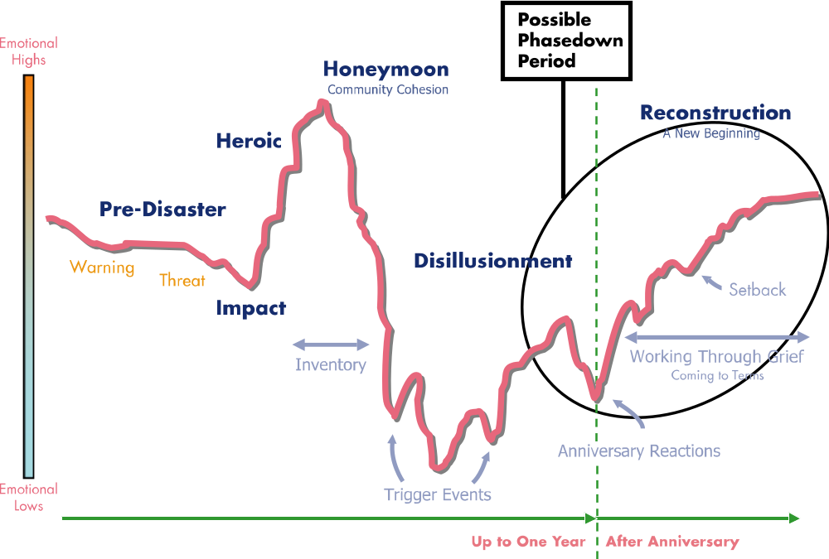
Phase of Disaster
What phase of the disaster are you in?
Source: Zunin/Meyers, as cited in U.S. Department of Health and Human Services. (2000). Training manual for mental health and human service workers in major disasters (DHHS Publication 90–538). Washington, DC: U.S. Department of Health and Human Services, Substance Abuse and Mental Health Services Administration , Center for Mental Health Services.

Slide 9
Key Concepts
The CCP should:
  Support, but not replace, community infrastructure.
  Transition services to local organizations.
  Facilitate community ownership of meeting the needs of survivors.

Slide 10
Key Concepts (cont.)
  Revise public education and media plans to reflect phasedown efforts.
  Use public education and media messaging to deliver a message of hope, recovery, and resilience for individuals and the community.
  Prepare individuals, community, and staff for program phasedown.

Slide 11
Section 2—Assessing and Addressing Remaining Survivor Needs
Assessing and Addressing Individual Needs
Assessing and Addressing Community Needs
Identifying Community Service Capacity

Slide 12
Session Objectives
  Identify remaining survivor and community needs.
  Implement strategies to address remaining needs.

Slide 13
Assessing and Addressing Individual Needs
  How many individuals are we still serving?
  How many of these individuals need referrals to existing services?
  How will we identify existing services and make referrals?
  How will we transition them to existing services?
  How will we determine when an individual will not need referral?
  How will we handle newly identified survivors who may request services?

Slide 14
Assessing and Addressing Individual Needs (cont.)
Crisis counselors should:
  Help survivors reflect on the progress they have made.
  Assist survivors in reflecting on the coping skills that have been most useful.
  Encourage survivors to continue to set and prioritize goals.
  Use public education and media messaging to promote a message of hope, recovery, and resilience.

Slide 15
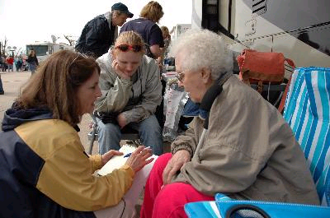
Assessing and Addressing Individual Needs (cont.)
  Ensure that survivors are aware of existing services and knowledgeable about referral mechanisms.
  Continue to utilize public messaging and distribution of educational materials to communicate how to access resources.
  Engage survivors in assessing their need for substance abuse and mental health services.

Slide 16
Assessing and Addressing Community Needs
Discuss experiences, and analyze data collected in order to:
  Determine populations and areas with remaining needs.
  Identify special populations with remaining needs.
  Identify those who are in need but have not accepted services.

Slide 17
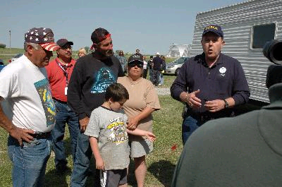
Assessing and Addressing Community Needs (cont.)
  Inform the community about the project phasedown.
  Inform community service providers of the transitioning of services.
  Enhance community-resilience activities and distribution of educational materials.

Slide 18
Assessing and Addressing Community Needs (cont.)
  Meet with community organizations to provide opportunities for partnerships and lasting relationships.
  Participate in community events that support recovery and resilience.
  Plan a public messaging campaign that:
    Announces the project phasedown, while emphasizing the completion of the goals by the time-limited CCP
    Acknowledges progress toward recovery
    Provides information about available community resources

Slide 19
Identifying Community Service Capacity
  Reengage behavioral health providers to identify available services and educate them about survivor behavioral health needs.
  Reengage local disaster-related organizations, including faith-based groups, to identify available services and inform them of remaining survivor needs.
  Ensure there is a mechanism available to the public to access needed services, such as a local hotline.
  Inform individuals and community groups about available resources once the CCP has ended through public education and media messaging.

Slide 20
Working Group Task Slide
  Choose the topic you are most interested in: individual needs, community needs, community service capacity.
  Each working group will have three or four questions to discuss—see the questions listed in your workbook.
  You’ll have 30 minutes for your discussion.
  Choose a facilitator to guide the discussion, a recorder to capture key points, and a reporter to present highlights and actions items.

Slide 21
Section 3—Assessing and Addressing Staff Needs
Assessing Staff Needs
Addressing Staff Needs

Slide 22
Session Objective
  Identify strategies to address staff needs related to phasedown.

Slide 23
Assessing Staff Needs
Consider the following:
  Separation from valued work
  Ending of relationships with disaster survivors and coworkers
  Decreased morale as the program comes to an end
  Job loss and new job search
  Returning to non-disaster work
  Stress related to disaster work and phasedown

Slide 24
Assessing Staff Needs (cont.)
  What personal concerns do you have about the ending of the project?
  What are your needs as the project comes to a close?
  Make notes on the worksheet in your workbook.

Slide 25
Table Task
  Consider the list of concerns and needs generated.
  What recommendations do you have for program management?
    Brainstorm a list of recommendations.
    Choose two or three to report back.

Slide 26
Addressing Staff Needs
  Ensure that staff are aware of the project end date.
  Provide organized opportunities for staff to share experiences and accomplishments.
  Connect staff with employment resources (e.g., résumé writing or job search workshops).
  Provide references for new jobs.
  Arrange for events or ceremonies to recognize program and staff achievements.
  Encourage staff to continue stress management and self-care.

Slide 27
Section 4—Revising Public Education and Media Plans
Assessing and Revising Public Education Strategies
Assessing and Revising the Media Plan
Developing Talking Points

Slide 28
Session Objective
  Adapt public education and media messaging for phasedown.

Slide 29
Assessing and Revising Public Education Strategies
  What community leaders and groups need to be educated about phasedown?
  What strategies should be used to reach them?
  What are the messages we want to convey?
  How will we convey these messages through public education?

Slide 30
Assessing and Revising the Media Plan
  What is the current media plan?
  What messages have been conveyed?
  What messages need to be conveyed during phasedown?
  Who should be involved in developing and implementing the revised plan?

Slide 31
Developing Talking Points
Talking points should convey:
  Information about availability of CCP services
  Information about phasedown and transitioning of services with announcement of end date
  Education about the status of community recovery with an emphasis on resilience and hope
  Highlights of program successes through survivor stories
  Cultural sensitivity

Slide 32
Working Group Sessions
  Choose which topic you want to discuss: public education, media plan, or talking points.
  The questions to be addressed by each working group are listed in your workbook.
  You have 30 minutes for your discussion.
  Identify a facilitator to guide the discussion, a recorder to capture the key points on a tear sheet, and a reporter to present the highlights.

Slide 33
Section 5—Leaving a Legacy
What Is a Legacy?
Legacy for Survivors
Legacy for the Community
Personal Legacy
Legacy for Staff
Strategies for Leaving a Legacy

Slide 34
Session Objective
  Describe the CCP’s legacy for survivors, the community, and the staff.

Slide 35

What Is a Legacy?
  What does “legacy” mean?
  Whom is the legacy meant to affect?
  What are some tangible expressions of the legacy?

Slide 36
Legacy for Survivors and the Community
For the group assigned to your table—either survivors or the community—discuss:
  What is the legacy of this program for them?

Slide 37
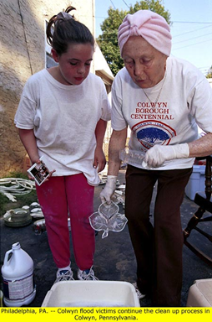
Legacy for Survivors
  Understanding of the behavioral health effects of disaster
  Improved coping skills
  Knowledge of community resources
  Skills to access existing supports
  The establishment of personal rituals

Slide 38
Legacy for the Community
  A cadre of staff trained in disaster behavioral health response
  A more collaborative provider network
  A community that is better educated about disasters and their behavioral health effects
  Enhanced resilience
  Established rituals and commemorations
  Community organizations better informed about survivors’ practical needs

Slide 39
Personal Legacy
  Individually, reflect on:
  What have I done to leave a legacy?
  What would I like to do before the CCP is done?
  Find a partner and share your responses with him or her.

Slide 40
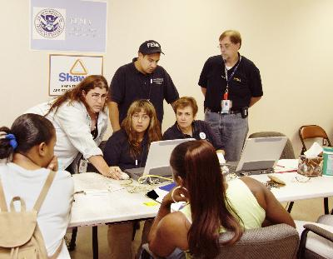
Legacy for Staff
  Improved skills
  Sense of satisfaction and self-worth
  Improved coping and stress management skills
  Community connections
  Job opportunities

Slide 41
Strategies for Leaving a Legacy
  Create public health messages about recovery, social support, and hope.
  Leave educational materials and self-help resources with community partners.
  Include analysis of data and program best practices in the CCP Final Report.
  Provide training and consultation to health providers, educators, and community leaders.

Slide 42
Strategies for Leaving a Legacy (cont.)
  Maintain a database of trained crisis counselors and partner agencies for use in future disasters.
  Encourage low-cost or no-cost community projects and collaborations that can continue in an in-kind capacity.
  Determine if the hotline or helpline can continue to handle information and referrals.

Slide 43
Section 6—Final Program Report
Why Is This Report Important?
Strategies for Contributing to the Report

Slide 44
Session Objective
  Assist with preparation of the CCP Final Report.

Slide 45
Why Is This Report Important?
A comprehensive CCP Final Report:
  Tells the story of the disaster and the CCP
  Identifies program highlights, accomplishments, and best practices
  Documents programmatic and fiscal accountability
  Provides recommendations to state and federal staff
  Is an essential part of the legacy of the CCP
  Becomes a public document

Slide 46
Strategies for Contributing to the Report
  The Final Report should “tell the story of the CCP.”
  Include information about the state and all service providers.
  Involve local provider staff in compiling the data and creating the “story.”
  The Final Report should reflect the activities and accomplishments of the entire program.
  Include information on program phasedown and legacy.

Slide 47
Strategies for Contributing to the Report (cont.)
  Be familiar with the Final Report format.
  Incorporate the vision of the program by:
    Identifying its greatest accomplishments
    Describing challenges and how they were overcome
    Reflecting on how the community has benefited from the program

Slide 48
Strategies for Contributing to the Report (cont.)
  Discuss and document:
    Program vision and accomplishments
    Survivor success stories
    Community success stories
    Challenges and how they were addressed
    Program best practices
    Personal achievements of staff

Slide 49
Planning to Contribute to the Final Report
For your group’s topic area, brainstorm one of the following:
  Key points for that section of the Final Report
  Actions to take to gather the information needed for that section of the report
  Other instructions:
  Take 10 minutes for your discussion.
  Be prepared to report out to the rest of the group.
  Record your ideas on a tear sheet.

Slide 50
Section 7—Phasedown Plan
Role of Managers
Role of Crisis Counselors
Developing a Phasedown Plan
Communicating and Implementing the Phasedown Plan

Slide 51
Session Objective
  Help develop a written phasedown plan.

Slide 52
Role of Managers
Managers should:
  Analyze program data and assess provider activity to determine when to begin the formal phasedown process.
  Elicit crisis counselor feedback on the status of survivor and community recovery.
  Consider an early phasedown if there is a greatly reduced need.
  Revise outreach and service-delivery approaches to accomplish phasedown.
  Adjust staffing levels according to remaining need.

Slide 53
Role of Managers (cont.)
  Prepare the hotline/helpline for phasedown, and determine availability after phasedown.
  Ensure that media messaging is appropriate to phasedown.
  Clearly communicate the end date of the program.
  Prepare final provider reports.

Slide 54
Role of Crisis Counselors
Crisis counselors should:
  Further identify survivor needs and available local resources.
  Participate in unmet-needs or long-term care committee meetings.
  Develop strategies for addressing continued service needs of survivors and special populations.
  Prepare community organizations for transition of services from the CCP.
  Continue distribution of educational and informational materials.
  Adjust media messaging to reflect phasedown.
  Prepare hotline staff for phasedown.

Slide 55

Developing a Phasedown Plan
The phasedown plan should address:
  Remaining survivor needs
  Remaining community needs
  Remaining needs of the staff and staffing issues
  Strategies to address these needs
  Final media messaging and public education
  Final reporting activities

Slide 56
Communicating and Implementing the Phasedown Plan
  How should the phasedown plan be communicated to staff and other community stakeholders?
  How can the CCP ensure effective implementation of the plan?

Slide 57
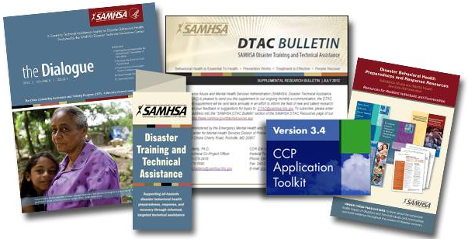
Substance Abuse and Mental Health Services Administration (SAMHSA) Disaster Technical Assistance Center (DTAC)
SAMHSA DTAC supports SAMHSA’s efforts to prepare states, territories, and local entities to deliver an effective behavioral health response during disasters.
  Toll-Free: 1-800-308-3515
  E-mail: DTAC@samhsa.hhs.gov
  Web: http://www.samhsa.gov/dtac

