Slide 1
Urgent and Emerging Issues in Prevention:
Marijuana, Kratom, E-cigarettes
Elinore F. McCance-Katz, MD, PhD
Assistant Secretary for Mental Health and Substance Use
Substance Abuse and Mental Health Services Administration
U.S. Department of Health and Human Services
SAMHSA Prevention Day 2019

Slide 2
Preventionists-Key to the Health and Welfare of Americans
Opioids crisis continues, but with evidence for positive effects of government efforts in partnership with states, communities, organizations
Ongoing work of preventionists, clinicians, peers, first responders, faith-based groups, volunteers, families
  Major decline in heroin initiates in 2017
  Large increases in naloxone distribution, overdose reversals
Prevention becomes even more important as we watch the unfolding story of the impact of substance use on American communities
Preventionists: the first line in addressing the risks presented by substance use in our communities
Increased focus on potential harms of substances
Raise awareness of risks with substance use
Community outreach to youth as well as adults

Slide 3
Substances of Increasing Importance: Marijuana, Kratom and E-cigarettes (Nicotine)
Marijuana/cannabis:
  Increasing prevalence of use
  Increasing understanding of risks associated with use
  Public lack of information on these risks
Opioids Issues:
Fentanyl-Contaminated Cocaine
Kratom
  Botanical that at low doses produce stimulation and at higher doses produce opioid effects
  Potential for physical dependence and opioid-type effects/toxicities
  Marketed in Western countries and increasing use/toxicities being reported
E-cigarettes
  Vaping: heating and aerosolizing nicotine for inhalation
  Nicotine is addictive and has adverse health effects
  In 2017 e-cigs were the most commonly used nicotine product among high (11.7%; 1.73 million) and middle (3.3%; 0.39 million) school students.
Notes:
E cigs more widely used than cigarettes?

Slide 4
Marijuana: The Issue
Marijuana is rapidly becoming more widely available in the U.S.
  33 states: allow medical marijuana with reduced penalties for possession; 9 states plus DC have legalized recreational use
  Huge and profitable industry that markets heavily with health claims that have little to no basis and which have had virtually no counter arguments put forward until the present time
    Numerous forms: smoked, edibles, oil for vaping, lotions, transdermal patches

Slide 5
Marijuana: The Issue
Increasing potency of marijuana:
  THC content: 3.8% (1990s) increased to 12.2% (2014)
  Average MJ extract has THC levels at > 50%
  THC: component responsible for euphoria/intoxication
  Can also produce anxiety, agitation, paranoia, and psychosis
  Responsible for addiction liability with estimates that 10-20% of users will develop a use disorder (Volkow ND et al. 2016)
Declining CBD content in currently available MJ
  Not thought to be addictive
  May reduce psychosis
  Medical value: FDA approved for certain seizure disorders (Ehsoly MA et al. 2016)
Notes:
Add reference for THc content and extract THC content

Slide 6
Risks and Adverse Outcomes
Downplayed by industry; ignored by states
  Low birth weight
  Pulmonary symptoms
  MVAs
  Cognitive impairment
  Poor performance in school and at work
  Addiction

Slide 7
What Happens as State Laws Liberalize?
Past Year Marijuana Use among Persons Aged 12 or Older Residing in States with No Legalization of Marijuana, by State: Percentages and Estimated Numbers (in Thousands), Annual Averages Based on 2012-2013, 2013-2014, 2014-2015, and 2015-2016 NSDUHs
Range: 9-13%
State | Effective Date | 2012-13 Percentages | 2012-13 Numbers | 2013-14 Percentages | 2013-14 Numbers | 2014-15 Percentages | 2014-15 Numbers | 2015-16 Percentages | 2015-16 Numbers
Alabama | N/A | 9.69% | 389 | 9.98% | 404 | 9.60% | 389 | 9.50% | 386
Georgia | N/A | 11.44% | 925 | 11.75% | 963 | 12.67% | 1,052 | 12.46% | 1,048
Idaho | N/A | 9.82% | 127 | 11.58% | 152 | 11.40% | 152 | 11.62% | 158
Indiana | N/A | 11.05% | 598 | 12.86% | 700 | 13.88% | 760 | 13.35% | 733
Iowa | N/A | 10.40% | 266 | 9.74% | 251 | 9.05% | 235 | 9.75% | 254
Kansas | N/A | 8.21% | 192 | 11.01% | 259 | 12.38% | 292 | 11.17% | 265
Kentucky | N/A | 9.22% | 334 | 10.93% | 398 | 12.28% | 449 | 12.79% | 470
Louisiana | N/A | 10.76% | 405 | 11.23% | 425 | 11.22% | 427 | 11.22% | 429
Mississippi | N/A | 8.78% | 213 | 9.40% | 229 | 8.67% | 212 | 9.46% | 231
Missouri | N/A | 11.64% | 581 | 12.73% | 639 | 13.53% | 683 | 13.19% | 668
Nebraska | N/A | 9.98% | 152 | 10.35% | 158 | 10.75% | 166 | 11.33% | 176
North Carolina | N/A | 10.88% | 877 | 12.07% | 986 | 11.79% | 975 | 11.90% | 996
North Dakota | N/A | 9.92% | 58 | 10.25% | 62 | 9.90% | 61 | 9.80% | 61
Oklahoma | N/A | 9.97% | 310 | 10.75% | 338 | 11.28% | 358 | 11.18% | 357
South Carolina | N/A | 11.72% | 460 | 11.55% | 460 | 12.56% | 507 | 10.92% | 448
South Dakota | N/A | 9.64% | 66 | 8.97% | 62 | 10.77% | 75 | 11.85% | 83
Tennessee | N/A | 9.93% | 535 | 10.29% | 560 | 11.05% | 606 | 12.82% | 709
Texas | N/A | 9.38% | 1,972 | 9.52% | 2,043 | 10.10% | 2,213 | 10.14% | 2,264
Utah | N/A | 8.76% | 196 | 9.84% | 224 | 9.07% | 211 | 9.62% | 229
Virginia | N/A | 12.39% | 839 | 13.04% | 891 | 11.54% | 796 | 11.06% | 768
West Virginia | N/A | 10.12% | 159 | 10.93% | 172 | 11.07% | 174 | 11.45% | 179
Wisconsin | N/A | 11.12% | 534 | 11.86% | 572 | 12.05% | 584 | 12.18% | 592
Wyoming | N/A | 10.11% | 48 | 10.72% | 51 | 10.87% | 52 | 10.62% | 51

Slide 8
What Happens as State Laws Liberalize?
Past Year Marijuana Use among Persons Aged 12 or Older Residing in States with Legal Medical Marijuana Use Only, by State: Percentages and Estimated Numbers (in Thousands), Annual Averages Based on 2012-2013, 2013-2014, 2014-2015, and 2015-2016 NSDUHs
Range: 11-21.8%
State | Effective Date | 2012-13 Percentages | 2012-13 Numbers | 2013-14 Percentages | 2013-14 Numbers | 2014-15 Percentages | 2014-15 Numbers | 2015-16 Percentages | 2015-16 Numbers
Arizona | Nov 2, 2010 | 12.94% | 699 | 13.69% | 752 | 13.12% | 734 | 12.22% | 696
Arkansas | Nov 9, 2016 | 9.69% | 235 | 11.37% | 277 | 11.59% | 284 | 11.14% | 274
Connecticut | Oct 1, 2012 | 14.00% | 425 | 14.00% | 427 | 15.67% | 479 | 15.08% | 461
Delaware | Jul 1, 2011 | 13.97% | 108 | 13.98% | 109 | 13.06% | 103 | 13.18% | 105
Florida | Jan 3, 2017 | 11.43% | 1,885 | 11.87% | 1,990 | 12.59% | 2,152 | 13.07% | 2,275
Hawaii | Dec 28, 2000 | 13.37% | 151 | 12.58% | 144 | 12.72% | 147 | 13.05% | 151
Illinois | Jan 1, 2014 | 11.66% | 1,247 | 12.16% | 1,305 | 12.47% | 1,339 | 12.31% | 1,320
Maryland | Jun 1, 2014 | 11.47% | 565 | 13.48% | 670 | 15.13% | 757 | 15.50% | 779
Michigan | Dec 4, 2008 | 15.22% | 1,268 | 15.60% | 1,304 | 15.10% | 1,266 | 15.68% | 1,317
Minnesota | May 30, 2014 | 11.93% | 536 | 12.22% | 553 | 12.69% | 579 | 12.91% | 592
Montana | Nov 2, 2004 | 15.78% | 134 | 14.07% | 120 | 15.38% | 133 | 18.41% | 160
New Hampshire | Jul 23, 2013 | 15.39% | 175 | 16.95% | 194 | 17.35% | 199 | 17.58% | 202
New Jersey | Jul 1, 2010 | 10.18% | 759 | 11.25% | 844 | 11.86% | 894 | 12.01% | 907
New Mexico | Jul 1, 2007 | 15.09% | 257 | 15.61% | 267 | 14.72% | 253 | 15.83% | 272
New York | Jul 5, 2014 | 14.13% | 2,342 | 14.24% | 2,372 | 15.04% | 2,519 | 14.86% | 2,491
Ohio | Sep 8, 2016 | 12.81% | 1,237 | 11.57% | 1,122 | 12.13% | 1,179 | 13.81% | 1,344
Pennsylvania | May 17, 2016 | 11.33% | 1,223 | 11.70% | 1,265 | 12.35% | 1,339 | 13.05% | 1,415
Rhode Island | Jan 3, 2006 | 20.22% | 181 | 18.95% | 170 | 18.81% | 170 | 20.31% | 184
Vermont | Jul 1, 2004 | 19.10% | 104 | 19.97% | 108 | 20.50% | 111 | 21.79% | 118

Slide 9
What Happens as State Laws Liberalize?
Past Year Marijuana Use among Persons Aged 12 or Older Residing in States with Legal Medical and Recreational Marijuana Use, by State: Percentages and Estimated Numbers (in Thousands), Annual Averages Based on 2012-2013, 2013-2014, 2014-2015, and 2015-2016 NSDUHs
Range: 13-25%
State | Effective Date | 2012-13 Percentages | 2012-13 Numbers | 2013-14 Percentages | 2013-14 Numbers | 2014-15 Percentages | 2014-15 Numbers | 2015-16 Percentages | 2015-16 Numbers
Alaska | Feb 24, 2015 | 19.69% | 114 | 19.60% | 114 | 21.92% | 127 | 23.00% | 134
California | Nov 9, 2016 (revised penalties) | 13.89% | 4,384 | 14.49% | 4,633 | 15.25% | 4,936 | 16.23% | 5,296
Colorado | Dec 10, 2012 (revised penalties); Jan 1, 2014 (commercial sales) | 18.92% | 814 | 20.74% | 909 | 23.09% | 1,033 | 23.12% | 1,057
District of Columbia | Feb 26, 2015 | 21.02% | 116 | 21.70% | 121 | 23.51% | 134 | 24.68% | 143
Maine | Jan 30, 2017 (grow and possess) | 16.24% | 186 | 19.55% | 224 | 19.69% | 227 | 19.81% | 228
Massachusetts | Dec 15, 2016 | 15.57% | 885 | 17.23% | 989 | 18.26% | 1,058 | 18.64% | 1,088
Nevada | Jan 1, 2017 | 14.10% | 324 | 13.01% | 304 | 12.95% | 309 | 13.13% | 319
Oregon | Mar 29, 2016 | 19.03% | 630 | 19.39% | 649 | 19.42% | 659 | 22.70% | 783
Washington | Dec 6, 2012 | 17.48% | 1,008 | 18.92% | 1,105 | 17.49% | 1,037 | 18.93% | 1,140

Slide 10
Illicit Drug Use Impacts Millions: Marijuana Most Widely Used Drug
10
PAST YEAR, 2017, 12+
Prescription opioids, sedatives, tranquilizers, stimulants
20.1
MILLION
People aged 12 or
older had a substance use disorder
0%
2%
4%
6%
8%
10%
12%
14%
16%

Slide 11
How did we get to where we are and what does the data tell us about ongoing risks?

Slide 12
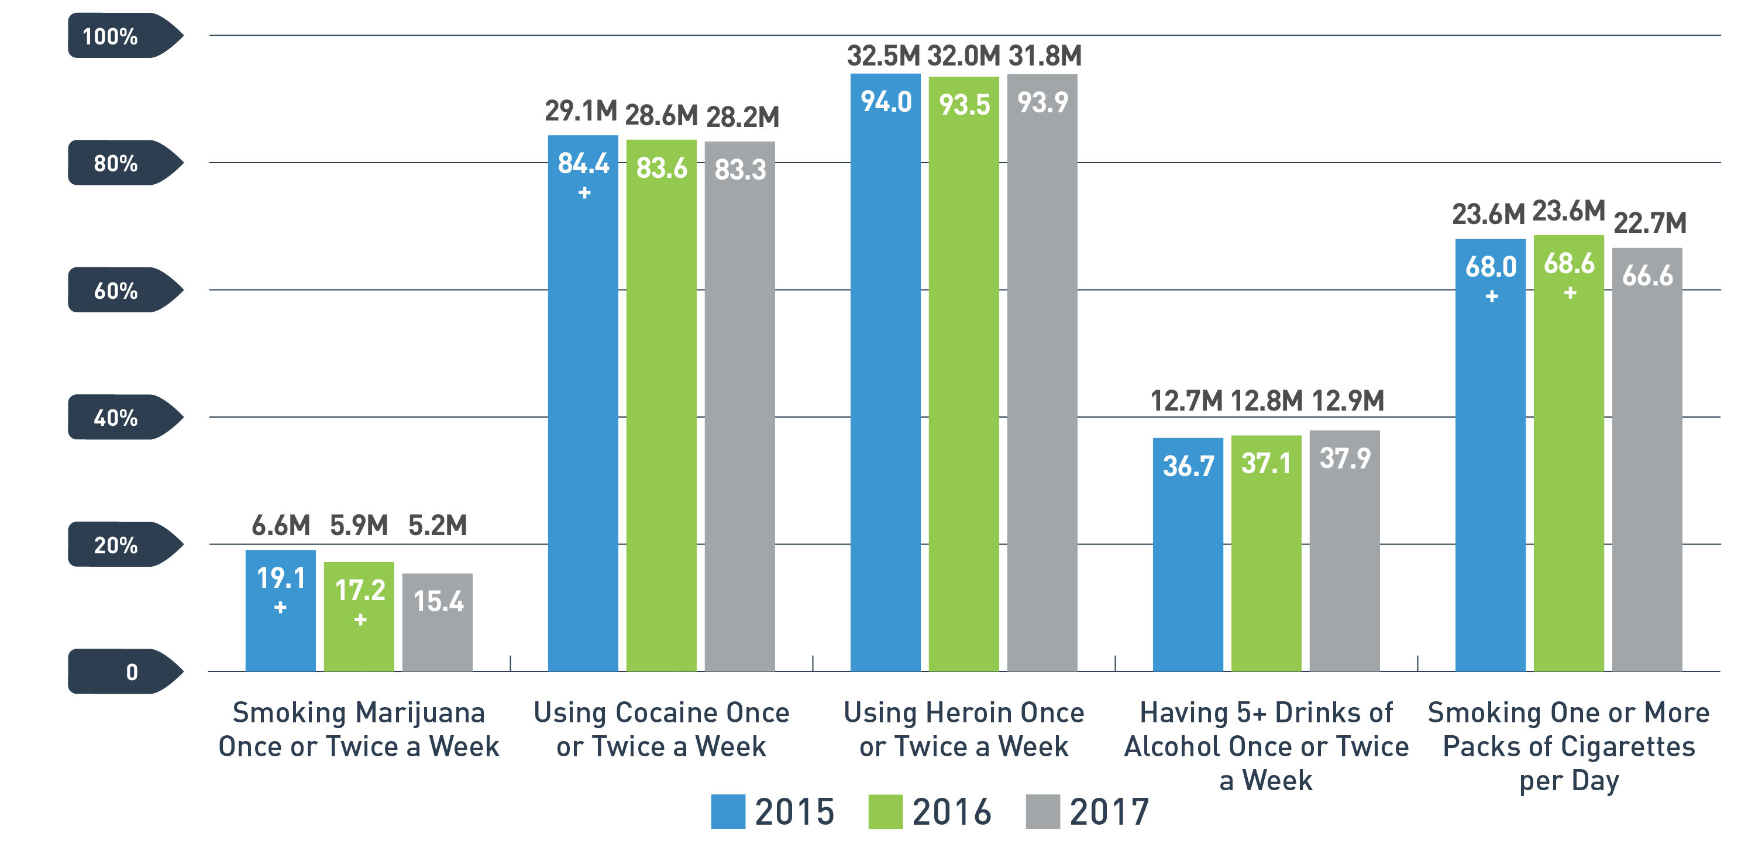
Young Adult Perceptions of Great Risk of Harm From Substance Use
PAST YEAR, 2015 - 2017, 18-25
+ Difference between this estimate and the 2017 estimate is statistically significant at the .05 level.
See table 3.1 in the 2016 and 2017 NSDUH detailed tables for additional information.

Slide 13
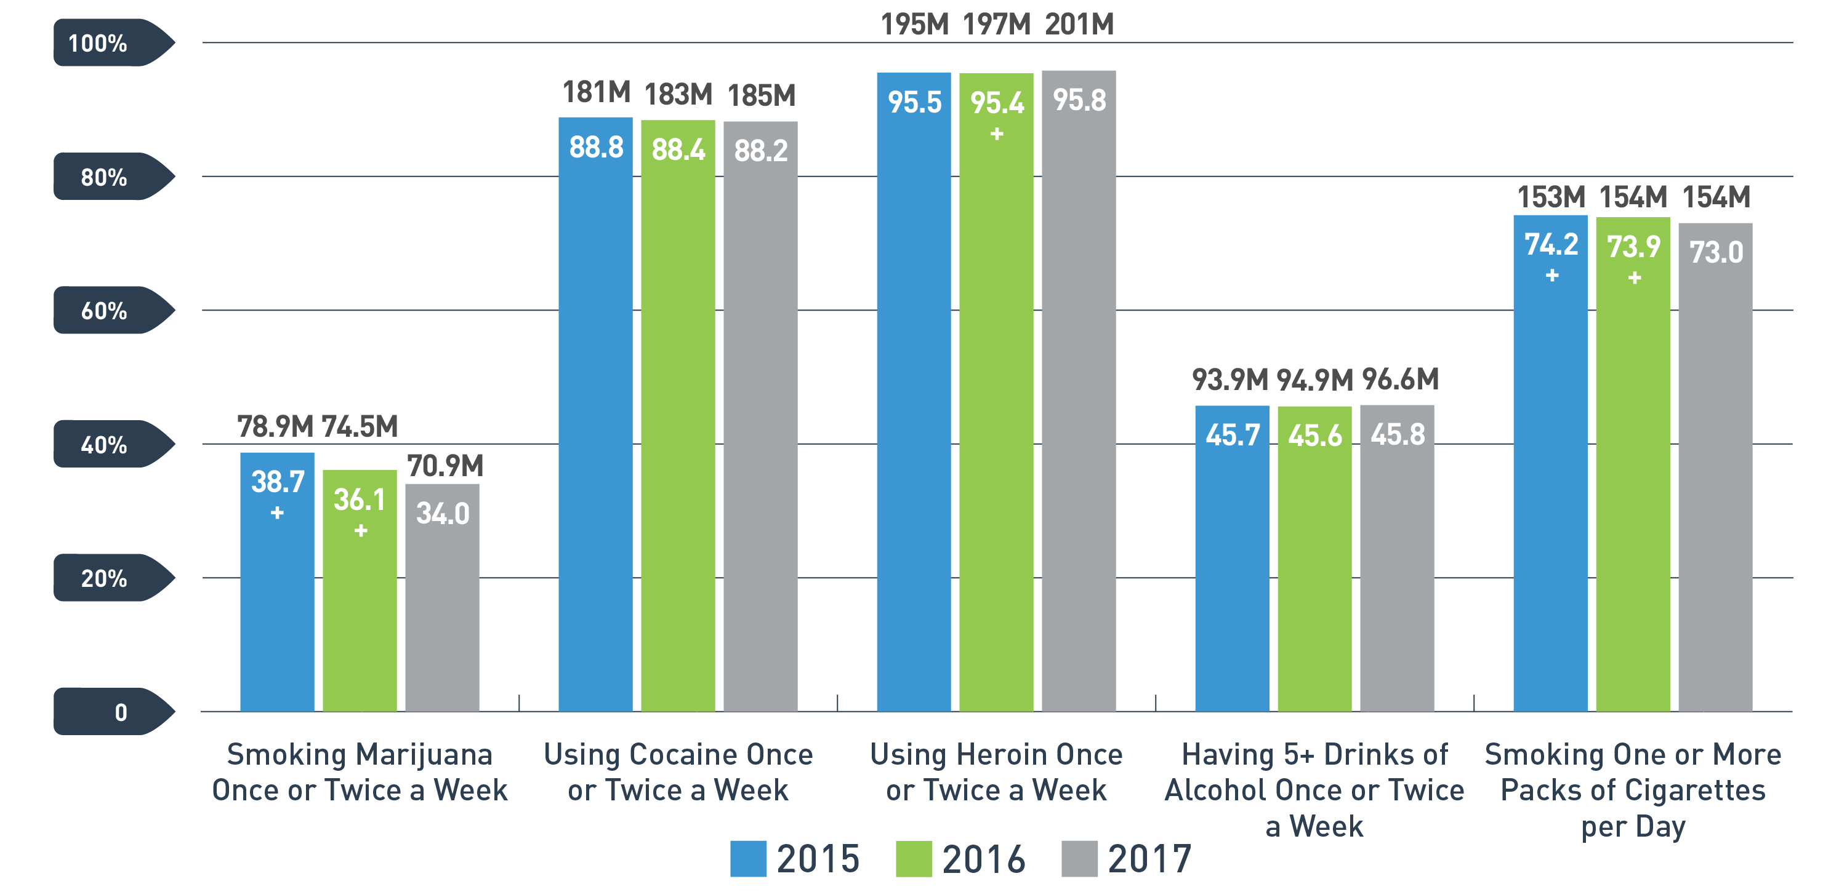
Perceptions of Great Risk of Harm From Substance Use Among Adults Aged 26 or Older
PAST YEAR, 2015 - 2017, 26+
+ Difference between this estimate and the 2017 estimate is statistically significant at the .05 level.
See table 3.1 in the 2016 and 2017 NSDUH detailed tables for additional information.

Slide 14
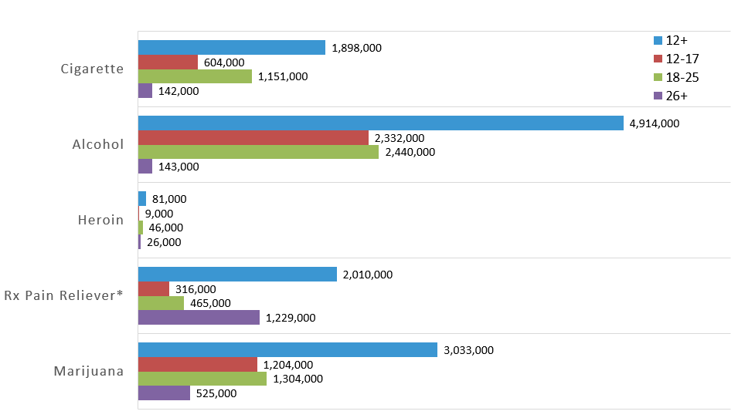
Past Year Initiates, Age Group & Substance
PAST YEAR, 2017, 12+
* Initiation of misuse

Slide 15
Marijuana Use Is Increasing in the U.S.
Since 2007, past year marijuana use has increased 37%
Frequent marijuana use (using ≥ 200 days in the past year) increased 37% since 2002
Nearly 1 in 3 people using marijuana in 2016 reported using ≥ 200 days in the past year
Source: Jones CM Analysis of the NSDUH 2002-2016 Public Use Files

Slide 16
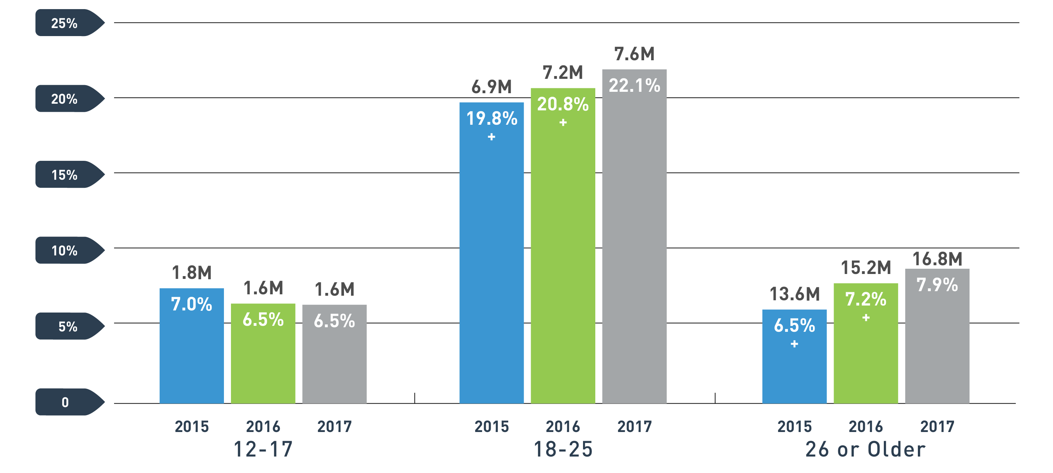
Marijuana Use
PAST MONTH, 2015 - 2017, 12+
See figure 13 in the 2017 NSDUH Report for additional information.
+ Difference between this estimate and the 2017 estimate is statistically significant at the .05 level.
Notes:
Add the numbers above the bars
Response: Added the numbers above the bars and indicators of significant differences.

Slide 17
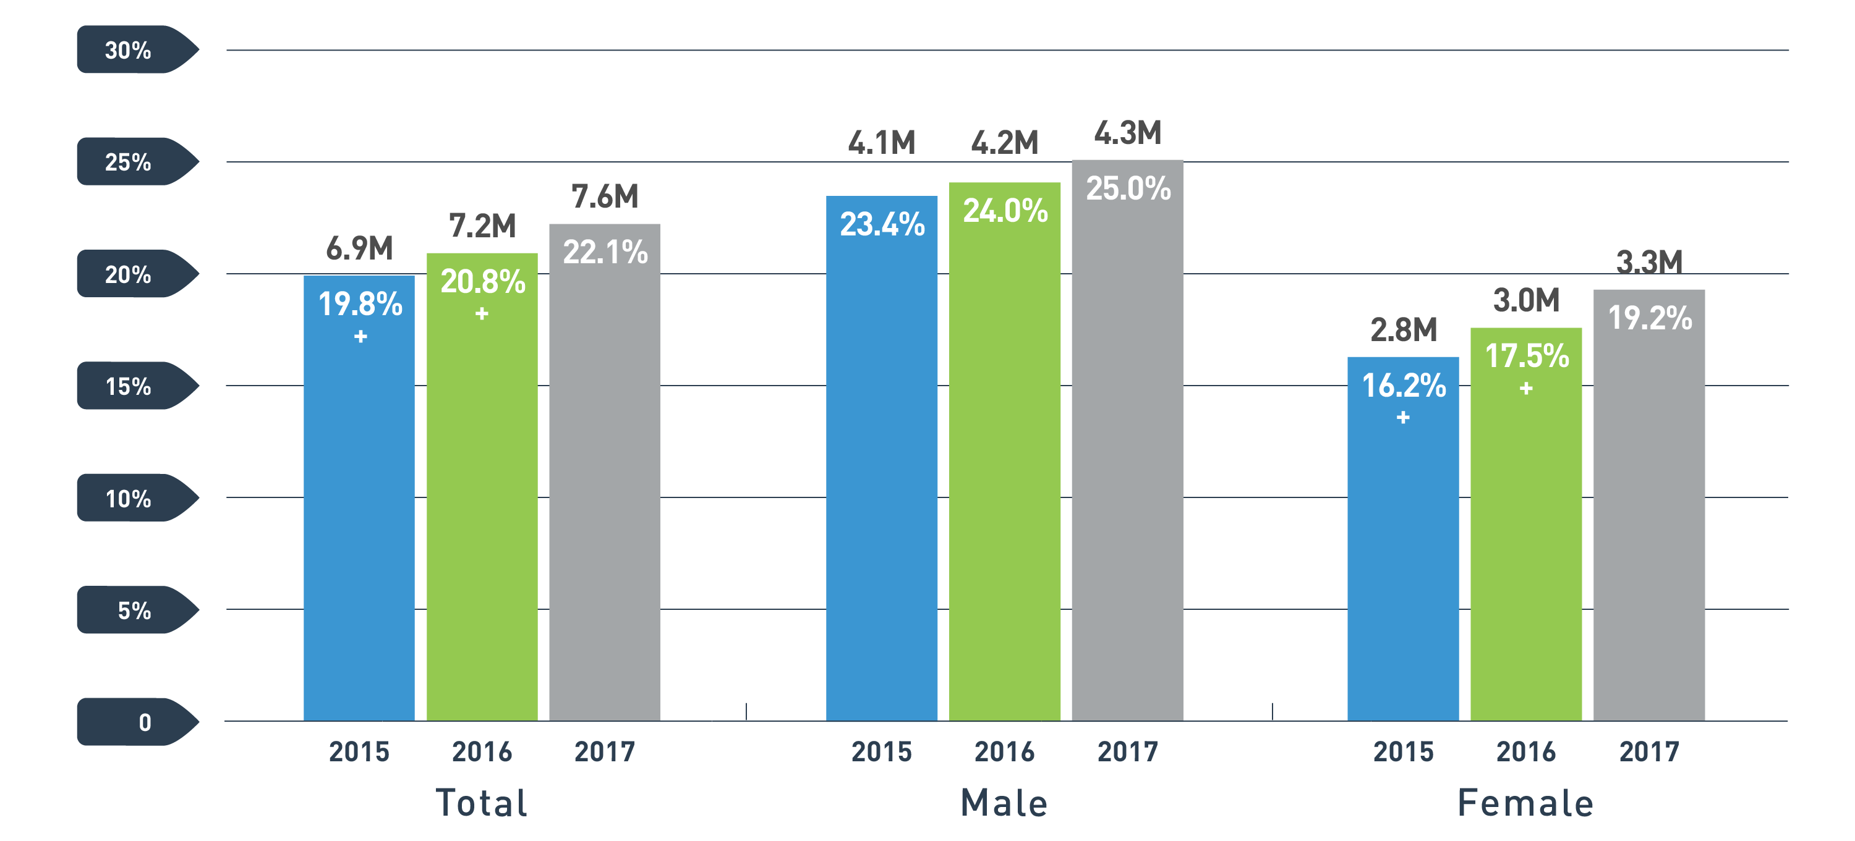

Marijuana Use among Young Adults: Significant Increases in Women
PAST MONTH, 2015 - 2017, 18 - 25
Special analysis of the 2017 NSDUH Report.
+ Difference between this estimate and the 2017 estimate is statistically significant at the .05 level.

Slide 18
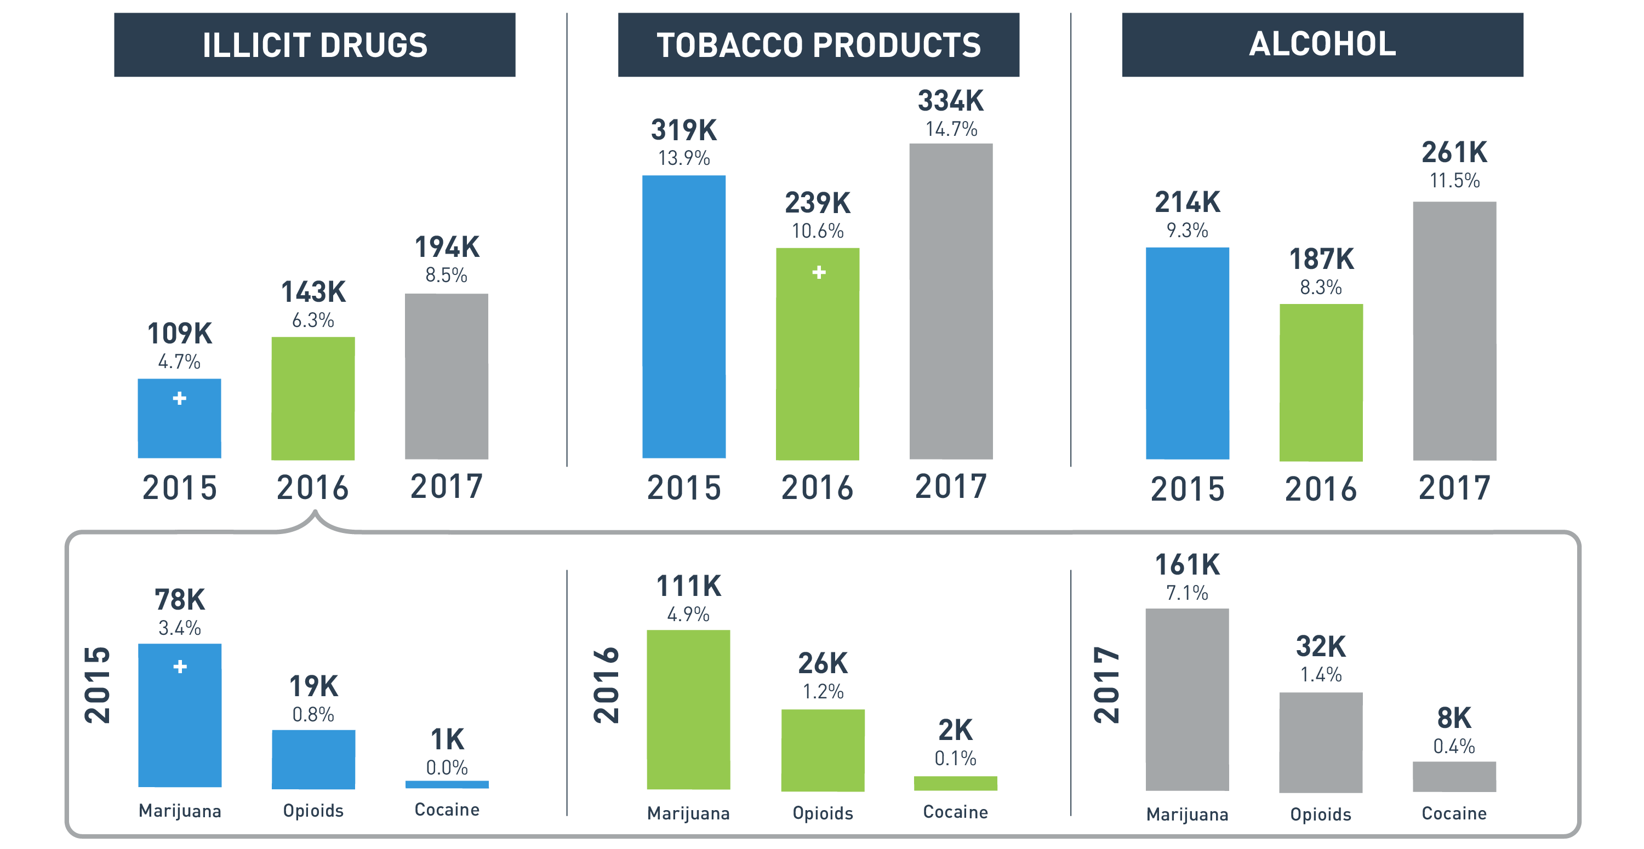
Substance Use in Past Month Among Pregnant Women
PAST MONTH, 2015 - 2017, 15 - 44
Special analysis of the 2017 NSDUH Report.
+ Difference between this estimate and the 2017 estimate is statistically significant at the .05 level.

Slide 19
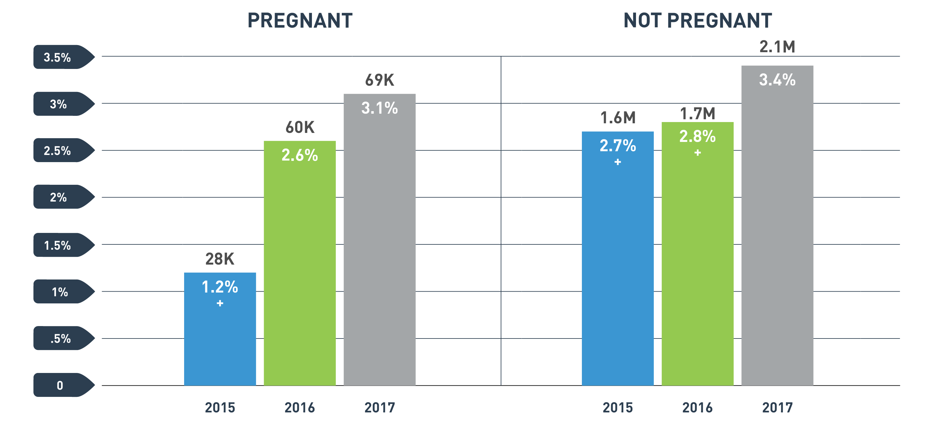
Daily or Almost Daily Marijuana Use among Women by Pregnancy Status
PAST YEAR, 2015 - 2017, 15 - 44
Special analysis of the 2017 NSDUH Report.
+ Difference between this estimate and the 2017 estimate is statistically significant at the .05 level.

Slide 20
Why is this Data Important?
Marijuana and Pregnancy
May be associated with:
Fetal growth restriction
Stillbirth
Preterm birth
May cause problems with neurological development:
Hyperactivity
Poor cognitive function (Metz TD and Stickrath EH, 2015)

Slide 21
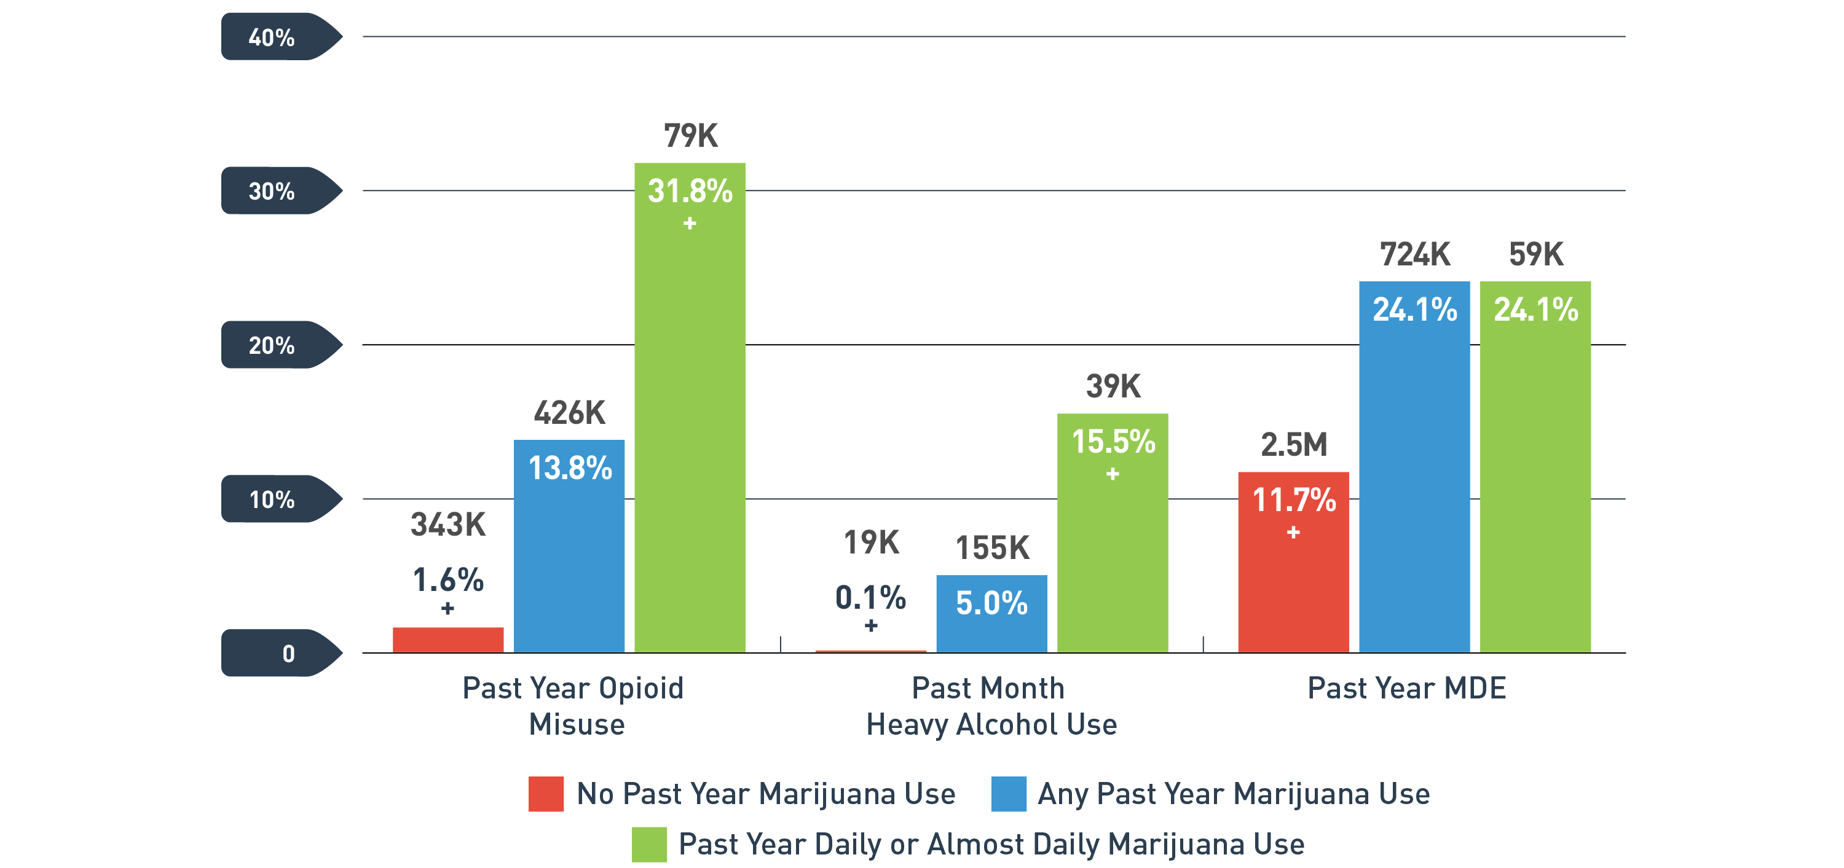
Co-Occurring Disorders: Youth Opioid Misuse, Heavy Alcohol Use, and Major Depressive Episode (MDE) by Marijuana Use Status
PAST YEAR/MONTH, 2017, 12 - 17
Special analysis of the 2017 NSDUH Report.
+ Difference between this estimate and the estimate youth with past year marijuana use is statistically significant at the .05 level.

Slide 22
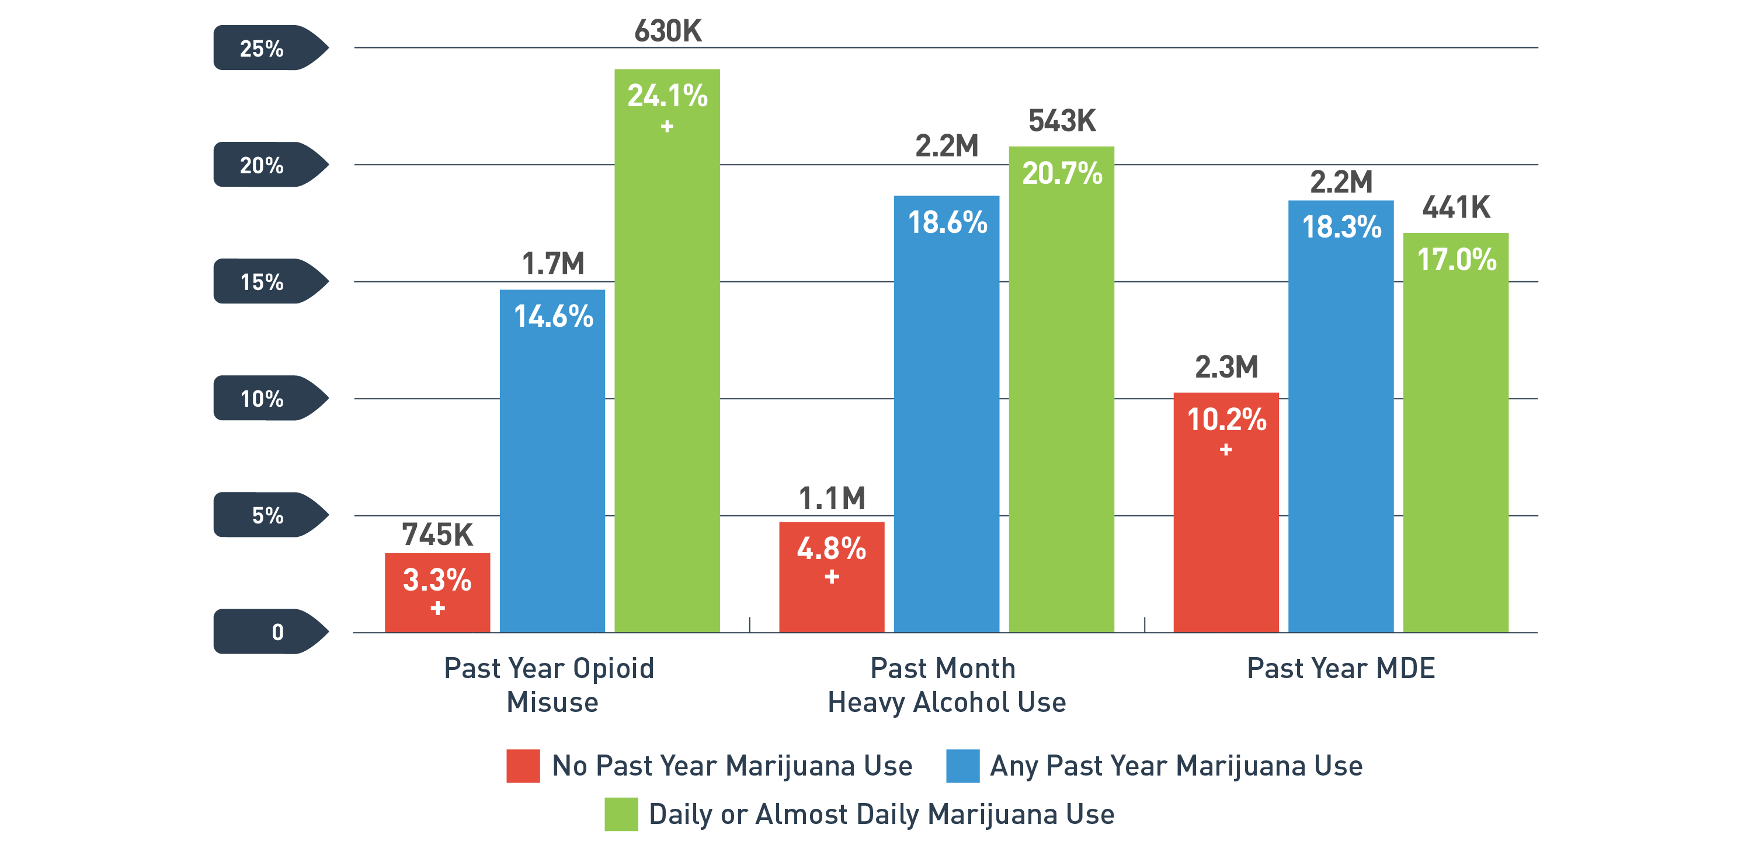
Co-Occurring Disorders: Young Adult Opioid Misuse, Heavy Alcohol Use, and Major Depressive Episode by Marijuana Use Status
PAST YEAR/MONTH, 2017, 18 - 25
+ Difference between this estimate and the estimate with past year marijuana use is statistically significant at the .05 level.
Special analysis of the 2017 NSDUH Report.

Slide 23
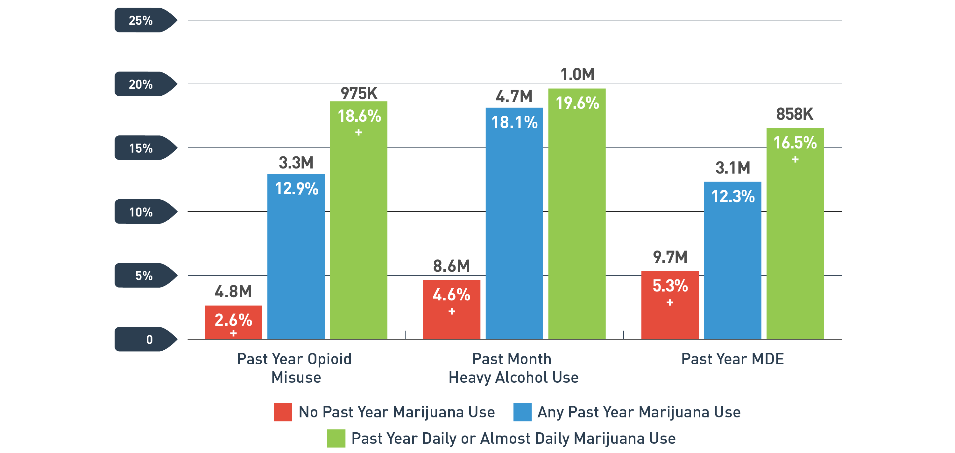
Co-Occurring Disorders: Adult Opioid Misuse, Heavy Alcohol Use, and Major Depressive Episode by Marijuana Use Status
PAST YEAR/MONTH, 2017, 26+
+ Difference between this estimate and the estimate with past year marijuana use is statistically significant at the .05 level.
Special analysis of the 2017 NSDUH Report.

Slide 24
Intelligence:
PERSISTENT CANNABIS (MARIJUANA) USE DISORDER LINKED TO SIGNIFICANT IQ DROP
BETWEEN CHILDHOOD AND MIDLIFE
Followed 1,037 individuals from birth to age 38.
Tested marijuana use and disorders at 18, 21, 26, 32 and 38 years of age.
Tested for IQ at ages 13 and 38
All groups started with roughly
equivalent IQ scores at age 13
By age 38, those who were diagnosed with cannabis dependence in 3 study waves (the most persistent
users of cannabis) had lost nearly
6 IQ points by the age of 38
There was a consistent dose-response relationship across the groups
Average Point Difference in IQ Score
(IQ at age 38 – IQ at age 13)
Source: Meier MH et al., PNAS Early Edition 2012
Notes:
Dunedin Study
Followed 1,037 individuals from birth to age 38
Tested marijuana use at ages 18, 21, 26, 32 and 38
Tested for IQ at ages 13 and 38

Slide 25
Marijuana Use: Link to Prescription Pain Medication (Opioid) Abuse
Association of marijuana use with abuse of prescription pain medications and addiction

Slide 26
Marijuana-Associated Psychosis
Higher risk of schizophrenia-like psychosis with younger age of first marijuana use
Risk of schizophrenia increases as marijuana use increases
30
20
Cases per 1,000
Odds ratio
10
0
0
1
2
10
<50
>50
Number of times marijuana taken
Source: Andréasson et al Lancet, 1987.
Source: Arseneault et al BMJ, 2002

Slide 27
Drug Risks Associated with Marijuana Use Among U.S. Adults 18 and Older
*
Source: Jones CM Analysis of 2015-2016 NSDUH Public Use File Data
* Result is not statistically significantly different

Slide 28
Mental Health and Social Risks of Marijuana Use Among U.S. Adults 18 and Older
Increased Risk for Adverse Outcome
*
¥
¥
¥
* Result is not statistically significantly different

Slide 29
Summary: Consequences of Marijuana Use
Acute, intoxicating effects of marijuana:
  Distorts perception; poor judgment and poor decision making (e.g.: unprotected sex, driving while intoxicated)
  Impairment in balance and coordination (important to injury risk in activities such as driving, sports)
  Difficulty with attention, concentration, and problem solving
  Difficulty with learning and memory (immediate and recall)
Adverse outcomes linked to marijuana use by youth:
  Poor school performance and increased drop out rates
  Chronic use in adolescence has been linked to decline in IQ that may not recover with cessation (Meier et al. 2012)
  Marijuana use in adolescence is associated with an increased risk for later psychotic disorder in adulthood (D’Souza, et al. 2016)
  Marijuana use linked to earlier onset of psychosis in youth known to be at risk for schizophrenia (McHugh, et al. 2017)

Slide 30
Summary: Consequences of Marijuana Use
Marijuana Use: Health Consequences
Significant numbers who try marijuana will become addicted (Lopez-Quintero, et al. 2011)
Higher overall rates of car crashes in states that have legalized (WAPO, June 2017)
Association of marijuana use with abuse of prescription pain medications (Olfson et al. 2017)
Notes:
Provide brief summary of legalized MJ experience in CO, WA

Slide 31
Is There Medical Use for Marijuana?
Evidence for some medical value of some components
  CBD and seizure disorder (Dravet’s syndrome and Lennox-Gastaut syndrome)
  THC products for wasting illnesses and appetite production
Medications must have undergone substantial research to answer critical questions before getting to market and widespread use in humans:
    Isolation of single components; manufacture processes
    Delivery mechanism
    Pharmacokinetics/pharmacodynamics
    Dose-response relationships (e.g.: doubling a dose may or may not double the effect)
    Therapeutic range
    Adverse events: what are they and how best to avoid/address should they occur?
  These types of studies would be difficult for marijuana because there are so many components

Slide 32
Where Do We Go From Here?
Government has a responsibility to inform Americans of the risks of marijuana use
People need to be able to make informed choices
States should consider short and long term issues related to marijuana
  Tax revenue
  Societal costs
  Government costs
Major Issue to Consider: Marijuana has gotten ahead of regulation
How do we define intoxication?
What are the ‘legal limits’ of use (equivalent to BAC)
How should marijuana sales centers be regulated (should we better control the opening of marijuana sales locations?)
Should warning labels be required on marijuana products?
How do we assure that underage sales are not occurring? (as with tobacco products, for example)
Should people be allowed to openly use in public?
Should people be allowed to use and operate motor vehicles?
What are the penalties?

Slide 33
New Stimulant Toxicity: Fentanyl-Contaminated Cocaine
Cocaine laced with fentanyl:
7% of cocaine seized in New England in 2017 was contaminated with fentanyl
Connecticut: deaths involving fentanyl-laced cocaine up 420% in last 3 years
Reported increases in deaths in NYC, PA, MA, NJ, OH, CA
https://www.ncadd.org/blogs/in-the-news/cocaine-laced-with-fentanyl-causing-growing-number-of-deaths
Why?
Poor quality control in packaging?
High Risk Groups:
Primary cocaine users
Opioid users may use cocaine to counteract sedation/intensify effect of opioid
Underscores the need to warn the public and provide treatment for cocaine use disorders
Epidemic is not just about opioid addiction
Cocaine users lack opioid tolerance: fentanyl overdose/death more likely
Naloxone
Discourage use alone
https://www.npr.org/sections/health-shots/2018/03/29/597717402/fentanyl-laced-cocaine-becoming-a-deadly-problem-among-drug-users

Slide 34
Kratom
Kratom is a tropical tree (Mitragyna speciose) native to Southeast Asia, used
traditionally to combat fatigue and improve work productivity among farm
populations in Southeast Asia
Has recently become popular as a novel psychoactive substance in Western
countries (Cinosi et al, 2015).
FDA is concerned that kratom, which affects the same opioid brain receptors as
morphine, appears to have properties that expose users to the risks of addiction,
abuse, and dependence
Currently, there are no FDA-approved uses for kratom, and the agency
has received concerning reports about its safety

Slide 35
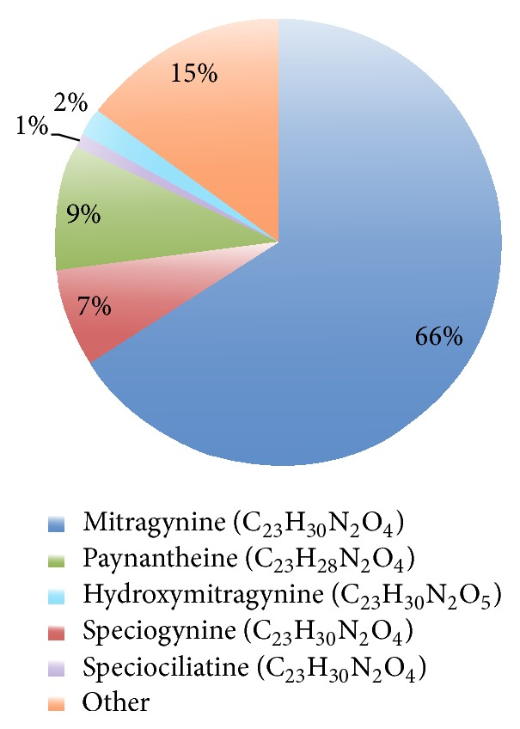
Kratom Extract Composition
Kratom preparations contain varying amounts of several phytochemicals, making their pharmacological and toxicological evaluation unique and difficult.
More than 20 alkaloids in kratom have been identified in the laboratory.
Mitragynine is classified as a kappa-opioid receptor agonist and is roughly 13 times more potent than morphine.
Mitragynine/OH-mitragynine thought to be responsible for the opioid-like effects.
Source: Cinosi E.; Martinotti; et all. Following “the Roots” of Kratom (Mitragyna speciosa): The Evolution of an Enhancer from a Traditional Use to Increase Work and Productivity in Southeast Asia to a Recreational Psychoactive Drug in Western Countries; Biomed Res Int. 2015; 2015: 968786

Slide 36
Kratom: How Used
Capsules
Pills
Extract
Leaves
  Chewed
  Brewed as tea
  Smoked

Slide 37
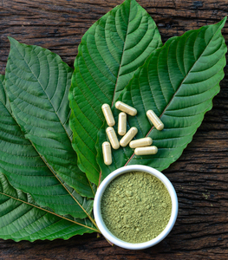
Kratom: Effects
The effects of kratom in humans are dose-dependent:
Small doses produce stimulatory effects resembling the stimulant effect of drugs such as cocaine or amphetamines.
Larger dosages associated with sedative-narcotic, pain reducing effects that resemble drugs such as opiates.
Regular kratom use is associated with addictive disorders, as evidenced by craving and compulsive use. Opioid withdrawal symptoms upon cessation.
SOURCE: Prozialeck W. C., Jivan J. K., Andurkar S. V. Pharmacology of Kratom: an emerging botanical agent with stimulant, analgesic and opioid-like effects. Journal of the American Osteopathic Association. 2012;112(12):792–799; Singh, 2014; Suwanlert, 1975; Ahmad and Aziz, 2012; Vicknasingam et al., 2010; Singh et al., 2014

Slide 38
Use of Kratom in the US
An anonymous online survey was conducted in October 2016 of 10,000 current kratom users through available social media and from the American Kratom Association (https://speciosa.org/home/ )
8,049 respondents completed the survey.
Findings:
  Kratom was primarily used by a middle-aged (31-50 years) males (56.91%) with income $35,000 or higher with private insurance (61.31%).
  Kratom was used to self-treat pain (68%) and emotional or mental conditions (66%) and for withdrawal symptoms associated with prescription opioid use.
  Subjects reported dose-dependent nausea and constipation with high doses (5g) and with and frequent dosing (Q22 doses/wk).
SOURCE: Grundmann O.; Patterns of kratom use and health impact in the USVresults from an online survey. Drug Alcohol Depend. 2017; 175(5):63Y70.

Slide 39
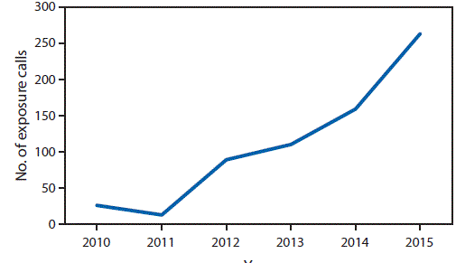
Number of Kratom-related Reported Exposure Calls to Poison Centers in the US
National Poison Data System - United States and Puerto Rico January 2010–December 2015
SOURCE: Anwar M, Law R, Schier J. Notes from the Field. Kratom (Mitragyna speciosa) Exposures Reported to Poison Centers — United States, 2010–2015. MMWR Morb Mortal Wkly Rep 2016;65:748–749. DOI: http://dx.doi.org/10.15585/mmwr.mm6529a4

Slide 40
Fatal Overdoses Involving Kratom
In 2017, the Food and Drug Administration (FDA) began issuing a series of warnings
about kratom and has now identified at least 44 deaths related to its use.
Most kratom associated deaths appeared to have resulted from adulterated products or taking kratom along with other potent
substances.
From July 2016 to June 2017, 25 fatal overdoses involving kratom across 8 CDC SUDORS states were identified
States | ME | NH | NM | OH | PA | RI | WV | WI | Total
Opioid overdose deaths | 301 | 402 | 322 | 4,534 | 3,231 | 265 | 844 | 825 | 10,724
Deaths involving kratom | 4 | 2 | 1 | 3 | 8 | 1 | 5 | 1 | 25
Percent involving kratom | 1.3% | 0.5% | 0.3% | 0.07% | 0.25% | 0.4% | 0.6% | 0.1% | 0.23%
Caution: testing of kratom is not uniform thus these numbers are underestimates
Source: CDC SUDORS Overdose Death Data
Notes:
What is a SUDORS?

Slide 41
Kratom Concerns
Kratom has gained popularity for its euphoric effects and is being popularized as a safe herbal product capable of giving a “legal” high (Swogger et al., 2015), and as an alternative to other sedative and stimulant type drugs (Warner et al., 2016).
Reports of physical dependence on kratom in Western nations emerge from case reports from the UK (Boyer et al., 2008, McWhirter and Morris, 2010), Germany (Kapp et al., 2011) and the US (Dorman et al., 2014, Nelsen et al., 2010, Forrester, 2013, Sheleg and Collins, 2011).
It can be surmised that given the large and growing number of internet purchase sites for kratom (cited in Cinosi et al., 2015), addiction to kratom is also likely to be growing in the Western countries.
No treatment specific for kratom addiction available
One case of NAS in an infant whose mother was a kratom user and who responded to opioid treatment.

Slide 42
International Status of Kratom
Kratom is restricted or illegal in:
Australia Lithuania Romania
Denmark Myanmar South Korea
Finland Malaysia Sweden
Israel Poland Thailand
United Kingdom
Scheduling under consideration in U.S.
On November 14, 2017, the FDA issued a public health advisory related to
mounting concerns regarding the risks associated with kratom and reported
deaths with use.

Slide 43
Conclusions
Kratom is a recognized emerging public health threat (MMWR. July 29, 2016;65(29):748Y749)
People need to understand that ‘‘legal’’ and ‘‘available’’ are not the same as ‘‘safe.’’
In the West, kratom has been valued for its analgesic effects and to aid in managing opioid withdrawal. However, some of these individual attempts have resulted in cases of toxicity and fatalities.
Physicians should be aware of these herbal supplements and potential toxicity or withdrawal effects in patients including in newborns which cannot be picked up by the standard toxicology screen (Davidson et al, 2018).
Preventionists should be aware of this drug and work with their communities raising awareness, providing education about effects and risks.

Slide 44
E-cigarettes
Vaping in the US: Trends and Effects

Slide 45
Cigarette Smoking Continues to Decline
15.5% of adults are current smokers
7.6% of youth are current smokers
Source: Adult cigarette smoking prevalence data are from the National Health Interview Survey (NHIS).
High school cigarette smoking prevalence data are from the National Youth Risk Behavior Survey.

Slide 46
46
E-Cigarette Use on the Rise: Adult Ever Use of E-Cigarettes by Cigarette Smoking Status – US, 2010-2017
Source: CDC. Styles Survey. 2010-2017

Slide 47
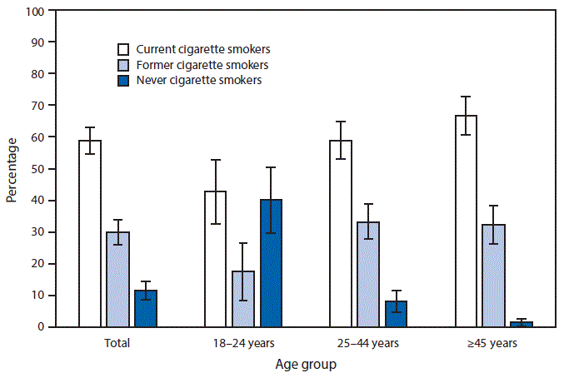
47
Cigarette Smoking Status Among Current
Adult E-Cigarette Users, by Age Group
Source: QuickStats: Cigarette Smoking Status Among Current Adult E-cigarette Users, by Age Group — National Health Interview Survey, United States, 2015. MMWR Morb Mortal Wkly Rep 2016;65:1177.

Slide 48
48
Current E-cigarette Use Among U.S. Adults, BRFSS, 2017
2.3% – 3.7%
3.8% – 4.2%
4.3% – 4.7%
Current e-cigarette users: Persons who reported using
e-cigarettes or some other electronic “vaping” product “some days” or “every day”
4.8% – 7.1%

Slide 49
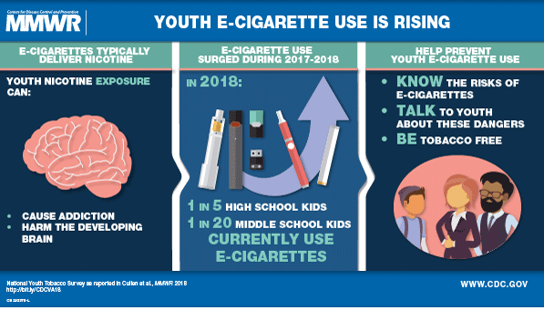
49
Youth E-cigarette Use: Infographic from CDC’s MMWR
Source: Cullen KA, Ambrose BK, Gentzke AS, Apelberg BJ, Jamal A, King BA. Notes from the Field: Use of Electronic Cigarettes and Any Tobacco Product Among Middle and High School Students — United States, 2011–2018. MMWR Morb Mortal Wkly Rep 2018;67:1276–1277.
Notes:
Need brief description of nicotine adverse health effects with references.

Slide 50
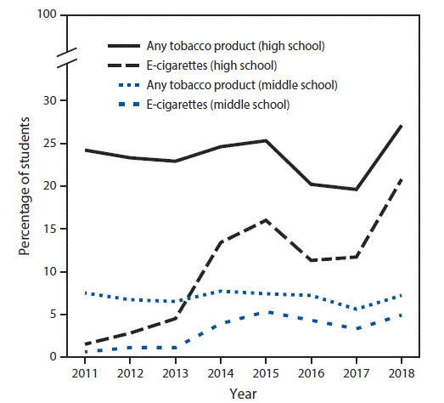
50
Current Use of E-cigarettes and Any Tobacco Product Among Middle and High School Students— NYTS, US, 2011–2018
Source: Cullen KA, Ambrose BK, Gentzke AS, Apelberg BJ, Jamal A, King BA. Notes from the Field: Use of Electronic Cigarettes and Any Tobacco Product Among Middle and High School Students — United States, 2011–2018. MMWR Morb Mortal Wkly Rep 2018;67:1276–1277.

Slide 51
51
Adverse Health Effects of Nicotine
Nicotine exposure during adolescence can result in addiction.
Nicotine can harm the developing adolescent brain.
Nicotine delivered by e-cigarettes during pregnancy can result in multiple adverse consequences, including sudden infant death syndrome, and could result in altered corpus callosum, deficits in auditory processing, and obesity.
Ingestion of e-cigarette liquids containing nicotine can cause acute toxicity and possibly death if the contents of refill cartridges or bottles containing nicotine are consumed.
Source: U.S. Department of Health and Human Services. E-Cigarette Use Among Youth and Young Adults. A Report of the Surgeon General. Atlanta, GA: U.S. Department of Health and Human Services, Centers for Disease Control and Prevention, National Center for Chronic Disease Prevention and Health Promotion, Office on Smoking and Health, 2016.
Notes:
References for these statements added please

Slide 52
52
E-cigarette Adverse Health Effects
E-cigarettes expose users to several chemicals, in addition to nicotine: heavy metals (chromium, lead, manganese, nickel and zinc), arsenic, volatile organic compounds (propylene glycol or glycerol), all known to have adverse health effects.
The health effects and potentially harmful effects of doses of heated and aerosolized constituents of e-cigarette liquids, including solvents, flavorants, and toxicants, are not completely understood.
E-cigarettes can also be used to deliver other drugs, including marijuana. In 2016, one-third of U.S. middle and high school students who ever used e-cigarettes had used marijuana in e-cigarettes.
Sources (Bullets 1-2): U.S. Department of Health and Human Services. E-Cigarette Use Among Youth and Young Adults. A Report of the Surgeon General. Atlanta, GA: U.S. Department of Health and Human Services, Centers for Disease Control and Prevention, National Center for Chronic Disease Prevention and Health Promotion, Office on Smoking and Health, 2016.
Bullet 3: Trivers KF, Phillips E, Gentzke AS, Tynan MA, Neff LJ. Prevalence of Cannabis Use in Electronic Cigarettes Among US Youth. JAMA pediatrics. 2018;172(11):1097-1099.

Slide 53
SAMHSA Actions in coming year
Marijuana:
Continue NSDUH and DAWN data collection related to marijuana
Provide education/training materials oriented to providers and to the public
related to marijuana risks
Specific materials aimed at special populations e.g.: pregnant women, youth
Assist in identification of hazardous use and use disorders with SBIRT
Fund prevention, treatment and recovery services in states/communities
Kratom
Education for healthcare providers and the public on kratom properties/adverse effects
PSAs
E-cigarettes/vaping
Add NSDUH questions to better understand epidemiology
Education for healthcare professionals and public, PSAs
Continue to speak out on known risks and accumulating evidence for adverse effects of marijuana, kratom, and e-cigarettes/nicotine

Slide 54
Thank you!
Elinore.McCance-Katz@samhsa.hhs.gov

Slide 55
Kratom:
Cinosi E.; Martinotti; et al. Following “the Roots” of Kratom (Mitragyna speciosa): The Evolution of an Enhancer from
a Traditional Use to Increase Work and Productivity in Southeast Asia to a Recreational Psychoactive Drug in Western
Countries; Biomed Res Int. 2015; 2015: 968786.
https://www.fda.gov/NewsEvents/PublicHealthFocus/ucm584952.htm

Slide 56
The Surgeon General's Warning on Marijuana
The Surgeon General of the Public Health Service has issued the following warning on marijuana:
Marijuana use is a major public health problem in the United States. In the past 20 years, its' use has increased 30-fold; it estimated that more than a quarter of the
American population has used it. The age at which persons first use marijuana has decreased gradually to the junior high school years. Until recently, nearly 11% of
high school seniors used it, and although that figure has declined to 7%, its daily use still exceeds that of alcohol; more high school seniors use marijuana than smoke
cigarettes. In a recent study, 32% of those surveyed had used marijuana during the previous 30 days, while 25% had smoked tobacco.
On March 24, 1982, the Department of Health and Human Services submitted to Congress a report reviewing the consequences of marijuana use. Marijuana and
Health, 1982, ninth in a series, is primarily based on two recently conducted, comprehensive, scientific reviews by the Institute of Medicine of the National Academy
of Sciences, the Canadian Addiction Research Foundation, and the World Health Organization (WHO).
Both independent reviews corroborate the Public Health Service's findings of health hazards associated with marijuana use: Acute intoxication with marijuana
interferes with many aspects of mental functioning and has serious, acute effects on perception and skilled performance, such as driving and other complex tasks
involving judgement or fine motor skills.
Among the known or suspected chronic effects of marijuana are:
short-term memory impairment and slowness of learning.
impaired lung function similar to that found in cigarette smokers. Indications are that more serious effects, such as cancer and other lung disease, follow extended use.
decreased sperm count and sperm motility.
interference with ovulation and pre-natal development.
impaired immune response.
possible adverse effects on heart function.
by-products of marijuana remaining in body fat for several weeks, with unknown consequences. The storage of these by-products increases the possiblilties for
chronic, as well as residual, effects on performance, even after the acute reaction to the drug has worn off. Of special concern are the long-term developmental
effects in children and adolescents, who are particularly vulnerable to the drug's behavioral and psychological effects. The "amotivational syndrome," characterized
by a pattern of energy loss, diminished school performance, harmed parental relationships, and other behavorial disruptions, has been associated with prolonged
marijuana use by young persons. Although more research is required, recent national surveys report that 40% of heavy users experience some or all of those symptoms.
The Public Health Service concludes that marijuana has a broad range of psychological and biological effects, many of which are dangerous and
harmful to health, and it supports the major conclusion of the National Academy of Sciences' Institute of Medicine.

