Slide 1
The NIH R15 Program:
AREA and REAP
Lisa Chadwick, Ph.D.
Program Director
Division of Genome Sciences, NHGRI

Slide 2
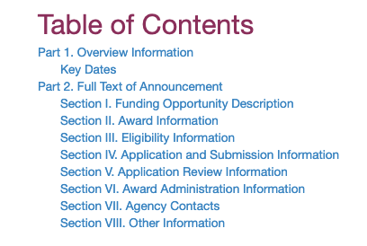
Today, you will learn…
What is the R15?
How to read the R15 Funding Opportunity Annoucements (FOAs)
The differences between the R15 and the R01
The differences between AREA and REAP
Some strategies for success
Hint:
Check the Funding Announcement!

Slide 3
What is the goal of the R15 program?
Support meritorious, small scale research grants at institutions that do not receive substantial funding from the NIH
Provide research opportunities to students who might not otherwise have access to them
Strengthen the overall research environment at the institution

Slide 4
The R15 at a glance
Three year project period
12 page research strategy
Can request up to $300,000 in direct costs to be spent over the 3 year project period
Can be renewed

Slide 5

How is the R15 different from an R01?
Both are RESEARCH grants
  R15 should make an important contribution
R15 scope is more limited
  Budget, project period smaller than R01
  Fewer resources may be available at your institution
Must describe research opportunities for students
Must describe how the grant will strengthen the research environment of the institution

Slide 6
Two sets of Funding Opportunity Announcements for different types of institutions
Academic Research Enhancement Award (AREA) for Undergraduate-Focused Institutions
Research Enhancement Award Program (REAP) for
Health Professional and Graduate Schools
PAR-21-154 (CT)
PAR 21-155 (no CT)
PAR-19-135 (CT)
PAR-19-134 (no CT)

Slide 7




Is my institution eligible for the R15?
AREA
Primarily undergraduate
REAP
Health professional School
Graduate School
Institution
NIH Funding
Cannot exceed $6M/year for 4 of the last 7 years
Does the component enroll more undergraduates or more graduate students?
For AREA: Do the non-health professional components as a whole meet the funding requirement?
For REAP: Does the Institution as a whole meet the requirement?
Need more help? See R15 page at grants.nih.gov

Slide 8

How do I document eligibility?
Oh no, I forgot to upload a signed letter from my Provost or similar institutional official verifying that my institution meets the eligibility criteria!
Don’t let this be you!
Your application will be withdrawn

Slide 9
Am I eligible to apply for an R15?
Primary appointment at an eligible institution
Cannot be the PI of another NIH Research grant at time of award (other roles OK)
All PIs
Do not need to meet these requirements
But… remember the goals of the R15!
does this “strengthen research environment”?
does this engage students at your institution?
is most of the work being done at your institution?
Collaborators

Slide 10
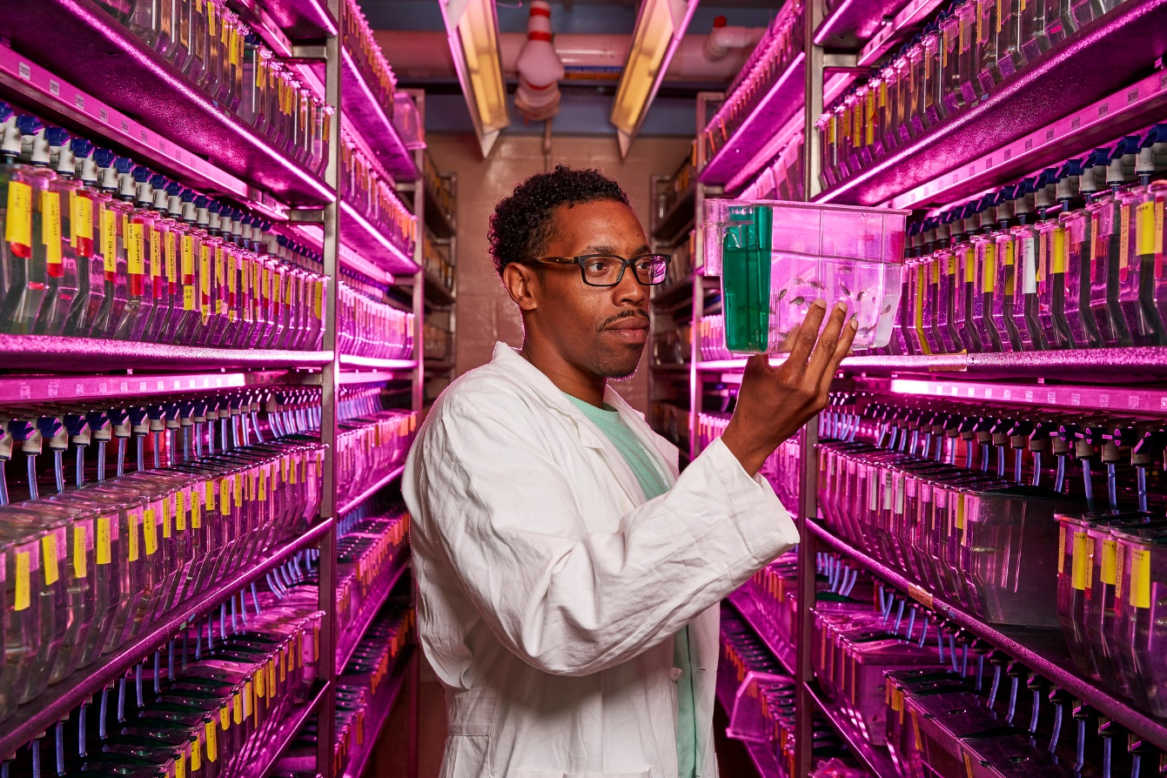
It’s time to put your application together!
Read the FOA carefully
Sketch out some specific aims
What institute funds this kind of work?
  Check NIH RePORTER
Do they participate in this funding announcement?
Reach out to a Program Officer
Now, how exactly am I going to pay for all of these fish?

Slide 11

Program Officers are here to help you!
Reach out to the listed scientific/research contacts for answers to all of these questions …and more!
Is this kind of science appropriate for your institute?
Is this a good fit for this funding announcement?
Who is likely to review this?
Do you have feedback on my aims?
NIH STAFF
Email them your aims
Set up a call

Slide 12

The art of crafting a successful R15 application
It’s just magnificent
First and foremost, this is a research grant
Scientifically interesting
Publishable data
Clear hypothesis
Well justified
Feasible
Scope is realistic
Have needed resources
I know

Slide 13

Writing the Research Strategy
Read the review criteria and program goals
  Make sure you discuss them
  Reviewers are asked to comment on these specifically
Include preliminary data if possible
  Supports your hypothesis
  Shows reviewers that you can do the work
Describe how students will be involved

Slide 14
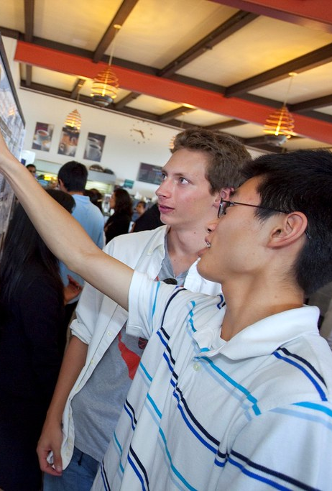
Involvement of students is a major goal of the R15
  Present at meetings and conferences (includes lab meeting, campus events)
  Help design experiments
  Collect and analyze data
  Help write manuscripts
How do I show “meaningful involvement”?
  Describe in research strategy, biosketch
  Discuss your history of mentoring students
  Highlight where they have co-authored papers
  Mention how they will be recruited
  Be specific

Slide 15
Putting the budget together
R15 is a multi-year funded award
Budget for all years is requested in the first budget year
$300,000 direct cost limit
Can support a range of expenses
  Research needs
  Student wages
  Collaborator (subawards)
  Travel

Slide 16
Where are R15 applications reviewed?
Special emphasis panel for R15 applications
Clustered within standing study sections
How will I know?
Search NIH RePORTER
Ask a Program Officer
Either way - reviewers will use review criteria listed in the FOA

Slide 17
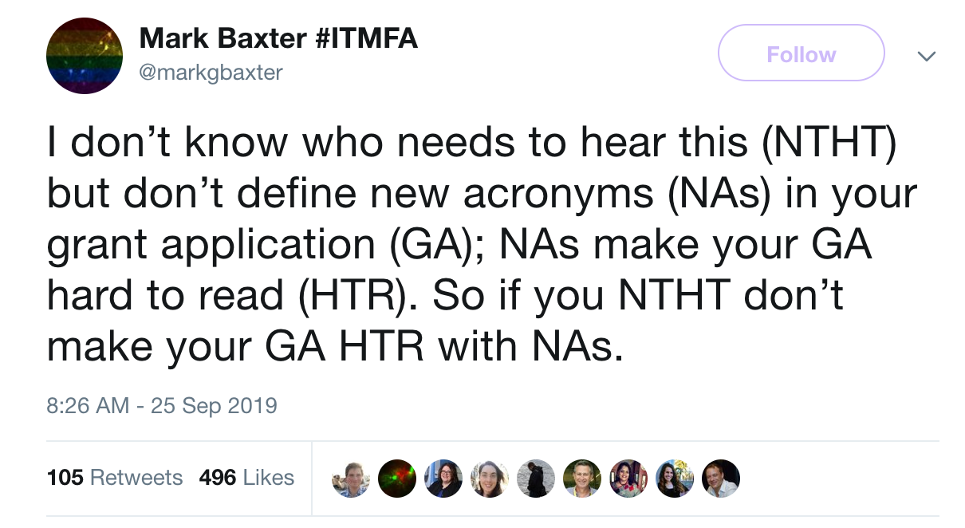
Help your reviewers by writing a great application!
Lay things out logically
Write for a broad audience
Be clear and concise, don’t use jargon
Organize the page
Proofread
Know what they are looking for and give it to them!

Slide 18

Your summary statement
PO contact information <- USE IT!
Review information (including roster and SRO)
Score
Human subjects and vertebrate animal concerns noted by reviewers
Summary of discussion IF DISCUSSED
Written critiques from assigned reviewers
Any budgetary recommendations from reviewers

Slide 19
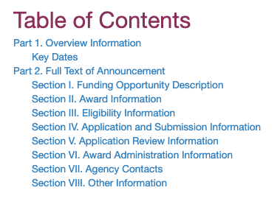
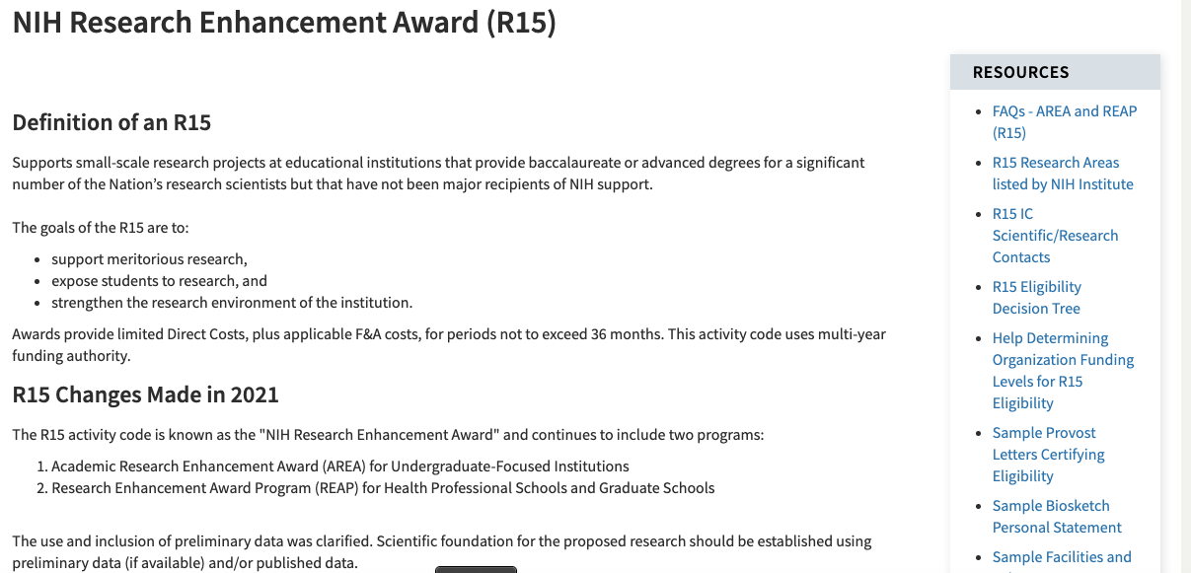
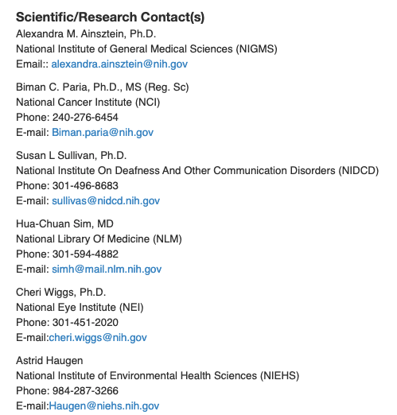
Final thoughts
Go here!
https://grants.nih.gov/grants/funding/r15.htm

