Slide 1
Commitment Transparency
NIH Office of policy for extramural research administration

Slide 2
Overview
Background
  Why are we focused on commitment transparency and disclosures?
Required Disclosures
Overview of Forms Updates
  Biosketch
  Other Support
FAQs
Resources

Slide 3
Background

Slide 4
What is commitment transparency?
Transparency and reporting of all research activities, domestic and foreign
Openness and transparency enables productive collaboration and helps ensure appropriate disclosure of potential conflicts of interest and commitment
Failure by some researchers at NIH-funded institutions to disclose substantial contributions of resources from other organizations, including foreign governments, threatens to distort decisions about the appropriate use of NIH funds

Slide 5
Inter-Agency Areas of Focus
Some foreign governments are working vigorously to illicitly acquire, and in some cases outright steal, U.S. research and technology
Key Issues:
  Conflicts of Interest: An individual, their spouse, or dependent children have a financial interest/relationship which could directly and significantly affect the design, conduct, reporting, or funding of research
  Conflicts of Commitment: an individual accepts or incurs conflicting obligations between or among multiple employers or entities.
  Talent Recruitment Programs
For Details visit OSTP Blog

Slide 6
NDAA-223
2021 National Defense Authorization Act (NDAA), Section 223 Disclosure of Funding Sources in Applications for Federal Research and Development Awards
Applies to all applicants for research and development awards from Federal Research Agencies
Requires each covered individual listed in the application to:
  Disclose the amount, type and source of all current and pending support
  Certify the disclosure is current, accurate and complete
  Agree to update such disclosure at the request of the agency prior to award and at any subsequent time the agency determines appropriate
See full text here

Slide 7
NSPM-33
National Security Presidential Memorandum (NSPM) on Research Security and Integrity, signed January 14, 2021
Implementation led by Office of Science and Technology Policy (OSTP)
Purpose: To strengthen protections of US Government supported Research and Development (R&D) against foreign government interference and exploitation
Funding agency responsibilities: require participants involved in the R&D enterprise to disclose appropriate information, ensure recipients have policies and processes for research security and integrity, and share information across federal funding institutions
See full text here

Slide 8
NSPM-33 Disclosure Requirements
Organizational affiliations and employment.
Other support, contractual or otherwise, direct and indirect, including current and pending private and public sources of funding or income, both foreign and domestic
Current or pending participation in, or applications to, programs sponsored by foreign governments, instrumentalities, or entities, including foreign government-sponsored talent recruitment programs
Positions and appointments, both domestic and foreign, including affiliations with foreign entities or governments. This includes titled academic, professional or institutional appointments, whether or not renumeration is received, and whether full-time, part-time or voluntary (including adjunct, visiting or honorary)

Slide 9
So, what about NIH?

Slide 10
Issues Seen at NIH
Failure by some researchers at NIH‐funded institutions to disclose substantial contributions of resources from other organizations, including foreign governments and businesses, which threatens to distort decisions about the appropriate use of NIH funds and accurate evaluation of commitment of effort to US‐supported research;
Diversion of proprietary information included in grant applications or produced by NIH‐ supported biomedical research to other entities, including other countries; and
Failure by some peer reviewers to keep information in grant applications confidential; including, in some instances, disclosure to foreign entities or other attempts to influence funding decisions.

Slide 11
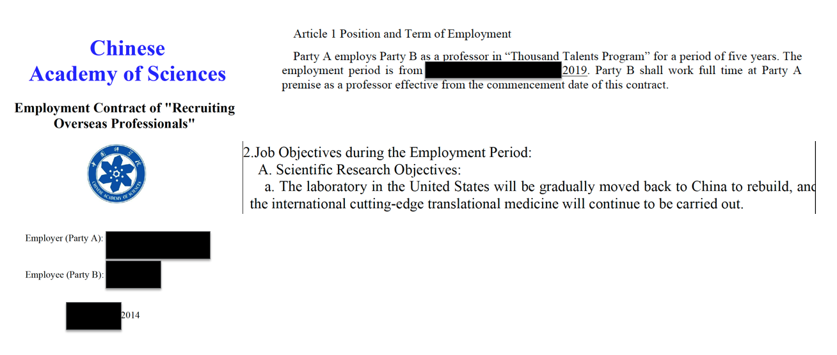
Undisclosed Employment Agreements

Slide 12
Undisclosed Employment Agreements
Time commitment – sometimes full-time
Substantial funding for research (including start-up funds)
Laboratory, equipment, personnel
Signing bonus, salary, housing, other benefits
Deliverables: training personnel, papers, patents/IP
Creates conflicts of commitment (>100% effort), interest

Slide 13
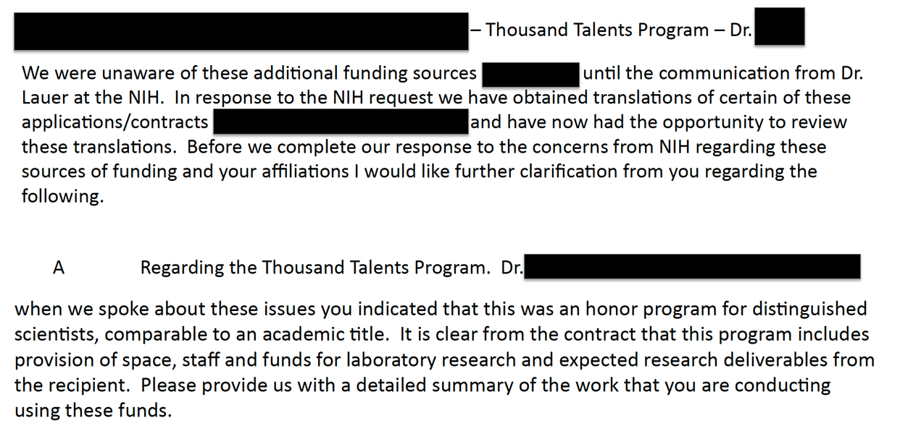
Institutions say they are unaware

Slide 14
New cases continue
At least 225 scientists (NIH has contacted institutions)
90+ institutions, many fields of biomedicine, all over US
Denials despite documentation to the contrary; explanations
  “I allowed XXX to use my name as PI”
  “I knew nothing about this grant…”
  “I didn’t actually do the work…”
  “The affiliations [in published papers] were in error.”

Slide 15
Our Approach
To support the need for full transparency, NIH has updated forms and instructions
Collaborated with OSTP and with other research agencies to implement NSPM-33 and NDAA 233
Institutions and researchers need to fully disclose, and institutions must have policies to ensure that they are aware of all research endeavors
Form updates ensure that NIH is receiving all the information needed to support sound funding decisions

Slide 16
Required Disclosures

Slide 17
Considerations for Recipients
When a recipient is determining the likelihood of a compliance risk related to improper influence (foreign or domestic) they should consider and identify relationships, existing and potential, that may impact research integrity, financial conflict of interest, and/or overlap. In evaluating these relationships, institutions should consider the following questions and factors:
a) Does the relationship affect the integrity of the research by impacting established professional norms and ethical principles in the performance of all activities related to scientific research? In answering this question, institutions should consider the following factors:
  The “relationship” could be with a collaborator, an outside employer, an external appointment relationship, etc.
  The “impact” could be real or apparent
  The “compensation” could be of any type or level; NIH has not established a de minimis level of compensation and considers all types of support, in-kind or otherwise.
b) Is there potential overlap in any of the following areas?
  Scientific
  Budgetary
  Commitment
c) Is there a potential Financial Conflict of Interest?
If the answer to any of these questions is “yes,” then the relationship is generally reportable. When in doubt, recipients should reach out to NIH early and often.
Notes:
This is the preamble we developed for applicants/recipients.

Slide 18
NIH Disclosure Requirements
Type of Activity | Biographical Sketch | Other Support | Annual Project Reports | Post-Award Information Terms & Condition
Professional preparation (e.g., educational degrees) | X
Organizational Affiliations and Appointments | X
Academic, professional or institutional appointments, whether or not remuneration is received, and whether full-time, part-time, or voluntary | X
Organization affiliations, appointments, and educational information is disclosed in the Biographical sketch. All current appointments must be listed. Historical information is not required.

Slide 19
NIH Disclosure Requirements
Type of Activity | Biographical Sketch | Other Support | Annual Project Reports | Post-Award Information Terms & Condition
All projects currently under consideration from whatever source, and all ongoing projects, irrespective of whether support is provided through the proposing organization, another organization or directly to the individual, and regardless of whether or not they have monetary value (e.g., even if the support received is in-kind such as office/laboratory space, equipment, supplies, or employees.) |  | X | X | X
Current or pending participation in, or applications to, programs sponsored by foreign governments, instrumentalities, or entities, including foreign government-sponsored talent recruitment programs. | X (Appropriate placement may be contract-dependent)
All current and pending projects, from all sources, must be disclosed. Completed support is not required.

Slide 20
NIH Disclosure Requirements
Type of Activity | Biographical Sketch | Other Support | Annual Project Reports | Post-Award Information Terms & Condition
In-kind contributions not intended for use on the project/proposal being proposed. |  | X | X | X
In-kind contributions not intended for use on the project/proposal being proposed in this application must be reported as Other Support.
  If the time commitment or dollar value is not readily ascertainable, reasonable estimates should be provided.
  There is no de minimis value. Applicants and recipients may apply a “reasonable standard.” Disclosure is not expected for sources with insignificant value or material contribution.
In-kind contributions intended for use on the project being proposed to NIH must be included as part of the Facilities and Other Resources or Equipment section.

Slide 21
NIH Disclosure Requirements
Type of Activity | Biographical Sketch | Other Support | Annual Project Reports | Post-Award Information Terms & Condition
Visiting Scholars in Labs funded by an external entity |  | X |  | X
Students and postdoctoral researchers funded by an external entity |  | X | X | X
If a visiting scholar, graduate student, or post-doc is performing research in support of the PD/PI or other senior/key personnel’s research, then their support must be disclosed as an in-kind resource.
If the relationship is solely a mentor/mentee arrangement, with no research activities (e.g. associated time commitment), then it is not a resource, and does not need to be reported.
Notes:
External entity includes foundation, home university, or Federal agency.

Slide 22
NIH Disclosure Requirements
Type of Activity | Biographical Sketch | Other Support | Annual Project Reports | Post-Award Information Terms & Condition
Consulting that falls outside of an individual’s appointment; separate from institution’s agreement. |  | X | X | X
Travel supported/paid by an external entity to perform research activities with an associated time commitment |  | X | X | X
Consulting activities that involve research and fall outside of an individual’s appointment, separate from institution’s agreement, must be disclosed as Other Support.
Notes:
Talking Point: Consulting that is permitted by an individual's appointment does not require disclosure. Note: Agencies and research organizations should ensure that scientists do not inappropriately characterize research activities as consulting. Authorship or co-authorship on a scientific or technical published paper or posted pre-print would be one manifestation of an activity that involves research.

Slide 23
NIH Disclosure Requirements
Type of Activity | Biographical Sketch | Other Support | Annual Project Reports | Post-Award Information Terms & Condition
Certification by the individual that the information disclosed is accurate, current, and complete (e.g., signature of the researcher). |  | X | X
Other Support forms must be signed electronically.
Supporting Documentation (e.g., contracts, grants, other agreements) |  | X
Supporting documentation, which includes copies of contracts/agreements specific to senior/key-personnel foreign appointments and/or employment with a foreign institution for all foreign activities and resources that are reported in Other Support. If the contracts/agreements are not in English, recipients must provide translated copies.
Notes:
Put venture capital financing here.

Slide 24
NIH Disclosure Requirements
Type of Activity | Biographical Sketch | Other Support | Annual Project Reports | Post-Award Information Terms & Condition
Significant Financial Interests : Disclosure Not Required in Other Support. See NIH FCOI Policy NIH GPS 4.1.10. Disclosures must be made in FCOI module.
Financial Conflicts of Interest (FCOI) are an important part of commitment transparency. NIH has separate regulations and policies for FCOI.
See NIH GPS 4.1.10 and 42 CFR 50, Subpart F
Notes:
Private equity financing and venture capital would be a potential FCOI rather than Other Support.

Slide 25
Other Support does not include:
Training awards
Prizes
Gifts
  Gifts are resources provided where there is no expectation of anything (e.g. time, services, specific research activities, money, etc.) in return. An item or service given with the expectation of an associated time commitment is not a gift and is instead an in-kind contribution and must be reported as Other Support
Start-up support provided to the individual by the applicant organization
Consulting activities where the PD/PI or other senior/key personnel is not conducting research (e.g. no authorship or co-authorship of publications is anticipated from the activity)

Slide 26
Form and instruction updates

Slide 27
Form & Instruction Updates
Updates outlined in NOT-OD-21-073 and NOT-OD-21-110.
Updated forms, instructions, samples and public frequently asked questions are posted for Biosketch and Other Support.
The updated forms and instructions are required for use in applications and Research Performance Progress Reports (RPPRs) submitted for on or after January 25, 2022.

Slide 28
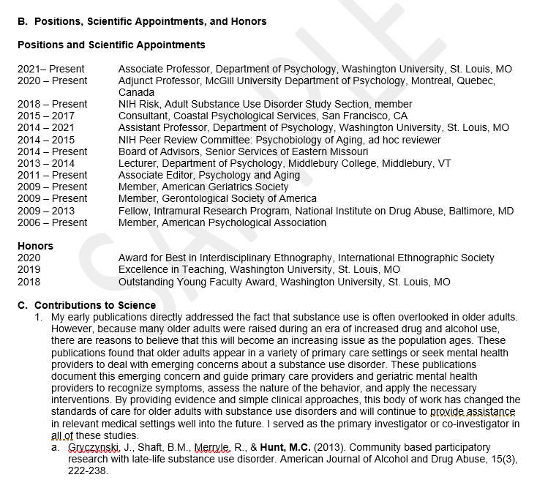
Biosketch Format Updates
Section B. ‘Positions and Honors’ has been renamed, ‘Positions, Scientific Appointments and Honors.’
Applicants and recipients must list all current positions and scientific appointments, both domestic and foreign, including affiliations with foreign entities or governments. This includes titled academic, professional or institutional appointments whether or not renumeration is received, and whether full-time, part-time or voluntary (including adjunct, visiting or honorary)
  Must be listed in reverse chronological order
If all required information is not included, the Biosketch is incomplete
See full sample here

Slide 29
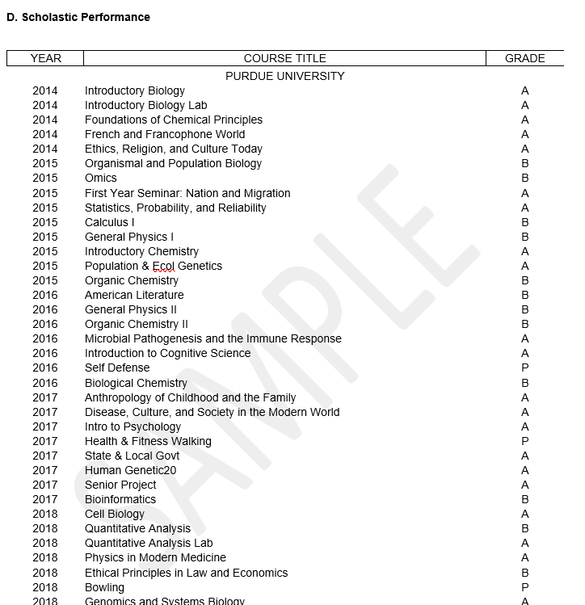
Biosketch - Requirements
Section D now only includes Scholastic Performance, and is only required for:
    Applicants for predoctoral and postdoctoral fellowships
    Applicants for dissertation research grants (e.g. R36)
    Candidates for research supplements to promote diversity in health-related research from the undergraduate through post-doctoral levels.
The 5-page limit for Biosketch has not changed
See full fellowship samples here
Notes:
Include example screenshot of new section D.

Slide 30
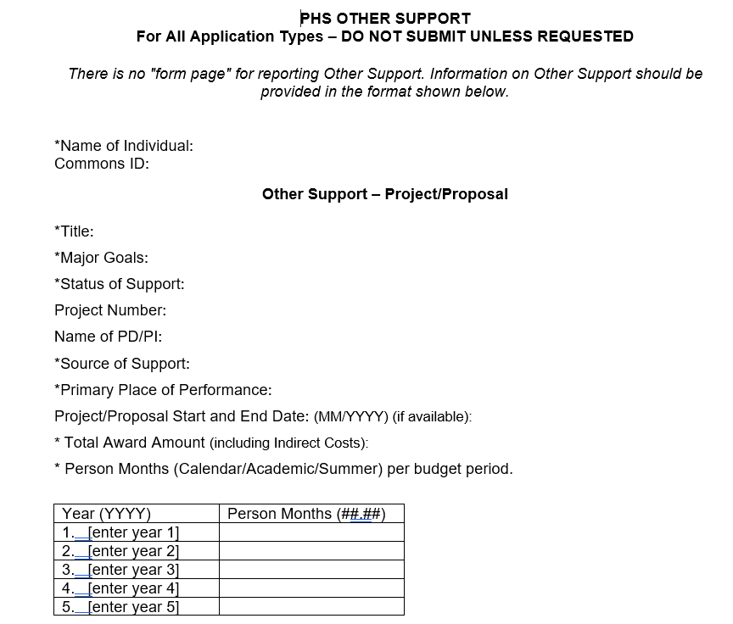
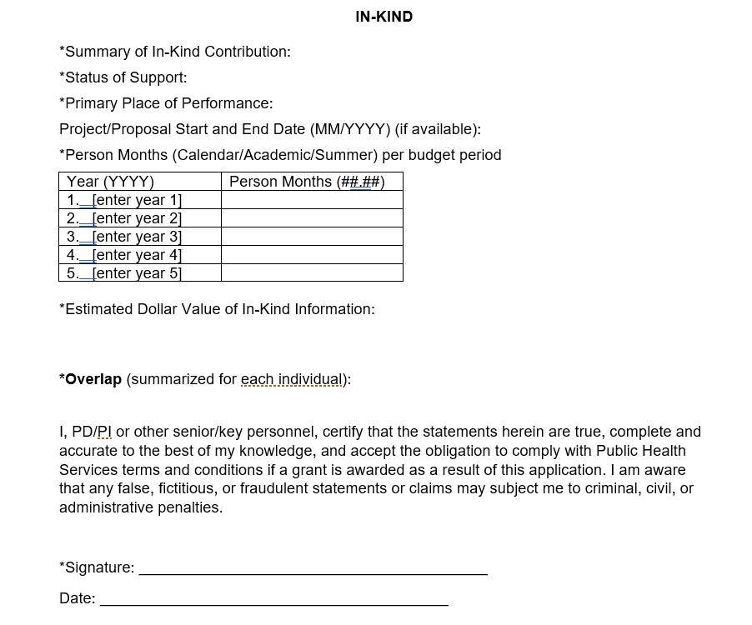
Other Support Format Updates
Updated form and instructions provide clearer format and data elements, and to align with fed-wide implementation efforts.

Slide 31
Other Support Format Updates Cont.
Supporting documentation
  Copies of contracts, grants or any other agreement specific to senior/key personnel foreign appointments and/or employment with a foreign institution for all foreign activities and resources that are reported in Other Support. If the contracts, grants or other agreements are not in English, recipients must provide translated copies.
Immediate notification of undisclosed Other Support
  When a recipient organization discovers that a PI or other Senior/Key personnel on an active NIH grant failed to disclose Other Support information outside of Just-in-Time or the RPPR, as applicable, the recipient must submit updated Other Support to the Grants Management Specialist named in the Notice of Award within 30 days of becoming aware of the non-disclosure.
PI or other senior/key personnel will electronically sign submissions to certify accuracy of the information provided

Slide 32
common questions

Slide 33
Biosketch – Common Questions
Since research support is no longer in Section D., is that information captured elsewhere in the Biosketch? Research support information previously provided in section D is now included in Section A. Personal Statement.
The Biosketch instructions state that all positions and scientific appointments must be provided. Does this refer to active positions and appointments, or all positions a researcher has ever held? The Biosketch must include all current positions and scientific appointments. The instructions have been updated to reflect this clarification

Slide 34
Biosketch – Common Questions Cont.
Is the use of SciENcv required? Not at this time.
Are hyperlinks permitted in the Biosketch? Hyperlinks are not permitted in the Biosketch, and may not be used in citations. Applicants may provide a URL to a full list of their published work. This URL must be to a Federal Government website (a .gov suffix). NIH recommends using My Bibliography.
What does NIH consider to be a “scientific appointment”? Applicants and recipients must determine what constitutes a scientific appointment, in accordance with their institutional policies and procedures for tracking and managing outside activities.
For more FAQs visit our Biosketch Page

Slide 35
Other Support Common Questions
Does NIH require disclosure of recently completed support? No, NIH does not require disclosure of recently completed support in Other Support submissions, only current and pending resources.
Do the forms updates impact the timing of submission (e.g. Just-In-Time, RPPR)? No. The updates to Other Support are to the form and instructions and do not change the process or timing of submission.
NIH does not allow electronic signatures on attachments in electronic applications. Will electronic signatures be accepted on Other Support submissions? Other Support submissions must be submitted as a flattened PDF, after all signatures are obtained. Recipients and applicants may use the electronic signature software of their choice, and in alignment with their institutional practices. A typed name is not an electronic signature and is not acceptable.

Slide 36
Other Support Common Questions Cont.
I am key personnel on an NIH grant in the United States. I am collaborating with another scientist in the US, whose experiments have directly benefitted my research. Their experiments were conducted with funds awarded to their institution. Should this be reported as Other Support? Yes. Other Support includes domestic research collaborations that directly benefit the researcher’s research endeavors.
For in-kind resources that do not have any associated effort, can researchers enter zero effort? Yes, for in-kind resources with no associated time commitment, researchers can list zero effort, but must provide the estimated dollar value of the in-kind resource. The effort and dollar value cannot be both be zero.
For more FAQs visit our Other Support Page
Notes:
When reporting on collaborations, apply a reasonable standard. If the collaboration is anticipated to result in co-authorship, then it must be reported.

Slide 37
Resources

Slide 38
Resources Available
SciENcv
  Updated SciENcv Biosketch template is available!
  NIH is collaborating with SciENcv on a template for Other Support
  Use of SciENcv will NOT be required
Additional Resources (Continually updated)
  Other Support Page
    Forms, Instructions, FAQs and samples
  Biosketch Page
    Forms, Instructions, FAQs and samples

