Slide 1


Overview of Grant Application and Review Changes
Impacting Due Dates On or After
January 25, 2025
Updated February 14, 2025

Slide 2
2025 Changes
Simplified Review Framework for Most Research Project Grants
Improvements to the NRSA Fellowship Application and Review Process
Updates to Reference Letter Guidance
Updates to NRSA Training Grant Applications
Updated Application Forms (FORMS-I)
Common Forms for Biographical Sketch and Current and Pending (Other) Support

Slide 3

NIH
Simplified Review
Framework:
Research Project Grants
(RPGs)

Slide 4
Overview of Simplified Review of Most Research Project Grant (RPG) Applications
To simplify peer review and reduce the potential for reputational bias to affect peer review outcomes
Reorganizes the five review criteria into three factors:
  Factor 1: Importance of the Research (Scored 1-9)
  Factor 2: Rigor and Feasibility (Scored 1-9)
  Expertise and Resources (considered in overall impact, no individual score)
Applicability: applies to peer review of most research project applications submitted for due dates on or after January 25, 2025.

Slide 5
NIH
Simplified Review
Framework for RPGs:
Resources
LEARN MORE
Web page:
https://grants.nih.gov/policy/peer/simplifying-review.htm
Webinars:
April 17, 2024: Overview and what to expect as NIH begins reissuing funding opportunities
(Recording Available)
Fall 2023: Overview of Changes
(Recording Available)

Slide 6

Ruth L. Kirschstein
National Research Service
Award (NRSA) Fellowships:
Revisions to the Application and Review Process

Slide 7
Overview of Revisions to the Fellowship Application and Review Process
Goals:
  Better focus reviewer attention on three key assessments
    the fellowship candidate’s preparedness and potential
    research training plan
    commitment to the candidate.
  Ensure a broad range of candidates and research training contexts can be recognized as meritorious by clarifying and simplifying the language in the application and review criteria.
  Emphasize the commitment to the candidate without undue consideration of sponsor and institutional reputation.
Applicability: applications for due dates on or after January 25, 2025.

Slide 8
Changes to
Fellowships:
Resources
LEARN MORE
Web page:
https://grants.nih.gov/policy/peer/revisions-nih-fellowship-application-review-process.htm
Webinars:
September 19: Revisions to the Fellowship Application and Review Process (Recording Available)

Slide 9

Reference Letters:
Instruction Updates

Slide 10
Updates to Reference Letter Instructions
Intended to produce more structured letters that better assist reviewers in understanding the candidate's strengths, weaknesses, and potential to pursue a productive career in biomedical science.
Applies to reference letters for fellowship (F) and mentored career development (K) awards.
Applicability: all reference letters associated with applications for due dates on or after January 25, 2025.

Slide 11
Updated Reference Letter Instructions: Resources
LEARN MORE
Updated instructions available at:
https://grants.nih.gov/grants/how-to-apply-application-guide/write-application/reference-letters.htm

Slide 12

NIH Institutional
Training Grants:
Changes to Tables and Forms

Slide 13
Changes to NIH Institutional Training Grants
Updating the NRSA Data Tables to reduce applicant and reviewer burden.
Including Training in the Responsible Conduct of Research as an item that contributes to the overall impact score.
Enhancing research training programs by further defining expectations for mentor training and clarifying positive outcomes related to preparing trainees for the breadth of research and related careers relevant to the NIH mission.
Applicability: applications for due dates on or after January 25, 2025.

Slide 14
Changes to Institutional Training Grants:
Resources
LEARN MORE
Web Page:
https://grants.nih.gov/policy/changes-coming-jan-2025/updates-to-training-grants.htm
Webinars:
June 5: Updates to NIH Training Grant Applications (recording available)

Slide 15

Updated
Application Forms:
FORMS-I

Slide 16
Overview of Application Forms Changes (FORMS-I)
Updated forms:
  Provide the needed form fields to implement policy updates
  Align form instructions and field labels with current terminology (e.g., grantee to recipient)
Availability:
  Application guides for FORMS-I were posted in the fall of 2024
Applicability: required for applications for due dates on or after January 25, 2025.

Slide 17
Updated Application Forms (FORMS-I):
Resources
LEARN MORE
Updated form instructions available on:
https://grants.nih.gov/grants-process/write-application/how-to-apply-application-guide

Slide 18
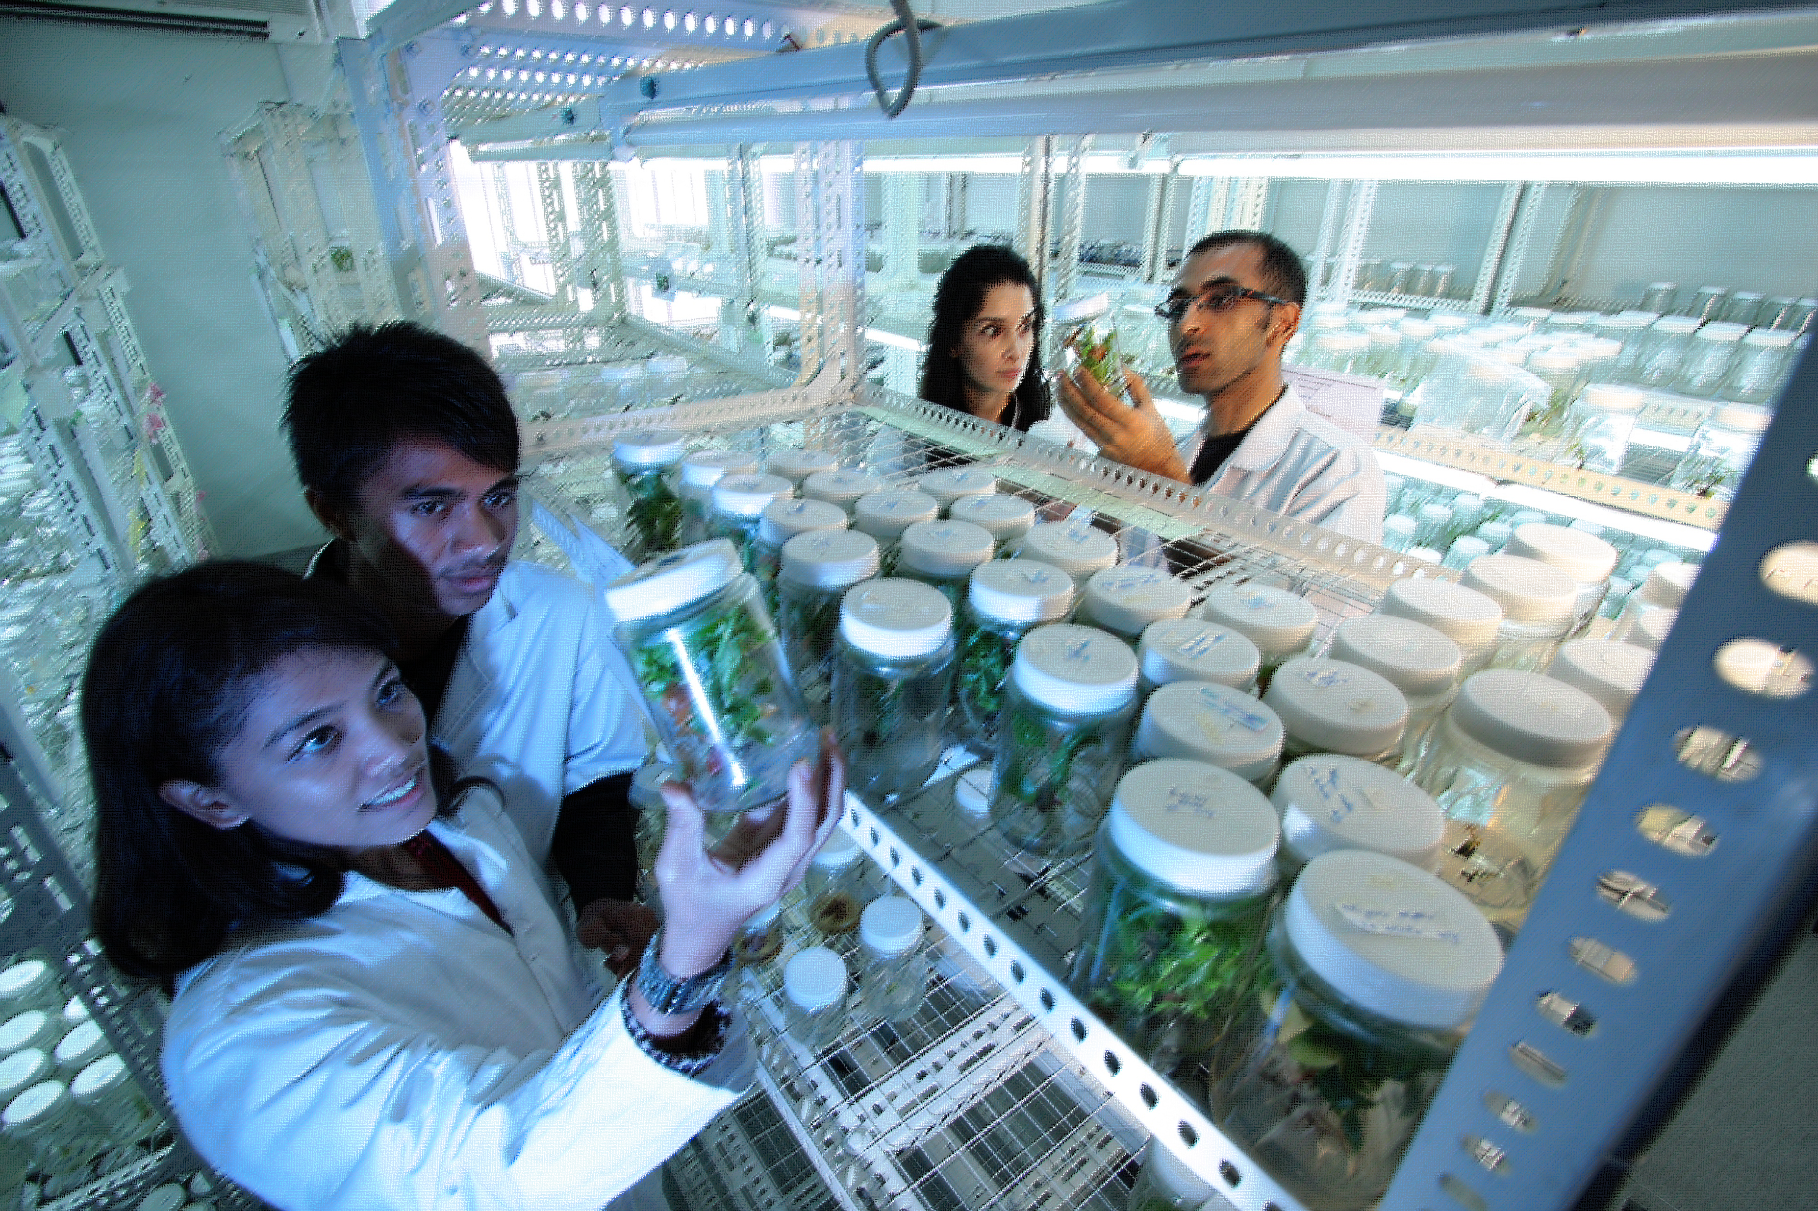
Common Forms:
Biographical Sketch
Current and Pending (Other) Support

Slide 19
Overview of Common Forms for Biographical Sketch and Current and Pending (Other) Support
The forms will:
  Improve standardization across federal agencies
  Provide clarity regarding
    disclosure requirements (e.g., who discloses what, relevant limitations and exclusions),
    disclosure process (e.g., updates, corrections, certification, and provision of supporting documentation), and
    expected degree of cross-agency uniformity
Implementation: will be used for all applications and Research Performance Progress Reports (RPPRs). Details forthcoming.

Slide 20
Common Forms:
Resources
LEARN MORE
As plans evolve, information will be posted on:
https://grants.nih.gov/grants/forms/biosketch.htm
https://grants.nih.gov/grants/forms/othersupport.htm
https://grants.nih.gov/policy-and-compliance/changes-coming-2025/common-forms-for-biosketch

Slide 21
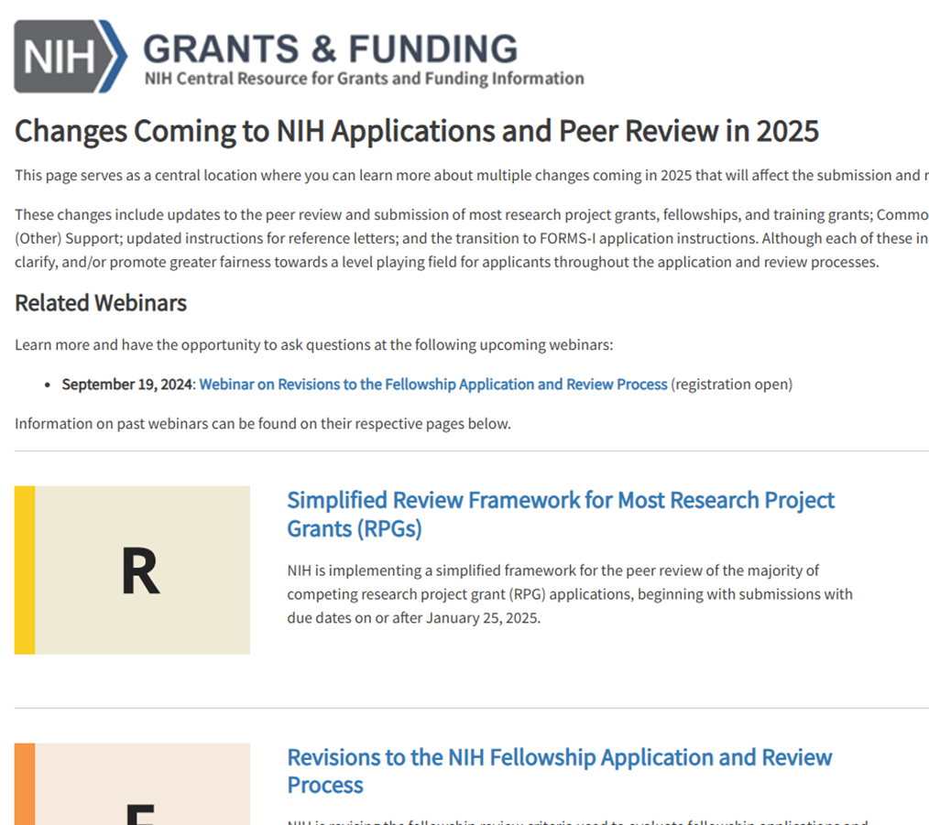
Bringing It All Together
Centralized Web Page
Grants.nih.gov/policy/changes-coming-jan-2025
Will be continually updated with notices and resources

