Slide 1


Ready, Set, Submit!
GRANT Application Preparation & Submission
November 2019

Slide 2

Where do I start?

Slide 3
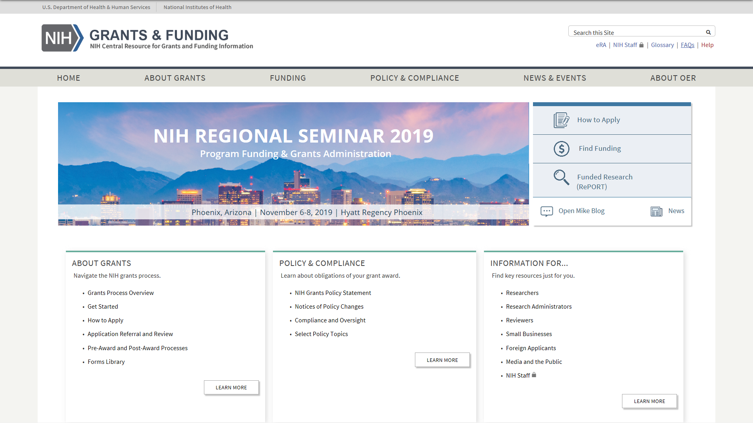

NIH Grants & Funding
Bookmark https://grants.nih.gov/
How to Apply- Application Guide

Slide 4
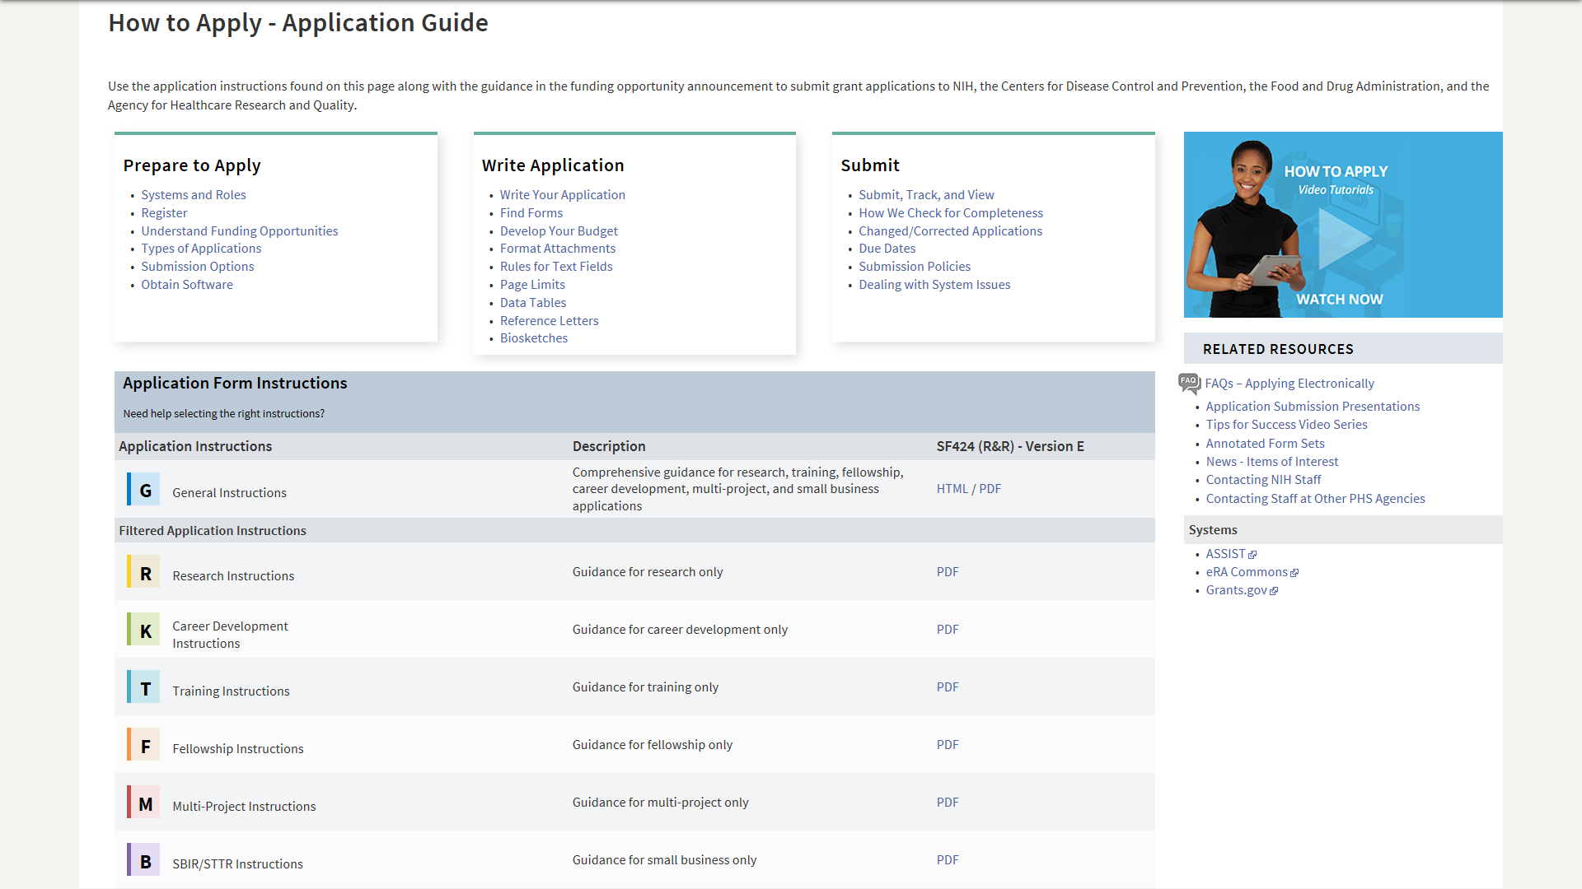
How to Apply – Application Guide
General Application Process Information
Resources
Form Instructions

Slide 5


Understand Key Systems & Roles
Grants.gov
eRA Commons
E-Business Point of Contact (EBiz POC)
Authorized Organization Representative (AOR)
Signing Official (SO)
Principal Investigator (PI)
https://grants.nih.gov/grants/how-to-apply-application-guide/prepare-to-apply-and-register/key-systems-and-roles.htm

Slide 6
What registrations are needed to submit a grant application to NIH?

Slide 7

If your organization isn’t registered, get started now!
Your organization must be registered in multiple systems to submit.
Start early – can take 6 weeks!

Slide 8

Organization Registration
DUNS – provides unique organization identifier
  NOT-OD-19-098 - Notification of Upcoming Change in Federal-wide Unique Entity Identifier Requirements
  GSA Unique Entity Identifier Update page
SAM (System for Award Management) – required to do business with government
  Requires annual renewal
Grants.gov – required to submit grants
eRA Commons – required to do business with NIH
SBA (Small Business Administration) – required for small business applications
https://grants.nih.gov/grants/how-to-apply-application-guide/prepare-to-apply-and-register/registration/org-representative-registration.htm

Slide 9

Individual eRA Commons Registrations
Who needs an eRA Commons account?
  At least one Signing Official (SO)
  Project Director/Principal Investigator (PD/PI) and any multiple-PD/PIs
  Component leads on a multi-project application
  Sponsor on a fellowship application
  Candidates for diversity and re-entry supplements
  Primary mentor identified on individual mentored career development applications
  Anyone doing data entry in ASSIST
  If awarded, additional individuals may need accounts for reporting purposes
https://grants.nih.gov/grants/how-to-apply-application-guide/prepare-to-apply-and-register/registration/investigators-and-other-users/era-commons-user-registration.htm

Slide 10
Where can I find grant funding opportunities?

Slide 11
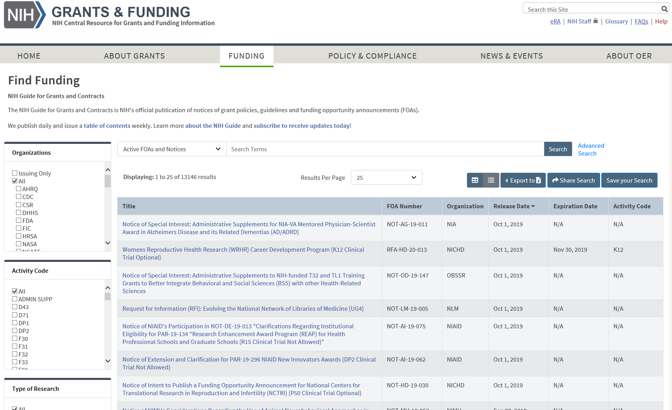
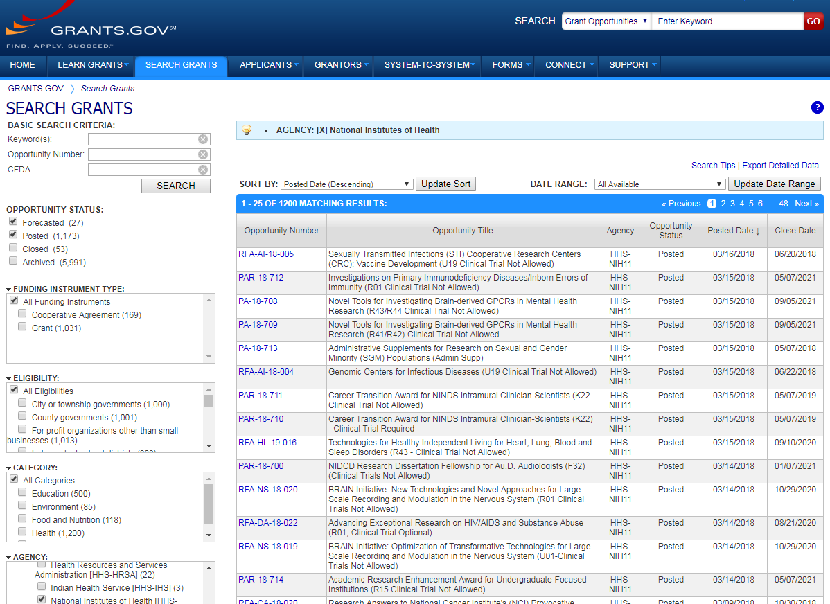
Funding Opportunity Announcements (FOAs)
NIH Guide for Grants & Contracts
Grants.gov Search Grants
Search both places. NIH Guide – searches full announcements & notices. Grants.gov – searches synopses & all agencies.

Slide 12
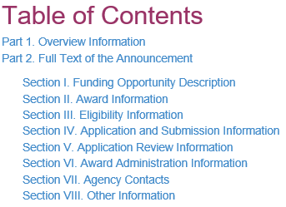

Funding Opportunity Announcement Content
Section IV. Application and Submission Information
Includes any FOA-specific submission instructions
Finding & Understanding
FOAs (Breakout 3F, Th. 1:45)

Slide 13
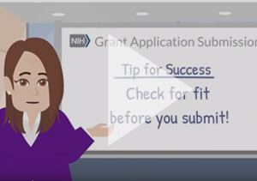
Check for fit before you submit!
Participating institutes
  FOA Part 1, Participating Organizations & Components of Participating Organizations
Program description
  FOA Part 2, Section I Funding Opportunity Description
Type of Application – New, Resubmission, Renewal, Revision
  FOA Part 2, Section II Award Information
Clinical trials allowability
  FOA Part 2, Section II Award Information
Eligibility
  FOA Part 2, Section III Eligibility Information
Tip: Check for fit, before you submit! (video) - https://www.youtube.com/watch?v=tTQSm4sQYl8&t=

Slide 14
Increased Use of Notices of Special Interest
Highlight areas of scientific interest
Designate existing FOAs to use for application submission
May include additional submission instructions that supersede the instructions in the FOA or application guide
  Most require the notice number in the Agency Routing Identifier field (4b) on the SF424 R&R form
May identify NIH Institutes or Centers participating in the notice initiative that are not listed in the FOA used for submission
  Including the notice number in the Agency Routing Identifier field alerts our Receipt & Referral staff of your intentions regarding Institute assignment

Slide 15
Where can I find the forms needed to submit a grant application ?

Slide 16

Application Forms
Each FOA has its own unique set of forms
Use one of the available submission options to access, prepare, and submit the forms needed to apply
Check with your administrative officials before choosing how to submit
https://grants.nih.gov/grants/how-to-apply-application-guide/format-and-write/find-forms.htm

Slide 17
What submission options does NIH support?

Slide 18




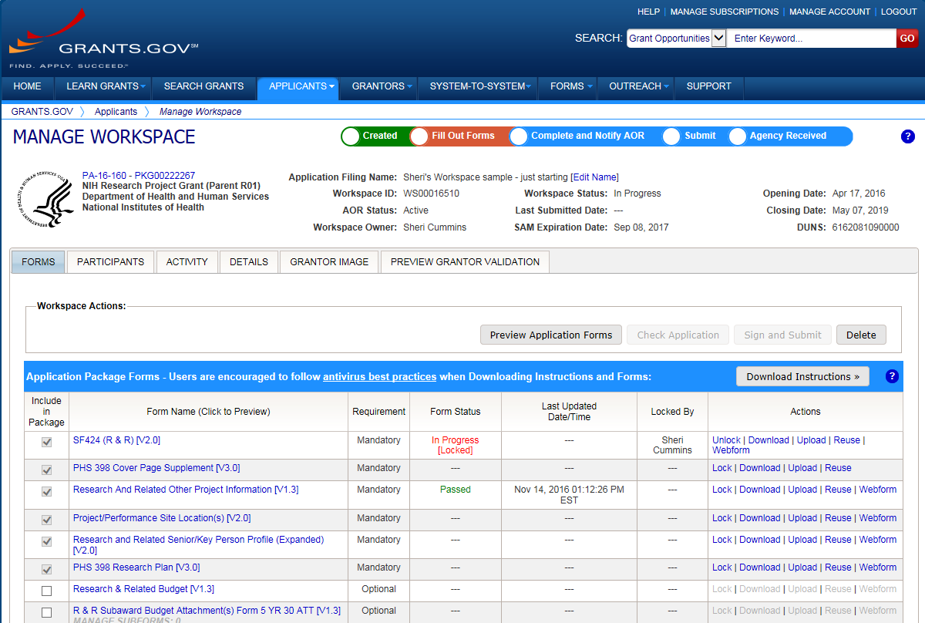




Submission Options Supported by NIH
ASSIST
System-to-System
Workspace
https://grants.nih.gov/grants/how-to-apply-application-guide/prepare-to-apply-and-register/submission-options.htm

Slide 19
Comparison of Submission Options
NIH ASSIST
Grants.gov Workspace
Managed by NIH
Multi-user access
Leverages eRA Commons accounts
Pre-population from eRA Commons profiles
Pre-submission validations
Pre-submission preview in agency format
Track application status in a single system
Copy data to different application package
Supports all NIH competing applications
Pull study information from ClinicalTrials.gov
Integrated NIH messaging (tips, system alerts)
Managed by Grants.gov
Multi-user access
Requires additional user registrations
No pre-population from existing profiles
Pre-submission validations
Pre-submission preview in agency format
Must track application in multiple systems
Reuse forms; copy application data
Supports NIH single-project competing applications (no multi-project support)
https://grants.nih.gov/grants/how-to-apply-application-guide/prepare-to-apply-and-register/submission-options/assist.htm
https://www.grants.gov/web/grants/applicants/workspace-overview.html

Slide 20



Your Application will be…
Subject to the same registration requirements
Completed with the same data items
Routed through Grants.gov
Validated against the same NIH business rules
Assembled in a consistent format for review consideration
Tracked in eRA Commons
…regardless of submission option used.

Slide 21
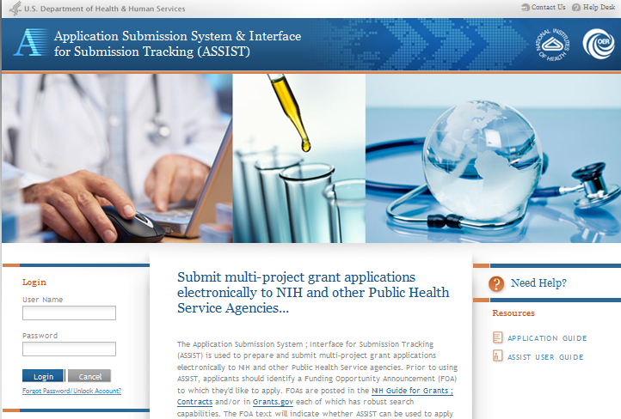
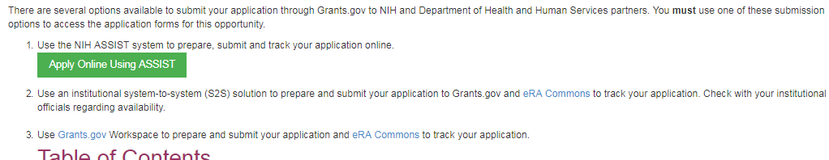
Access Application Forms via ASSIST
Excerpt from single-project FOA in NIH Guide…
Log in with eRA Commons credentials

Slide 22
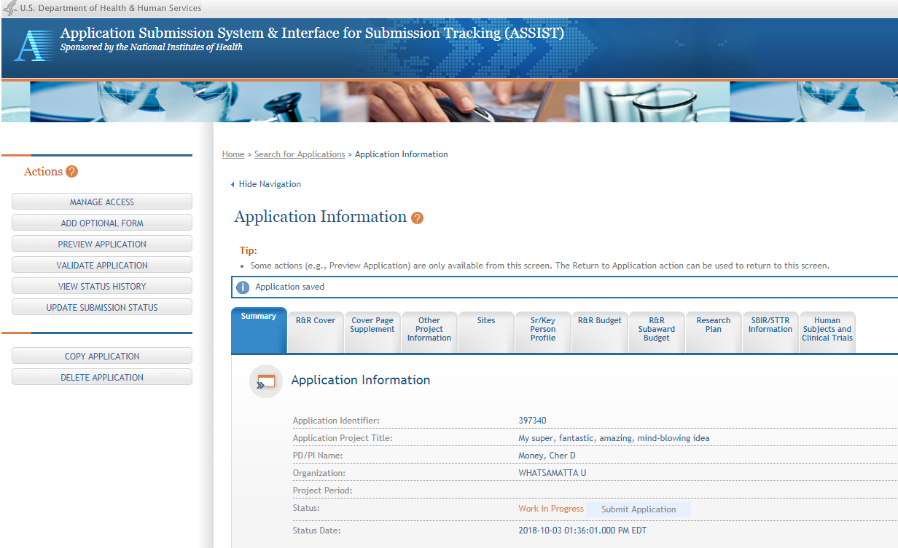
ASSIST screen layout
Application forms

Slide 23
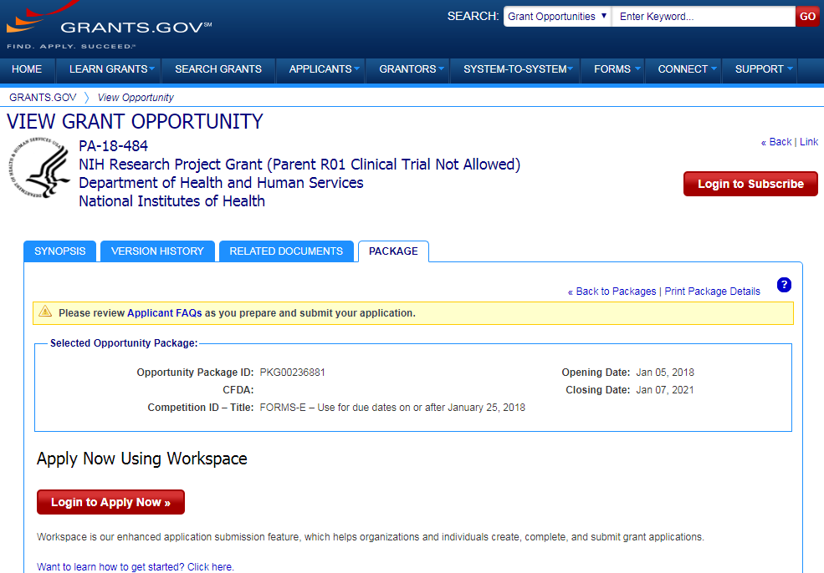
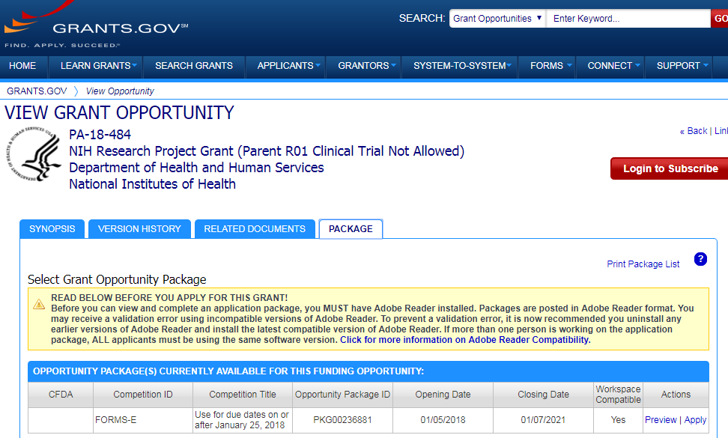
Access Application Forms via Workspace
Excerpt from single-project FOA in NIH Guide…

Slide 24
Sample Workspace Screen
Application forms list
Access forms using Download/Upload actions or enter data directly into Webform

Slide 25
Where can I find grant application instructions?

Slide 26
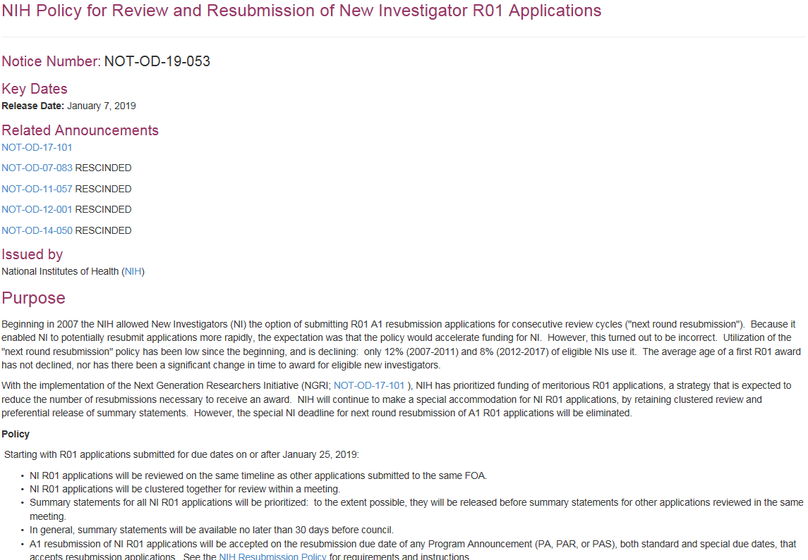
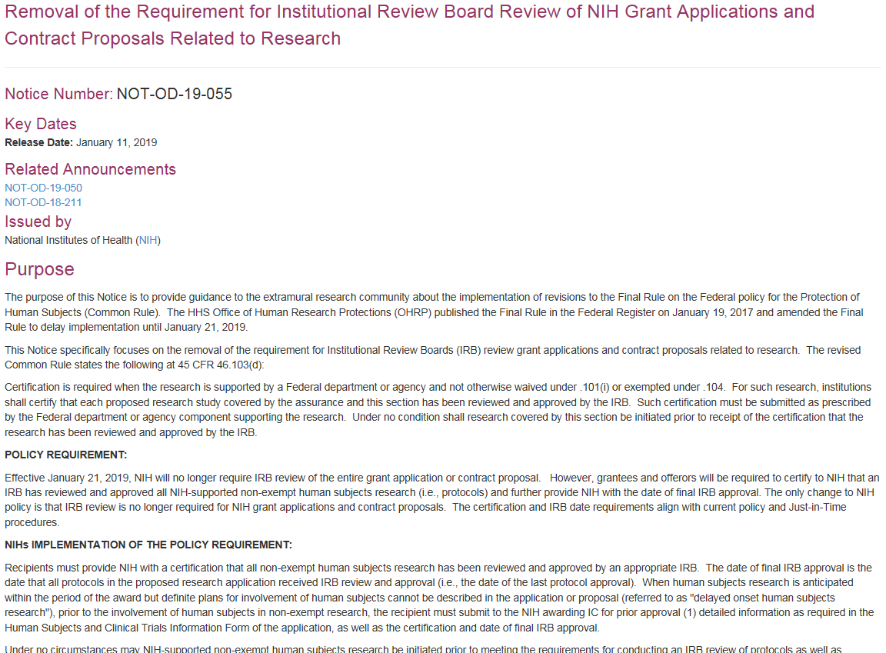

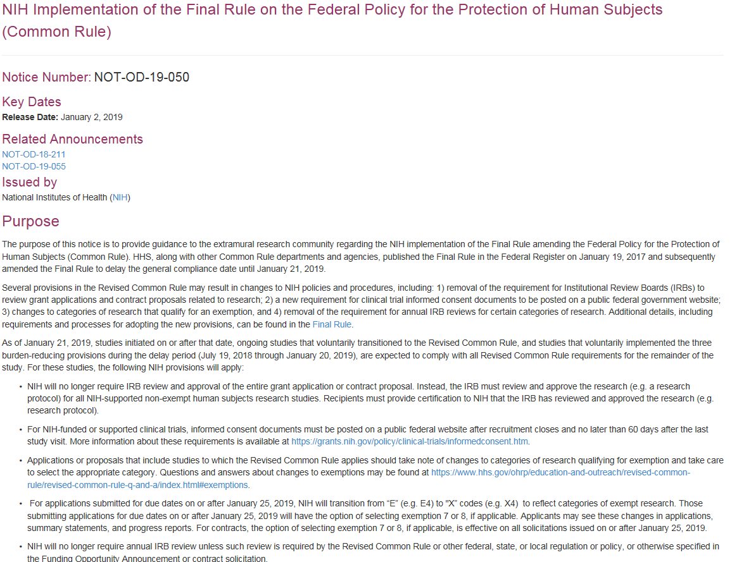
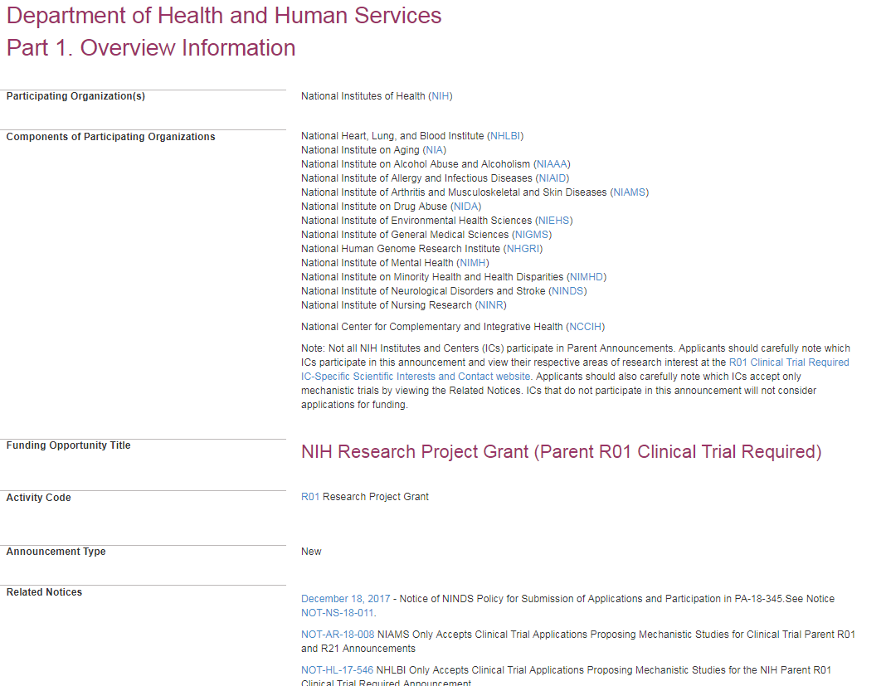
Grant Application Instructions
General Guidance | FOA-specific Guidance | FOA-specific & New Policy Updates
How to Apply - Application Guide | Funding Opportunity Announcement Section IV. Application and Submission Information | Notices in NIH Guide for Grants & Contracts
Least Precedence / Importance Most

Slide 27
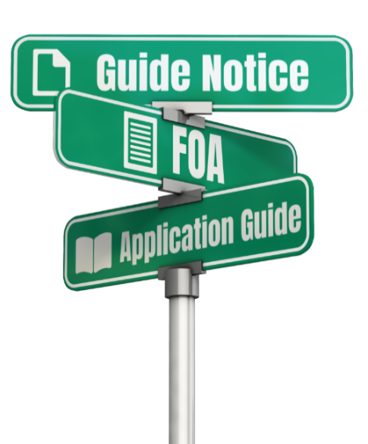

Example: What would you put in the SF424 R&R Agency Routing Identifier field given these instructions?
Excerpt from NOT-AG-19-012 - Notice of Special Interest: High-Priority Research Topic for PAR-19-070
  For funding consideration, applicants must include "NOT-AG-19-012" (without quotation marks) in the Agency Routing Identifier field (box 4B) of the SF424 R&R form. Applications without this information in box 4B will not be considered for this initiative.
FOA – no instruction for SF424 R&R Agency Routing Identifier
Application Guide

Slide 28
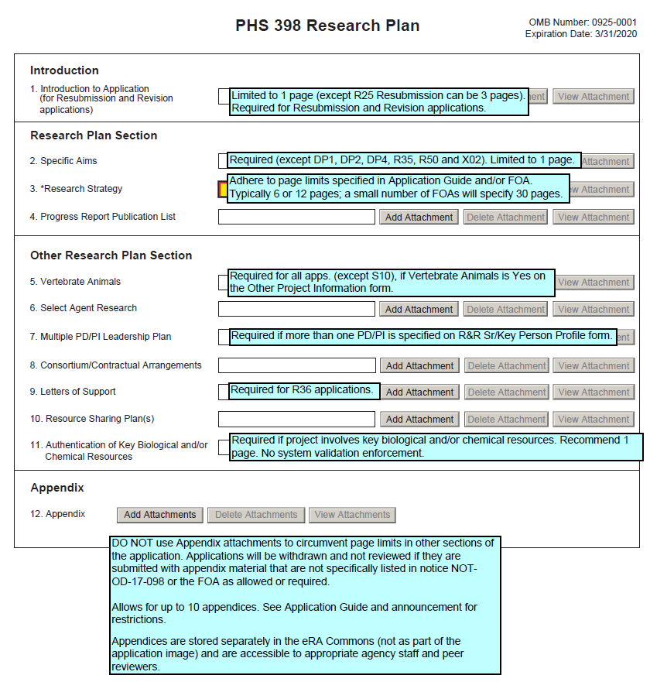
Handy Resource – Annotated Form Sets
Annotated form sets
  General, Small Business, and Multi-project versions available
  Visual reference for data collected on each form with annotations on general rules for many fields
Does not replace official Application Guide, FOA, or Guide notice guidance
https://grants.nih.gov/grants/how-to-apply-application-guide/resources/annotated-form-sets.htm

Slide 29
What are application attachments?

Slide 30
Attachments – The Good Stuff!
Application forms have several kinds of fields
  Check boxes, dates, data entry text fields, Attachments
Attachments
  Prepared outside the application using Word or other editing software, converted to PDF format, and then added or uploaded to the application
Upon submission, NIH combines prepared forms and related attachments into a single e-Application PDF document used by NIH staff and reviewers (often referred to as an “application image”)

Slide 31
Format Attachments Correctly
Use simple PDF-formatted files for all attachments (preserves applicant formatting)
  Disable security features such as password protection
Filenames must be unique within the application & 50 characters or less
Use meaningful filenames
  If FOA specifies a filename – use it!
Do not include headers or footers
  Section headings as part of the text (e.g., Significance, Innovation, Approach) are encouraged
Follow guidelines for fonts and margins
Follow specified page limits (Page Limits page; Section IV.2 of announcement)
https://grants.nih.gov/grants/how-to-apply-application-guide/format-and-write/format-attachments.htm

Slide 32
When is my application due?

Slide 33

On-time Submission
Each FOA or Notice of Special Interest indicates available due dates
Deadline = 5 pm local time of submitting organization
  All registrations must be complete and active before the deadline (including SAM renewals)
  Application must be free of all federal system-identified errors (Grants.gov & eRA)
Submit early!
  Measure early on a calendar, not a clock
  Allow time to correct any unexpected errors or submission issues

Slide 34

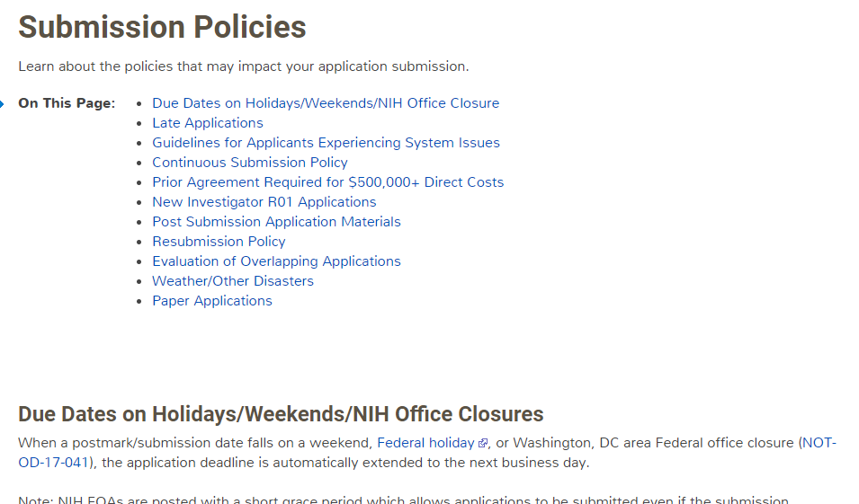

Submission Policies Page
https://grants.nih.gov/grants/how-to-apply-application-guide/due-dates-and-submission-policies/submission-policies.htm

Slide 35

Do you think your application would be accepted late under these circumstances?
1
PI has heavy teaching burden.
5
PI served on NIH study section the week of the due date.
Document in cover letter; submit in late window; high chance of acceptance.
Won’t be accepted.
Document in cover letter; submit in late window; high chance of acceptance.
2
Document in cover letter;
submit in late window; high chance of acceptance.
PI submitting R35 &
eligible for con-
tinuous submission.
6
PI in hospital on the due date.
3
Signing Official (SO) in hospital on the due date.
7
PD/PI on overseas travel during due date.
Without other extenuating circumstances, won’t be accepted.
Won’t be accepted.
Didn’t complete registrations; started 1 week before due date.
4
Without other extenuating circumstances, not likely to be accepted.
Problem with local system-to-system solution.
8
Not likely to be accepted.

Slide 36
How does NIH check my application for completeness?

Slide 37



Application Checks (Validations)
We really care about the details
Multiple levels of application checks for completeness
  Grants.gov
  eRA systems
  Agency staff
Check!
Check!
Check!
https://grants.nih.gov/grants/how-to-apply-application-guide/submission-process/check-your-application.htm

Slide 38

Sample Validations
Grants.gov
eRA Systems
Agency Staff
Active System for Award Management (SAM) registration
Submitter has AOR role for DUNS on application
Submission made to active opportunity and application package
Virus check
Filenames include only appropriate characters
Fields required by agency, but not required federal-wide
  R&R Sr/Key form
    Credential for PD/PIs
    Organization name for all sr/key
    Biosketch for all sr/key
  Performance Site form
    DUNS for primary site
Attachments in PDF format
Filenames 50 characters or less
Adherence to page limits in our Table of Page Limits
Required attachments included
Fit with NIH/Institute mission
Eligibility
“Overstuffing”
On-time submission
Adherence to funding opportunity announcement specific instructions
Font and margin guidelines
Simultaneous review of essentially same application

Slide 39
What are the main steps in the application submission process?

Slide 40








Application Submission Process
Step 1: Find Opportunity
Step 2: Plan your Submission
Step 3: Initiate application
Step 4: Build team
Step 5: Enter data
Step 6: Finalize Application
Step 7: Submit
Step 8: Track & View Application in eRA commons

Slide 41
What does the application preparation & submission process look like using ASSIST?
Preparing & Submitting Multi-project Grant Applications Using ASSIST (Breakout 8B, Fri. 12:30)

Slide 42
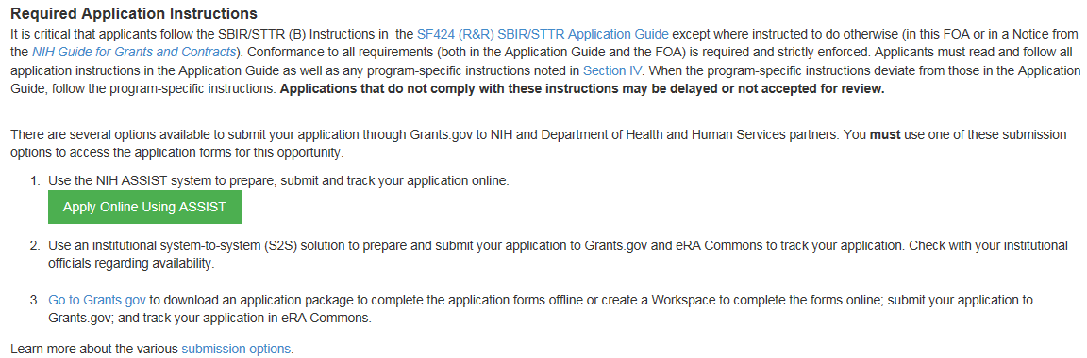

Login to ASSIST & Initiate Application
Excerpt from FOA in NIH Guide…
https://public.era.nih.gov/assist
Login with eRA Commons Username & Password

Slide 43
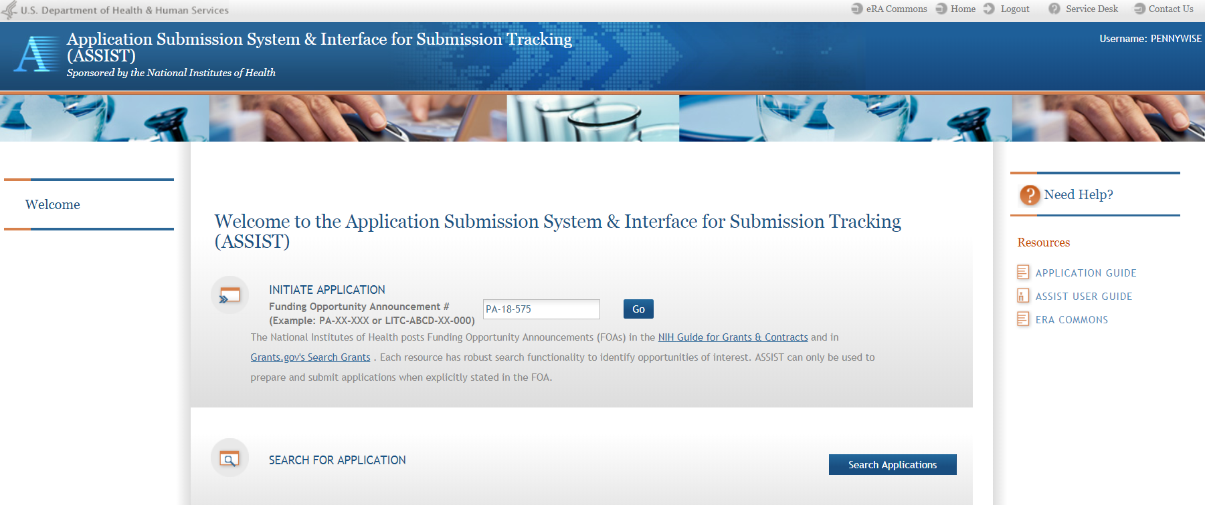
ASSIST Welcome Screen
Initiate Application

Slide 44
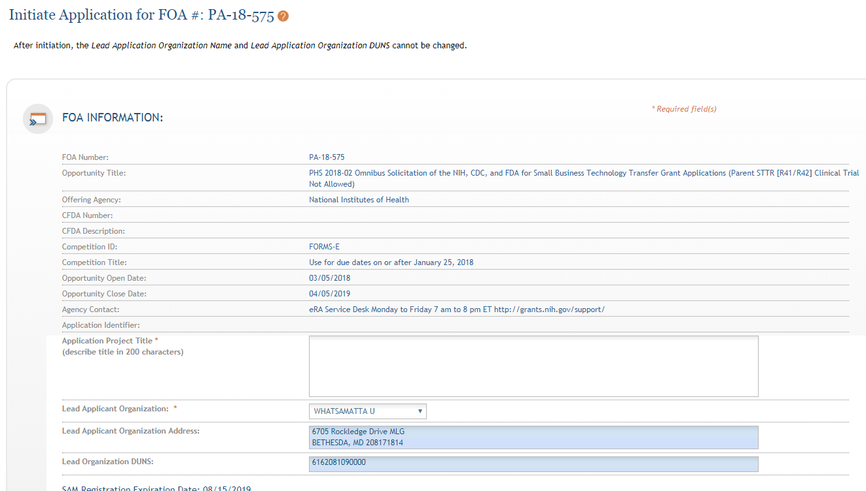
ASSIST Initiate Screen
Enter Project Title
Drop-down list of organizations affiliated with your eRA Commons account
Data pre-populated from organization selection
44

Slide 45
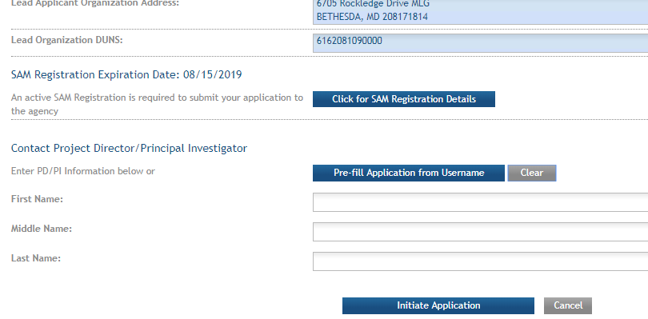
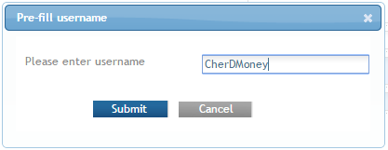
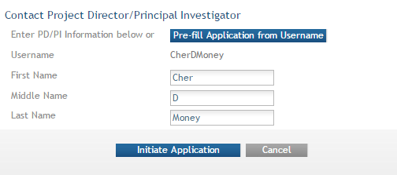
Initiate –
Pre-population
Visibility to SAM registration expiration date & details
Can manually enter PD/PI information or provide eRA Commons username to auto-populate

Slide 46
Screen Layout
Breadcrumb navigation
Access online help
Screen tips
ASSIST messages
Form navigation
Actions - vary based on application context and access

Slide 47
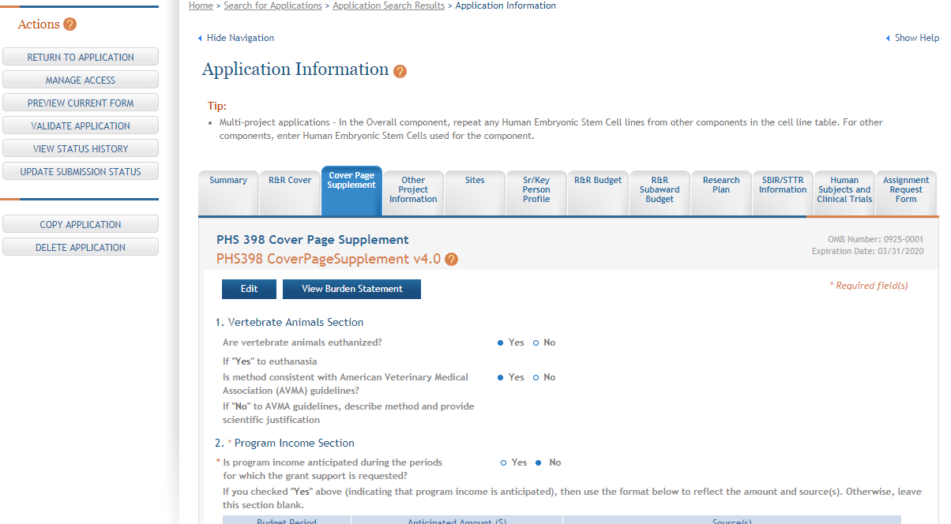
Data Entry Screens - Edit
Click each tab to access form data entry screens
Clicking Edit blocks other users from editing form

Slide 48
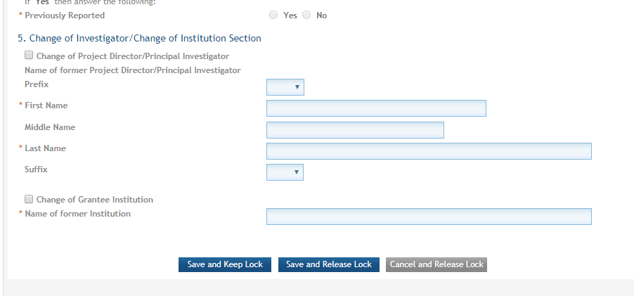
Data Entry Screens - Save
Save and continue to lock out others from editing this form
Save and release lock on form so others can edit this form

Slide 49
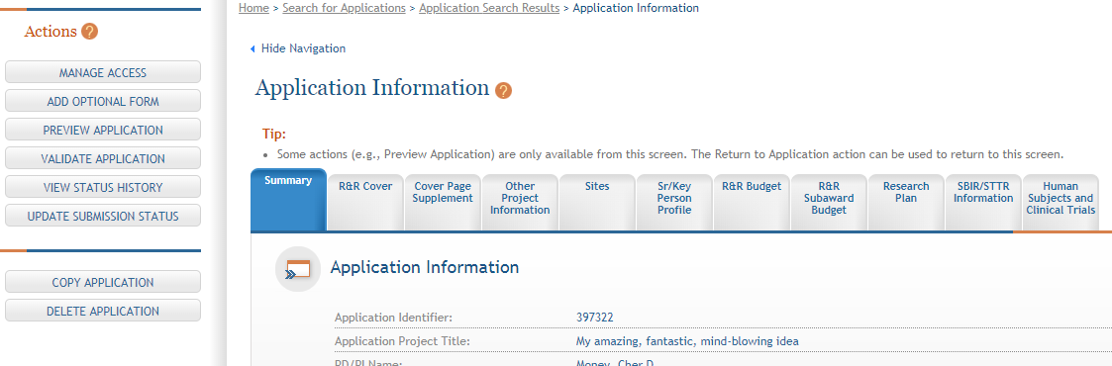
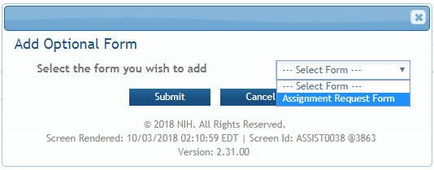
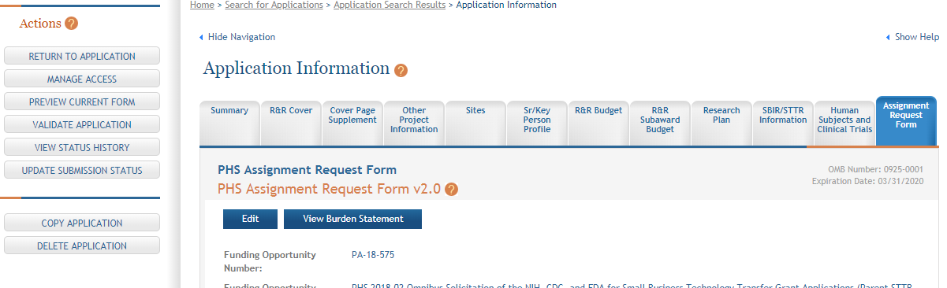
Add
Optional Form
Select form and click Submit
The form tab is added to navigation

Slide 50
Finalize Your Application
Validate your application data against system-enforced NIH business rules
Generate a pre-submission image of your assembled application in the NIH format
Update Submission Status to “Ready for Submission”

Slide 51
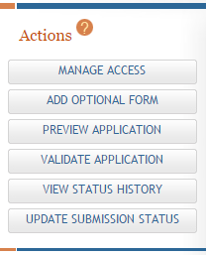
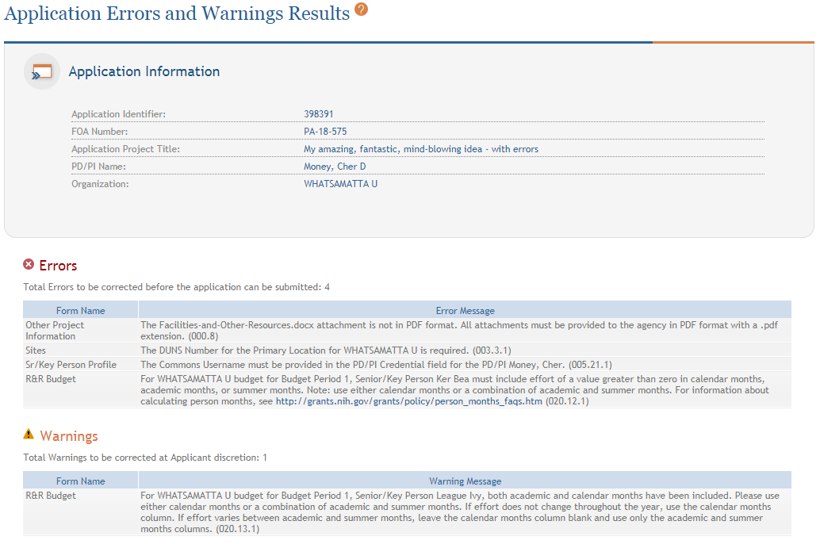
Validate Application
Errors and Warnings are displayed

Slide 52


Corrective submissions must be made BEFORE the submission deadline and overwrite previous submissions.
Errors stop application processing and must be corrected
  You will be unable to submit in ASSIST until all identified errors are corrected
Warnings do not stop application processing and are corrected at the discretion of the applicant

Slide 53
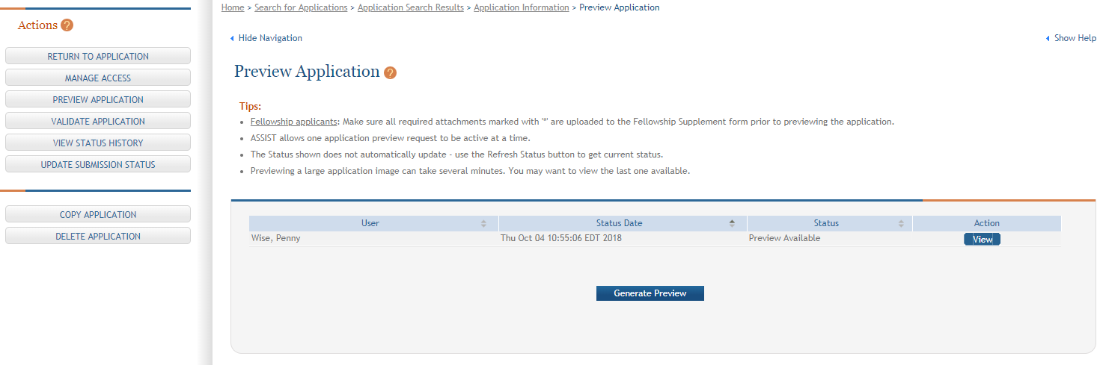
Generate Application Preview in Agency Format
View last preview
Generate new preview

Slide 54
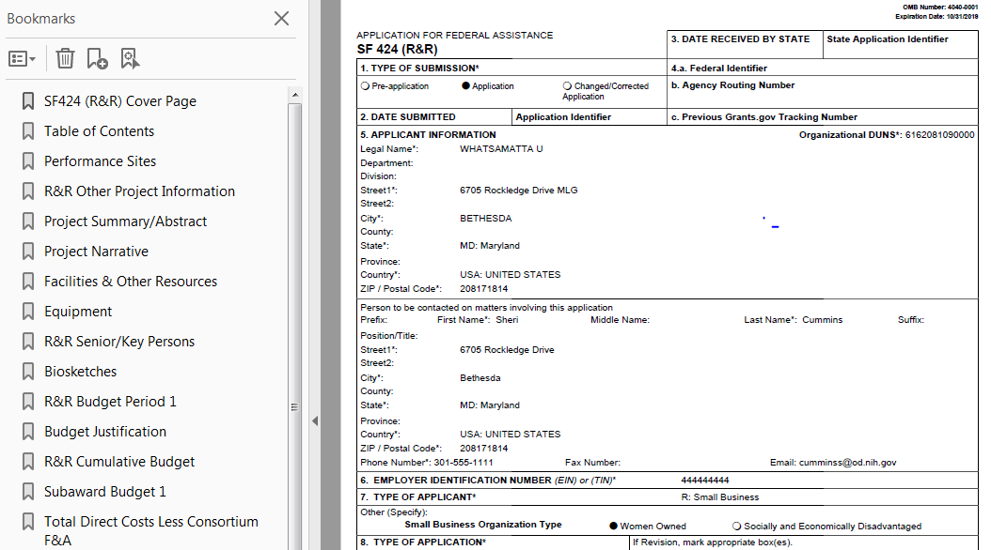
Application Preview
The preview is exactly how your application would be assembled upon submission, except a few items in the footer (e.g., Grants.gov tracking number, submission timestamp) are not filled in.

Slide 55
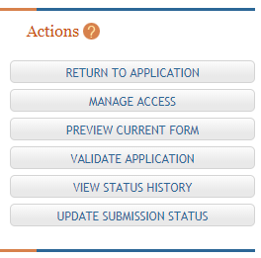
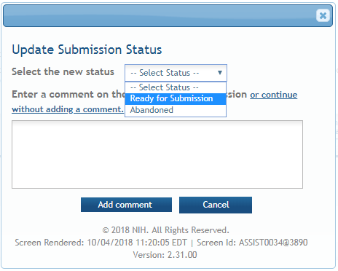
Update Submission Status
Select status
Enter comment to be added to status history

Slide 56
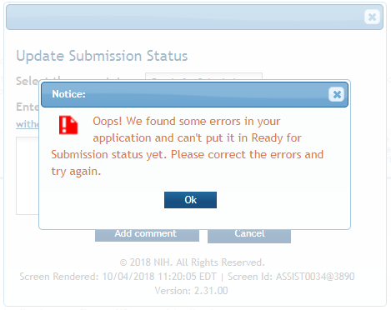

Final Check for Errors
Before an application is changed to Ready for Submission status, it must pass validations (Warnings are OK).

Slide 57
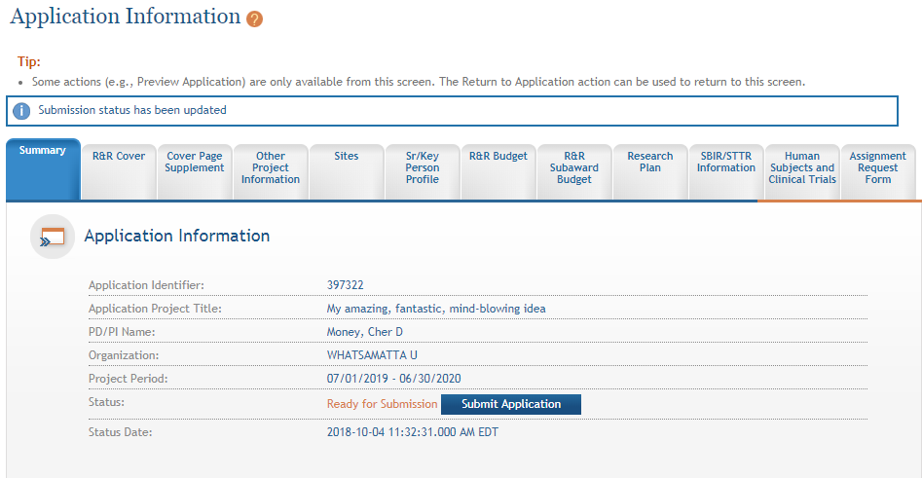
Updated Status Reflected in Summary Tab

Slide 58
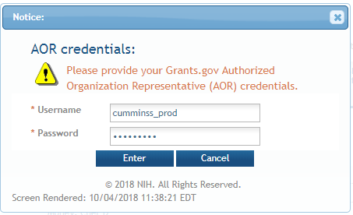
Submit Application
For Submit button to be active, user must be logged into ASSIST with an SO account and the application must be in a Ready for Submission status.

Slide 59
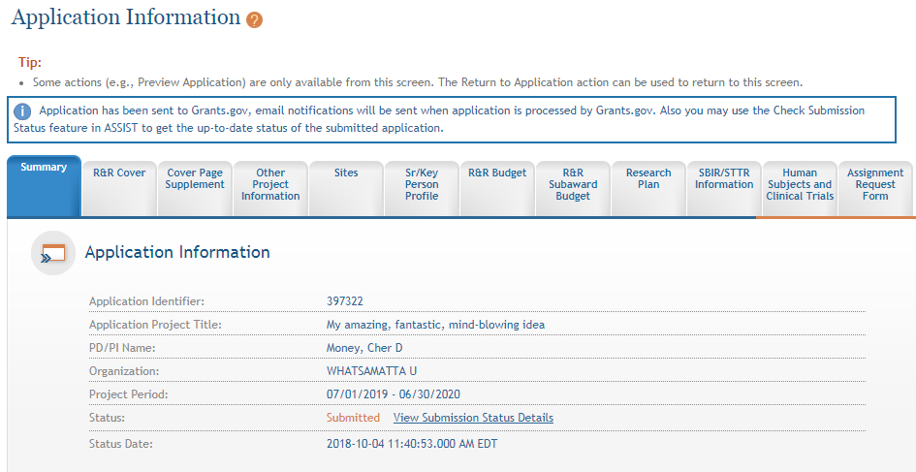
Application Sent to Grants.gov
Message indicates application has been sent to Grants.gov.

Slide 60

You’re Not Finished Yet…
Application
Successfully
submitted
to NIH
Submitting to Grants.gov is NOT the last step in the process!

Slide 61
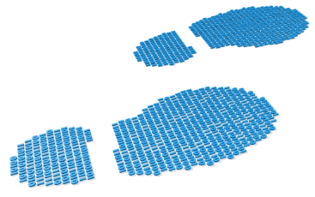
Track Your Application
eRA Commons Status is an integral part of your submission
  Applications that pass Grants.gov validations are picked up by eRA Commons and checked against many application guide and opportunity instructions
Authorized users can check eRA Commons Status for processing results
  Signing Officials (SOs)
  Administrative Officials (AOs)
  Principal Investigators (PIs)
  Delegated Assistants (ASSTs)
E-mail notifications sent

Slide 62
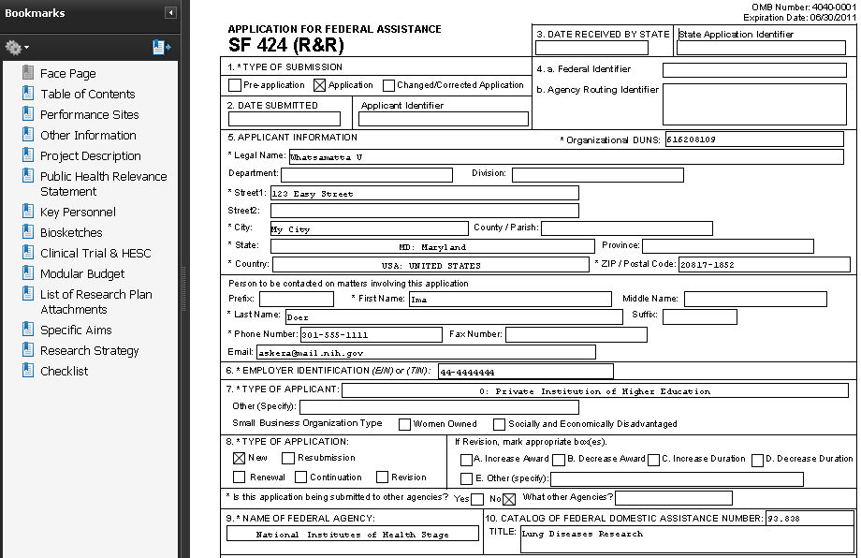

Application Image Assembly
Once an error-free application is received by NIH, the eRA system will:
  Assemble the grant application image
  Insert headers (PI name) and footers (page numbers) on all pages
  Generate Table of Contents and bookmark important sections
  Post the assembled application image in the PD/PI’s eRA Commons account
  Send notification
    Email can be unreliable – proactively
    check application status

Slide 63

Application Viewing Window
Applicants have two (2) business days to view the assembled application image before the application automatically moves forward for further processing
Signing official can Reject application in eRA Commons within viewing window to prevent it from moving forward to NIH
Changed/Corrected applications must be submitted before the submission deadline
If you can’t VIEW it, we can’t REVIEW it!

Slide 64
View Submission Status Details
Submit button replaced with link to track status.

Slide 65
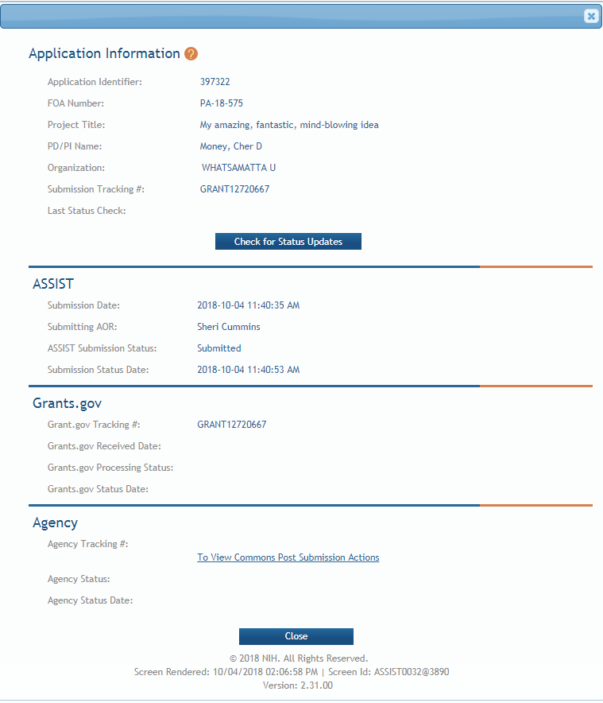
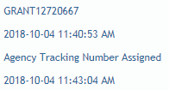

Follow status through all systems.
It can take anywhere from a few minutes to a few hours to process an application
You may have to click the Check for Status Updates button multiple times before status shows for all systems.

Slide 66
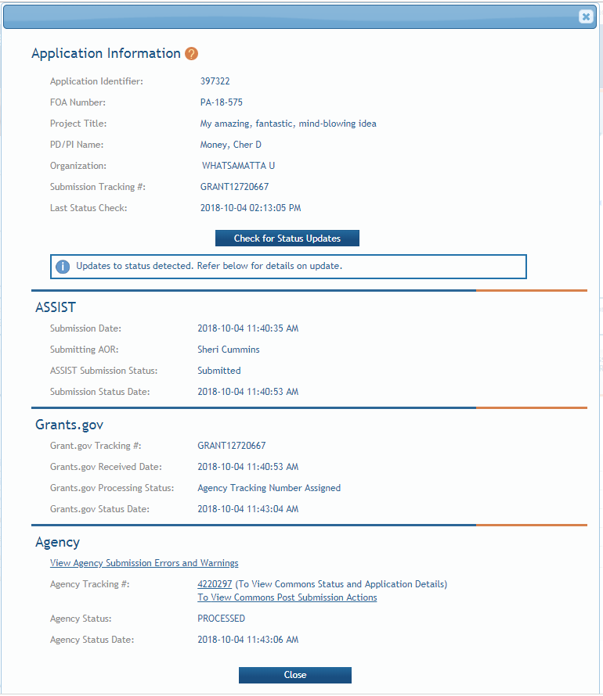
Assignment of Agency Tracking Number indicates application image is available.
Grants.gov tracking number and timestamp used to determine on-time submission.
Direct link to eRA Commons detailed status screen for the submission.

Slide 67
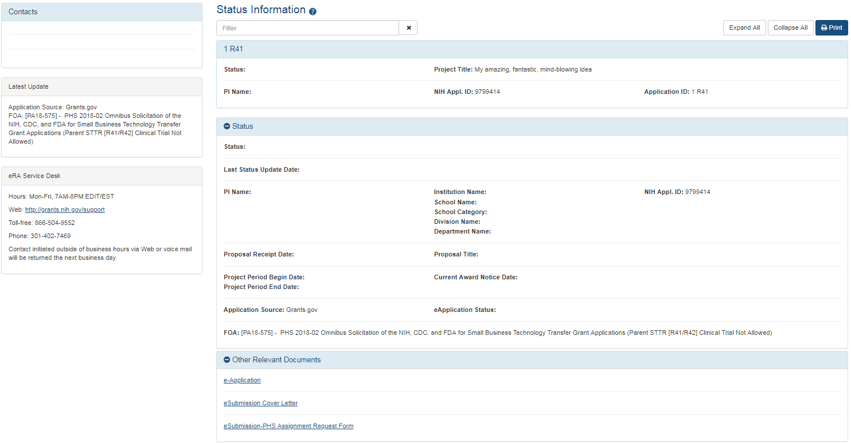
Viewing Your Application in eRA Commons
eApplication is the application image used by NIH staff and reviewers.
Cover Letter, PHS Assignment Request Form, and Appendices (when allowed) are stored separate from the image.

Slide 68
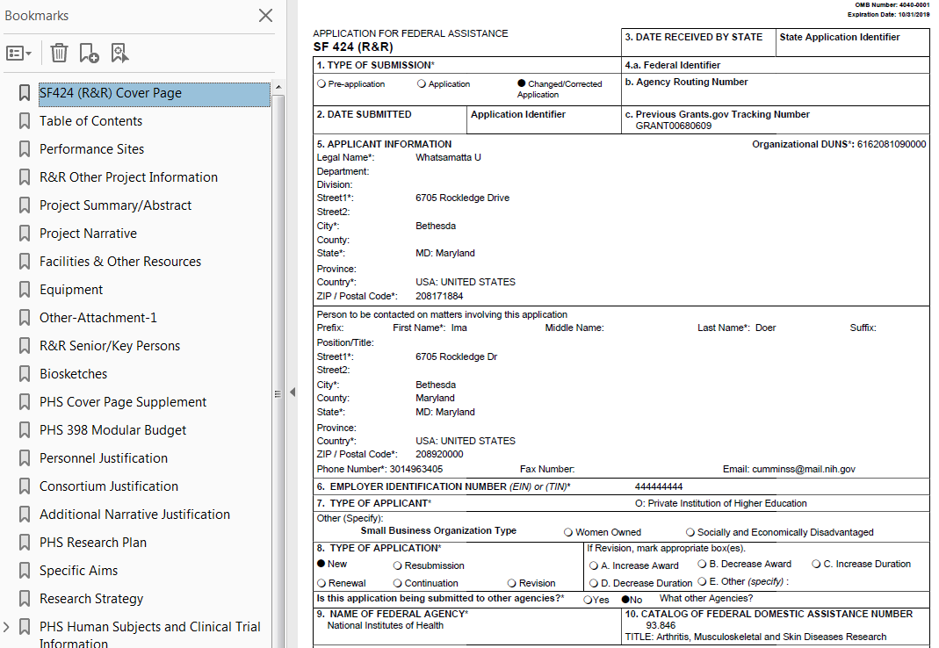
View Application Image (e-Application)
If you can’t VIEW it, we can’t REVIEW it!
Closely check the version in eRA Commons, even if you checked the preview.

Slide 69

Submission Complete!
If no action is taken during the two business day viewing window, the application automatically moves forward for further processing at NIH
Interacting Electronically with NIH: How eRA Commons
Fits into the Grant Process Puzzle (Breakout 3B, Th. 1:45)

Slide 70
What’s new or happening soon?

Slide 71
Applications Proposing Use of Human Fetal Tissue (HFT)
NIH Guide Notices: NOT-OD-19-128, NOT-OD-19-137
  Due dates on/after September 25, 2019
  Applications proposing the use of human fetal tissue (HFT) from elective abortions must include
    Justification of the use of HFT
    Details regarding procurement and costs (using R&R Budget form)
    Information about how the applicant will use HFT
  Applications that do not address all required information will be withdrawn without review

Slide 72
ORCID iDs
ORCID iDs are free, unique identifiers
  Connect researchers and their contributions to science over time and across changes of name, location, and institutional affiliation
NIH Guide Notice: NOT-OD-19-109
  Due dates on/after January 25, 2020
  PD/PIs on Fellowship and Career Development applications must have ORCID iDs linked to their eRA Commons Personal Profiles at time of application

Slide 73
Updated Application Forms (FORMS-F)
Update reflects latest versions of forms approved by the Office of Management and Budget (OMB)
Must use application packages with a Competition ID of “FORMS-F” for due dates on/after May 25, 2020
Resources
  NIH Guide Notice
  Preview of Grant Application Form Changes (FORMS-F)
  Do I Have the Right Forms for my Application?
  FAQs

Slide 74
Unique Entity Identifier (UEI)
NIH Guide Notice – NOT-OD-19-098
Effort led by U.S. General Services Administration (GSA) to transition from DUNS to a SAM-issued identifier to uniquely identify entities doing business with the government
  GSA Unique Entity Identifier Update page
Future application form changes are likely, but are not planned as part of FORMS-F update

Slide 75
What resources are available to help me with the process?

Slide 76
Help Desks
eRA Service Desk
Grants.gov Contact Center
Web: https://grants.nih.gov/support/
Phone: 1-866-504-9552
Hours : Mon-Fri, 7a.m. to 8 p.m. ET
Toll-free: 1-800-518-4726
Hours : 24x7 (Except Federal Holidays)
Email : support@grants.gov
Resources: https://www.grants.gov/web/grants/support.html

Slide 77
Online Resources & Websites
NIH Grants and Funding
https://grants.nih.gov/grants/oer.htm
How to Apply – Application Guide
https://grants.nih.gov/grants/how-to-apply-application-guide.html
Annotated form sets
https://grants.nih.gov/grants/how-to-apply-application-guide/resources/annotated-form-sets.htm
Preparing Your Application Using ASSIST
https://grants.nih.gov/grants/how-to-apply-application-guide/prepare-to-apply-and-register/submission-options/assist.htm

Slide 78

Stay Connected – Subscribe to Listservs
Electronic Research Administration (eRA) News
  For administrators, principal investigators, and the people that support them
  Used by NIH to notify the community of information related to eRA Commons, ASSIST and eSubmission
NIH Guide to Grants and Contracts
  Weekly summary of all NIH Guide announcements and notices
NIH Extramural Nexus
  Regular updates on NIH grants policies and activities that impact the entire
  grants community
https://grants.nih.gov/news/subscribe-and-follow/listservs_and_rss.htm

Slide 79

Questions?

