Slide 1
Revisions to the Fellowship Application and Review Process
Drop-in slides – the first 7 can be used as a set; slides 10-14 are provided in case you’d like to present in more detail
Updated: April 18, 2024

Slide 2
Use these slides if you want to cover the topic briefly

Slide 3
Changes Coming:
Revisions to NIH Fellowship Application and Review Criteria
Aims:
Better focus reviewer attention on three key assessments: the fellowship candidate’s preparedness and potential, research training plan, and commitment to the candidate.
Ensure that a broad range of candidates and research training contexts can be recognized as meritorious by clarifying and simplifying the language in the application and review criteria.
Reduce bias in review by emphasizing the commitment to the candidate, without undue consideration of sponsor and institutional reputation.
Scope:
Applies to all fellowship applications submitted for due dates after January 25, 2025
Guide Notice
NOT-OD-24-107

Slide 4
Impending changes to NIH fellowship process
Why?
Community concerns about fairness, bias, and openness of the process
NIH data show applications are highly concentrated in a small number of institutions
NIH data show applications from senior sponsors and institutions that submit many applications do much better than other applications
The aim is to encourage candidates from broader academic, institutional, and research backgrounds to apply

Slide 5
Highlights of the Changes
Redefined review criteria
  Candidate criteria encompasses a wider range of indicators of scientific potential and preparedness to better identify promising scientists
  The Research Training Plan reframes the research project in terms of its value as a training vehicle and as part of the overall training plan of the fellowship
  Evaluations of the sponsor and institutional environment de-emphasize track record and instead emphasize their contributions to the current candidate’s research training plan
Revised fellowship application
  Shorter, more structured, aligned with the new review criteria
  Less emphasis on sponsor track record, more emphasis on the research training plan and candidate preparedness
  Defined who should author each section
  Updated Reference Letter instructions

Slide 6








Reorganized Fellowship Review Criteria
Current Fellowship Review Headings
New Fellowship Review Headings
Fellowship Applicant
Sponsors, Collaborators, Consultants
Research Training Plan
Training Potential
Institutional Environment & Commitment to Training
Candidate Preparedness and Potential
Research Training Plan
Commitment to Candidate
No changes to Additional Review Criteria or to Additional Review Considerations
Notes:
No changes to Additional Review Criteria (e.g., Protections for Human Subjects; Inclusion of Women, Minorities and Individuals Across the Lifespan; etc.) or to Additional Review Considerations (e.g., Training in the Responsible Conduct of Research, Resource Sharing Plans, Budget, etc.).

Slide 7
Notable Revisions to Application Instructions
Applicant Section (now “Candidate Section”)
  Candidate biosketch: Grades will no longer be required or allowed
  Candidates will be required to submit four personal statements: (1) professional and fellowship goals; (2) fellowship qualifications; (3) self-assessment; and (4) scientific perspective
Research Training Plan Section
  The headings of some sections have been revised to emphasize the importance of training in the fellowship plan
  The section Selection of Sponsor and Institution has been removed in favor of including the information elsewhere in the application
  The sections include: (1) Training Activities and Timeline; (2) Research Training Project Specific Aims; (3) Research Training Project Strategy, including the Scientific Foundation & Rationale and Approach
Candidate Sponsor and Co-sponsor Section (now “Commitment to Candidate, Mentoring, and Training Environment”)
  Sponsors and Co-sponsors will be required to submit five statements: (1) Mentoring Approach and Candidate Mentoring Plan; (2) Prior Commitment to Training and Mentoring; (3) Commitment to the Candidate’s Research Training Plan; (4) Research Training Environment; and (5) Candidate’s Potential. A sixth statement on Clinical Training will be required for candidates proposing to gain clinical trial experience

Slide 8
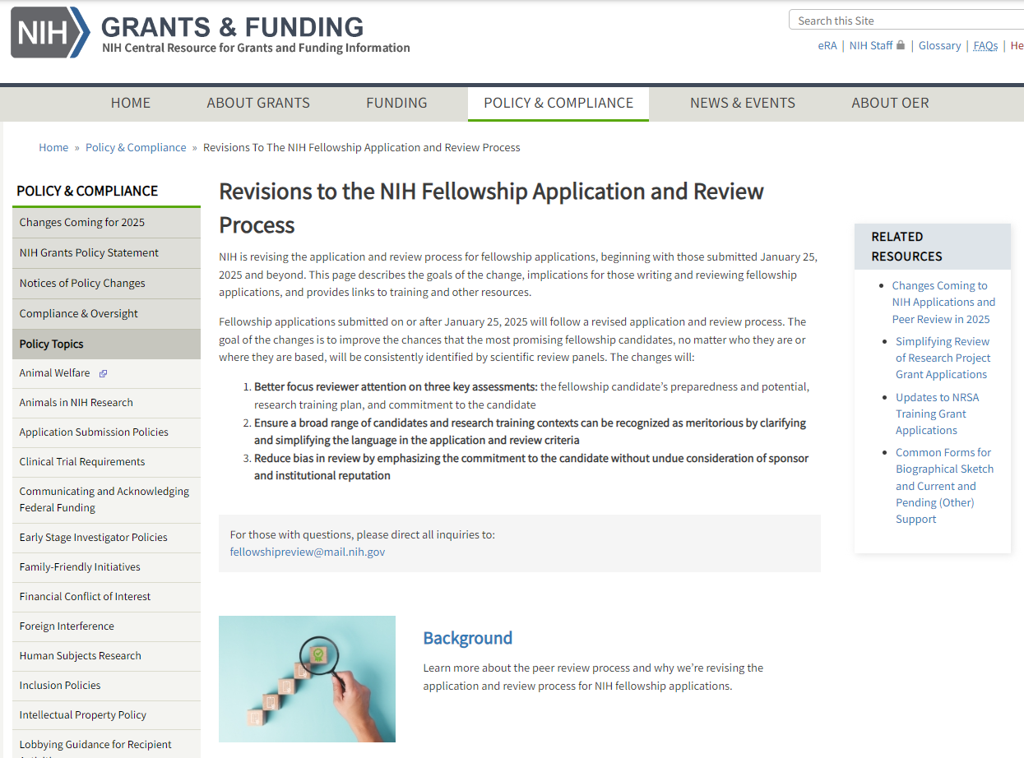
Public Website on the Revisions to Fellowship Application and Review
Rational for the revisions
Description of the changes to application and review
Applicant guidance
Reviewer guidance
Training and resources
Notices, blogs, and reports
FAQs
Contacts
Link: grants.nih.gov/policy/peer/revisions-nih-fellowship-application-review-process.htm

Slide 9
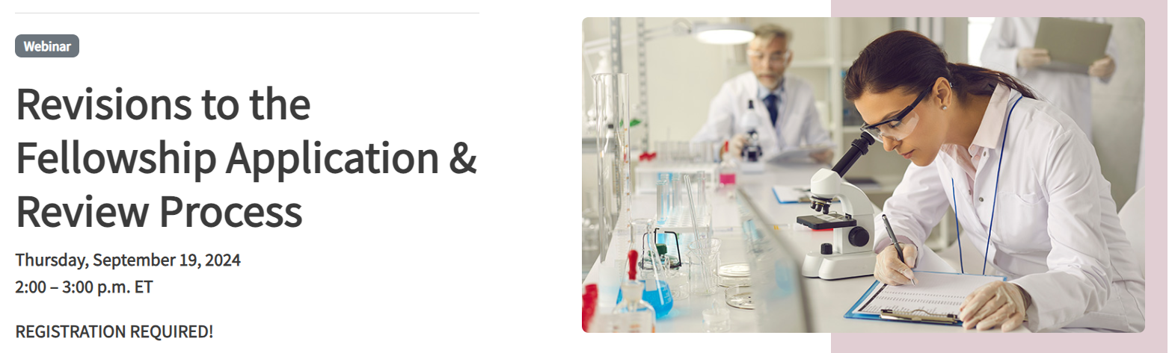
Public Webinar – September 19, 2024
Join us for a public webinar on September 19, 2024, from 2 – 3PM ET
This webinar will explain the changes coming to the NIH fellowship application and review process and offer an opportunity to have your questions by NIH experts during a live Q & A
Register at: grants.nih.gov/learning-center/fellowship-application-review-process-revisions-webinar

Slide 10
Use these slides for additional background

Slide 11
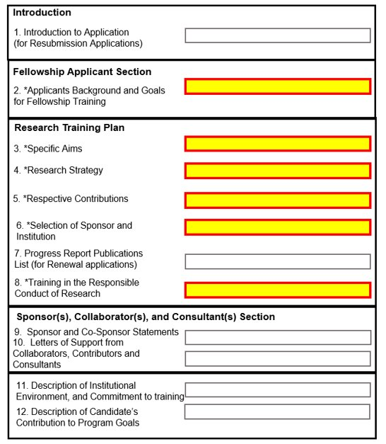
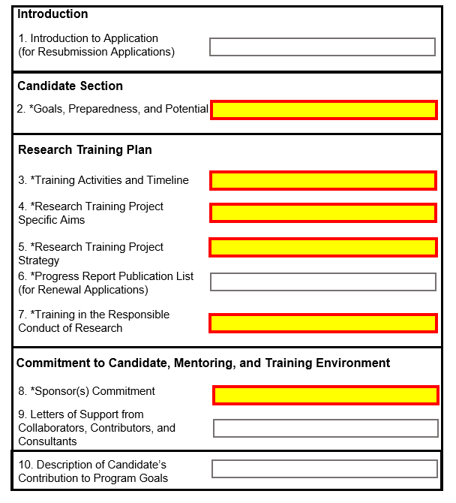
Revisions to the Fellowship Application Structure
Highlighted sections reflect changes to the application structure

Slide 12
The Changes are Meant to Cast a Wider Net
The changes are meant to make the application process simpler and more equitable.
  The revised review criteria allow NIH to ‘cast a wider net’ in identifying promising scientists by decreasing the reliance on narrow markers of academic success and reducing the impact of sponsor or institutional reputation. The aim is to encourage candidates from broader academic, institutional, and research backgrounds to apply.

Slide 13
Tips for Applicants – What Application Forms do I Need?
Forms and instructions for applications submitted after January 25, 2025 will become available in late November 2024. These forms and instructions will be included in the notices of funding opportunities; supplemental application instructions will also be available on the Grants Application Guide.
  Are you applying for a fellowship prior to Jan 25, 2025? Use the current forms and instructions referenced in active funding opportunities and on the Grants Application Guide. For NIH-wide funding opportunities, standard due dates are available here.
  Because forms and instructions are changing significantly for application due dates on or after January 25, 2025, candidates planning to apply after January 25, 2025 may wish to wait for updated forms and instructions coming in the fall of 2024 before preparing their applications

Slide 14
Tips for Applicants – Can I Use an Old Application as a Template?
Applications submitted on or after January 25, 2025 will differ significantly from those submitted previously. Changes will affect the materials submitted by the candidate, sponsor(s), and referees.
NIH is revising the instructions for reference letter writers. Revised instructions will be available on the NIH Grants page on Reference Letters later in 2024.
  The changes are meant to ensure that letters better assist reviewers in understanding the candidate’s strengths, opportunities for growth, and potential to pursue a productive career within the biomedical research workforce. This means that letter writers will need to carefully tailor new letters to the candidate’s application.

Slide 15
Tips for Applicants – What About Resubmissions?
Resubmission applications will be reviewed as they are presented at the time of receipt using the guidelines in place for that application due date.

