Slide 1

Tutorial of iCn3D Structure Viewer
Jiyao Wang, Staff Scientist, NIH/NLM/NCBI, 8/7/2023
Platforms:
  Web: https://structure.ncbi.nlm.nih.gov/icn3d
  Jupyter Notebook: https://pypi.org/project/icn3dpy
  Python Scripts: https://github.com/ncbi/icn3d/tree/master/icn3dpython
  Node.js Scripts: https://github.com/ncbi/icn3d/tree/master/icn3dnode
  VR: VR Headset (e.g., Meta Quest 2)
  AR: Android Phone
  3D Printing: Web: iCn3D Menu “File > 3D Printing”
Source Code:
  GitHub: https://github.com/ncbi/icn3d
  npm: https://www.npmjs.com/package/icn3d

Slide 2

Simplify Menus
Use the simplified iCn3D menus via the menu “File > Customize Menus > Simple Menus”. The simple menu will be sticky and be remembered by the browser.
To revert back to all menus, click the menu “File > Customize Menus > All Menus”. Or customize the menus via the menu “File > Customize Menus > Preferences”.
Other UIs:
  Icons could be used by clicking the “Toolbar” link next to the “Help” menu.
  All features are applied to the selected atoms. The toggle “All Atoms / Selection”
  next to the “Help” menu is used to switch between all atoms and selected atoms.
  The “Search” button next to the “Help” menu is used to search residues with one-letter
  residue names.

Slide 3
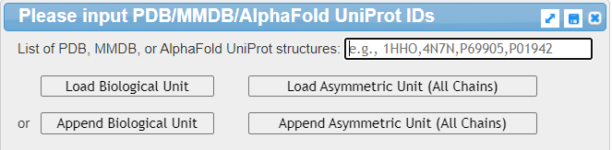
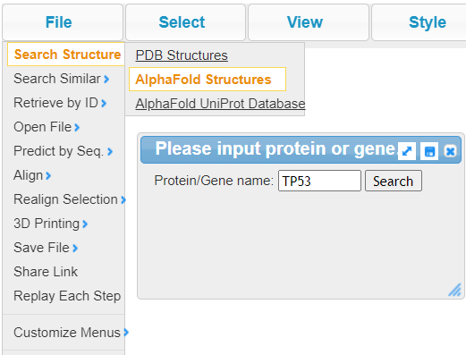
Load 3D Structures https://www.ncbi.nlm.nih.gov/Structure/icn3d
Option 1. By default, input PDB or AlphaFold IDs
Option 2. Input PDB Files:
menu: File > Open File > PDB Files
Option 3. Search with protein name or gene name

Slide 4
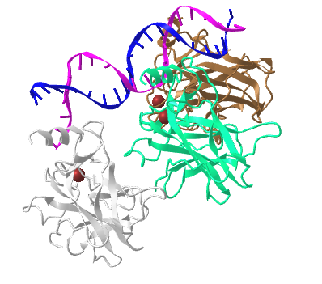
Transform in iCn3D
Rotate
  Left mouse (Click & Drag)
  Key L: left
  Key J: right
  Key I: up
  Key M: down
  Shift + Key L: left 90°
  Shift + Key J: right 90°
  Shift + Key I: up 90°
  Shift + Key M: down 90°
Zoom
  Middle mouse (Pinch & Spread)
  Key Z: zoom in
  Key X: zoom out
Translate
  Right mouse (Two Finger Click & Drag)
Share Link : https://structure.ncbi.nlm.nih.gov/icn3d/?mmdbid=1tup

Slide 5
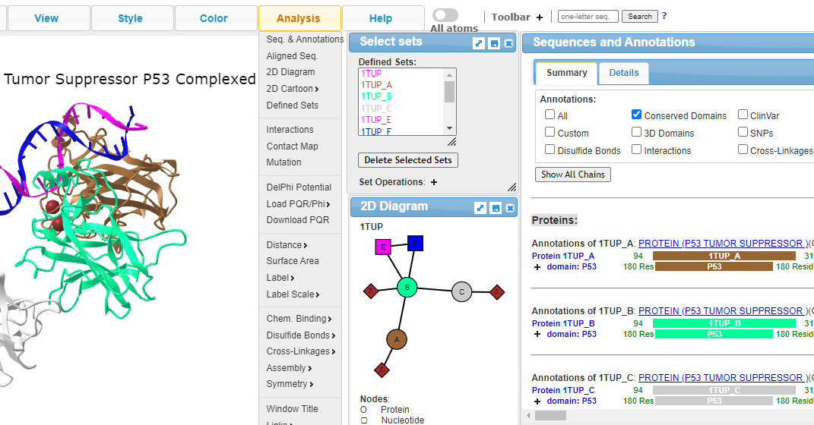
Synchronized 3D, 2D, & 1D views
By default, all atoms are selected
Share Link: https://structure.ncbi.nlm.nih.gov/icn3d/share.html?riAVySQmpyNhrh9n9

Slide 6
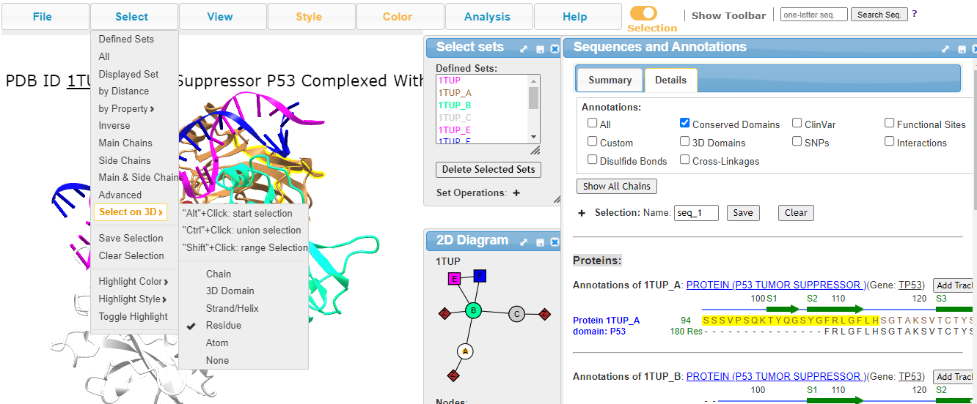
Select a subset in 3D, 2D and 1D
After selection, all actions will be on the selection (see the toggle)
Share Link: https://structure.ncbi.nlm.nih.gov/icn3d/share.html?3U8FtWpwd5uTh2yk8

Slide 7
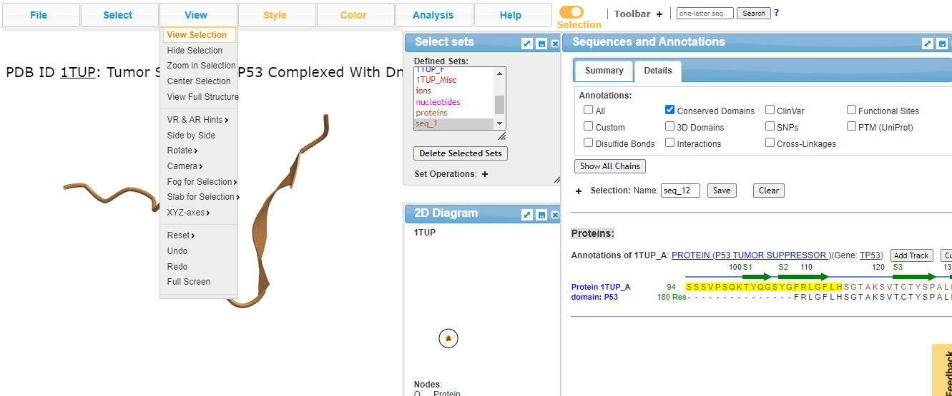
View Selection
click the toggle to see full structure.
Share Link: https://structure.ncbi.nlm.nih.gov/icn3d/share.html?MLFJgVm4PxkVDSeq7

Slide 8
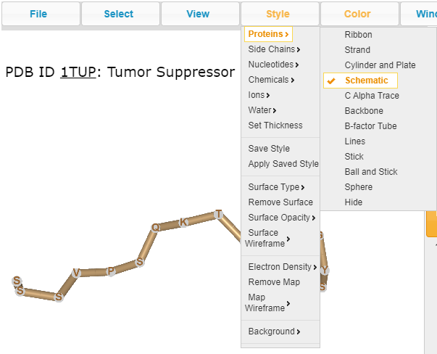
Change Style
Style is applied only on the selection
Share Link: https://structure.ncbi.nlm.nih.gov/icn3d/share.html?r6o73i9xWpf4NrgH6

Slide 9
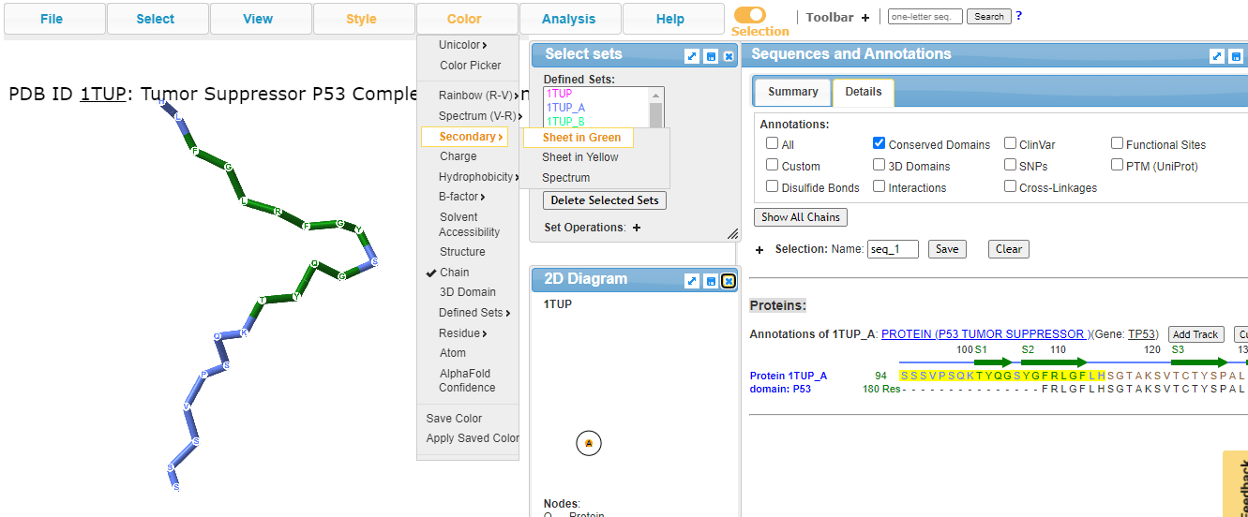
Change Color
Color is applied only on the selection
Share Link: https://structure.ncbi.nlm.nih.gov/icn3d/share.html?EJcPLfJecycB1tED6

Slide 10
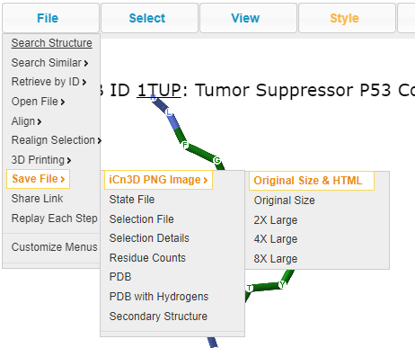
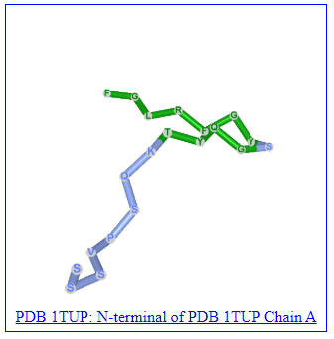
Save your work
Option 1: iCn3D PNG Image
Save “iCn3D PNG Image” to keep both the image file and the HTML file containing the Share Link.
You can create your own gallery by concatenating the source code of the HTML files. Here is one example of gallery.
The PNG image can also be loaded into iCn3D.

Slide 11
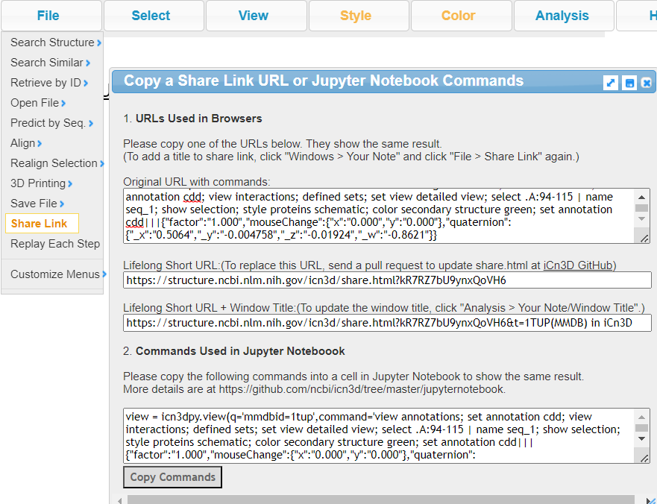
Save your work
Option 2: Share Link
Use the short “Share Link” URL to share the custom view with colleagues.
Commands used in Jupyter Notebook are also listed.

Slide 12
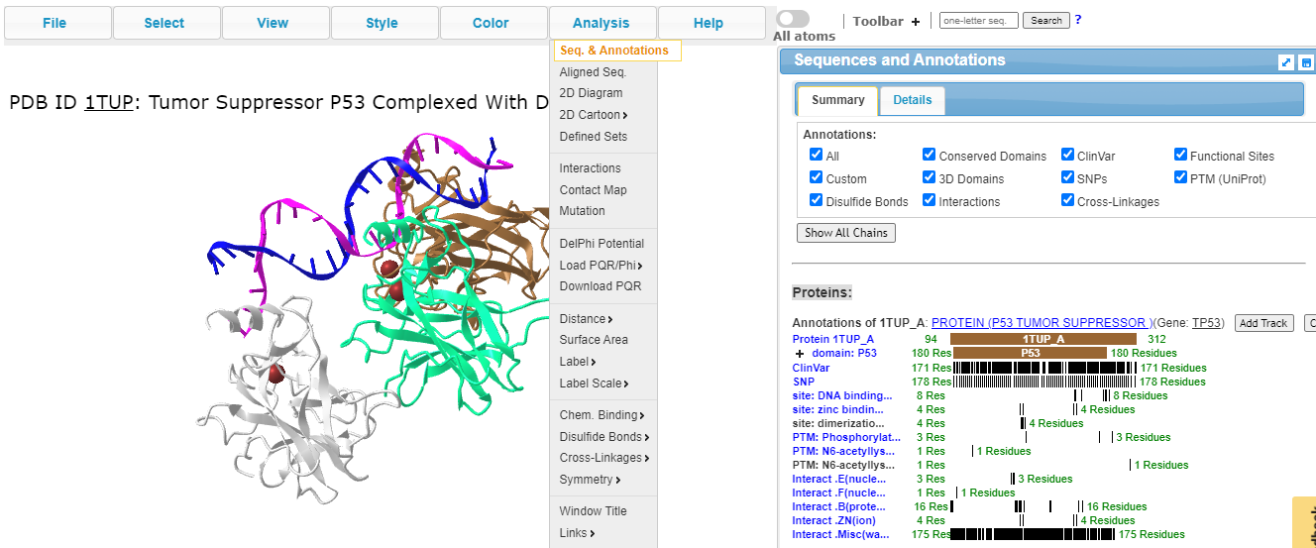
Show Annotations: SNPs, Domains, Sites, PTMs, etc.
Share Link: https://structure.ncbi.nlm.nih.gov/icn3d/share.html?5E1iqjZN16vy3eXz6

Slide 13
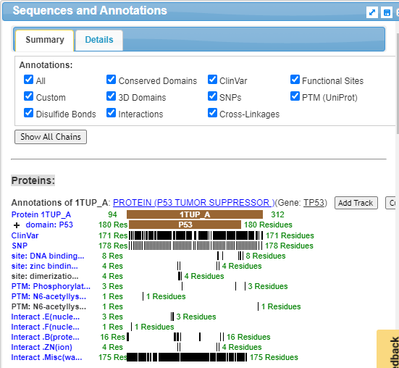
Retrieve Annotations with Scripts
Option 1. Node.js Scripts: “annotations.js” at https://github.com/ncbi/icn3d/tree/master/icn3dnode
Command to retrieve PTM annotation:
node annotations.js 9
Option 2. Python Scripts: “batch_export_panel.py” at https://github.com/ncbi/icn3d/tree/master/icn3dpython/icn3d_url
Command: python3 batch_export_panel.py
Share Link: https://structure.ncbi.nlm.nih.gov/icn3d/share.html?5E1iqjZN16vy3eXz6

Slide 14
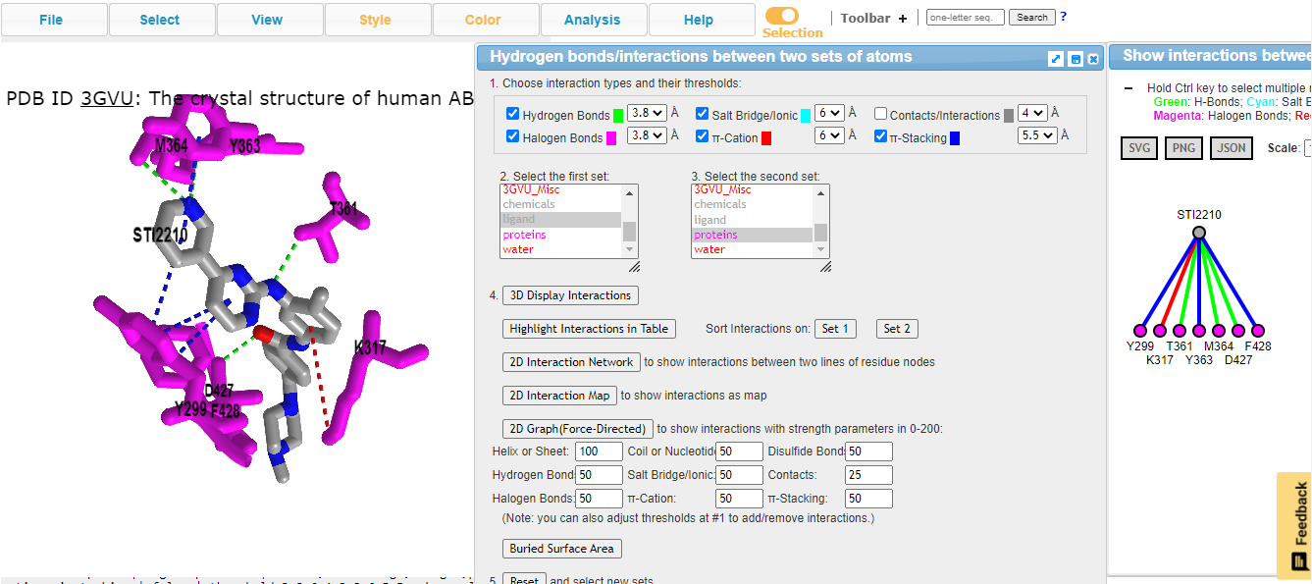
Interaction Analysis (menu: Analysis > Interaction)
Share Link: https://structure.ncbi.nlm.nih.gov/icn3d/share.html?v64emnefDmzhSBzq6

Slide 15
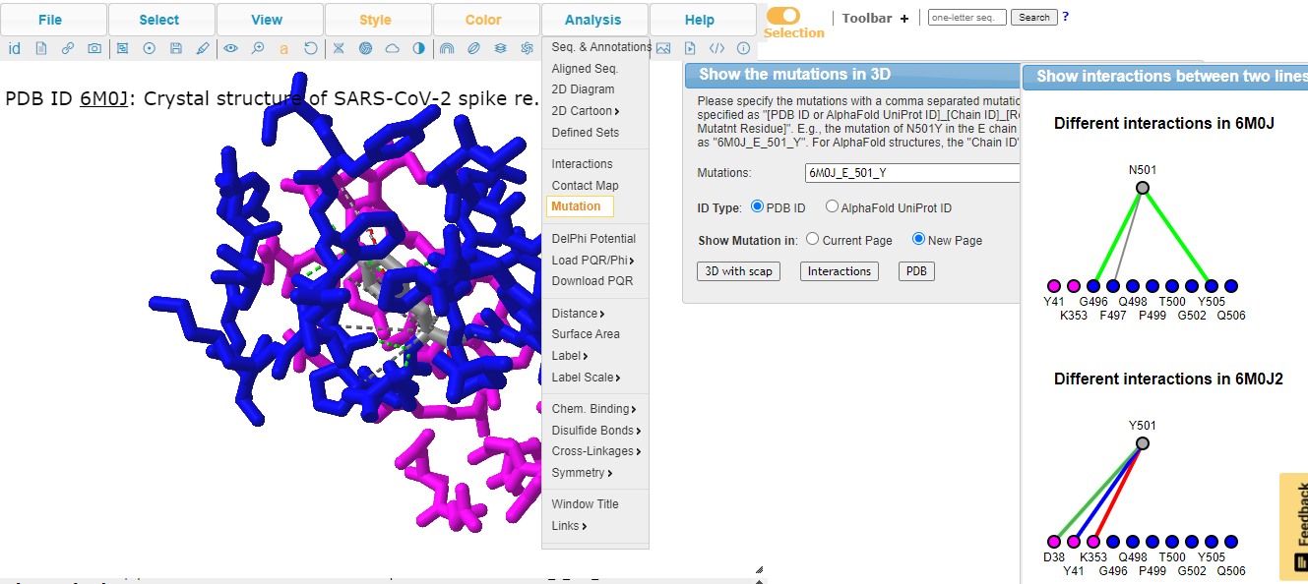
Mutation Analysis
Share Link: https://structure.ncbi.nlm.nih.gov/icn3d/share.html?uykGUb6Zgw6YAP896

Slide 16
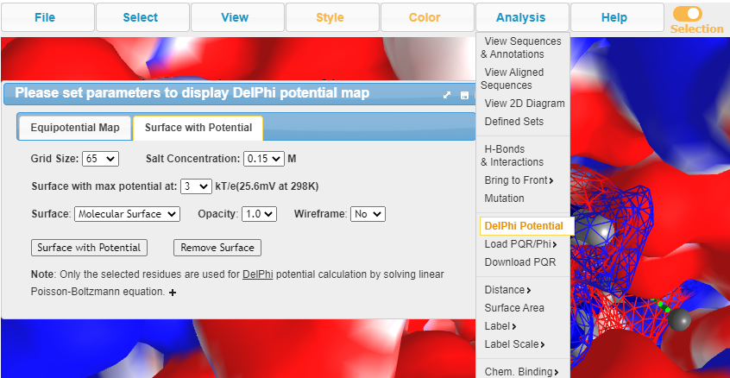
Electrostatic Potential
Share Link: structure.ncbi.nlm.nih.gov/icn3d/share.html?XCxR6fSTmXHxR3o1A

Slide 17
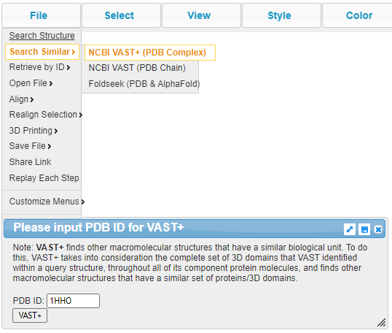
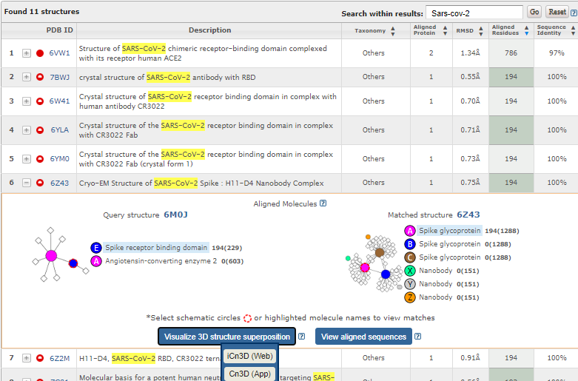
Find Similar Structures Using VAST+
Share URL: https://www.ncbi.nlm.nih.gov/Structure/vastplus/vastplus.cgi?uid=6m0j

Slide 18
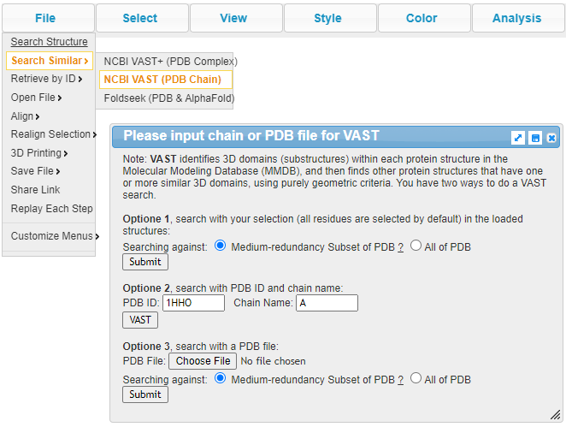
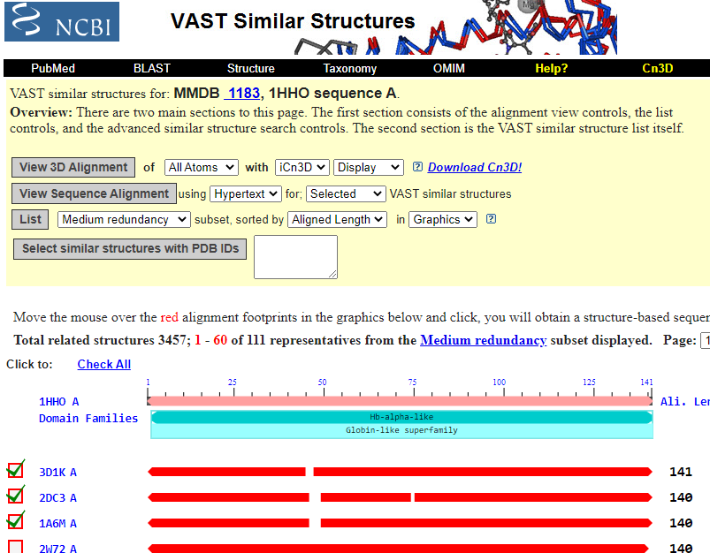
Find Similar Chains Using VAST: (1) with PDB ID as Input
Share Link: https://www.ncbi.nlm.nih.gov/Structure/vast/vastsrv.cgi?pdbid=1HHO&chain=A

Slide 19
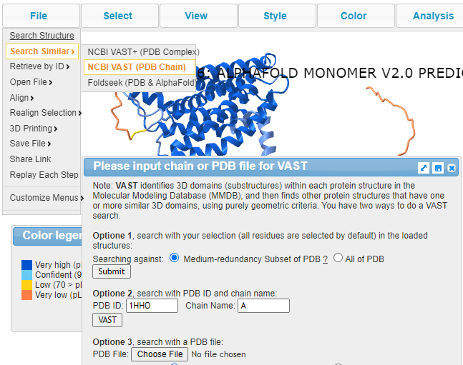
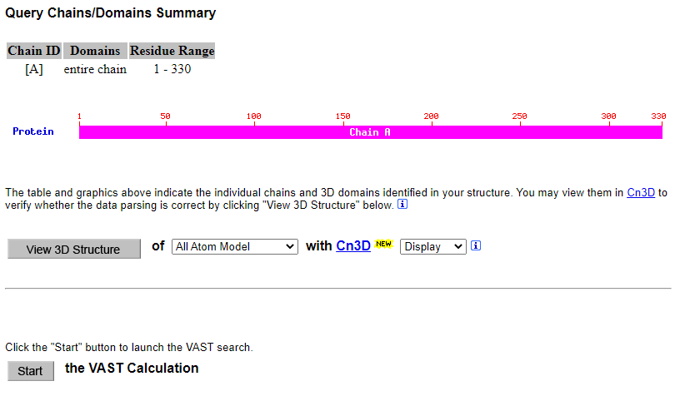
Find Similar Chains Using VAST: (2) with Loaded Structure as Input
Share Link: https://www.ncbi.nlm.nih.gov/Structure/vast/vastsrv.cgi?pdbid=1HHO&chain=A

Slide 20
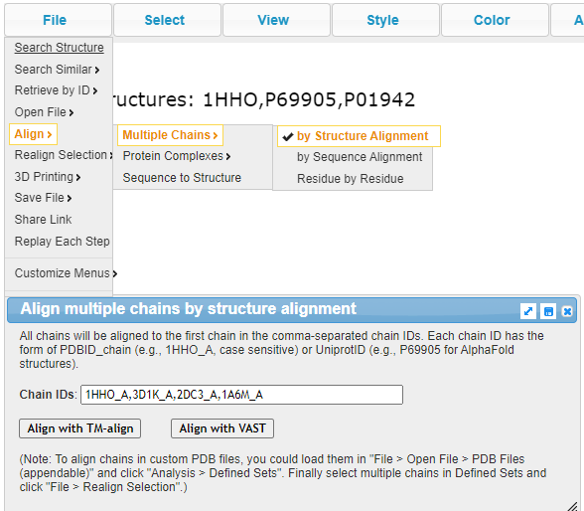
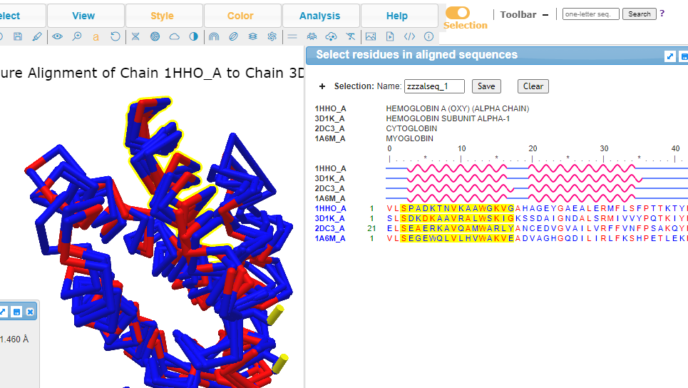
Align Multiple Chains
Share Link: https://structure.ncbi.nlm.nih.gov/icn3d/share.html?TYKqGncu2Utyr3X19

Slide 21
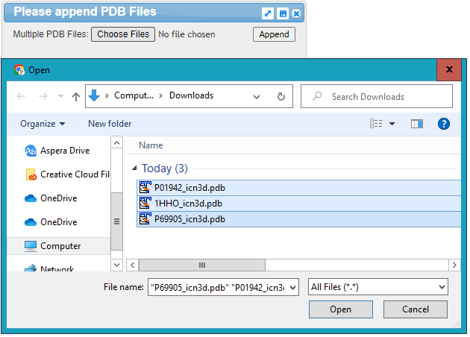
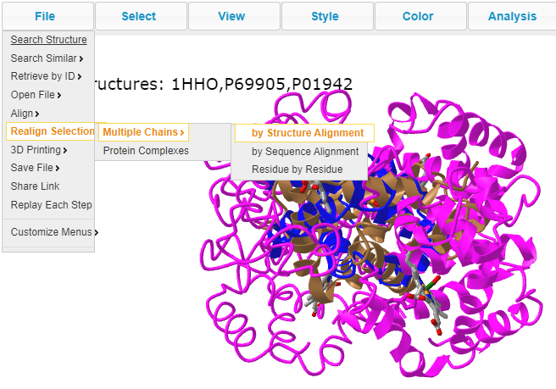
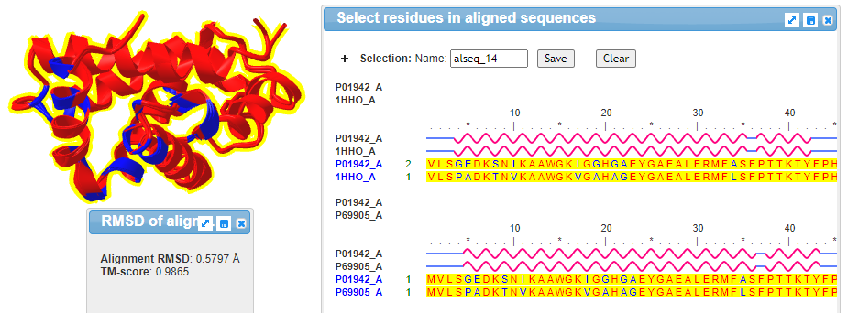
Realign Multiple Structures

