Slide 1
Navigating NIH Programs to advance your career at nih
Ericka Boone, Ph.D.
Acting Director, Division of Biomedical Research Workforce
Office of the Director, Office of Extramural Research
National Institutes of Health

Slide 2

Who Are We? The NIH!

Slide 3
FY 2020 Operating Budget: ~$40B
Training: $886,806
Career: $844,348
Total: $1,731,154
NIH Budget Office: http://officeofbudget.od.nih.gov/index.htm

Slide 4
NIH includes 27 Institutes & Centers
Office of Extramural Research
Division of Biomedical Research Workforce (DBRW)
Office of the Director
Office for Scientific Workforce Diversity
Office Intramural Training and Education
National Institute
on Aging
National Institute
on Alcohol Abuse
and Alcoholism
National Institute
of Allergy and
Infectious Diseases
National Institute
of Arthritis and
Musculoskeletal
and Skin Diseases
National Cancer
Institute
National Institute
of Child Health
and Human
Development
National Institute on
Deafness and Other
Communication
Disorders
National Institute
of Dental and
Craniofacial
Research
National Institute
of Diabetes and
Digestive and
Kidney Diseases
National Institute
on Drug Abuse
National Institute
of Environmental
Health Sciences
National Eye
Institute
National Institute
of General
Medical Sciences
National Heart,
Lung, and Blood
Institute
National Human
Genome Research
Institute
National Institute
of Mental Health
National Institute
of Neurological
Disorders and
Stroke
National Institute
of Nursing Research
National Center
for Complementary
and Integrative
Health
Fogarty
International
Center
National Center
for Advancing
Translational
Sciences
National Library
of Medicine
National Institute of
Biomedical Imaging
and Bioengineering
National Institute on
Minority Health and
Health Disparities
Clinical Center
Center for
Information
Technology
Center for
Scientific Review

Slide 5
ONE NIH, 27 Cultures
Each IC has its own mission
Each IC has its own budget
Each IC has its own activities
Each IC has its own way of doing business
So, how do you figure out WHERE to start?? Here’s some advice!

Slide 6
Interacting with NIH
NIH Staff
Program
Officer
Scientific Review Officer
Grants Management Officer
Scientist & Administrator
Identifies areas of scientific need
Communicates NIH priorities to investigators and others
Manages grants
Communicates with IC Leadership about the science
Scientist & Administrator
Manages grant reviews
Appoints members to review groups & panels
Prepares summary statements
Implements the funding process
Oversees the budget
Ensures grantee compliance with NIH policies & regulations

Slide 7
Who Should I talk to? When? And About What?
NIH People
Program Officer
Scientific Review Officer
Grants Management Officer
Before applying discuss
  Concept paper aims & fit with NIH priorities
  Appropriate funding mechanism
  Responsiveness to review criteria
  After Review to discuss next steps
After application is assigned to a review committee until review is complete to discuss:
  Review committee selection
  Missing info
  Supplemental info
Before or after review to discuss:
  NIH grants policy
  Budget
  Change of institutions
  Grant start dates

Slide 8
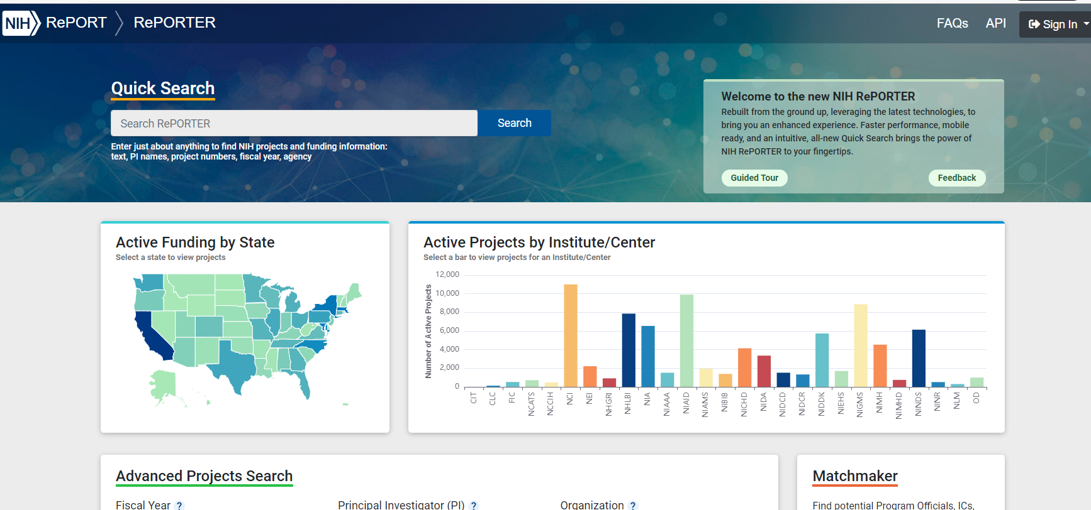
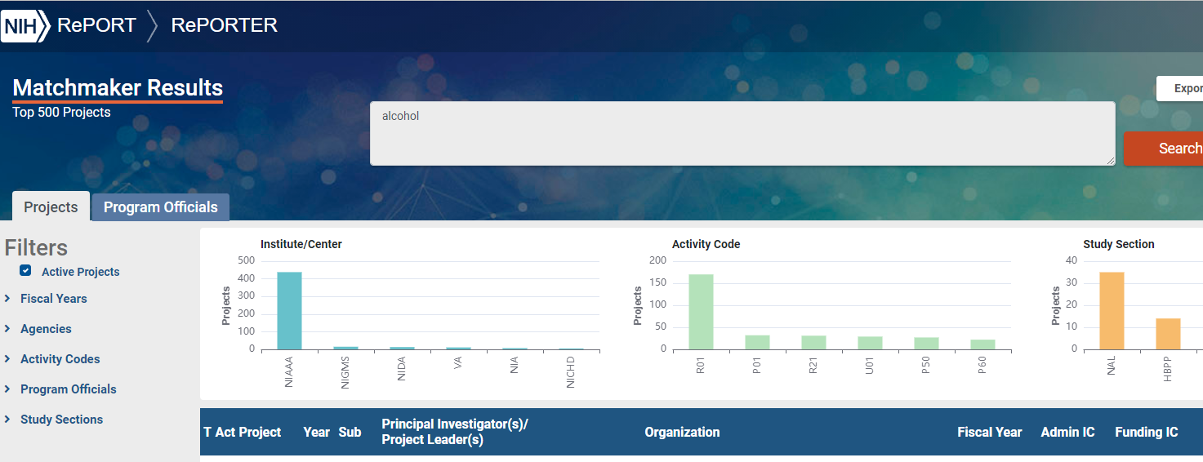
Use These Resources to Find the Right IC and PO
Talk to mentors and colleagues
Search NIH RePORTER for funded projects
Search NIH MATCHMAKER for similar projects and their POs
Review IC missions, strategic plans, & research priorities
Review IC division or program webpages

Slide 9
Normalize the ‘Reaching Out’…
Contact POs via email - WELL BEFORE YOUR DEADLINE
No dissertations, please
  Include a 1-2 Page concept
  Research Project Grants (RPG)
    Include brief background, significance of the problem or question being addressed and specific aims
  Training (e.g., F30, R36, F31, F32) and Career Development Grants (e.g., K01, K08, K23)
    Brief background, significance of the problem or question the project will address, specific aims; training goals; mentoring team and their current funding and a CV or NIH Biosketch
Follow-up as needed – email piles are deep

Slide 10

Additional Advice for Navigating NIH Programs
Review IC priorities and goals (they can differ by IC and programs)
Learn the NIH application & review process
Make early contact with program officers
Find innovative, well-respected mentors & collaborators
Study successful grant applications
Propose your best and most creative ideas
Review funding opportunity announcements (FOAs)
    Grants.gov
    NIH Guide for Grants and Contracts
Dig deeper:
- Finding and Understanding FOAs

Slide 11
Types of Funding Opportunity Announcements (FOA)
Type of FOA | Description
Program Announcements (PA, PAR, PAS) | Highlights specific, high-priority areas of scientific focus/interest PAS: PA with set aside funds; PAR: has a special receipt, referral and/or review considerations (described in PA) Usually ongoing (3 years) Often use standard receipt dates (you can control when you apply!) Most (but not all) NIH ICs participate
Requests for Applications (RFA) | Identifies specific scientific areas, amt of set-aside funds, anticipated # of awards Usually, single receipt date IC usually convenes review panel
Parent Announcements | Broad FOAs allowing applicants to submit “investigator initiated” or “unsolicited” research ideas to a specific activity code (e.g., R01, R03) Most apps to NIH = investigator initiated Usually ongoing (3 years); standard receipt dates (you have flexibility)

Slide 12


NIH Research Training Website
https://researchtraining.nih.gov

Slide 13
Funding Options by Career Phase
Undergraduate Graduate/ Clinical Training
Postdoctoral Training/Clinical Residency
Early Research Career
Established Investigator
T34, R25
T32, T35
T32
K01, K07, K25
K08, K23
R03, R21, DP2
R01, R35
R01, R35
P01, P50
F32, DP5
R38, (K38)
R25, K12
K22,
K99
K22, R00
F30, F31
K02, K24
Loan Repayment Programs
https://www.lrp.nih.gov/
Diversity Supplements : PA-20-166
Re-Entry Supplements: NOT-OD-20-054

Slide 14
Diversity Supplement
* PA-20-166
Administrative supplement to an existing, actively funded research grant designed to:
Diversify the biomedical research workforce via support of investigators from diverse & underrepresented groups
Support many career stages from undergraduate to faculty
Could be a bridge to an F or K award
Add to ongoing research and career development
Expectation of a subsequent application for NIH support
Administratively reviewed by the Institute or Center (IC) funding the original grant
Note: different NIH ICs have different deadlines and policies

Slide 15

Loan Repayment Program
2-year Research Commitment
Up to $50,000/year – renewals eligible
50% Success Rate
LRP Resources – www.lrp.nih.gov
Extramural LRP
Application Deadline
November 18, 2021

Slide 16
Predoc and Early Postdoc Training
Undergraduate
Graduate/
Clinical
Training
Postdoctoral Training/
Clinical Residency
Early Research Career
Established Investigator
T34,R25 T32, T35
T32
F30,
F31
F32
Diversity Supplements: : PA-20-166
Diversity supplements can be useful to support a transition to individual fellowship or beyond

Slide 17

Ruth L. Kirschstein NRSA
Goal to ensure diverse pool of highly trained scientists in appropriate scientific disciplines, to address the Nation's biomedical, behavioral, & clinical research needs
Institutional Training Programs (T32-Series):
Awards to an institution to support research training activities for graduate student and/or postdoc trainees selected by the institution
Require a program director and experienced faculty to serve as mentors
Individual Fellowships (F-Series)-require primary sponsor:
Awards for combined clinical and research doctoral degree training (F30)
Awards for graduate students working towards research doctoral degree (F31 & F31D)
Awards for postdoctoral fellows working towards research independence (F32)
As well as primary sponsor, a mentoring team is highly recommended

Slide 18
Common Features of NRSAs
FY21 NRSA Tuition, Stipend and TRE/IA Levels
Trainees & Fellows are required to pursue full-time research training (40 hrs/week)
Stipends: Allowance to defray living expenses: Stipends increased each year since 2017
Tuition and Fees: NIH contributes to the combined cost of tuition and fees
Institutional Allowance (F) or Training Related Expenses (T): Defray expenses such as health insurance, research supplies, equipment, books, travel to scientific meetings: Increased each year (postdocs) to better support costs of medical expenses
NRSA trainees or fellows may gain clinical trials research experience but cannot lead an independent clinical trial.
  F-Kiosk: https://researchtraining.nih.gov/programs/fellowships
  T-Kiosk: https://researchtraining.nih.gov/programs/training-grants

Slide 19
Institutional NRSA: Predoctoral
Individual NRSA: Predoctoral and Postdoctoral
T32: Provides a strong foundation in research design, methods, and analytic techniques to enhance the trainees’ ability to conceptualize pursue a research project with increasing independence
T35: Short-term training programs to expose medical/clinical students to research and encourage them to pursue research careers
F30: Supports predoc fellows during clinical and graduate training leading to a combined doctoral degree, e.g., MD/PhD, DDS/PhD (PA-21-050)
F31: Supports promising research doctoral candidates who have identified a mentor and will be performing dissertation research (PA-21-051)
Diversity F31: supports individuals from groups underrepresented in the biomedical or behavioral sciences (PA-21-052)
F32: Supports highly promising applicants during their mentored postdoctoral training under the guidance of outstanding faculty sponsors (PA-21-048)
  Training grants are restricted to domestic (U.S.) institutions; Trainees must be citizens, non-citizen nationals, or lawfully admitted for permanent residence by the time of appointment

Slide 20
NIH Director's Early Independence Award (DP5)
Graduate/
Clinical
Training
Postdoctoral Training/
Clinical Residency
Early Research Career
Established Investigator
DP5
Skip Postdoctoral Period
DP5
DP5: High-risk, high-reward program supporting exceptional investigators to pursue independent research directly after completion of their research doctoral degree or clinical residency
Bypasses traditional post-doctoral training and accelerates entry into an independent research career
Applicants must be within 12 months before or after receiving a research doctoral degree or completing clinical postgraduate training
Awardees are expected to be competitive for continued funding of her/his research program and for a permanent research position
Funded via Common Fund

Slide 21
Career Development and Other Early Career Awards
Graduate/
Clinical
Training
Postdoctoral Training/
Clinical Residency
Early Research Career
Established Investigator
K01, K07, K25
K12, KL2
K08, K23
K12, KL2
R03, R21, DP2
K22,
K99
K22, R00
Loan Repayment Programs
Diversity Supplements : PA-20-166
Re-Entry Supplements: NOT-OD-20-054

Slide 22
Early-Stage Investigators
Definition of Early-Stage Investigator (ESI): A PD/PI who has completed their terminal research degree or end of post-graduate clinical training, whichever date is later, within the past 10 years and who has not previously competed successfully as PD/PI for a substantial NIH independent research award. Following is a list of NIH grants that a PD/PI can hold and still be considered an ESI:
  Research Grants: R00, R03, R15, R21, R25, R90, RL9, RL5, R34, R36, R41, UT1, R43, U43, R55, R56, SC2, SC3, X01
  Training-Related and Mentored Career Awards: “F”, “K”, L30, L32, L40, L50, L60, T32, T34, T35, T90, D43
  Instrumentation, Construction, Education, Health Disparity Endowment Grants, or Meeting Awards: G07, G08, G11, G13, G20, R13, S10, S15, S21, S22

Slide 23
ESI Status Has Its Benefits…
Funding
  NIH sets funding target ESIs and prioritizes R01 applications with meritorious scores for funding (i.e., attempt to create greater parity in success rates among early-stage and established investigators)
Peer Review
  Peer reviewers look more at potential than advanced track record
    Weigh academic and research background
    Expect new R01 investigators to have fewer preliminary data/publications than more established researchers
  When feasible, early-stage investigator applications are not interspersed with those of established investigators at the review meeting

Slide 24
Common Features of K-Awards
Intended for investigators at earlier phases of their research career
Provide salary and mentored research support for up to 5 years of protected time under the guidance of an experienced mentor
By the time of award/appointment, candidates must be citizens, U.S. nationals, or lawfully admitted for permanent residence in the U.S. (Except for the K99-R00)
Awardees/appointees must have a research or clinical doctoral degree from an accredited domestic (U.S.) or foreign institution
Awardees or appointees must have a full-time appointment at the institution, and must commit a minimum of 9 person-months (75% of full-time professional effort) to research career development
Former PD/PIs on major NIH research grants (e.g.R01), other career development awards (i.e., K–awards), or the equivalent are not eligible
K-Kiosk: https://researchtraining.nih.gov/programs/career-development

Slide 25
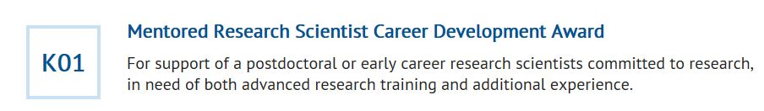
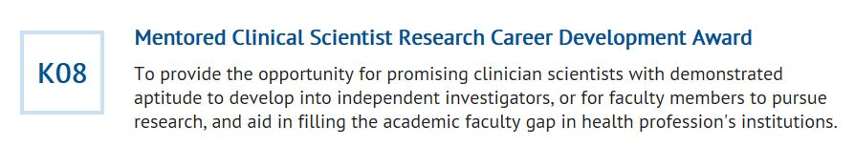

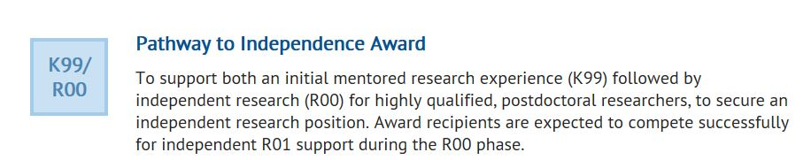
Career (K) Kiosk
Active FOAs (Parent & IC specific) can be found at: https://researchtraining.nih.gov/programs/
career-development
At that website click on each
K award type to view active FOAs
https://researchtraining.nih.gov/programs/fellowships

Slide 26
K01, K08 and K23 FOAs with different requirements
Funding Opportunity Announcements (FOAs) for K Awards will :
Require PD/PI to conduct an independent clinical trial
PA-20-176 (K01;14 IC)
PA-20-202 (K08;15 IC)
PA-20-206 (K23;17 IC)
K applicant/awardee has primary or lead responsibility for conducting & executing the trial (Funding is from the K award & may be an ancillary or feasibility study)
Permit clinical trial research experience but will NOT permit an independent clinical trial
  PA-20-190 (K01;16 IC)
  PA-20-203 (K08; 20 IC)
  PA-20-205 (K23; 19 IC)
K applicant/awardee may propose research experience in a clinical trial led by the K award mentor or co-mentor.
Permit Basic Experimental Studies with Humans (BESH)
  PA-20-191 (K01; 9 IC)
  PA-20-201 (K08; 13 IC)
  PA-20-204 (K23; 12 IC)
K applicant/awardee may propose basic science experimental studies involving humans which can be “prospective basic science studies involving human participants.”

Slide 27
Institutional Mentored K-Awards
K12/KL2: Institutional program to support highly promising candidates (scholars) training for careers in specified research areas of interest to one or more NIH Institutes and Centers (IC)
  IC specific (e.g., some K12/KL2 for clinicians or clinically relevant research)
    Some for PhD (e.g., IRACDA program with combined research & teaching involving partnerships with research intensive institutions and institutions with an emphasis on undergraduates or graduates from under-represented groups)
  Provides institutions with flexibility to prepare clinically-trained scientists or PhDs for independent research careers or academic careers at multiple institution types
  Requires experienced program director with research and administrative experience, and highly competent faculty mentors
  Individualized and intensive supervised research experiences and career development guidance for scholars selected by the grantee institution
Encouragement/expectation to apply for either individual K award, e.g., K08, K23, K01 – or research project grants (R03/R21/foundation/R01)

Slide 28

Pathway to Independence Award Mentored Scientists Awards (K99/R00)
K99/R00: Goal to facilitate transition from a mentored postdoctoral research position to an independent research position with independent NIH research support at an earlier stage than the current norm
Supports protected time (75%) in 2 distinct phases – update FOA #s below:
K99 – Phase 1- 2 years
Mentored: must be affiliated with an institution
Within 4 years of attaining PhD or completing clinical training
~ 90% transition to R00.
R00 – Phase 2 (3 years)
Independent (tenure-track or equivalent),own lab limited teaching and/or clinical responsibilities to assist pathway to next independent award.
‘Quality’ of tenure-track offer administratively reviewed by NIH staff before R00 awarded
No U.S. citizenship requirement for applicants to the parent K99 (PAR-21-271)
NIAID Physician Scientist K99-R00: PAR-20-209; PAR-20-210; NOT-AI-19-034; Requires 50% effort; no U.S. citizenship requirement
NIDCR Dual Degree Dentist Scientist K99-R00 (PAR-18-432; PAR-19-144; PAR-19-141) no U.S. citizenship requirement.
Brain Research through Advancing Innovative Neurotechnologies (BRAIN) Initiative K99-R00 to promote diversity (RFA-NS-19-043 RFA-NS-19-044) requires citizenship/permanent resident status.
Maximizing Opportunities for Scientific and Academic Independent Careers (MOSAIC) Postdoctoral Career Transition Award to Promote Diversity K99-R00 requires citizenship/permanent resident status; first due date February 12th 2020 (PAR-21-271); Institutional UE5 Co-operative Agreement (PAR-21-277) provides courses for skills development & mentoring.
Due to COVID two cycle extension of eligibility announced for Parent K99 NOT-OD-21-106; NIDCR K99 NOT-DE-21-003; Mosaic K99 NOT-GM-21-057

Slide 29
Maximizing Opportunities for Scientific & Academic Independent Careers (MOSAIC) Transition Award to Promote Diversity - Program Goal
MOSAIC is designed to facilitate the transition of promising postdoctoral researchers from diverse backgrounds, for example individuals from groups underrepresented in the biomedical research workforce at the faculty level, into independent, research-intensive faculty careers
The overarching goal of the NIH MOSAIC program is to enhance the diversity of independent investigators conducting research within the NIH mission. Program priority is to address documented underrepresentation at the faculty level (e.g., see NIH’s Notice of Interest in Diversity).

Slide 30
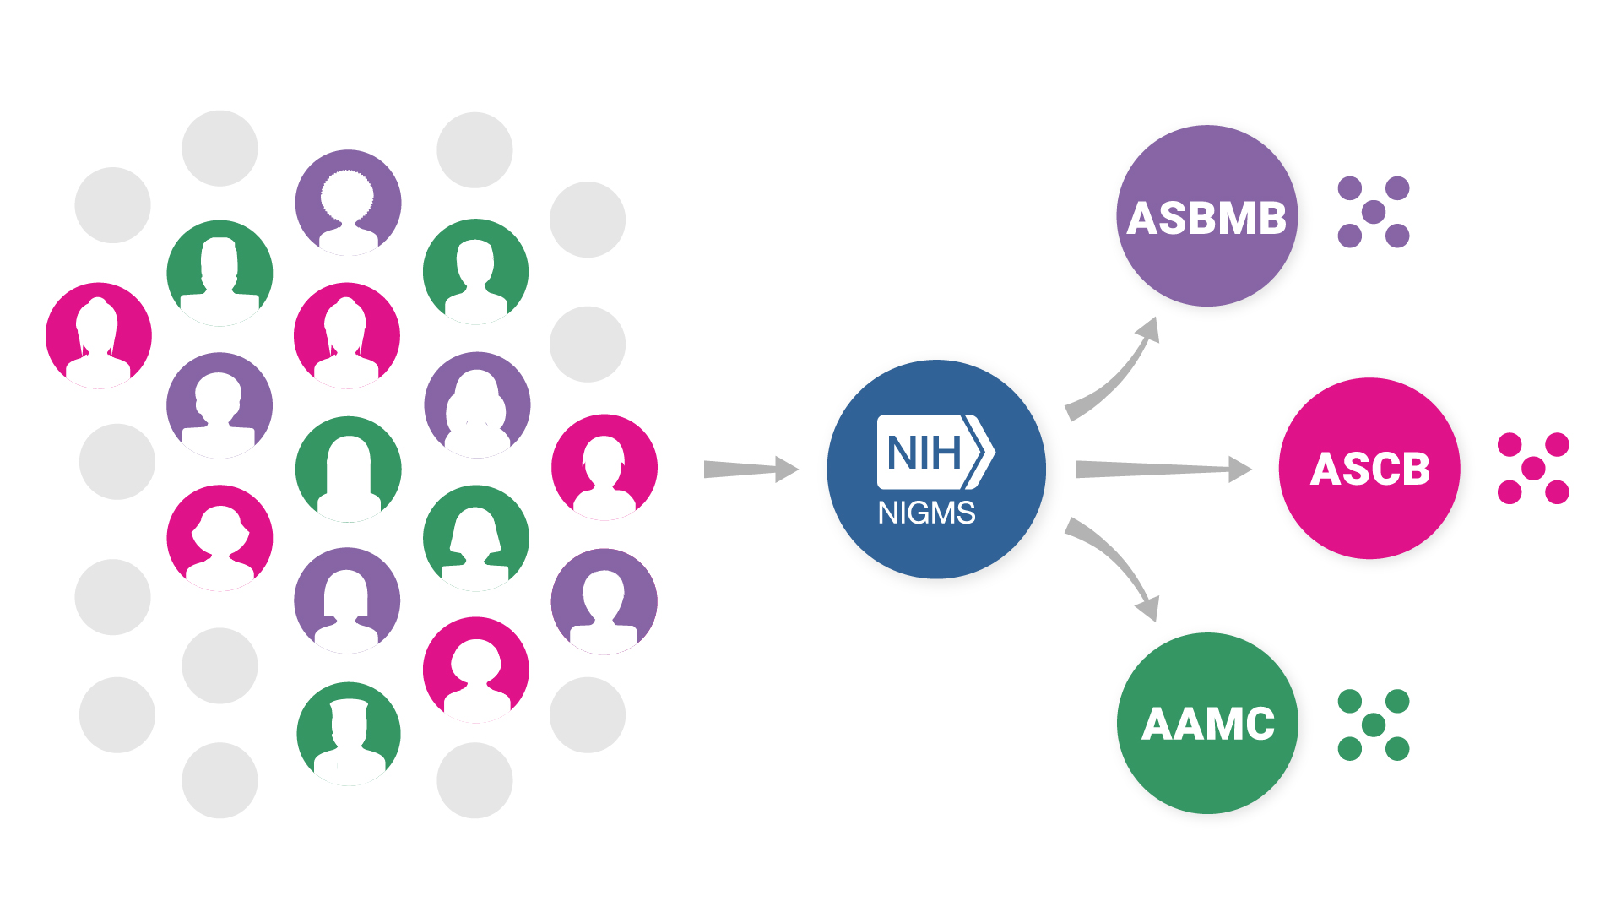
MOSAIC - Approach
Postdoctoral Career Transition Award to Promote Diversity (K99/R00) – PAR-21-271, -272, and -273
Institutionally Focused Research Education Cooperative Agreement to Promote Diversity (UE5) – PAR-21-277
MOSAIC K99/R00 Applicants
MOSAIC K99/R00 Scholars Participate in Cohorts Organized by UE5

Slide 31




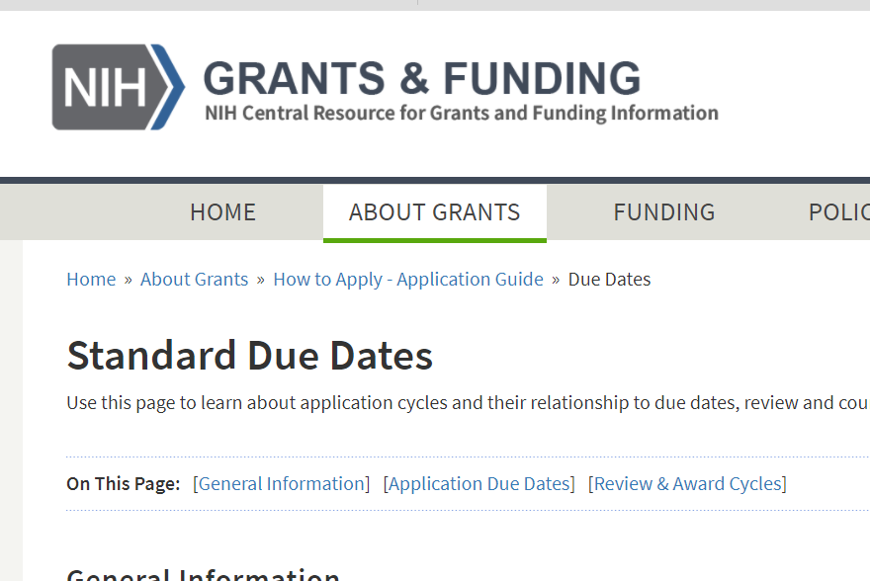
Timeline for (new) K Applications
RECEIPT DATE | REVIEW | COUNCIL | AWARD DATE
Feb 12 (Mar 12) | Jun/July | October | December
Jun 12 (Jul 12) | Oct/Nov | January | April
Oct 12 (Nov 12) | Feb/Mar | May | July
https:////grants.nih.gov/grants/how-to-apply-application-guide/due-dates-and-submission-policies/due-dates.htm

Slide 32
Small Grant Program
Academic Research Enhancement Award
R03: Provides limited funding for a short period of time to support a variety of types of projects, including:
  Pilot or feasibility studies
  Collection of preliminary data
  Secondary analysis of existing data
  Small, self-contained research projects
  Development of new technology, etc.
Limited to two years of funding, and grants are not renewable
Direct costs generally up to $50,000 per year
Check FOAs to see which ICs participate
R15: Supports small-scale research projects conducted by faculty and students at educational institutions that have not been recipients of major NIH research grant funds
  The goals of the program are to: (a) support meritorious research; (b) expose students to research; and (c) strengthen the research environment of the institution
  The project period is limited to 3 years, and grants are renewable
  While preliminary data are not required, it may be provided as appropriate
  Direct costs are limited to $300,000 over the entire project period
PA-20-200

Slide 33
Exploratory/Developmental Research Award
NIH Director’s New Innovator Award
R21: Encourages new, exploratory and developmental research projects by providing support for the early stages of project development
  Sometimes used for pilot and feasibility studies
  Preliminary data are not required but may be included if available
  Limited to up to two years of funding
  Combined budget for direct costs for the two-year project period usually may not exceed $275,000
  Not all Institutes/Centers participate in this program
DP2: Supports exceptionally creative early career investigators who propose innovative, high-impact projects in the biomedical, behavioral or social sciences within the NIH mission. No detailed experimental plan or preliminary data are required
  Work proposed ‘high risk, high reward’ – more innovative than outside the standard R01
  Awardees are required to commit at least 25% of their research effort each year to activities supported by the New Innovator Award
  Awards are up to $300,000 in direct costs each year for 5 years, plus applicable indirect costs
  Complements ongoing efforts by NIH to fund early-stage investigators through R01 grants
  Funded through the Common Fund
PA-20-195
PA-20-194
PA-20-196
RFA-RM-20-012

Slide 34
Maximizing Investigators Research Award (MIRA) for Early-Stage Investigators (R35)
Katz Award (R01)
Goals:
Enable ESIs to apply earlier in their independent research careers
Secure funding to launch & sustain successful research careers.
Enhance ability to move into research areas distinct from their postdoctoral mentors, which could lead to new scientific discoveries.
Reduce time writing and reviewing grant applications & allow more time to conduct research.
Enable investigators to mentor trainees in a more stable research environment.
Goals:
PD/PI must be designated as an ESI
Proposed research can rely on the prior work and expertise as foundation, but must represent a different direction (not just incremental expansion)
Change in direction can involve a new approach, methodology, technique, discipline, therapeutic target, paradigm
Make sure you talk to your PO prior application (be sure to get the deets!)
New program! First awards announced December 2021
Can request up to $500K/year in direct costs
PAR-20-117
PAR-21-038

Slide 35
Research Project Grant
R01
  Supports a discrete, specified, circumscribed project in areas representing the specific interests and competencies of the investigator(s)
  Proposed project must be related to the programmatic interests of one or more of the participating Institutes and Centers based on their scientific missions
  Most NIH Institutes and Centers support the R01 grant mechanism
  Typically provides funding support for up to 5 years
  Modular budget format allows you to request up to $250,000 per year in direct costs; traditionally capped at $ 500,000 per year
  Successful R01 grant application requires preliminary data to support proposed research

Slide 36
Wrapping Up…Additional Helpful Information

Slide 37
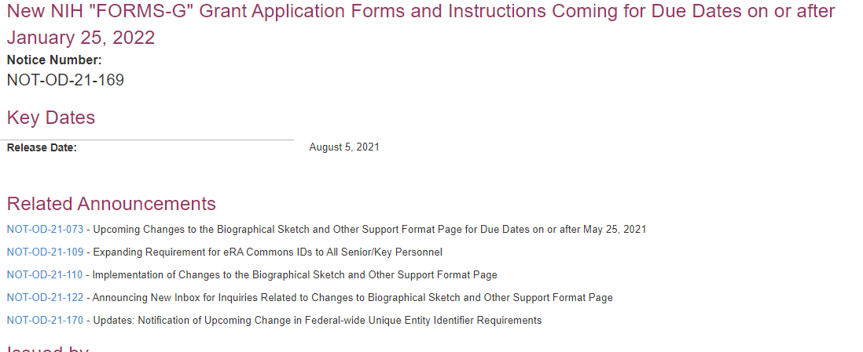
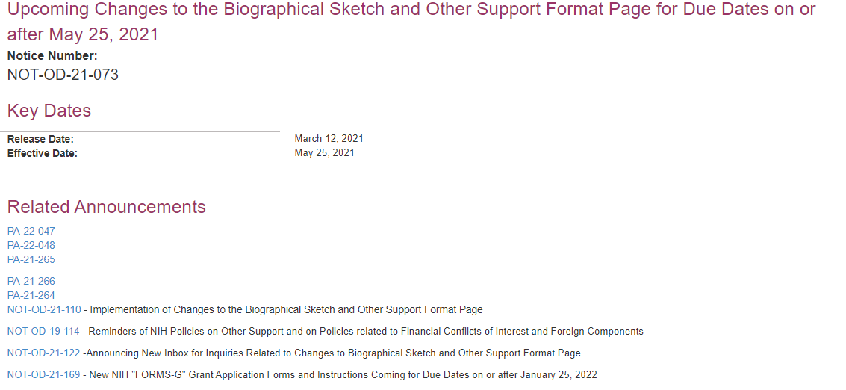
NIH Issues Important Policy Updates via Notices (NOT)
NOT-OD-21-073 - Upcoming Changes to the Biographical Sketch and Other Support Format Page for Due Dates on or after May 25, 2021
NOT-OD-21-109 - Expanding Requirement for eRA Commons IDs to All Senior/Key Personnel
NOT-OD-21-110 - Implementation of Changes to the Biographical Sketch and Other Support Format Page
NOT-OD-21-122 - Announcing New Inbox for Inquiries Related to Changes to Biographical Sketch and Other Support Format Page
NOT-OD-21-170 - Updates: Notification of Upcoming Change in Federal-wide Unique Entity Identifier Requirements
NOT-OD-19-109 - ORCID iD Requirement for Trainees, Fellows & Career Development (K) Appointees or Awardees:

Slide 38

Grants.gov
Search Grants.gov for funding opportunities from all agencies.

Slide 39

Grants and Funding – Grants.nih.gov
http://grants.nih.gov/grants/oer.htm

Slide 40
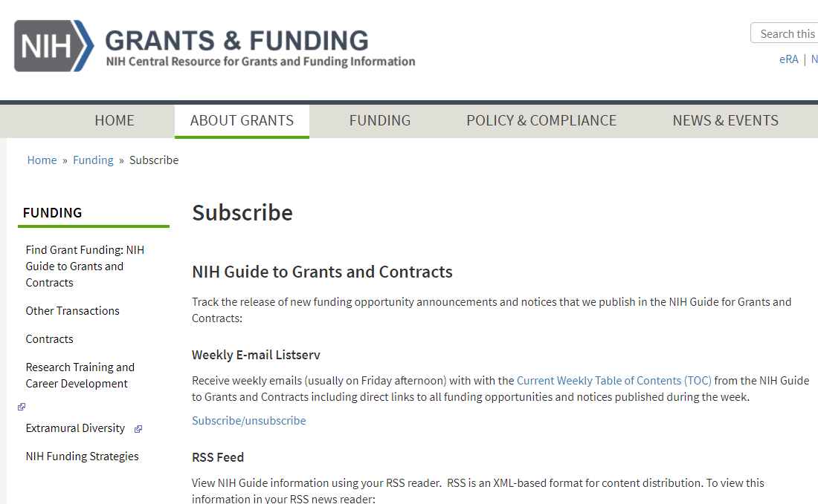
Subscribe to Receive the Weekly NIH Guide Table of Contents
NIH Guide is published daily.
Subscribe to listserv to receive table of contents each Friday…
or subscribe to our RSS feed or follow us on Twitter
http://grants.nih.gov/grants/guide/listserv_dev.htm

Slide 41
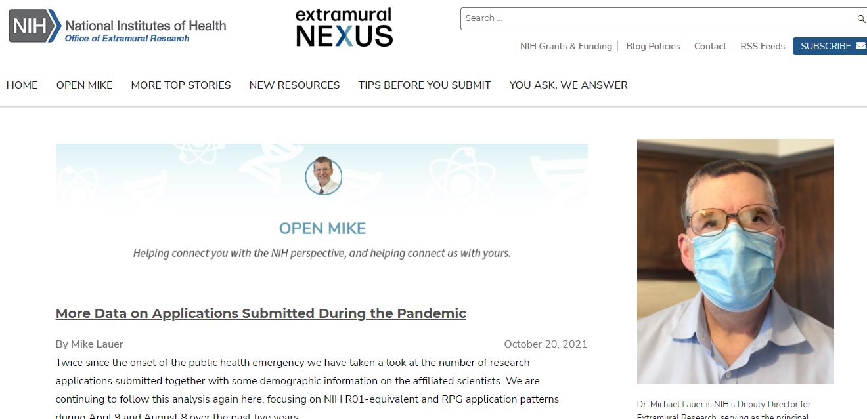
Extramural Nexus and Open MikeBlog
Subscribe to the monthly Nexus for a summary of NIH grant happenings, resources, events.
Provide comment, join the discussion!
http://nexus.od.nih.gov
http://nexus.od.nih.gov

Slide 42
Thank You!
Division of Biomedical Research Workforce
Office of Extramural Research
Research Training/Career Development Questions: https://researchtraining.nih.gov
Questions about ESI extension requests: esi_extensions@od.nih.gov
ESI Policies, FAQs Podcasts - https://grants.nih.gov/policy/early-stage/index.htm

