Slide 1

Turning the Kaleidoscope:
Changes in the big picture
The NLM Update – Part 3
Betsy L. Humphreys, MLS, FMLA
Acting Director
National Library of Medicine
National Institutes of Health
U.S. Department of Health and Human Services
blh@nlm.nih.gov
May 17, 2016
Notes:
Be part of the big picture.
When things in life shatter, use the pieces to create a mosaic that is even more awesome and beautiful that what you started with.
Moving pieces/innovation/recombination in new forms

Slide 2
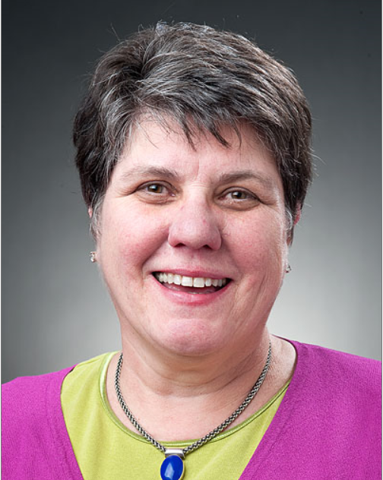
New NLM Director,
Patricia Flatley Brennan, RN, Ph.D. FAAN, FACMI
ARRIVING!!
New NLM Director – August 2016
Patricia Flatley Brennan, RN, Ph.D. FAAN, FACMI
Moehlman Bascom Professor of Nursing & Industrial Engineering
School of Nursing & College of Engineering
University of Wisconsin-Madison

Slide 3
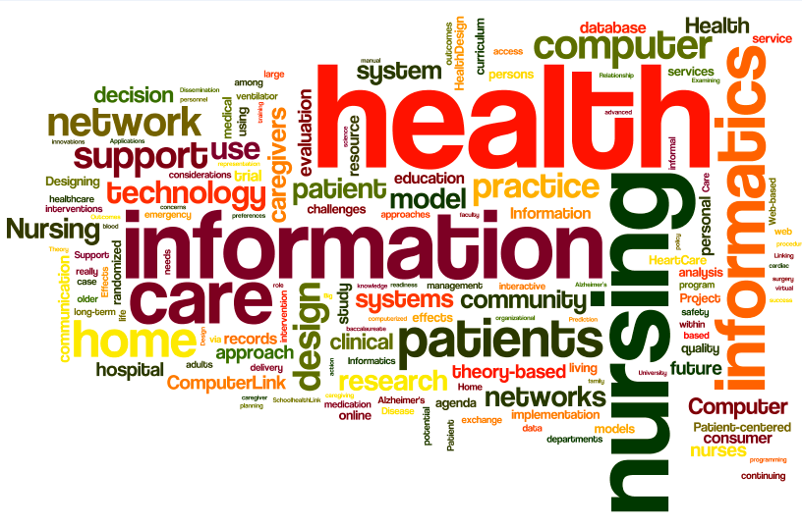
Source Text: titles of peer-reviewed articles in PF Brennan’s CV(3/2016)
Notes:
SafeHome Simulator system, a set of immersive Virtual Reality Training tools and display systems to train patients in safe discharge procedures in captured environments of their actual houses. The aim is to lower patient readmission by significantly improving discharge planning and training.

Slide 4
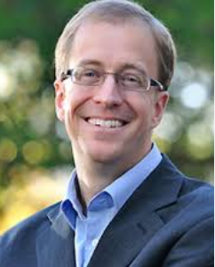
ARRIVING
New Director,
NIH Precision Medicine Cohort Program – June 2016
Eric Dishman
Vice-President and Intel Fellow
Intel Corporation’s Health & Life Sciences Group
Recent Member, NLM Board of Regents

Slide 5
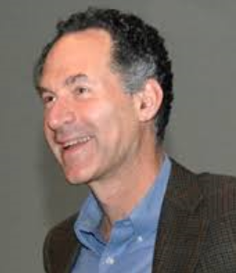
Staying…
David Lipman, MD
Director, National Center for Biotechnology Information,
National Library of Medicine, 1989—
Associate Director for Biomedical Information Resources, NIH, 2016--

Slide 6
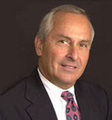
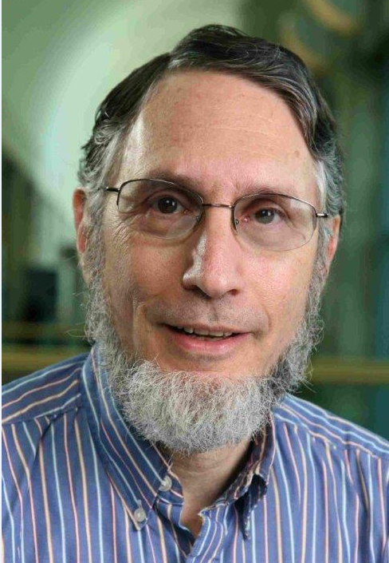
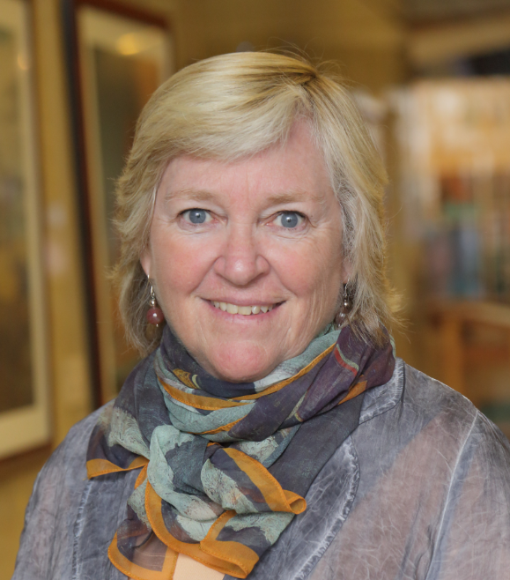
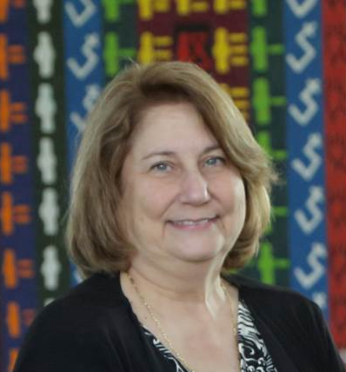
Departing…
Steve Phillips, MD
Associate Director for
Specialized Information Services
Mike Ackerman, Ph.D.
Assistant Director for
High Performance Computing
& Communications
Martha Fishel, MLS
Chief, Public Services Division
(June 2016)
Gale Dutcher, MS, MLS
Acting Associate Director for
Specialized Information Services
(September 2016)

Slide 7
Advisory Committee to the Director, NIH
NLM Working Group Report, June 11, 2015
New NLM Director to initiate Strategic Planning process within this framework
NLM must continually evolve to remain a leader in assimilating and disseminating accessible and authoritative biomedical research findings and trusted health information to the public, healthcare professionals, and researchers across the world
NLM should lead efforts to support and catalyze open science, data sharing, and research reproducibility, striving to promote the concept that biomedical information and its transparent analysis are public goods
NLM should be the intellectual and programmatic epicenter for data science at NIH and stimulate its advancement throughout biomedical research and application
NLM should strengthen its role in fostering the future generation of professionals in biomedical informatics, data science, library sciences, and related disciplines through sustained and focused training efforts
NLM should maintain, preserve, and make accessible the nation’s historical efforts in advancing biomedical research and medicine, thereby ensuring that this legacy is both safe and accessible for long-term use
New NLM leadership should evaluate what talent, resources, and organizational structures are required to ensure NLM can fully achieve its mission and best allocate its resources
http://acd.od.nih.gov/reports/Report-NLM-06112015-ACD.pdf

Slide 8
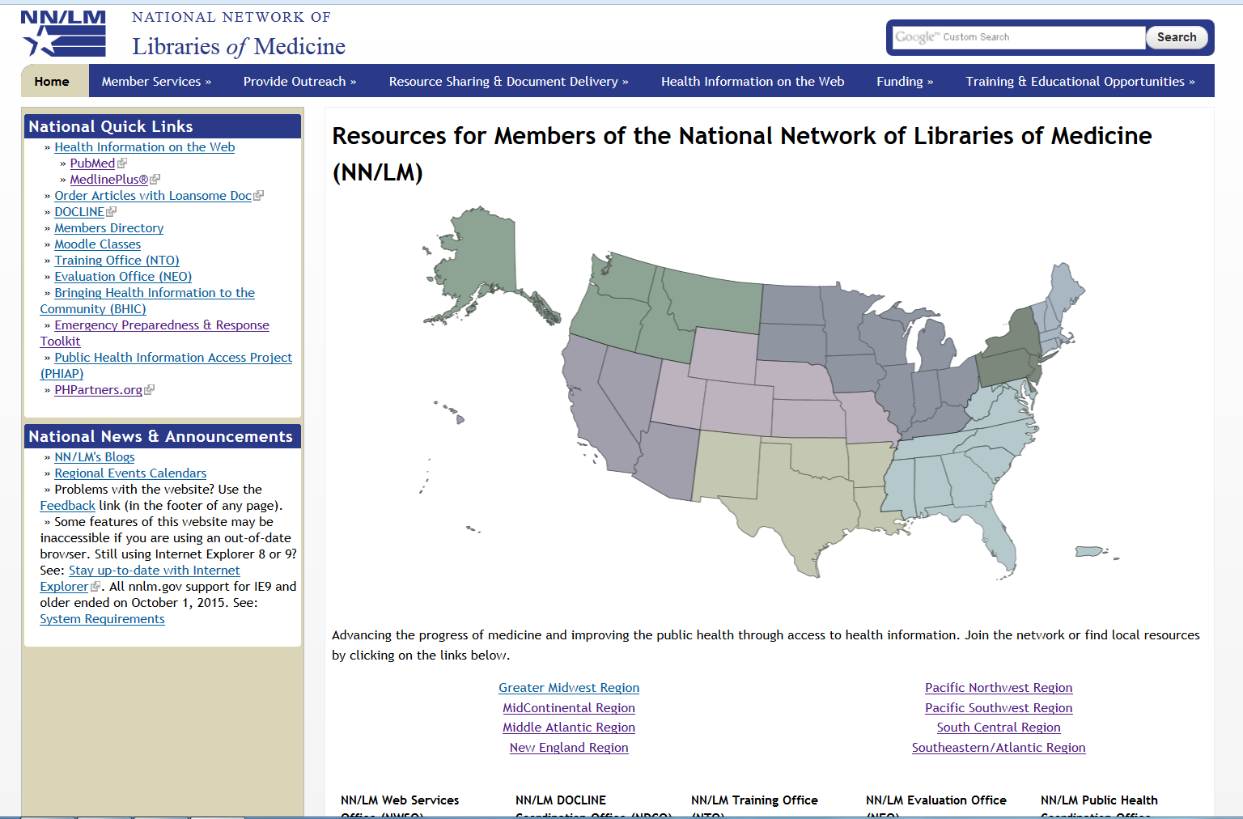
National Network Reboot
National Network Reboot

Slide 9
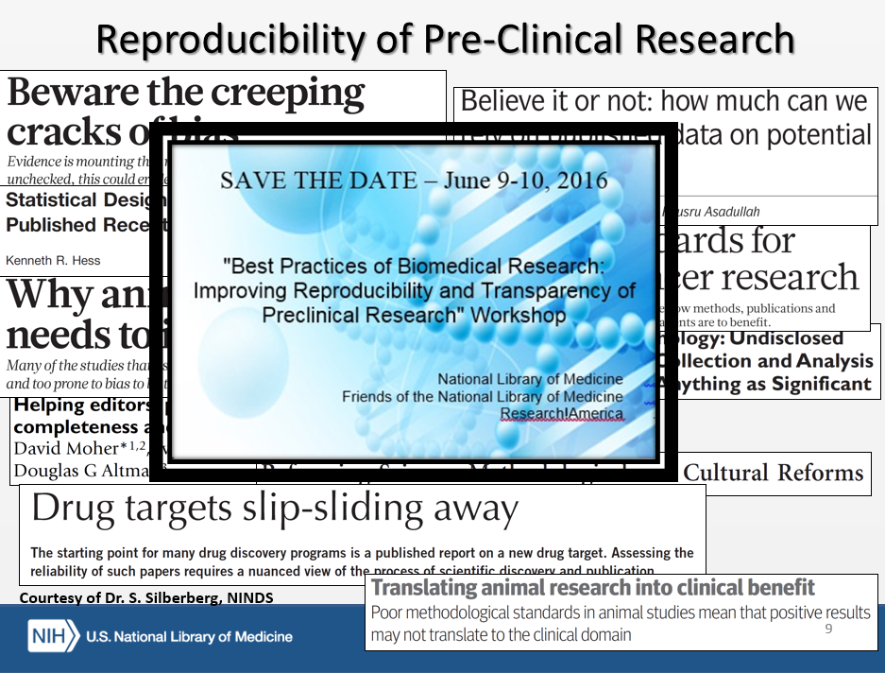
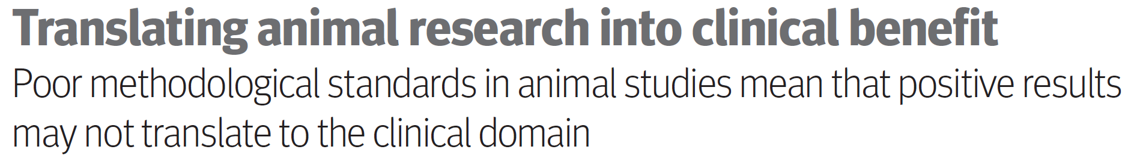
Reproducibility of Pre-Clinical Research
Courtesy of Dr. S. Silberberg, NINDS
Notes:
Reproducibility of Pre-Clinical Research
Research!America
Save the date: June 9-10, 2016
National Library of Medicine

Slide 10
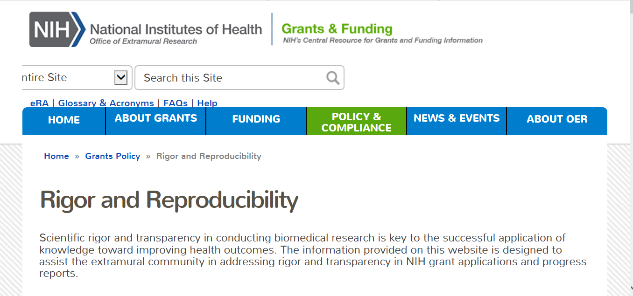
New NIH grant requirements: research (2016--); training (2017--)
Notes:
Last October, NIH published new guidance about addressing scientific rigor in research grants applications, effective in 2016. Last December, NIH announced the intention to issue new requirements for training grant applications, which will become effective in 2017.

Slide 11
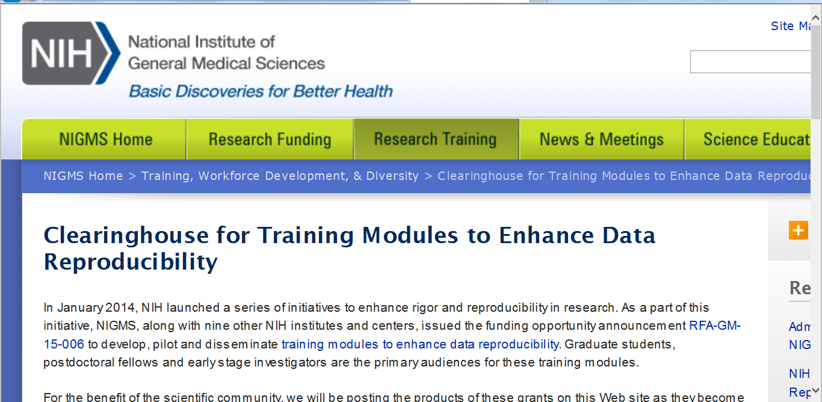
Training resources that may help…

Slide 12
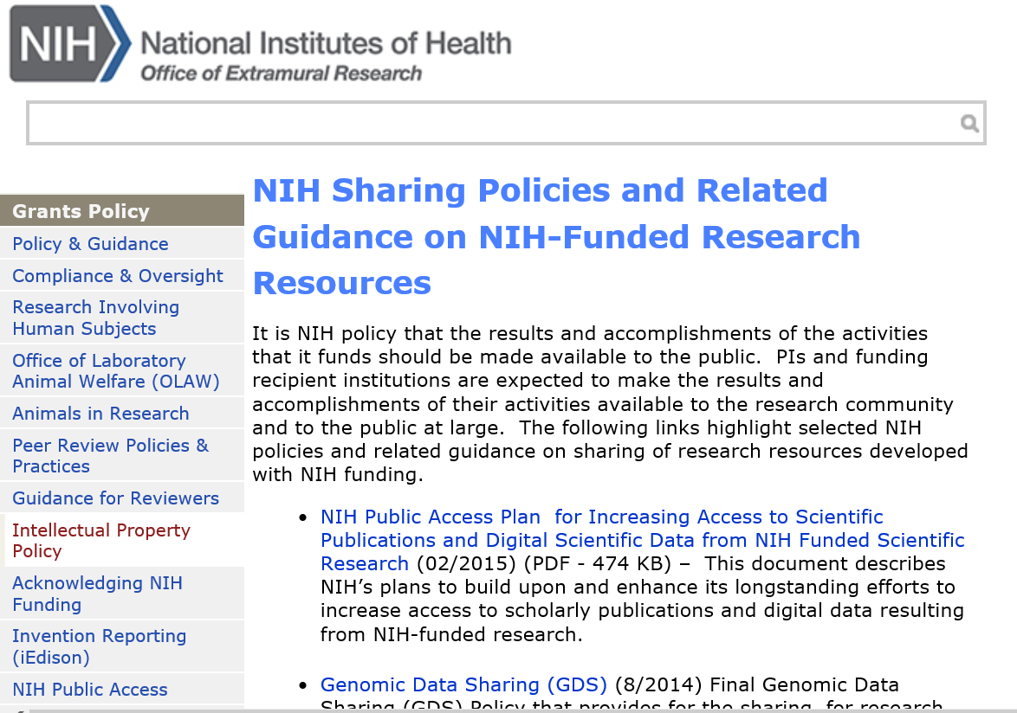
r

Slide 13
NIH Plan: Digital Scientific Data
Require Data Management and Sharing Plans
Ensure Policy Considerations are Addressed
Evaluate Data Management Plans
Support for Data Management
Leverage Existing Archives and Repositories
Improve Public Access to Scientific Data
Optimize Accessibility, Interoperability, and Long-Term Stewardship
Develop Attribution for Scientific Data
Support Training and Workforce Development
Notify Researchers of Obligations
Ensure compliance with data management plans and policies
Cooperate with the Private Sector
Conduct cost-benefit analysis
Assess Long-Term Preservation Needs
Additional NIH guidance not yet released

Slide 14
More NIH Requests for Input Coming
  Data Annotation in Biomedical Core Research Facilities and Related Needs for Community Education and Training
  Data Priorities, Data Citation, etc.
  NLM and NN/LM will publicize these as they are issued.

Slide 15
BD2K Open Educational Resource Grants Managed by NLM, FY 2015
Demystifying Biomedical Big Data: A User’s Guide. Haddad, Bassem. R25 LM012285 Georgetown U
Best Practices in Research Data Management Massive Open Online Course. Martin Elaine. R25 LM012284 U Mass Worchester
Enabling Data Science in Biology. Lawson, Catherine. R25 LM012286 Rutgers
Training & Tools for Informationists to Facilitate Sharing of Next Generation Sequencing Data. Seymour, Anne. R25 LM012288 JHU
Preparing Medical Librarians to Understand and Teach Research Data Management. Surkis, Alisa. R25 LM012283 NYU

Slide 16
FY 2015 Informationist Supplements
Eleven awards issued, 18 informationists embedded in research teams, e.g.,
Farrell, Brenda F. Curation & Management of Electrophysiological Data from Outer Hair Cells of Cavia Porcellus. Baylor U.
  Informationist Jason Bengston will develop a data management plan to curate data, including metadata, documentation for future users, and placement in public repositories.
Pang, Xiaowu. Howard/Hopkins Intercenter Collaboration in HPV-Associated Cancer Studies. Howard U.
  Informationist Young-Joo Lee will build a system to improve quality and transfer of data in 3 pilot projects between Howard U and JHU; develop a data dictionary. Develop metadata for citing data, and identify useful visualization tools.
Evanoff, Bradley. Washington U CTSA.
  Informationists will help them improve reproducibility by interviewing researchers, studying workflows for writing up methods and data reporting, and developing a scoring system for reproducibility of research.

Slide 17
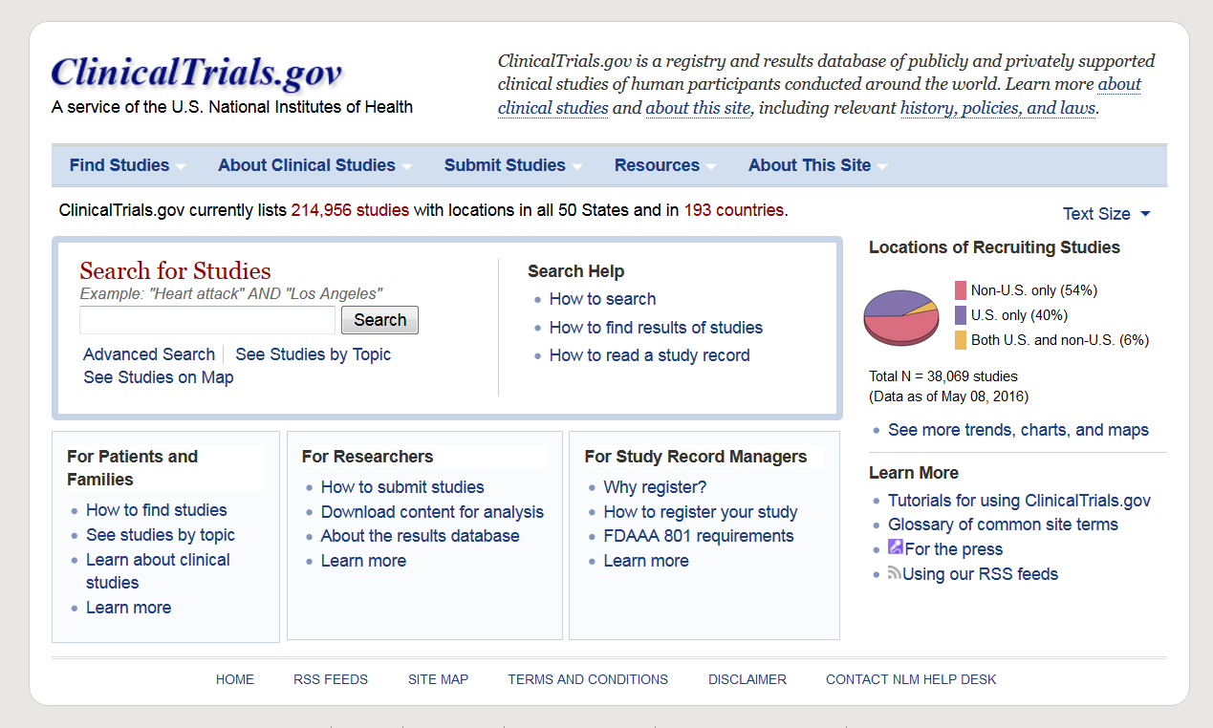
15,273 in Canada 5/9/2016
Summary results for 21,245 trials 5/9/2016

Slide 18
U.S. Clinical Trials Registration & Results Submission
Rulemaking Process – drug & device trials (2008-- )
Announce in Unified Agenda
Agency develops draft NPRM
Departmental (HHS) review
Public comment period
Departmental review
OMB review
Publish final rule
Congressional review
Rule takes effect (e.g., 90 days after publication)
OMB review
Publish in Federal Register
Agency response to comments
We are here
Proposed NIH Policy also covers Phase 1 and trials of ANY intervention

Slide 19
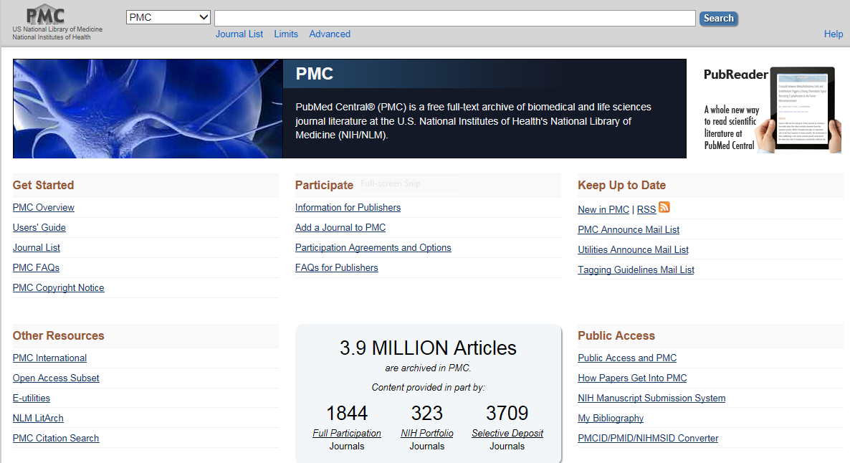
Progress on public access to publications
Author manuscripts now available for download – in addition to open access subset

Slide 20















PMC-Public Access Participants

Slide 21
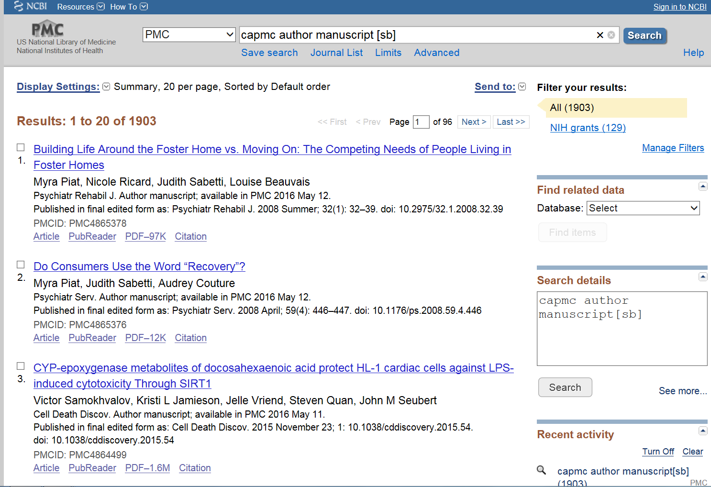
Author manuscripts submitted via the
Canadian Institutes of Health Research

Slide 22
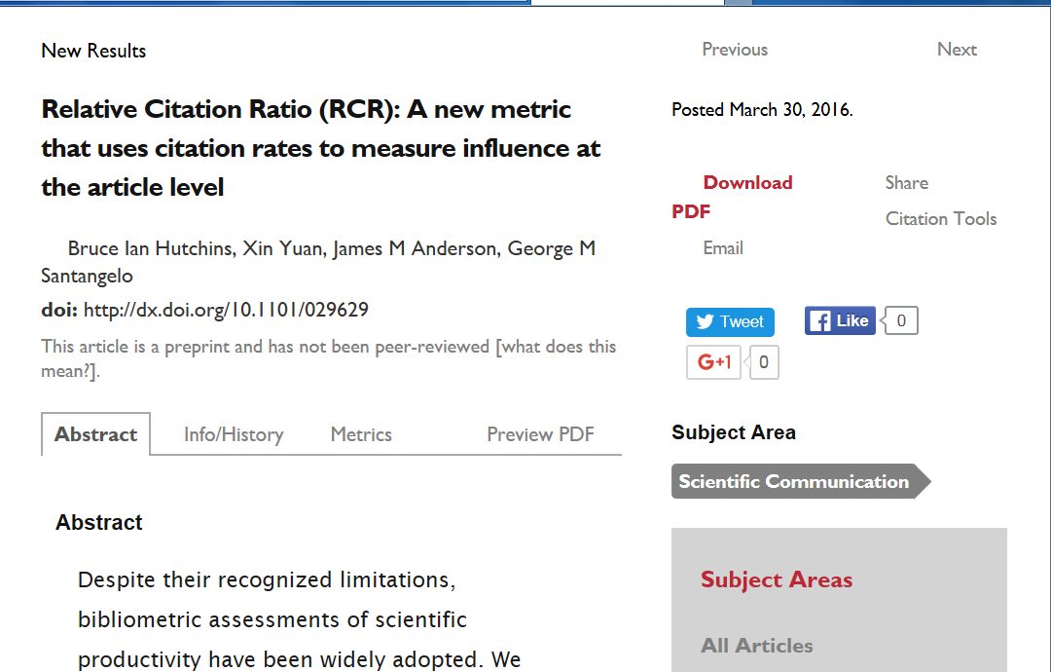
New (better?) measure of impact of articles
Try it at: https://icite.od.nih.gov

Slide 23
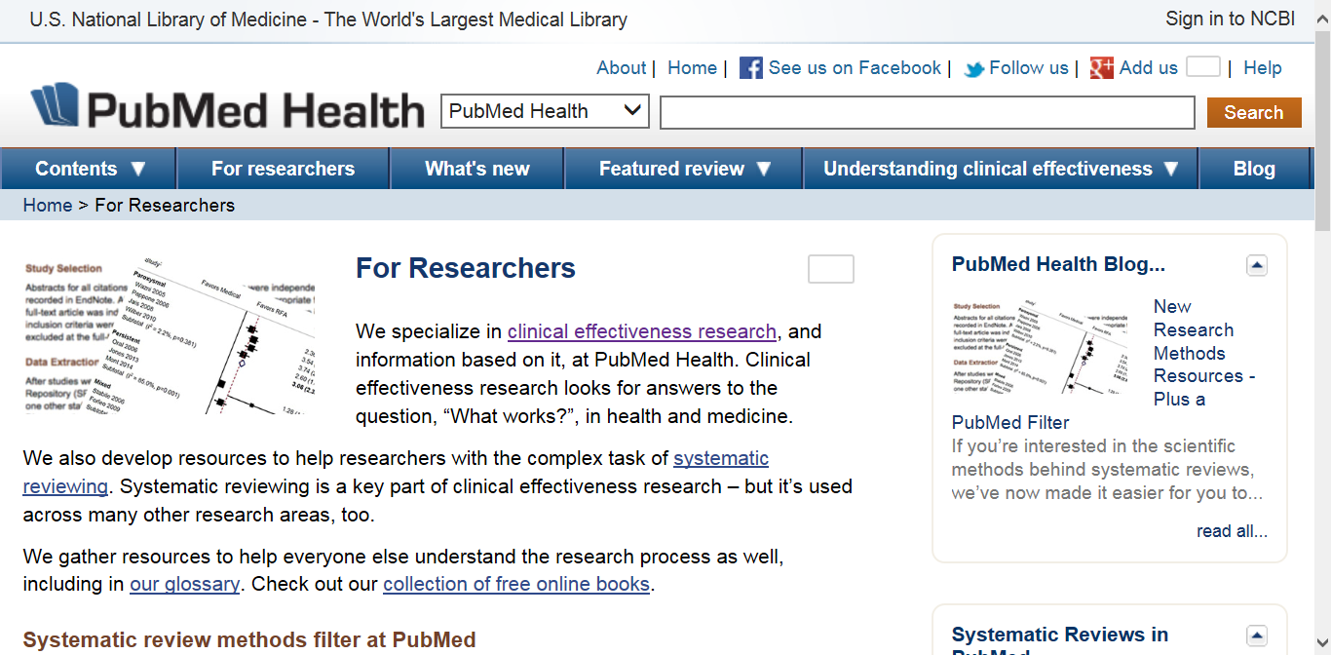

Consolidated Access to International Evidence

Slide 24
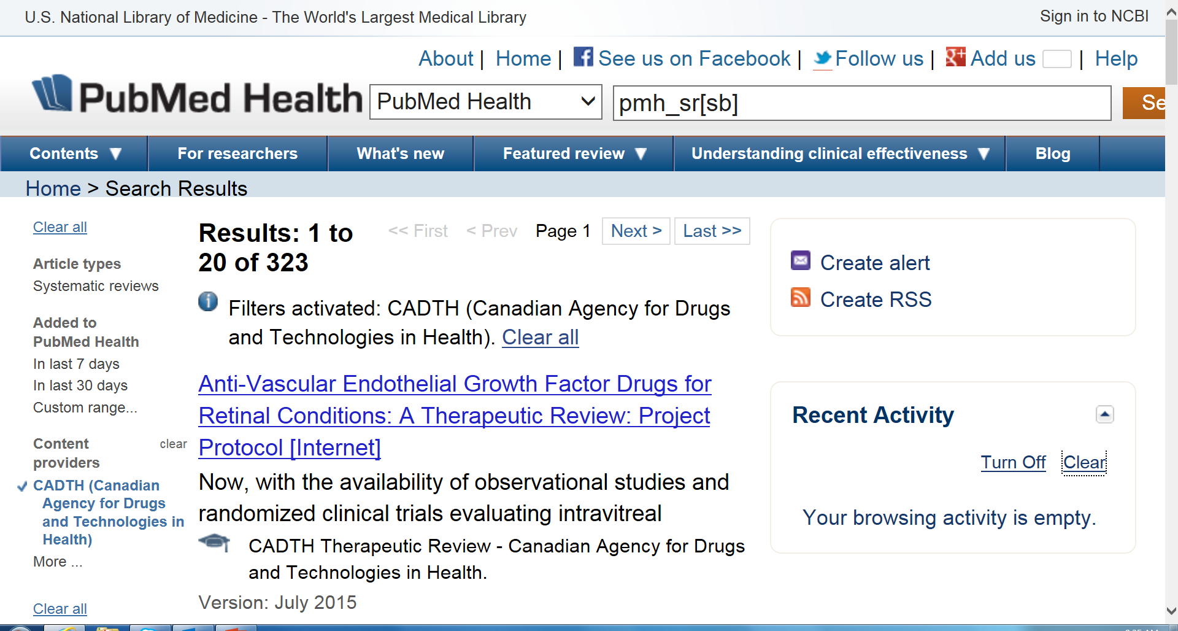
Including Canadian Reviews

Slide 25
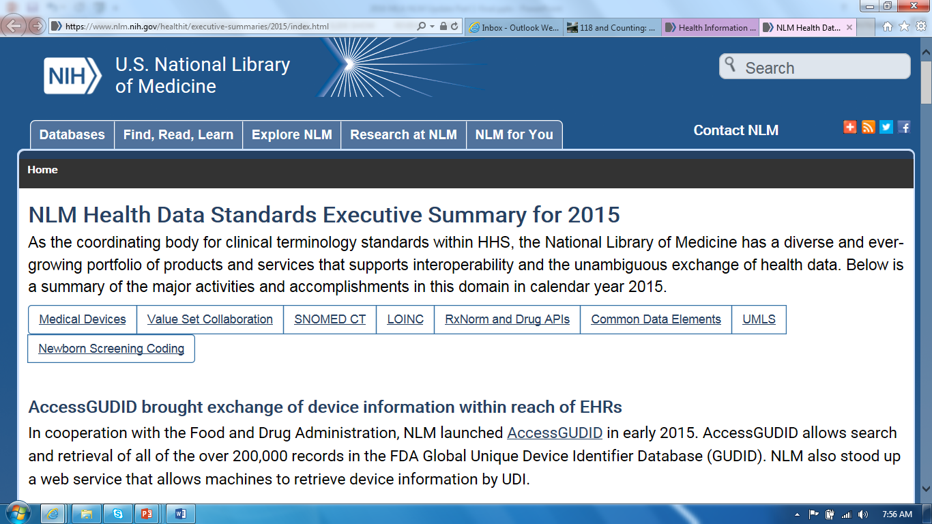
EHRs and Clinical Research Data

Slide 26
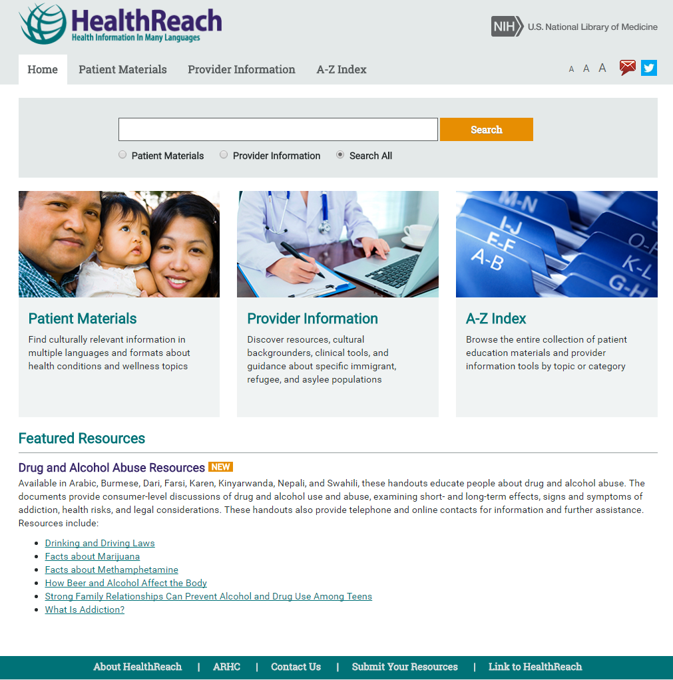
HealthReach https://healthreach.nlm.nih.gov
Enhancements of redesign:
Streamlined search & results
Responsive design for tablets and mobile devices
Detailed abstracts
Listserv for new content updates
Coming soon – end of May
Notes:
HealthReach is a database of quality multilingual and multicultural health resources. Consumer health information is available in multiple languages, with many documents available in audio.
Once a portal for refugee service providers as RHIN.org, the website now serves anyone assisting limited English-proficiency individuals.
The website redesign is based on a needs assessment and usability study involving refugee health coordinators, healthcare professionals, and information professionals.
The new site will be live by the end of May.

Slide 27
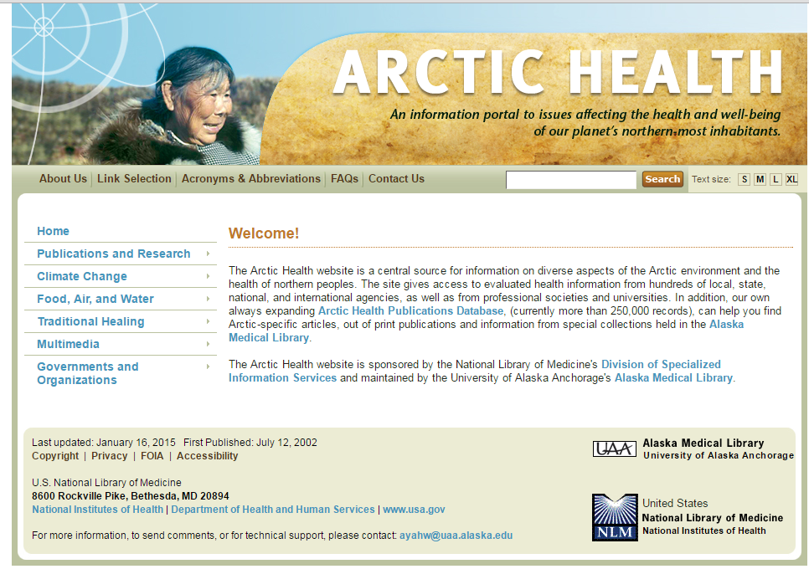
Arctic Health http://arctichealth.nlm.nih.gov/
Notes:
Arctic Health is a central source for information on the diverse aspects of the Arctic environment and the health of northern peoples. The site provides access to over 250,000 evaluated health information records from hundreds of local, state, national, and international agencies, as well as from professional societies and universities. Information specific to Arctic research, climate change, traditional healing, food, air and water and other resources from the special collections of the Alaska Medical Library is included.
The Arctic Health website is sponsored by the National Library of Medicine's Division of Specialized Information Services and maintained by the University of Alaska Anchorage's Alaska Medical Library.

Slide 28
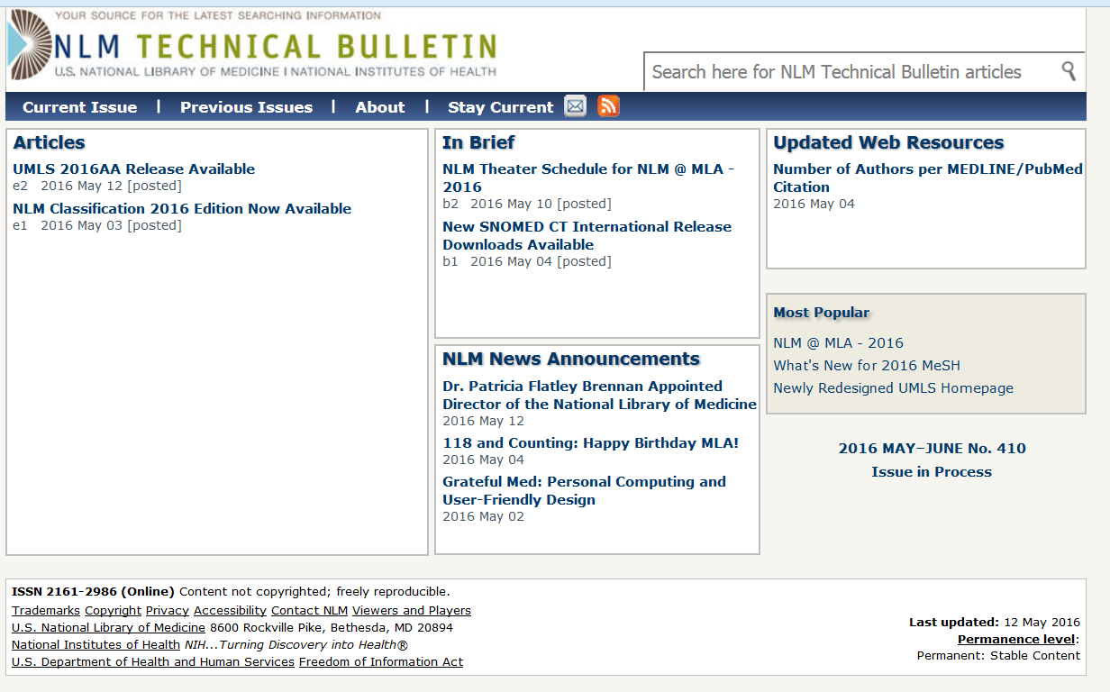
Constantly updated sources of NLM Updates
Notes:
Fun facts: Average number of personal authors per citation has risen steadily since 1950 and is now about 5.5 per MEDLINE/PubMed citation.
The article with the largest number of authors has 5,124.

Slide 29
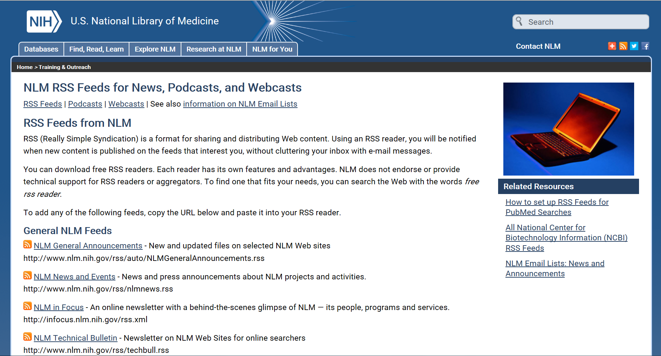
Constantly updated sources of NLM Updates

Slide 30
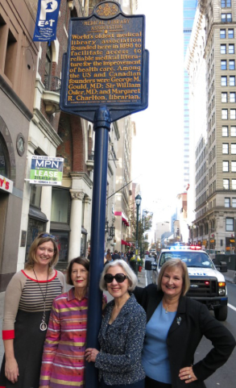
Some things DON’T Change…
118 years of cooperation between Canadian & US health sciences librarians
https://circulatingnow.nlm.nih.gov/2016/05/02/118-and-counting-happy-birthday-mla/

Slide 31
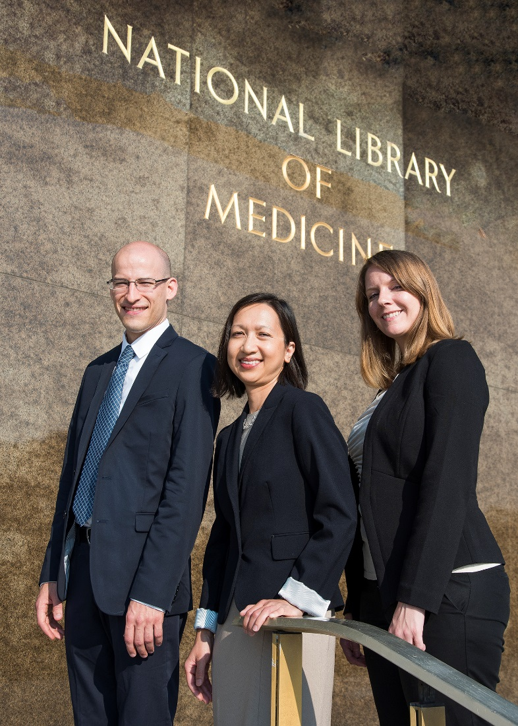
NLM Associate Fellows 2015-2016
Tyler Nix
Loan Nguyen
Becky Baltich Nelson

Slide 32
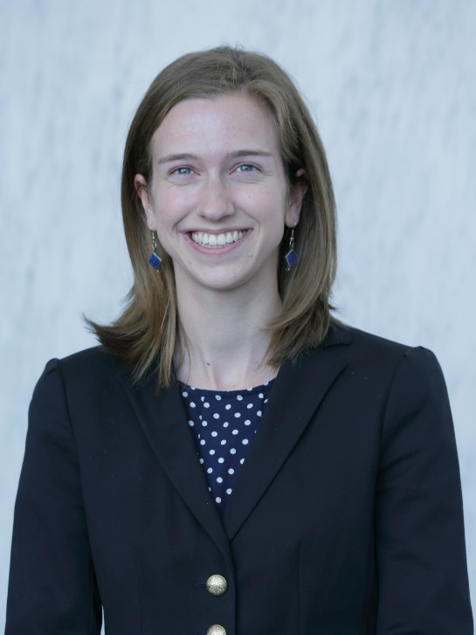
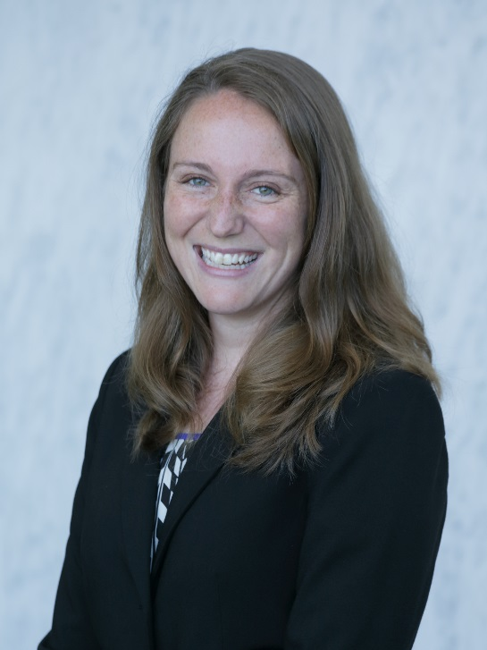
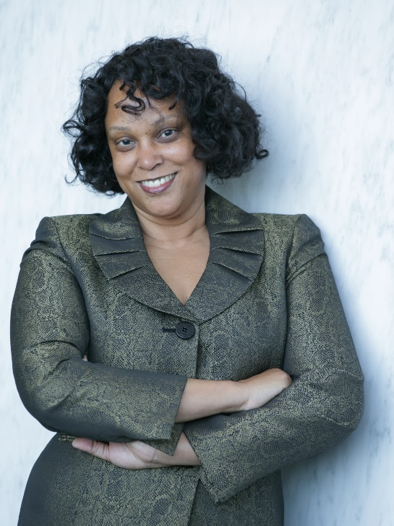
NLM Associate Fellows, 2nd Year
Ariel Deardorff Erin Foster Lori E. Harris
University of California, Oregon Health & Science University University of Cincinnati
San Francisco

Slide 33
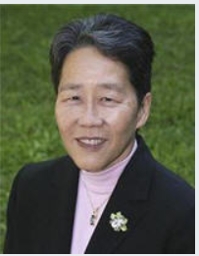
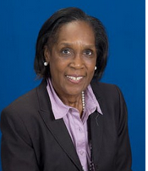
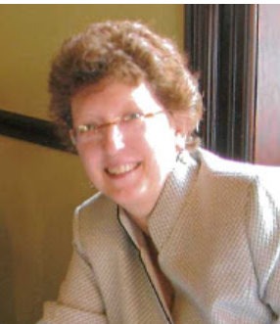
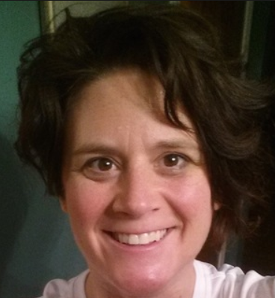
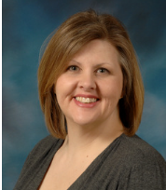
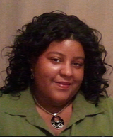
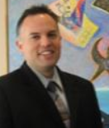
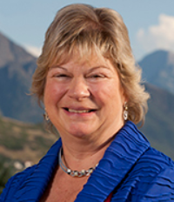
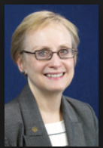
Great advice and counsel from great people…
Gail Yokote MS
UC Davis
NLM Board of Regents
(Outgoing Chair)
Sandra Martin MSLS
Wayne State Univ.
NLM Board of Regents
Nancy Tannery, MLS
Univ. Pittsburgh.
NLM LSTRC (Chair)
Marisa Conte, MLIS
U Michigan
NLM LSTRC
Kristi Holmes PhD
Northwestern
NLM BLIRC
Taneya Koonce MPH MSLS
Vanderbilt
NLM BLIRC
Gabe Rios MLIS
Indiana University
NLM BLIRC
Jean Shipman, MLS
Univ. Utah.
NLM BLIRC
Karen Butter, MS
UCSF
PMC NAC

Slide 34
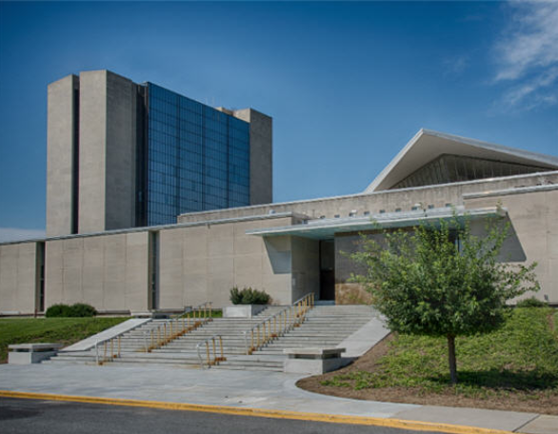
You and your thoughts welcome here! -- blh@nlm.nih.gov

