Slide 1
Joyce Backus – Library Operations
Looking back, looking ahead
Regional Medical Library Program – 2011-2016
MEDLINE Indexing today and tomorrow
Notes:
Thank you, Betsy. Every year, NLM has the privilege of addressing you, the members of the MLA and this year we’re honored to be in this wonderful city in Canada and talk to our Canadian froleagues as well. (thanks, MJ) Today, I’ve chosen two topics to share with you, and I will be looking back and looking ahead. First, I’m going to look back at the last five years of our national network of libraries of medicine and look forward to the new cooperative agreements. And then, I’ll share a behind the scenes look at our MEDLINE indexing, both how we do it know and how we’re improving it going forward.

Slide 2
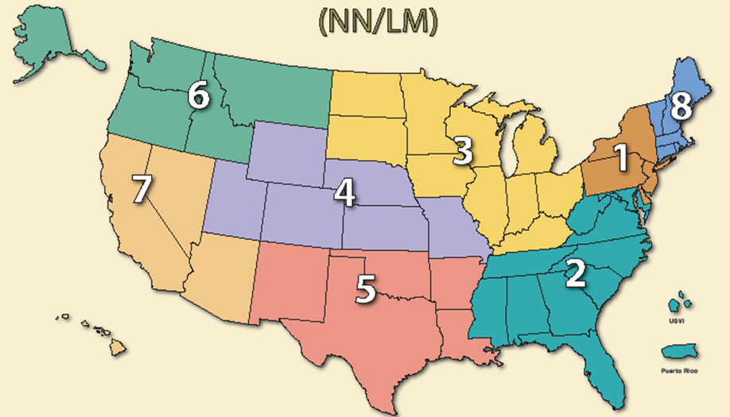
2011-2016 AND 2016-2021
1: Middle Atlantic
2: Southeastern Atlantic
3: Greater Midwest
4: MidContinental
5: South Central
6: Pacific Northwest
7: Pacific Southwest
8: New England
Notes:
NLM has many services that benefit the entire international community. But, for people in the US, we sponsor the Regional Medical Library Network whose staff serve as a field force for NLM. On April 30, these 8 regional medical libraries ended their five year contracts so here’s a whirlwind tour of their accomplishments. I hope that this quick overview may highlight a project you’ll want to explore or possibly even emulate whether your library is here in Canada or in the US.

Slide 3



2011-2016 Region 1: Middle Atlantic Region
University of Pittsburgh Health Sciences Library System (HSLS)
Notes:
The University of Pittsburgh Health Sciences Library increased network membership by 30%. They gathered feedback from network members which resulted in many new programs including, a 6-credit CE course called “Running your Hospital Library like a Business”, and a Hospital Library Mentorship Program which is being piloted with 3 pairs of hospital libraries. They also partnered with AAHSL on training in Research Data Management, Webinars on the Affordable Care Act, and contributed to the conference “Teaching & Learning in New Library Spaces: The Changing Landscape of Health Sciences Libraries”. This RML also provided support to libraries throughout NY and NJ that were devastated in Superstorm Sandy.

Slide 4









2011-2016 Region 2: Southeastern/Atlantic Region
University of Maryland, Baltimore, Health Sciences and Human Services Library
$1.6M for 375 projects, 441 outreach activities, 10,380 participants
923 classes/site visits/presentations to 23,799 participants
Military Partners and Families Coalition Community Health Care Report
MaFlo’s Health and Awareness Team
Notes:
In the last five years, the southeastern Atlantic regional medical library has provided over $1.6 million dollars to members like you who carried out hundreds of projects benefitting thousands of participants. One example is the Military Partners and Families Coalition, supporting the study of health care for gay and lesbian military personnel, their partners, and families the results of which are now part of a military-wide study. Another notable program is MaFlo’s Health & Awareness Team, an outreach project run from a South Carolina beauty shop, which Region 2 says “is emblematic of our continued outreach to small organizations, helping them to realize their ability to effect real change.”

Slide 5


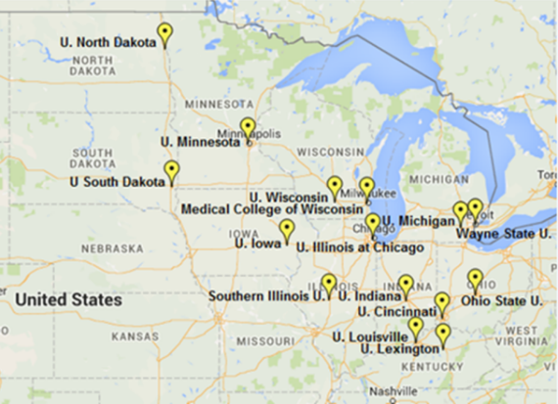


2011-2016 Region 3: Greater Midwest Region
The University of Illinois at Chicago, Library of the Health Sciences
RSNA
GMR Outreach Libraries
Tribal Initiatives
Notes:
From 2011 to 2016, the greater Midwest region at the University of Illinois at Chicago worked with its many network members to increase access to health and biomedical information for the Greater Midwest Region, by bringing training and information to librarians and health professionals and Native American populations as well.

Slide 6

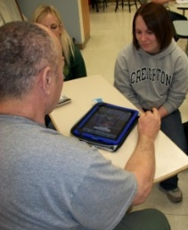


Region 4: MidContinental Region
University of Utah, Spencer S. Eccles Health Sciences Library, Salt Lake City
Information at the Ready
Showing the Value of Librarians
Improving Health Information Access Support
Notes:
Recognizing the potential of tablet technology, the staff at the midcontinental region 4 put iPads into the hands of community based organization staff and health sciences librarians. This portability made health information at the ready—where and when it was needed in client homes, clinics, at community events, and in hospitals and as a result, libraries increased their user population. As you can see from this graph, region four network members highly value the communication tools used in supporting their mission to provide access to health information resources.

Slide 7
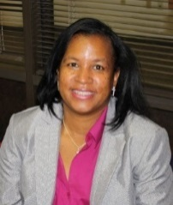




2011-2016 Region 5: South Central Region
Houston Academy of Medicine, Texas Medical Center Library
RML from 1991 – 2016
Network growth: 880 to 960 affiliate members
Awards to over 250 library and community partners
Continuing Nurse Education (CNE) Credits
  Used by all RMLs
Developed Grant and Proposal Writing Course
Library Student Outreach Awards
  Launched future health sciences librarians into productive, rewarding careers.
Disaster Preparedness focus
Notes:
The Houston Academy of Medicine, Texas Medical Center Library served as an RML from 1991 through 2016. During the last five years, their number of affiliate network members grew to nearly 1,000. This RML benefited, not only their region, but the entire network by negotiating nursing continuing education credits and creating a grant writing course, both used by all the RMLs. And, of course this RML, serving the Gulf coast region which is prone to hurricanes, has had a special role in education for disaster preparedness and response.

Slide 8



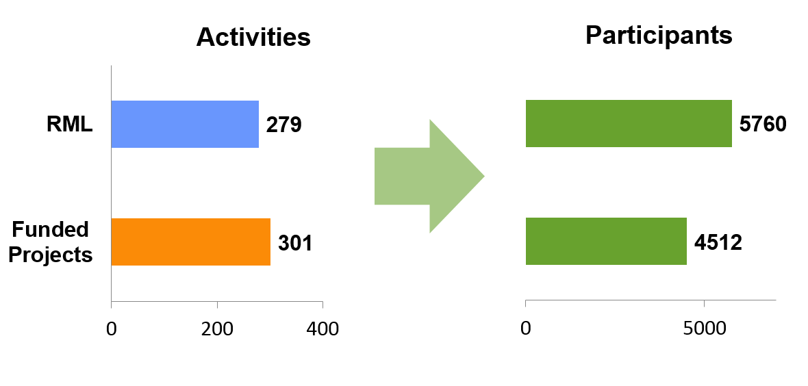


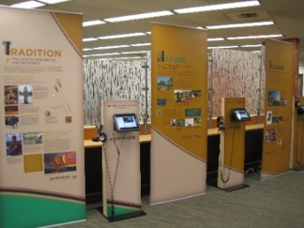


2011-2106 Region 6: Pacific Northwest Region
University of Washington,
Health Sciences Libraries and Information Center, Seattle
8
580 Outreach Activities by RML and Subcontractors
7
6
2
4
3
5
#NNLMdataforum
March 2016
Notes:
The pacific northwest region was involved in the Native Voices project which brought native concepts of health to visitors to the website or travelling exhibition and also brought a totem pole from the pacific northwest to NLM in Maryland. They funded nearly 600 outreach activities and led cooperations with a number of community, professional and healthcare organizations.

Slide 9
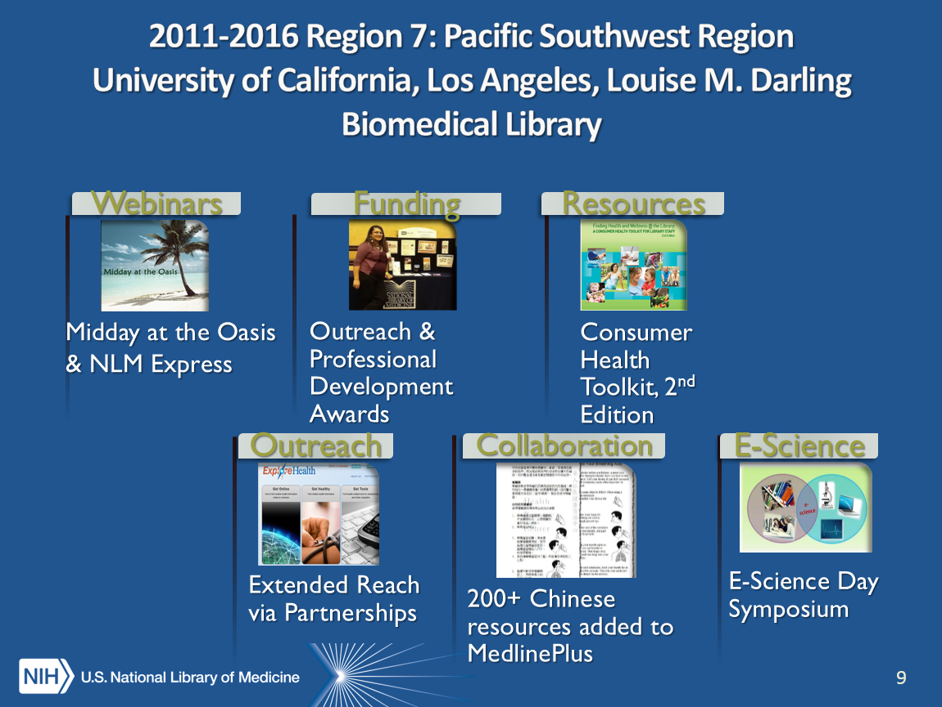
2011-2106 Region 7: Pacific Southwest Region
University of California, Los Angeles, Louise M. Darling Biomedical Library
Notes:
In the Pacific Southwest Region, the staff at UCLA completed an E-Science Day Symposium in partnership with UC Davis, released an updated edition of the 2010 Consumer Health Toolkit used by librarians all over the US. This RML also provided expert advice for a UC, Davis, Broadband Grant reaching 35 counties in California. Leveraging regional language expertise, they worked with the Chinese Community Health Resource Center in San Francisco to add over 200 resources in to MedlinePlus which are therefore available in Canada, the US and around the world.

Slide 10
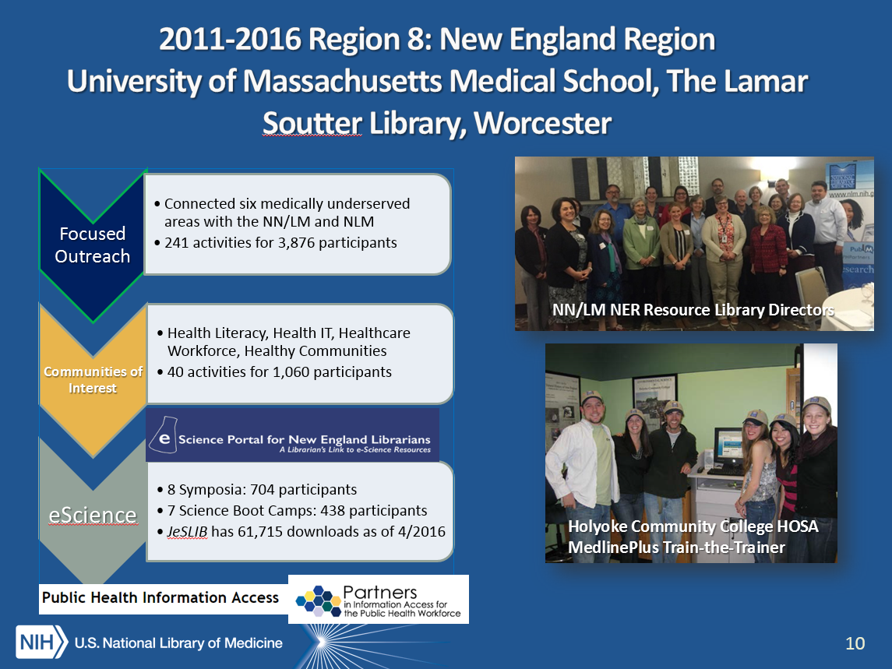
2011-2106 Region 8: New England Region
University of Massachusetts Medical School, The Lamar Soutter, Worcester
Notes:
The New England Region used a Focused Outreach model, to target medically underserved geographic areas and populations to maximize staff outreach impact. The staff coordinated Communities of Interest offering workshops, on a variety of topics including supporting the Affordable Care Act, adding Value to EHRs, and demonstrating community benefit. The NER has also developed unique programming in public health coordinating the PHPartners website and the Public Health Information Access Project .

Slide 11
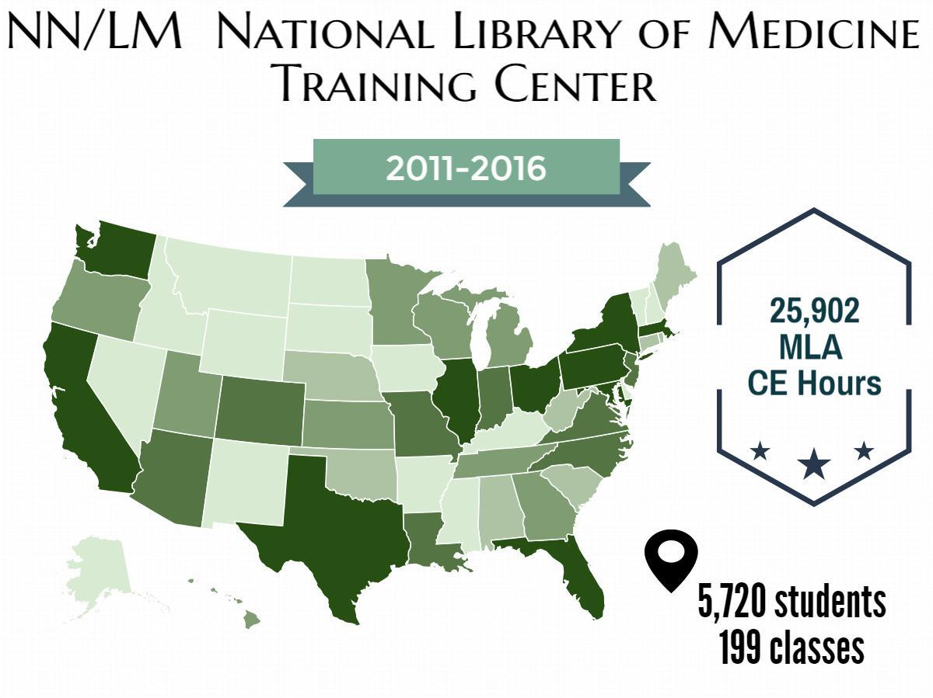
2011-2016 National Training Center (NTC), University of Utah
Notes:
The NTC moved the majority of training online to provide better access for all of you, and also pioneered new class formats, such as the modular, self-paced Discovering TOXNET, and collaborated to expand training opportunities in bioinformatics for librarians with “Fundamentals of Bioinformatics” and a “Librarian’s Guide to NCBI. “

Slide 12

2011-2016 Outreach Evaluation Resource Center (OERC) , University of Washington
OERC booklet series, edition 2
Evaluation training program
OERC blog
Evaluation consultations
Evaluation services to NN/LM
Notes:
During this contract, the outreach evaluation resource center published edition two of the popular booklet “Planning and Evaluating Health Information Outreach Projects” and has distributed nearly 800 copies of the latest edition internationally. I highly recommend it for any of you engaged in outreach here in Canada, the US or elsewhere.

Slide 13
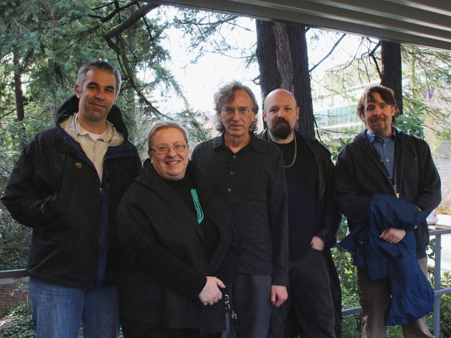
2011-2016 Web Services Technology Operations Center (Web-STOC), University of Washington
Supporting NN/LM users and maintaining performance with minimal down-time:
Section 508 compliance improvements
Website health and fitness monitoring refinements
Enhanced server security
Drupalization: RMLs, Centers, courses, all migrated
Aron Beal (Web Apps Developer), Tania Bardyn (Director),
Michael Boer (Assistant Director), Deric Ruhl (Linux System Administration Specialist), Mike Weiss (Security Engineer)
Notes:
And lastly, the web service technology center provided the virtual digital glue of the web sites and services that kept the entire RML network connected to each other and to all of you and we thank them for that vital service.

Slide 14
Looking Ahead - 2016-2021 Cooperative Agreements
Region 1 - Middle Atlantic Region
University of Pittsburgh, Health Sciences Library System, Pittsburgh, PA
States Served: DE, NJ, NY, PA
Region 2 - Southeastern/Atlantic Region
University of Maryland at Baltimore
Health Sciences and Human Services Library, Baltimore, MD
States Served: AL, FL, GA, MD, MS, NC, SC, TN, VA,WV, the District of Columbia, Puerto Rico, and the U.S. Virgin Islands
Region 3 - Greater Midwest Region
University of Iowa, Hardin Library for the Health Sciences, Iowa City, IA
States Served: IA, IL, IN, KY, MI, MN, ND, OH, SD, WI
Region 4 - MidContinental Region
University of Utah, Spencer S. Eccles Health Sciences Library, Salt Lake City, UT
States Served: CO, KS, MO, NE, UT, WY
Region 5 - South Central Region
University of North Texas Health Science Center, Gibson D. Lewis Library, Fort Worth, TX
States Served: AR, LA, NM, OK, TX
Region 6 - Pacific Northwest Region
University of Washington, Health Sciences Library, Seattle, WA
States Served: AK, ID, MT, OR, WA
Region 7 - Pacific Southwest Region
University of California, Los Angeles
Louise M. Darling Biomedical Library
Los Angeles, CA
States Served: AZ, CA, HI, NV, and U.S. Territories in the Pacific Basin
Region 8 - New England Region
University of Massachusetts Medical School
Lamar Soutter Library
Worcester, MA
States Served: CT, MA, ME, NH, RI, VT
National Coordinating Offices:
NN/LM Web Services Office (NWSO)
University of Pittsburgh, Health Sciences Library System, Pittsburgh, PA
NN/LM DOCLINE Coordination Office (NDCO)
University of Maryland at Baltimore, Health Sciences and Human Services Library, Baltimore, MD
NN/LM Training Office (NTO)
University of Utah, Spencer S. Eccles Health Sciences Library, Salt Lake City, UT
NN/LM Evaluation Office (NEO)
University of Washington, Health Sciences Library, Seattle, WA
NN/LM Public Health Coordination Office (NPHCO)
University of Massachusetts Medical School
Lamar Soutter Library, Worcester, MA
Notes:
Going forward, these are the institutions who you will be counting on to connect you to NLM products and services, our national workforce that are creating wonderful tools and resources for those of you in the US that of course, our neighbors here in the north are welcome to use as well.
And, if I could ask any of you in the room who were part of any of the RMLs of the recently ended contract, or any of you who are part of the cooperative agreements going forward, I would like to lead your froleagues in thanking you.

Slide 15
Looking back, looking ahead - MEDLINE
International MEDLINE
MEDLINE indexing growth
MEDLINE indexing staff
What do indexers do now?
  Behind the scenes – the Indexing System
  Tools to improve efficiency
Looking ahead MTI – Medical Text Indexer
Notes:
I know everyone is familiar with MEDLINE and you’ve probably used PubMed/MEDLINE if not in the last minute, maybe the last week or so. And, at some point, someone probably taught you how NLM indexes articles for MEDLINE, but let’s take a behind the scenes look anyway since I personally know some indexers pretty well and they gave me the scoop to share with you this morning.

Slide 16

Journals indexed for MEDLINE
Published in 85 countries, written in 40 languages
Notes:
At this international meeting, I want to point out that journals indexed for MEDLINE are published in 85 countries and articles can be written in any of almost 40 languages though most are in English and almost every one has English abstract

Slide 17
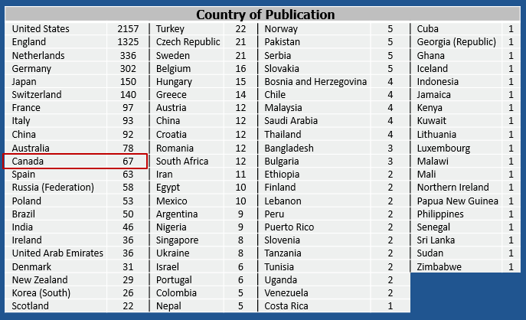
Journals indexed for MEDLINE
Notes:
Here is the list of countries of publication. A fair number are published here in Canada.

Slide 18
MEDLINE indexing growth
Notes:
But, let’s take a look at the growth of MEDLINE indexing

Slide 19
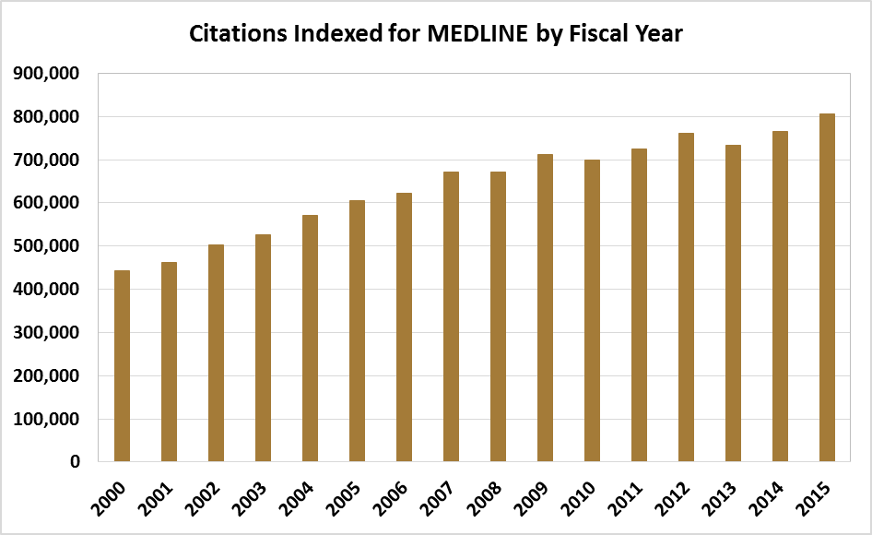
MEDLINE indexing growth
Notes:
Here are the numbers for the past 15 years.
This graph illustrates the growth of MEDLINE indexing over the past 15 years.
In FY 2000, we indexed 442,00 articles from 4,332 MEDLINE journals – this was done by 104 indexers.
In FY 2015, we indexed almost twice as many articles -- 805,000 articles from 5,618 journals.
This tremendous increase in work was done by 127 indexers – so without a doubling of the number of human indexers.

Slide 20
MEDLINE indexing growth
805,326 citations
5,618 journals
127 indexers
442,000 citations
4,332 journals
104 indexers
Notes:
In the year 2000, 104 people indexed 442,000 articles from over 4,300 MEDLINE journals. In 2015, 127 indexers indexed approximately 805,000 articles from 5,600 journals –

Slide 21
MEDLINE indexing growth
805,326 citations
5,618 journals
127 indexers
442,000 citations
4,332journals
104 indexers
82% increase in articles indexed
22% increase in the number of people
Notes:
As you can see, these experts increased their production by 82% with only a 22% increase in the number of people doing the work. Our indexing section has been working hard in partnership with our Lister Hill center for biomedical communications to make this trend possible, and we hope, sustainable.

Slide 22
MEDLINE indexing staff
27 in-house and 100 contract indexers
Extensive domain knowledge
Minimum of Bachelor’s degree, but most have advanced degrees
Range of experience from 3 months to 50 years
Journals assigned based on subject matter and language expertise
Notes:
People often ask if the MEDLINE indexers and librarians. Yes, some of them are, but most of them are subject experts, with advanced degrees in science and health care. Journals are assigned based on indexer subject matter and language expertise. For example,

Slide 23
Journal assignment for indexing
Notes:
This journal would be indexed by someone with a degree in pharmacy

Slide 24
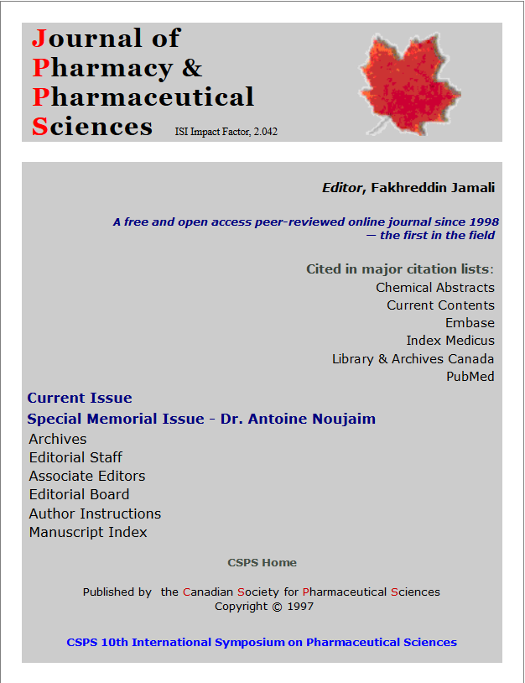
Journal assignment for indexing
Indexer with pharmacy degree
Notes:
This journal would be indexed by someone with a degree in pharmacy

Slide 25
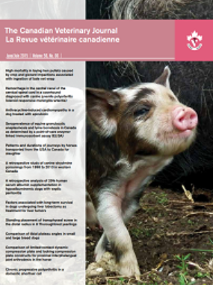
Journal assignment for indexing
Indexer with pharmacy degree
Indexer with veterinary degree
Notes:
This title would be appropriate for someone with a veterinary degree or animal science background

Slide 26

Journal assignment for indexing
Indexer with pharmacy degree
Indexer with veterinary degree
Indexer with nursing degree
Notes:
And someone with a nursing background might index this title. We have more Canadian journal examples, but you get the idea

Slide 27
Indexing process
Notes:
Now here’s the behind the scenes on the actual indexing process

Slide 28
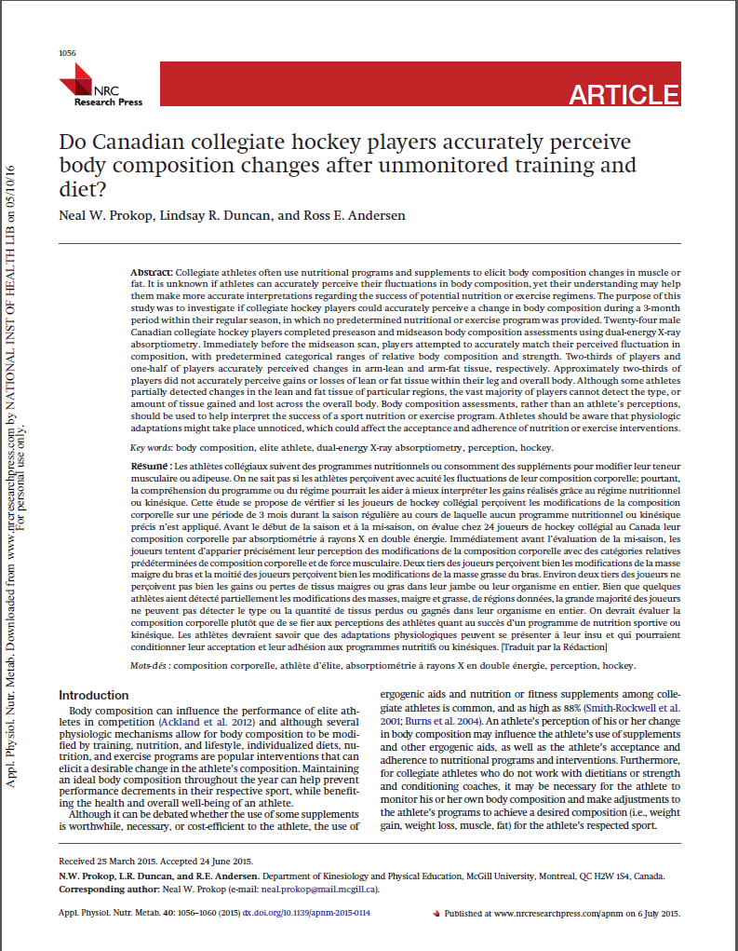
Indexing process
Indexers don’t read the entire article
Notes:
Indexers don’t actually read the entire article
We are often asked whether indexers read the entire article – they do not. Their approach is to
Read and understand the title
Scan the abstract for an overview of content
Scan the introduction to the statement of purpose
Check the materials and methods for details about the study subject and techniques used
Focus on the Results
The intellectual process of indexing represents article “aboutness” – not past or future work, but the present described in a given article
Indexers tell this story of what an article is about using the controlled vocabulary of MeSH

Slide 29
Indexing process
Indexers don’t read the entire article
  Read and understand title
Notes:
Their approach is to read and understand the title

Slide 30
Indexing process
Indexers don’t read the entire article
  Read and understand title
  Scan abstract for overview of content
Notes:
Scan the abstract for an overview of the article’s content

Slide 31
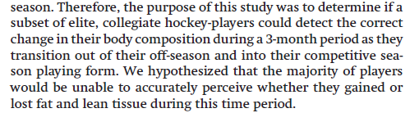
Indexing process
Indexers don’t read the entire article
  Read and understand title
  Scan abstract for overview of content
  Scan introduction to statement of purpose
Notes:
Scan the introduction until the statement of purpose

Slide 32
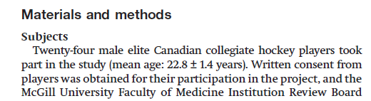
Indexing process
Indexers don’t read the entire article
  Read and understand title
  Scan abstract for overview of content
  Scan introduction to statement of purpose
  Check materials and methods
Notes:
They check the materials and methods section for information about study participants and techniques which are important to capture for the MEDLINE metadata you count on for comprehensive searching, especially for systematic reviews.

Slide 33
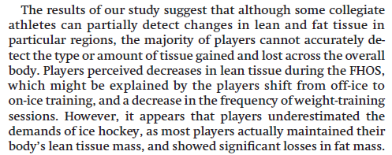
Indexing process
Indexers don’t read the entire article
  Read and understand title
  Scan abstract for overview of content
  Scan introduction to statement of purpose
  Check materials and methods
  Focus on the results
Notes:
Finally, they focus on the results section

Slide 34
Indexing process
Indexers don’t read the entire article
  Read and understand title
  Scan abstract for overview of content
  Scan introduction to statement of purpose
  Check materials and methods
  Focus on the results
Content Analysis
  What are the major points?
  What are the minor points?
  What is the article genre?
Notes:
As indexers are going about this process, they are asking themselves questions about the major points of the article? the minor points? and the article genre, a Review or Meta-Analysis, for example

Slide 35
Indexing process
Intellectual process of indexing
Represent “aboutness”
  Not describing the past
  Not describing the future
  Describing the present
Tell the story of what this article is about using the controlled vocabulary MeSH
Notes:
We are often asked whether indexers read the entire article – they do not. Their approach is to
Read and understand the title
Scan the abstract for an overview of content
Scan the introduction to the statement of purpose
Check the materials and methods for details about the study subject and techniques used
Focus on the Results
The intellectual process of indexing represents article “aboutness” – not past or future work, but the present described in a given article
Indexers tell this story of what an article is about using the controlled vocabulary of MeSH

Slide 36
Indexing process
Potential Indexing Concepts
Title, Introduction/Statement of Purpose
  Body composition
  Diet
  Hockey
  Perception
  Athletic training
  Adipose Tissue
Methods
  24 elite Canadian collegiate hockey players
    Aged 22.8 +/- 1.4 years male/female
  Whole-body DXA scans
  Questionnaires
Results
  Physiologic adaptation
  Sports nutrition
  Knowledge
Article genre – journal article
Notes:
For this article, here are the potential indexing concepts that they would have identified from the various sections of the article

Slide 37
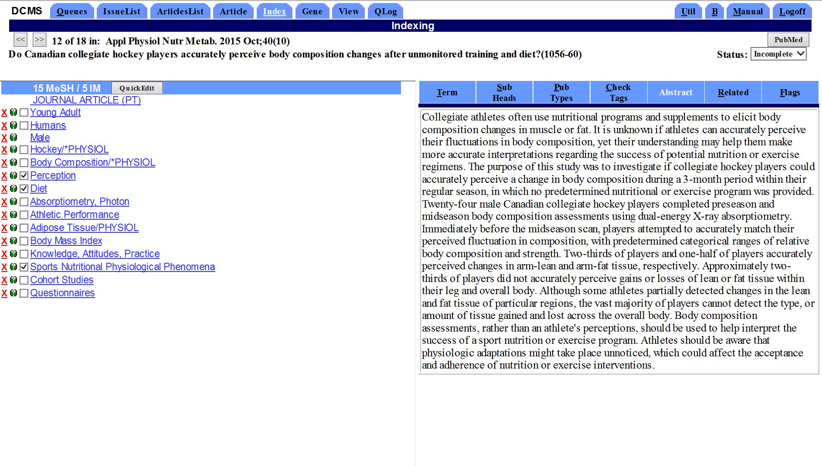
View of the indexing system
Notes:
Now, let’s take a quick look at the screen of the indexing system where this work happens

Slide 38
View of the indexing system
Check tags
  describe study subjects
Notes:
Indexing terms that describe the study subjects are called “check tags”

Slide 39
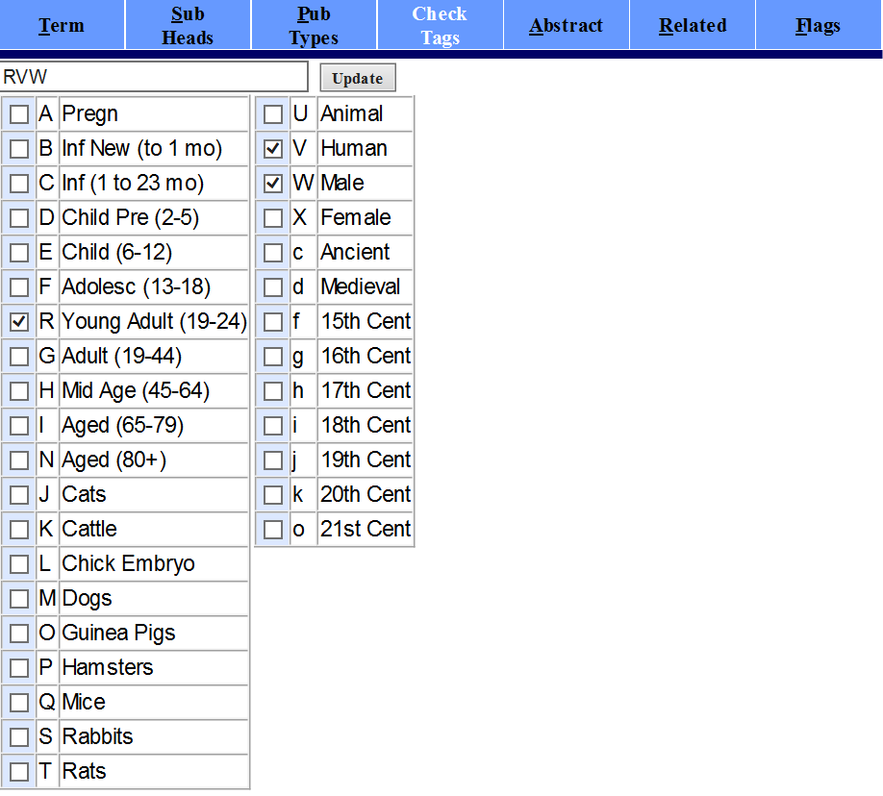
View of the indexing system
Check tags
  describe study subjects
Notes:
These are called check tags because these frequently indexed terms are available on a check list for indexers to select.

Slide 40
View of the indexing system
Subject terms
  describe content
Notes:
Indexing is of course also comprised of subject terms, which indexers Primarily select from a lookup list.

Slide 41
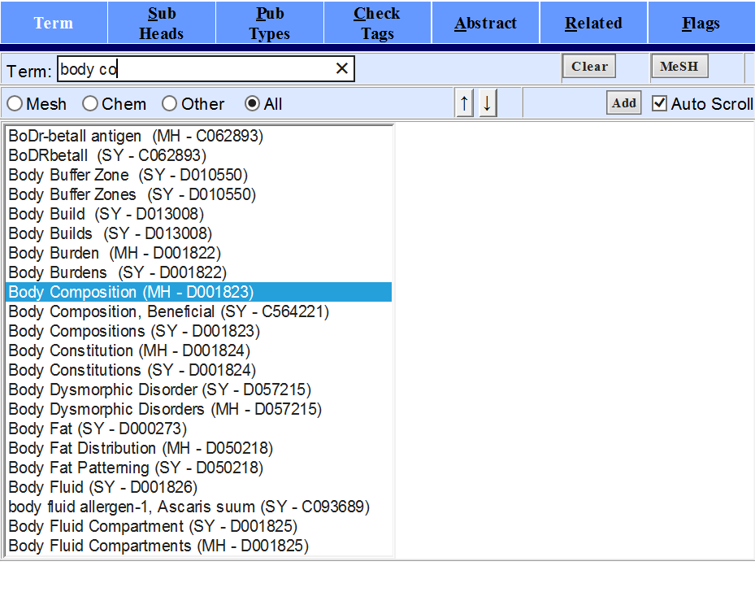
View of the indexing system
Subject terms
  describe subject content
Subheadings
  describe facets of a subject term
Notes:
Subject terms may be “qualified” with subheadings to describe facets of a concept
And, you searchers know that indexers may designate terms as a main point of an article

Slide 42
View of the indexing system
Subject terms
  describe subject content
Subheadings
  describe facets of a subject term
“*”Designates main point
Notes:
In this article, the physiology of body composition is a main point of the article
Amazingly, our experts index an average of over four articles every hour using this methodology.

Slide 43
View of the indexing system
Subject terms
  describe subject content
Subheadings
  describe facets of a subject term
“*” IM designation
  Designates main point
Body composition/*ph

Slide 44
Tools to improve efficiency
Notes:
now, here are some of the tools we have to improve efficiency. Sticking with our hockey players.

Slide 45
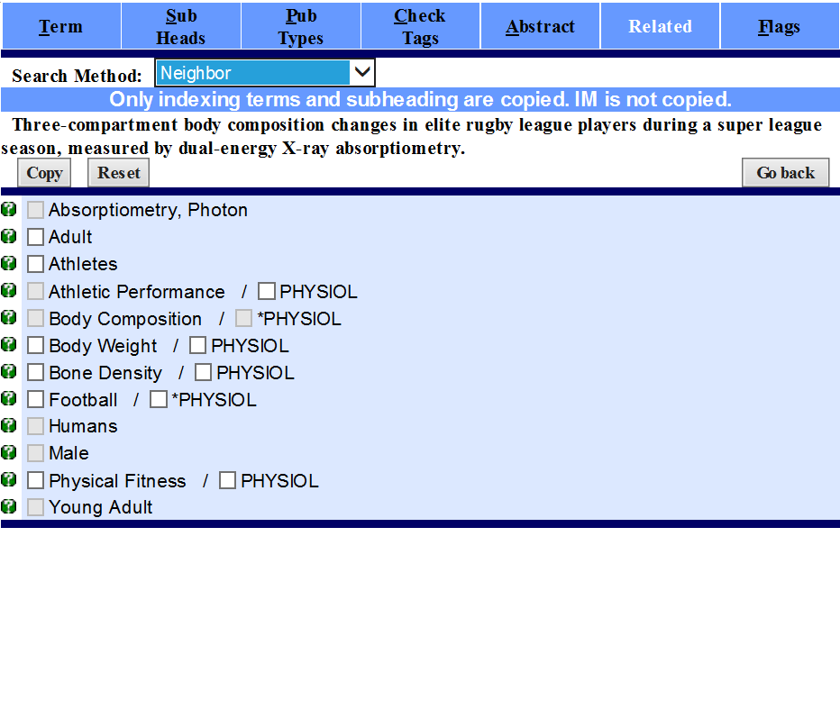
Tools to improve efficiency
Indexing of PubMed Similar Articles
Notes:
An indexer can look at the terms indexed for the top 10 Similar Articles in PubMed – also known as called the Related Citations and They can select terms that are appropriate for their particular article, saving time

Slide 46
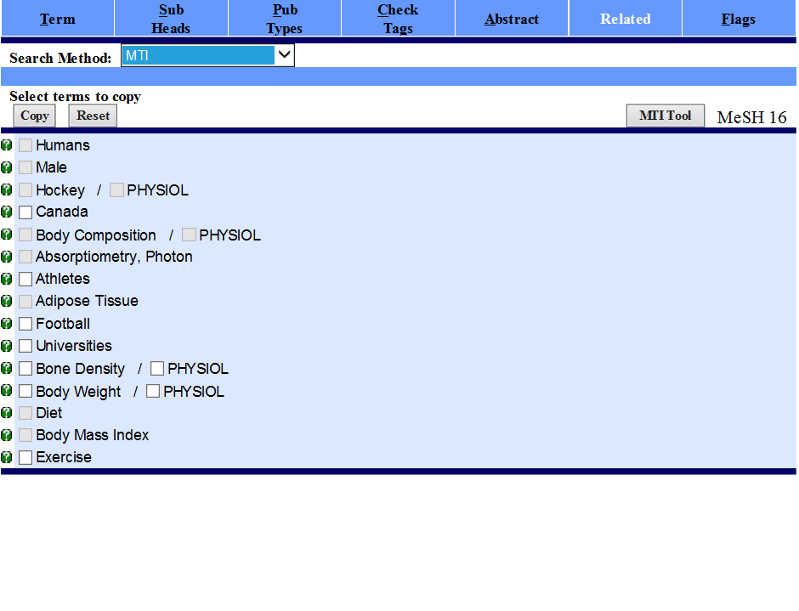
Tools to improve efficiency
Indexing suggestions by computer algorithm – Medical Text Indexer or MTI
Notes:
In addition…Indexers may also see the indexing suggestions produced by a computer algorithm called Medical text indexer or MTI.

Slide 47
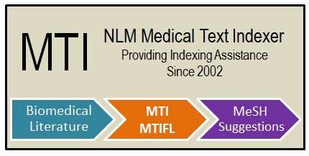
MTI – Medical Text Indexer
Main product of the NLM Indexing Initiative
Combines natural language processing and Index Section expertise to curate the biomedical literature more efficiently
Notes:
MTI comes from the NLM Indexing Initiative in one of our research divisions, the Lister Hill Center for Biomedical Communications and had it beginnings almost 20 years ago.
It combines natural language processing and Index Section Expertise to curate the biomedical literature more efficiently

Slide 48
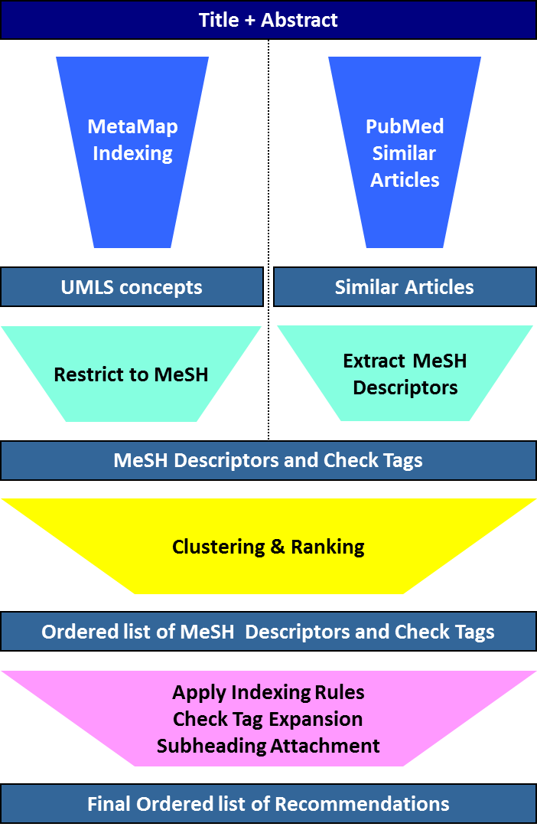
MTI – Medical Text Indexer
Main product of the NLM Indexing Initiative
Combines natural language processing and Index Section expertise to curate the biomedical literature more efficiently
Notes:
Here is a diagram of how MTI works, showing that there are two sources for terms

Slide 49
MTI – Medical Text Indexer
Main product of the NLM Indexing Initiative
Combines natural language processing and Index Section expertise to curate the biomedical literature more efficiently
Mapping language of TIAB to MeSH
Notes:
Mapping the author’s language of the title and abstract to MeSH and

Slide 50
MTI – Medical Text Indexer
Main product of the NLM Indexing Initiative
Combines natural language processing and Index Section expertise to curate the biomedical literature more efficiently
Mapping language of TIAB to MeSH
Indexing of Similar Articles
Notes:
The MeSH indexing of the MEDLINE/PubMed similar articles

Slide 51
MTI – Medical Text Indexer
Main product of the NLM Indexing Initiative
Combines natural language processing and Index Section expertise to curate the biomedical literature more efficiently
Mapping language of TIAB to MeSH
Indexing of Similar Articles
Rank terms
Refine terms
Notes:
The possible terms are ranked and refined To produce a final ordered list of recommended indexing terms

Slide 52
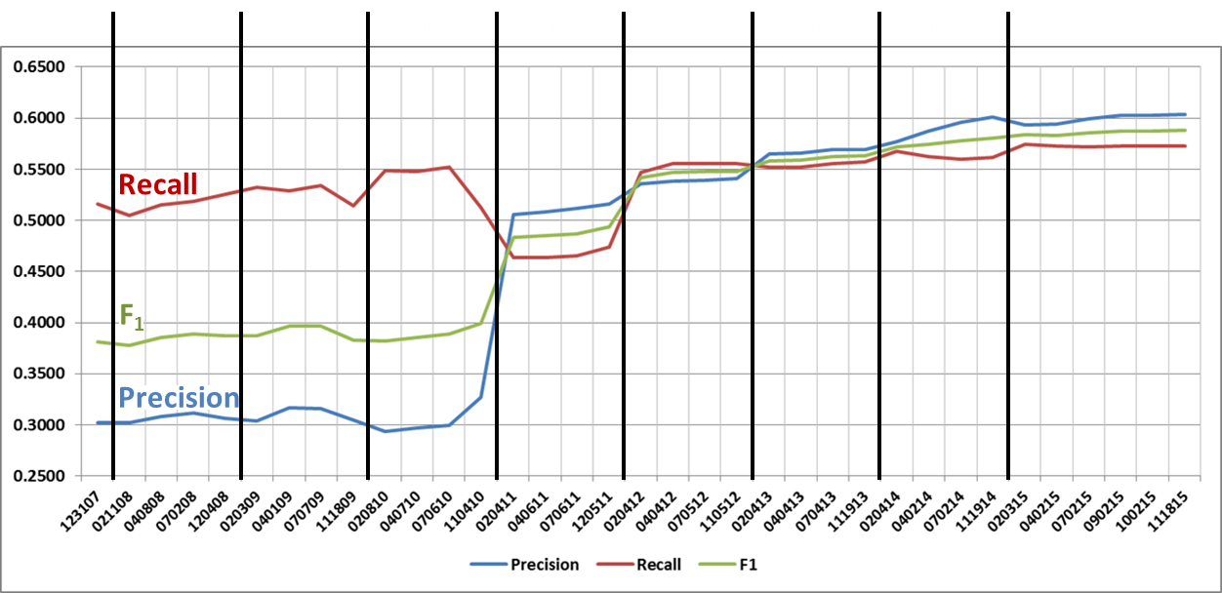
MTI Development
Notes:
this graph shows the dramatic improvement in MTI performance Particularly in the past 5 years and particularly terms of the accuracy of terms, measured by precision – the blue line

Slide 53
MTI Development
Vocabulary Density
  MeSH indexing for past 5 years
  Data from 3.5 million indexed citations
  Average 1,167 terms per journal title
  Maximum 19,864 (PLoS One)
Notes:
One was we’ve improved MTI is to use something we call “vocabulary density.” This approach considers the population of terms that have been used to index the articles in a given journal title for the past 5 years and gives special emphasis to those terms in creating the ranked list presented to the indexer.
We’ve found that the average number of MeSH terms indexed for a given journal is about 1,100
And, no surprise that PloS One is the outlier as this journal has used about 20,000 of the 27,000 possible MeSH terms

Slide 54
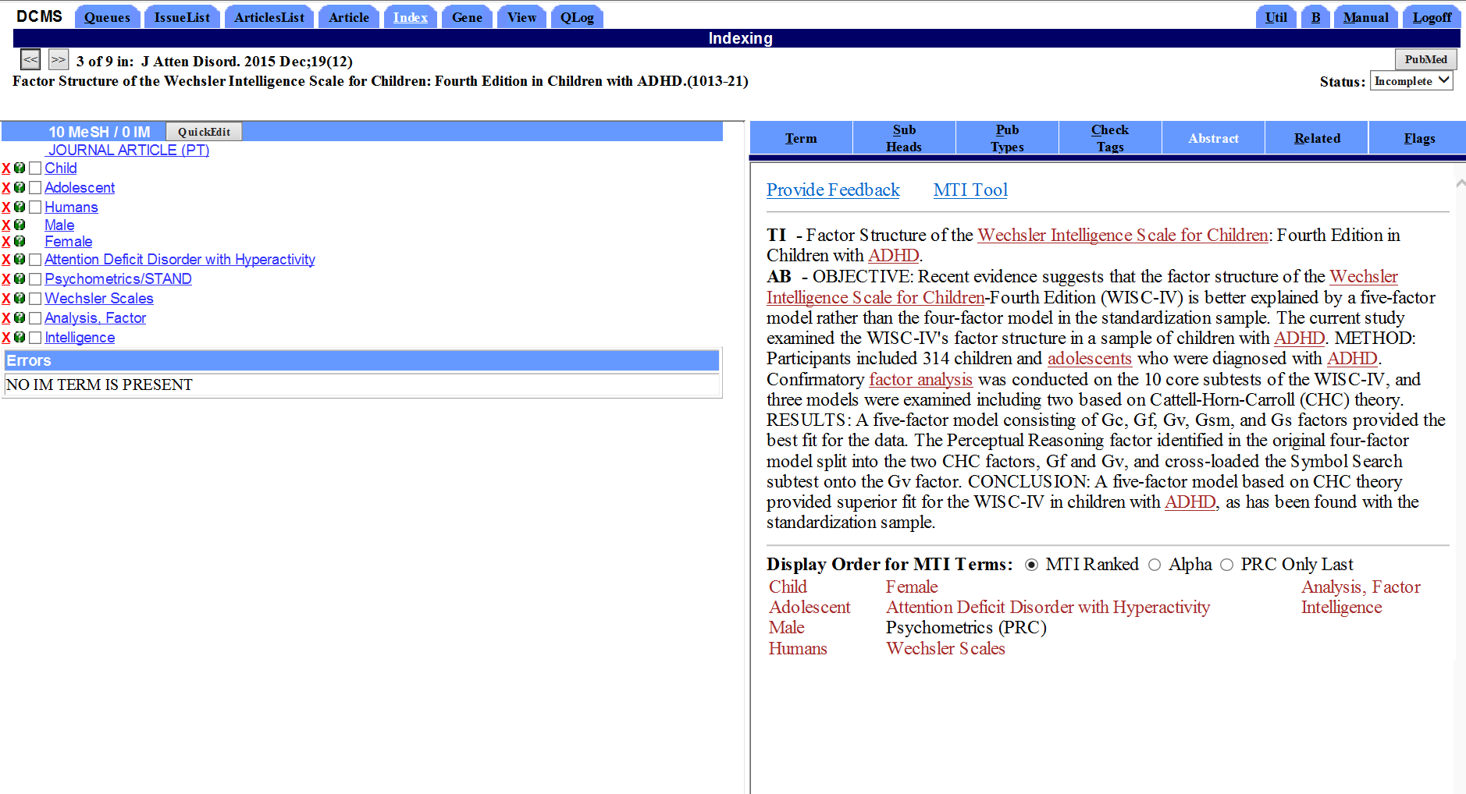
MTI as first-line indexer – MTIFL
MTI has provided initial indexing
Human indexer must complete
May add or delete terms
Designate main points
Notes:
Working closely with expert indexers, MTI has improved so much that Five years ago, NLM promoted this algorithm to become a “first-line” indexer
For certain journal titles, MTI provides the initial indexing and a human indexer completes the process making any changes necessary for accurate indexing
Currently more than 400 journals indexed first by MTI, and more journals are added every month few months.

Slide 55
MTI as first-line indexer – MTIFL Completion
MTI has provided initial indexing
Human indexer must complete
May add or delete terms
Designate main points
Abstract display shows term derivation
Notes:
Working closely with expert indexers, MTI has improved so much that Five years ago, NLM promoted this algorithm to become a “first-line” indexer
For certain journal titles, MTI provides the initial indexing and a human indexer completes the process making any changes necessary for accurate indexing
Currently more than 400 journals indexed first by MTI, and more journals are added every month few months.

Slide 56
MTI as first-line indexer – MTIFL Completion
MTI has provided initial indexing
Human indexer must complete
May add or delete terms
Designate main points
Abstract display shows term derivation
MTIFL Completion began with 4 journals in 2011
Currently more than 400 journals are done by MTIFL Completion
Journals are selected based on MTI performance data and other factors
Notes:
Working closely with expert indexers, MTI has improved so much that Five years ago, NLM promoted this algorithm to become a “first-line” indexer
For certain journal titles, MTI provides the initial indexing and a human indexer completes the process making any changes necessary for accurate indexing
Currently more than 400 journals indexed first by MTI, and more journals are added every month few months.

Slide 57
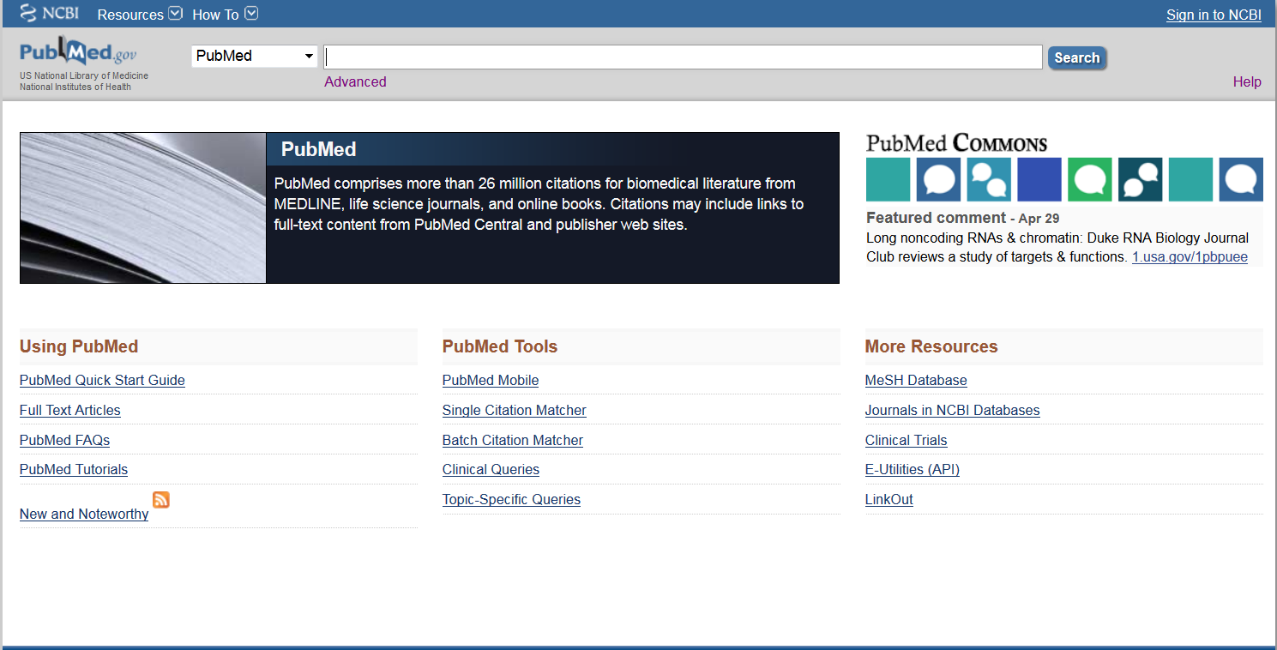
MEDLINE indexing
Notes:
I hope you’ve enjoyed this backstage tour of MEDLINE indexing – the way we’ve done it in the past and the future of machine assisted indexing.

Slide 58
MEDLINE indexing
26 million citations in PubMed
23 Million have been indexed for MEDLINE –
  human-curated with the vocabulary of MeSH and other metadata
  Using more than 239 million MeSH terms
A rich resource for biomedical discovery
Notes:
Of the 26 million citations contained in PubMed…
More than 23 million have been indexed for MEDLINE – human-curated with the vocabulary of MeSH to represent what an article is about
These articles have been indexed with a total of more than 239 million MeSH terms
And with that, I turn you over to Stacey Arnesen who will share more about NLM resources.

