Slide 1
Nanoparticles in drug delivery

Slide 2

What is a nanoparticle?

Slide 3
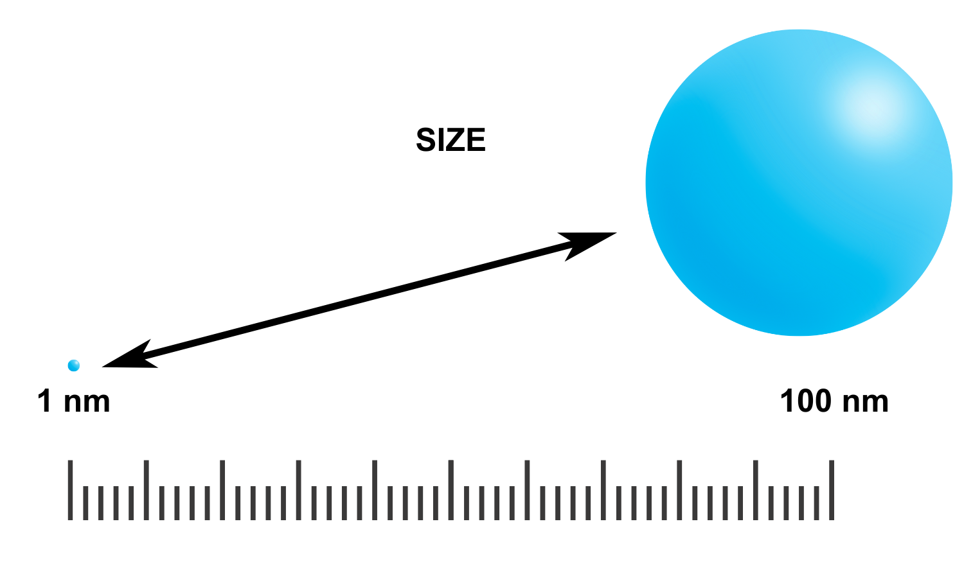
What is a nanoparticle?
Nanoparticles are very tiny particles (spheres) that are about 1 to 100 nanometers in size.
They are both naturally occurring and can be man-made.

Slide 4
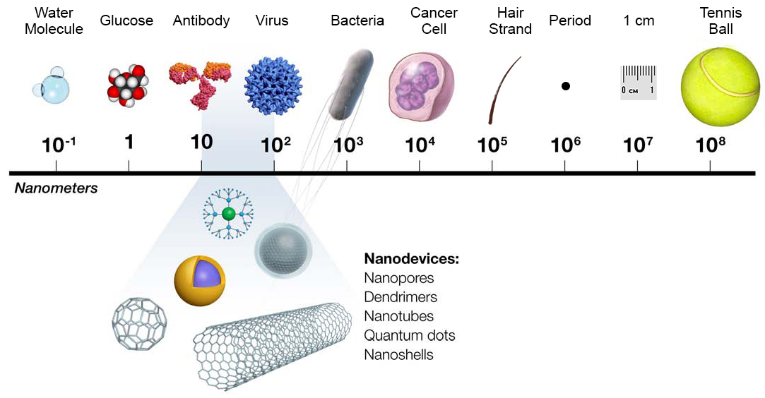
They are very tiny!

Slide 5
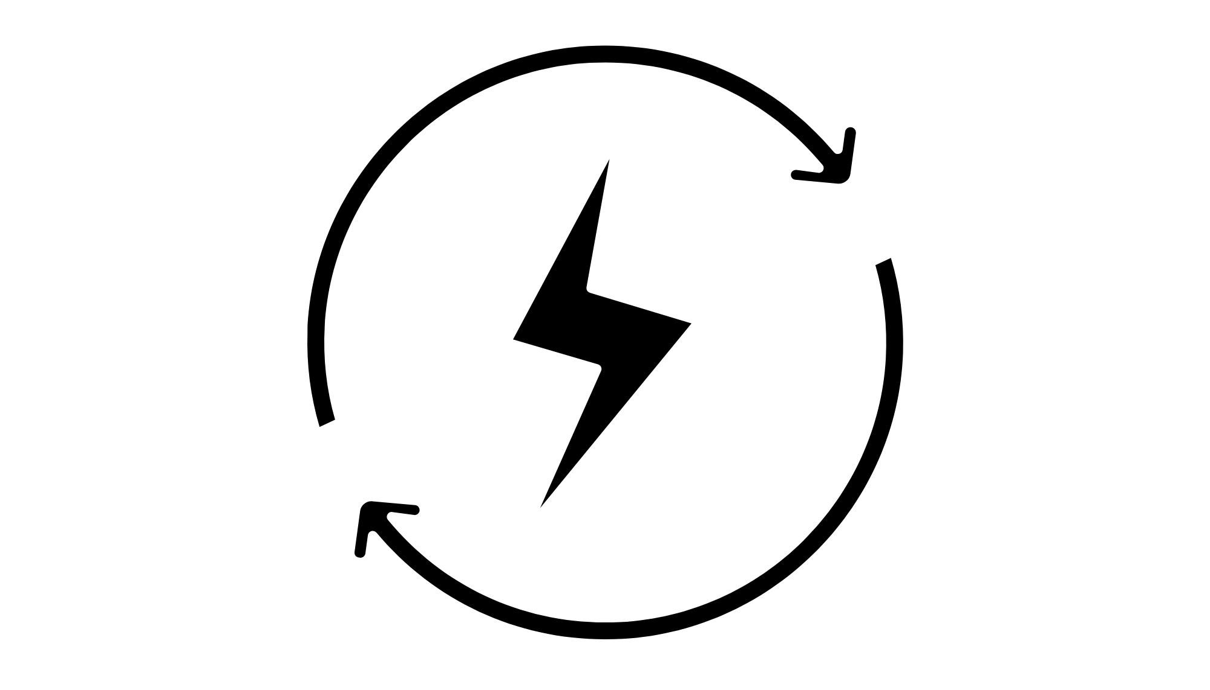
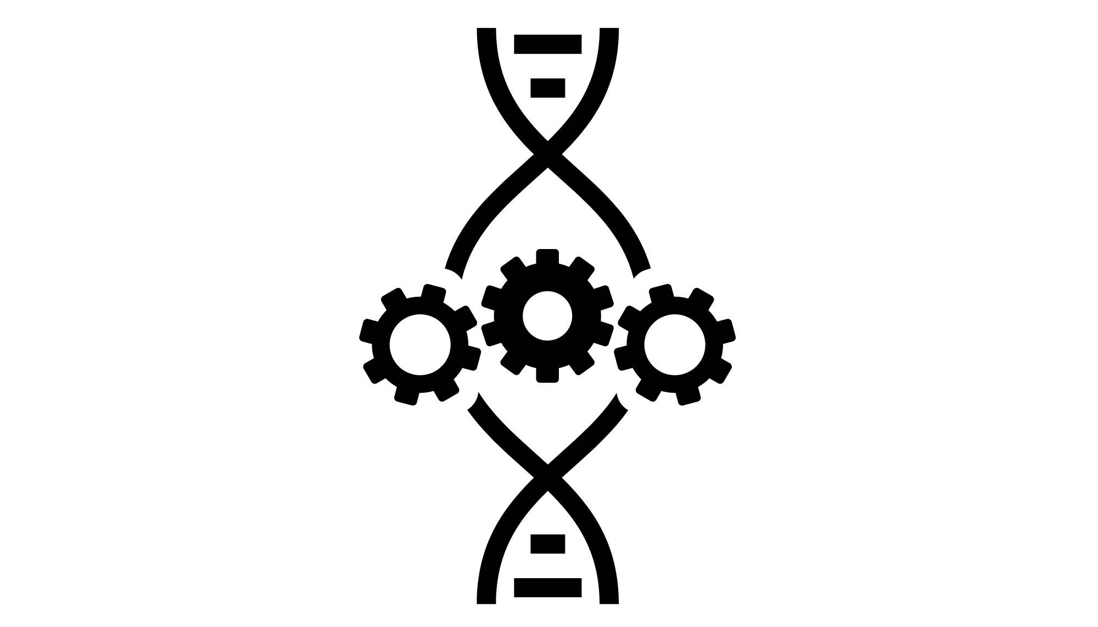
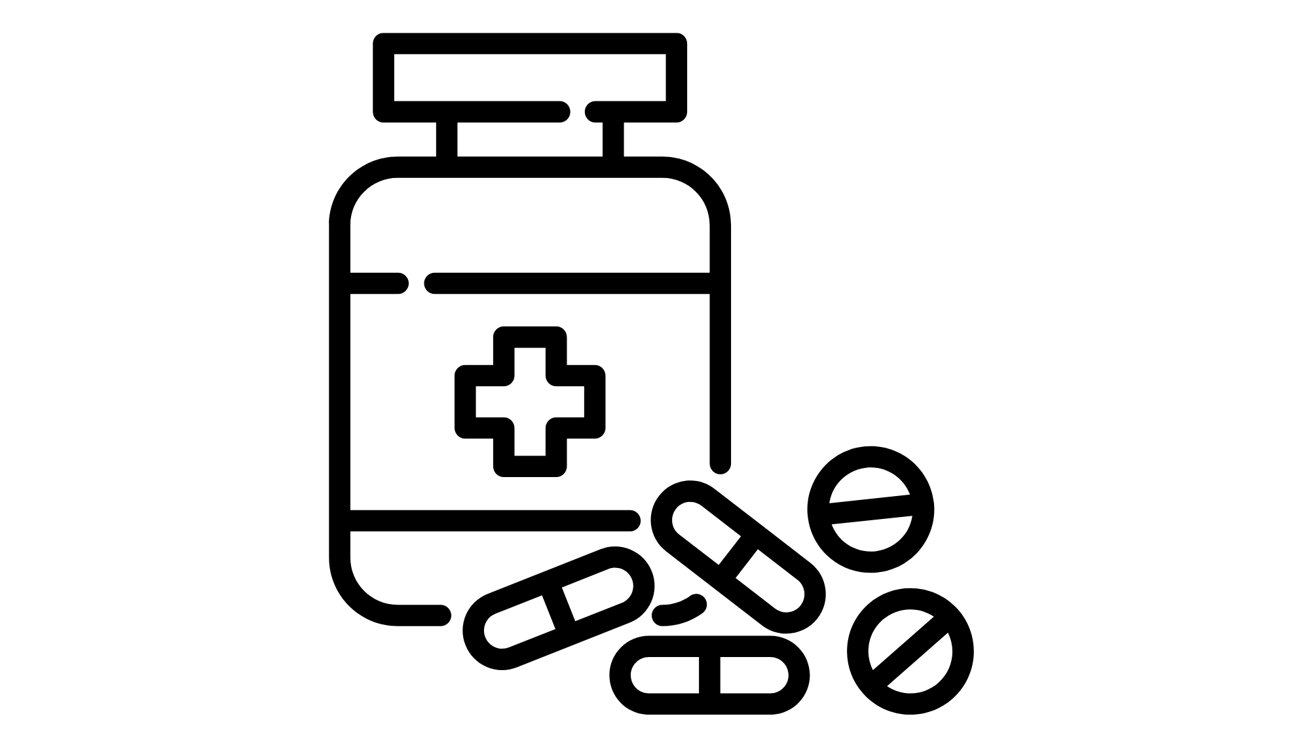
What’s the point?
Nanoparticles are used in many ﬁelds!
Energy
Biomedical Engineering
Medicine

Slide 6
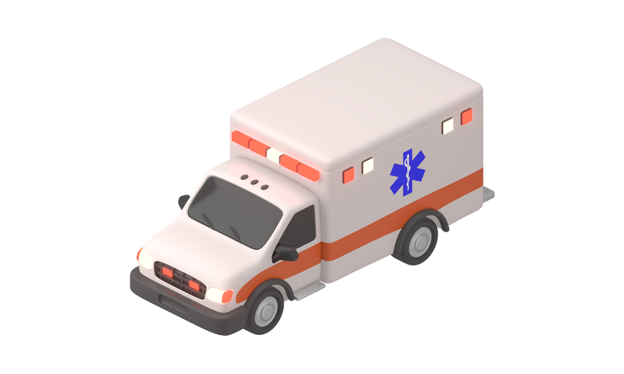
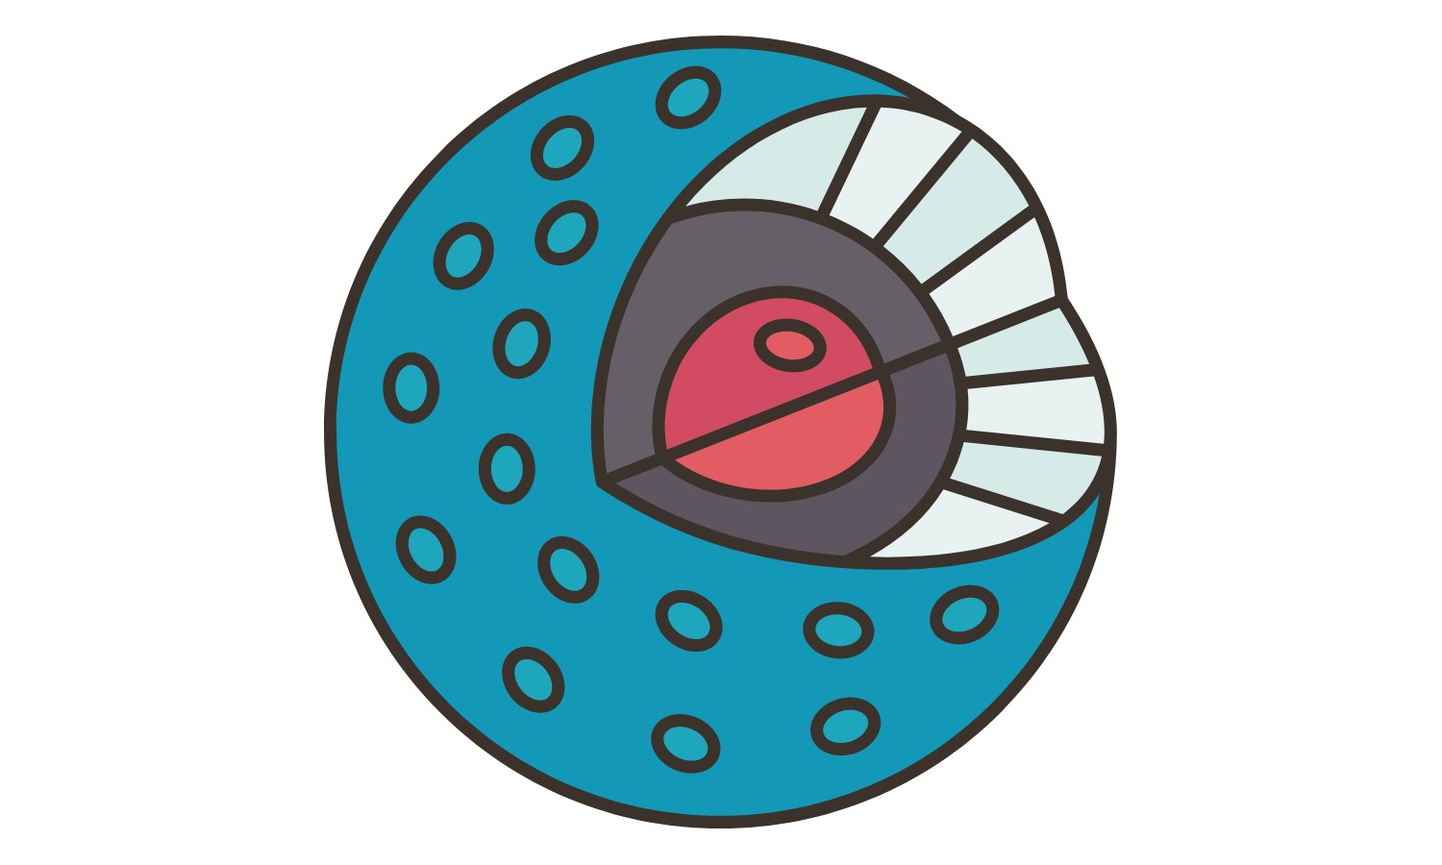
Nanoparticles are like little ambulances that can go to diseased areas in the body!
=

Slide 7
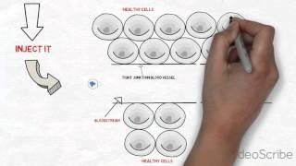
Example of nanoparticle in action!
Video: https://www.youtube.com/watch?v=f7hMhL_N4k8

Slide 8
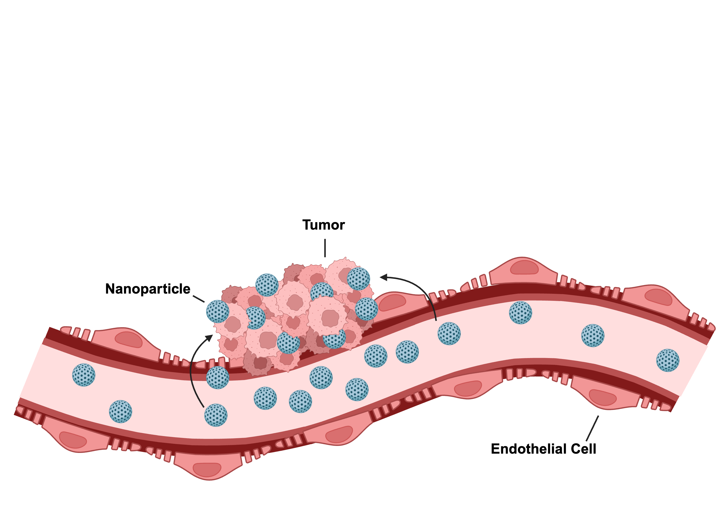
Why are nanoparticles needed over traditional medicine?
They can get to areas that normal medicine can sometimes not get to, and provide stronger, more direct treatment.

Slide 9
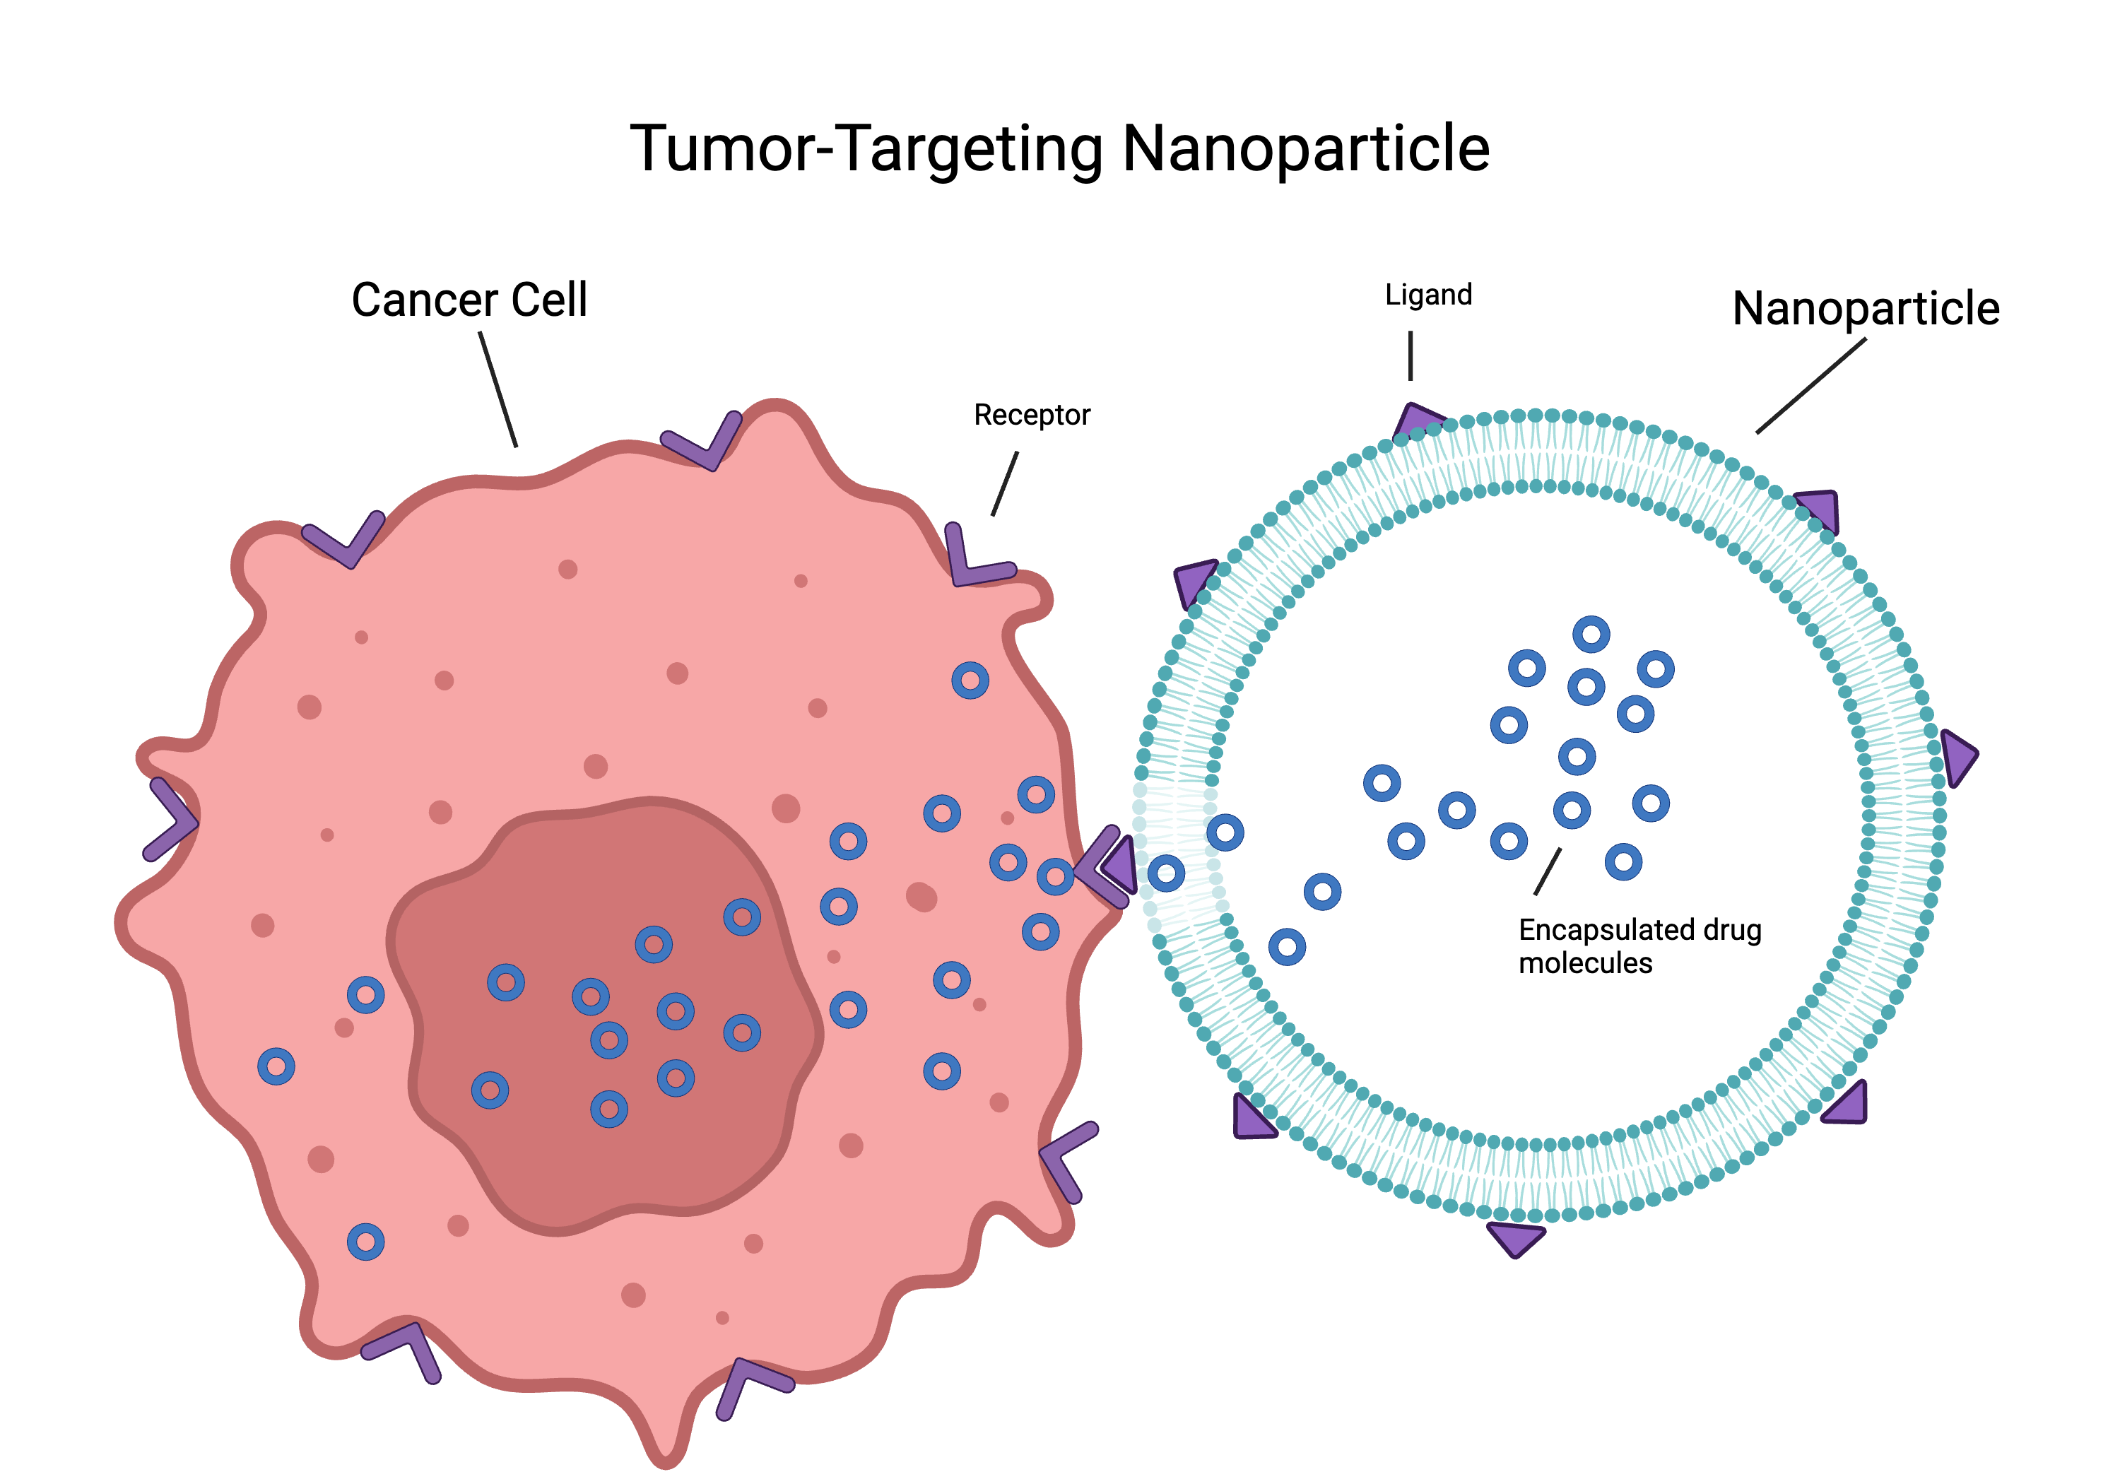
Why are nanoparticles needed over traditional medicine?
They can speciﬁcally target diseased areas, and not healthy areas, leading to less side effects!

Slide 10
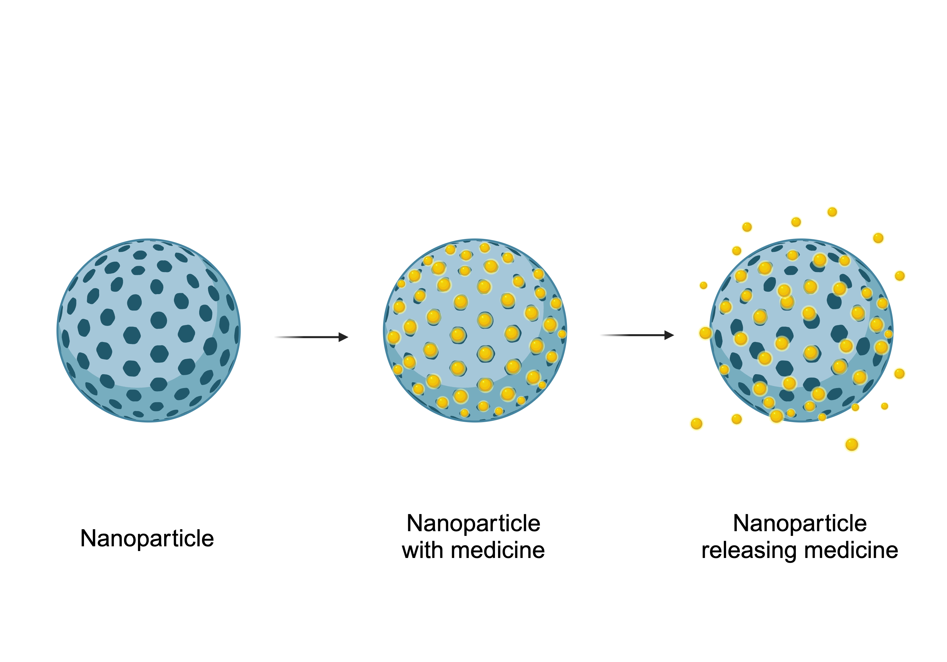
Why are nanoparticles needed over traditional medicine?
They can release contained medicine/drugs, thus leading to better dosage for the disease!

Slide 11
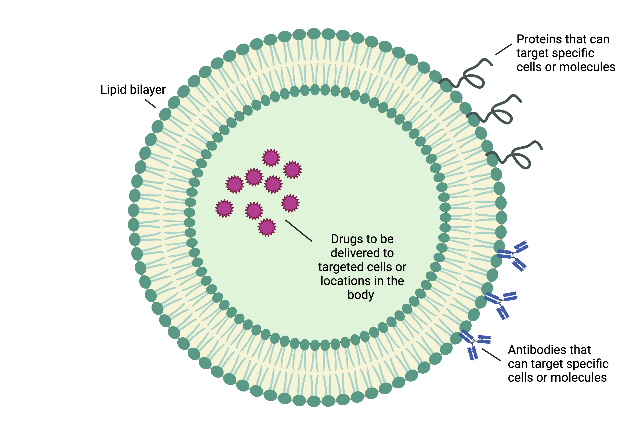
Why are nanoparticles needed over traditional medicine?
They can prevent contained drugs from the rest of the body before it gets to the diseased area to release medicine.
Liposome
Nanoparticle

Slide 12
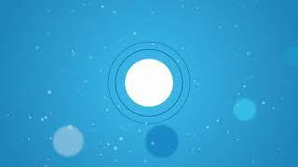
Another example of a nanoparticle in action!
This is an example of a nanoparticle carrying mRNA. This is how
COVID-19 vaccines work!
Video: http://www.youtube.com/watch?v=kdX2IRLxO3g

Slide 13
Teacher demonstration:
The teacher will demonstrate an example of a nanoparticle using a gelatin capsule.

Slide 14
Class discussion
Let’s discuss what you learned about drug delivery, nanoparticles, and answer any questions you may have.

Slide 15
Quiz:
What is the size range of nanoparticles?
1 to 100 millimeters
1 to 100 micrometers
1 to 100 nanometers
1 to 100 centimeters

Slide 16
Quiz:
Why are nanoparticles useful in drug delivery?
They make drugs taste better.
They can carry drugs to the right place in the body.
They are larger than most drug molecules.
They are easy to see with the naked eye.

Slide 17
Quiz:
Which of the following things in drug delivery can nanoparticles NOT help address?
Targeted delivery
Controlling drug release
Making drugs more affordable
Protecting sensitive drugs from degradation

Slide 18
Quiz:
What is one real-life application of nanoparticles in drug delivery mentioned in the lesson?
Using nanoparticles to make coffee taste better
Using nanoparticles to repair phones
Using nanoparticles to thin blood
Using nanoparticles to carry drugs

Slide 19
Quiz:
During the teacher's demonstration, what did the gelatin capsule represent in relation to drug delivery?
A tiny spaceship
A protective coating around a drug
A large container for drugs
A common candy

Slide 20
Homework:
Research a chosen disease of interest, focusing on its symptoms, causes, and current treatments. Are there any news articles or papers showing that nanoparticles are being researched for treating this?
Write a 2 paragraph summary answering this.

Slide 21
Any questions so far?

Slide 22
Image Credits:
Slide 2: Canva.com
Slide 3: Canva.com
Slide 4: National Institutes of Health, https://www.nih.gov/sites/default/files/research-training/nanotechnology-new-understanding-capabilities-approaches-improving-health.pdf
Slide 5: Canva.com
Slide 6: Meade/Created with BioRender.com, Canva.com
Slide 8: Meade/Created with BioRender.com
Slide 9: Meade/Created with BioRender.com
Slide 10: Meade/Created with BioRender.com
Slide 11: Meade/Created with BioRender.com

Slide 23
Nanoparticle lab!

Slide 24
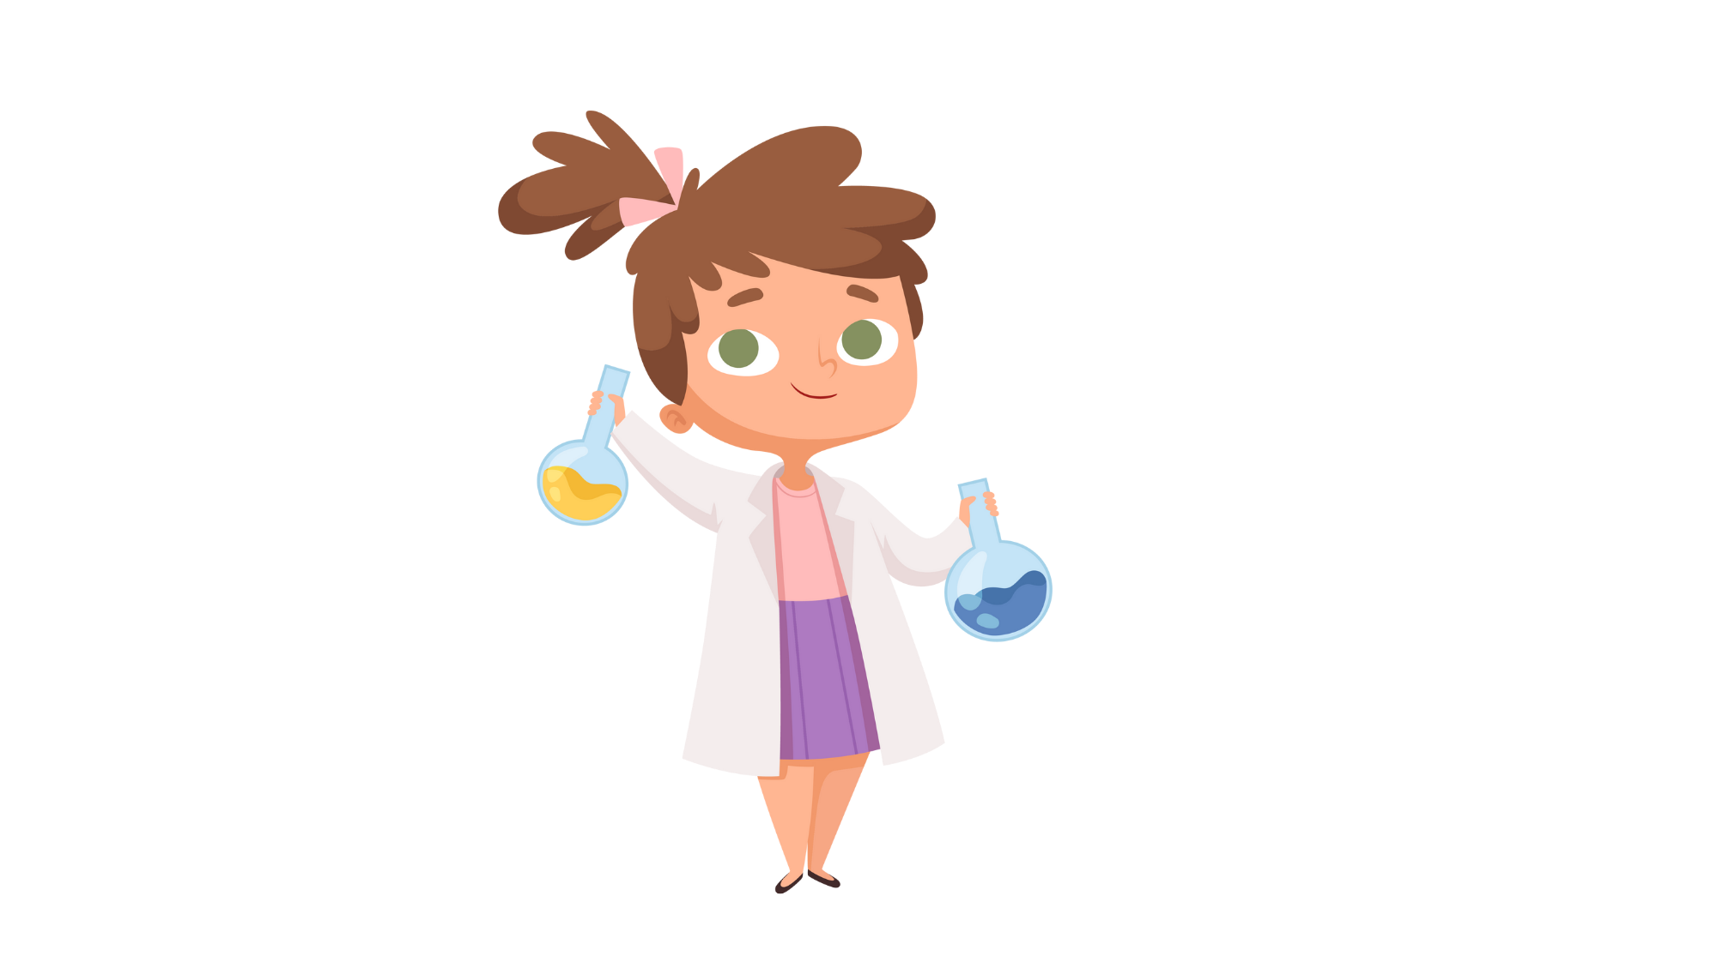
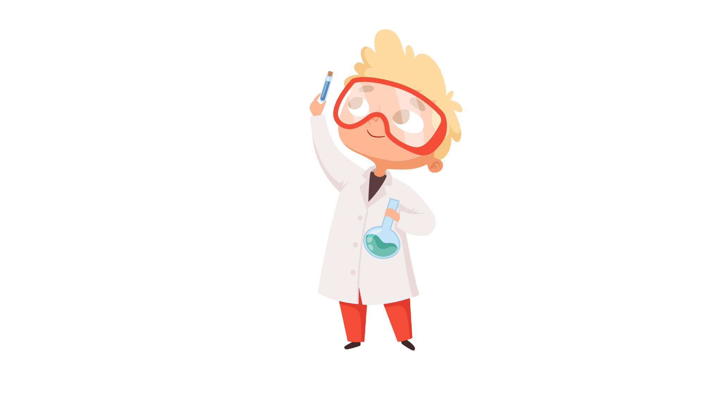
Today you all will become nanoparticle scientists and make a ‘nanoparticle’ that releases medicine (candy)!

Slide 25
Flashback
In the previous lesson, we learned about how some nanoparticles can contain and release drugs/medicine and release it in the body.

Slide 26
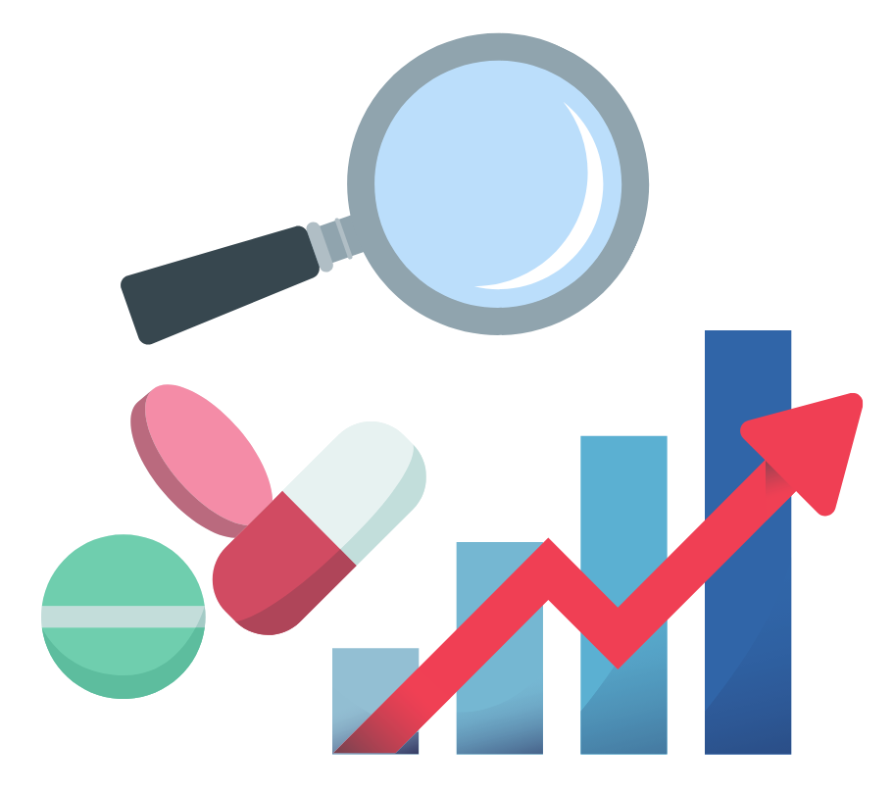
Why is this important?
Aside from protecting the drug inside the particle and releasing it more directly to the area of disease, the particle can also be modiﬁed to release the drug at a certain rate.
This means that you can control when the particle releases the drug so that you can treat the disease more effectively!
Drug effectiveness goes up!

Slide 27
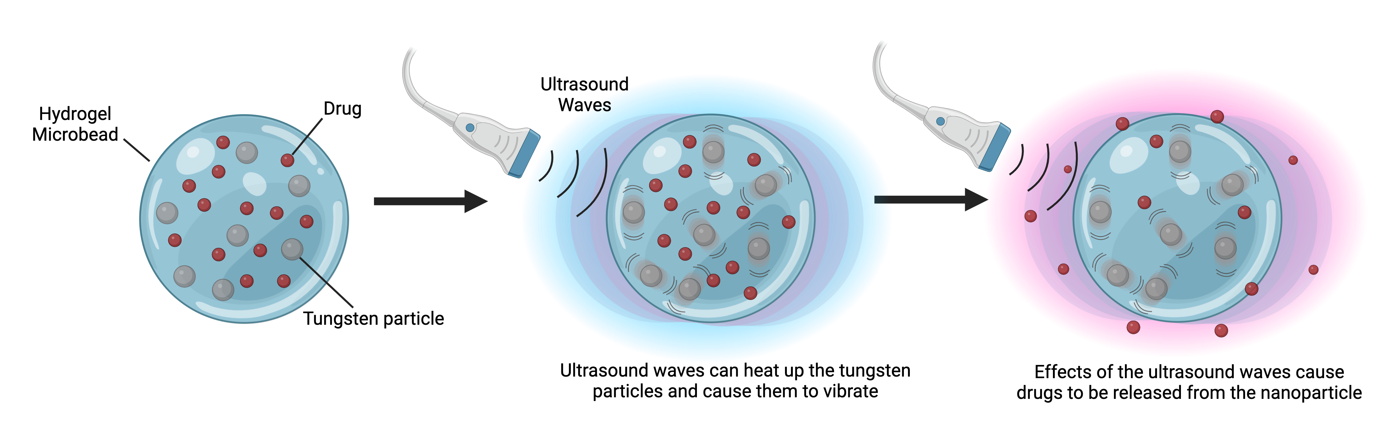
How do scientists control when the particle releases the drug?
There are several ways! One example is designing the particle so that a different device can cause the drug release.

Slide 28
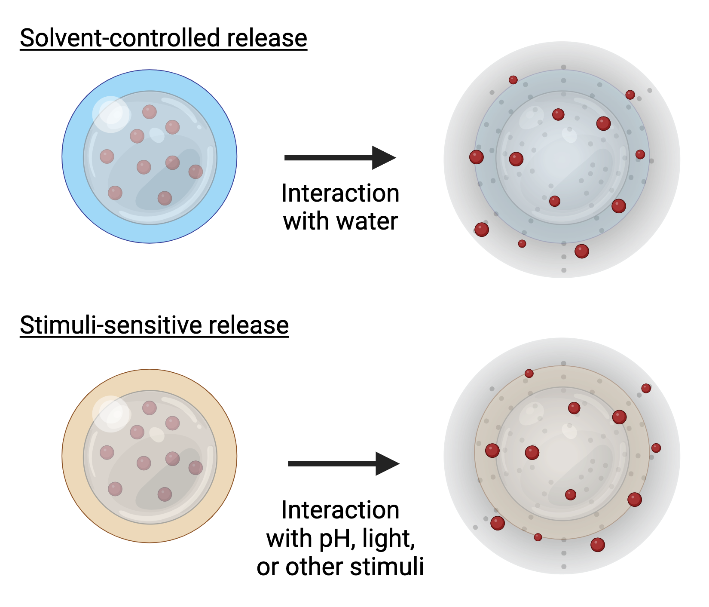
How do scientists control when the particle releases the drug?
One can also design the particle to break apart when its
surroundings change in a certain way, such as:
having a certain water amount
having a certain pH (how acidic the surrounding is)

Slide 29
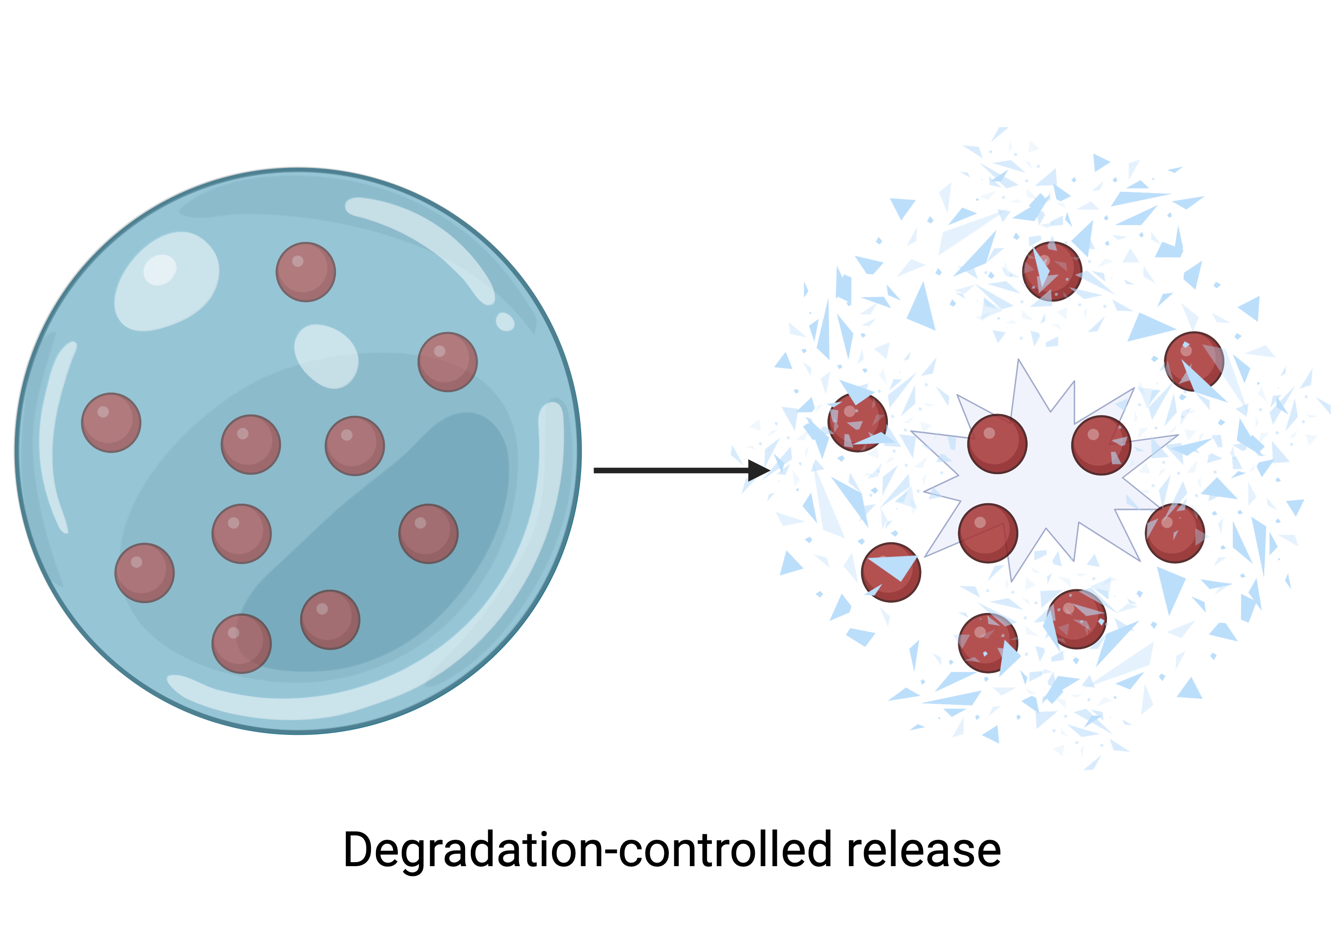
How do scientists control when the particle releases the drug?
One could also simply design the particle so it releases drugs as it breaks apart over time.

Slide 30
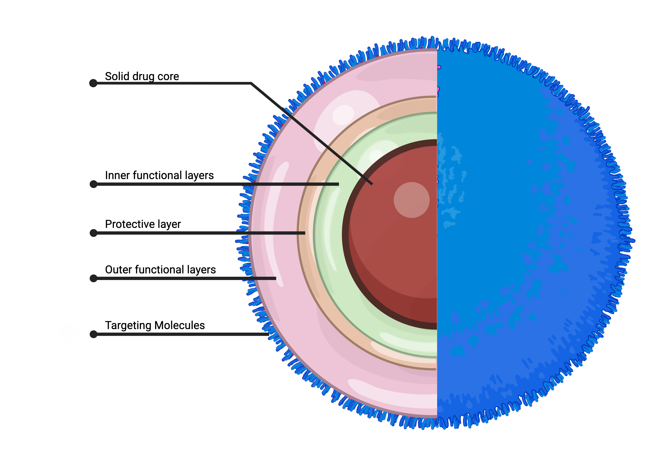
Nanoparticle ‘layering’
In addition, one can ‘layer’ the nanoparticle by covering the nanoparticle with different nanoparticle layers!
This allows for drugs to be released at certain times after each layer degrades.

Slide 31
Today’s lab
We will be making layered nanoparticles using gelatin capsules as a substitute!
We will be making:
1 Fast release drug (It releases what’s inside fast)
1 Slow release drug (It releases what’s inside slower)
We will make the release slower by layering the capsule

Slide 32
Question
If you layer the capsule by putting it inside another capsule, will it dissolve faster or slower?

Slide 33
Procedure
Get Ready: First, get into your groups, and the teacher will give you the stuff you need for the experiment.
Fill Small Capsules: Fill some small capsules with things like food coloring liquid, small candies, or colored sugar. You can put in as much as you think is needed for the experiment.
Layer the Capsules: Take some of those small capsules you just ﬁlled and put them inside bigger capsules. You can also add more "drugs" into the bigger capsules along with the small capsules. This is like making layers in the capsules.
Understand Coating Layering: The big capsules with the small capsules inside represent how medicines can be layered in real drug delivery systems.
Start the Timer: As you put the small capsules and the layered capsules into containers with warm water, start a timer or stopwatch.
Watch and Record: Keep an eye on what happens to the capsules in the water. Record how long it takes for the small capsules to dissolve and how long it takes for the layered capsules to dissolve.
Discuss with Your Group: Talk to your group about what you saw and the times you recorded.

Slide 34
Any questions so far?

Slide 35
Discussion questions:
Tell me about the two types of capsules you made during the experiment: the small ones and the layered ones. What made them different, and why was that important for understanding controlled drug release?
How did your capsules do in the experiment when it came to releasing the "drugs" quickly or slowly? What factors do you think affected how quickly or slowly a type of capsule released the drug?

Slide 36
Homework:
Answer these following questions with a paragraph response each:
What is "controlled/slow drug release," and how is it different from drugs that work quickly? Can you give an example of when controlled drug release is useful?
If you were a scientist making drug capsules, what things would you think about when making them? How would you decide how fast the drug should be released?
During the experiment, you made two kinds of capsules - small ones and layered ones. What did you notice about how they released the "drugs"? Why do you think they were different?
Why is it good for scientists to do experiments like the one in class when they make drug capsules? How did this experiment help you understand science better, and what parts of it did you ﬁnd most interesting or tricky?

Slide 37
Image Credits
Slide 2: Canva.com
Slide 3: Meade/Created with BioRender.com
Slide 4: Canva.com
Slide 5: Meade/Created with BioRender.com
Slide 6: Meade/Created with BioRender.com
Slide 7: Meade/Created with BioRender.com
Slide 8: Meade/Created with BioRender.com

Slide 38
Real-Life Applications of Nanoparticle Drug Delivery

Slide 39
Recap: Experiment with gelatin capsules
One can ‘layer’ the nanoparticle by covering the nanoparticle with different nanoparticle layers!
This allows for drugs to be released at certain times after each layer degrades.

Slide 40
What’s the point?
Nanoparticles are used in many ﬁelds and are very important in biomedical engineering and medicine!
Biomedical Engineering
Medicine

Slide 41
Nanoparticles are like little ambulances that can go to diseased areas in the body!
=

Slide 42
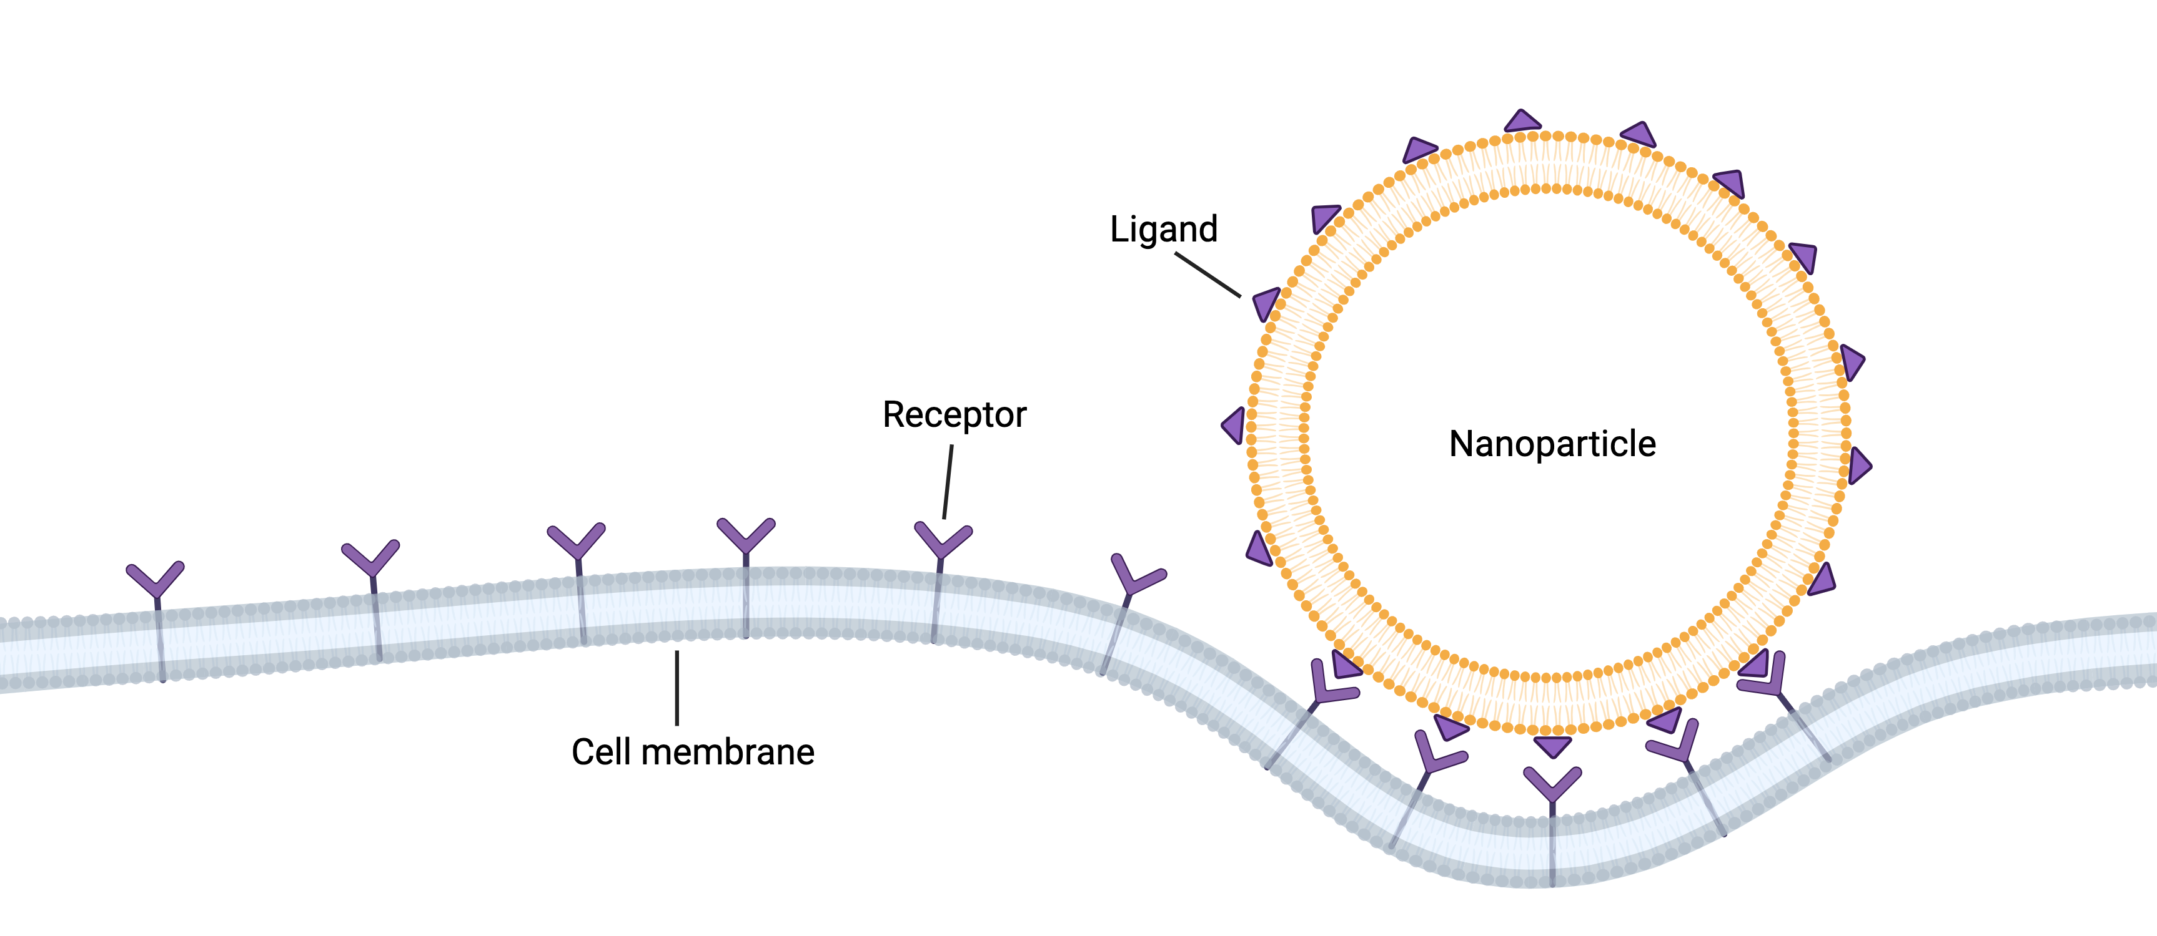
How do nanoparticles know where to go?
Ligands and receptors!

Slide 43
What are ligands and receptors?
Ligands are like tiny keys on nanoparticles, and receptors are like special locks on cells/tissues.
The nanoparticles have little keys(ligands) on them, and they can only open with very speciﬁc locks in the body (receptors).
The locks are designed to ﬁt perfectly with the keys (ligands) on these nanoparticles. So, when a ligand (the key) on a nanoparticle ﬁts with a receptor (the lock), it can do things like open it up, change its shape, or help it do its job.

Slide 44
What is the point of this?
It means nanoparticles can target speciﬁc areas for disease and treat it more effectively!

Slide 45
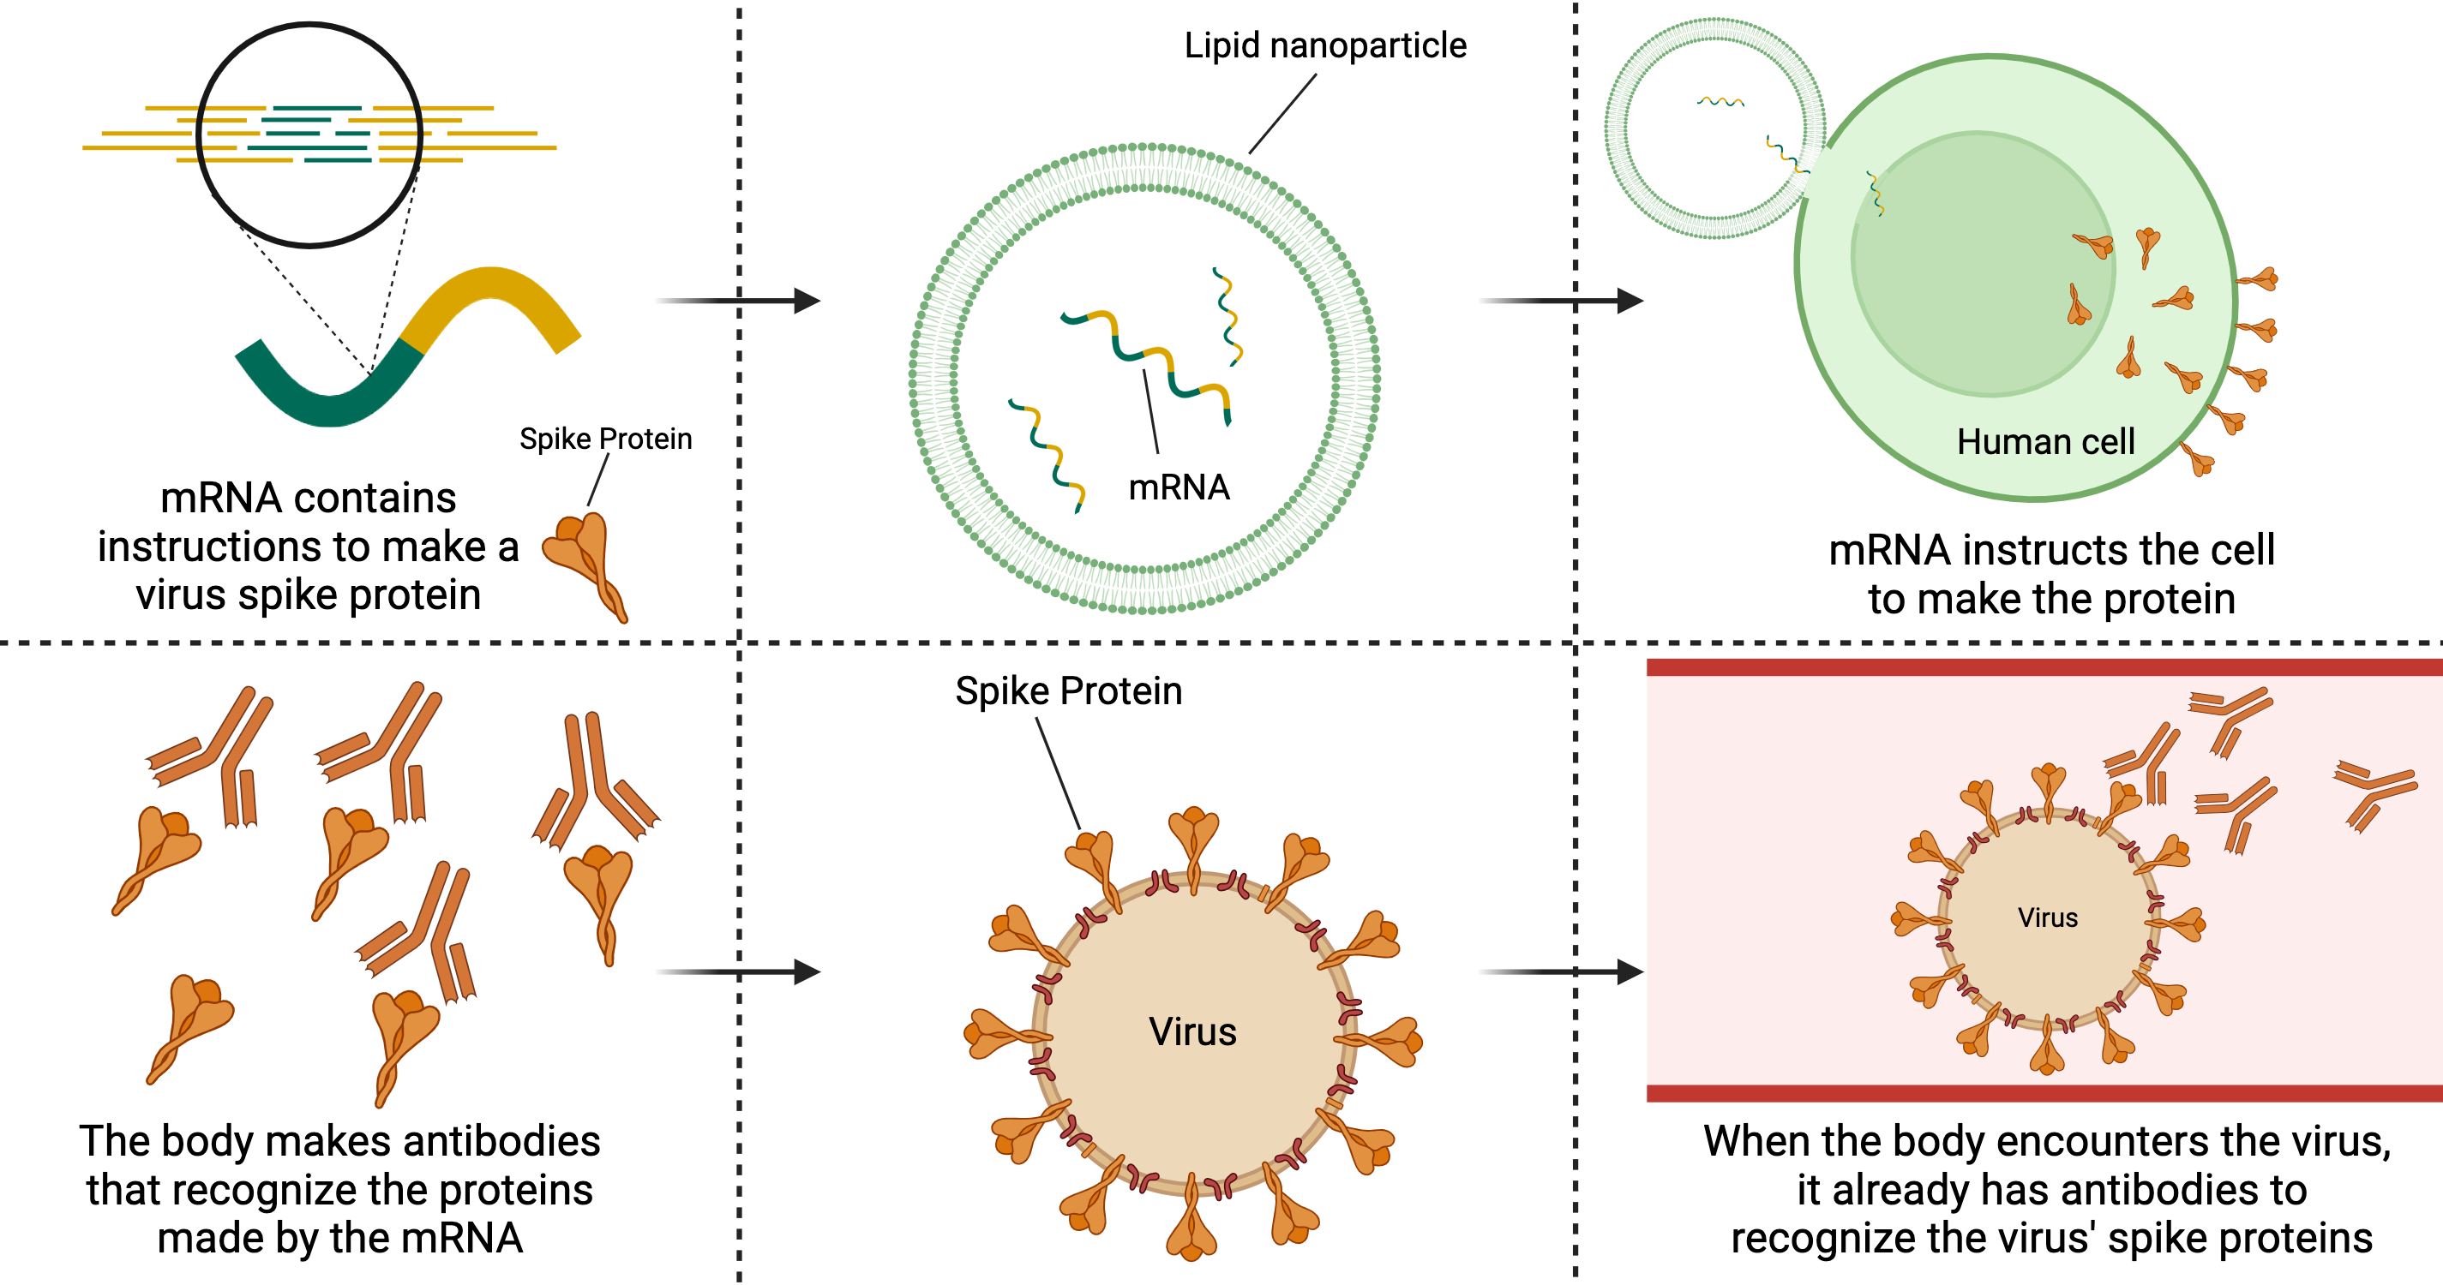
Case study: COVID-19
How mRNA
Vaccines Work
Some COVID-19 vaccines use lipid nanoparticles to protect and shuttle the mRNA where it needs to go.

Slide 46
Case study: COVID-19
How mRNA
Vaccines Work
When we get the vaccine, these nanoparticles carry the mRNA to our cells. Our cells then read this message and follow the instructions to make a harmless, but unique part of the coronavirus, which is the Spike protein.

Slide 47
Case study: COVID-19
How mRNA
Vaccines Work
Now that the body has seen what the spike protein looks like, it can recognize it if the COVID-19 virus gets into the body and can fight it.

Slide 48
Video example
How COVID-19 vaccines work!
Video: http://www.youtube.com/watch?v=kdX2IRLxO3g

Slide 49
What would happen without the nanoparticle to carry the mRNA?

Slide 50
What would happen without the nanoparticle to carry the mRNA?
How COVID-19 vaccines work!

Slide 51
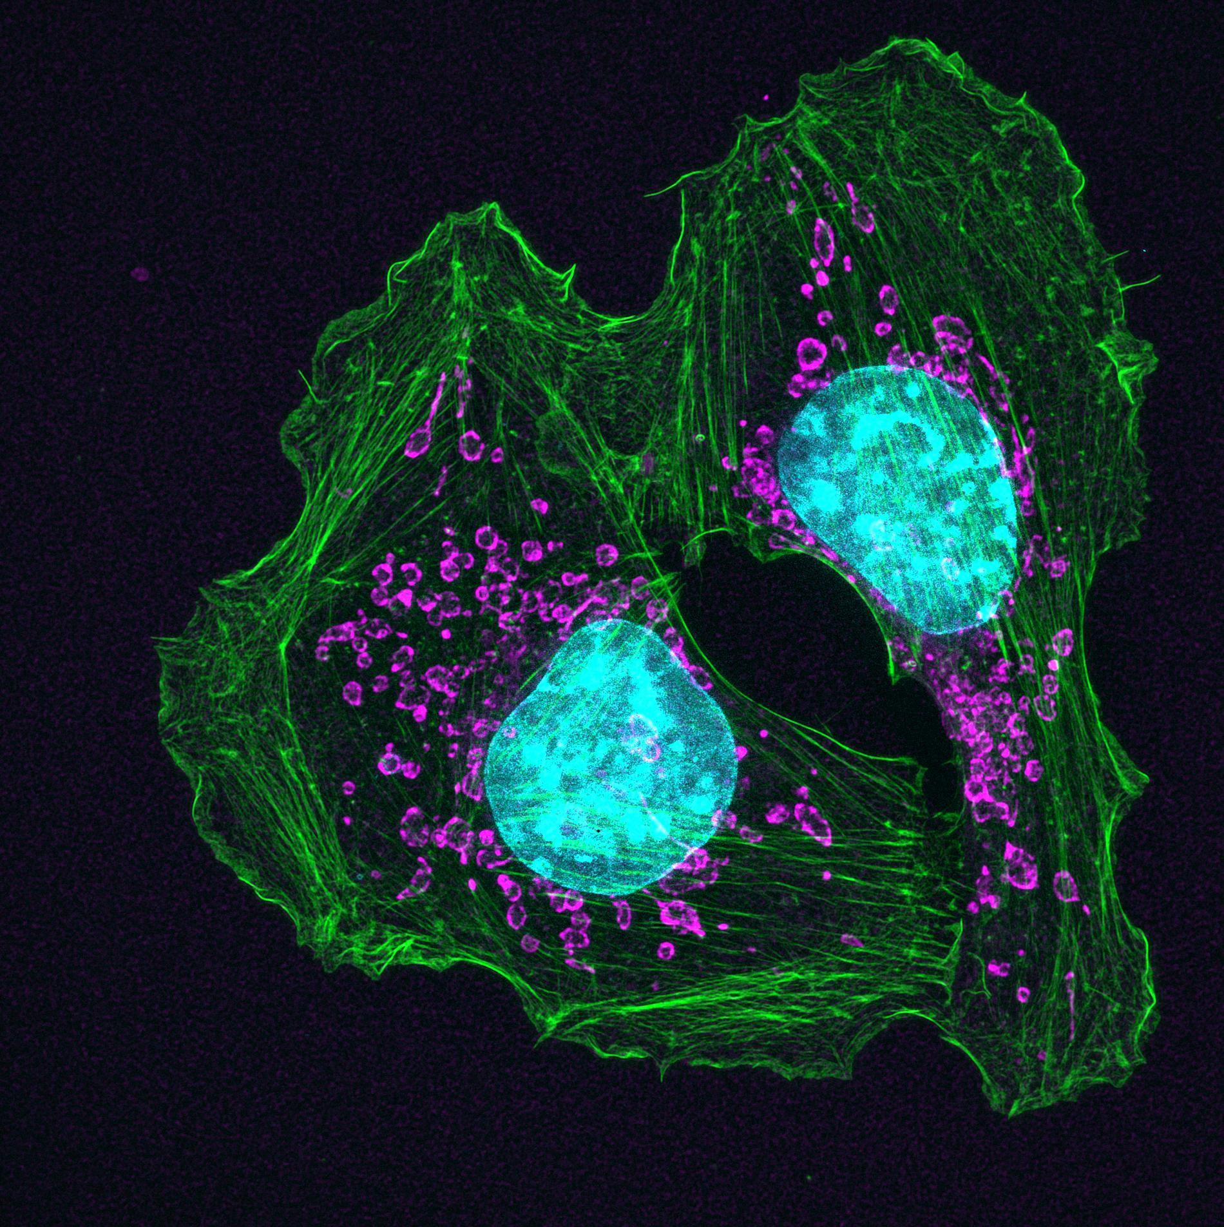
Case study: Cancer targeting
Nanoparticles have signiﬁcant applications in treating cancer.
Cancer is a disease that happens when cells divide uncontrollably, resulting in a lump/growth commonly known as a tumor in the body.
Two mouse skin cancer cells are connected by actin (green), a protein in the cellular skeleton. Although actin is required by many cells for normal movement, it also enables cancer cells to spread to other parts of the body.

Slide 52
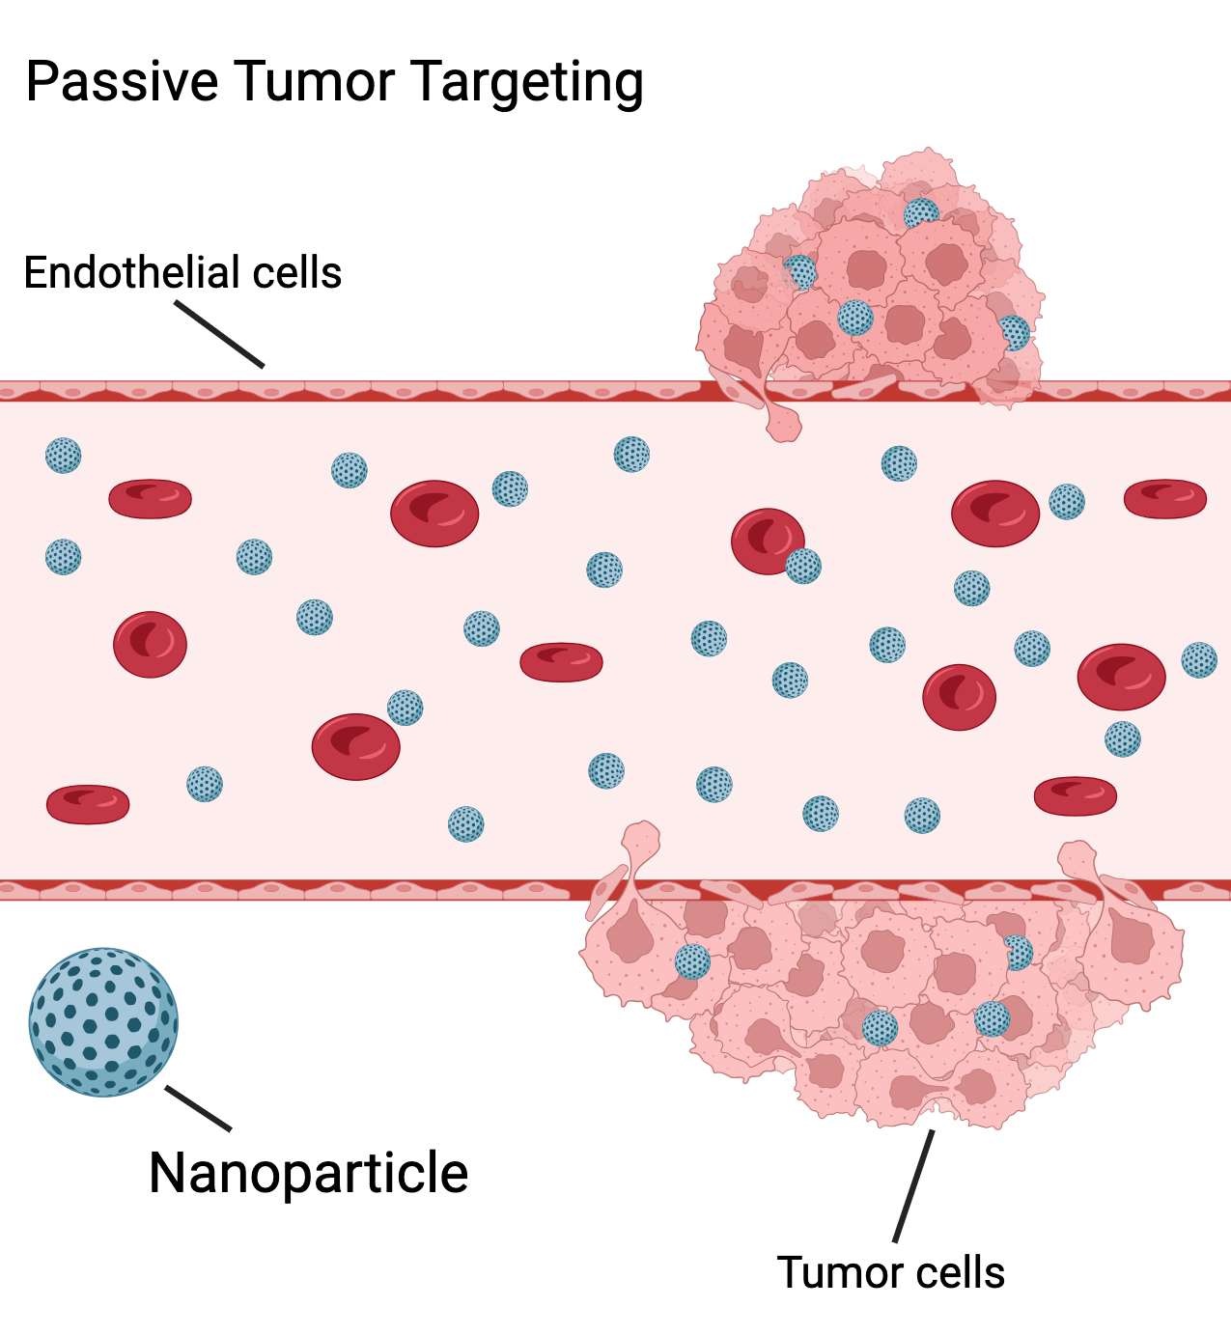
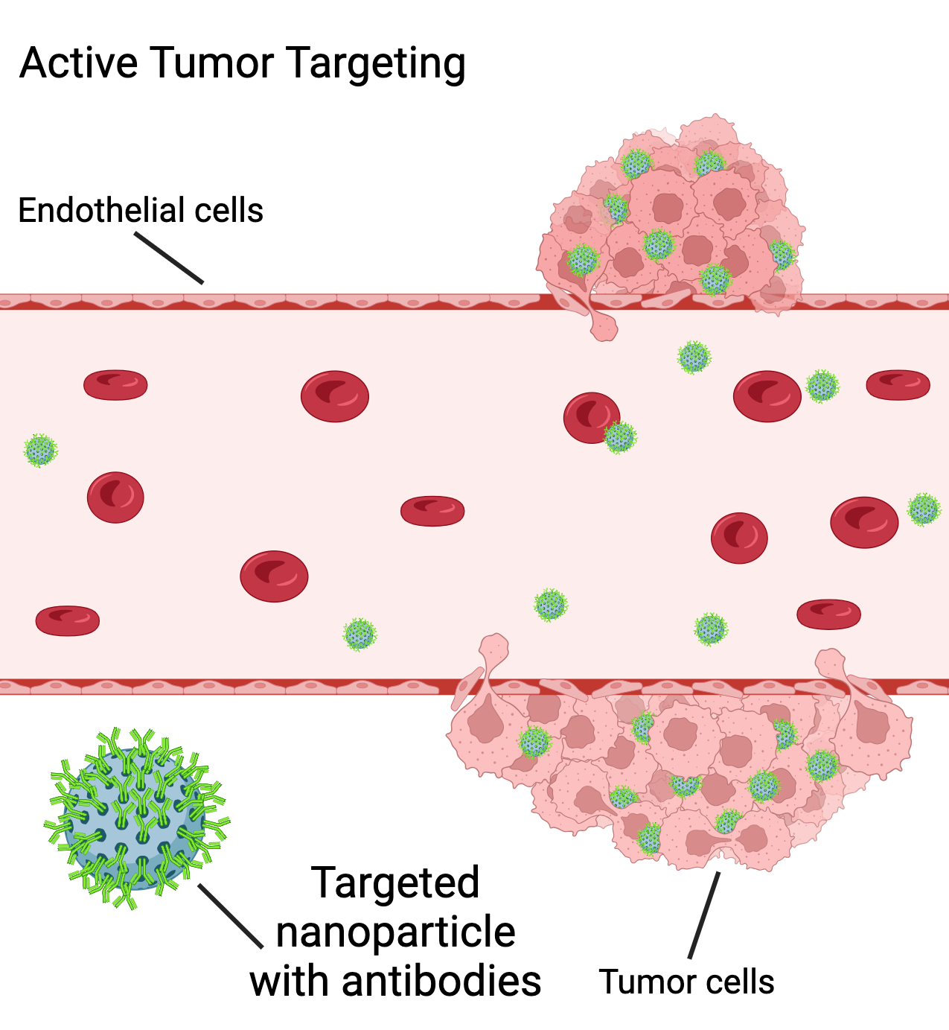
Case study: Cancer targeting
In the picture to the right, nanoparticles (the blue/green dots) are used to deliver treatment to the tumor in two ways, ‘passive’ and ‘active’.
What do you think this means?

Slide 53
Case study: Cancer targeting
Passive targeting means that the nanoparticles are circulating without anything to guide them to the tumor, so some nanoparticles are coming to the tumor by chance. This can be improved!

Slide 54
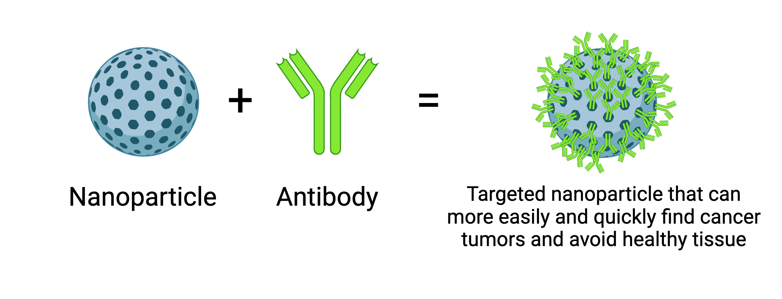
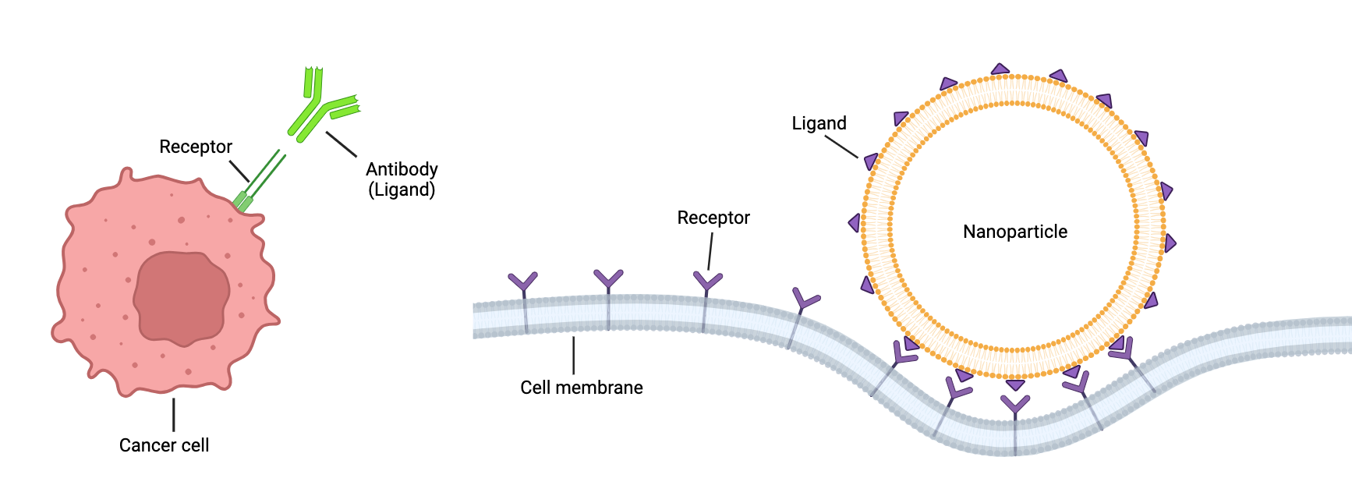
Case study: Cancer targeting
We can add an antibody to the nanoparticle to help it target the tumor. The antibody can act as a ‘ligand’ to the tumor’s ‘receptor.

Slide 55
Case study: Cancer targeting
What happens? Now the nanoparticles know where to go! As a result, you have many more nanoparticles (pink dots) on the blue tumor to the right.
This means that more drug is reaching the tumor, and that the treatment is more effective.

Slide 56
Class discussion
What are your thoughts on the case studies shown?

Slide 57
Any questions so far?

Slide 58
Homework:
Research a current research article or paper showing nanoparticle treatment for a disease. Write a 2 paragraph summary on what the disease is, and why do you think the nanoparticle is needed for the disease? (It’s okay if you’re not sure! Feel free to guess, but make sure you say why)

Slide 59
Designing your own nanoparticle!

Slide 60
Today you all will become nanoparticle scientists and design a nanoparticle for a disease of choice!

Slide 61
At the end of the period you will present a quick summary of the disease you researched and how you designed your nanoparticle.

Slide 62
Examples of diseases to tackle with nanoparticles + medications
Research and select a disease of your choice. Some examples:
Cancer
Diabetes
Asthma
Flu
COVID-19

Slide 63
Any questions so far?

Slide 64
Homework:
Write a 3-5 paragraph essay where you have:
in-depth explanations of your chosen disease
the science behind your nanoparticle design
and the impact of your treatment

Slide 65
Other Resources:
How mRNA Vaccines Work (CDC)
https://www.cdc.gov/coronavirus/2019-ncov/downloads/vaccines/COVID-19-mRNA-infographic_G_508.pdf
Packaging mRNA for the pancreas
https://www.nibib.nih.gov/news-events/newsroom/packaging-mrna-pancreas
Finger on the pulse of drug delivery
https://www.nibib.nih.gov/news-events/newsroom/finger-pulse-drug-delivery
Directing vaccines to dendritic cells
https://www.nibib.nih.gov/news-events/newsroom/directing-vaccines-dendritic-cells

Slide 66
Image Credits:
Slide 2: Meade/Created with BioRender.com
Slide 3: Canva.com
Slide 4: Meade/Created with BioRender.com, Canva.com
Slide 5: Meade/Created with BioRender.com
Slide 6: Meade/Created with BioRender.com
Slide 7: Meade/Created with BioRender.com
Slide 8: Meade/Created with BioRender.com
Slide 9: Meade/Created with BioRender.com
Slide 10: Meade/Created with BioRender.com
Slide 14: Catherine and James Galbraith, Oregon Health and Science University, Center for Spatial Systems Biomedicine, Knight Cancer Institute
Slide 15: Meade/Created with BioRender.com
Slide 16: Meade/Created with BioRender.com
Slide 17: Meade/Created with BioRender.com
Slide 18: Meade/Created with BioRender.com
Slide 23: Canva.com

