Slide 1
RIGOR AND REPRODUCIBILITY:
BACK TO BASICS
Patricia Valdez, Ph.D.
NIH Extramural Research Integrity Officer
National Institutes of Health

Slide 2
Overview
Why the concern about reproducibility?
The NIH response
Addressing rigor in grant applications
Training and resources

Slide 3


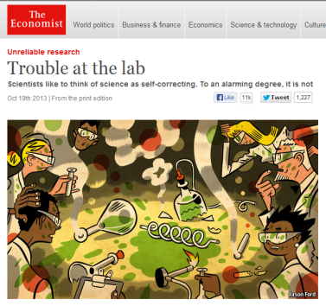
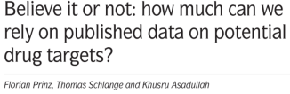



The Reproducibility Challenge
Noted by research community; in multiple publications
  Across research areas
  Especially in preclinical research

Slide 4
A call for transparency

Slide 5
Challenges to Rigor and Transparency in
Reporting Science
Science often viewed as self-correcting
  Immune from reproducibility problems?
  Principle remains true over the long-term
In the short- and medium-term, interrelated factors can short-circuit self-correction
  Leads to reproducibility problem
  Loss of time, money, careers, public confidence

Slide 6

Factors That “Short Circuit”
Self-correction
Poor training
  Inadequate experimental design
  Inappropriate use of statistics (“p-hacking”)
  Incomplete reporting of resources used and/or unexpected variability in resources

Slide 7


Factors That “Short Circuit”
Self-correction
Publication practices
  Difficulty in publishing negative findings
  Overemphasis on the “exciting, big picture” findings; leaves out necessary details
Current “hyper-competitive” environment
  Historically low funding rates
  Grant review and promotion decisions depend too much on “high profile” publications

Slide 8
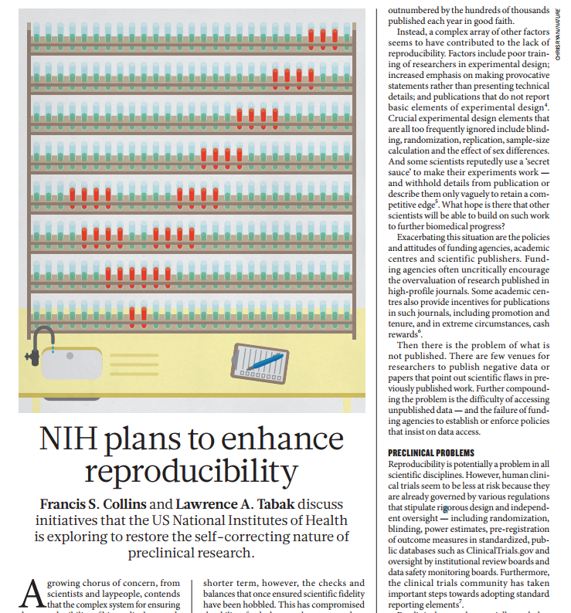
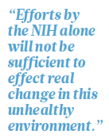
NIH plans to enhance reproducibility

Slide 9
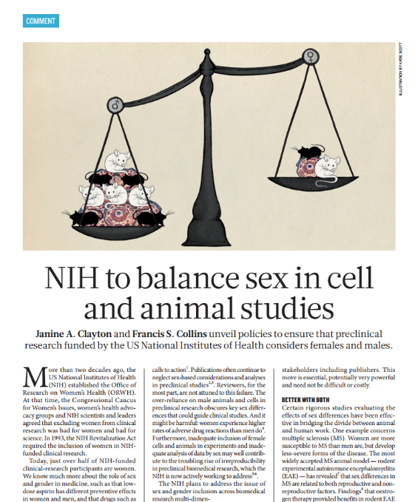
NIH to balance sex in cell and animal studies
“Over the course of FY 2015, NIH plans to roll out policies that will require applicants to address inclusion of both sexes in biomedical research.”

Slide 10
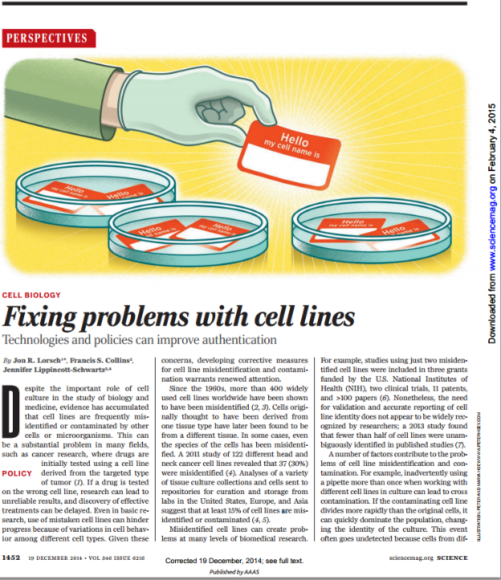
Fixing problems with cell lines
Since the 1960s, more than 400 widely used cell lines worldwide have been shown to have been misidentified
A 2011 study of 122 different head and neck cancer cell lines revealed that 37 (30%) were misidentified
Studies using just two misidentified cell lines were included in 3 grants funded by the NIH, two clinical trials, 11 patents, and >100 papers

Slide 11
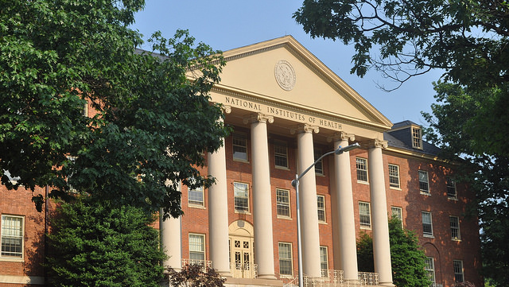
Our Guiding Principles for
Rigor & Transparency
Clarify NIH’s long-standing expectations regarding rigor and transparency in applications
Raise awareness and begin culture shifts in the scientific community
Improve the way that applicants describe their work; provide sufficient information for reviewers
As always, ensure that NIH is investing in the best science and minimizing unnecessary burden
11

Slide 12
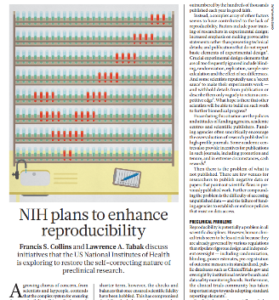
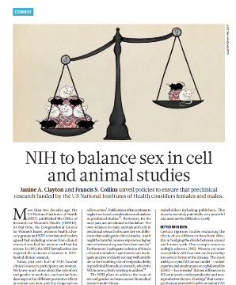
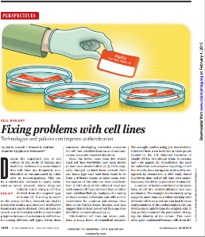
Four Areas of Clarification
Rigor of the prior research
Scientific rigor of the proposed research
Relevant biological variables, such as sex
Authentication of key biological and/or chemical resources
Starting with applications due on January 25, 2016

Slide 13
RPG Application and Review
Element of Rigor | Section of Application | Criterion Score | Additional Review Consideration | Contribute to Overall Impact?
Rigor of the Prior Research | Research Strategy | Significance | NA | Yes
Rigor of the Prior Research | Research Strategy | Approach | NA | Yes
Scientific Rigor | Research Strategy | Approach | NA | Yes
Consideration of Relevant Biological Variables Such as Sex | Research Strategy | Approach | NA | Yes
Authentication of Key Biological and/or Chemical Resources | Attachment | NA | Acceptable or Unacceptable | No

Slide 14
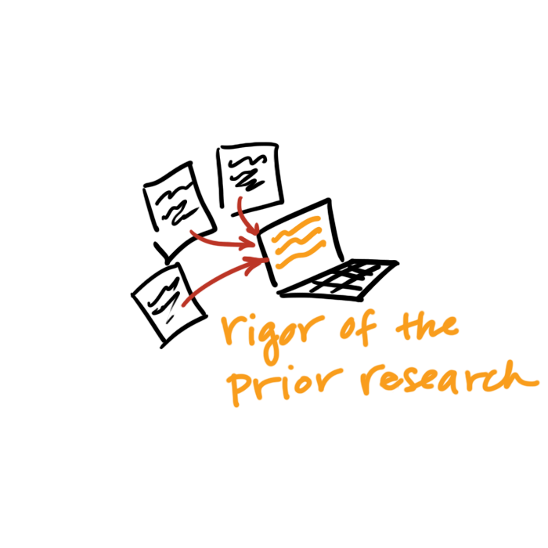
Rigor of the Prior Research
Assess the strength & weaknesses in the rigor of the prior research that serves as key support for the proposed research project.
  Prior research can include:
    observations,
    preliminary data, or
    published literature
Describe plans to address weaknesses in the rigor of the prior research that serves as the key support for the proposed project.

Slide 15
FAQ: What Do I Include When Describing the Rigor of the Prior Research?
When assessing the rigor of the prior research that serves as key support for the application, consider:
  Appropriate sample sizes
  Randomization and blinding
  Adequate positive and negative controls
  Appropriate statistical tests
  Consideration of relevant biological variables
  Authentication of key resources
  Other measures

Slide 16
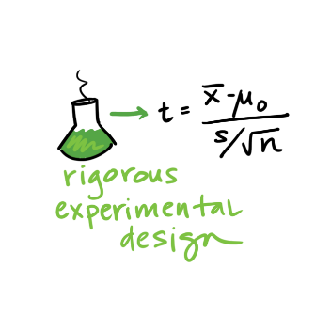
Scientific Rigor
The strict application of the scientific method to ensure robust and unbiased experimental design, methodology, analysis, interpretation and reporting of results.
Describe the experimental design and methods proposed and how they will achieve robust and unbiased results.

Slide 17
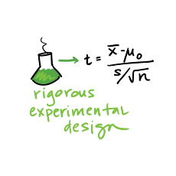
FAQ: How Much Detail Should
I Include to Address Scientific Rigor?
Succinctly state what is planned
  Include information on sample size estimation, effect size, blinding, randomization, statistical analyses…
  Describe experimental animal numbers here (power calc).
Be transparent about your plans for analysis
Stay within page limits

Slide 18
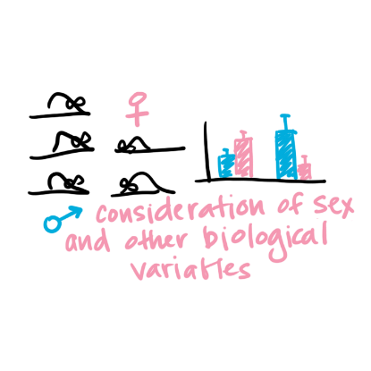
Relevant Biological Variables Such as Sex
Affect health or disease
  sex,
  age,
  weight, and
  underlying health conditions
Explain how relevant biological variables, such as sex, are factored into research designs & analyses for studies in vertebrate animals & humans.
Proposing to study one sex?
  Need strong justification from the scientific literature, preliminary data, or other relevant considerations

Slide 19

FAQ: Will I Have to Double My Animal Numbers?
May not need to power initial study to detect sex differences
  Begin to collect data on sex for early-stage research.
Justification should be provided if the application proposes to study one sex
  sex-specific condition of phenomenon (e.g., ovarian or prostate cancer),
  acutely scarce resources, or
  sex-specific hypotheses possible due to known differences between males and females.
Cost and absence of known sex differences are inadequate justifications for not addressing sex.

Slide 20
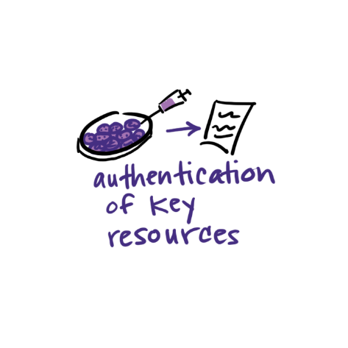
Authentication of Key Biological and/or Chemical Resources
Quality of established resources is critical
Cell lines, Antibodies, Chemicals, Mice, etc.
Provide a plan to regularly authenticate to ensure identity & validity
Each investigator determines which resources are key

Slide 21
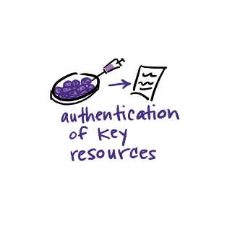
Reminder: Authentication Of Key Biological and/or Chemical Resources (NOT-OD-17-068)
Definition of key biological and/or chemical resources
Examples (cell lines, chemicals, genetically modified animals or cells)
Do not include:
  Plans for authentication of data sets, databases, machinery, or electronics
  Plans for the development and authentication of new key biological and/or chemical resources
  Plans for authentication of standard laboratory reagents that are not expected to vary
  Authentication or other data

Slide 22

Research Performance Progress Reports
(RPPR)
B.2 What was accomplished under these goals?
Goals are equivalent to specific aims. In the response, emphasize the approaches taken to ensure robust and unbiased results. Include the significance of the findings to the scientific field.
B.6 What do you plan to do for the next reporting period to accomplish the goals?
Include any important modifications to the original plans, including efforts to ensure that the approach is scientifically rigorous and results are robust and unbiased. Provide a scientific justification for any changes involving research with human subjects or vertebrate animals. A detailed description of such changes must be provided under Section F. Changes.

Slide 23
Training in Rigor (2020)
Institutional Research Training & Institutional Career Development
  Describe how the program and faculty will provide training in rigorous research design and relevant data science and quantitative approaches.
  Plan for Instruction in Methods for Enhancing Reproducibility
Fellowships & Individual Career Development
  Address, as applicable, any new research skills they expect to acquire in the areas of rigorous research design, experimental methods, quantitative approaches, and data analysis and interpretation.
See NOT-OD-20-090

Slide 24
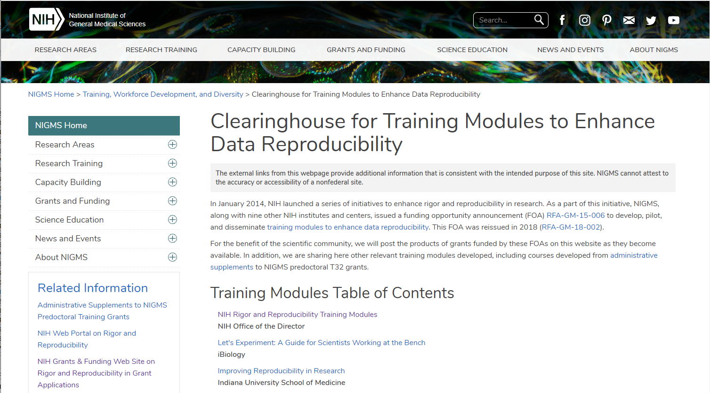
Training
https://www.nigms.nih.gov/training/pages/clearinghouse-for-training-modules-to-enhance-data-reproducibility.aspx

Slide 25
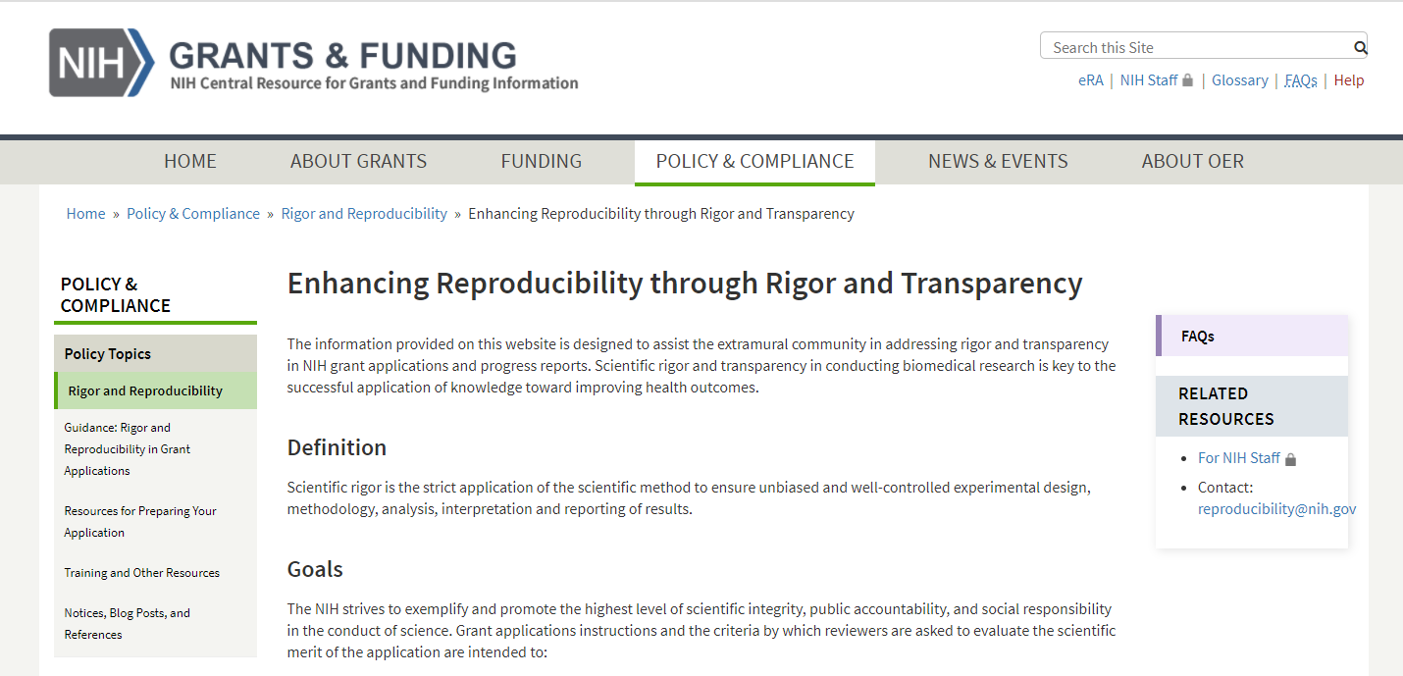
Enhancing Reproducibility through Rigor and Transparency
https://grants.nih.gov/policy/reproducibility/index.htm

Slide 26

Found on the website
Resources Include
Scientific Rigor Examples
Resources and Tools for Rigorous Experimental Design
Authentication Plan Examples
And more…

Slide 27
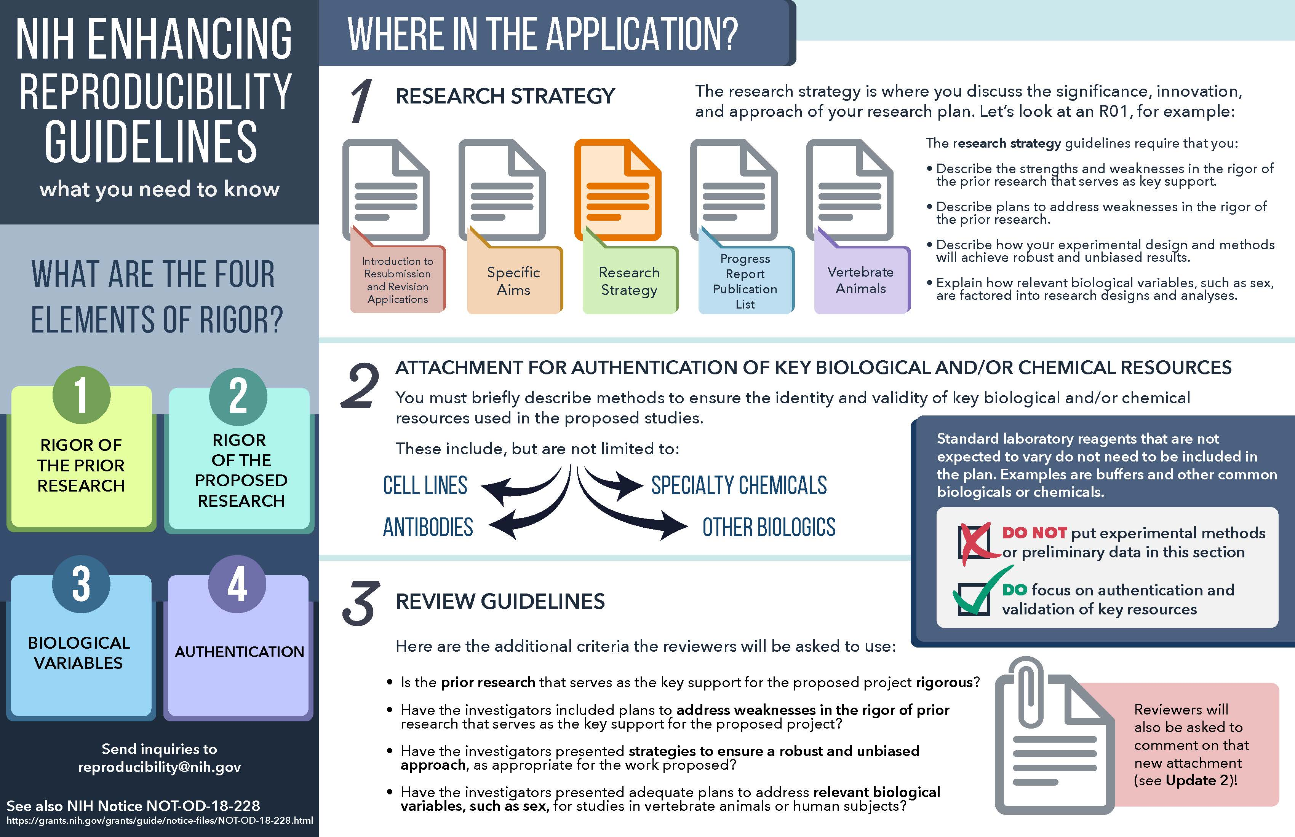
NIH Enhancing Reproducibility Handout - 1

Slide 28
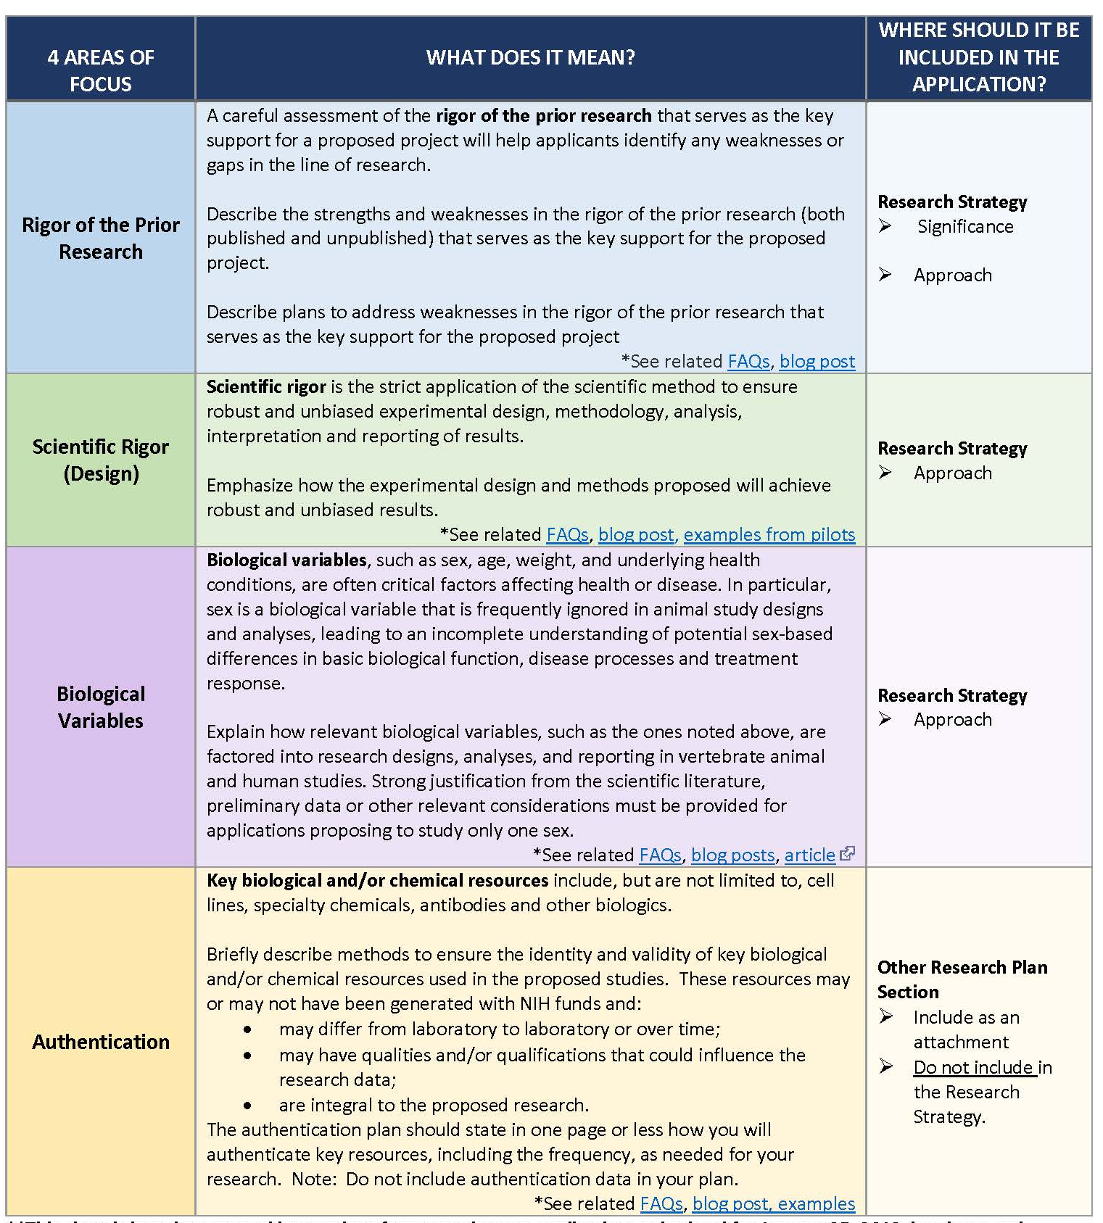
NIH Enhancing Reproducibility Handout - 2

Slide 29
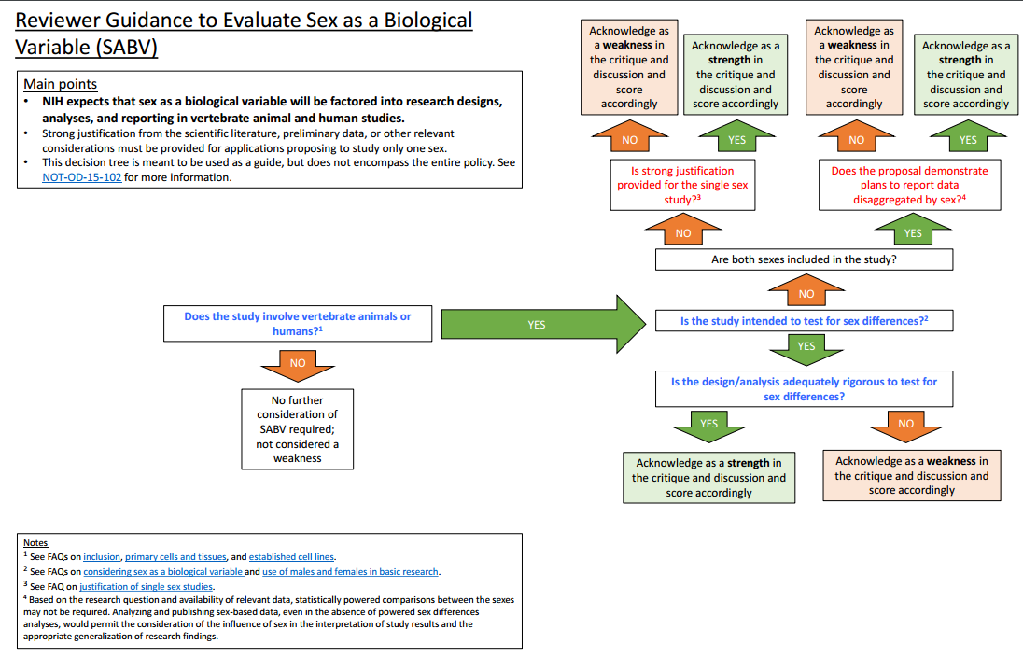
Reviewer Guidance

Slide 30
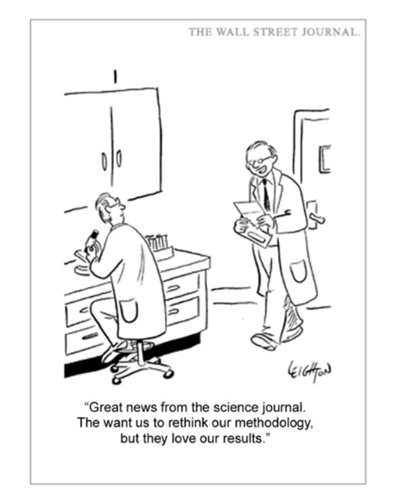
Thank You!
Questions? reproducibility@nih.gov

