Slide 1
Navigating the New
NIH Genetic Testing Registry
Presented by:
Wendy Rubinstein, MD, PhD, FACP, FACMG
Adriana Malheiro, MS
Brandi Kattman, MS, CGC

Slide 2
We encourage questions to be asked throughout the presentation.
*Please use your “chat feature” to send in any questions to presenters. If you have trouble using the chat feature, please feel free to email your question in to amelvin@nsgc.org

Slide 3
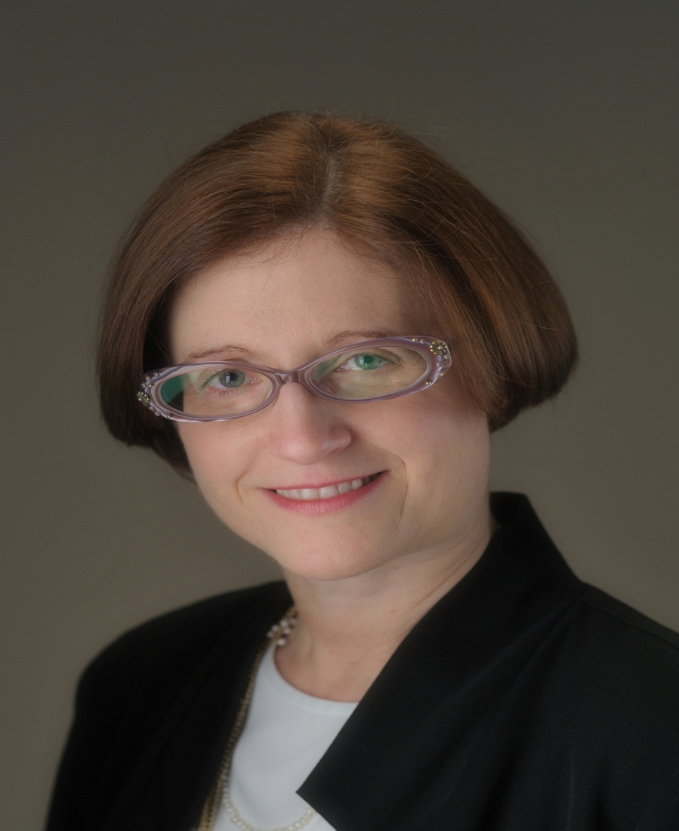
Wendy Rubinstein, MD, PhD, FACP, FACMG
Wendy Rubinstein, M.D., Ph.D., FACP, FACMG, is a Senior Scientist at the NIH and Director of the NIH Genetic Testing Registry in the National Center for Biotechnology Information. Dr. Rubinstein earned her Ph.D. in Biomedical Sciences from the City University of New York and her M.D. from Mount Sinai School of Medicine. She was a Clinical Associate Professor at the University of Chicago Pritzker School of Medicine and Chief of the Division of Genetics at NorthShore University HealthSystem. Recently named a Top Doctor by U.S. News, her clinical and research expertise is on hereditary cancer syndromes, computerized family history, and quantitative genetic risk assessment. In 2010-2011 she spent a sabbatical at the NHGRI working on whole exome sequencing analysis. Dr. Rubinstein is certified by the American Board of Internal Medicine, holds dual certification from the American Board of Medical Genetics in clinical genetics and clinical molecular genetics, and is a Fellow of both the American College of Medical Genetics and the American College of Physicians.

Slide 4
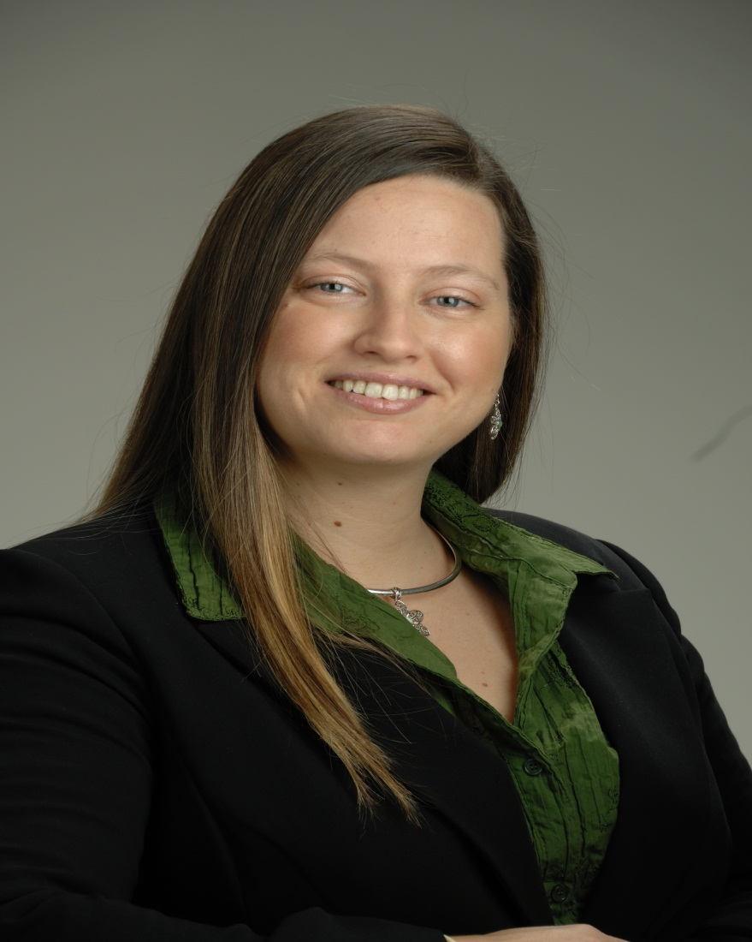
Adriana Malheiro, MS
Adriana Malheiro, M.S., a genetic counselor, was appointed Staff Scientist at the National Institutes of Health, National Center for Biotechnology Information in August 2010 and serves as a curator for the Genetic Testing Registry and ClinVar projects. She received her M.S. in Genetics and Human Genetics, Genetic Counseling track from Howard University. She worked at the Howard University, Department of Pediatrics and Child Health as a genetic counselor at the department’s clinic. She also served as a research coordinator for programs assessing clinical progress of pediatric patients with hemoglobinopathies and as the project manager for the District of Columbia Greater Access to Pediatric Sickle Cell Services (DCGAPS), a comprehensive case management program for children and families with sickle cell disease.

Slide 5
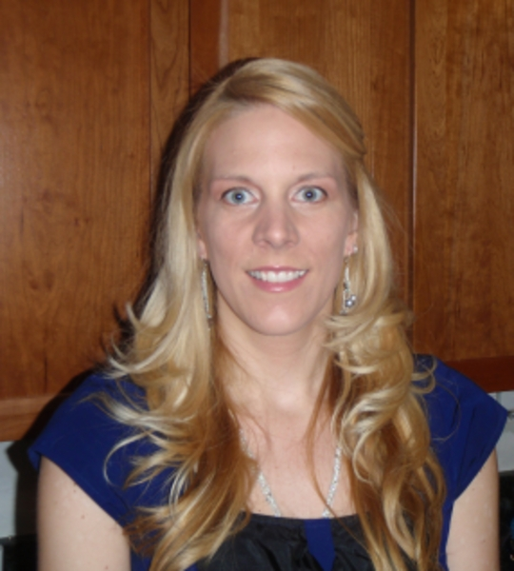
Brandi Kattman, MS, CGC
Joining the GTR team was an easy decision for Brandi Kattman. With her clinical and lab experience, she brings a well-rounded view to the creation of the GTR. Brandi worked for GeneDx for six years, with roles as Genetic Counseling Services Program Manager and Director of Cardiology Genetic Services. While at GeneDx, she led the creation and implementation of the laboratory’s information management system (LIMS) and was the primary contact with GeneTests for the over 400 tests listed by GeneDx. Prior to working in the laboratory setting, Brandi saw patients in several clinics in the metro DC area. Brandi is an active NSGC member, recently finishing a 3 year term as a co-chair of the Industry SIG. A member of the hydrocephalus Association, her expertise lies in X-linked hydrocephalus and genetic testing for rare disorders.

Slide 6
Navigating the New
NIH Genetic Testing Registry
Gain familiarity with the transition from the GeneTests Laboratory Directory to the NIH Genetic Testing Registry (GTR)
Wendy Rubinstein, MD, PhD, FACP, FACMG
Senior Scientist, National Institutes of Health
Director, NIH Genetic Testing Registry
The following relationship(s) exist related to this presentation:
No relationships to disclose.

Slide 7
Outline
Why the Genetic Testing Registry (GTR)?
  SACGHS and others – increase transparency of genetic testing
  Clinical Genomics
    ClinVar
GTR Team and Advisors
Stakeholder Input
Phased Approach
Intended Audience
GTR Launch and Transition Plan
  GeneTests laboratory directory phase out, GeneReviews continues
  Data Migration
Quality of Information
Key features of GTR navigation

Slide 8

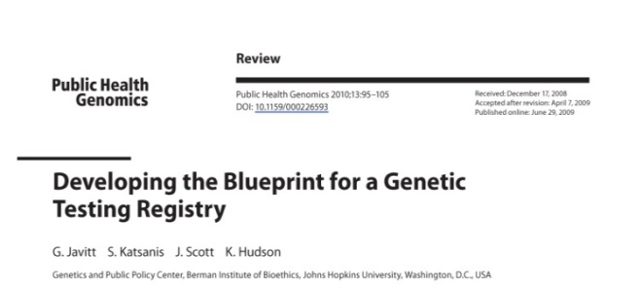
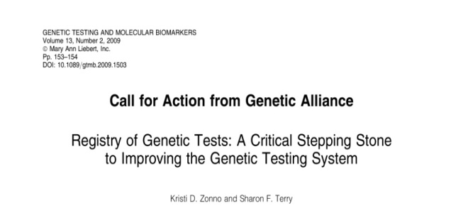
Calls for a Genetic Testing Registry
SACGHS and other groups such as the Johns Hopkins Genetics and Public Policy Center and Genetic Alliance, recommended that HHS establish a test registry to increase the transparency of genetic testing
Notes:
8

Slide 9
Calls for a Genetic Testing Registry
SACGHS and other groups such as the Johns Hopkins Genetics and Public Policy Center and Genetic Alliance, recommended that HHS establish a test registry to increase the transparency of genetic testing
Voluntary
Notes:
9

Slide 10
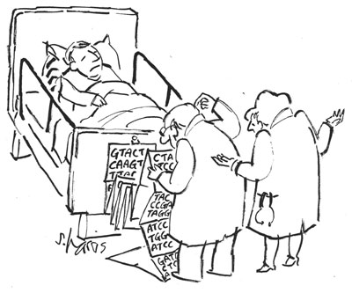
Clinical Genomics
Need database anchored on tests, not diseases
Must accommodate complex information
  Arrays
  Whole genome and whole exome tests

Slide 11
ClinVar
http://www.ncbi.nlm.nih.gov/clinvar
  Companion resource that represents the relationship of genotype, phenotype, and clinical interpretation based on supporting evidence.
  Aggregating information about medically important human variation.
  Will be a distinct web resource later this year.

Slide 12
GTR Team
NIH Office of the Director – Policy oversight
Jim Ostell, PhD
  Chief, NCBI Information Engineering Branch
  Directs NCBI’s suite of genome tools and resources
    GenBank, dbSNP, dbGaP, RefSeq, PubMed, PubMed Central, etc.
Wendy Rubinstein, MD, PhD
  GTR Director, Clinical genetics and Clinical molecular genetics
Donna Maglott, PhD
  Lead, Database development
Jennifer Lee, PhD
  Lead, Web development
Brandi Kattman, MS, CGC
  Genetic counselor
Adriana Malheiro, MS
  Genetic counselor
Team of programmers, web developers, usability experts

Slide 13
GTR Advisory Groups
NCBI Medical Genetics Working Group
NIH Clinical Advisory Group
Ivona Aksentijevich, M.D.
Leslie Biesecker, M.D.
Thomas A. Fleisher, M.D.
Daniela Gerhard, Ph.D.
Katrina Gwinn, M.D.
Stephen C. Groft, Pharm.D.
Emily Harris, Ph.D.
Suzanne Hart, Ph.D.
Rochelle M. Long, Ph.D.
Francis McMahon, M.D.
Catherine McKeon, Ph.D.
Winifred K. Rossi, M.A.
Robert Shamburek, M.D.
Bryan Traynor, M.D., M.M.Sc.
Tiina Urv, Ph.D.
Christine Seidman, M.D.
Leslie Biesecker, M.D.
Wendy Chung, M.D., Ph.D.
David S. Konecki, Ph.D.
Robert Nussbaum, M.D.
Charmaine D.M. Royal, Ph.D.
Wendy R. Uhlmann, M.S.
Marc S. Williams, M.D.

Slide 14
Stakeholder Input: 2010 - 2011
Diverse
  Laboratory test developers, manufacturers, health care providers
80 public comments – from 3 Federal Register notices
17 public comments – 11/2/10 stakeholder meeting
95 comments – ‘Contact GTR’ email
19 meetings / teleconferences with stakeholder groups
3 meetings with other government agencies e.g., FDA, CMS, CDC
10 consultations with two Clinical Advisory Groups
7 professional meetings including NSGC, ACMG, ASHG, AMP

Slide 15
How did stakeholder input help NIH shape the GTR?
Phased approach
Data elements
Intended audience

Slide 16
NIH Will Use a Phased Approach
Initial phase
  Single gene tests for Mendelian disorders
  Pharmacogenetic tests
    Expert input by CPIC (Clinical Pharmacogenetics Implementation Consortium)
  Test panels and arrays
Not in initial phase
  Somatic gene tests
    Solid tumors
    Hematological malignancies
  Infectious agents
  Direct-to-Consumer tests
  Whole exome sequencing / whole genome sequencing

Slide 17
Data Elements
Designed to collect the maximum amount of information while taking into consideration
    Burden on the submitters
    Input from a variety of stakeholders
  Distinctions between minimal, recommended, and optional fields
  Not included
    Test price
    Patents and licensing agreements
    Turn-around time
    Proprietary information

Slide 18
Intended Audience
Initial target audience is health care providers
GTR aims to serve a wider audience and to
increase usability for
  Non-genetics health care providers
  Patients/consumers

Slide 19
Transition Plan
GTR launch planned in February 2012
  Search site active – early February
  Submission site – pending approval by the Office of Management and Budget to collect information
GeneTests and GTR will overlap for about 1 year
  Users have time to become familiar with GTR
  Labs have time to register their tests
Notes:
19

Slide 20
Transition Plan
GeneReviews will be viewable throughout GTR
  NIH/NCBI has been supporting/hosting GeneTests for many years
  http://www.ncbi.nlm.nih.gov/sites/GeneTests/
  NIH/NCBI is committed to continue its support of GeneReviews after the GeneTests Laboratory directory is no longer active
Notes:
20

Slide 21
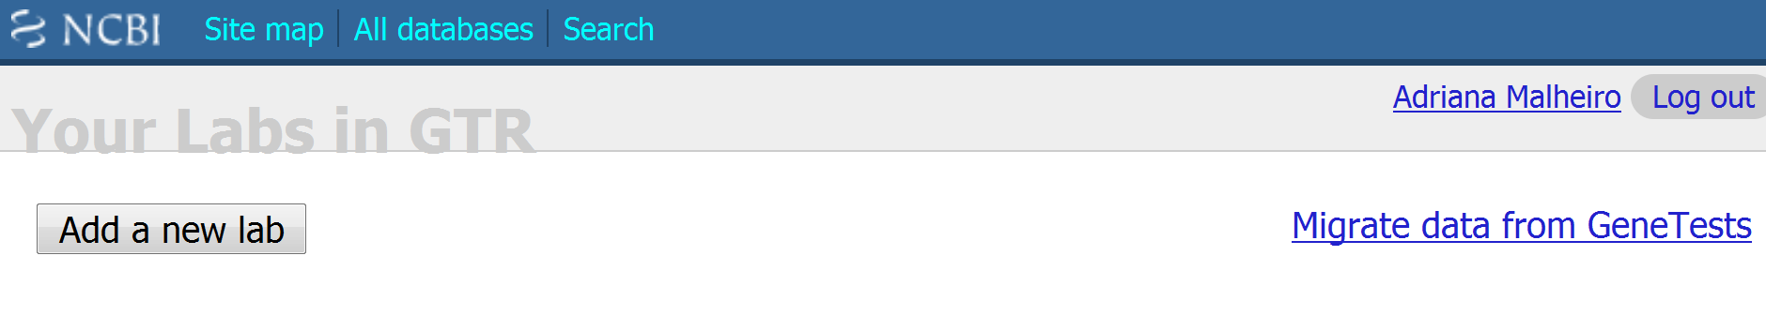
Data migration
NCBI will facilitate data migration from GeneTests to GTR to reduce burden of submission
If you select ‘migrate’, data for your lab currently stored in GeneTests will automatically map and populate the respective fields in GTR for your review

Slide 22
5 extra fields required
31 ‘minimal’ fields are required to register a test in GTR
  16 fields for laboratory information*
    Lab name, location, certifications, personnel
    Entered only once
  15 fields for test information
    10 map to fields in GeneTests*
    Only 5 need to be completed for tests migrated from GeneTests
  * Completed automatically when labs migrate their data from GeneTests to GTR
Notes:
22

Slide 23
Quality of Information
Code of Conduct
  Information that is accurate and not misleading
Professional organization ‘stamp of approval’ invited

Slide 24
Transition Plan
GTR information content – Tests
  Feb 2012 – all test information in GeneTests, reformatted in GTR, along with GTR navigation features and clinical resource links
  Mid 2012 – with data migration and additional fields, show full potential of GTR test display
Making GTR work for you
  Elicit structured feedback from users
Notes:
24

Slide 25
Key features of GTR navigation
Global search and tabbed searches
Autocomplete dictionary
Quickly limit disease search results
  Tests, OMIM, or GeneReviews available
Quickly filter test results
  Condition/Phenotype
  Clinical or Research test
  Test purpose
  Test method
  Certifications e.g., NY CLEP-certified
  Laboratory Location
Compare labs and their methodology menus
  Plan sequential testing in proband and family

Slide 26
Key features of GTR navigation
Detailed Test pages with overview and tabs
Discovery Panel – context-specific
  Clinical practice guidelines e.g., ACMG, EGAPP, CPIC
  Automated searches e.g., GeneReviews, OMIM, Orphanet, PubMed
Locate a genetics professional
  ACMG, NSGC, GeneTests, NCI, ABMG
Consumer Resources
  Print information for your patient from Genetics Home Reference
Access to NCBI’s suite of molecular tools and resources
  Variation
Login to MyNCBI to save preferences for displays and retrieval sets
Stable accession and version history

Slide 27
Navigating the New
NIH Genetic Testing Registry:
Learn basics about how to navigate GTR from the home page including how to locate GeneReviews
Adriana Malheiro, MS
Staff Scientist – Genetic Counselor
NIH, National Center for Biotechnology Information

Slide 28
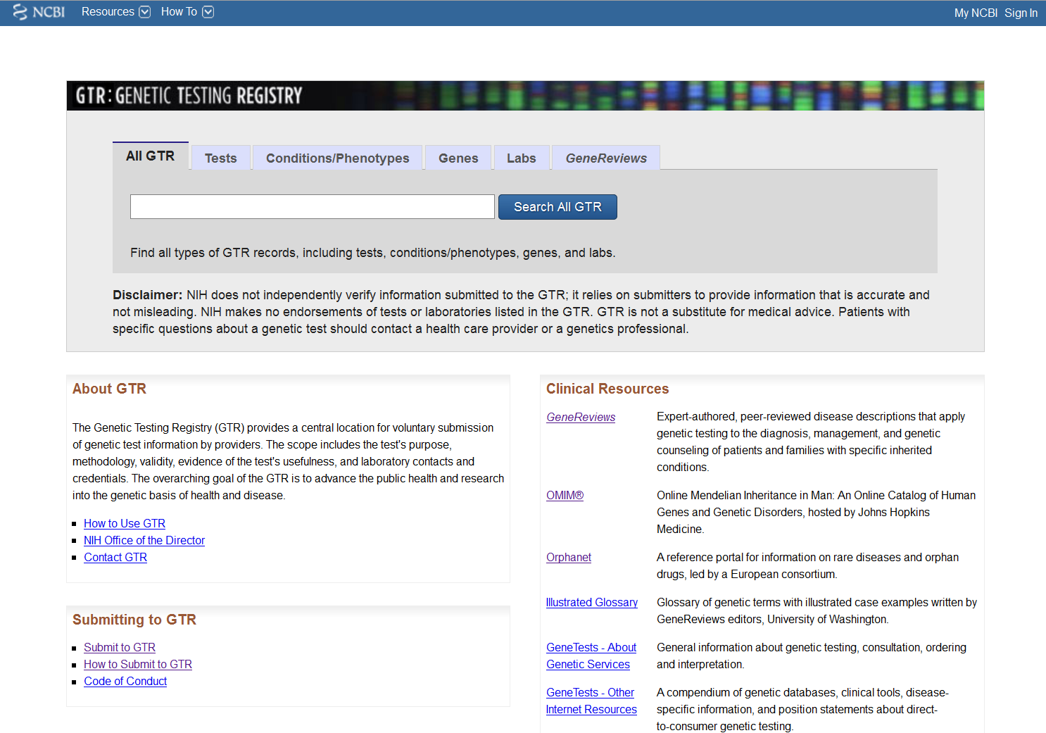
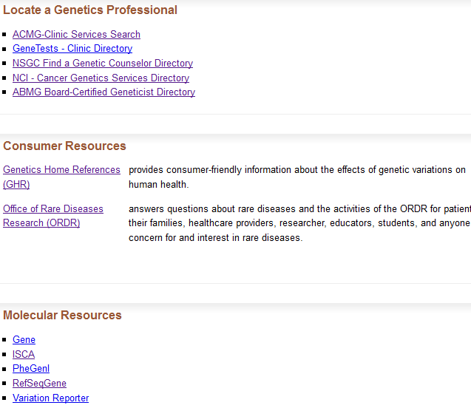

Slide 29
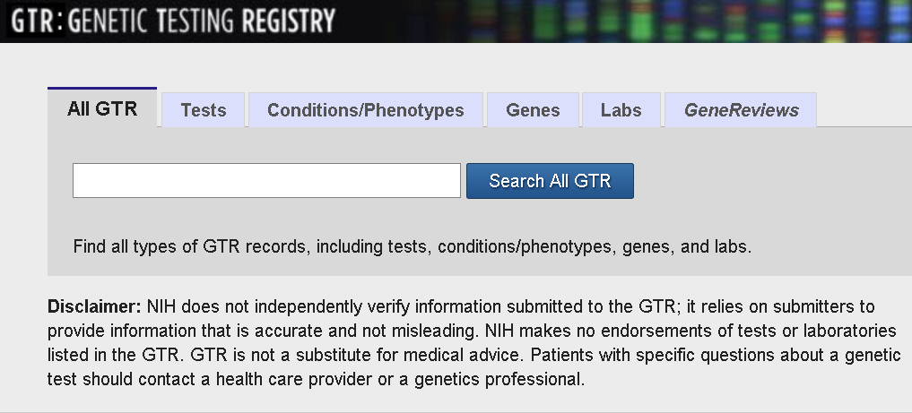
Searching GTR

Slide 30
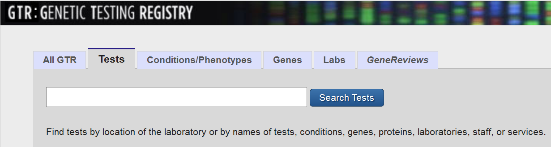
Find conditions and phenotypes by searching for disease names, traits, drugs, proteins and analytes
Find laboratories by searching lab names, directors, staff, locations and services, disease names and phenotypes
Find genes by searching gene symbols and names, conditions and phenotypes
Find a GeneReview

Slide 31
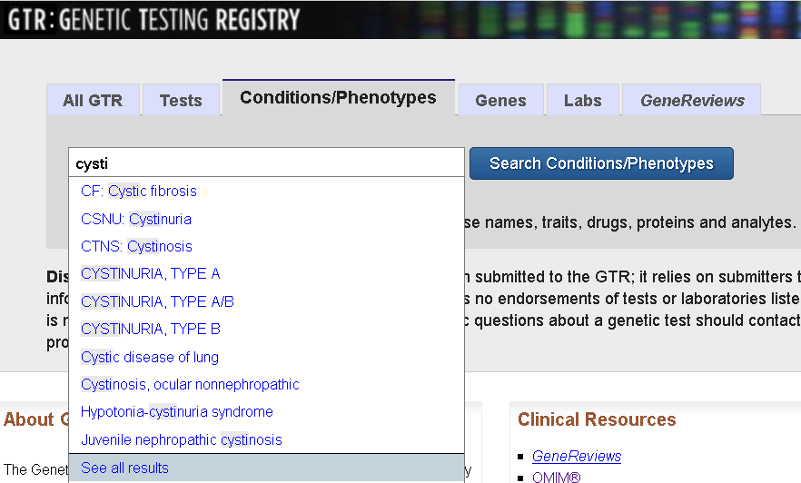
Autocomplete dictionary
Item Page
List Page

Slide 32
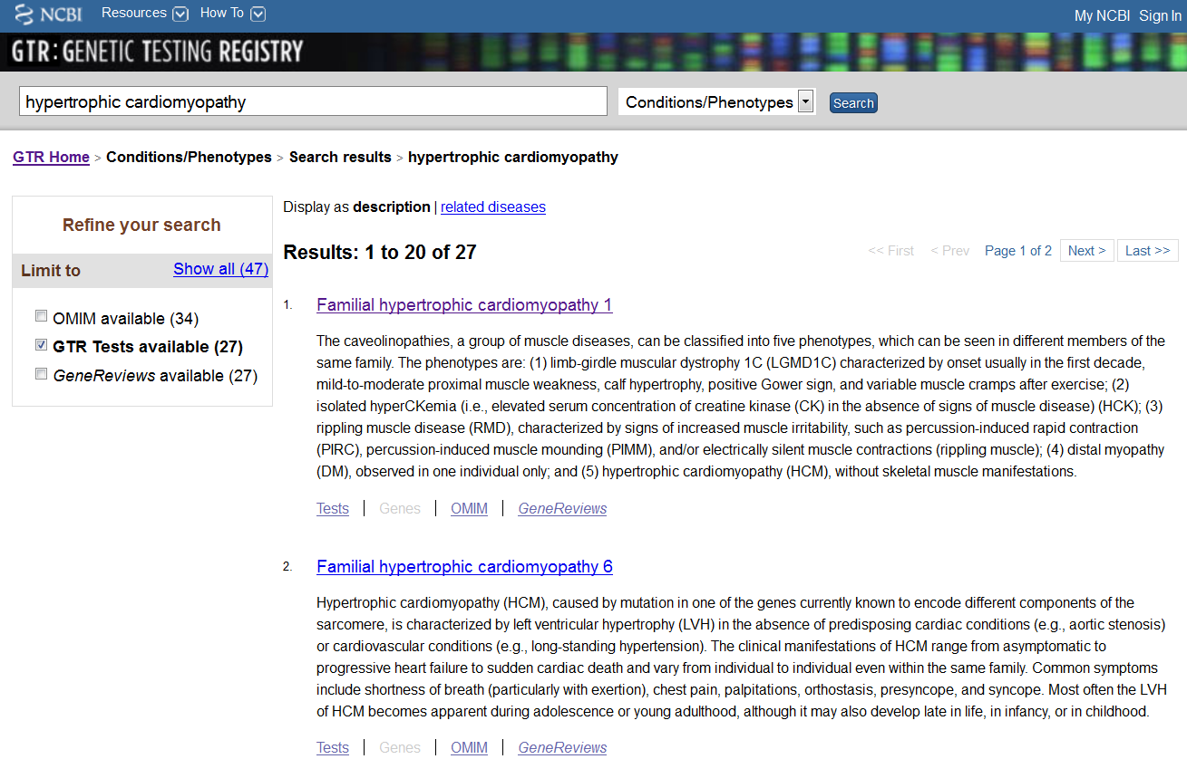
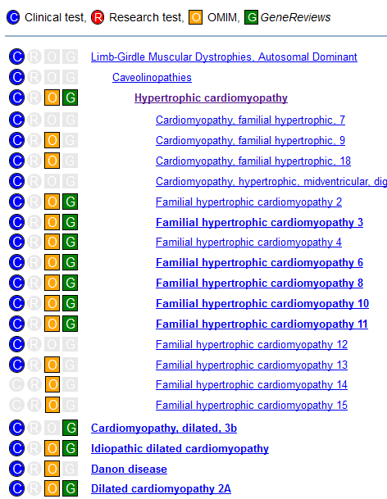

Slide 33
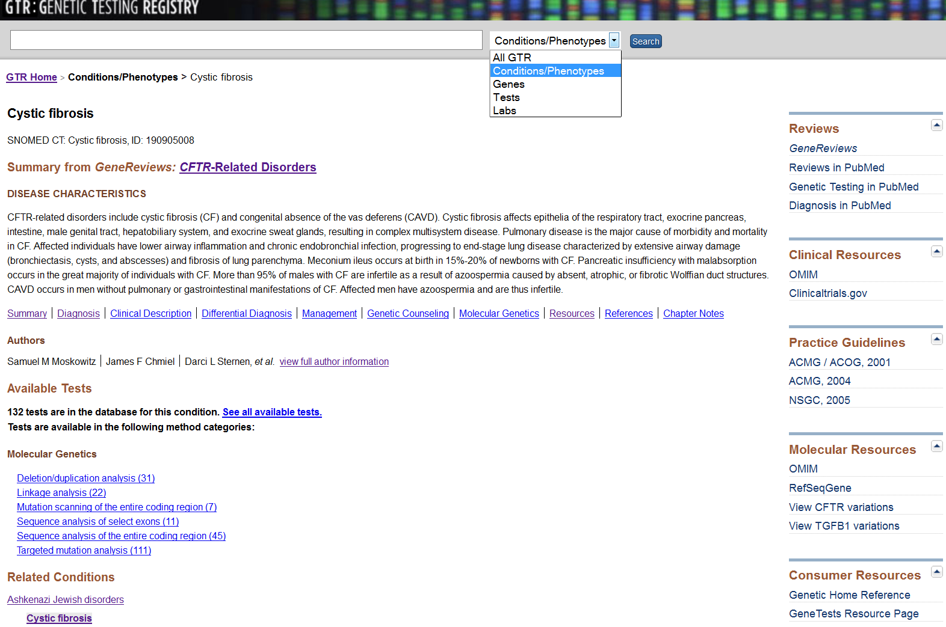
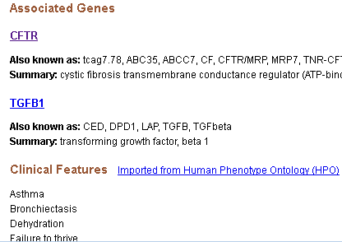

Slide 34
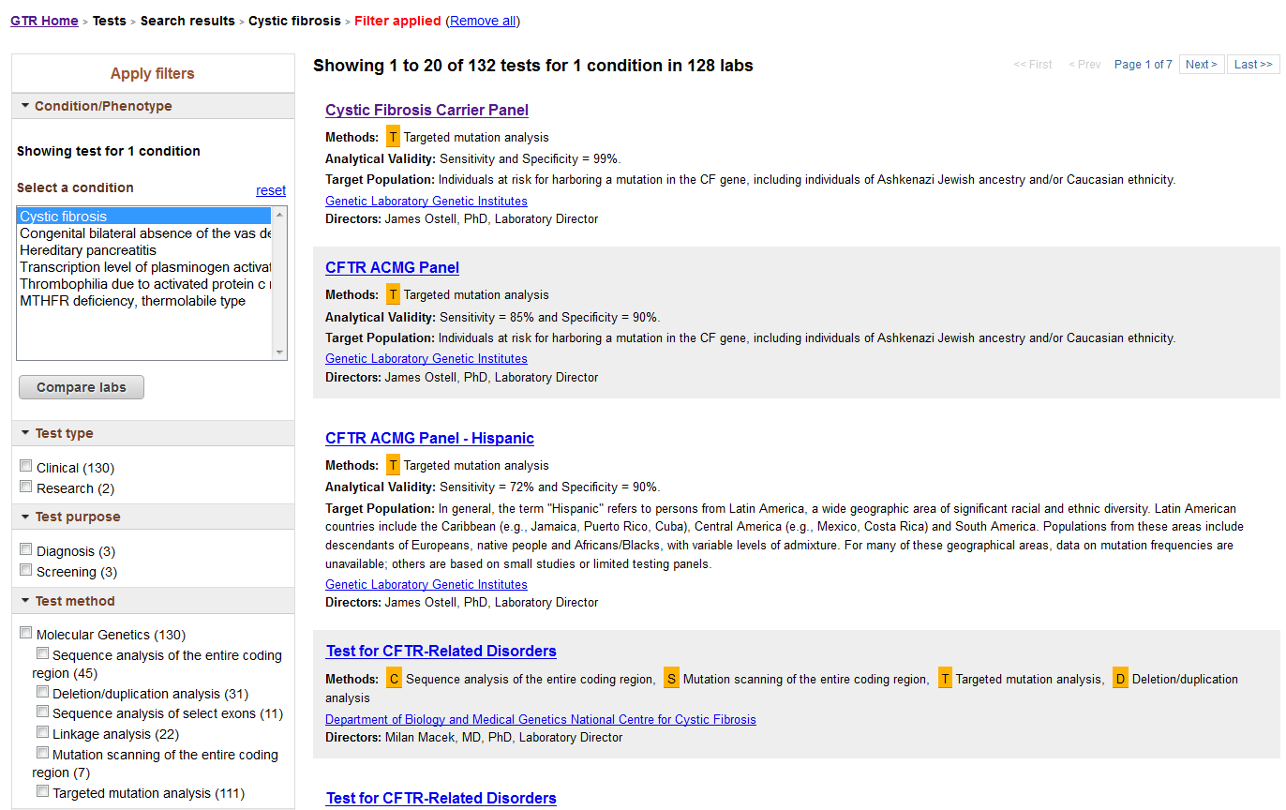
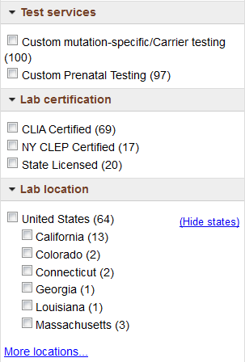
List of tests
Test name as defined by the lab
Generic test name before lab reviews records

Slide 35
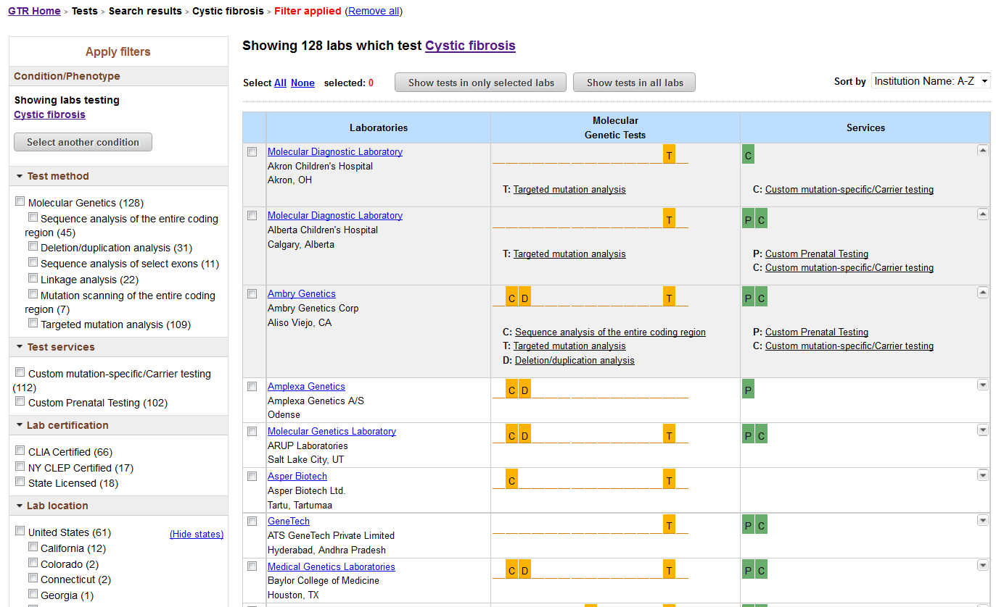
List of laboratories

Slide 36
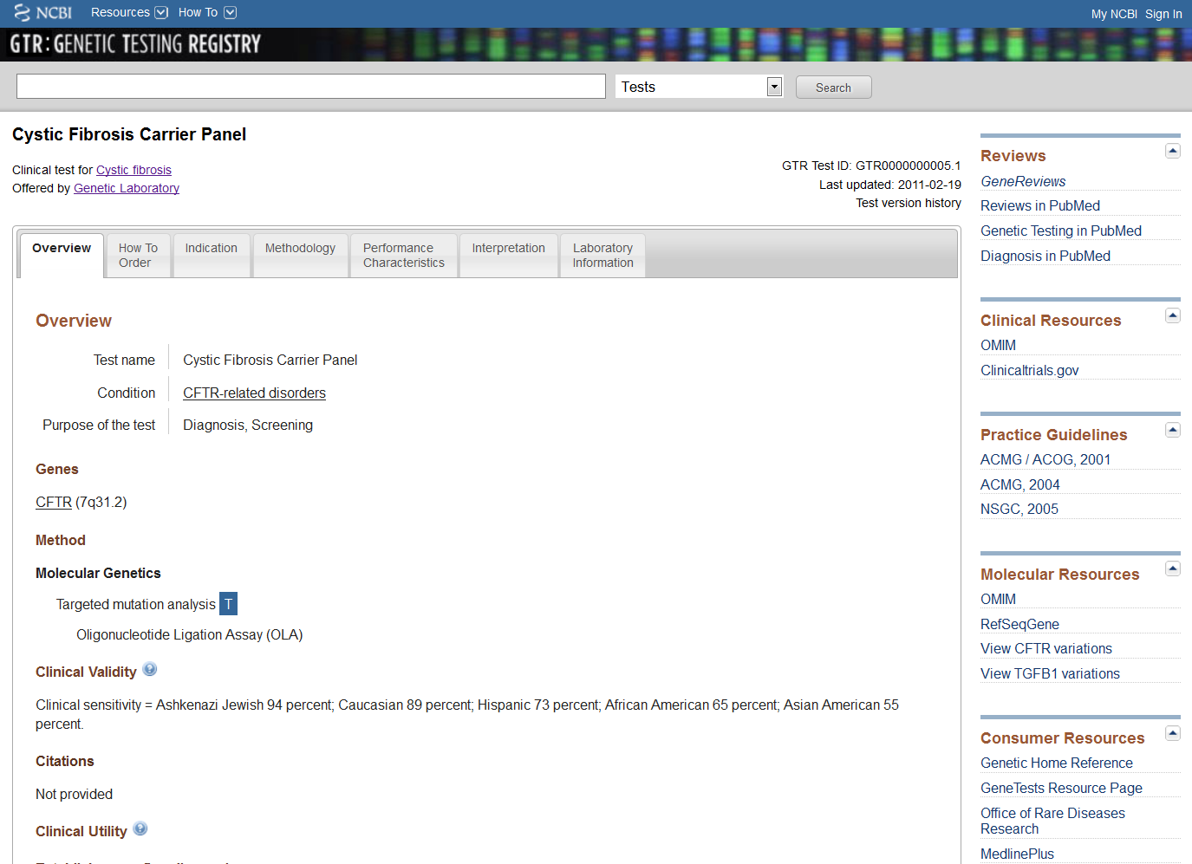
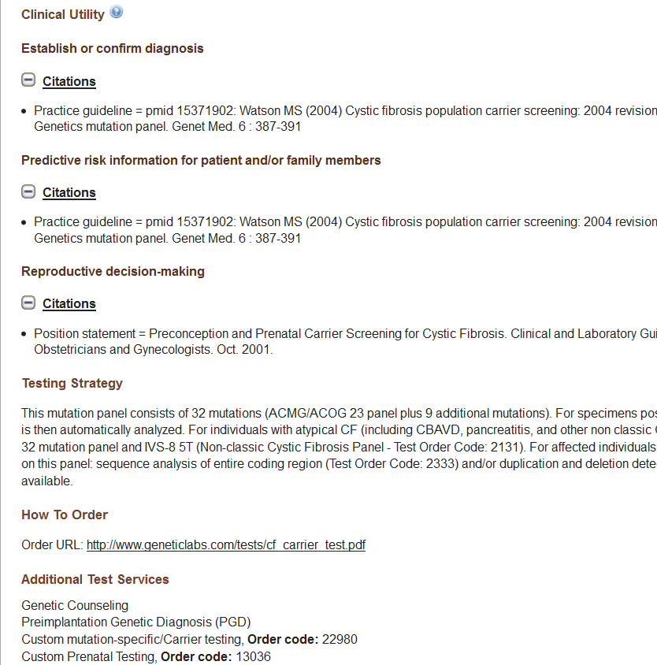

Slide 37
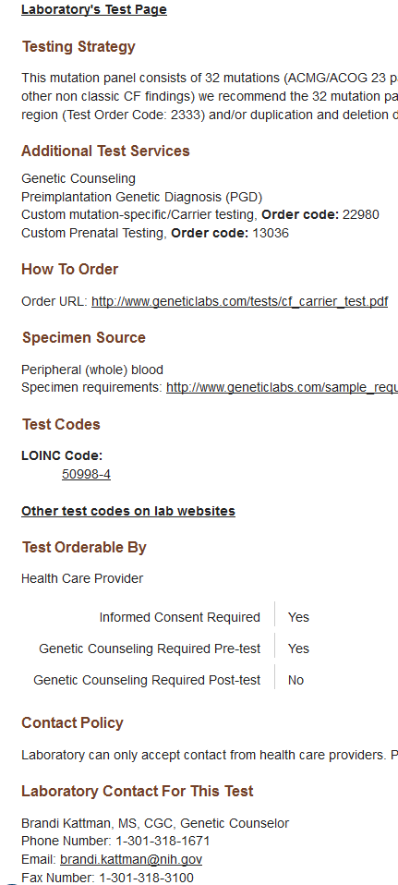
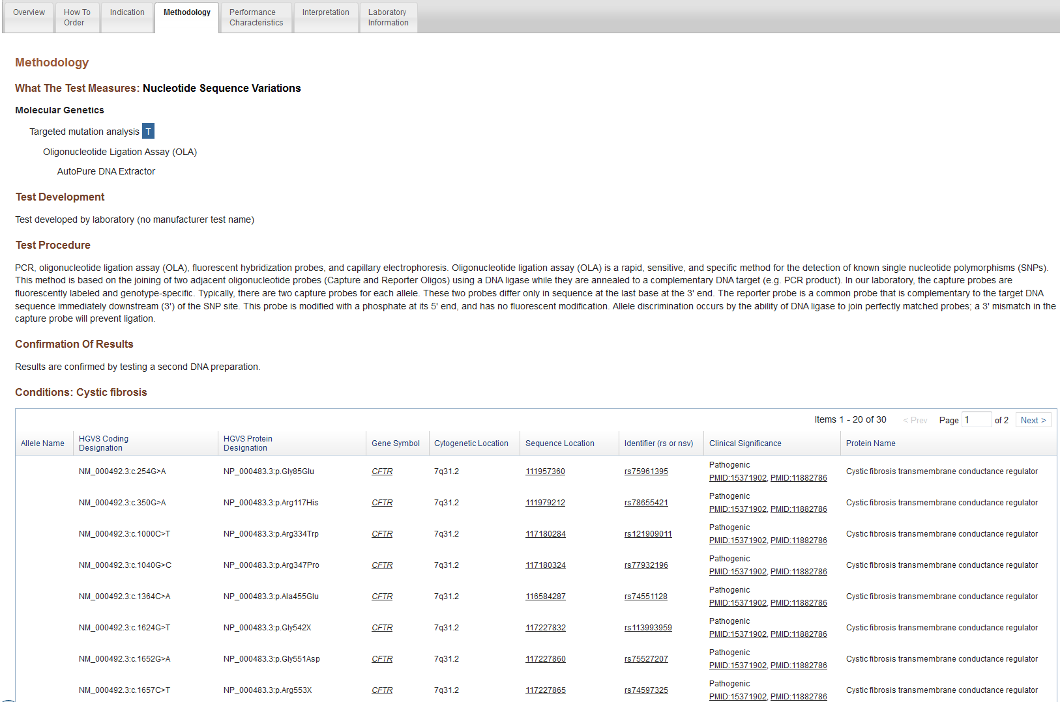
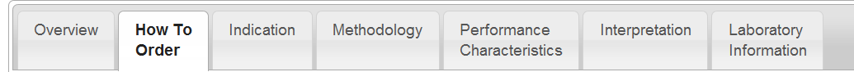
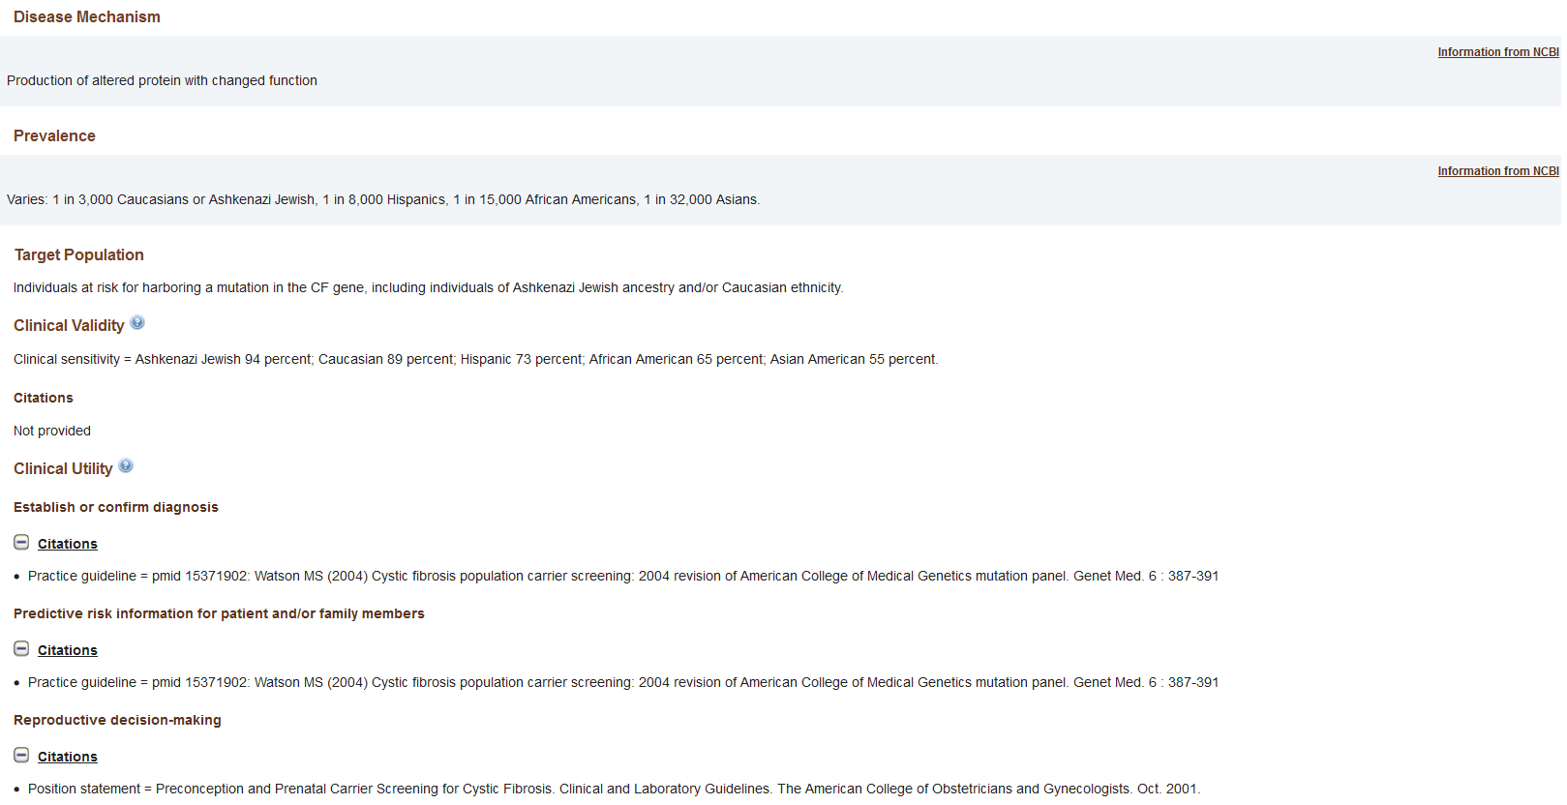
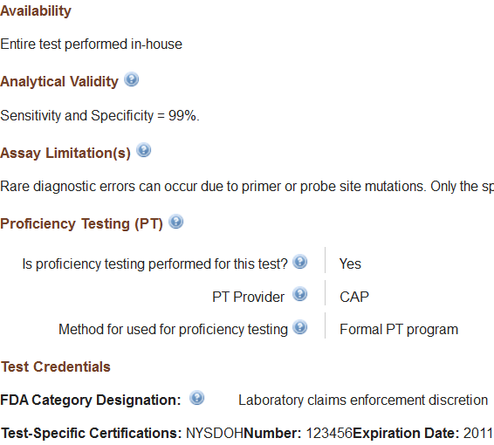

Slide 38
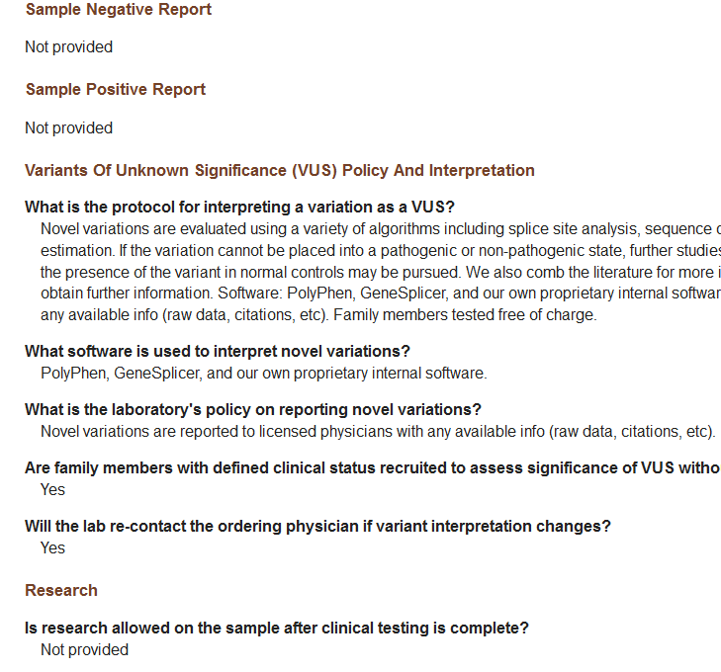
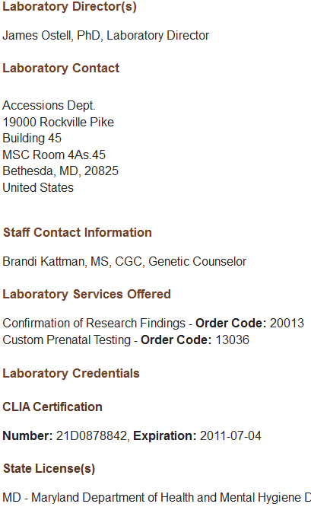

Slide 39
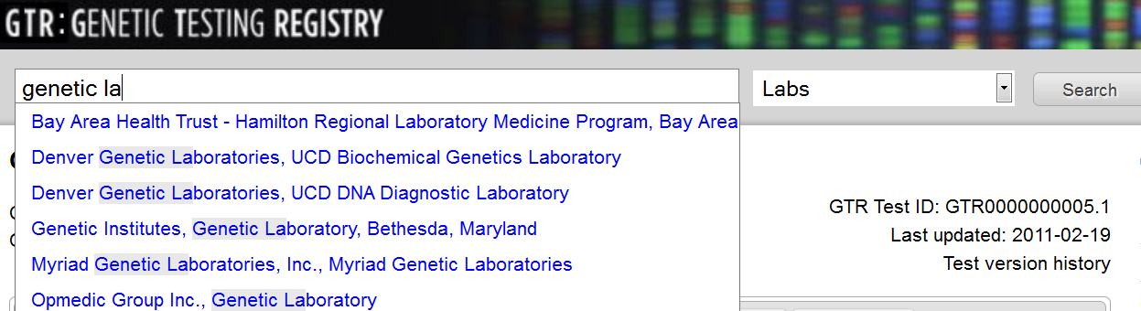
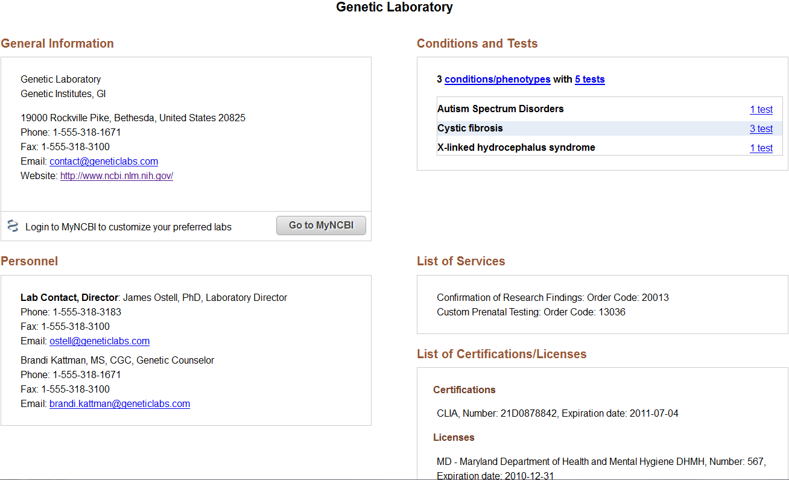

Slide 40
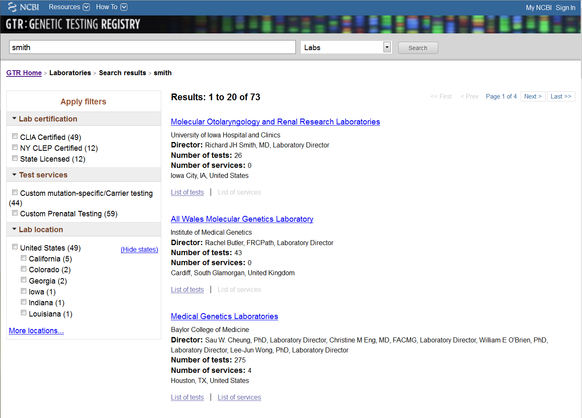

Slide 41
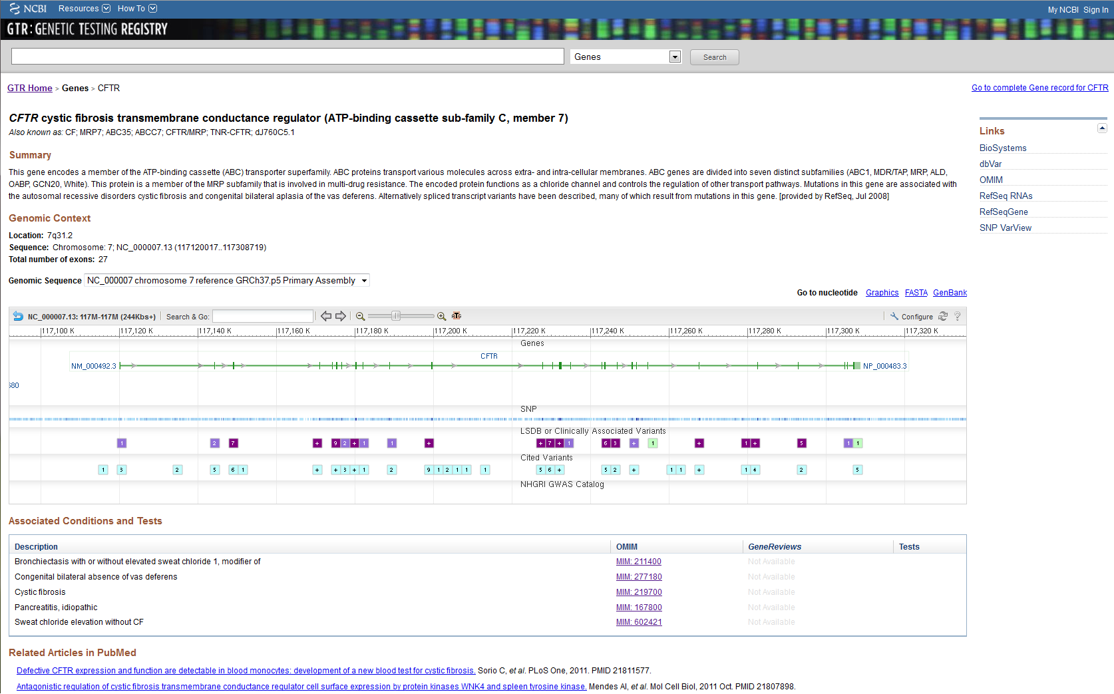

Slide 42
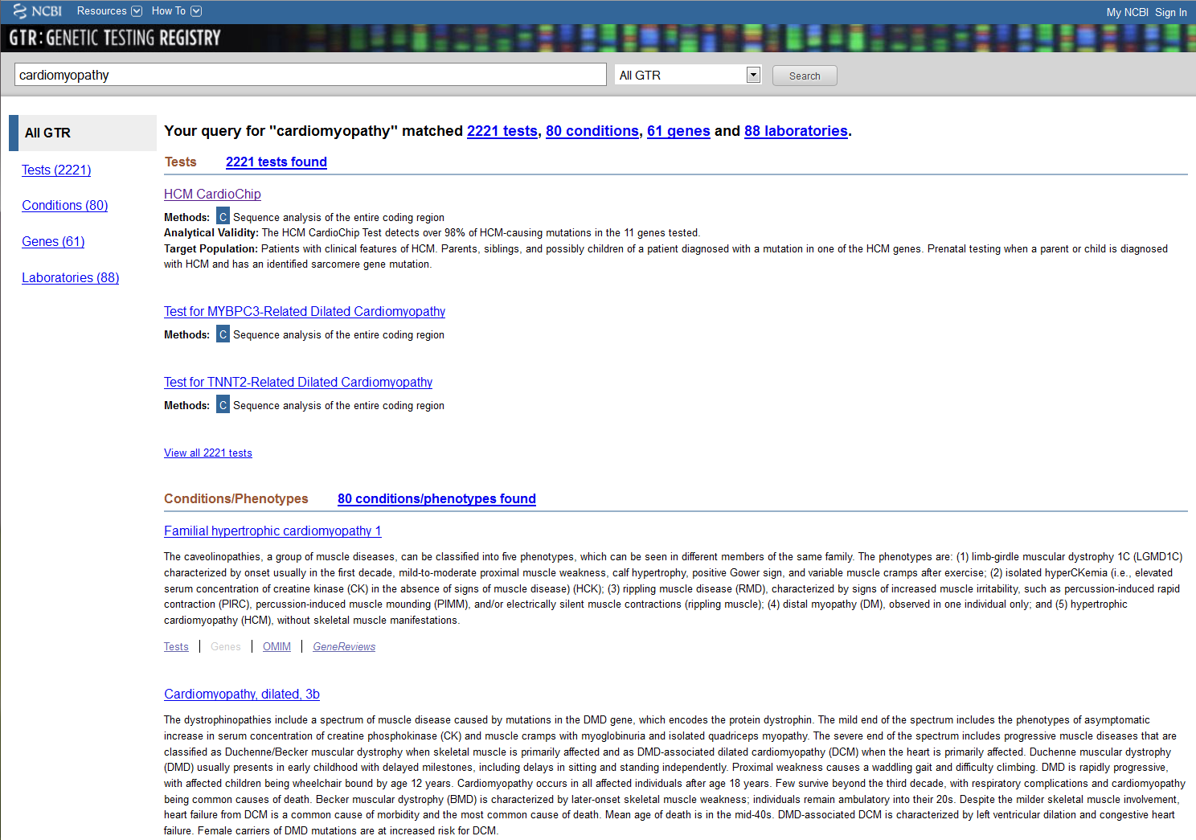

Slide 43
Navigating the New
NIH Genetic Testing Registry:
Learn how to find a genetic test in 3 minutes or less
Brandi L. Kattman, MS, CGC
Staff Scientist – Genetic Counselor
NIH, National Center for Biotechnology Information

Slide 44
Find a Test by Test Name

Slide 45
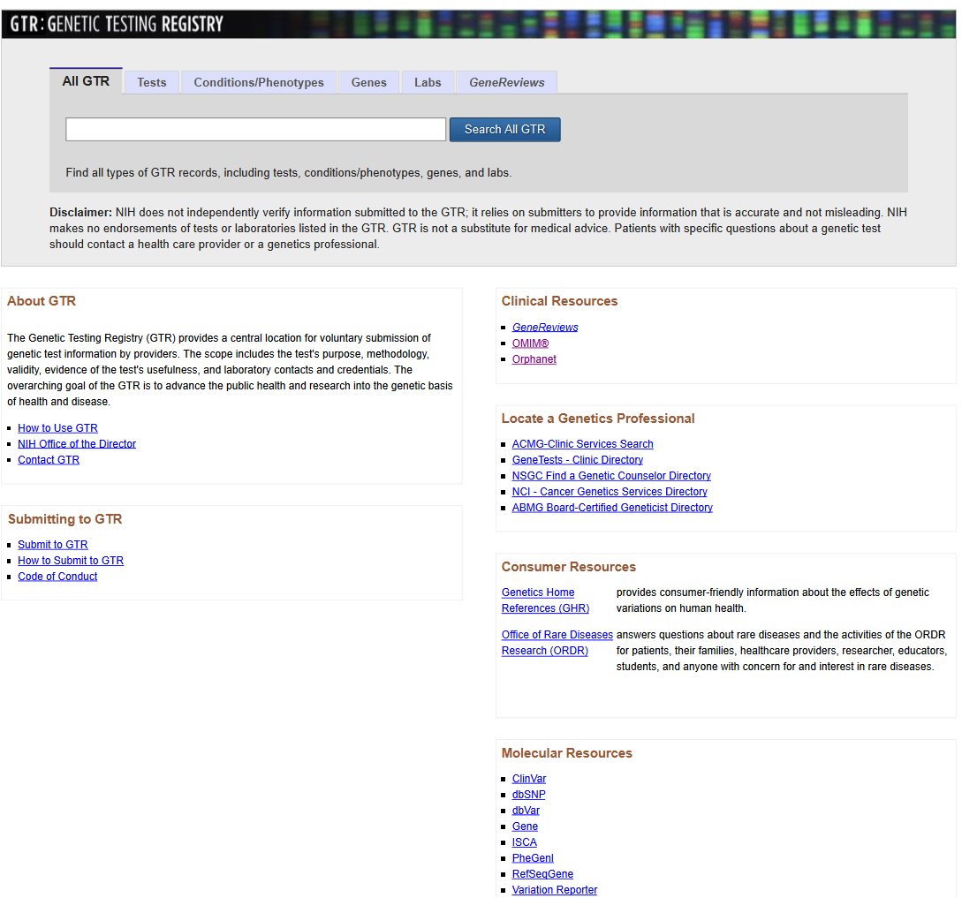
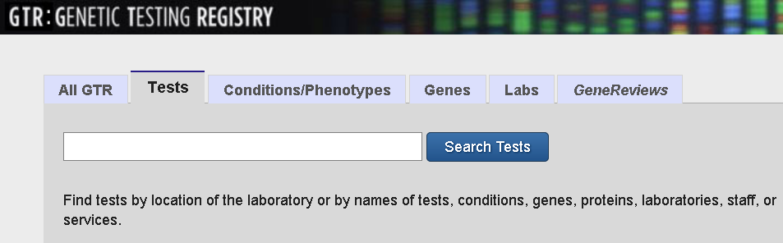

Slide 46
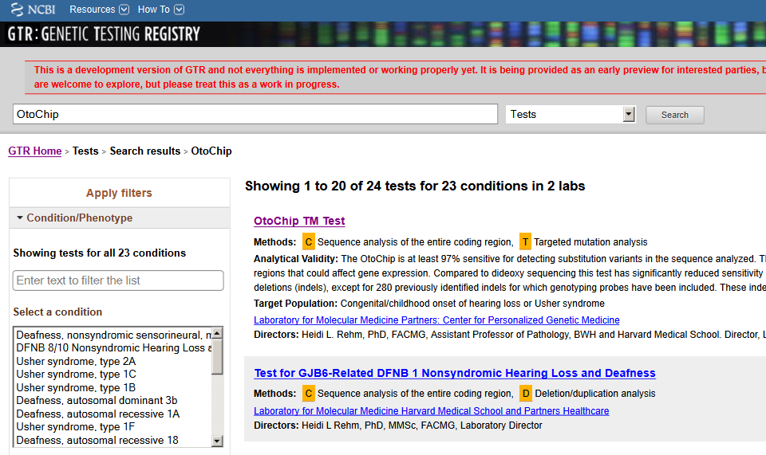

Slide 47
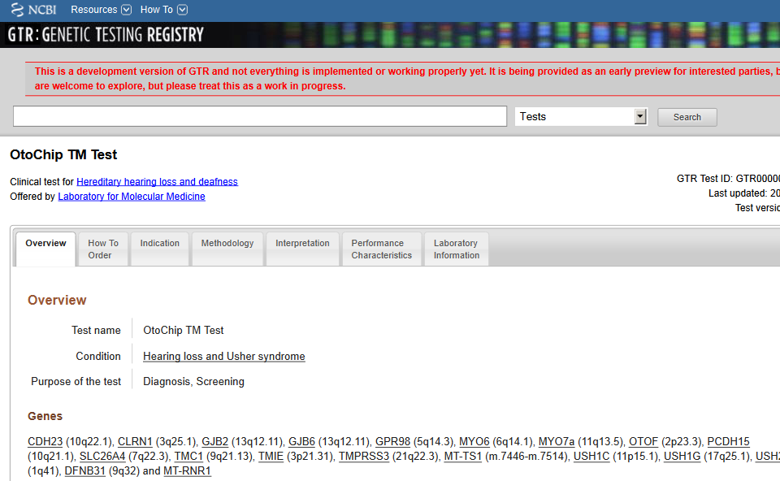

Slide 48
Find a Test by Condition/Phenotype

Slide 49
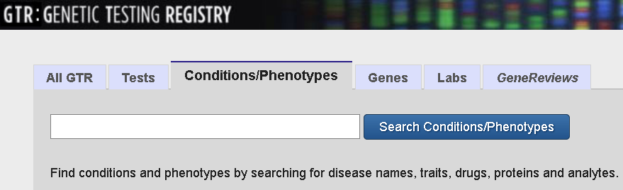
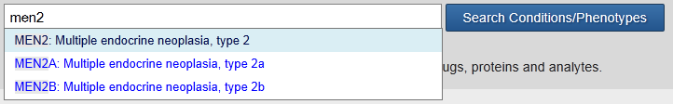

Slide 50
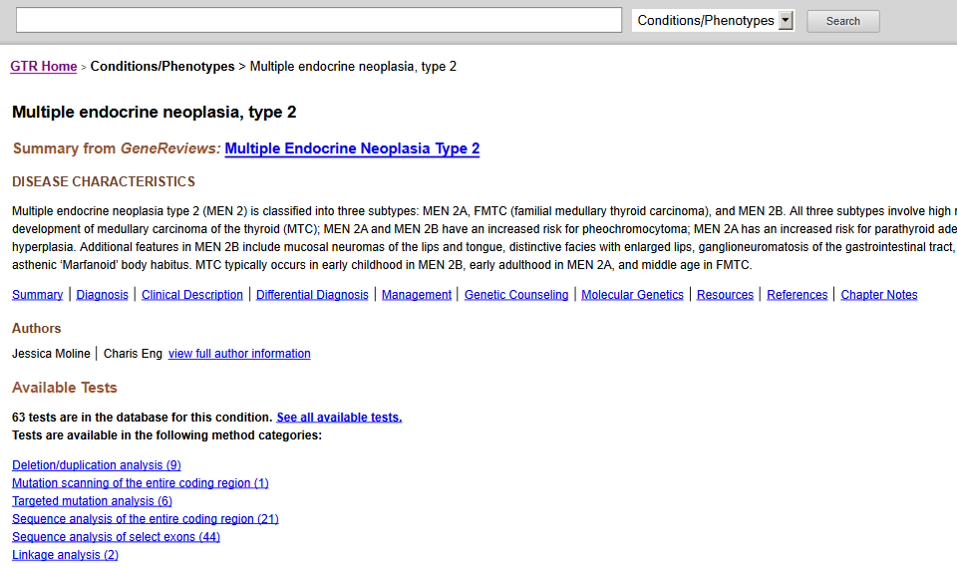

Slide 51
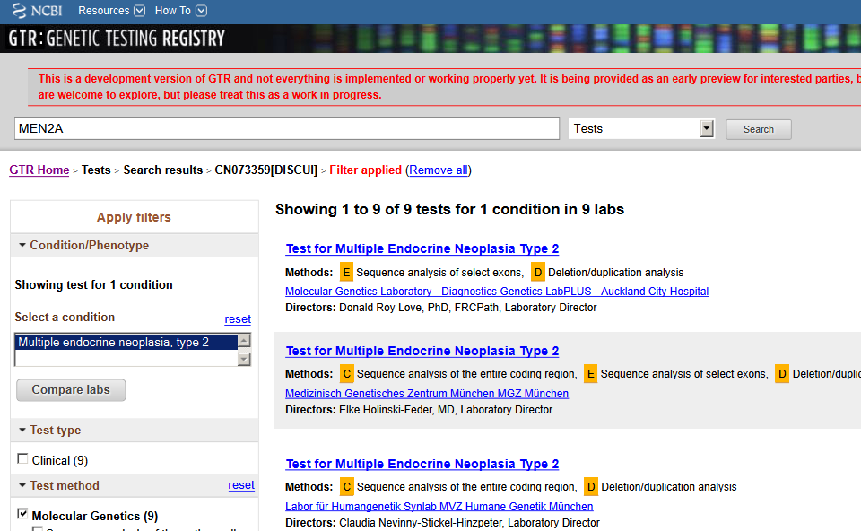

Slide 52
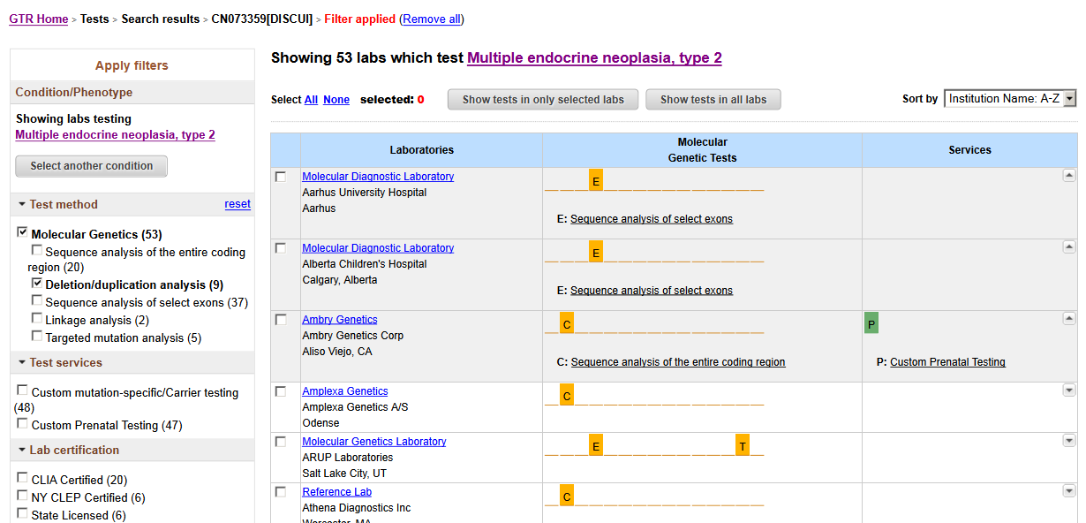

Slide 53
Find a Test by Gene Symbol

Slide 54
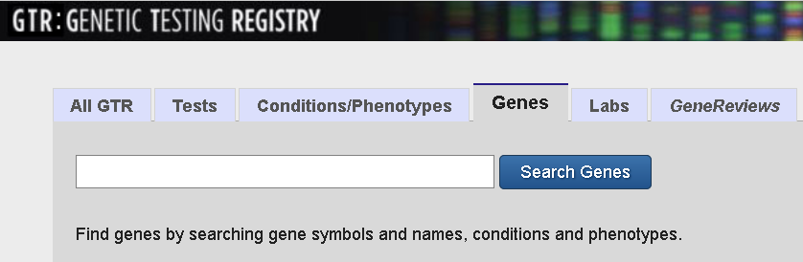
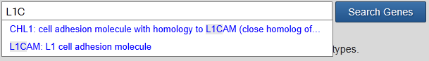

Slide 55
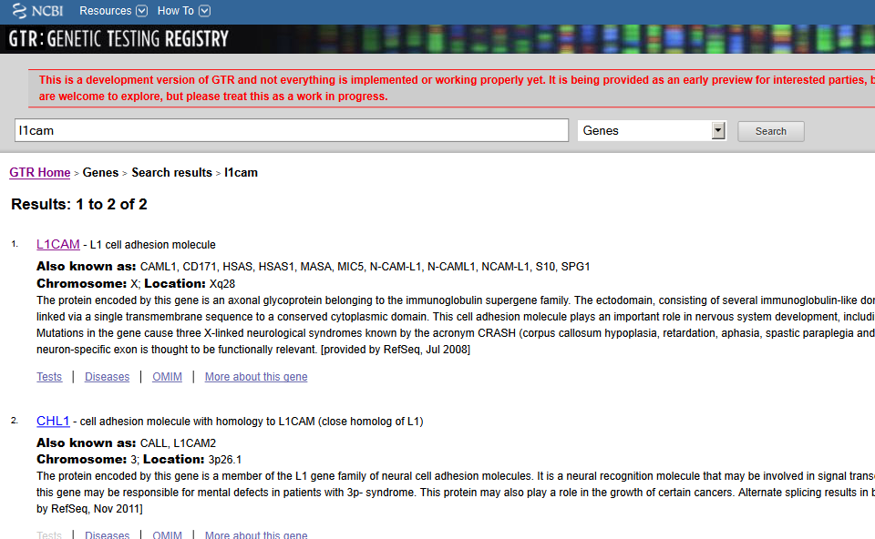

Slide 56
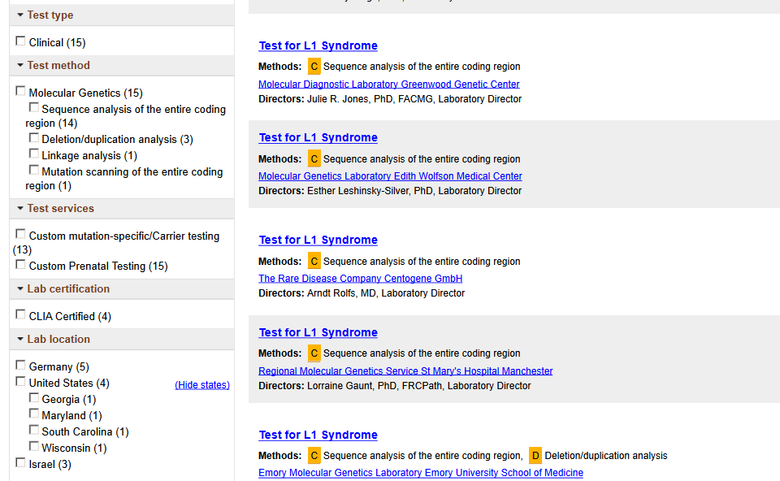

Slide 57
Find a Test by Lab Name

Slide 58
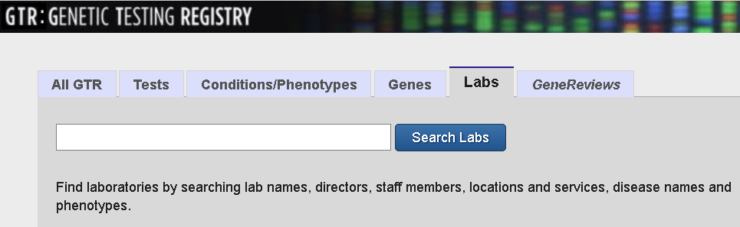
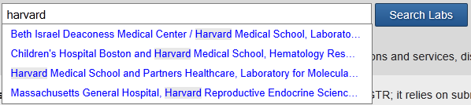

Slide 59
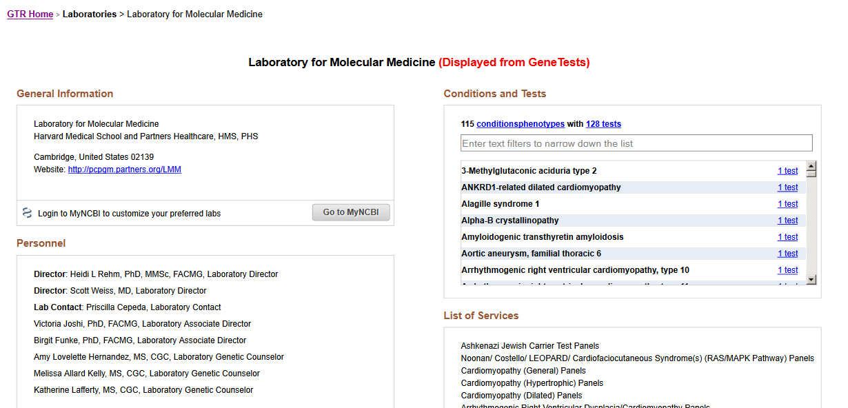

Slide 60
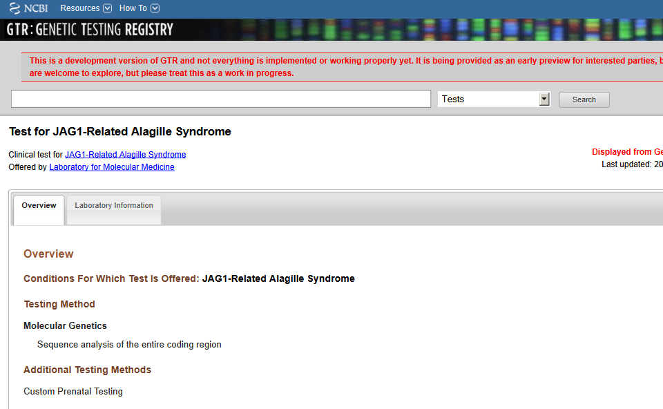

Slide 61
Find a Test Using All GTR

Slide 62


Slide 63


Slide 64
Locate a Test in 3 Minutes - Recap
Search on the test tab for a test name
Search on the conditions/phenotype tab
  Narrow by a test method
  Choose a test or filter further
Search on the gene tab
  Click tests link
  Choose a test or filter further
Search on the labs tab
  Click tests link
Search on All GTR
  Browse through result categories
  Choose a test or filter further

Slide 65
Learn more about the GTR
Coming soon to a PC near you!
www.ncbi.nlm.nih.gov/gtr
Review additional details on the project
Join the mailing list
Bookmark now
Thank you!

Slide 66
Questions?
*Please use your “chat feature” to send in any questions to presenters. If you have trouble using the chat feature, please feel free to email your question in to amelvin@nsgc.org

