Slide 1


Not Funded … Now What? Guidance from the Experts
NIH Regional Seminar
November 2, 2021
Michael Sesma, Ph.D.; Shawn Gaillard, Ph.D.; Amanda Melillo, Ph.D.; Kris Willis, Ph.D.
Notes:
Mike

Slide 2

Should I revise and Resubmit? Critical Points
Should I revise and Resubmit? Critical Points:
Revised applications have a higher success rate than first time apps
Contact your Program Officer to discuss the review and your plans for a revision
Revised applications can include an Introduction page to summarize what has been changed in the revision
Revised applications are assigned to the same review panel as before but may have different reviewers
Reviewers have access to the prior review (Summary Statement) but not the original application
Notes:
MIKE

Slide 3
Topics
Determine when it makes sense to submit an amended application, and when it does not
Describe important components needed in a resubmission
Describe some common submission errors
Notes:
MIKE

Slide 4
When to resubmit, and when not!
Shawn Gaillard, Ph.D.
Developmental and Cellular Processes Branch
GMCDB, NIGMS
Notes:
Shawn

Slide 5
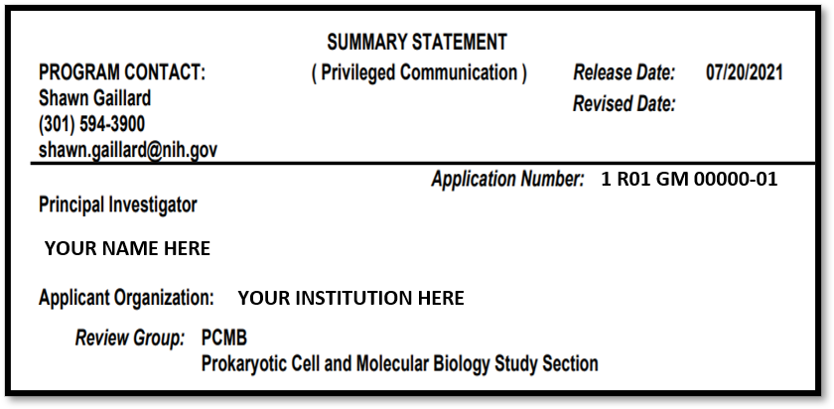
1. Contact your Program Officer (PO)!
  PO Name/Contact info is listed on top left of your Summary Statement
  Email (don’t cold call!) PO to set up a time to talk
  Have discussion of IRG critiques: strengths (same) & weaknesses (address)
When to resubmit, and when not!
Notes:
Shawn

Slide 6
2. Resubmit or Not?
  You must have the Summary Statement back before you can resubmit
  Usually, best to regroup and resubmit - aptly addressing the previous reviewers' critiques
  But if substantial weaknesses (significance, investigators, innovation, environment & approach) then perhaps restart new project/new application
  If a lot of time passes before you can resubmit, reassess the science and consider submitting a new application instead of a resubmission, particularly if the science has evolved
  Discussion with PO can help you determine to resubmit or not
  NOTE - You must submit a new application (not a resubmission) if switching between a program announcement (PA) and request for application (RFA) or if changing grant mechanisms (e.g., R01 to R15)
When to resubmit, and when not!
Notes:
Shawn but there are times when an amended application may not do well (e.g., IRG questions if significant quest, research already done/not adding anything new to the field, not right environment or expertise for proposed research, etc., any one/few of these is okay, but when multiple/all review criteria is an issue then it may be time to start from scratch with new idea (a new -A0 application, not -A1). PO can help you determine if -A1 or new -A0 may be best during your discussion.

Slide 7
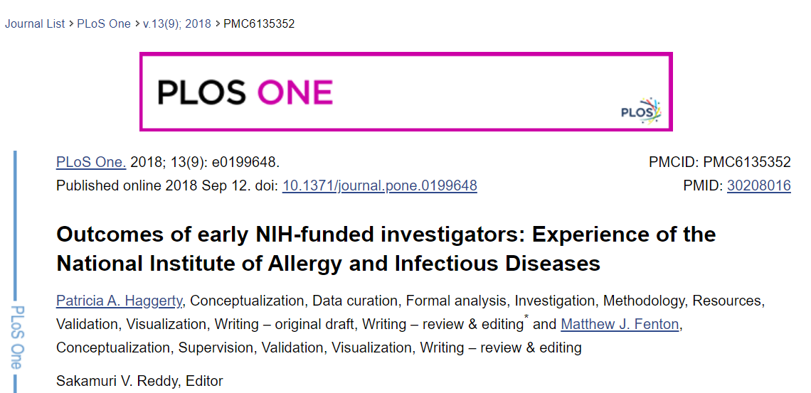
3. Must be in it to win it!
  Only way to NOT get funded is to Not apply; must be in it to win it!
…Investigators who successfully obtained new grants showed remarkable within-person consistency across multiple grant submission behaviors, including submitting more applications per year, more renewal applications…
https://www.ncbi.nlm.nih.gov/pmc/articles/PMC6135352/
When to resubmit, and when not!
Notes:
Shawn

Slide 8
4. Seek Wise Counsel!
5. Read before Write!
  Suggestion: Prior to resubmission ask your colleagues/mentors to serve as your own internal review panel before resubmitting to NIH. Have you addressed well the review critiques from the first submission?
  Read the FOA (again) before resubmitting. Are you using most recent announcement? Has anything changed since first submission? Does the FOA even allow resubmissions? (NIGMS’ R35 MIRA program does not, would need a new application), etc.
When to resubmit, and when not!

Slide 9
Important components in a resubmission!
Amanda Melillo, Ph.D.
Integrative Biology and Infectious Diseases Branch
DER, NIDCR
Notes:
Amanda

Slide 10
Tips for a Strong Resubmission Application
Capitalize on your strengths
Respond point by point
Include an introduction (required; one-page limit)
  Summarize the issues and criticisms and your response
  Summarize substantial additions, deletions, and changes
  If possible, address comments point by point
Update the research plan and elsewhere in the body of your application as needed
Notes:
Capitalize on your strengths throw out or revise the parts reviewers felt were weak. Check again that your Specific Aims line up with your hypothesis.
Respond point by point to the reviewers' comments and suggestions, stating how you dealt with all the criticisms in the summary statement. Your program officer may be able to advise you as you consider application changes.
Introduction. If possible within your introduction's one-page limit, address comments point by point. Be sure your introduction at least does the following:
Summarizes the issues and criticisms and respond in as much detail as possible.
Summarizes the substantial additions, deletions, and changes to the application.
Research Plan and elsewhere in the body of your application. Update as needed to respond. If you're cramped for space, don't drop important details in favor of making space to address reviewer comments.
Be respectful even if you disagree.
If you disagree, explain why, and provide additional information if possible.
Even better, change your proposal. For example, if reviewers don't like an approach, propose a different one, even if you don't agree.

Slide 11
More Tips for a Strong Resubmission Application
Don't drop important details in favor of making space to address reviewer comments
Identify changes by outlining them in your introduction
Add new findings and your own improvements
See what worked for others
Be respectful even if you disagree
Contact your PO. We can help guide you!

Slide 12
Other components to consider
For non-RPG application types
Multi-project applications: Must submit an introduction with the Overall component, but introductions within the other components are optional.
Career development and fellowship applicants: Must arrange for resubmission of the three reference letters required for those programs.

Slide 13
Additional Considerations
You must submit the resubmission application within 37 months of the new, renewal, or revision application it follows.
Note that identifying individual changes by using brackets, indents, or change of typography in the text of Specific Aims, Research Strategy, and other application attachments is no longer required, though NIH will continue to accept applications that contain the specific mark-ups.
Use the most recent version of the FOA and forms, even if it's not the one you used originally.

Slide 14
Avoid common resubmission errors!
Kris Willis, Ph.D.
Cancer Cell Biology Branch,
Division of Cancer Biology, NCI
Notes:
Kris

Slide 15
Common resubmission errors
Not contacting your program director – even if you are ND, you should call/email!
Not responding thoroughly to reviewer comments.
  Don’t rush. It’s better to wait for the next receipt date than to send an application back prematurely.
Missing the forest for the trees.
  Don’t focus only on technical critiques and fail to make needed revisions to the big picture.
Panel hopping.
  Don’t focus more on getting a different audience than on improving your application

Slide 16
Some resubmission errors are also common in first submissions
1. Undervaluing visual communication
Leave good white space
Make figure legends large enough to read
Make sure figures labels are accurate and clear
Use of bold text strategically
Make good use of paragraph breaks
2. Not speaking to your audience
The key to good grant writing is communicating your idea in a way that excites reviewers

Slide 17
Questions?

