Slide 1
NIH Update Regarding Oversight of Foreign Subawards
For the Extramural Research Community
September 14, 2023

Slide 2




NIH Presenters
MODERATOR
MEGAN COLUMBUS
LAWRENCE A. TABAK, D.D.S., PH.D.
MICHAEL S. LAUER, M.D.
MICHELLE BULLS
Director
Division of Communication and Outreach
Office of Extramural Research
NIH
Acting Director
NIH
Deputy Director for Extramural Research
NIH
Director
Office of Policy for Extramural Research Administration (OPERA)
Office of Extramural Research
NIH

Slide 3
Dr. Lawrence A. Tabak
(Video ONLY, no PPT Slides)

Slide 4
Oversight of Foreign Subawards:
Response to OIG and GAO Audits
Michael S. Lauer, M.D.
Deputy Director for Extramural Research
Office of the Director (OD)
National Institutes of Health

Slide 5
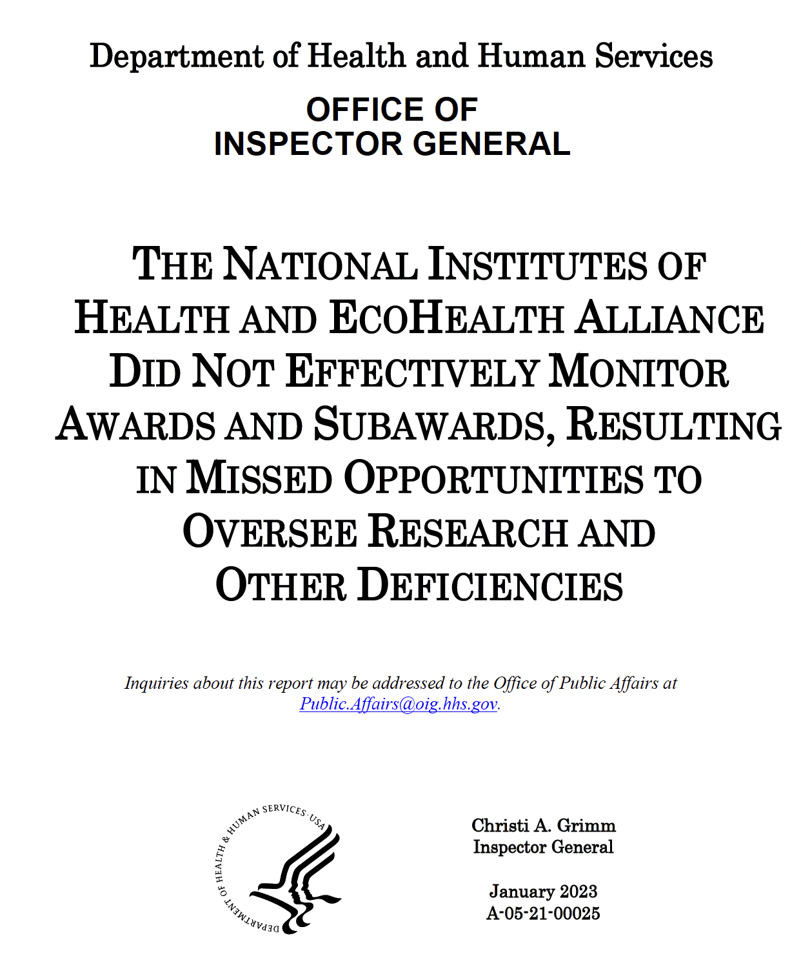
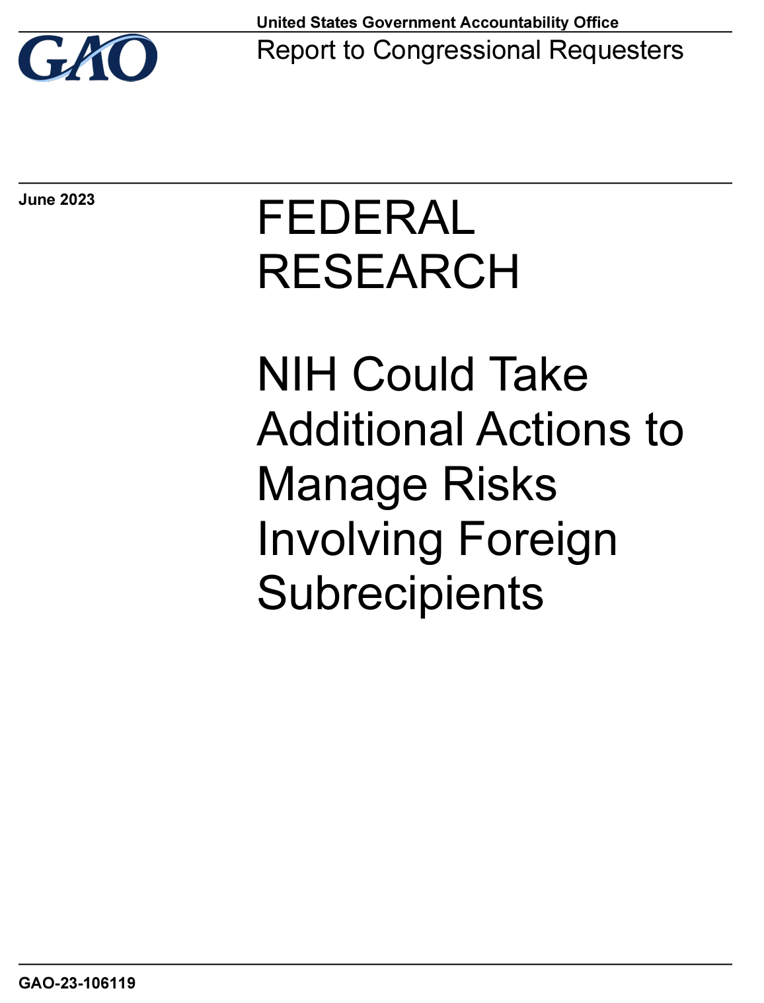
Two Audits

Slide 6
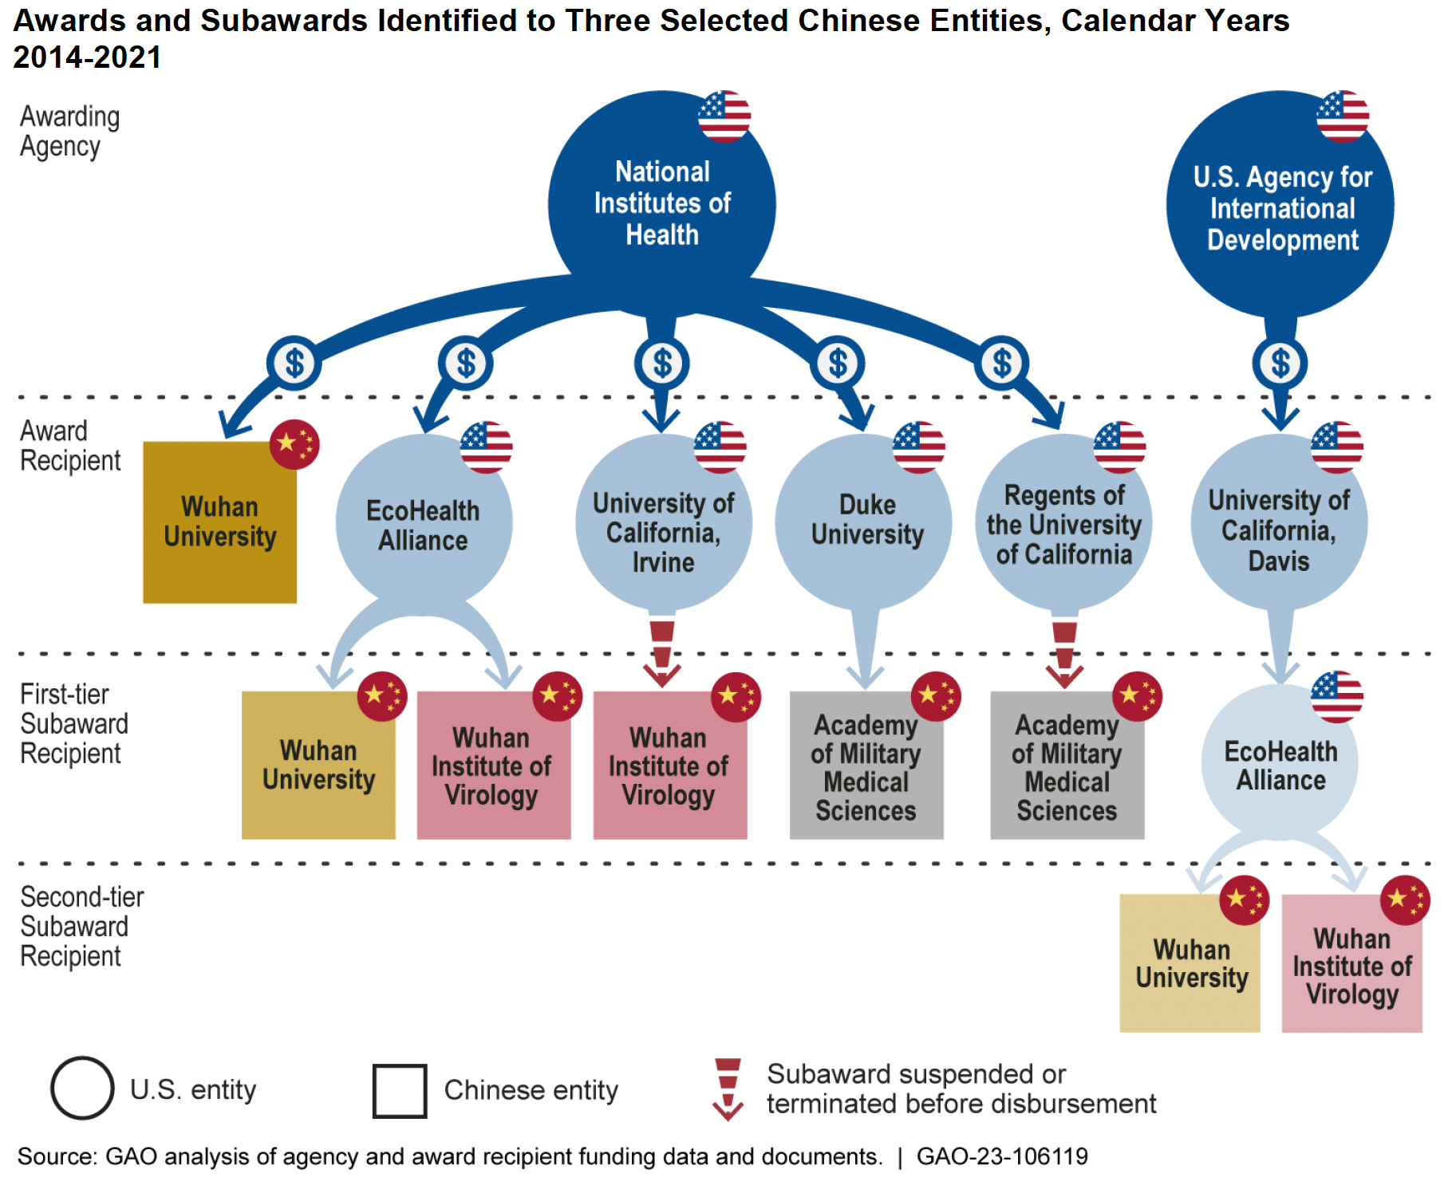
Awards and Subawards Identified to Three Selected Chinese Entities: 2014-2021
Terms & Conditions
Agency
“Prime”
Subrecipient

Slide 7
Longstanding General Principle
“The recipient, as the direct and primary recipient of NIH grant funds, is accountable to NIH for the performance of the project, the appropriate expenditure of grant funds by all parties, applicable reporting requirements, and all other obligations … The terms and conditions flow down to subrecipients … the requirements that apply to the recipient … apply to consortium participant(s).”
NIH GPS 15.1, 2 CFR Part 200.101(b)(2) and 45 CFR Part 75.101

Slide 8
Flows Down to
Subrecipient
“Requirements for pass-through entities. All pass-through entities must … Ensure that every subaward includes the following information at the time of the subaward … A requirement that the subrecipient permit the pass-through entity and auditors to have access to the subrecipient's records and financial statements as necessary for the pass-through entity to meet the requirements of this part …”
2 CFR Part 200.332(a)(5) and 45 CFR Part 75.352(a)(5)

Slide 9
One Obligation:
Access to Records
“Records of non-Federal entities. The HHS awarding agency, Inspectors General, the Comptroller General of the United States, and the pass-through entity, or any of their authorized representatives, must have the right of access to any documents, papers, or other records of the non-Federal entity which are pertinent to the Federal award, in order to make audits, examinations, excerpts, and transcripts.”
NIH GPS 8.4.2, 2 CFR Part 200.337 and 45 CFR Part 75.364

Slide 10
First
Audit

Slide 11
OIG Audit: What Happened (1)
Research Performance Progress Report (RPPR): The progress report identified concerns about possible non-compliance
RPPR (progress report):
  Main vehicle for assessing scientific progress
  Opportunity to assure ongoing compliance
  Agency makes decision about whether to continue funding or take other actions (e.g., withholding support, imposing specific award conditions)

Slide 12
What Happened (2)
Disagreement over compliance with terms and conditions
Requested (twice) from prime recipient
  Lab notebook entries
  Original electronic files
Prime recipient did not have these records, nor did they have access to them
Prime recipient passed on request to foreign subrecipient
Requests not honored

Slide 13
OIG Commentary
“Our oversight work has continually demonstrated that grant-awarding agencies’ oversight of subrecipients, whether domestic or foreign, is challenging. This is partly due to governmentwide regulations that NIH follows that are designed to have a prime grant recipient monitor the activities of a subrecipient, rather than requiring the grant-awarding agency … to conduct active monitoring of subrecipients.”
https://oig.hhs.gov/oas/reports/region5/52100025.asp

Slide 14
OIG Commentary (2)
“For foreign subrecipients, the effectiveness of the prime recipient’s monitoring may depend on the level of cooperation between the recipient and the subrecipient. In certain countries in which research is performed, there may be a risk that larger political or governmental issues may impede cooperation and prime recipients will have limited ability to effectively monitor their foreign subrecipients.”
https://oig.hhs.gov/oas/reports/region5/52100025.asp

Slide 15
OIG Commentary (3)
“Although documentation indicates that WIV cooperated with EcoHealth’s monitoring for several years, WIV’s lack of cooperation with the international community following the COVID-19 outbreak—consistent with the response from China—limited EcoHealth’s ability to monitor its subrecipient, and greater transparency is needed …”
https://oig.hhs.gov/oas/reports/region5/52100025.asp

Slide 16
OIG Recommendations
“Implement enhanced monitoring, documentation, and reporting requirements for recipients with foreign subrecipients.”
https://oig.hhs.gov/oas/reports/region5/52100025.asp

Slide 17
NIH Response
“NIH generally concurs … NIH will evaluate how best to consider the OIG recommendation within the framework of 2 C.F.R. §§ 200.331 - 200.333 … (Uniform Administrative Regulations). NIH will also need to consider 2 CFR 200.102(c), which states that ‘The Federal awarding agency may adjust requirements to a class of Federal awards … when approved by [OMB] ...’ NIH will also evaluate best practices across government ...”
https://oig.hhs.gov/oas/reports/region5/52100025.asp

Slide 18
Second
Audit

Slide 19
GAO Commentary
“In March 2023, NIH officials told us they did not have a timeline for implementing the HHS-OIG’s recommendation … However, obtaining additional authority in accordance with 2 C.F.R. 200.102(c) could be a lengthy process … While NIH pursues long-term actions, such as obtaining additional authority from OMB, it has not initiated near-term actions, which could enhance its own internal processes …”
https://www.gao.gov/products/gao-23-106119

Slide 20
GAO Commentary (2)
“Evaluating opportunities to enhance its existing internal processes, in tandem with other longer-term efforts to implement the HHS-OIG’s January 2023 recommendation, would better position NIH to more immediately demonstrate progress to improve its oversight of awards with foreign subrecipients.”
https://www.gao.gov/products/gao-23-106119

Slide 21
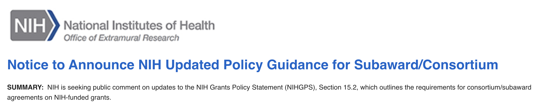
NIH Guide Notice and Federal Register Notice (FRN)
“NIH reserves the right to request copies of the written agreement and relevant supporting documentation … Failure to provide requested documentation may lead to remedies … and potential enforcement actions … NIH encourages recipients to ask potential subrecipients … to submit language in their letters of support indicating their awareness … willingness to abide by all requirements ...”
https://rfi.grants.nih.gov/?s=646e6654a8ba09024f09e852

Slide 22
NIH Guide Notice and FRN (2)
“For foreign subrecipients, a provision requiring the foreign subrecipient to provide copies of all lab notebooks, all data, and all documentation that supports the research outcomes as described in the progress report. These supporting materials must be provided to prime recipient with each scientific update (no less than once every six months, or more frequently …) ...”
https://rfi.grants.nih.gov/?s=646e6654a8ba09024f09e852

Slide 23
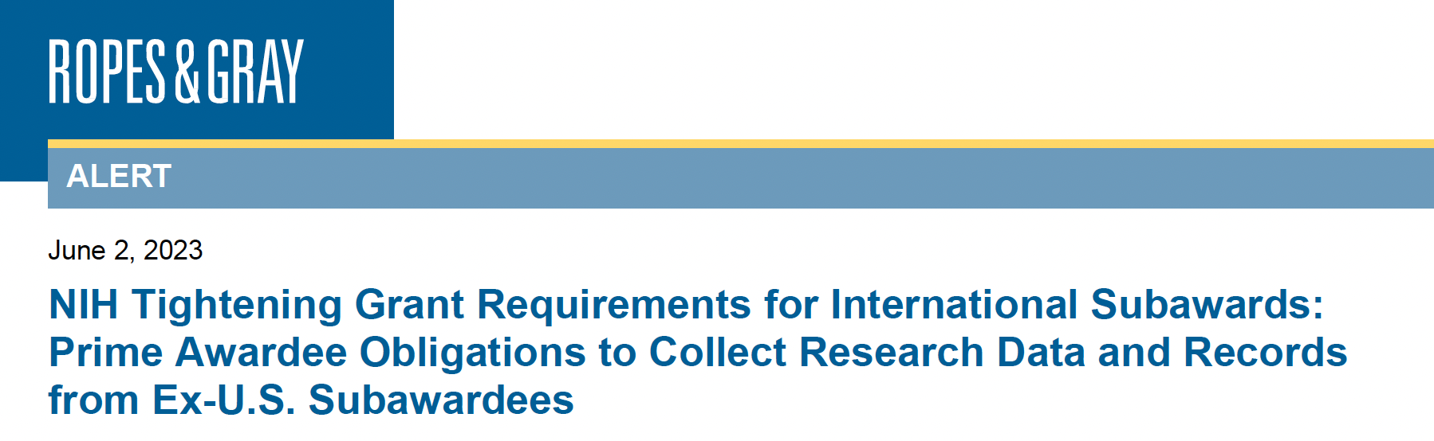
Ropes & Gray Independent Commentary
“Through this new requirement, NIH effectively has underscored the importance of subrecipient monitoring as an essential obligation.”
https://www.ropesgray.com/en/newsroom/alerts/2023/06/nih-tightening-grant-requirements-for-international-subawards-prime-awardee-obligations-to-collect

Slide 24
Feedback Concerns (FRN Responses)
More time needed … external input
Excessive administrative burden; inequities
Need for risk-based approach (allusions to NSPM-33)
Why focus on foreign subrecipients?
  “Smacks of colonialism”
Why every 6 months? Progress reports are annual.
What about digital platforms?

Slide 25
Planned Revisions
“For foreign subrecipients, a provision requiring the foreign subrecipient to provide access to copies of all lab notebooks, all data, and all documentation that supports the research outcomes as described in the progress report, to the primary recipient with a frequency of no less than once per year, in alignment with the timing requirements for the Research Performance Progress Report submission. Such access may be entirely electronic.”

Slide 26
Thank You
WEBSITE
Visit https://grants.nih.gov/ for additional NIH policy information and resources.

Slide 27
MODERATED Q&A
(Video ONLY, no PPT Slides)

Slide 28
RELATED PPT RESOURCES
Video
Transcript

